Slide 1
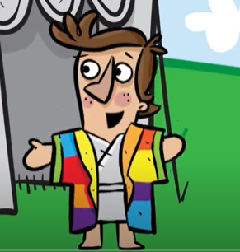
The unusual dreams caused Joseph’s brothers to be more envious of him. Later on, they literally decided to take his life because of jealousy. When an opportunity came, the brothers threw Joseph into a well and then made up a story to hide the truth to their father. You see how jealousy wrecks even a close family relationship.
God protects me, I am…

Slide 2
Joseph was cast into a well by his jealous brothers and they eventually sold him to traders as a slave. Even though Joseph did not know God’s plan for his life, he remained faithful to God instead of complaining
God is always with me, I am…

Slide 3
Joseph teaches us that even in tough times God is with us. When people turn against us and we have difficulties, we should never abandon God. Even when people threaten us, God is with us.
God is always with me, I am…

