Slide 1
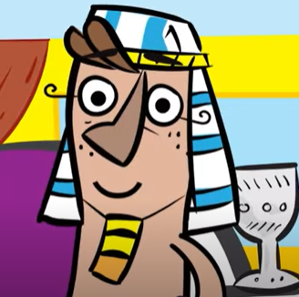
Joseph’s promotion brought him bigger roles and responsibilities. Because of his unquestionable character and wisdom, Joseph was able to save two nations from starvation, Israel and Egypt. Success does not happen overnight. Promotion and true prosperity will come through hard work and being fair in all of your dealings. Just like Joseph, you need to be more diligent and pursue a relationship with God first.
God forgives me, I am…

Slide 2
By the time Joseph met his brothers in Egypt, he was now a leader and they didn’t recognize him. Joseph’s dreams became a reality when his brothers did indeed bow down to him in respect. This would have been a perfect opportunity to take revenge but he didn’t do it. Instead, Joseph forgave his brothers.
God forgives me, I am…

Slide 3
It’s not easy for Joseph to forgive because of the horrible that things the brothers did to him. Although he may now have the opportunity to take revenge as a governor of Egypt, he chose forgiveness over resentment and anger. We must always chose forgiveness, because Jesus forgives us.
God forgives me, I am…

