Slide 1
Prayer

Slide 2
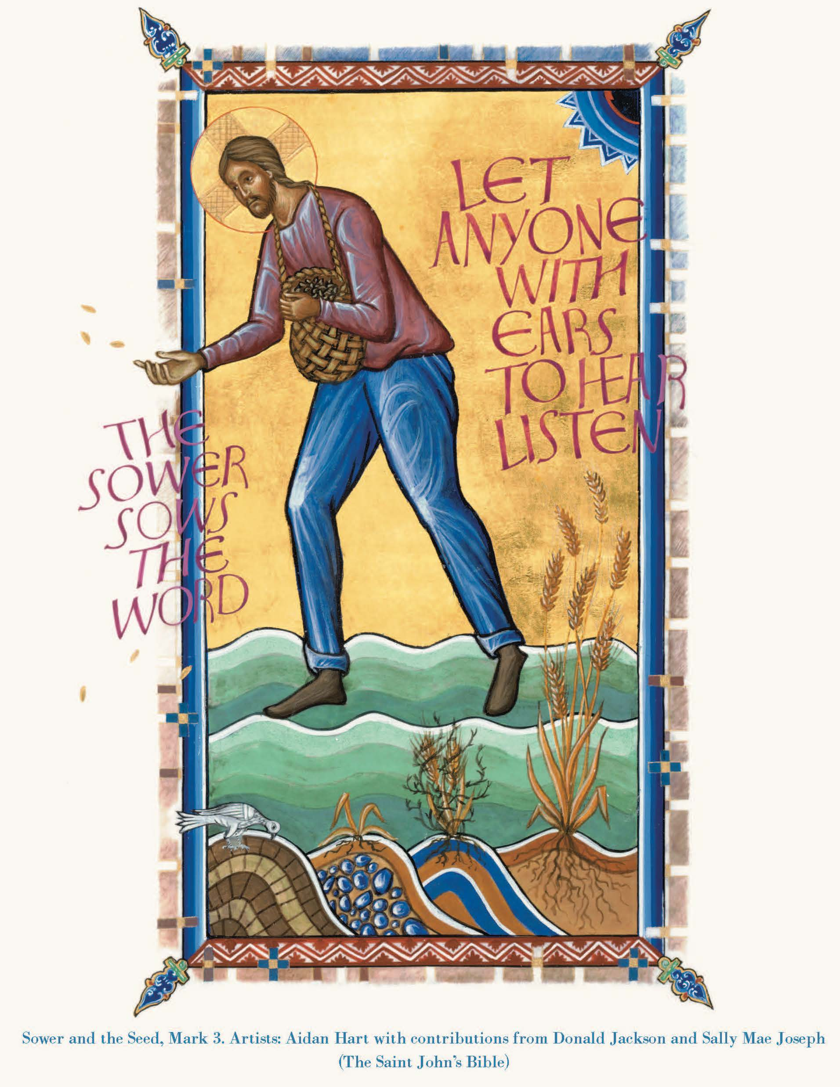
“A sower went out to sow. And as he sowed, some seed fell on the path, and the birds came and ate it up. Other seed fell on rocky ground, where it did not have much soil, and it sprang up quickly, since it had no depth of soil. And when the sun rose, it was scorched; and since it had no root, it withered away. Other seed fell among thorns, and the thorns grew up and choked it, and it yielded no grain. Other seed fell into good soil and brought forth grain, growing up and increasing and yielding thirty and sixty and a hundredfold.” (Mark 4:3-8)

Slide 3
Look at the image and let your eyes stay with the very first thing that you see. Keep your attention on that one part of the image that first catches your eye.
Breathe deeply and let yourself gaze at that part of the image for a minute or so.
Now, let your eyes gaze at the whole image. Take your time and look at every part of it. See it all. Reflect on the image for a minute or so.
What emotions does this image evoke in you?
What does the image stir up in you, bring forth in you?

Slide 4
What does this story and image mean for your ministry?
How can it inform and shape your ministry?

Slide 5
“The kingdom of God is as if someone would scatter seed on the ground, and would sleep and rise night and day, and the seed would sprout and grow, he does not know how. The earth produces of itself, first the stalk, then the head, then the full grain in the head. But when the grain is ripe, at once he goes in with his sickle, because the harvest has come.” (Mark 4:26-29)

