Slide 1
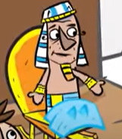
Throughout his life, God blessed Joseph with the ability to interpret dreams. Joseph told Pharaoh what his dream meant that Egypt would have seven years of bounty, followed by seven years of drought and famine. Because of this, the people in Egypt ate during the famine, and people came from all over the world to purchase the food during that time as well. Relying on the Lord for wisdom and help will always be the best place to start preparing for the future.
God is good to me, I am…

Slide 2
Joseph shows how to glorify God in the dark places, and how to credit Him for carrying His followers through those places. ”You Brothers, you meant evil against me, but God meant it for good.” In the storms of life, in the darkest moments, remember God’s promises…
God is good to me, I am…

Slide 3
The difficulties in our life can sometimes knock us down. But the life of Joseph demonstrates God’s ability to transform our hard times into a positive result. God is in control even when you think your world is out of control. As you continue to fulfill God’s plan for your life, remember…
God is good to me, I am…

