Slide 1



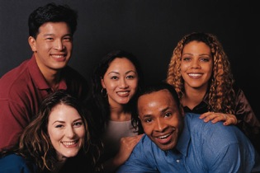

John Roberto jroberto@lifelongfaith.com www.LifelongFaith.com
Faith Formation for Every Adult in Your Church—It’s Possible Today!

Slide 2

The Changing World of
21st Century Adults
Generational
Developmental
Ethnic & Cultural
Family Structures
Faith Practice & Participation in Parish Life
Religious & Spiritual Needs

Slide 3
Developmental & Generational Diversity
Developmental
Emerging Adults: 20s
Young Adults: 30s-40s
Mid-Life Adults: 40s-50s
Mature Adults: 60s-70s
Older Adults: 80+
Generational
Millennials (1980-1999)
Generation X (1964-1979)
Boomers (1946-1964)
Builders (up to 1945)

Slide 4
Diversity of Adult Life Experiences
For each stage of adulthood. . .
  Life Tasks
  Life Issues
  Milestones and Life Transitions
  Spiritual & Religious Needs
  Ethnic-Cultural Needs

Slide 5
The Changing Landscape
No Religious Affiliation
Declining Church Participation
Increasing Diversity & Pluralism
Changing Marriage & Family Life
Digital Revolution
Spiritual, not Religious
Declining Religious Socialization
Aging Baby Boomers

Slide 6




Slide 7
No Religious Affiliation
15% of all Americans claim no religious affiliation
25% of all 18-29 years
10% drop in the number of Christians
The challenge to Christianity in the U.S. does not come from other religions but from a rejection of all forms of organized religion.

Slide 8
Spiritual but not Religious
    Today, 18% of 18-39 year olds say that are “spiritual, but not religious” compared to only 11% a decade ago.

Slide 9
Participation in Churches
Declining worship attendance
Declining participation in celebration of sacraments & rites of passage

Slide 10
Diversity & Pluralism
Diversity of ethnic cultures & nationalities
No single authority exercises supremacy; no single belief or ideology dominations
Tapestry of religious and spiritual alternatives and choices

Slide 11
Family Life
Delaying marriage
Having fewer children and later in life
Decreasing number of children in two-parent households
Increasing number of unmarried couples living together

Slide 12
Family Religious Socialization
Parent Influence: The single most important social influence on the religious and spiritual lives of adolescents is their parents.
Embedded Family Religious Practices: Effective religious socialization comes about through specific religious activities that are firmly intertwined with the daily habits of family life

Slide 13
The Rise of Boomers & the Mature Adult Years
On Jan. 1, 2011, the oldest Baby Boomers will turn 65. Every day for the next 19 years, about 10,000 more will cross that threshold.
By 2030, when all Baby Boomers will have turned 65, fully 18% of the nation’s population will be at least that age (13% today)
We are witnessing the emergence of a new stage of life between adult midlife–typically focused on career and child-rearing–and old age, traditionally marked by increasing frailty and decline. This new stage of life spans several decades and is characterized by generally good health, relative financial stability, and an active, engaged lifestyle.

Slide 14

Ministry with Baby Boomers
Service: Boomers want service opportunities that have a mission – doing things that give their lives purpose, meaning, and fulfillment.
Spiritual Growth: Boomers are in a season of significant life transitions – seeking meaning and purpose in the second half of life.
Intergenerational Relationships: Boomers want to stay connected with the other generations – sharing their lives and faith across generations.

Slide 15


Slide 16
Addressing Religious & Spiritual Diversity

Slide 17

Spiritual & Religious Diversity
Will trends in U.S. culture lead people to become more receptive to organized religion, and in particular Christianity or will trends lead people to become more resistant to organized religion and Christianity?
Will people’s hunger for and openness to God and the spiritual life increase over the next decade or will people’s hunger for and openness to God and the spiritual life decrease.

Slide 18
Faith Formation 2020 Matrix
Dominant Cultural Attitude toward Organized Religion
Receptive
Low High
People’s Hunger for God and the Spiritual Life
Resistant

Slide 19
Spiritual & Religious Diversity
Scenario 3 Unaffiliated & Uninterested
Scenario 1 Vibrant Faith & Active Engagement
Scenario 4 Uncommitted & Participating
Scenario 2 Spiritual but Not Religious

Slide 20
4-Scenario Thinking
Fashioning faith formation around the people
Expanding faith formation to reach a diversity of people and their religious and spiritual needs of people in each scenario
Reaching & Connecting people to faith formation experiences that respond to their spiritual and religious needs

Slide 21
Targeting Religious & Spiritual Needs
Scenario #4 | Scenario #1
Scenario #3 | Scenario #2

Slide 22
Responding to the 4 Scenarios
Scenario #4 + Life issues + Extending worship + Online FF center + Service projects & mission trips + Deepening faith & engagement | Scenario #1 + Life issues + Extending worship + Courses/workshops/small group programs + Online FF center + Service projects & mission trips
Scenario #3 + Life issues + Third Place settings + Events (movie nights, concerts, festivals, theater) + Service projects | Scenario #2 + Life issues + Third Place settings + Service Projects & Mission Trips + Spiritual formation + Spiritual seeker faith formation

Slide 23
21st Century Adult
Faith Formation

Slide 24

Vision of Adult Faith Formation
We seek to form parishes that are vitally alive in faith. These communities provide a parish climate and an array of activities and resources designed to help adults more fully understand and live their faith.

Slide 25
Vision of Adult Faith Formation
We seek to form adults who actively cultivate a lively baptismal and eucharistic spirituality with a powerful sense of mission. Nourished by word, sacrament, and communal life, they will witness and share the Gospel in their homes, neighborhoods, places of work, and centers of culture.

Slide 26
Vision of Adult Faith Formation
A Living, Explicit, and
Fruitful Faith
Invite and enable ongoing conversion to Jesus in holiness of life.
Promote and support active membership in the Christian community.
Call and prepare adults to act as disciples in mission to the world.

Slide 27
21st Century Adult Faith Formation
What could a 21st century approach to adult faith formation look like?
How would we address the diversity of people’s religious and spiritual needs today?
How would we engage people? How would we reach people?
What technologies would we use?
What resources would we access?

Slide 28
It’s not a message problem-the Gospel still works!
It’s not a vision problem!
It’s a delivery system problem – how to provide adult faith formation in the 21st century!

Slide 29

The 20th Century: Age of the School

Slide 30
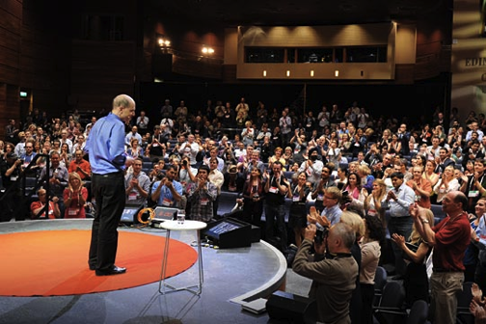

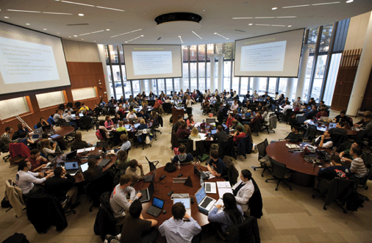
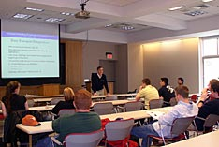

Slide 31
Your Parish Can Provide Faith Formation for Every Adult in Your Church—Today!

Slide 32

21st Century: Age of the Network

Slide 33
The Shift to Networks
“Planned information structures like textbooks and courses simply can’t adapt quickly enough to incorporate network-speed information development. Instead of being the hub of the learning experiences, books, courses, and classrooms become something more like a node in part of a much broader (often global) network. The shift to networks is transformative in how a society organizes itself.”
George Siemens

Slide 34
A Network Approach
Faith Formation Network
Church Programs
Small Groups & Support Groups
Mentors
Social Media for Connection
User-Generated Content
Community Programs
Online Courses & Activities
Online Resources: Print, Audio, Video
Apps
Blogs
Video Conference
A Lifelong Faith Formation Network is a way to provide faith formation for everyone, anytime, anywhere, 24x7x365.

Slide 35

The New “Book” of the 21st Century

Slide 36
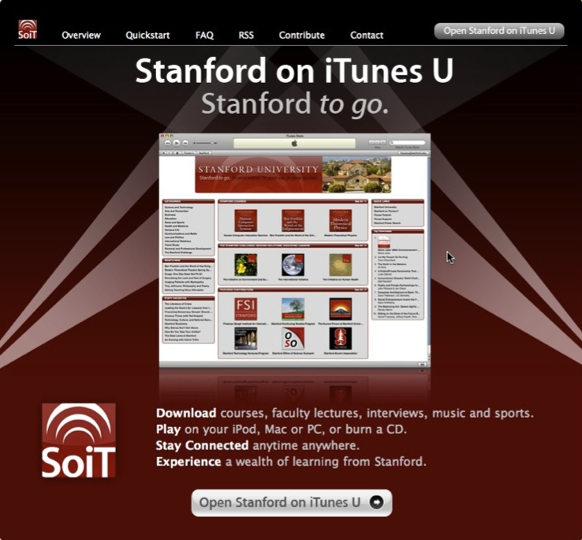

Slide 37
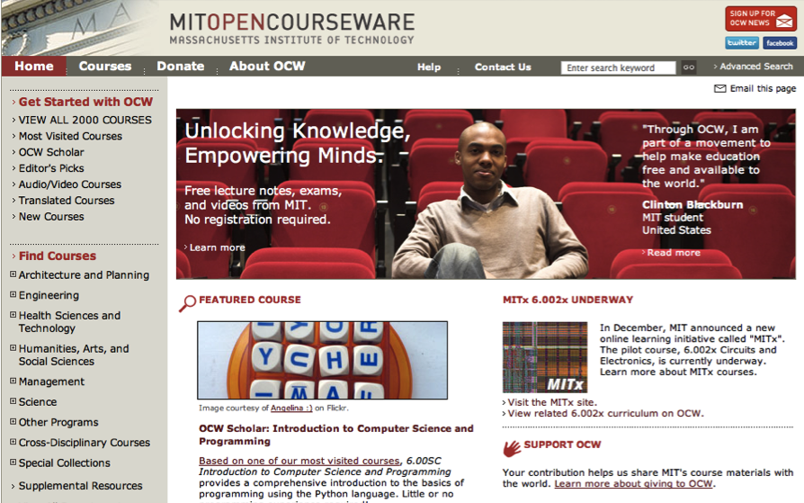

Slide 38
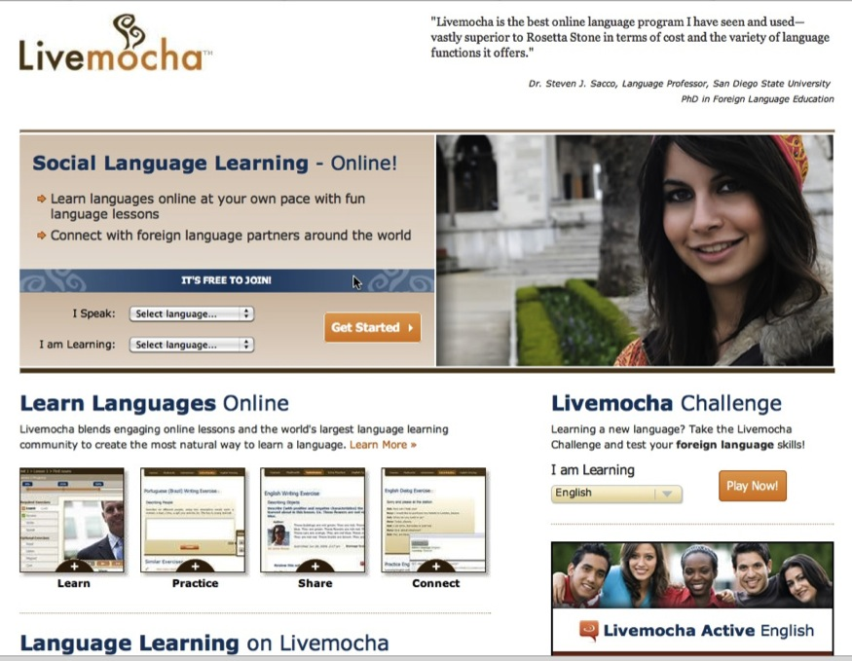

Slide 39
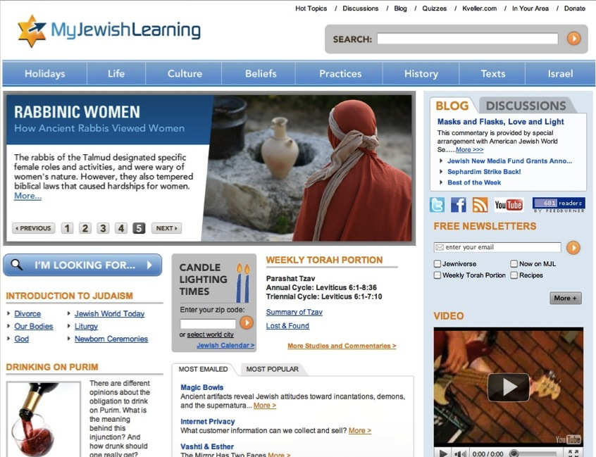

Slide 40
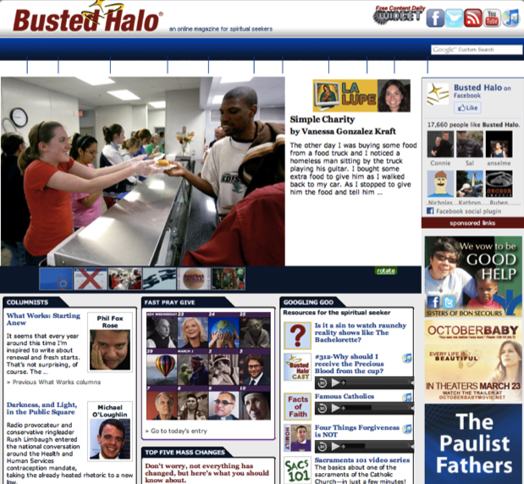
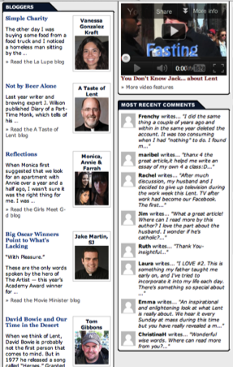

Slide 41






Slide 42




Slide 43
Learning in the Age of Networks
Learn the Bible
Bible Study @ Church
Online Course or Bible Study Group
Online Resource Center
Books
Audio
Video
Educational Program
- course
- conference

Slide 44

Learning in the Age of Networks

Slide 45





YouVersion Bible App Study Bibles
Online Bible Center

Slide 46
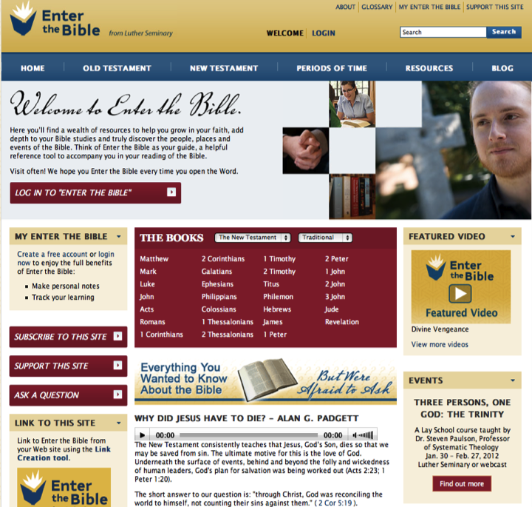

Slide 47

iTunes U

Slide 48
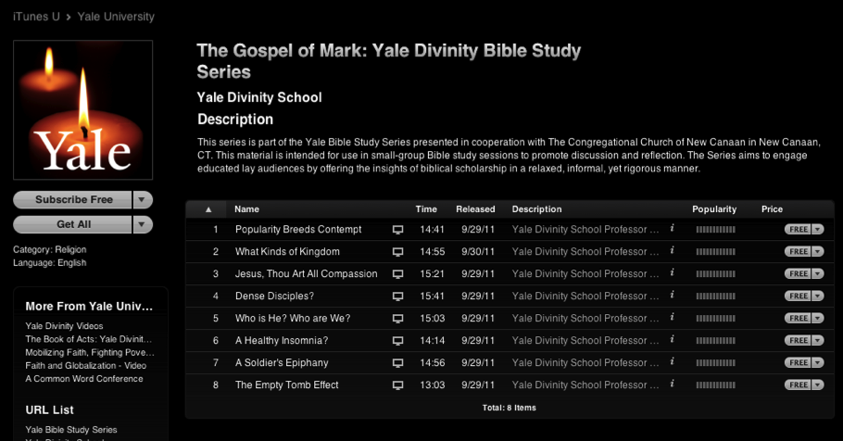
Online Courses

Slide 49
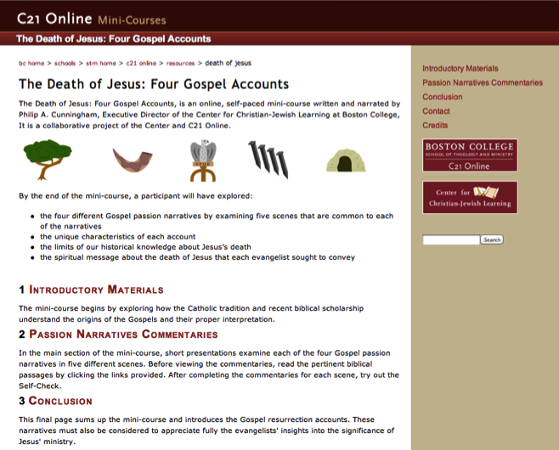
Online Courses

Slide 50
An Adult Faith Formation Network: Principles

Slide 51
Significant Shift
Shifting from. . .
“One Size Fits All” Curriculum & Programming
to
A Network of Personalized & Customized Faith Formation Activities & Resources
focusing on addressing people’s spiritual and religious growth by offering a wide variety of religious content and experiences
“Differentiated Faith Formation”

Slide 52
A Network Approach
Faith Formation Network
Church Programs
Small Groups & Support Groups
Mentors
Social Media for Connection
User-Generated Content
Community Programs
Online Courses & Activities
Online Resources: Print, Audio, Video
Apps
Blogs
Video Conference
A Lifelong Faith Formation Network is a way to provide faith formation for everyone, anytime, anywhere, 24x7x365.

Slide 53
Features
Address the diverse spiritual and religious needs with a variety of content, programs, activities, and resources.

Slide 54
Targeting Adults
Emerging Adults: 20s
Young Adults: 30s-40s
Mid-Life Adults: 40s-50s
Mature Adults: 60s-70s
(Baby Boomers)
Older Adults: 80+
  Life Tasks
  Life Issues
  Milestones and Life Transitions
  Spiritual & Religious Needs
  Ethnic-Cultural Needs

Slide 55
Features
Recognize that learning is a process of active inquiry with the initiative residing within the individual.

Slide 56
Features
Guide adults in discerning their spiritual and religious needs and creating personal plans for faith growth and learning.

Slide 57
A Process for a Developing a Personalized Faith Growth Plan
Assessing Spiritual Growth
Working with a Mentor/Guide
Finding Resources on the Network
Engaging in Formation
Sharing with the Community
Reflecting on Growth and Identifying New Needs

Slide 58
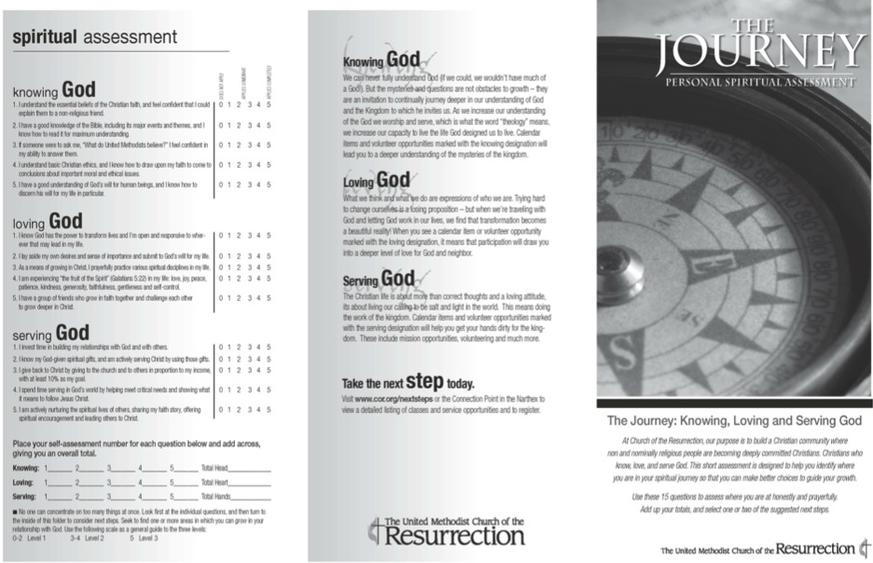

Slide 59
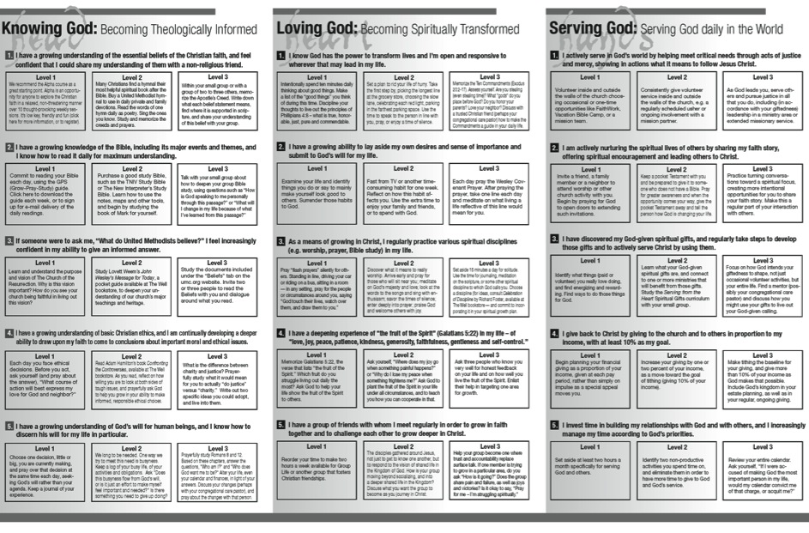

Slide 60
Features
Incorporate informal learning, as well as formal learning in faith formation.
FORMAL | LEARNING
classes & workshops speaker series online courses small group Bible study | self-study Bible study social networking faith-sharing groups
INTENTIONAL | UNEXPECTED
reading /watching a DVD mentoring service/mission activity program at the library or local bookstore | internet surfing watching a movie TV show shopping at a home improvement store
INFORMAL | LEARNING

Slide 61
Features
Utilize a variety of faith formation models to address the diverse life tasks, religious and spiritual needs, and interests of people:
    on your own
    at home
    in small groups
    in large groups
    in the congregation
    in the community and world

Slide 62
Diversify Faith Formation Models
Face-to-Face
& Virtual
On Your Own
Small Group
Large Group
Mentored
Church Community
Community & World
@Home

Slide 63
Features
Offer programs and activities in face-to-face physical settings; in virtual, online settings, and in blended settings that combine both.
  They can be offered only in physical locations, such as church facilities, homes, retreat centers, camps, and community settings
  They can be offered only in virtual settings, such as an online course, collaborative wiki, and online resource center.
  They can be offered in a blended approach, combining a gathering in a physical location with online delivery (activities, group projects, interaction) and some element of individual control over time, place, path, and/or pace.

Slide 64
Blended Approaches
Fully online program or activity with options for face-to-face interaction in physical settings. | Mostly or fully online program or activity with regular interaction and programming in physical settings. | An online platform that delivers most of the program or activities with leaders providing on-site support on a flexible and adaptive as-needed basis through in-person mentoring and small group sessions. | Programs and activities in physical settings guided by a leader with online components that extend beyond the program sessions. | Programs and activities in physical settings that include online resources to supplement the program content.

Slide 65
Features
Incorporate communities of practice to connect individuals and groups throughout the congregation.
  Connect people studying the Bible
  Connect people involved in justice and service – learning and action
  Connect people involved in spiritual formation

Slide 66
Features
Serve as curators who find, organize and deliver the most relevant content and experiences to address the specific needs of people.

Slide 67
An Adult Faith Formation Curator

Slide 68
Faith Formation Curator
Shifting from providing religious content and programming to curating religious content and experiences for all ages
A content curator is someone who continually finds, groups, organizes, and shares the best and most relevant content on a specific subject to match the needs of a specific audience.

Slide 69
Faith Formation Curator
What would you curate?
Parish Programs & Activities
Community Programs & Activities
People Resources
Print Resources
Audio & Video Resources
Art, Drama, and Music Resources
Online Content: Websites, Courses, Blogs
Apps & Digital Resources

Slide 70
The Process of Curation
Research
Aggregate & Evaluate
Deliver
Communicate & Connect

Slide 71
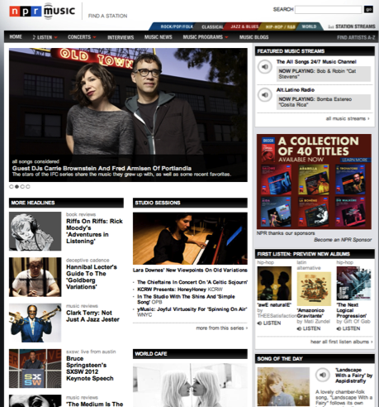
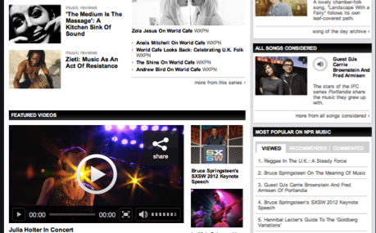

Slide 72
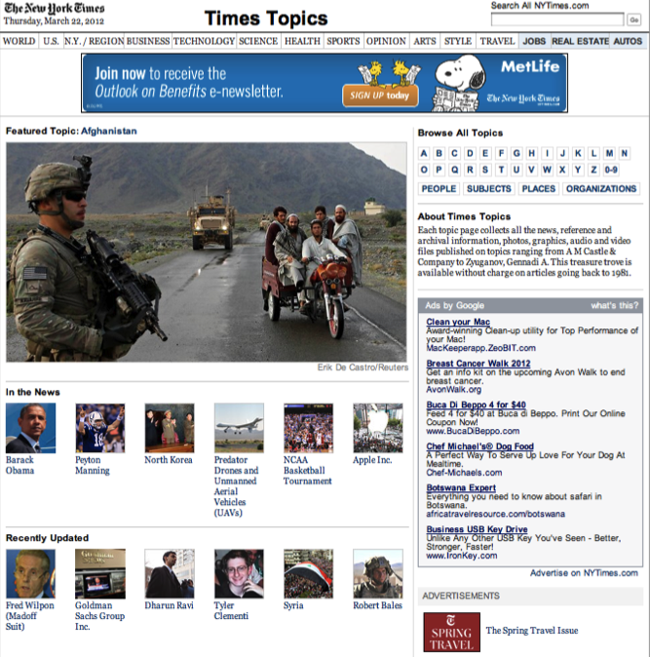

Slide 73
Building Networks
Around Sunday worship
Around service and mission projects
Around programming: children’s faith formation, youth ministry, Vacation Bible School
Around age groups/generations: young adults, midlife adults, Baby Boomers, older adults
Around families

Slide 74
A Network Approach
Faith Formation Network
Church Programs
Small Groups & Support Groups
Mentors
Social Media for Connection
User-Generated Content
Community Programs
Online Courses & Activities
Online Resources: Print, Audio, Video
Apps
Blogs
Video Conference

Slide 75
Targeting Adults
Emerging Adults: 20s
Young Adults: 30s-40s
Mid-Life Adults: 40s-50s
Mature Adults: 60s-70s
(Baby Boomers)
Older Adults: 80+
  Life Tasks
  Life Issues
  Milestones and Life Transitions
  Spiritual & Religious Needs
  Ethnic-Cultural Needs

Slide 76
Spiritual & Religious Diversity
Scenario 3 Unaffiliated & Uninterested
Scenario 1 Vibrant Faith & Active Engagement
Scenario 4 Uncommitted & Participating
Scenario 2 Spiritual but Not Religious

Slide 77
Responding the 4 Scenarios
Scenario #4 + Life issues + Extending worship + Online FF center + Service projects & mission trips + Deepening faith & engagement | Scenario #1 + Life issues + Extending worship + Courses/workshops/small group programs + Online FF center + Service projects & mission trips
Scenario #3 + Life issues + Third Place settings + Events (movie nights, concerts, festivals, theater) + Service projects | Scenario #2 + Life issues + Third Place settings + Service Projects & Mission Trips + Spiritual formation + Spiritual seeker faith formation

Slide 78
Baby Boomer Adult Faith Formation Network
Online Courses
Audio & Video Programs
Books & Book Clubs
Life Transitions
Prayer & Spiritual Practices
Justice & Service
Small Group Studies
Extended Learning Programs
Parish-based Programs
Life Tasks & Issues
Sunday Worship

Slide 79
Faith Formation Models
Face-to-Face
& Virtual
On Your Own
Small Group
Large Group
Mentored
Church Community
Community & World
@Home

Slide 80

Vibrant Faith @ Home

Slide 81
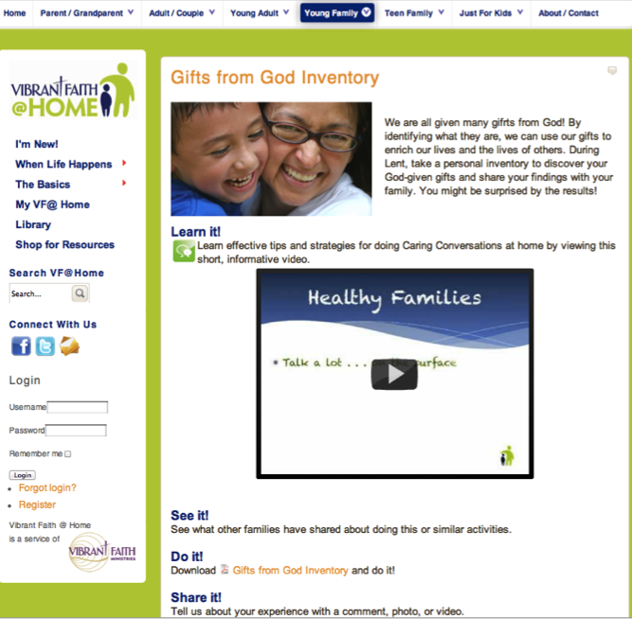
Vibrant Faith @ Home

Slide 82
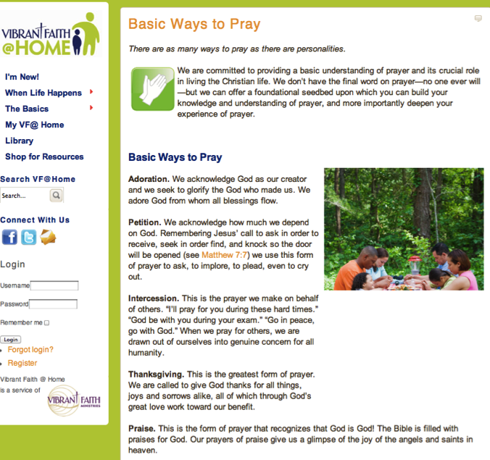
Vibrant Faith @ Home

Slide 83

Life Issues

Slide 84
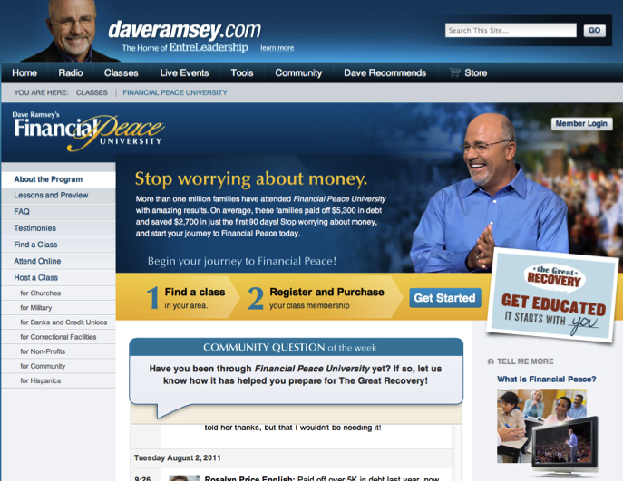
Life Issues

Slide 85
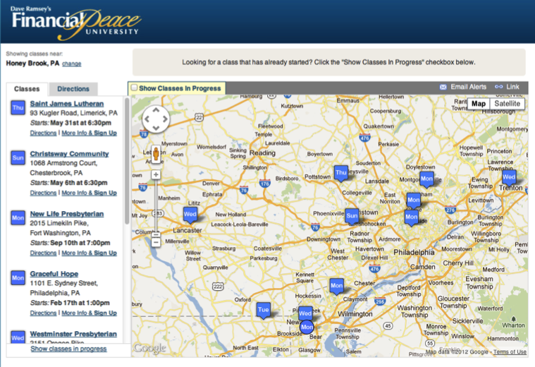
Life Issues

Slide 86

Life Issues

Slide 87
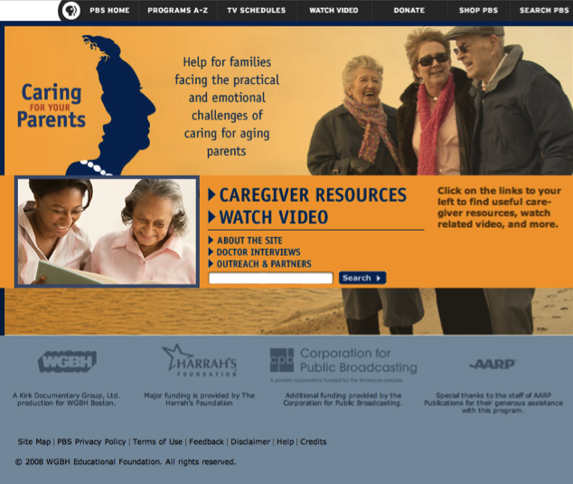
Life Issues

Slide 88
Extending Worship
Sunday Worship
Share It
Blog/Forum
After Mass Conversation
At-Home Conversation Activity
Live It
Ideas for living the Message
Christian Practice of the Week
Justice & Service Ideas
Study It
Taking Faith Home Insert
Homily Video + Study Guide
Daily Readings
Scripture Online Bible Study
Pray It
Weekly Table Prayer
Praying with the Saints
AM & PM Prayer

Slide 89
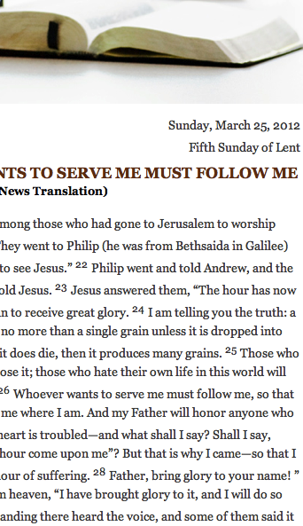

Slide 90
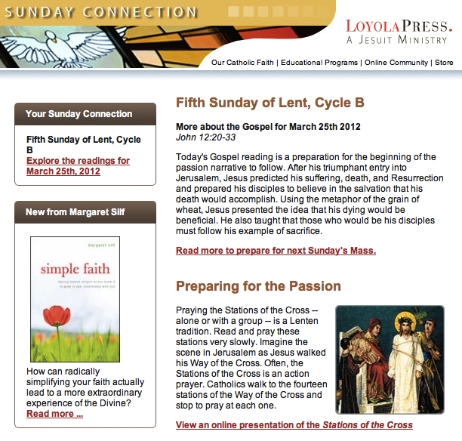

Slide 92
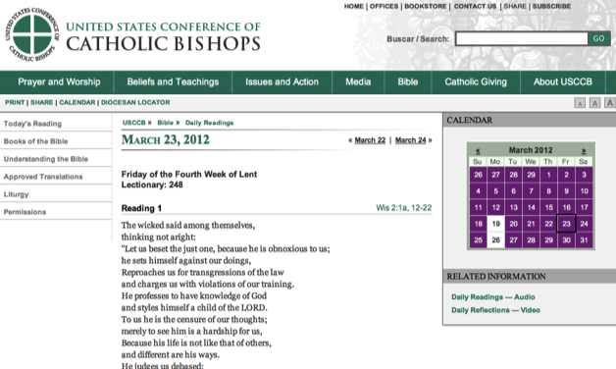
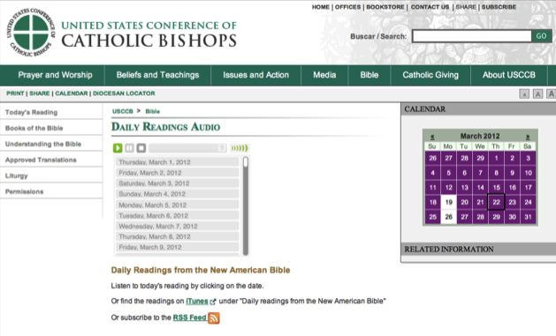

Slide 93
Extending Parish Programs
Gathered Program
Talk About It: Conversation Questions
Learn More: Watch a Video, Listen to a Talk, Read an Article
Live:
Action Project for the Month
Pray
Devotions, Bible Reading, Table Prayer
Share What Your Learning: Write a Blog Entry, Create & Share a Video or Project

Slide 94
Focusing on a Theme or Event
Theme or Church Event
On Your Own (Print, Audio, Video, Online Resources)
@Home Resources
(Print and/or Online)
Small Group Course
(online & physical settings)
Adult 4-Week Series @ Church
(Videotaped & online)
Online Course or Presentation

Slide 95
Utilizing Online Courses: iTunes U

Slide 96
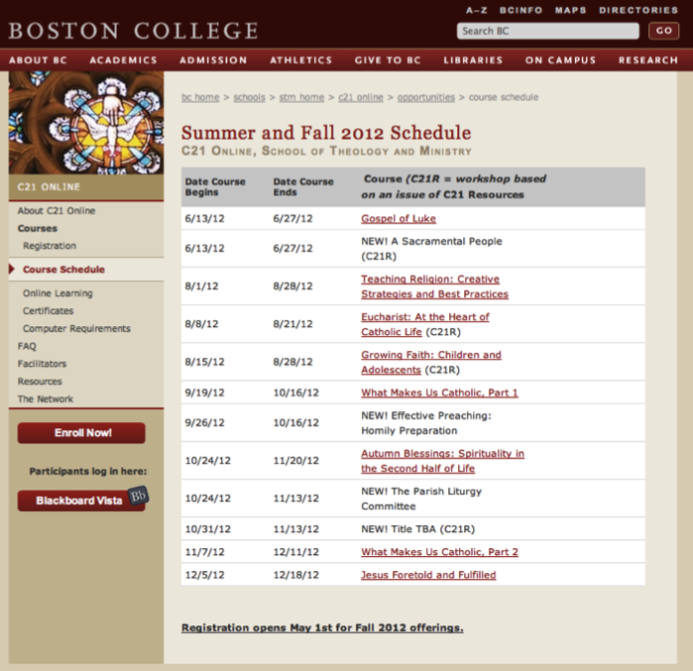

Slide 97
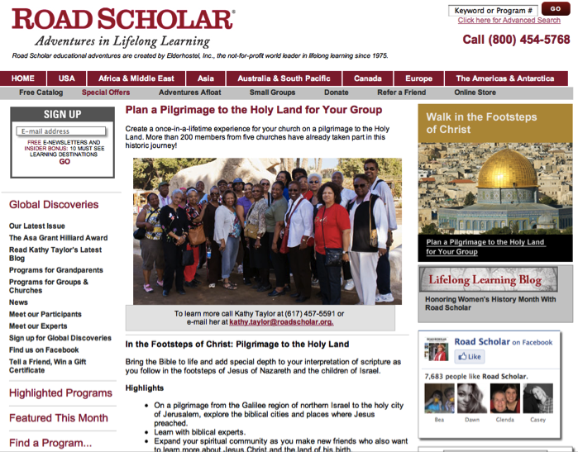
Extended Learning/Trips

Slide 98
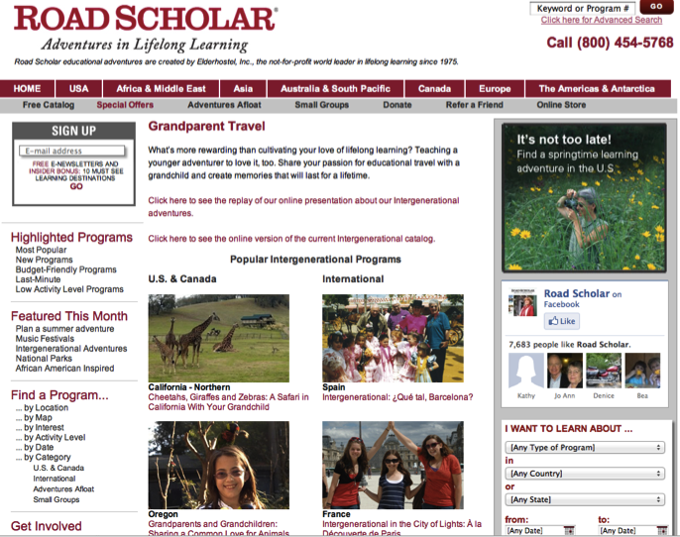
Extended Learning/Trips

Slide 99
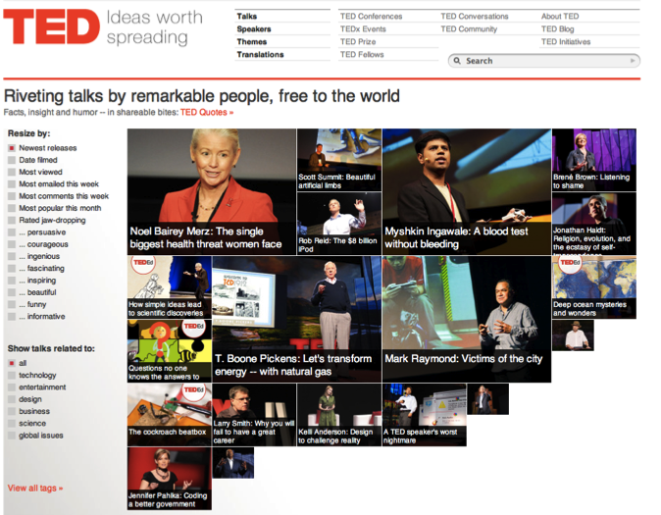
Utilizing Online Presentations

Slide 100


Utilizing DVD Study Programs

Slide 101
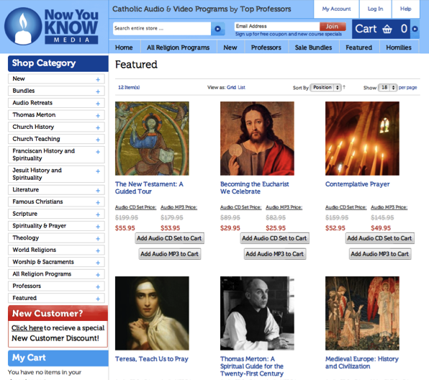


Developing a Parish Faith Formation Resource Center

Slide 102


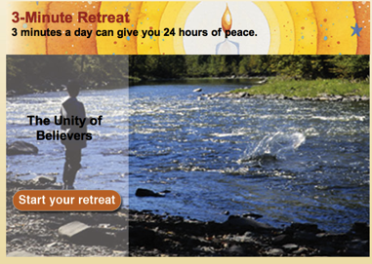
Curating Apps
Glo Bible App

Slide 103
YouVersion Bible App

Slide 104
Offering Spiritual Formation Resources
Lectio Divina
Scripture Reflection
Spiritual Reading
Contemplation
Praying with Art and Music
Fixed-hour Prayer
The Examen
Sabbath
Discernment
Fasting
Prayer Styles & Traditions
Formats
Courses
Workshops
Small Groups
Mentors/Spiritual Directors
Retreats
Online
Pilgrimages

Slide 105

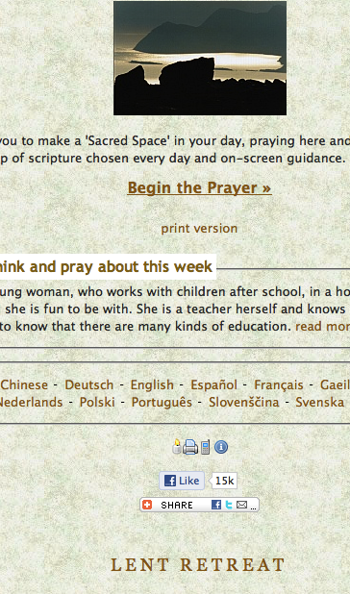

Slide 106
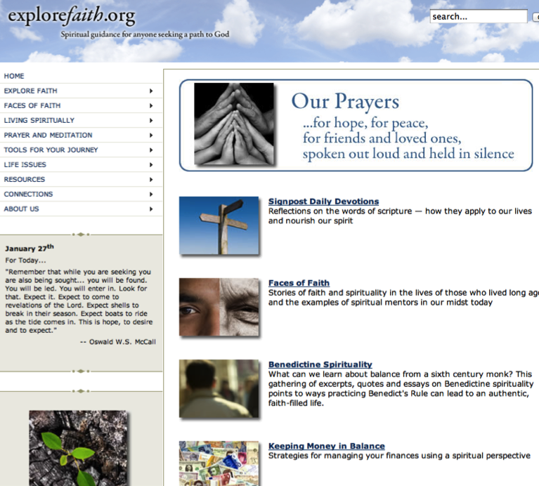

Slide 107
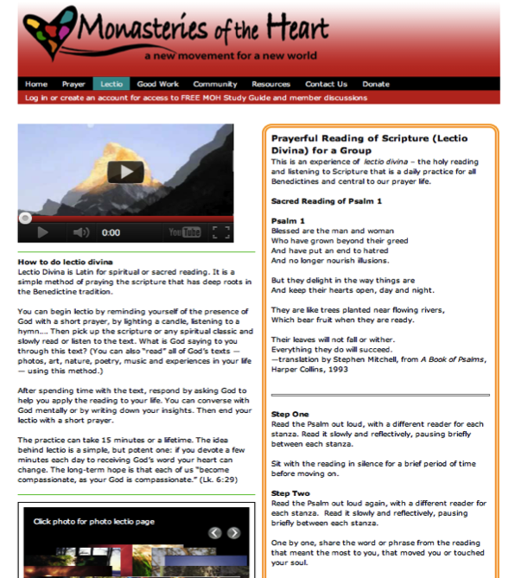

Slide 108
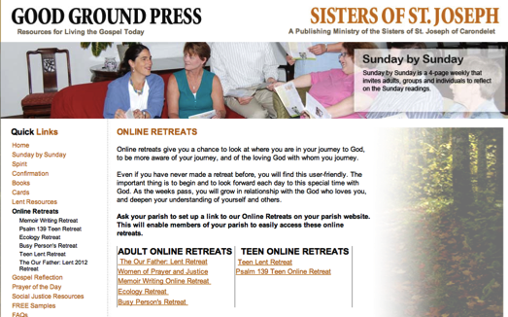
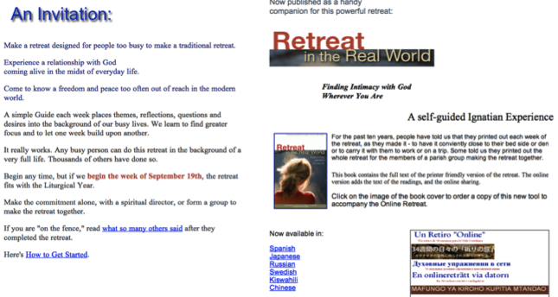

Slide 109
Service & Mission
local and global
“developmental” with increasing depth and scope:
    introduction: several hours to a full day
    short term: multi-day and local
    weeklong and national mission trips
    global expedition of one or more weeks

Slide 110
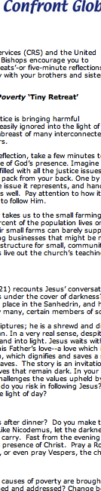

Slide 111

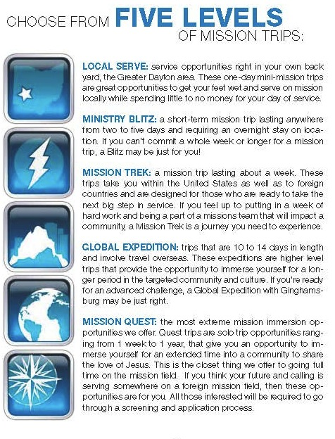

Slide 112
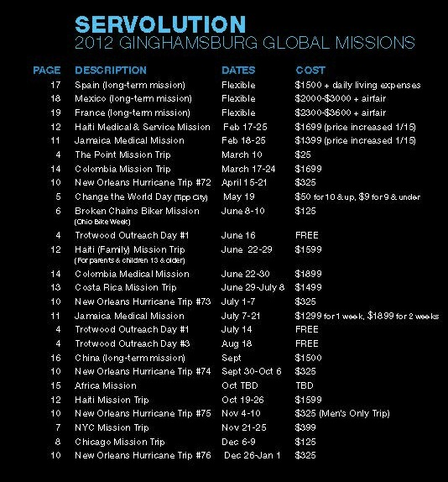

Slide 113
Third Place Settings
Establish a Third Place gathering space in the community, that offers hospitality, builds relationships, hosts spiritual conversations, provides programs and activities, and nourishes the spiritual life of people.

Slide 114


Slide 115
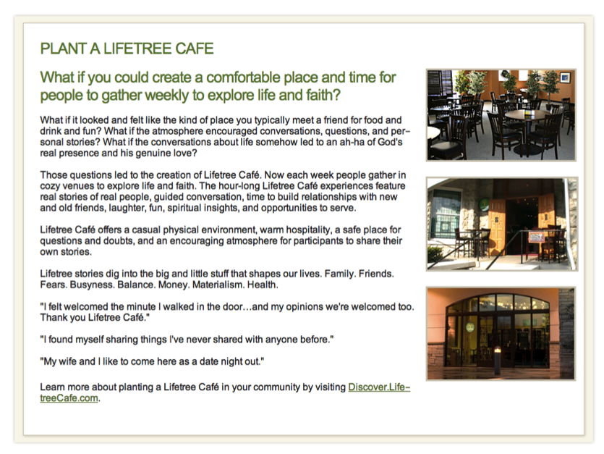

Slide 116
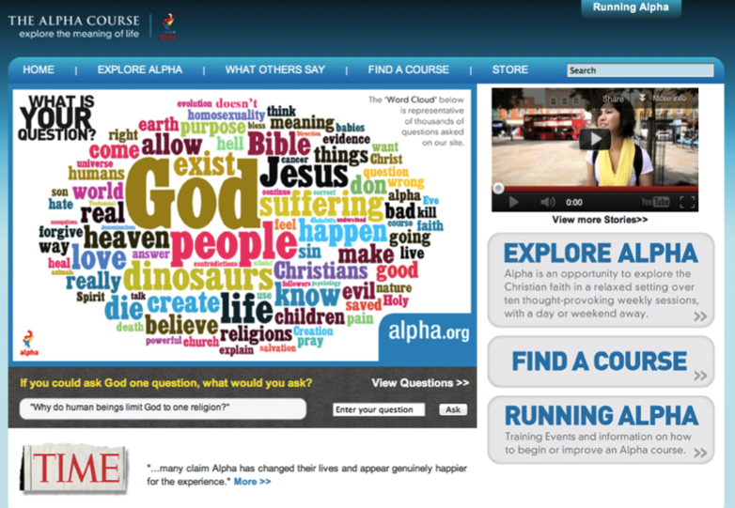
Spiritual Seekers

Slide 117
Spiritual Seekers: Alpha
Introduction Dinner: Is there more to life than this?
Week 1: Who is Jesus?
Week 2: Why did Jesus die?
Week 3: How can we have faith?
Week 4: Why and how do I pray?
Week 5: Why and how should I read the Bible?
Week 6: How does God guide us?
Week 7: How can I resist evil?
Week 8: Why & how should we tell others?
Week 9: Does God heal today?
Week 10: What about the Church?
Weekend: Who is the Holy Spirit? What does the Holy Spirit do? How can I be filled with the Holy Spirit? How can I make the most of the rest of my life?

Slide 118

Discovering Christ

Slide 119

Spiritual Seekers: Awakening Faith
Spirituality: What’s the Buzz?
Who is Jesus?
Do We Need the Spirit?
Can I Accept God’s Mercy?
Can Mass Make My Life Meaningful?
The Church and Me

Slide 120
Designing An Adult Faith Formation Network

Slide 121
A Network Approach
Faith Formation Network
Church Programs
Small Groups & Support Groups
Mentors
Social Media for Connection
User-Generated Content
Community Programs
Online Courses & Activities
Online Resources: Print, Audio, Video
Apps
Blogs
Video Conference

Slide 122


Slide 123
Design Process for an New Initiative
Select a Target Group (or need)
Research
(Empathize)
Defined Spiritual & Religious Needs, Concerns & Interests
Generate Ideas
Create Prototypes to Pilot
Test the Prototypes
Evaluate, Improve, & Expand the Innovation

Slide 124
All Ages & Generations
Families through Life
Children
Adolescents
Emerging Adults: 20s
Young Adults: 30s-40s
Mid-Life Adults: 40s-50s
Mature Adults: 60s-70s
(Baby Boomers)
Older Adults: 80+
  Life Tasks
  Life Issues
  Milestones and Life Transitions
  Spiritual & Religious Needs
  Ethnic-Cultural Needs

Slide 125
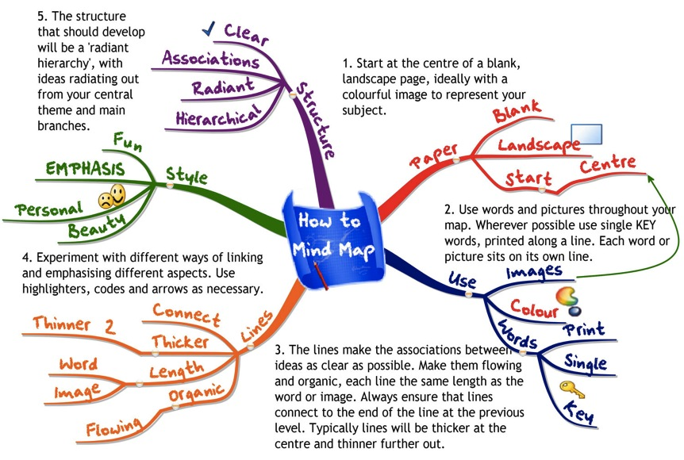
Generating Ideas: Mindmapping

Slide 126
Promoting/Marketing Network
Connect it to a gathered event (Mass, sacramental celebration, Church Year season)
Connect it to a parish-based program
Connect it to a life stage or milestone event
Use Facebook - regular announcements
Use an E-newsletter (Constant Contact or Mail Chimp) – regular “mailings”
Create interest through short “You-Tube” style videos
Create testimonials
Engage users to invite others to be involved

