Slide 1
“Beneath the Surface: Changing Religious Preferences & Practices”

Slide 2
What the Research Tells Us

Slide 3
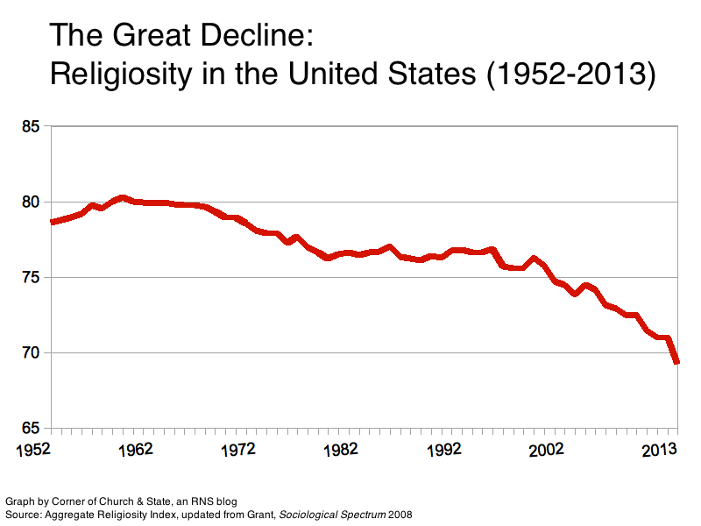

Slide 4
America’s Changing Religious Landscape Christians Decline Sharply as Share of Population; Unaffiliated and Other Faiths Continue to Grow Pew Research Center, May 12, 2015

Slide 5
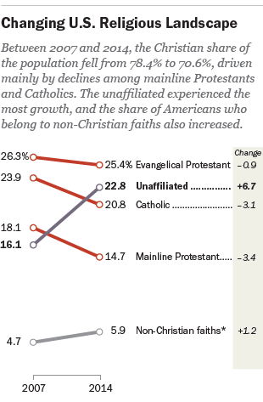

Slide 6
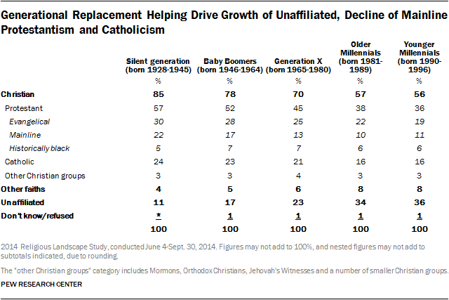

Slide 7
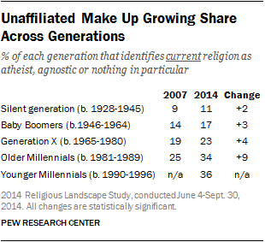

Slide 8
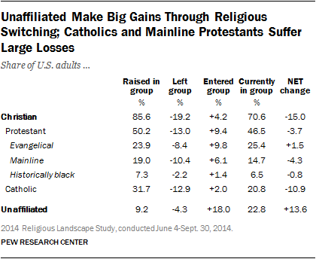

Slide 9
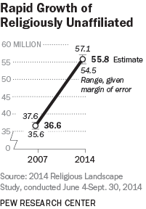
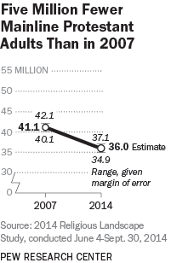
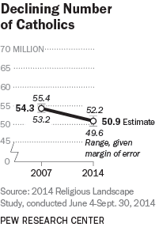

Slide 10
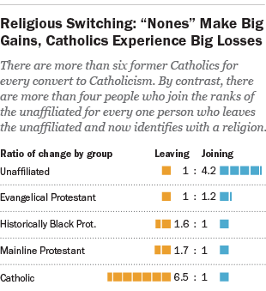

Slide 11
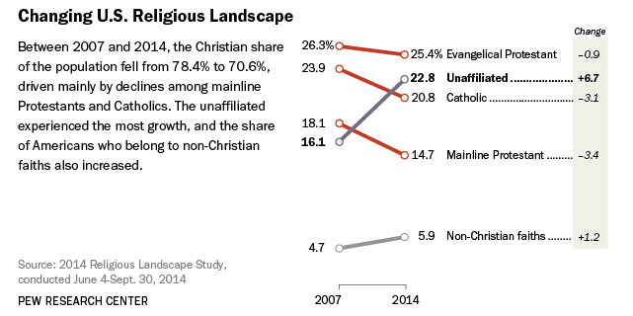

Slide 12
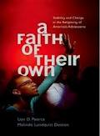
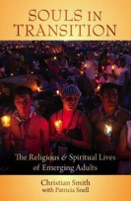
Youth & Young Adults
Youth (teens)
Abiders Adapters Assenters Avoiders Atheists
20% 20% 31% 24% 5%
Emerging Adults (20s)
Committed Selected Spiritually Religiously Religiously Irreligious Traditionalists Adherents Open Indifferent Disconnected
15% 30% 15% 25% 5% 10%

Slide 13
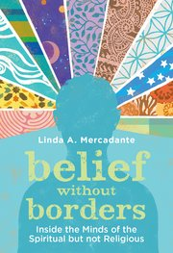
Types of SBNR People
Dissenters are people who largely stay away from institutional religion (“protesting dissenters” or “drifted dissenters”)
Casuals are people whose religious or spiritual practices are primarily functional (makes me feel better).
Explorers are like spiritual tourists who enjoy the journey but do not plan to settle anywhere (theological hybrids).
Seekers are searching for a spiritual home (reclaiming an earlier religious identities or moving on to something new).
Immigrants have moved to a new spiritual “land” and are trying to adjust to this new identity and community (tension between commitment, constancy, and group loyalty – and SBNR ethos of independence, freedom, non-dogmatism, and an open and questing attitude).

Slide 14
The Catholic Family Study (CARA, 2015)
Do any of your children currently attend…
A Catholic elementary or middle school: 8%
A Catholic high school: 3%
A parish-based Catholic religious education program: 21%
A youth ministry program: 5%
None of the above: 68%

Slide 15
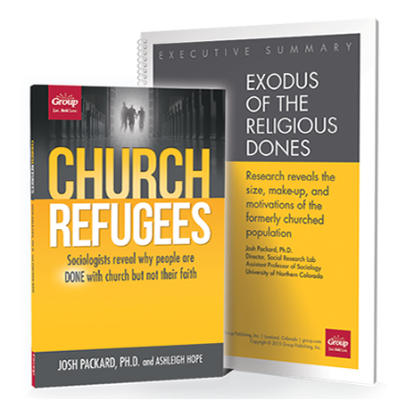

Slide 16
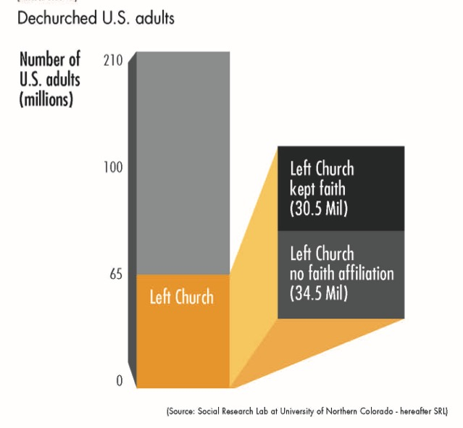

Slide 17
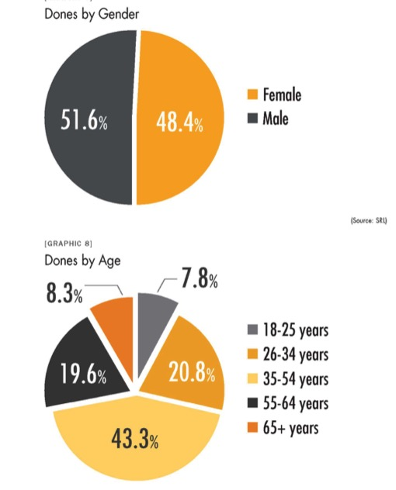

Slide 18
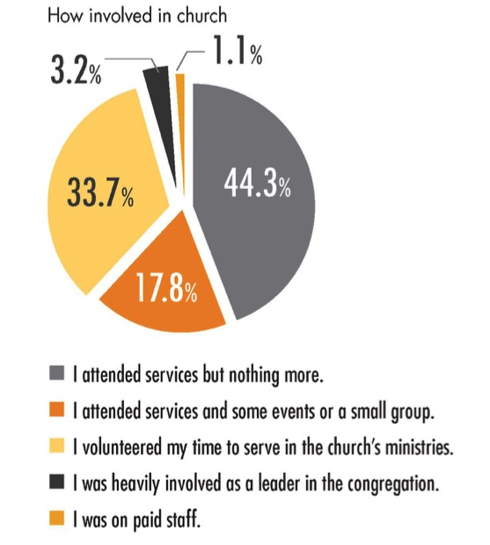

Slide 19
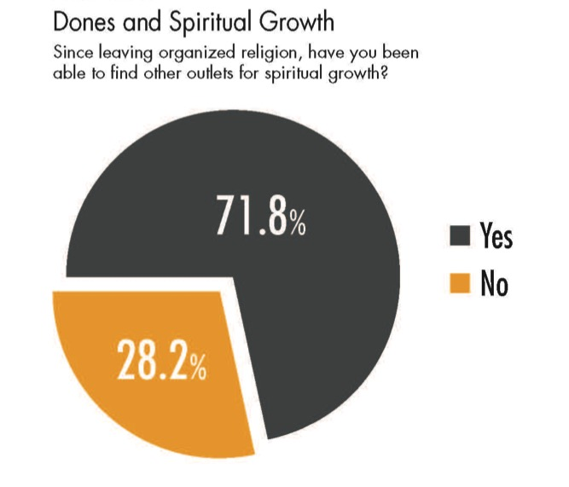

Slide 20
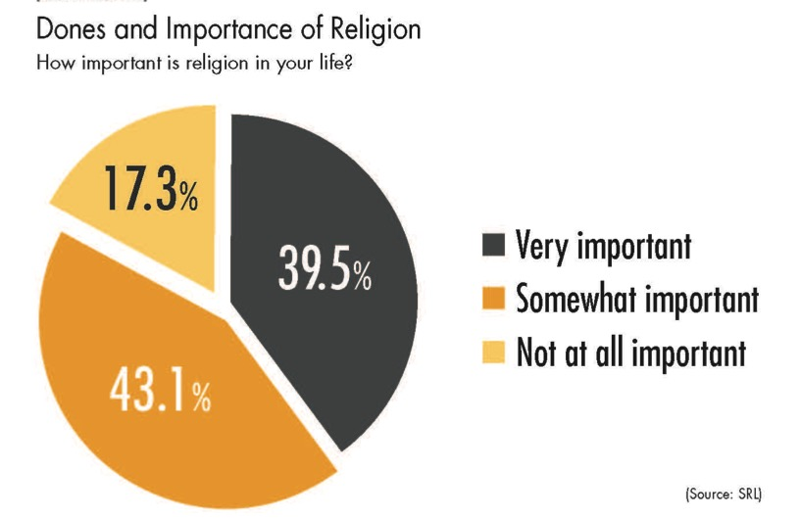

Slide 21
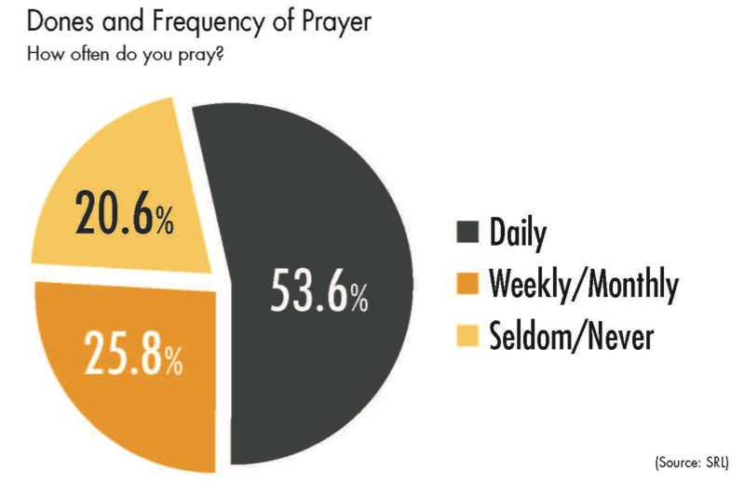

Slide 22
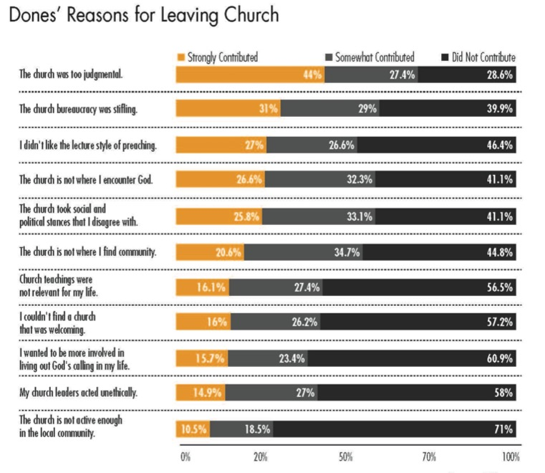

Slide 23
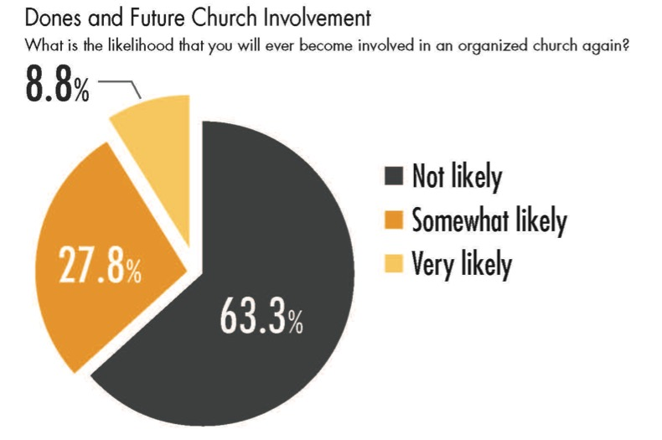

Slide 24
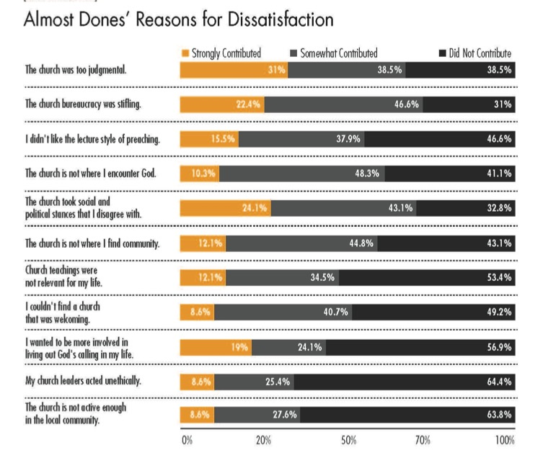

Slide 25
Analysis

Slide 26
Analysis: Generational Transition
Younger generations more unaffiliated and less involved in faith communities
Older generations more affiliated and more involved and supportive
Generational transition: as younger generations replace the older generations there will be fewer engaged and more unaffiliated

Slide 27
Analysis: Importance of Religion
40% of the “no religion in particular” say it is “very” or “somewhat” important in their lives
The overwhelming majority of religiously unaffiliated believe in God
Less about people “losing their religion” than dissatisfaction with available institutional options
Young generations seem allergic to large-scale institutions that demand not only spiritual allegiance but financial commitment. None of these things are “religion” for these people.

Slide 28
Analysis: Importance of Religion
Corporate, mega-church dominated models of religious & spiritual activity are starting to be replaced by smaller, more locally oriented church communities, and by larger churches that attract the masses for a spiritual or musical performance, and a sense of belonging to something much larger than themselves.
Young people are looking for intimacy and personal connections, deep spiritual experiences, service to others, and the opportunity to create their own community.

Slide 29
Analysis Importance of Religion
Religion is not going away anytime soon, regardless of how people may identify themselves. But business as usual among existing religious institutions will not stem the losses we are seeing.
(Richard Flory, USC)
(http://religiondispatches.org/u-s-christianity-is-dead-long-live-u-s-christianity)

Slide 30
Analysis Religious Transmission
Value & religious transmission is a family affair (research by Bengston & Smith)
Families can transmit a particular religious faith tradition or not
Declining levels of family religious transmission and faith practice at home are a result of non-affiliation
1st generation & 2nd generation
If the pattern continues, expect higher levels of non-affiliation and lower levels of church involvement in younger families

Slide 31
Suggested Directions
Family: Starting Early
Missional Outreach
Missional Pathways
Design for Spiritual Diversity

Slide 32
Directions Engaging Reality
Working what matters
In context… In language and actions… That give life.
Identity: Who am I? What’s like to be me? How do I live well with myself?
Belonging: Who else works life with me? Where do I fit in? How do I be with others who matter? Can I trust anyone?
Meaning: What’s going on? What matters to me…to those I care about…at all? Why am I here? Does life ever make sense?
Brokenness: How do I live with life’s messiness? What works? How do endure pain? How do I focus in the
Stress: Why am I so busy out? What should I do? What shouldn’t I do? Will I ever not be overwhelmed?
Hope: Is there good future? Whose promises can I count on? Where should I put my trust?

Slide 33
Directions Christianity as Mission
Becoming a Faith Community in Mission:
Cultivating a community of faith where God is at the center of conversation and action…and where God shapes the focus and work of the people...whose concern focuses on the world God loves.
By practicing….
Dwelling in the Word:
Immersing oneself in the Word so that it shapes imagination, intentions and actions.
Dwelling in the World:
Becoming alert to, observant of and connected with the people in the world where God send us.

Slide 34
Directions Christianity as Mission
Hospitality:
Creating a welcoming and generative community within God’s mission in the world.
Spiritual Formation and Discernment:
Following and facilitating the Holy Spirit’s work in the formation of faith, community and mission.
Announcing the Reign of God:
Recognizing and bearing witness to God’s presence and work in the world most especially in the life Jesus.
Focused Missional Action:
Discerning and focusing attention and action on that which is central to mission in our time and context.

Slide 35
Directions Family Faith Formation
Starting early to equipping families to become centers of learning, faith growth, and faith practice. . .
Family Faith: nurturing family faith at home through faith practices
Parents: Developing parental faith, and skills for effective parenting & nurturing faith growth
Family Strengths: Building strong families by developing family assets
nurturing relationships, establishing routines, maintaining expectations, adapting to challenges, and connecting to the community

Slide 36
Directions Developmental Relationships
Express Care: Show that you like me and want the best for me.
Challenge Growth: Insist that I tray to continuously improve
Provide Support: Help me complete tasks and achieve goals
Share Power: Hear my voice and let me share in making decisions
Expand Possibilities: Expand my horizon and connect me to opportunities

Slide 37
Directions Missional Outreach
Missional faith formation expands and extends the church’s presence through outreach, connection, relationship building, and engagement with people where they live—moving faith formation out into the community.
Moving worship and faith formation into the community
Opening programs to everyone – VBS
Life skills: parenting, careers, training, mentoring
Small group programs on a variety of topics
Community-wide service
Community events: arts, music, theater

Slide 38
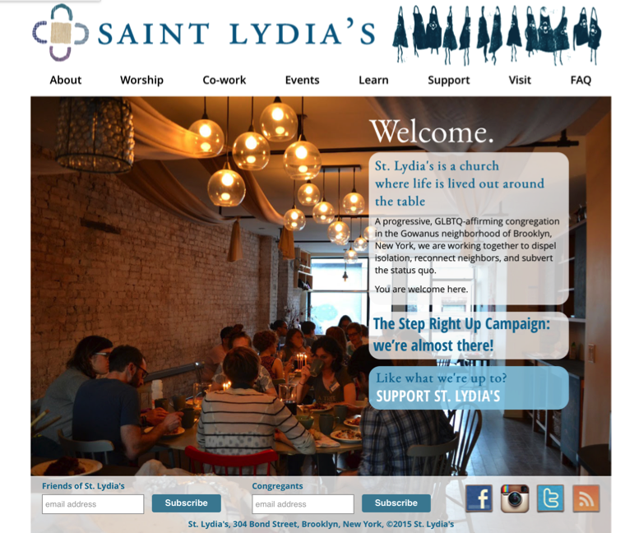

Slide 40
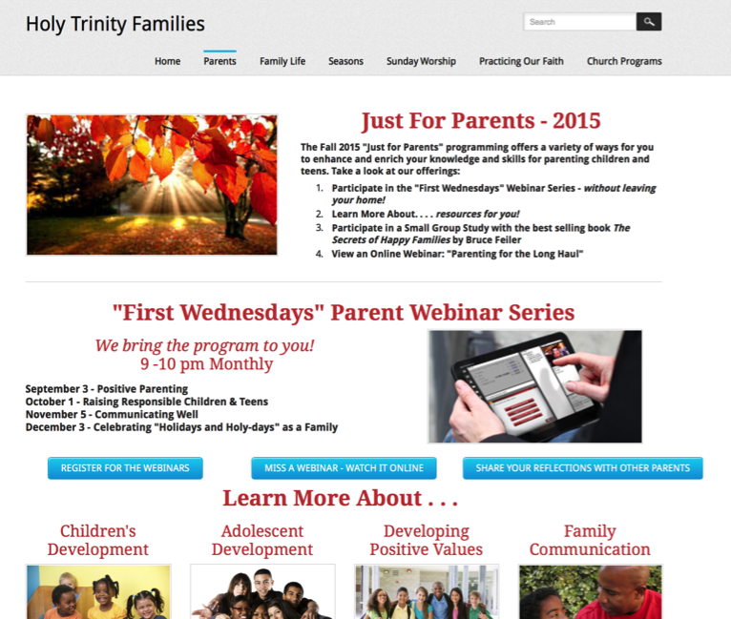

Slide 41
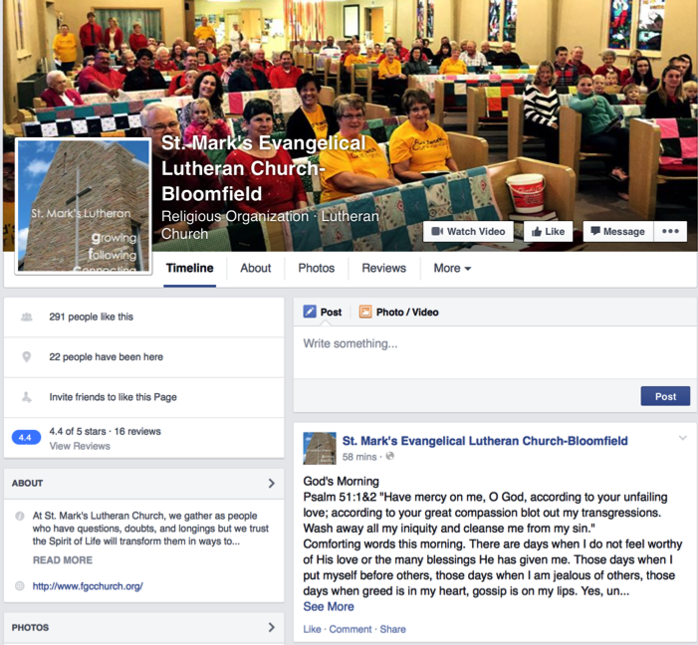
St. Mark’s
Daily Devotion

Slide 42
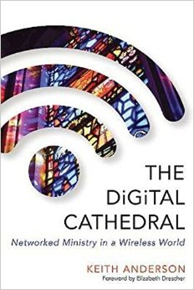
Directions Missional Outreach

Slide 43
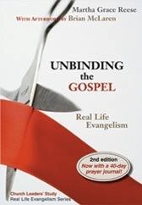
Missional Outreach Invitation & Mentoring
Step 1. Prepare church leaders
Step 2: 40-day preparation for community members (study, prayer, worship, small groups)
Step 3: Invitation to one person & four-week small group experience with “taste & see” church experiences

Slide 44
Directions Missional Pathways
Missional faith formation provides pathways for people to consider or reconsider the Christian faith, to encounter Jesus and the Good News, and to live as disciples in a supportive faith community.

Slide 45
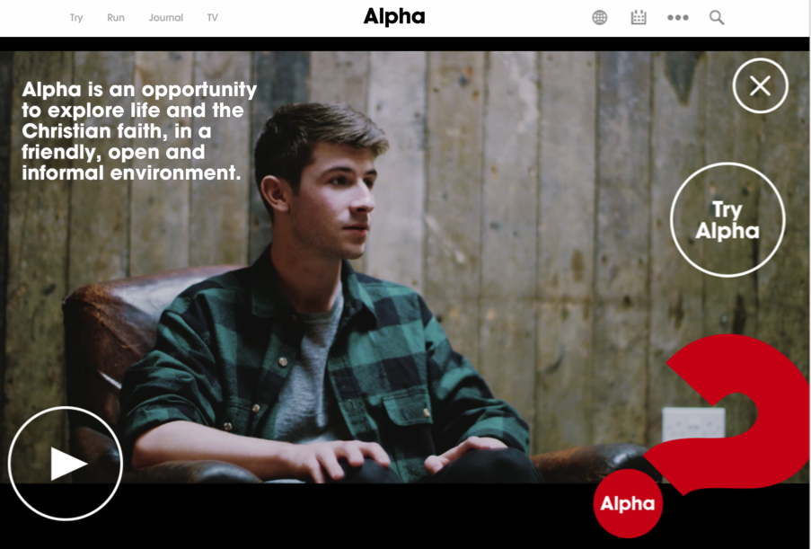

Slide 47
Directions Design for Spiritual Diversity
Rituals/Milestones Preparation
Marriage
Baptism
First Communion
Confirmation Funerals
Educational Programming
Vacation Bible School
Worship Experiences

