Slide 1
Engaging in a Hope-Filled Future
Diocese of Ogdensburg
John Roberto
www.LifelongFaith.com
jroberto@lifelongfaith.com

Slide 2
Part 2. Creating a New Future
Engaging in a Hope-Filled Future

Slide 3
Intergenerational Faith Community
Age Group/Generational Faith Formation
Family Faith Formation
Missional Faith Formation
Online & Digitally-Enabled Faith Formation
Comprehensive
Faith formation is comprehensive – connecting four essential contexts for making disciples and promoting lifelong faith growth, facilitated by the use of new online communities & resources, and digitally-enabled approaches to faith formation.

Slide 4
Faith Forming
Intergenerational Faith Formation through church life:
caring community, celebrating, learning, praying, serving
Age-Specific Faith Formation across the entire life-span:
children – teens –
young adults – adults
Missional Faith Formation:
outreach & presence
pathways for encounter & engagement
Family Faith Formation:
family faith practice & faith transmission
family life enrichment
parent faith formation and parenting education

Slide 5
Intergenerational

Slide 6
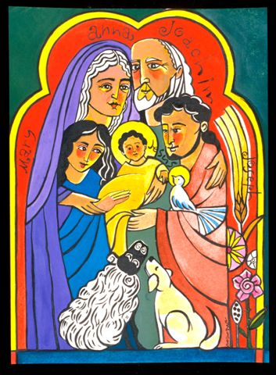
Intergenerational
Throughout Scripture there is a pervasive sense that all generations were typically present when faith communities gathered for worship, for celebration, for feasting, for praise, for encouragement, for reading of Scripture, in times of danger, and for support and service. . . . To experience authentic Christian community and reap the unique blessings of intergenerationality, the generations must be together regularly and often—infants to octogenarians.
(Holly Allen and Christine Ross)

Slide 7
Intergenerational
Caring: Community building activities, storytelling, mentoring, social events
Celebrating: Sunday Worship, whole community sacramental celebrations, milestones celebrations, church year feasts and seasons
Learning: Intergenerational learning programs (weekly, monthly, small group); incorporating intergenerational learning into age group programming
Praying: Community prayer experiences, intergenerational prayer groups, spiritual guides
Serving: Intergenerational service projects and mission trips, church-wide service days

Slide 8
Intergenerational Learning
As the curriculum for the whole community
In Lectionary-based catechesis
In sacramental preparation
In vacation Bible school
In parent-child and parent-teen programs
In milestone celebrations
In intergenerational service projects
In liturgical season celebrations
In retreat experiences or parish missions

Slide 9
Connecting Faith, Worship, & Life
St. Elizabeth of Hungary Parish uses a liturgy-centered, lifelong, and intergenerational approach to Catholic faith formation. The goal is to help and support everyone who wishes to become a better disciple by integrating faith, worship, and life in light of the Gospel. Since this is an ongoing, lifelong task, we invite EVERYONE in the parish to participate. All are welcome!

Slide 10
Liturgical
September: Mass for the 24th Sunday in Ordinary Time
October: Mass for the 28th Sunday in Ordinary Time
November: Mass for the 32nd Sunday in Ordinary Time
December: Mass for the 2nd Sunday of Advent
January: Mass for the Baptism of the Lord
February: Mass for the 1st Sunday of Lent
March: Mass for Palm Sunday
April: Mass for the 4th Sunday of Easter
May: Mass for Holy Trinity Sunday

Slide 11
Life-Stage

Slide 12
Life-Stage Faith Formation
Age group and generational faith formation addresses the unique life tasks, needs, interests, and spiritual journeys of people at each stage of life.
Intergenerational Faith Community
Children & Parents
Youth & Parents
Young Adults
Mid-life Adults
Mature Adults
Older Adults

Slide 13
Life-Stage Faith Formation
Life-stage/generational—addressing the unique life tasks, needs, interests, and spiritual journeys of people at each stage of life:
  Children (and parents)
  Adolescents (and parents)
  Young adults (20s-30s)
  Midlife adults (40s-50s)
  Mature adults (mid 50s-mid 70s)
  Older adults (75+).

Slide 14
Life-Stage & Intergenerational
Learn with Peers
Experience in Community
Live the Learning
Reflect on Learning & Living

Slide 15
Life-Stage Faith Formation
Provides a variety of content, methods, formats, and environments to address the diverse life tasks and situations, needs and interests, and spiritual and faith journeys of children, teens, and adults.
Moving away from “one-size-fits-all” mentality

Slide 16
Life-Stage Faith Formation
Incorporate seven learning environments—
  Self-directed
  Mentored
  At home
  Small groups
  Large groups
  Church-wide
  Community & World

Slide 17
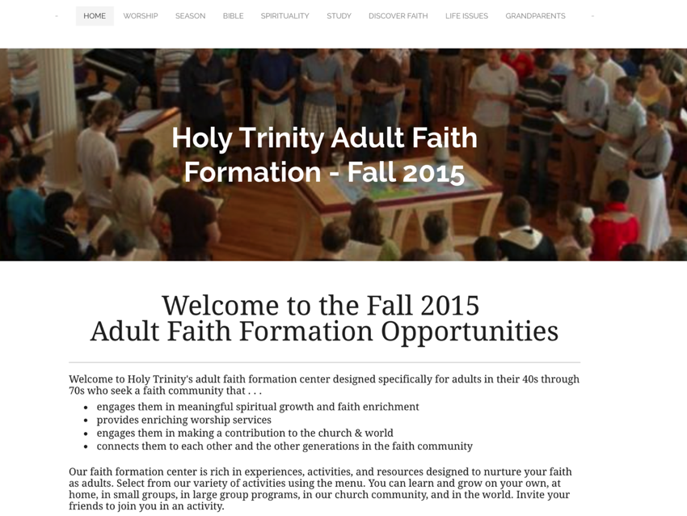

Slide 18
Family

Slide 19
Family Faith Formation
Congregations equip families to become centers of learning, faith growth, and faith practice in 5 ways:
Nurturing family faith at home through eight faith forming processes
Building strong families by developing family assets: nurturing relationships, establishing routines, maintaining expectations, adapting to challenges, and connecting to the community.
Parent faith formation
Parenting for faith growth training
Parenting education

Slide 20
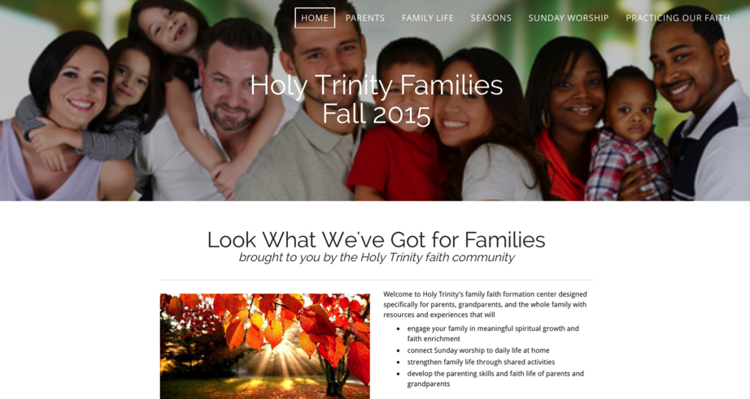

Slide 21
Target the Special Times
Through the day: meal times, car times, morning and bedtime, exits and entries, family sharing times
Through the year: church year seasons, rituals and celebrations
Through the lifecycle: milestones and rites of passage
Through key family moments – good times and hard times, times of joy and sorrow
Through life issues and life skills: parenting, decision-making, financial planning, communication, and more

Slide 22


Slide 23
Family Strategies
Utilize church ministries and programming to teach, model, and demonstrate family faith practices, and then provide the resources for families to live the practice at home.
Involve the whole family in congregational life, programs, and leadership roles.
Offer family and intergenerational learning programs, as well as parent-child/teen programs.
Develop family faith formation around life-cycle milestones.

Slide 24
Family Strategies
Offer a variety of developmentally-appropriate family or parent-teen service projects.
Provide at-home resources for the core family faith practices.
Focus on parents—parent faith formation and parental training.
Develop a family faith formation website as an online resource center.

Slide 25
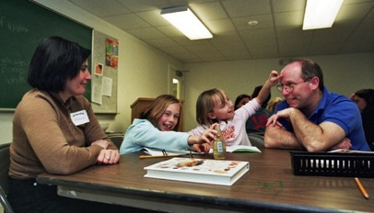
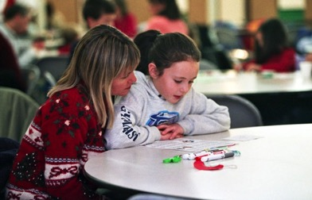
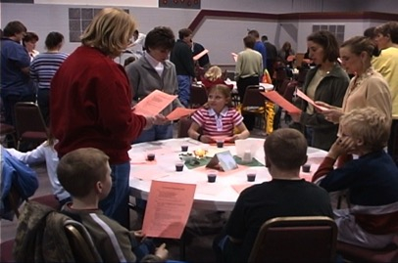
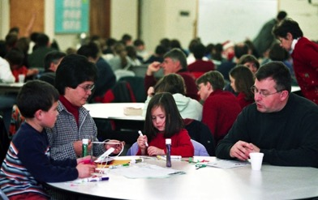
Family-Centered Learning

Slide 26
Family-Centered Learning
Offer family learning programs
Monthly or seasonal programs
Family workshops
Family cluster/small group learning
Family-centered Lectionary-based programs
Family vacation Bible school
Family retreats and camps

Slide 27
Family Assets (Search Institute)

Slide 28
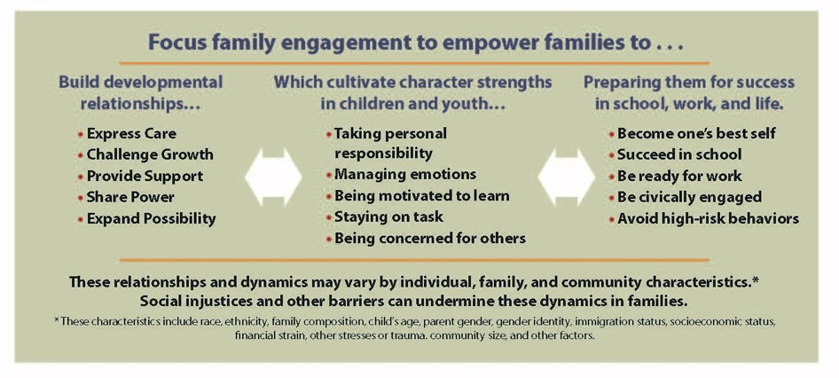

Slide 29
Starting Early
Start early in life with parents and young children.
prepare parents for the vocation of parenting & understand the young child
Baptism milestone resources
resources for faith formation with young children; new materials every six months
parent education programs & support groups for parents

Slide 30
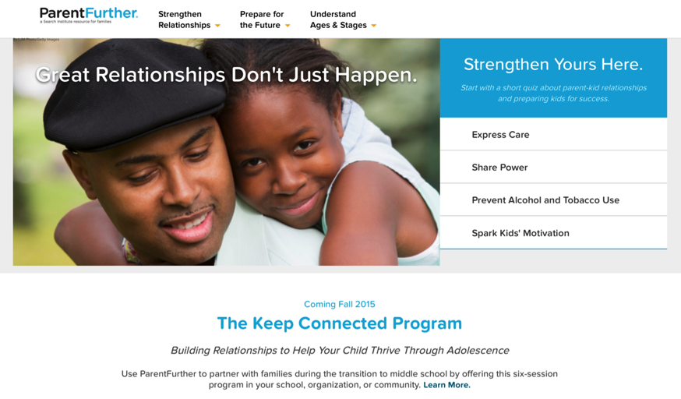
Parent Resource Center

Slide 31


Slide 32
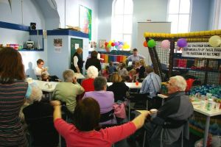
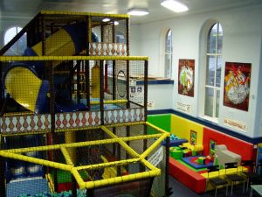
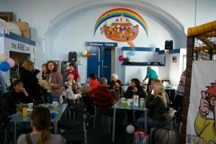
The Wesley Playhouse
www.freshexpressions.org.uk/stories/playhouse

Slide 33
Missional

Slide 34
Missional Faith Formation
Missional faith formation expands and extends the church’s presence through outreach, connection, relationship building, and engagement with people where they live—moving faith formation out into the community.
Missional faith formation provides pathways for people to consider or reconsider the Christian faith, to encounter Jesus and the Good News, and to live as disciples in a supportive faith community.

Slide 35
Missional Faith Formation
Missional faith formation expands and extends the church’s presence through outreach, connection, relationship building, and engagement with people where they live—moving faith formation out into the community.
  Moving worship and faith formation into the community
  Opening programs to everyone – VBS
  Life skills: parenting, careers, training, mentoring
  Small group programs on a variety of topics
  Community-wide service
  Community events: arts, music, theater

Slide 36


Slide 37
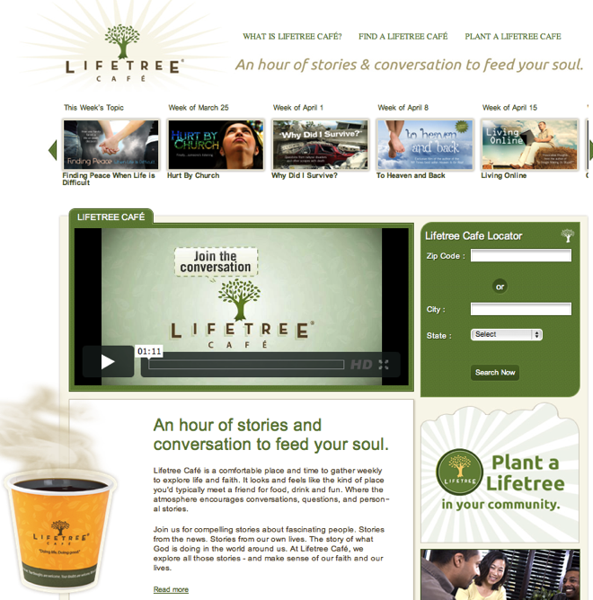
A Third Place gathering space in the community, offers hospitality, builds relationships, hosts spiritual conversations, provides programs and activities, and nourishes the spiritual life of people.

Slide 38
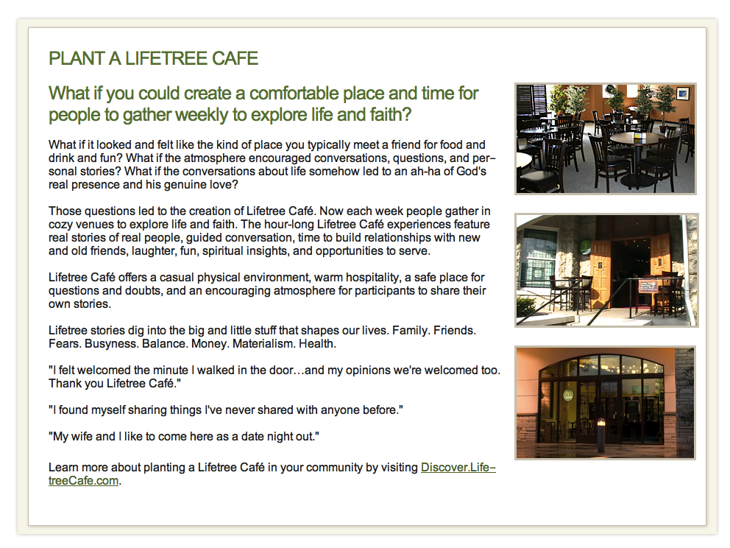

Slide 39
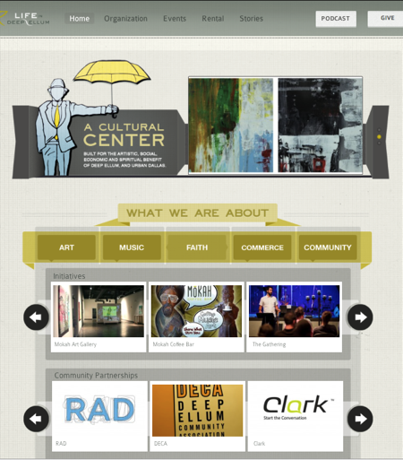
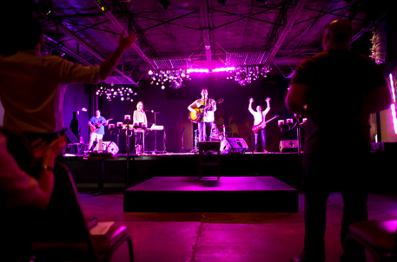
Congregations as
Community Centers
Life in Deep Ellum is a cultural center built for the artistic, social, economic, and spiritual benefit of Deep Ellum and urban Dallas. Through its four pillars of Art, Music, Commerce, and Community, it strives to promote life and growth in our city through creative initiatives and strategic partnerships. Life in Deep Ellum is about a way of life, cultivating purpose, and guiding people into relationship with God.

Slide 40
Missional Faith Formation
Missional faith formation provides pathways for people to consider or reconsider the Christian faith, to encounter Jesus and the Good News, and to live as disciples in a supportive faith community.

Slide 41
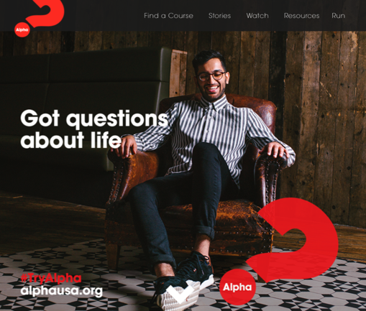


Slide 42
Pathway: The Alpha Course
Introduction Dinner: Is there more to life than this?
Week 1: Who is Jesus?
Week 2: Why did Jesus die?
Week 3: How can we have faith?
Week 4: Why and how do I pray?
Week 5: Why and how should I read the Bible?
Week 6: How does God guide us?
Week 7: How can I resist evil?
Week 8: Why & how should we tell others?
Week 9: Does God heal today?
Week 10: What about the Church?
Weekend: Who is the Holy Spirit?

Slide 43
Pathway: Our Lady of Soledad Parish
Mini-Retreat 101: “Catholics Alive!”
  “What does it mean to be a follower of Christ?”
Mini-Retreat 201: “Alive and Growing Spiritually!”
  Maturing in the Catholic faith
Mini-Retreat 301: “Alive and Gifted!”
  Discerning how to serve God in ministry
Mini-Retreat 401: “Alive in the World!”
  Living as witnesses for Christ, as contagious Catholic Christians
Mini-Retreat 501: “Alive to Praise God!”
  Catholic worship and the sacraments

Slide 44

Pathway: Unbinding the Gospel
Step One. Church Leader’s Study: Unbinding the Gospel
Step Two: All-Church Saturation Study: Unbinding Your Heart: 40 Days of Prayer & Faith Sharing.
  six-week, church-wide, small group E-vent!
  pray each day’s scripture and prayer exercise and work with a prayer partner
  study a chapter of the book with their small group
  worship with sermons, music, and prayers centered on the week’s chapter

Slide 45
Pathway: Unbinding the Gospel
Step Three: An Experiment in Prayer and Community: Unbinding Your Soul.
  a no-obligation experience of substantial spiritual discussion, prayer and community for people who aren’t connected with a church
  church members invite their friends into a four-week small group experience with short study chapters, an individual prayer journal, prayer partner activities, and group exercises.

Slide 46
Online & Digitally-Enabled Faith Formation

Slide 47


Slide 48
Digitally-Enabled Faith Formation
Faith formation is digitally-enabled—blending gathered community settings with online learning environments and utilizing the abundance of digital media and tools for learning and faith formation; and digitally-connected—linking intergenerational faith community experiences, peer experiences and programs , and daily/home life using online and digital media.

Slide 49
Digitally-Enabled Faith Formation
We now have the technology, online platforms, and digital content to:
engage people with a wide variety of faith forming content for all ages - anytime, any place
extend church events into people’s daily lives via online content and experiences
connect faith formation in gathered settings with faith formation in online settings
offer a variety of online faith formation content, experiences, and courses for self-study and small group study

Slide 50
Digitally-Enabled
Online Faith Formation
Mostly Online with Regular Interaction in Gathered Sessions
Online Faith Formation & Gathered Sessions (Flipped Classroom)
Gathered Program with Supportive Online Content
Gathered Program with Online Components beyond the Program

Slide 51
Gathered with Online Content
A gathered program using online content from websites, videos from YouTube or other video sites, and blogs and other social media. With an abundance of high quality digital content, this first option is the easiest way to bring the digital world into a gathered program.

Slide 52
Gathered and Online Content
Connecting church programs or events with online content that extends and deepens the experience through learning, prayer, ritual, action, etc.
  Sunday worship & church year feasts and seasons
  Intergenerational & family programs
  Children, youth, and adult classes & programs
  Extended programs: mission trips, retreat experiences, and vacation Bible school, summer camp

Slide 53
Church Event or Program
At Home & Daily Life

Slide 54
Event or Program
TALK
Conversation Activities
LEARN
Read
Listen
Watch
ACT
Practices
Service
Projects
PRAY
Devotions Bible Reading Daily Prayer
SHARE
Blog Facebook
Video
Projects

Slide 55
Example: Sunday Worship
Church Life ➔ | Daily & Home Life | ⬅ Online Life
Experience of Worship in the Congregation Sunday worship and lectionary Church year feasts and seasons Church rituals: baptism, communion, funerals, etc. | Experience of Sunday worship, rituals, and church year seasons in daily life Reflecting on the sermon and readings at home Practices: Lectio, etc. Application to daily living | Online worship, church year, and lectionary resources on the church’s faith formation website Lectionary commentaries online Video reflections and commentary Online activities and projects

Slide 56
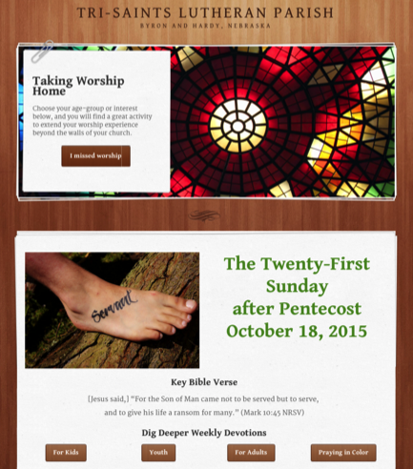
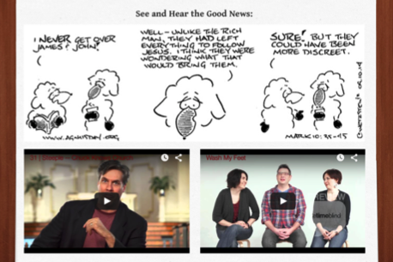

Slide 57
Example: 40-Day Lent Curriculum
Church Life ➔ | Daily & Home Life | ⬅ Online Life
Ash Wednesday Lenten Sunday liturgies Stations of the Cross Lenten prayer Lenten retreat Lenten service Lenten soup suppers | Fasting Praying Service/Almsgiving Lectionary reflection Family activities | Lenten learning resources Lenten calendar Daily Lenten prayer Weekly table prayer Video resources Online retreat experience

Slide 58
Online and Gathered
“Flip the classroom or program” by creating a digital platform to provide the content that people would learn in the gathered setting in an online learning space using print, audio, video, and more. And then transform the gathered program using interactive activities, discussion, project-based learning, and practice and demonstration.

Slide 59
Online and Gathered
  Flip children’s programming: At home learning with parents (print, video, online); in-class application with activities, project-centered learning
  Flip confirmation programming
  Develop a online justice and service center

Slide 60
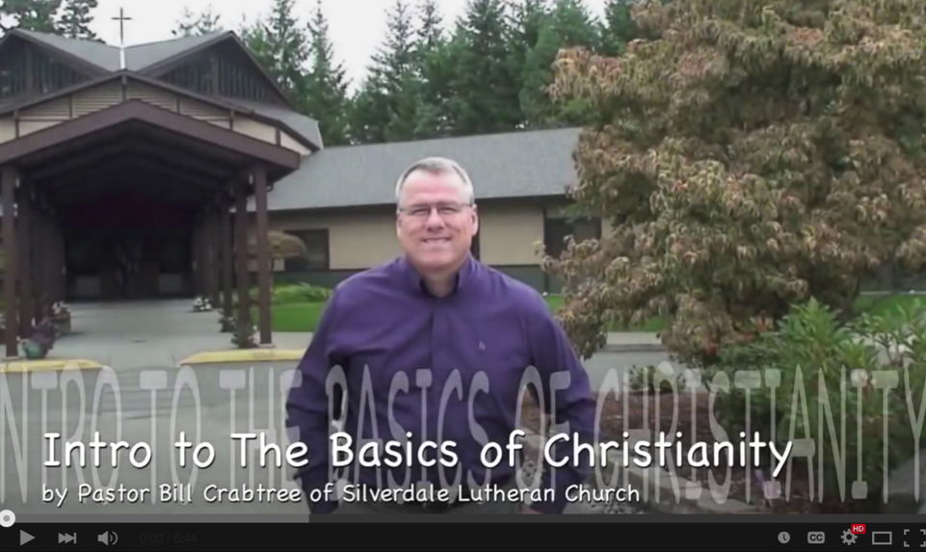

Slide 61
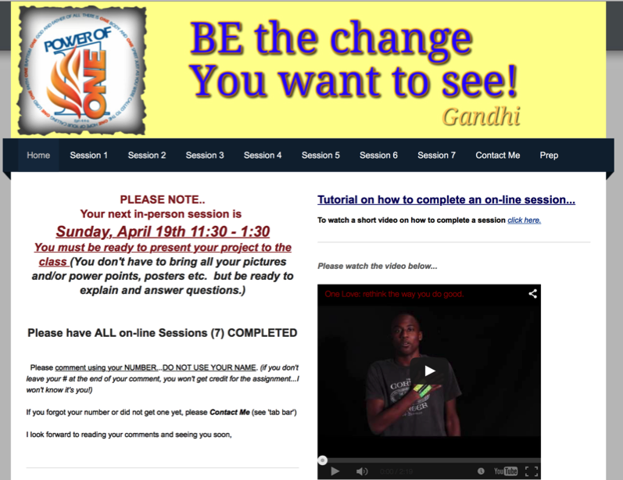

Slide 62
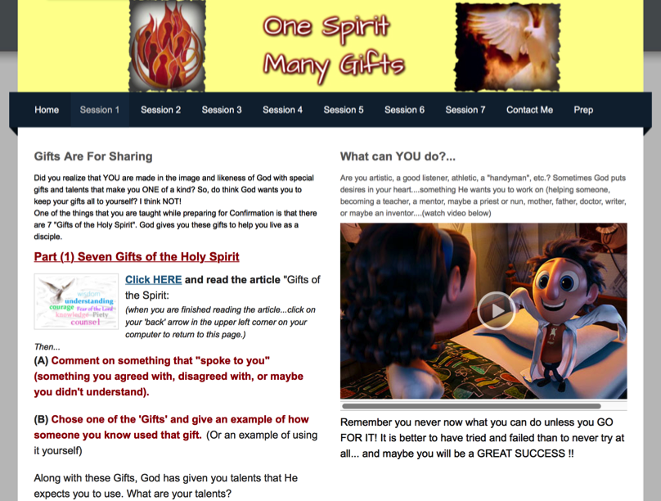

Slide 63
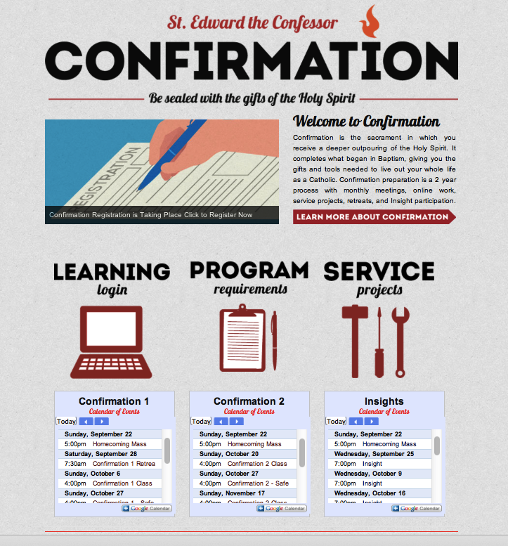

Slide 64
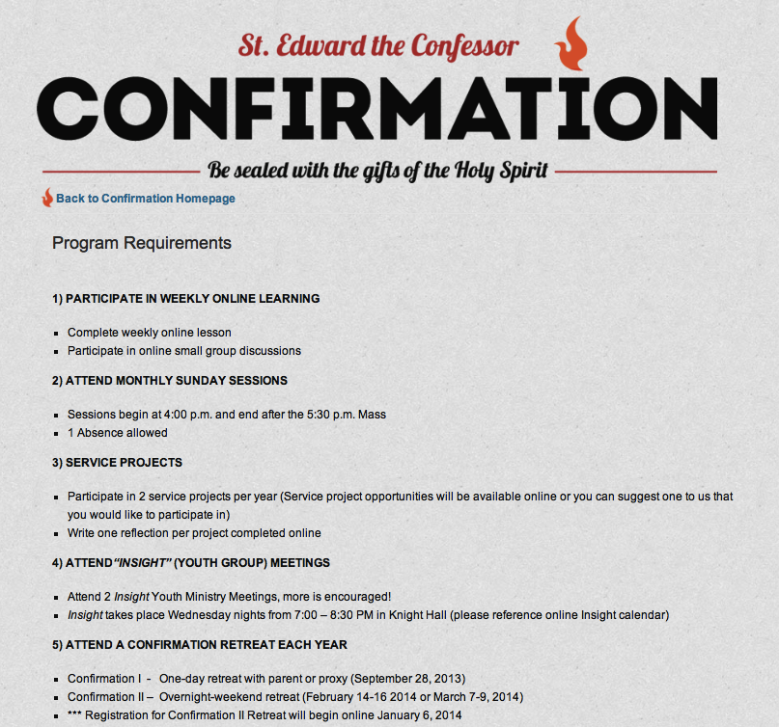

Slide 65
Mostly Online
Offering opportunities for individuals, families, and small groups to utilize the digital platform as their primary learning setting and provide opportunities for regular interaction in face-to-face, gathered settings or in a web conference format, such as a Google+ Hangout.
  Parent webinar programs delivered to parents at home in four-month semesters: three webinars followed by a parent gathering at church; three more webinars and concluding with a parent gathering at church.

Slide 66
Mostly Online
  Online learning resources for self-study or small group study, and gathering at the conclusion to share their insights with others who participated.
  Online Bible study where groups can meet regularly in a physical setting or virtually through Skype or a Google+ Hangout for sharing their learning.
  Selected online courses and activities from colleges, seminaries, and religious organization for individualized learning with the option for a mentor or small group gathering.

Slide 67
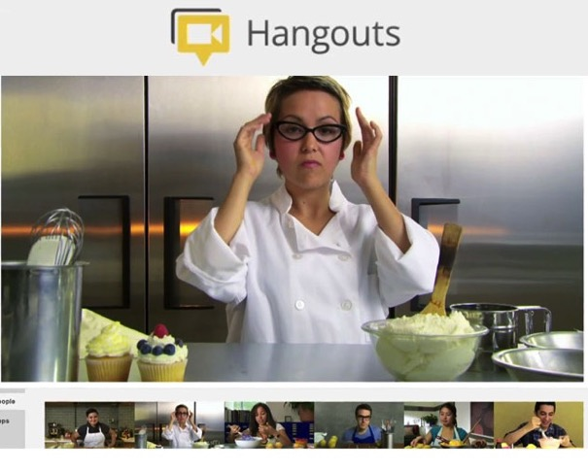
Web Conferencing
Online Course, Small Group,
Workshop, or 1-1 Mentoring
Broadcast a Presentation
Record the Presentation

Slide 68
Fully Online
The rise of high quality and easily accessible online religious content—courses, activities, print and e-books, audio and video programs, and content-rich websites—has made designing online faith formation feasible.
  Online Bible and theology courses, video programs, webinars for individual study

Slide 69
Fully Online
  Online prayer and spirituality center where people can access daily prayer reflections and devotions, offer prayer intentions, pray for others, learn about spiritual practices, download prayer activities for the home
  Online parent resource center with the best knowledge, practices, and tools for parenting (print, audio, video)
  Online retreat experience

Slide 70

Digital Platform
Weebly.com Wordpress.org Wix.com Squarespace.com

Slide 71
A Faith Formation Network
Caring Relationships
Celebrating the Seasons
Celebrating Rituals & Milestones
Learning the Christian Tradition
Praying & Spiritual Formation
Reading the Bible
Serving, Working for Justice, & Caring for Creation
Worshipping God
Missional
Life Issues
Life-Stage
Major Programs
Faith Community
Content Area
Content Area
Content Area
Content Area
Content Area
Content Area

Slide 72
Programming on the Network
Content Area
Activity 1
Resource
Resource
Activity 3
Resource
Resource
Activity 2
Resource
Resource

Slide 73
Faith Enrichment
Sunday Worship
Intergenerational Experiences & Connections
Justice & Service
Spiritual Enrichment
Scripture Enrichment
Discovering Faith
Seasons of the Year
Milestones & Rituals
Life Stage Issues
Adult
Network

Slide 74
Families with Children
Network
Intergenerational Faith Community
Just For Parents
Seasons of the Year
Sunday Worship
Reading the Bible & Learning the Faith
Celebrating Rituals & Milestones
Serving Others
Family Life
Praying & Spiritual Growth

Slide 75
Three Seasons of Programming
Fall Season: September 1 – January 1
Winter/Spring Season: January 1 – May 1
Summer Season: May 1 – September 1
Fall
Winter-Spring
Summer

Slide 76
Curriculum Planning
Process | IG | Young Child & Family | Older Child & Family | Young Adol & Family | Older Adol & Family
Caring Relationships
Church Year Feasts & Seasons
Learning the Tradition
Prayer & Spiritual Formation
Reading the Bible
Rituals & Milestones
Service & Working for Justice
Worship
Missional
Life Issues

Slide 77
Curriculum Planning
Process | IG | Young Adult | Midlife Adult | Mature Adult | Older Adult
Caring Relationships
Church Year Feasts & Seasons
Learning the Tradition
Prayer & Spiritual Formation
Reading the Bible
Rituals & Milestones
Service & Working for Justice
Worship
Missional
Life Issues

Slide 78
Examples

