Slide 1
Designing a 21st Century Adult Faith formation curriculum
John Roberto
jroberto@lifelongfaith.com www.LifelongFaith.com

Slide 2
Holistic Faith & Formation
A way of the head (inform) demands a discipleship of faith seeking understanding and belief with personal conviction, sustained by study, reflecting, discerning and deciding, all toward spiritual wisdom for life.
A way of the heart (form) demands a discipleship of right relationships and right desires, community building, hospitality and inclusion, trust in God’s love, and prayer and worship.
A way of the hands (transform) demands a discipleship of love, justice, peace-making, simplicity, integrity, healing, and repentance.
(Thomas Groome)

Slide 3
Eight Faith Forming Processes
Faith formation is developed around the eight faith forming processes—providing both a framework for a comprehensive curriculum with age groups, generations, and families; and the content—knowledge and practices—of the Christian faith.

Slide 4
Faith Forming Processes
GROWTH IN FAITH
Caring Relationships
Rituals & Milestones
Church Year Seasons
Worshipping
Learning the Tradition
Praying
Spiritual Formation
Reading the Bible
Serving Working for Justice Caring for Creation

Slide 5
Planning for AFF
Process | IG | Young Adult | Midlife Adult | Mature Adult | Older Adult
Caring Relationships
Church Year Feasts & Seasons
Learning the Tradition
Prayer & Spiritual Formation
Reading the Bible
Rituals & Milestones
Service & Working for Justice
Worship
Missional
Life Issues

Slide 6
AFF Features Life-Stage Focused
AFF is life-stage/generational—addressing the unique life tasks, needs, interests, and spiritual journeys of people at each stage of adulthood; and intergenerational—engaging adults in the life and events of church life and the Christian faith through participation in intergenerational faith experiences.
AFF addresses the diverse life tasks and situations, needs and interests, and spiritual and faith journeys of adults:
Young adults (20s-30s)
Midlife adults (40s-50s)
Mature adults (mid 50s-mid 70s)
Older adults (75+).

Slide 7
Age Group Faith Formation
Age group and generational faith formation addresses the unique life tasks, needs, interests, and spiritual journeys of people at each stage of life.
Intergenerational Faith Community
Children & Parents
Youth & Parents
Young Adults
Mid-life Adults
Mature Adults
Older Adults

Slide 8
Life-Stage & Intergenerational
Learn about worship and how to worship; experience Sunday worship with the faith community and practice worshipping; and live the Sunday worship experience at home and in their daily lives.
Learn about the Bible and how to read it, interpret it, and apply it to their lives; experience the Bible at Sunday worship and at home; and develop their own practice of Bible study and reading.
Learn about Jesus and the Christian tradition—teachings, history, practices, what it means for life today, and how to live the Christian faith today; and experience the life of Jesus and the Christian tradition through participation in the events of church life, especially church year feasts and seasons.
Learn about prayer and spirituality and how to develop their spiritual lives through prayer and spiritual discipleship; experience the prayer life of the faith community; and develop their own practice of prayer and the spiritual disciplines.
Learn about the justice issues of our day and the biblical and church teachings on justice, service, and care for creation; experience acts of justice and service with the faith community—locally and globally; and engage in the practices of serving those in need, caring for creation, and working for justice—as individuals, with their peers, with their families, and with their church and other groups and organizations.

Slide 9
Life Stage & Intergenerational
Learn with Peers
Experience in Community
Live the Learning
Reflect on Learning & Living

Slide 10
AFF Features: Missional Faith Formation
Missional faith formation expands and extends the church’s presence through outreach, connection, relationship building, and engagement with people where they live—moving faith formation out into the community.
Moving worship and faith formation into the community
Opening programs to everyone – VBS
Life skills: parenting, careers, training, mentoring
Small group programs on a variety of topics
Community-wide service
Community events: arts, music, theater

Slide 11
AFF Features: Missional Faith Formation
Missional faith formation provides pathways for people to consider or reconsider the Christian faith, to encounter Jesus and the Good News, and to live as disciples in a supportive faith community.

Slide 12
AFF Features: Variety
AFF provides a variety of content, methods, formats, and delivery systems to address the diverse life tasks and situations, needs and interests, and spiritual and faith journeys of adults in four stages of adulthood
AFF provides a variety of experiences, programs, activities, resources, and social connections that are available anytime and anywhere, in physical places and online spaces
AFF incorporates seven learning environments—self-directed, mentored, at home, in small groups, in large groups, church-wide, in the community, and in the world—in online spaces and physical places, to provide a variety of ways for people to learn and grow in faith that respects their preferred styles of learning, their life situations, and their time constraints.
AFF incorporates formal and informal learning.

Slide 13
AFF Features: Motivation & Participation
AFF recognizes that learning and growth is a process of active inquiry with initiative residing in the adult learner and that adults are motivated to learn as they experience needs and interests that adult learning activities will satisfy.

Slide 14
Motivation
Adults are motivated
when facing life transitions. They seek learning and support to cope with changes in their lives that give rise to new developmental tasks, e.g., raising children, aging parents, financial matters, job changes, divorce
when there is a gap between their present level of understanding, skill, performance and/or growth and the desired level or goal that they set for themselves or that their organization or community expects of them.
by appealing to personal and spiritual growth and/or personal benefits.
when they identify they have a need to learn.
when the benefits of a learning experience outweigh their resistance.
when programs are enjoyable and enriching.
when they have the opportunity to do something they could not do before.
settings that have a natural, interactive, communal feel.
when programs are sensitive to their time constraints by keeping commitments short in terms of duration and offering choices of times for participation.

Slide 15
AFF Features: Personalized
AFF provides the opportunity for personalized and customized learning and faith growth, giving adults an active role in shaping their own learning and moving along their own personal trajectories of faith growth. Adults are guided by trusted mentors who find the right programs, activities, and resources to match with their learning and spiritual needs.

Slide 16
Personalized Faith Formation
Personalized pathways for discipleship & faith growth. . . .
Guide people in discerning their religious and spiritual needs
Equip people with the resources and tools to learn and grow at their own pace
Provide mentoring and support for the journey

Slide 17
The Flow of Personalized Learning
Discerning Learning Needs
Working with a Mentor/Guide
Finding Resources on the Network
Engaging in Formation in a Variety of Learning Environments
Sharing Learning with Others
Reflecting on Growth & Identifying New Needs

Slide 19
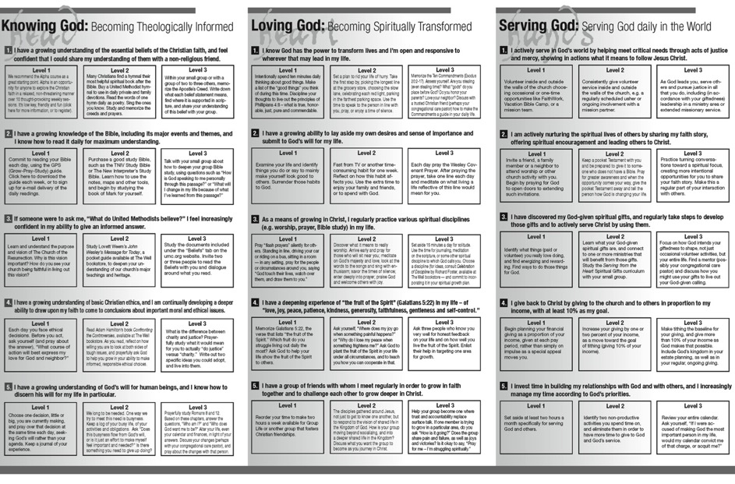

Slide 20
AFF Features: Communities of Practice
Adult faith formation intentionally nurtures communities of learning and practice around the shared interests, needs, life stages, and activities.

Slide 21
AFF Features: Online & Digitally-Enabled
Adult faith formation is digitally-enabled—blending gathered community settings with online learning environments and utilizing the abundance of digital media and tools for learning and faith formation; and digitally-connected—linking intergenerational faith community experiences, adult peer experiences and programs , and daily/home life using online and digital media.

Slide 22
Digitally-Enabled
Online Faith Formation
Mostly Online with Regular Interaction in Gathered Sessions
Online Faith Formation & Gathered Sessions (Flipped Classroom)
Gathered Program with Supportive Online Content
Gathered Program with Online Components beyond the Program

Slide 23
AFF Features Networked Faith Formation
What if we reimagined adult faith formation as a network of relationships, content, experiences, and resources—in physical places and online spaces? An adult formation network:
…is a way to offer wide variety of engaging and interactive content and experiences in online and physical settings.
…offers content and experiences to respond to the diverse religious and spiritual needs of adults today—from the spiritually committed and engaged to the spiritual but not religious and the unaffiliated.
…enables congregations to become centers for adult learning and faith growth by utilizing the best of the new digital technologies to bring an abundance of meaningful and engaging faith forming experiences—in the congregation and the world, and in a variety of media—to all adults

Slide 24
Planning for AFF
Process | IG | Young Adult | Midlife Adult | Mature Adult | Older Adult
Caring Relationships
Church Year Feasts & Seasons
Learning the Tradition
Prayer & Spiritual Formation
Reading the Bible
Rituals & Milestones
Service & Working for Justice
Worship
Missional
Life Issues

Slide 25
Adult
Faith Formation
Network
Faith Enrichment
Sunday Worship through the Week
Intergenerational Experiences & Connections
Service & Mission
Spiritual Enrichment
Scripture Enrichment
Life Issues
Discovering Faith
Grand-parents

Slide 26
Programming
Topic
Activity 1
Resource
Resource
Activity 3
Resource
Resource
Activity 2
Resource
Resource

Slide 27
Adult
Faith Formation
Network
Spiritual Enrichment
Online Courses
Retreats
Small Group Bible Study
Spiritual Book of the Month Club
Monthly Spiritual Practices Series
Apps & E-newsletters
Day at the Monastery
Online Prayer & Spirituality
Resource
Resource
Resources
Resources
Resource
Resource
Resource
Resource

Slide 28
Three Seasons of Programming
Fall Season: September 1 – January 1
Winter/Spring Season: January 1 – May 1
Summer Season: May 1 – September 1
Fall
Winter-Spring
Summer

Slide 29
Design a Season
Identify the season.
Add continuing age-group programs.
Add intergenerational programs and events.
Add redesigned, digitally-enabled programming
Select new programming ideas.
Develop the final version of the plan:
Select the program ideas for each content area
Schedule the programming, e.g., a monthly focus

Slide 30
Digital Platform
Other Platforms
www.wordpress.org www.wix.com www.squarespace.com

Slide 31
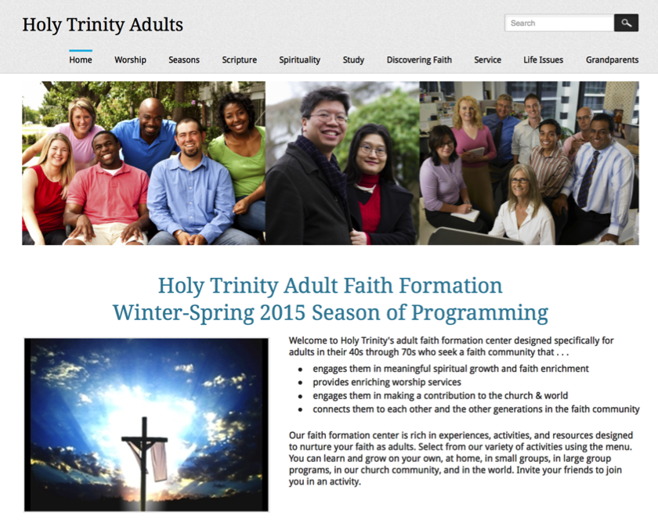

Slide 32
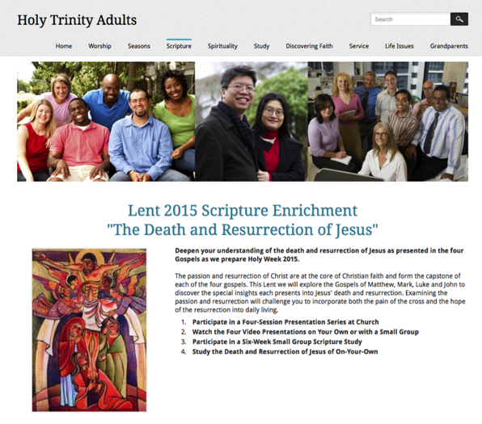
Programming a Page

Slide 33
Connected Faith Formation Virtual & Physical Settings
Online Faith Formation
Mostly Online with Regular Interaction in Gathered Sessions
Online Faith Formation & Gathered Sessions (Flipped Classroom)
Gathered Program with Supportive Online Content
Gathered Program with Online Components beyond the Program

Slide 34
Gathered with Online Content
A gathered program using online content from websites, videos from YouTube or other video sites, and blogs and other social media. With an abundance of high quality digital content, this first option is the easiest way to bring the digital world into a gathered program.

Slide 35
Gathered and Online Content
Connecting church programs or events with online content that extends and deepens the experience through learning, prayer, ritual, action, etc.
Sunday worship & church year feasts and seasons
Intergenerational & family programs
Children, youth, and adult classes & programs
Extended programs: mission trips, retreat experiences, and vacation Bible school, summer camp

Slide 36
Church Event or Program
At Home & Daily Life

Slide 37
Event or Program
TALK Conversation Activities
LEARN Read Listen Watch
ACT Practices Service Projects
PRAY Devotions Bible Reading Daily Prayer
SHARE Blog Facebook Video Projects

Slide 38
Extending Worship with Online Content
Church Life ➔ | Daily & Home Life | ⬅ Online Life
Experience of Worship in the Congregation Sunday worship and lectionary Church year feasts and seasons Church rituals: baptism, communion, funerals, etc. | Experience of Sunday worship, rituals, and church year seasons in daily life Reflecting on the sermon and readings at home Practices: Lectio, etc. Application to daily living | Online worship, church year, and lectionary resources on the church’s faith formation website Lectionary commentaries online Video reflections and commentary Online activities and projects

Slide 39
Extending a Church Season with Online Content
Lent
Church Life ➔ | Daily & Home Life | ⬅ Online Life
Ash Wednesday Lenten Sunday liturgies Stations of the Cross Lenten prayer Lenten retreat Lenten service Lenten soup suppers | Fasting Praying Service/Almsgiving Lectionary reflection Family activities | Lenten learning resources Lenten calendar Daily Lenten prayer Weekly table prayer Video resources Online retreat experience

Slide 40
Online and Gathered
“Flip the classroom or program” by creating a digital platform to provide the content that people would learn in the gathered setting in an online learning space using print, audio, video, and more. And then transform the gathered program using interactive activities, discussion, project-based learning, and practice and demonstration.

Slide 41
Online & Gathered Programming
Flipped Classroom
@ Home
Exploring the Content - print, audio, video, activities
@ The Program
Applying the Content: Create – Practice - Perform - Participate

Slide 43
Mostly Online
Offering opportunities for individuals, families, and small groups to utilize the digital platform as their primary learning setting and provide opportunities for regular interaction in face-to-face, gathered settings or in a web conference format, such as a Google+ Hangout.
Parent webinar programs delivered to parents at home in four-month semesters: three webinars followed by a parent gathering at church; three more webinars and concluding with a parent gathering at church.

Slide 44
Mostly Online
Online learning resources for self-study or small group study, and gathering at the conclusion to share their insights with others who participated.
Online Bible study where groups can meet regularly in a physical setting or virtually through Skype or a Google+ Hangout for sharing their learning.
Selected online courses and activities from colleges, seminaries, and religious organization for individualized learning with the option for a mentor or small group gathering.

Slide 45
Web Conferencing
Online Course, Small Group, Workshop, or 1-1 Mentoring
Broadcast a Presentation
Record the Presentation

Slide 46
Setting up A Google+ Class

Slide 47
Fully Online
The rise of high quality and easily accessible online religious content—courses, activities, print and e-books, audio and video programs, and content-rich websites—has made designing online faith formation feasible.
Online Bible and theology courses, video programs, webinars for individual study

Slide 48
Fully Online
Online prayer and spirituality center where people can access daily prayer reflections and devotions, offer prayer intentions, pray for others, learn about spiritual practices, download prayer activities for the home
Online parent resource center with the best knowledge, practices, and tools for parenting (print, audio, video)
Online retreat experience

Slide 49
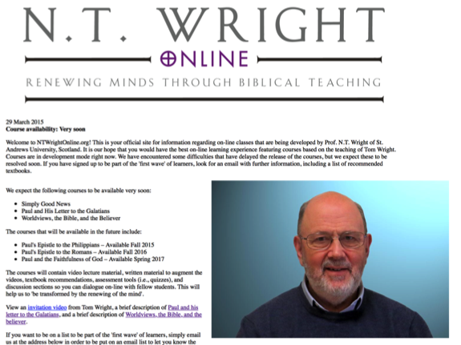

Slide 51
Emerging Roles
Current Roles
Emerging Roles
Developing religious content
Designing programming
Managing programming
Teaching/Facilitating programming
Designing learning environments—architecture
Curating religious content and experiences

Slide 52
What is Content Curation (Beth Kanter)
Content curation is the process of sorting through the vast amounts of content on the web and presenting it in a meaningful and organized way around a specific theme.
The work involves sifting, sorting, arranging, and publishing information.
A content curator picks the best content that is important and relevant to share with their community.
It isn’t unlike what a museum curator does to produce an exhibition: They identify the theme, they provide the context, they decide which paintings to hang on the wall, how they should be annotated, and how they should be displayed for the public.

Slide 53
Faith Formation Curators
A Faith Formation Curator is a trusted guide who continually finds, groups, organizes, evaluates, and connects the best and most relevant content and experiences on a specific topic to match the needs of a specific audience.

Slide 54
Curating Religious Content
Research & Organize Resources
Identify Potential Resources for Programming
Evaluate Resources
Select & Connect Resources to programming

Slide 55
Build a Curation Support System
Develop trusted expert curators to assist.
Develop a list of high quality online resource centers.
Subscribe to faith formation blogs and newsletters.

Slide 56
Curate with ReadKit - Mac & iOS

Slide 57
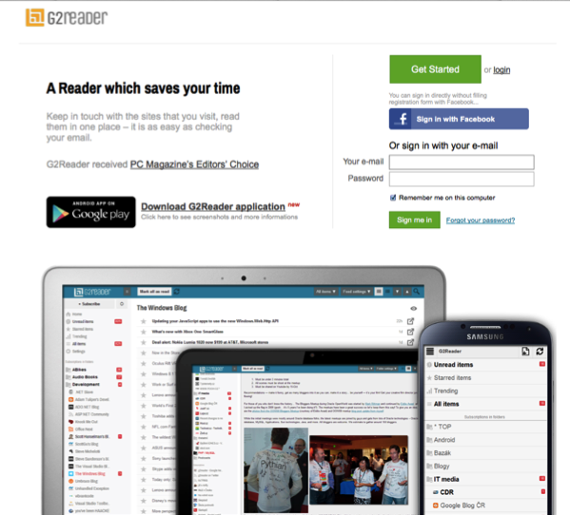
Curate with G2Reader - PC & Android

Slide 58
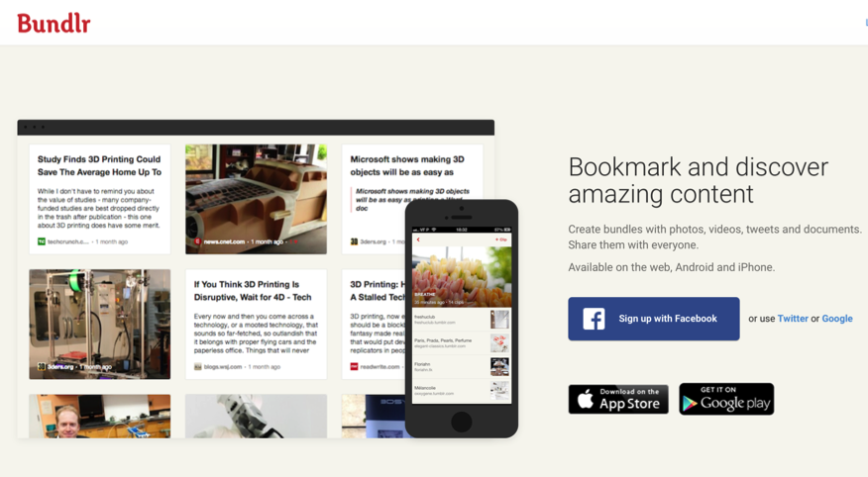
Curate with Social Bookmarking

Slide 59
Research Checklist
People: teachers, mentors/guides, program leaders, small group leaders, guest presenters
Community programs: churches, agencies, organizations,
Educational institutions: colleges, seminaries, educational organizations
Retreat and spiritual life centers, monasteries
Regional and national denominational programs, events, websites
Museums
Books (with study guides) & E-books
Apps
Audio podcasts & audio learning programs
Videos & Video learning programs
Online courses & online activities
Television shows
Organizational websites
Resource center websites

Slide 60
Evaluation Criteria
Biblical content and interpretation
Theological content and emphasis
Developmental appropriateness
Ethnic-Cultural appropriateness
Inclusive of diversity
Respect for diverse ways of learning
Appearance and visual appeal
Ease-of-Use
Quality of Experience
Applicable: Able to be incorporated into daily and home life

Slide 61
Curating Religious Content
Research & Organize Resources
Identify Potential Resources for Programming
Evaluate Resources
Select & Connect Resources to programming

