Slide 1

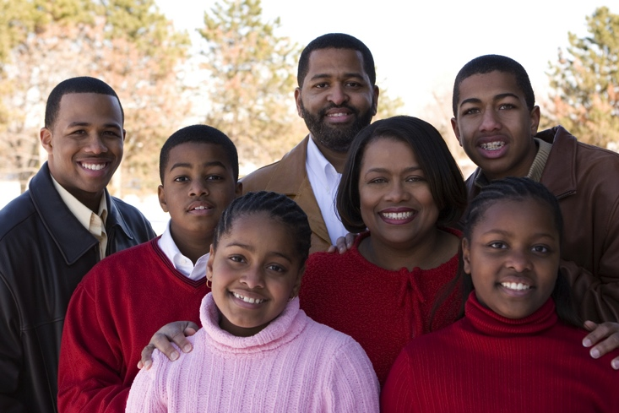
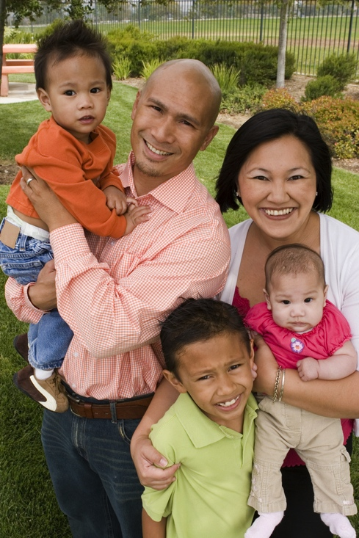


ministry with 21st century Families
John Roberto

Slide 2
21st Century Ministry with Families
Use the latest family research – family assets, family faith influences, & parenting – to design approaches and strategies for ministry with families
Design a 21st century model for ministry and faith formation with parents and families in the first two decades of life
Become familiar with programs, activities, resources, and technologies for ministry and faith formation with families

Slide 3
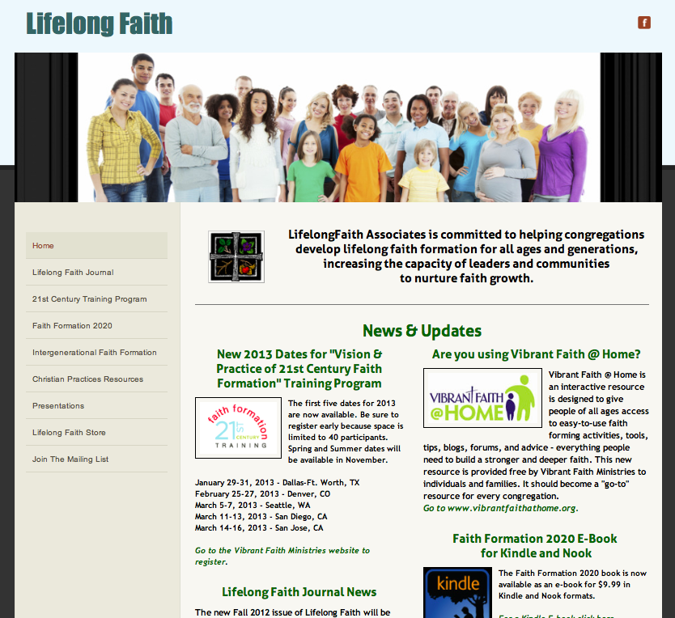
LifelongFaith.com

Slide 4

Lifelong Faith Journal

Slide 5

Faith Formation 2020 Book

Slide 6
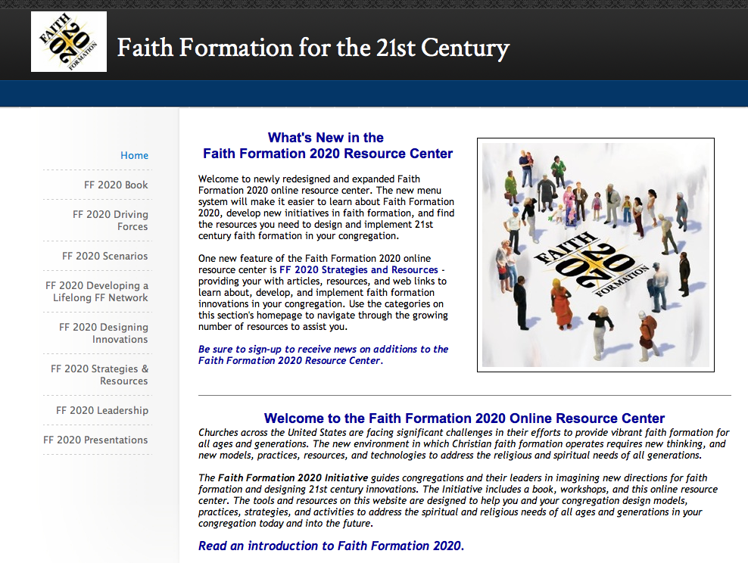
FaithFormation2020.net

Slide 7

FaithFormationLearningExchange.net

Slide 8
Benefits of Family Ministry

Slide 9
What happens when churches pay attention to families?
What shifts take place in churches when home and family life are a priority?
Religious formation and practice takes place at homes; parents are prepared.
Families and congregations are engaged in caring for others, especially hurting families.
There is greater intergenerational concern, relationships, and activities.

Slide 10
What happens when churches pay attention to families?
Churches become attentive to the ways church life and programs affects family time; develop family-sensitive and family-involving programming.
There is a recognition of the power of relationships for faith formation.
Churches promote positive community values.
Church’s vision expands beyond the walls of the church – to the larger context of family’s lives.

Slide 11
What happens when churches pay attention to families?
“Of great significance is the fact that all churches involved in this work share a deep and abiding commitment to families as a source of personal, public, and religious well-being.”
(“Family Perspectives,” by J. Bradley Wigger
A Lilly Endowment Report)

Slide 12
Part 1. Families Today

Slide 13
Key Themes
Family Ministry
Family Assets
Family Faith
Parent Competencies
Parental Faith
Parent Concerns

Slide 14
#1. Family Assets

Slide 15
Family Assets – Search Institute

Slide 16
Family Assets
Family Assets name 21 specific, dynamic qualities that strengthen families.
Family Assets identify positive dimensions of day-to-day family life that allow families and their members to flourish.
Family Assets focus on the family relationships, interactions, opportunities, values, skills, and self-perceptions that position family members to thrive.

Slide 18
Family Assets
Families with more assets are more likely to:
  Have children who are actively engaged in school and who earn higher grades
  Act in socially responsible ways like spending time together serving their communities.
  Teach youth to make good decisions.
  Foster positive identity and values.
  Nurture spiritual development.
  Build social-emotional skills.
  Encourage healthy life habits.

Slide 19
Family Assets
Managing Commitments
Parenting adults and youth struggle to navigate competing activities and expectations at home, school, and work.
(Only about 40% met the criterion.)

Slide 20
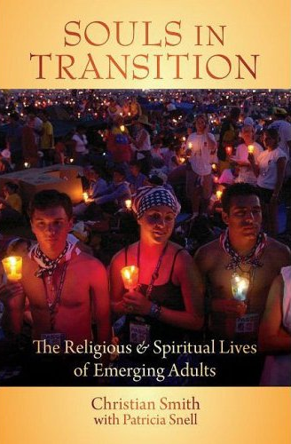



#2. Family Faith

Slide 21
Family Faith
Parental Influence: The single most important social influence on the religious and spiritual lives of children and adolescents (and emerging adults) is their parents.
Embedded Family Religious Practices: Effective religious socialization comes about through specific religious activities that are firmly intertwined with the daily habits of family life.

Slide 22
Family Faith - NSYR
Faith
Parental Faith
Parental Modeling & Teaching
Prayer
Scripture Reading

Slide 23
Family Faith
Embedded Family Religious Practices
  Eating Together – especially the power of Sunday meals and holidays
  Praying – bedtime rituals and prayer, grace before meals
  Having family conversations
  Displaying sacred objects and religious images, especially the Bible
  Celebrating holidays
  Providing moral instruction
  Engaging in family devotions and reading the Bible

Slide 24
Family Faith
Six Family Faith Factors
Praying
Caring Conversation
Reading the Bible
Celebrating Rituals
Serving Others
Learning & Applying Faith to Daily Life

Slide 25
Family Faith – Spirit & Culture of YM
Parental Faith Life & Practice
Family Harmony
Parental Affection toward Children
Parental Help with Problems

Slide 26
Family Faith – Spirit & Culture of YM
Parents possess and practice a vital and informed faith – understanding the Christian faith, participating in worship, praying, and engaging in service and mission.
Family members’ expressions of respect and love create an atmosphere promoting faith.
Parents engage youth and the whole family in conversations, prayer, Bible reading, and service that nurture faith and life.

Slide 27
Faith Factors - NSYR
The combination of the following factors makes an enormous difference in religious outcomes during emerging adulthood:
    the teenager’s parental religion
    importance of faith
    lack of religious doubts
    prayer
    Scripture reading and
    personal religious experiences
    having support nonparent adults in the church
These most influential factors make differences of sizeable magnitude in substantive outcomes.

Slide 28
Faith Factors - NSYR
In these seven factors alone, we have identified some powerful teenage factors associated with and, we think, causing differences in emerging adult religious commitment and practice.
    85% chance of being Highly Religious as an emerging adult if you were in the top 25% on the scales of:
      parental religion
      prayer
      importance of faith
      Scripture reading

Slide 29
Faith Factors - NSYR
    75% chance of being a Highly Religious emerging adult if you were in the the top 25% on scales of:
      having support nonparent adults in the church,
      having personal religious experiences
      lack of religious doubts

Slide 30
Faith Factors - NSYR
Approximately 70% of youth who at some time or other before mid-emerging adulthood commit to live their lives for God, the vast majority appear to do so early in life, apparently before the age of 14.
Most make their first commitments to God as children or during the preteen or very early teen years.
Many religious trajectories followed in the course of life’s development seemed to be formed early on in life.

Slide 31
Family Faith - NSYR
“Emerging adults who grew up with seriously religious parents are through socialization more likely (1) to have internalized their parents religious worldview, (2) to possess the practical religious know-how needed to live more highly religious lives, and (3) to embody the identity orientations and behavioral tendencies toward continuing to practice what they have been taught religiously.”
(Christian Smith & Patricia Snell)

Slide 32
Family Faith - NSYR
“At the heart of this social causal mechanism stands the elementary process of teaching—both formal and informal, verbal and nonverbal, oral and behavioral, intentional and unconscious, through both instruction and role modeling. We believe that one of the main ways by which empirically observed strong parental religion produced strong emerging adult religion in offspring is through the teaching involved in socialization.”
(Souls in Transition: The Religious & Spiritual Lives of Emerging Adults by Christian Smith with Patricia Snell)

Slide 33
Family Faith – Spirit & Culture of YM
Faith of the Parents…
My faith helps me know right from wrong
I have a sense of sharing in a great purpose
I have had feelings of being in the presence of God
I have a sense of being saved in Christ
I am spiritually moved by the beauty of God’s creation
God helps me decide what is right or wrong behavior
I have found a way of life that gives me direction.

Slide 34
Family Faith– Spirit & Culture of YM
Faith of the Parents…
Religious faith is important in my life.
My life is committed to Jesus Christ.
My life is filled with meaning and purpose.
I have a real sense that God is guiding me.
Each of the 11 items rate 7.30 or better
on a 9.0 scale.

Slide 35
Family Faith– Spirit & Culture of YM
Teens: How have your parents influenced your faith life?
Values are focused on serving others and God.
Positive influence on my religious faith
Talk with me about my relationship with Jesus Christ
Attending Sunday worship
Talked with my parent about religious faith
Reading the Bible

Slide 36
Family Faith– Spirit & Culture of YM
One in four teens said their family sat down together and talked about God, the Bible, and other religious things on a weekly or daily basis.
40% of teens said they did this once or twice a month.

Slide 37
Family Faith
Six Family Faith Factors
Praying
Caring Conversation
Reading the Bible
Celebrating Rituals
Serving Others
Learning & Applying Faith to Daily Life

Slide 38


Parents & “Sticky Faith”

Slide 39
Parents & “Sticky Faith”
Even more important than parental support throughout childhood, the research suggests that Sticky Faith depends on how parents express and live out their faith. Parents’ own faith is one of the primary influencers on their kids’ faith. Attend church just a couple of times a year? Expect the same from your kids.
When asked what it means to be Christian, one-third of college juniors (prior youth group attendees) listed answers related to “doing” the faith—a lifestyle of external behaviors insufficient to sustain their faith. Instead of the “Gospel of Sin Management”—that is, a long list of dos and don’ts that defines being a Christian—parents need to focus on teaching how to trust (not just obey) Christ along with teaching how he leads, guides, and changes us from the inside.

Slide 40
Parents & “Sticky Faith”
Kids need to develop a strong personal identity for faith to stick and community helps do just that. Whether it’s family or friends, building “social capital” into kids’ lives creates a network of caring supporters who aid in the self-discovery process and keep kids connected to faith for the long haul. Build a 5:1 (or 7:1, or 10:1, or whatever you determine works best for your family) sticky web adult to child ratio for mentoring your kids since other adults are often able to speak to them in ways you cannot as the parent.

Slide 41
Parents & “Sticky Faith”
What can parents & grandparents do?
Share verbally about their own faith journey.
Ask their children who they will turn to when they have doubts.
Connect their sons and daughters to at least 5 caring adults.
Reinforce that their faith is bigger than any moral failure or mistake.
Talk to high school juniors and seniors now about life after high school.

Slide 42
Intergenerational Connections
While most U.S. churches focus on building strong youth groups, teenagers also need to build relationships with adults of all ages.
  Participation in all-church worship during high school was more consistently linked with developing a mature faith in both high school and college than any other participation variable.
  Churches and families wanting to instill deep faith in youth should help them build a web of relationships with committed and caring adults.

Slide 43
Intergenerational Connection
Intergenerational connection and involvement during high school promotes mature faith in both high school and college – a “sticky faith.”
  Welcoming and valuing young people’s participation in the life of the church
  Worshipping with all of the generations
  Serving and building relationships with younger children
  Having significant relationships with adults in the church and having the community show interest in them

Slide 44
Intergenerational Connection
Churches and families wanting to instill deep faith in youth should help them build a web of relationships with committed and caring adults.
Becoming a 5:1 Church
5 Adults to 1 Young Person
in
Worship, Teaching, Mentoring, Rituals, and all of Community Life

Slide 45
#3. Parental Faith

Slide 46
Trends in Religiosity & Practice
Increasing number of “Nones” – no religious affiliation
Increasing number of “Spiritual but not Religious”
Embracing diversity – cultural, ethnic, sexual
Declining participation in Sunday worship and sacraments (marriage, baptism)
Declining levels of family faith practice & socialization

Slide 47

Trends in Religiosity & Practice
19% of Americans claim no religious affiliation
30% of 18-34
year olds
18% of 18-39 year olds say that are “spiritual, but not religious”

Slide 48
Trends in Religiosity & Practice
Fewer Marriages & Later in Life
Fewer Baptisms
Fewer Young Families
Lower Sunday Worship
Fewer First Communions
Fewer Confirmations

Slide 49
Trends in Religiosity & Practice
Not Religiously Affiliated
Spiritual but Not Religious
Minimal Engagement with Faith and Community
Vibrant Faith
& Active Engagement

Slide 50

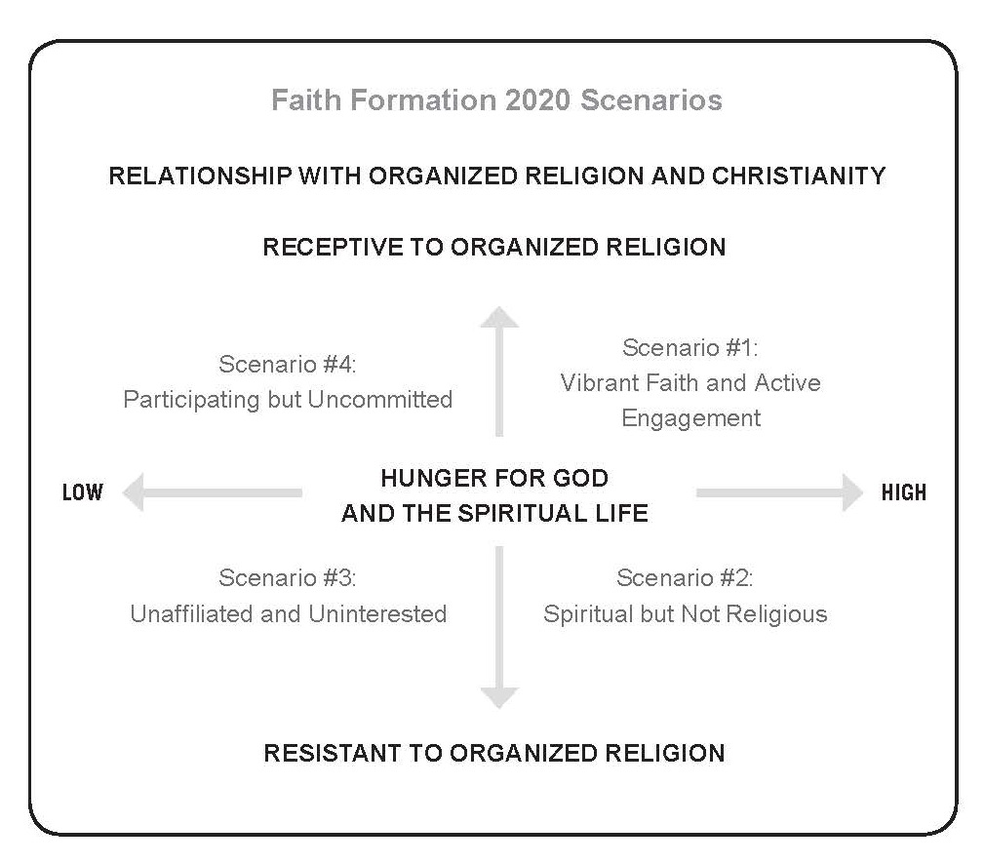

Slide 51
Interpreting through 4 Scenarios
Scenario 3 Unaffiliated & Uninterested
Scenario 1 Vibrant Faith & Active Engagement
Scenario 4 Uncommitted & Participating
Scenario 2 Spiritual but Not Religious

Slide 52
Scenario #1
People are actively engaged in a Christian church, are spiritually committed, and growing in their faith.
People have found their spiritual home within an established Christian tradition and a local faith community that provides ways for all ages and generations to grow in faith, worship God, and live their faith in the world.
The future of faith formation in Scenario #1 is being significantly impacted by people in their 20s & 30s leaving established Christian churches, and the decline in family religious socialization and practice at home.

Slide 53
Scenario #2
People are spiritually hungry and searching for God and the spiritual life, but most likely are not affiliated with organized religion and an established Christian tradition.
Some may join a nondenominational Christian church focused on their spiritual needs, while others may find an outlet for their spiritual hunger in small communities of like-minded spiritual seekers, in local or global acts of service, or in online spiritual resources and communities.
The Spiritual but Not Religious reflect a growing minority of the American population, especially among the eighteen- to thirty-nine-year-olds.

Slide 54
Scenario #3
A world in which people experience little need for God and the spiritual life and are not affiliated with organized religion and established Christian churches.
The Unaffiliated and Uninterested reject all forms of organized religion and reflect an increasing percentage of the American population, especially those in their 20s and 30s.

Slide 55
Scenario #4
People attend church activities occasionally, but are not actively engaged or spiritually committed.
They may participate in significant seasonal celebrations and celebrate sacraments and milestones (marriage, baptism). Some may even send their children to religious education classes.
Spiritual commitment is low and the connection to the church is more social and utilitarian than spiritual.
While receptive to an established church, their occasional engagement in church life does not lead them toward spiritual commitment, and their spiritual commitment does not lead them to engagement.

Slide 56
4-Scenario Thinking
Scenario #4 | Scenario #1
Scenario #3 | Scenario #2

Slide 57
#4. Parent Competencies

Slide 58
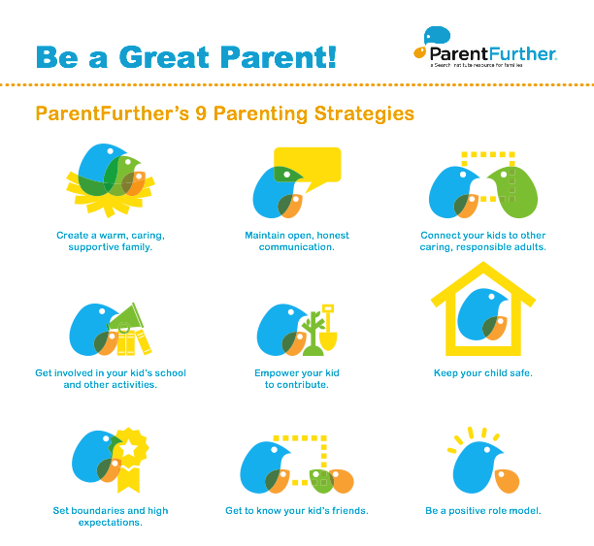

Slide 59
The Parents’ Ten Competencies
(Robert Epstein)
Here are 10 competencies that predict good parenting outcomes. The skills—all derived from published studies—were ranked based on how well they predict a strong parent-child bond and children’s happiness, health and success.
Love and affection. You support and accept the child, are physically affectionate, and spend quality one-on-one time together.
Stress management. You take steps to reduce stress for yourself and your child, practice relaxation techniques and promote positive interpretations of events.

Slide 60
The Parents’ Ten Competencies
(Robert Epstein)
Relationship skills. You maintain a healthy relationship with your spouse, significant other or co-parent and model effective relationship skills with other people.
Autonomy and independence. You treat your child with respect and encourage him or her to become self-sufficient and self-reliant.
Education and learning. You promote and model learning and provide educational opportunities for your child.
Life skills. You provide for your child, have a steady income and plan for the future.

Slide 61
The Parents’ Ten Competencies
(Robert Epstein)
Behavior management. You make extensive use of positive reinforcement and punish only when other methods of managing behavior have failed.
Health. You model a healthy lifestyle and good habits, such as regular exercise and proper nutrition, for your child.
Religion. You support spiritual or religious development and participate in spiritual or religious activities.
Safety. You take precautions to protect your child and maintain awareness of the child’s activities and friends.

Slide 62
#5. Family/Parent Concerns

Slide 63
Concerns
Employment-Underemployment-Unemployment
Online presence: interaction with strangers online, reputation management, information available to advertisers, impact on future opportunities (academic, work) [Pew Research]
Education of children/teens
Future of teens: college, work, etc.
Family communication

Slide 64
Concerns
Children & teen health issues: physical inactivity, obesity, drug and alcohol use, smoking
Teenage sexuality
Bullying
Stress

Slide 65
Part 2. 21st Century Ministry Model

Slide 66
#1. Technologies

Slide 67




New Technologies

Slide 68











New Digital Media Technologies

Slide 69
New Digital Resources

Slide 70
Adoption Patterns
66%

Slide 71
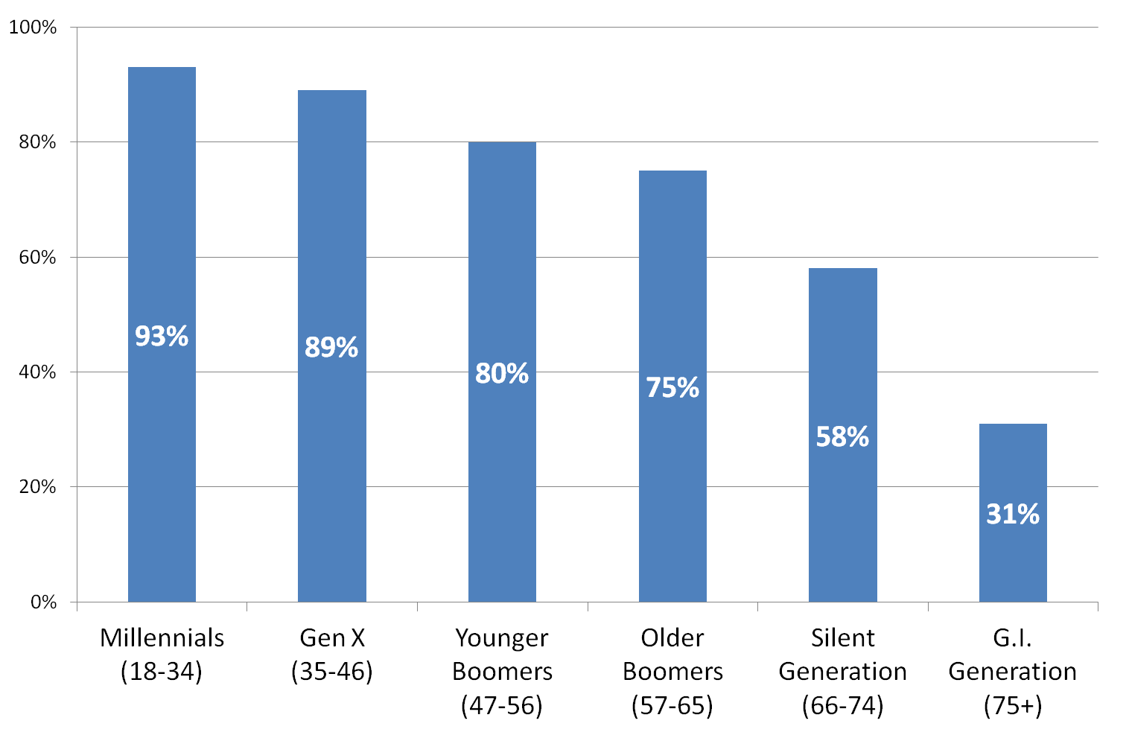
Adoption Patterns

Slide 72
Adoption Patterns
Social Networking: 52% of Adults
% of internet users

Slide 73
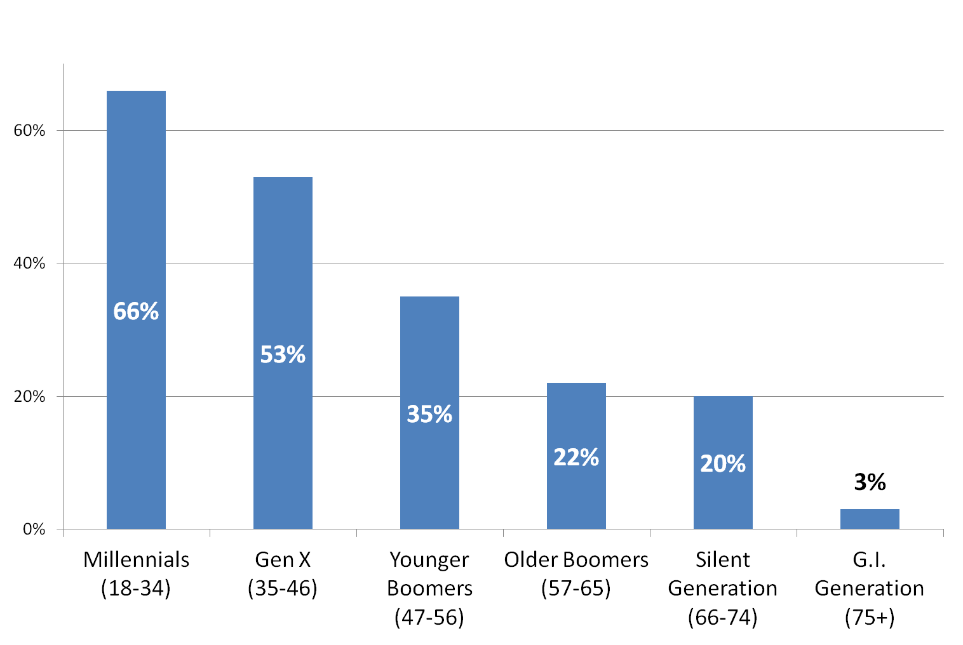
Adoption Patterns
Increase in Smartphones: 46%

Slide 74
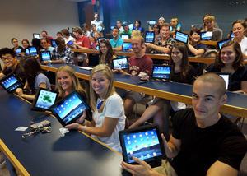
Adoption Patterns: Tablets
67 million iPads sold since 2010 when it was introduced.
2012 Sales:
120 million tablets – a 100% increase over 2011
2016 Prediction:
665 million tablets by 2016

Slide 75
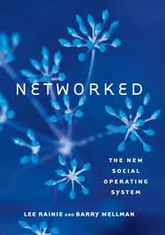
New Social Operating System
The Triple Revolution
Social Network Revolution
Internet Revolution
Mobile Revolution

Slide 76


Transition. . . .
EMBEDDED
SOCIAL NETWORKS

Slide 77
New Social Operating System
The Social Network, Internet, and Mobile Revolutions are coming together to shift people’s social lives away from densely knit family, neighborhood, and group relationships toward more far-flung, less tight, more diverse personal networks.

Slide 78
New Social Operating System
Networked Individualism
The three revolutions have made possible the new social operating system – Networked Individualism. The hallmark of networked individualism is that people function more as connected individuals and less as embedded group members.

Slide 79
Networked Individuals
Individual
Life Stage
Work
Sports & Activities
Interests
Shared Experiences
Family & Friends
Education

Slide 80
#2. Methods

Slide 81
Formats
Face-to-Face
& Virtual
On Your Own
Small Group
Large Group
Mentored
Church Community
Community & World
@Home

Slide 82
Faith Formation Network Methods
Online Courses & Activities
Audio & Video Programs
Church Events
Mentors
Retreats Extended Programs Trips
Courses Workshops Series
Study & Faith Sharing Groups
Online Blogs & Social Media
Apps & Digital Resources
User-Generated Content
Book Clubs
Study-Action & Service Projects
Webinars & Video Confer-encing

Slide 83
Methods
On your own: online courses, reading, audio programs and podcasts, video programs and podcasts, apps, online faith formation websites
Mentors, spiritual guides, and apprenticeships
Large group: workshops, speaker series, multi-session programs, single session program, roundtable discussions, intergenerational programs, film festivals, conferences, field trips
Small group: book clubs, online courses, discipleship or faith sharing groups, Bible study groups, theology study groups, Sunday lectionary-based or sermon-based faith sharing groups, practice-focused groups (prayer, service/faith in action), support groups
Retreats, camps, and extended programs
Study-action: study program with action projects, service projects and mission trips with reflection and learning
Online tools and social media: blogs, wikis, video conferencing (Skype, Google+), webinars, websites

Slide 84
#3. Family & Parent Networks

Slide 85
21st Century Model
Creating Networks of Personalized & Customized Activities & Resources
focusing on addressing people’s life issues and tasks, needs and interests, and spiritual and faith journey by offering a wide variety of content and experiences
Young Adults
Mid-Life Adults
Adolescents & Families
Children & Families
Older Adults
Intergenerational Community & Experiences
Mature Adults

Slide 86
21st Century Model
Children & Families
Teens & Families
Emerging Adults: 20s
Young Adults: 30s-40s
Mid-Life Adults: 40s-50s
Mature Adults: 60s-70s
(Baby Boomers)
Older Adults: 80+
  Life Tasks
  Life Issues
  Milestones and Life Transitions
  Spiritual & Religious Needs
  Ethnic-Cultural Needs

Slide 87
21st Century Model
We now have the resources and technologies to build networks around all of our people by:
Expanding ministry & faith formation to address the diversity of people today – life tasks and issues, religious and spiritual needs
Delivering content and experiences to people wherever they are, 24 x 7 x 365
Engaging people in a wide variety of experiences tailored to their needs, interests, spiritual journey, and tailored to their busy lives
Connecting people to each other – in physical places and virtual spaces

Slide 88
21st Century Model
Targeted Strategies to Respond to Diverse Needs
Not Religiously Affiliated
Spiritual but Not Religious
Minimal Engagement with Faith and Community
Vibrant Faith
& Active Engagement

Slide 89
21st Century Model
Become Intentionally Intergenerational
Intergenerational Community Life & Events (arts festivals, music and concerts, drama)
Intergenerational Mentoring (Reverse Mentoring)
Intergenerational Service
Intergenerational Learning
Intergenerational Retreats & Camps
Intergenerational Leadership
“Intergenerationalize” Age-Group Programs

Slide 90
Types of Networks
Events, ministries and activities such as Sunday worship, service and mission projects, and programming (children’s faith formation, youth ministry, Vacation Bible School)
Age groups, generations, and the whole family: children, adolescents, emerging adults, young adults, midlife adults, mature adults, older adults

Slide 91
Networks for Families with Children
Faith Formation Before Baptism
Preparation for and Celebration of Baptism
Faith Formation with Young Children

Slide 92
Families with Children Network
Scenario #4 Parent faith formation @Baptism Parent mentoring–Baptism & beyond “Deepening Faith & Engagement” Milestone & church year celebrations VBS (w/ parents), early childhood FF Mom’s groups / Dad’s groups Family service, family camp Online family resource center | Scenario #1 Faith Practices @Home (rituals, Bible reading, devotions, service, prayer) Parent faith formation & mentoring Milestones celebrations @Church family gatherings VBS, family camp, family service Early childhood faith formation Online family resource center
Scenario #3 Family life center Family events: movie nights, concerts, children’s festivals Mom’s groups, Dad’s groups VBS (with parents), family camp, family service Parenting programs & resources Online family resource center | Scenario #2 Small group family experiences VBS (w/parents), family camp, family service, children/family events Parenting programs “Spiritual Seeker” experiences for parents Mom’s groups, Dad’s groups Online family resource center

Slide 93
Children & Families Network
Bringing Sunday Worship Home
Intergenerational Experiences
Worship
Learning
Service
Community Life
Parent Faith Formation
Parenting Education &
Support Groups
Whole Family Programs
Milestones
Mentors for Parents
Faith Practices: Bible, Prayer, Rituals. Service
Children’s Programs & Events
Family Life Center
“Getting Started in Faith” Experiences
Parent Blog Social Media

Slide 94
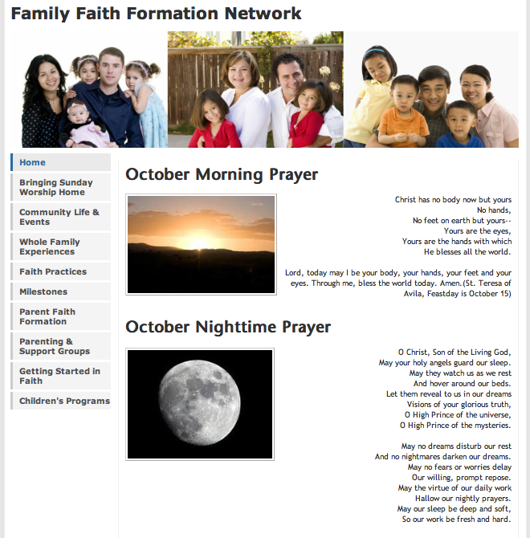

Slide 95
Youth & Families
Network
Service Projects Mission Trips
Intergenerational Experiences
Worship
Learning
Service
Community Life
Parent-Teen Activities & Resources
Prayer &
Spiritual Formation
Youth Leadership
Peer Relationships
Adolescent Life Issues
Bible Study & Religious Learning
Intergener-ational Connections
Parent Blog
Social Media
Parent Faith Formation
Parent Education & Support Groups
Milestones

Slide 96
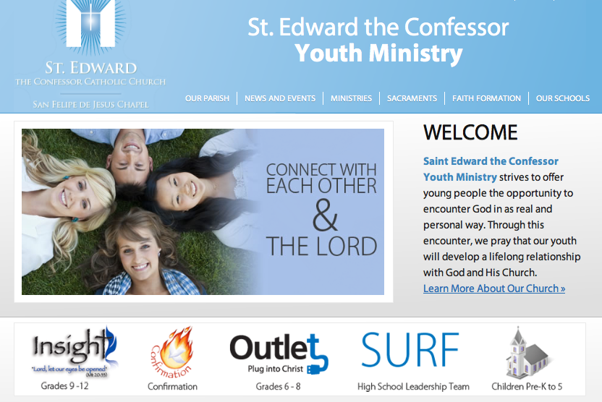
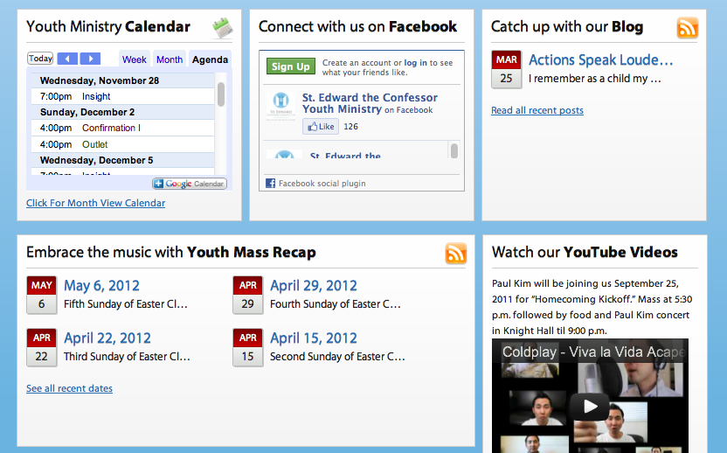

Slide 97
21st Century New Roles
A Ministry & Faith Formation Learning Architect:
Researches the life tasks and issues, interests and needs, and spiritual and religious needs of of people in our community
Plans, designs, and implements ministry and faith formation networks – virtual and physical environments in which people can engage in faith formation experiences
Coordinates resources and technologies to support faith formation networks

Slide 98
21st Century New Roles
A Faith Formation Curator:
  who continually finds, groups, evaluates, organizes, and shares the best and most relevant content and experiences on a specific topic to match the needs of a specific audience

Slide 99
21st Century New Roles
Curating. . . .
  Programs & Activities: Church, Community
  People Resources
  Print Resources
  Audio & Video Resources
  Art, Drama, and Music Resources
  Online Content: Websites, Courses, Blogs
  Apps & Digital Resources

