Slide 1
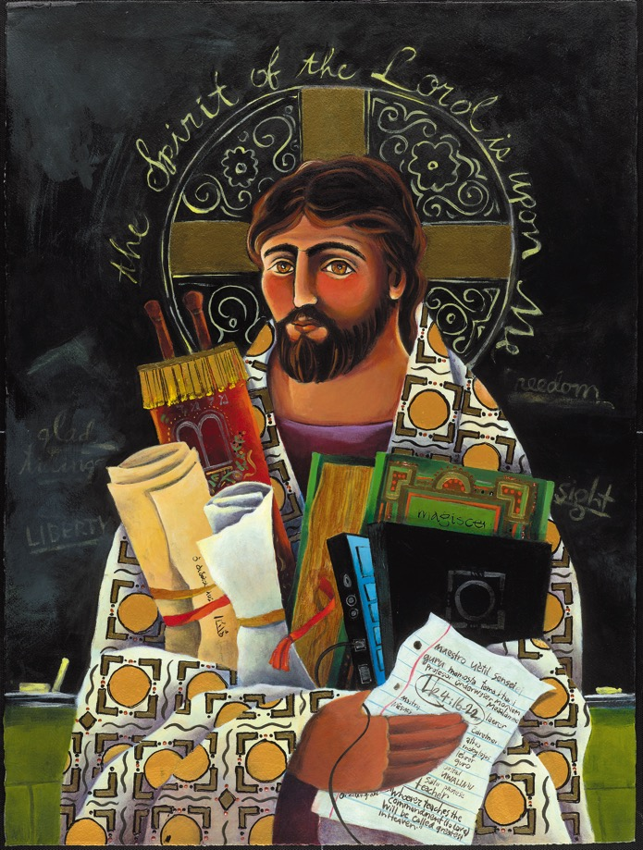
Reimagining faith formation for the 21st Century
John Roberto
jroberto@lifelongfaith.com www.LifelongFaith.com

Slide 2
Part 1. Adaptive Challenges

Slide 3
4 Big Adaptive Challenges
Increasing diversity throughout American society in the length of the lifespan, in generational identities, in family structures and marriage patterns, and in the ethnic makeup of America
Rise of new digital technologies that are reshaping society, and the emergence of a connected, networked society
Dramatic changes and increasing diversity in the religious beliefs, practices, and affiliation of Americans
Decline in religious transmission from generation to generation

Slide 4
Adaptive Challenge 1: Diversity
Diversity
Life-Span Diversity
Generational Diversity
Family Diversity
Ethnic Diversity

Slide 5

We Are More Diverse

Slide 6
Generational Diversity
Generational Differences
Relationship to Institutions
Relationship to Authority
Family Relationships
Work-Life Balance
Communication Style
Technology Usage
Learning Style
Religious Expression
Worship Style
Millennials (1980-99)
Generation X (1961-79)
Baby Boomers (1946-60)
Builders (pre 1946)
iGeneration (2000 - )

Slide 7
Life Span Diversity
0-10
50s
20s
30s
40s
60s
70s
80s
90s
11-19

Slide 8



Family Diversity
The 1950s Family
The 2010s Family

Slide 9
Family Diversity
Married Couple with Children (original biological family)
Married Couple with Children (blended family)
Single Parent with Children
Unmarried Couple with Children
Unmarried Couple without Children
Same Sex Couple with Children (married or unmarried)
Same Sex Couple without Children (married or unmarried)
Grandparents & Parents with Children (3-generational)
Grandparents as Primary Caregivers
Parents with Single Young Adults Living at Home

Slide 10
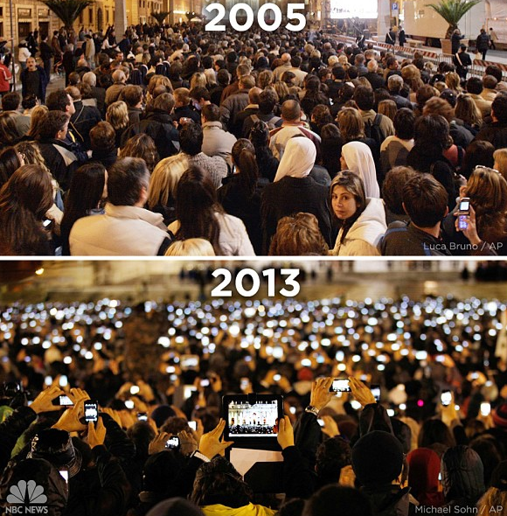
Adaptive Challenge 2: Digital

Slide 11
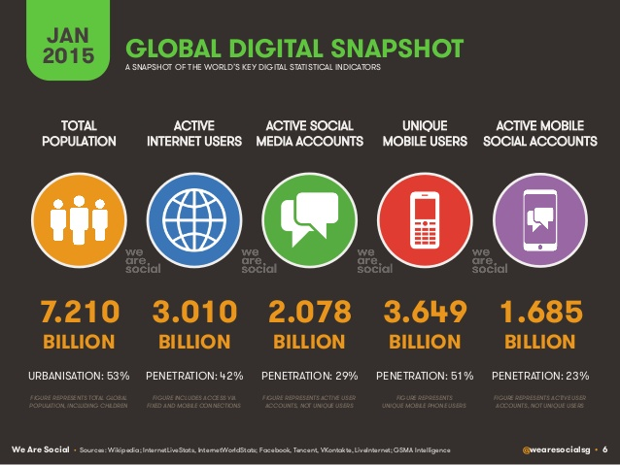

Slide 12

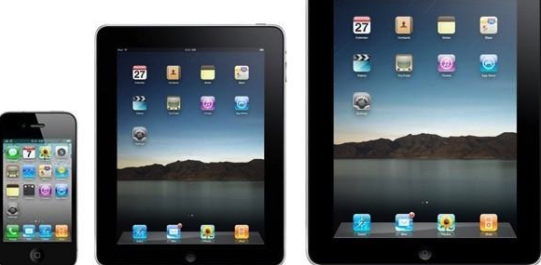
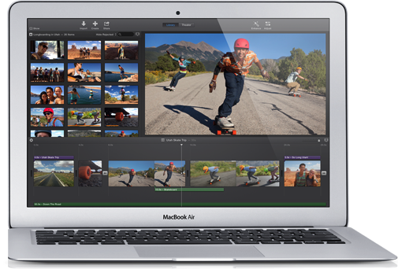


Mobile Technologies

Slide 13











Social Networking Tools

Slide 14
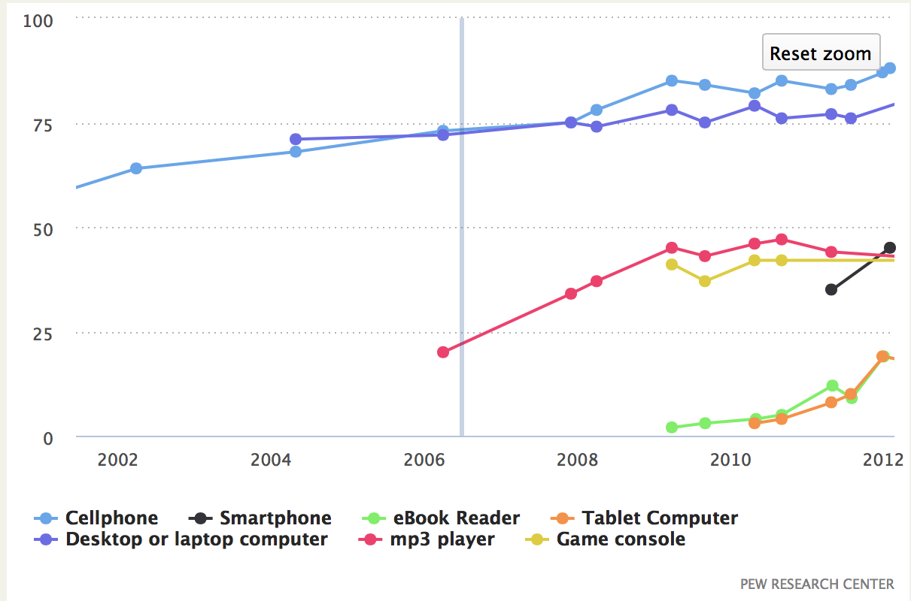
Mobile Usage

Slide 15
Mobile Revolution
Mobile devices have fundamentally changed the relationship between information, time, & space.
Information is now PORTABLE, PARTICIPATORY, PERSONAL
Information will find you through social networking.
“If news is important it will find its way to me.”
People turn to their social networks to help them evaluate new information they encounter.
People have become content creators – when they discover content they will share it with their broad network.
Reciprocal sharing is the way people build their social capital and reputations.

Slide 16
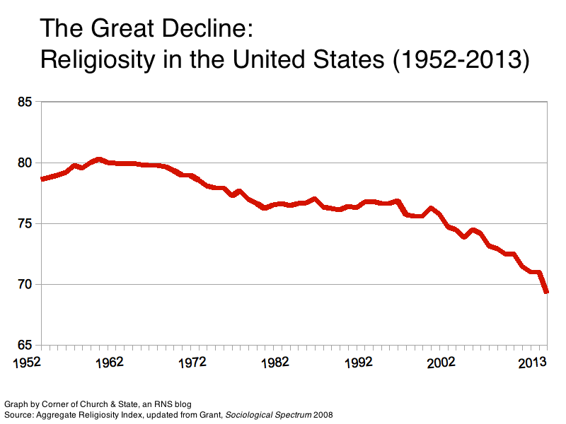
Adaptive Challenge 3: Religiosity

Slide 17
Religious Diversity
Not Religiously Affiliated
Spiritual but Not Religious
Minimal Engagement with Faith and Community
Vibrant Faith
& Active Engagement

Slide 18


Religious Diversity
Youth (teens)
Abiders Adapters Assenters Avoiders Atheists
20% 20% 31% 24% 5%
Emerging Adults (20s)
Committed Selected Spiritually Religiously Religiously Irreligious Traditionalists Adherents Open Indifferent Disconnected
15% 30% 15% 25% 5% 10%

Slide 19
Adaptive Challenge 4: Religious Transmission
Declining importance of religion and religious practice
Declining levels of family religious transmission and faith practice at home

Slide 20
Religious Transmission
“Emerging adults who grew up with seriously religious parents are through socialization more likely (1) to have internalized their parents religious worldview, (2) to possess the practical religious know-how needed to live more highly religious lives, and (3) to embody the identity orientations and behavioral tendencies toward continuing to practice what they have been taught religiously.”

Slide 21
Religious Transmission
“At the heart of this social causal mechanism stands the elementary process of teaching—both formal and informal, verbal and nonverbal, oral and behavioral, intentional and unconscious, through both instruction and role modeling. We believe that one of the main ways by which empirically observed strong parental religion produced strong emerging adult religion in offspring is through the teaching involved in socialization.”
(Souls in Transition: The Religious & Spiritual Lives of Emerging Adults by Christian Smith with Patricia Snell)

Slide 22
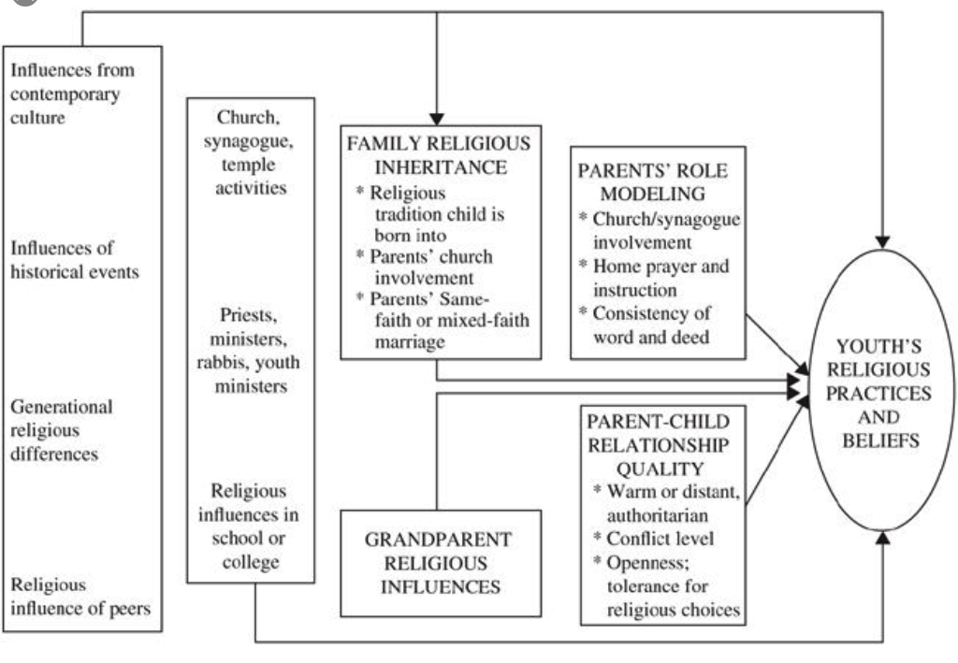

Religious Transmission

Slide 23
Concluding Thought
The world is now changing at a rate at which the basic systems, structures, and cultures built over the past century cannot keep up with the demands being placed on them. Incremental adjustments to how you manage and strategize, not matter how clever, are not up to the job. You need something very new to stay ahead in a age of tumultuous change and growing uncertainties.
(John Kotter, Accelerate: Building Strategic Agility for a Faster-Moving World

Slide 24
How do I get rid of the fear?
Alas, this is the wrong question.
The only way to get rid of the fear is to stop doing things that might not work, to stop putting yourself out there, to stop doing work that matters.
No, the right question is, "How do I dance with the fear?"
Fear is not the enemy. Paralysis is the enemy.
(Seth Godin)

Slide 25
Part 2. The New Ecosystem

Slide 26
You never change things by fighting the existing reality.
To change something, build a new model that makes the existing model obsolete.
Buckminster Fuller

Slide 27
Holistic Faith & Formation
A way of the head (inform) demands a discipleship of faith seeking understanding and belief with personal conviction, sustained by study, reflecting, discerning and deciding, all toward spiritual wisdom for life.
A way of the heart (form) demands a discipleship of right relationships and right desires, community building, hospitality and inclusion, trust in God’s love, and prayer and worship.
A way of the hands (transform) demands a discipleship of love, justice, peace-making, simplicity, integrity, healing, and repentance.
(Thomas Groome)

Slide 28
Eight Faith Forming Processes
GROWTH IN FAITH
Caring Relationships
Rituals & Milestones
Church Year Seasons
Worshipping
Learning the Tradition
Praying
Spiritual Formation
Reading the Bible
Serving Working for Justice Caring for Creation

Slide 29
Eight Faith Forming Processes
Faith formation is developed around the eight faith forming processes—providing both a framework for a comprehensive curriculum with age groups, generations, and families; and the content—knowledge and practices—of the Christian faith.

Slide 30
A New Faith Forming Ecosystem
Intergenerational Faith Formation
Age Group/Generational Faith Formation
Family Faith Formation
Missional Faith Formation
Online & Digital Faith Formation

Slide 31
Intergenerational Community
Intergenerational faith formation and whole community faith experiences are at the center of all faith formation networks, engaging all ages and generations in the life and events of church life and the Christian faith and participation in intergenerational faith experiences.

Slide 32
Intergenerational Community
We invite people into the way of life that embodies God’s love, justice, compassion, and reconciliation, by being, doing, and thinking about it together. The best curriculum for forming children, youth, and anyone else in Christian faith is guided participation in a community of practice where people are vibrantly, passionately risking themselves together in lives of faith in a world crying out for the love of Christ.
(Joyce Mercer)

Slide 33
Intergenerational Community
Guided participation in a community of practice puts a premium on both participation and practice. . . . We become Christian, taking on the identity of one who is a disciple of Jesus, by acting the way Christians act, and by talking the way Christians talk. Over time through practice, even our hearts and minds are formed in this way of life.
(Joyce Mercer)

Slide 34
Intergenerational Community
Caring: Community building activities, storytelling, mentoring, social events
Celebrating: Sunday Worship, whole community sacramental celebrations, milestones celebrations, church year feasts and seasons
Learning: Intergenerational learning programs (weekly, monthly, small group); incorporating intergenerational learning into age group programming
Praying: Community prayer experiences, intergenerational prayer groups, spiritual guides/mentors
Serving: Intergenerational service projects and mission trips, church-wide service days

Slide 35
Age Group Faith Formation
Age group and generational faith formation addresses the unique life tasks, needs, interests, and spiritual journeys of people at each stage of life.
Intergenerational Faith Community
Children & Parents
Youth & Parents
Young Adults
Mid-life Adults
Mature Adults
Older Adults

Slide 36
Family Faith Formation
Congregations equip families to become centers of learning, faith growth, and faith practice in five ways:
Nurturing family faith at home through eight faith forming processes

Slide 37
Eight Faith Forming Processes
GROWTH IN FAITH
Caring Relationships
Rituals & Milestones
Church Year Seasons
Worshipping
Learning the Tradition
Praying
Spiritual Formation
Reading the Bible
Serving Working for Justice Caring for Creation

Slide 38
Family Faith Formation
Parent faith formation
Parenting for faith growth training
Parenting education
Building strong families by developing family assets: nurturing relationships, establishing routines, maintaining expectations, adapting to challenges, and connecting to the community.

Slide 39
Family Assets (Search Institute)

Slide 40
Missional Faith Formation
Missional faith formation expands and extends the church’s presence through outreach, connection, relationship building, and engagement with people where they live—moving faith formation out into the community.
  Moving worship and faith formation into the community
  Opening programs to everyone – VBS
  Life skills: parenting, careers, training, mentoring
  Small group programs on a variety of topics
  Community-wide service
  Community events: arts, music, theater

Slide 41
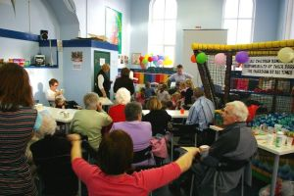
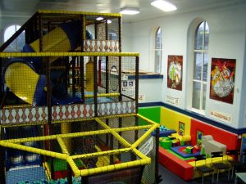
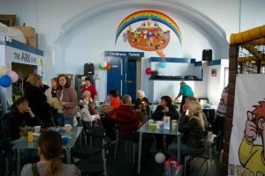
The Wesley Playhouse
www.freshexpressions.org.uk/stories/playhouse

Slide 42

Service in the Community

Slide 43
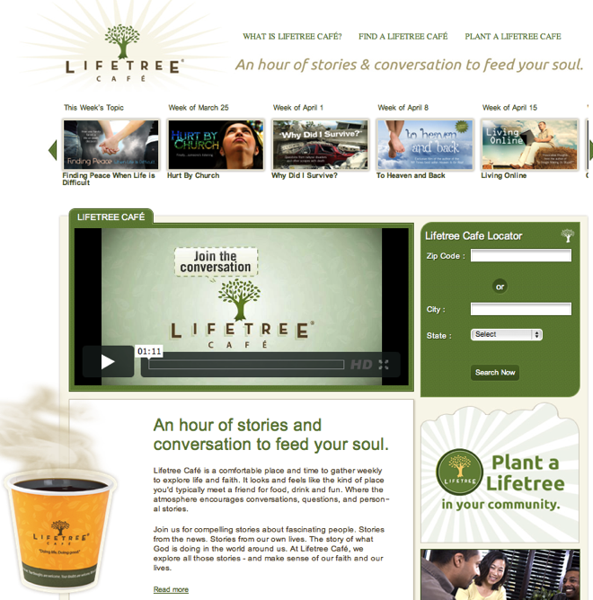
A Third Place gathering space in the community, offers hospitality, builds relationships, hosts spiritual conversations, provides programs and activities, and nourishes the spiritual life of people.

Slide 44
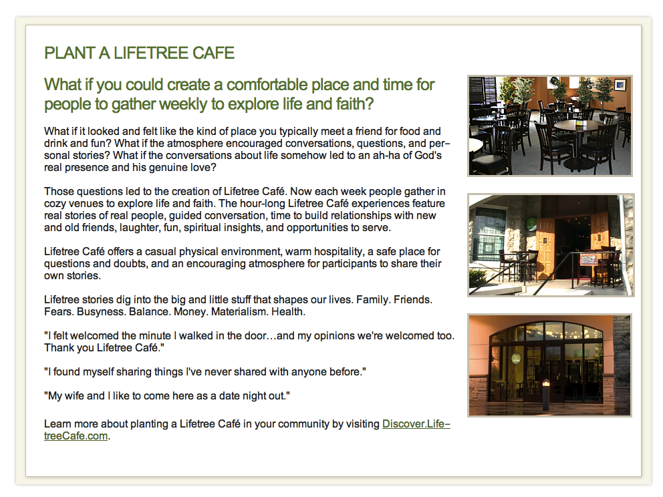

Slide 45
Missional Faith Formation
Missional faith formation provides pathways for people to consider or reconsider the Christian faith, to encounter Jesus and the Good News, and to live as disciples in a supportive faith community.

Slide 46
Pathway: The Alpha Course
Introduction Dinner: Is there more to life than this?
Week 1: Who is Jesus?
Week 2: Why did Jesus die?
Week 3: How can we have faith?
Week 4: Why and how do I pray?
Week 5: Why and how should I read the Bible?
Week 6: How does God guide us?
Week 7: How can I resist evil?
Week 8: Why & how should we tell others?
Week 9: Does God heal today?
Week 10: What about the Church?
Weekend: Who is the Holy Spirit?

Slide 47
Pathway: Our Lady of Soledad Parish
Mini-Retreat 101: “Catholics Alive!”
  “What does it mean to be a follower of Christ?”
Mini-Retreat 201: “Alive and Growing Spiritually!”
  Maturing in the Catholic faith
Mini-Retreat 301: “Alive and Gifted!”
  Discerning how to serve God in ministry
Mini-Retreat 401: “Alive in the World!”
  Living as witnesses for Christ, as contagious Catholic Christians
Mini-Retreat 501: “Alive to Praise God!”
  Catholic worship and the sacraments

Slide 48

Pathway: Unbinding the Gospel
Step One. Church Leader’s Study: Unbinding the Gospel
Step Two: All-Church Saturation Study: Unbinding Your Heart: 40 Days of Prayer & Faith Sharing.
  six-week, church-wide, small group E-vent!
  pray each day’s scripture and prayer exercise and work with a prayer partner
  study a chapter of the book with their small group
  worship with sermons, music, and prayers centered on the week’s chapter

Slide 49
Pathway: Unbinding the Gospel
Step Three: An Experiment in Prayer and Community: Unbinding Your Soul.
  a no-obligation experience of substantial spiritual discussion, prayer and community for people who aren’t connected with a church
  church members invite their friends into a four-week small group experience with short study chapters, an individual prayer journal, prayer partner activities, and group exercises.

Slide 50
Online & Digital Faith Formation
Faith formation utilizes the digital technologies and digital media to engage people with faith forming content anytime, any place, just-in-time; and that can extend and expand faith formation in physical, face-to-face settings into people’s daily lives through digital content and mobile delivery systems.

Slide 51
Digitally-Enabled Faith Formation
Fully Online Faith Formation
Mostly Online with Regular Interaction in Gathered Sessions
Online Faith Formation & Gathered Sessions (Flipped Classroom)
Gathered Program with Supportive Online Content
Gathered Program with Online Components beyond the Program

Slide 52

Digital Platform
Other Platforms
www.wordpress.org www.wix.com www.squarespace.com

Slide 53
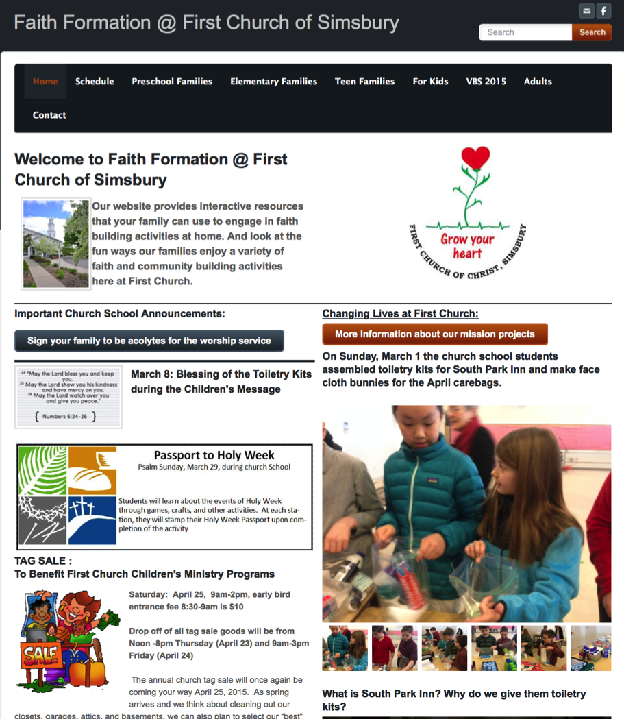

Slide 54
A New Faith Forming Ecosystem
Intergenerational Faith Formation
Age Group/Generational Faith Formation
Family Faith Formation
Missional Faith Formation
Online & Digital Faith Formation

Slide 55
Part 3. The Network & Curriculum

Slide 56
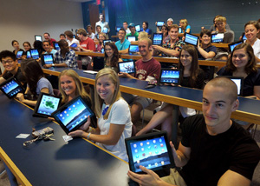
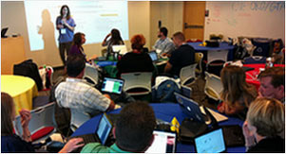
Learning in the 21st Century
A shift from education to learning anywhere, anytime.
A shift from consumption of information to
participatory learning.
A shift from institutions to networks.

Slide 57
Learning in the 21st Century
A shift from education to learning. Education is what institutions do, learning is what people do. Digital media enable learning anywhere, anytime; formal learning must be mobile and just in time.
A shift from consumption of information to participatory learning. A new system of learning must be peer-based and organized around learners’ interests, enabling them to create as well as consume information.
A shift from institutions to networks. In the digital age, the fundamental operating and delivery systems are networks, not institutions such as schools, which are a node on a young person’s network of learning opportunities. People learn across institutions, so an entire learning network must be supported.

Slide 58
21st Century Learning
What if learning adapted to each person instead of expecting each person to adapt to the school or the curriculum or the program?
Putting learners at the center
Enabling learners to be co-creators of their learning experiences
Connecting learning to life concerns and real world issues

Slide 59
Learning in a Network
Bible
Course
Online course
Book
Mentor
Video Program
Bible study group
Bible app
Audio book/podcast
Organize a study group

Slide 60
Families with Children
Faith
Formation
Network
Intergenerational Faith Community
For Parents
Faith Practices @ Home: Seasons of the Year
Sunday Worship
@ Home
Faith Practices @Home: Bible & Learning the Faith
Children’s Programs & Events
Faith Practices @Home: Rituals & Milestones
Faith Practices @ Home: Service
Family Life Assets
Missional / Discovering Faith

Slide 61
Adult
Faith Formation
Network
Faith Enrichment
Sunday Worship
Intergenerational Faith Community
Grand-parents
Spiritual Enrichment
Life Issues & Milestones
Scripture Enrichment
Liturgical Seasons
Service & Mission
Discovering Faith

Slide 62
Networked Faith Formation
Faith formation provides a variety of experiences, programs, activities, resources, and social connections that are available anytime and anywhere, in physical places and online spaces, and conducted in variety of settings—self-directed, mentored, at home, in small groups, in large groups, church-wide, in the community, and in the world.
Faith formation incorporates digital platforms (websites) that integrate all of the content (programs, activities, resources), connect people to the content and to each other, provides continuity for people across different learning experiences, and is available anytime, anywhere, anyplace, 24x7x365.
Faith formation integrates online and face-to-face learning, blending them in a variety of ways from online programs with minimal interaction in physical settings to programs in physical settings that utilize online content or extend the program using online content.

Slide 63

Personalized Learning & Faith Growth
Resource
Resource
Resource
Resource
Resource
Resource

Slide 64
Personalized Faith Formation
Personalized pathways for discipleship & faith growth. . . .
Guide people in discerning their religious and spiritual needs
Equip people with the resources and tools to learn and grow at their own pace
Provide mentoring and support for the journey

Slide 65
The Flow of Personalized Learning
Discerning Learning Needs
Working with a Mentor/Guide
Finding Resources on the Network
Engaging in Formation in a Variety of Learning Environments
Sharing Learning with Others
Reflecting on Growth & Identifying New Needs

Slide 66
Personalizing with a Faith Growth Plan
Create expectations for participation in faith formation and church life by providing a seasonal/yearly growth plan with a variety of options for experiencing the Christian faith through community life. For example:
  Sunday worship
  Church year feasts and seasons
  Service/mission projects
  Retreat experience
  Faith practices @ home, e.g. reading the Bible, praying, rituals, and more

Slide 67
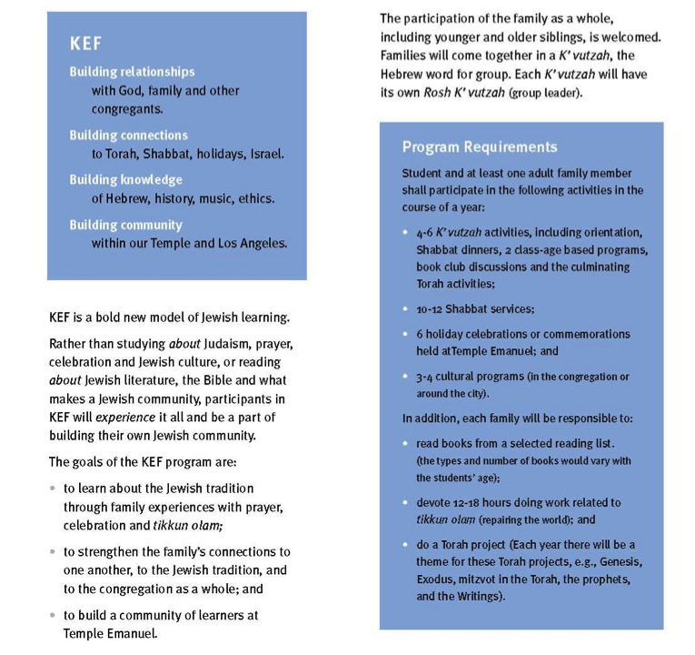

Slide 68
Part 4. Design

Slide 69
Designing a Network: Content Areas
Caring Relationships
Celebrating the Seasons
Celebrating Rituals & Milestones
Learning the Christian Tradition
Praying & Spiritual Formation
Reading the Bible
Serving, Working for Justice, & Caring for Creation
Worshipping God
Missional
Life Issues
Life-Stage
Major Programs
Faith Community
Content Area
Content Area
Content Area
Content Area
Content Area
Content Area

Slide 70
Three Seasons of Programming
Fall Season: September 1 – January 1
Winter/Spring Season: January 1 – May 1
Summer Season: May 1 – September 1
Fall
Winter-Spring
Summer

Slide 71
Designing a Network: Programming
Content Area
Activity 1
Resource
Resource
Activity 3
Resource
Resource
Activity 2
Resource
Resource
Current Activities & Programs
New Activities & Programs

Slide 72
Whole Community Network
Faith Community
Children & Families
Youth and Families
Young Adults
Mid-life Adults
Mature Adults
Older Adults

Slide 73
Families with Children
Faith
Formation
Network
Intergenerational Faith Community
For Parents
Faith Practices @ Home: Seasons of the Year
Sunday Worship
@ Home
Faith Practices @Home: Bible & Learning the Faith
Children’s Programs & Events
Faith Practices @Home: Rituals & Milestones
Faith Practices @ Home: Service
Family Life Assets
Missional / Discovering Faith

Slide 74
Faith Practices
@ Home
Daily Devotion
Resources
Serving Others
Resources
Reading the Bible
Resources
Caring Conversations
Resources
Church Year Seasonal
Learning about Faith
Resources
Resources
Rituals
Resources
Children & Families
Network

Slide 75
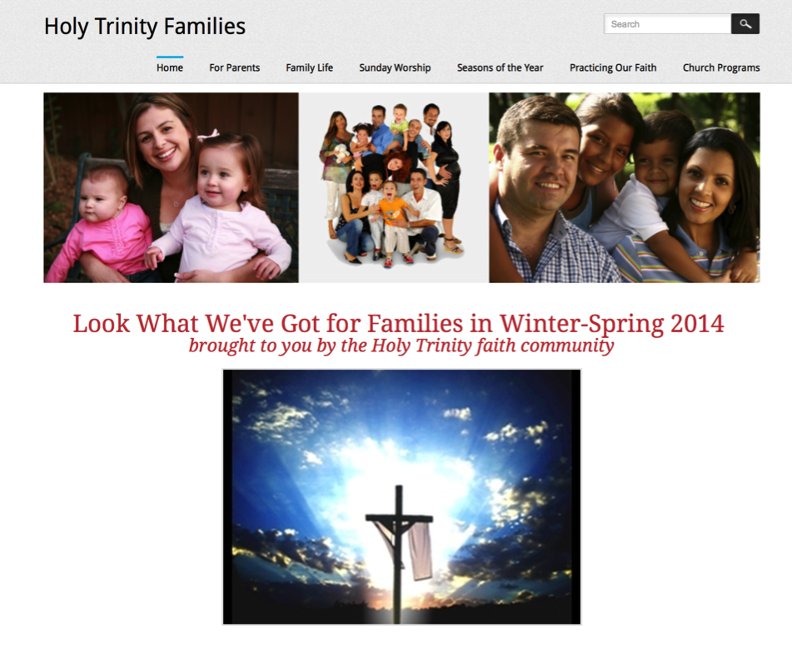
Family Faith Formation Network

Slide 76
Youth Faith Formation
Network
Service Projects Mission Trips
Faith Community
Prayer &
Spiritual Formation
Youth Leadership
Youth Programs
Bible Study & Religious Learning
For Parents
Milestones
Confirmation Program
Adolescent Life Issues
Parent-Teen Activities & Resources
Sunday Worship & Church Seasons
Missional

Slide 77
Prayer & Spiritual Life
Daily Devotion
Resources
Prayer Group
Resources
Spiritual Mentoring
Resources
Spiritual Practices Course
Resources
Retreat
Day at the Monastery
Online Prayer Intentions
Resources
Resources
Youth
Network

Slide 78
Young Adult Faith
Formation
Network
Justice, Service, Mission
Scripture Enrichment
Faith Community
Faith Enrichment
Spiritual Enrichment
Missional & Discovering Faith (Alpha Course)
Worship & Church Year
Life Issues, Transitions, & Milestones
Young Adult Peer Community

Slide 79
Adult
Faith Formation
Network
Faith Enrichment
Sunday Worship
Intergenerational Faith Community
Grand-parents
Spiritual Enrichment
Life Issues & Milestones
Scripture Enrichment
Liturgical Seasons
Service & Mission
Missional & Discovering Faith

Slide 80
Adult
Faith Formation
Network
Spiritual Enrichment
Online Courses
Retreats
Small Group Bible Study
Spiritual Book of the Month Club
Monthly Spiritual Practices Series
Apps & E-newsletters
Day at the Monastery
Online Prayer & Spirituality
Resource
Resource
Resources
Resources
Resource
Resource
Resource
Resource

Slide 81
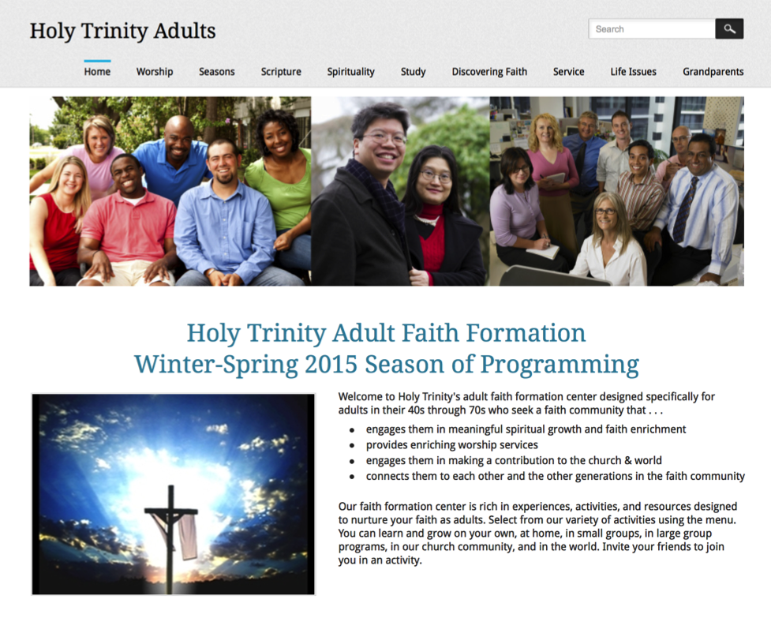
Adult Faith Formation Network

Slide 82
Digital Platform
Other Platforms
www.wordpress.org www.wix.com www.squarespace.com

Slide 83
Digitally-Enabled Faith Formation
Online Faith Formation
Mostly Online with Regular Interaction in Gathered Sessions
Online Faith Formation & Gathered Sessions (Flipped Classroom)
Gathered Program with Supportive Online Content
Gathered Program with Online Components beyond the Program

Slide 84
Gathered with Online Content
A gathered program using online content from websites, videos from YouTube or other video sites, and blogs and other social media. With an abundance of high quality digital content, this first option is the easiest way to bring the digital world into a gathered program.

Slide 85
Gathered and Online Content
Connecting church programs or events with online content that extends and deepens the experience through learning, prayer, ritual, action, etc.
  Sunday worship & church year feasts and seasons
  Intergenerational & family programs
  Children, youth, and adult classes & programs
  Extended programs: mission trips, retreat experiences, and vacation Bible school, summer camp

Slide 86
Gathered and Online Content
Event or Program
TALK
Conversation Activities
LEARN
Read
Listen
Watch
ACT
Practices
Service
Projects
PRAY
Devotions Bible Reading Daily Prayer
SHARE
Blog Facebook
Video
Projects

Slide 87
Example: Sunday Worship
Church Life ➔ | Daily & Home Life | ⬅ Online Life
Experience of Worship in the Congregation Sunday worship and lectionary Church year feasts and seasons Church rituals: baptism, communion, funerals, etc. | Experience of Sunday worship, rituals, and church year seasons in daily life Reflecting on the sermon and readings at home Practices: Lectio, etc. Application to daily living | Online worship, church year, and lectionary resources on the church’s faith formation website Lectionary commentaries online Video reflections and commentary Online activities and projects

Slide 88
Example: 40-Day Lent Curriculum
Church Life ➔ | Daily & Home Life | ⬅ Online Life
Ash Wednesday Lenten Sunday liturgies Stations of the Cross Lenten prayer Lenten retreat Lenten service Lenten soup suppers | Fasting Praying Service/Almsgiving Lectionary reflection Family activities | Lenten learning resources Lenten calendar Daily Lenten prayer Weekly table prayer Video resources Online retreat experience

Slide 89
Online and Gathered
“Flip the classroom or program” by creating a digital platform to provide the content that people would learn in the gathered setting in an online learning space using print, audio, video, and more. And then transform the gathered program using interactive activities, discussion, project-based learning, and practice and demonstration.
  Flip children’s programming: At home learning with parents (print, video, online); in-class application with activities, project-centered learning
  Flip confirmation programming
  Develop a online justice and service center

Slide 90
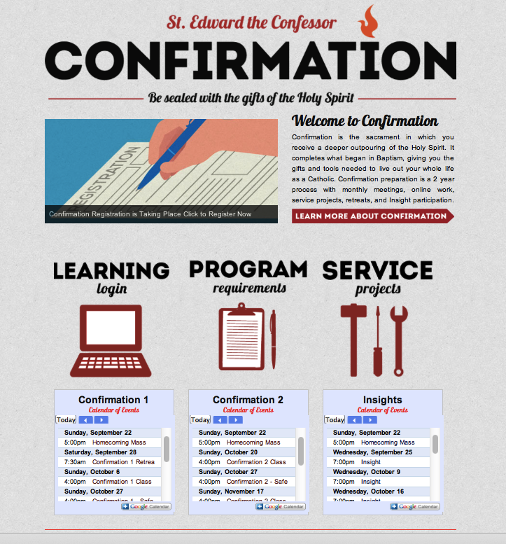
Flipped Classroom

Slide 91
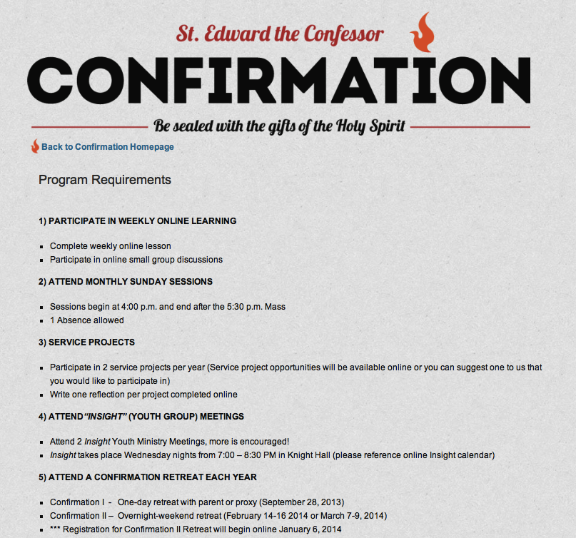
Flipped Classroom

Slide 92
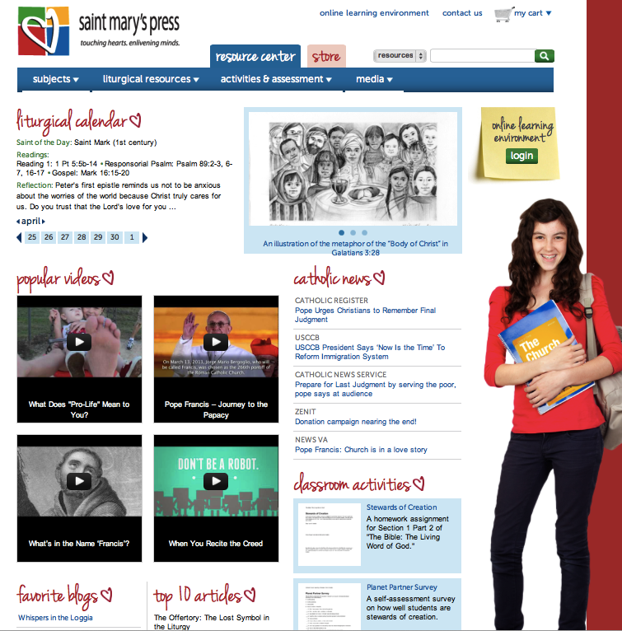
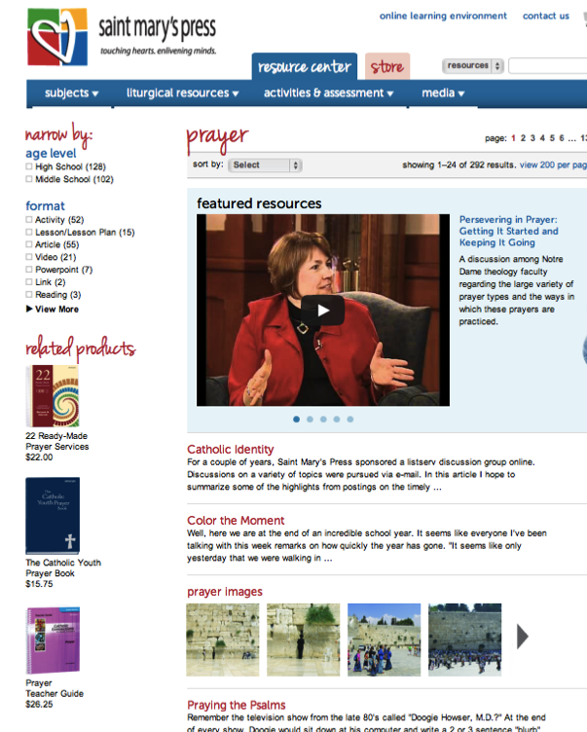
Online Resource Centers

Slide 93
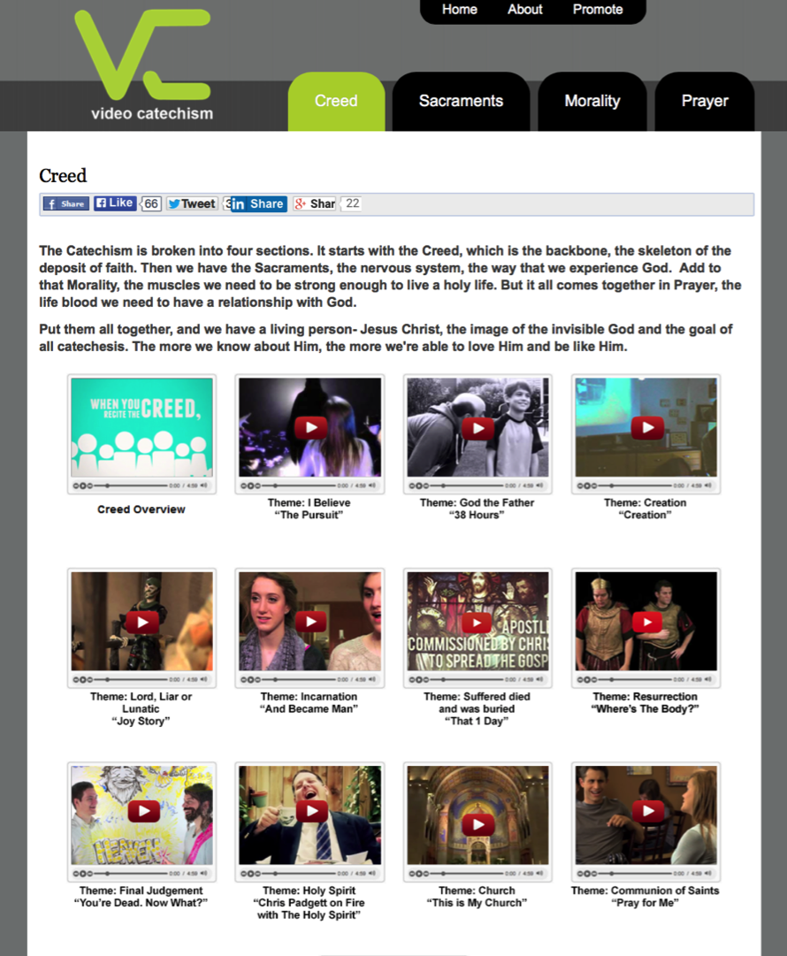

Slide 94
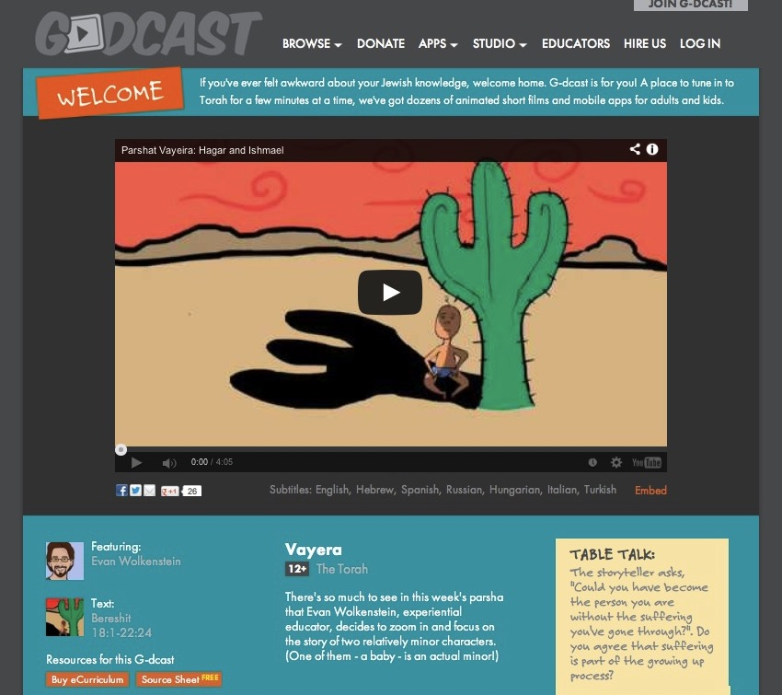

Slide 95
Mostly Online
Offering opportunities for individuals, families, and small groups to utilize the digital platform as their primary learning setting and provide opportunities for regular interaction in face-to-face, gathered settings or in a web conference format, such as a Google+ Hangout.
  Parent webinar programs delivered to parents at home in four-month semesters: three webinars followed by a parent gathering at church; three more webinars and concluding with a parent gathering at church.
  Online learning resources for self-study or small group study, and gathering at the conclusion to share their insights with others who participated.
  Online Bible study where groups can meet regularly in a physical setting or virtually through Skype or a Google+ Hangout for sharing their learning.
  Selected online courses and activities from colleges, seminaries, and religious organization for individualized learning with the option for a mentor or small group gathering.

Slide 96

Google+ Hangout
Online Course, Small Group,
Workshop, or 1-1 Mentoring
Broadcast a Presentation
Record the Presentation (YouTube)

Slide 97
Fully Online
The rise of high quality and easily accessible online religious content—courses, activities, print and e-books, audio and video programs, and content-rich websites—has made designing online faith formation feasible.
  Online Bible and theology courses, video programs, webinars for individual study
  Online prayer and spirituality center where people can access daily prayer reflections and devotions, offer prayer intentions, pray for others, learn about spiritual practices, download prayer activities for the home
  Online parent resource center with the best knowledge, practices, and tools for parenting (print, audio, video)
  Online retreat experience

Slide 98

Part 5. Curation

Slide 99
Emerging Roles
Current Roles
Emerging Roles
Developing religious content
Designing programming
Managing programming
Teaching/Facilitating programming
Designing learning environments—architecture
Curating religious content and experiences

Slide 100
What is Content Curation
(Beth Kanter)
Content curation is the process of sorting through the vast amounts of content on the web and presenting it in a meaningful and organized way around a specific theme.
The work involves sifting, sorting, arranging, and publishing information.
A content curator picks the best content that is important and relevant to share with their community.
It isn’t unlike what a museum curator does to produce an exhibition: They identify the theme, they provide the context, they decide which paintings to hang on the wall, how they should be annotated, and how they should be displayed for the public.

Slide 101
Faith Formation Curators
A Faith Formation Curator is a trusted guide who continually finds, groups, organizes, evaluates, and connects the best and most relevant content and experiences on a specific topic to match the needs of a specific audience.

Slide 102
Curating Religious Content
Research & Organize Resources
Identify Potential Resources for Programming
Evaluate Resources
Select & Connect Resources to programming

Slide 103
Build a Curation Support System
Develop trusted expert curators to assist.
Develop a list of high quality online resource centers.
Subscribe to faith formation blogs and newsletters.

Slide 104
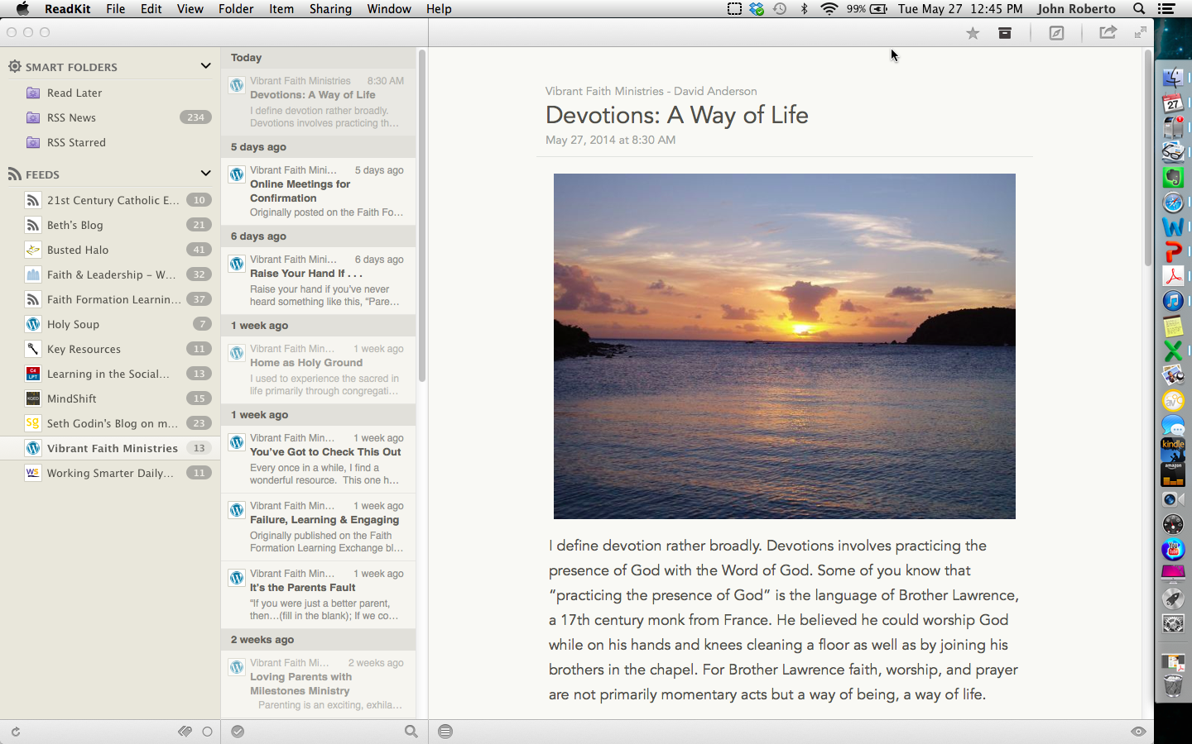
Curate with ReadKit - Mac & iOS

Slide 105
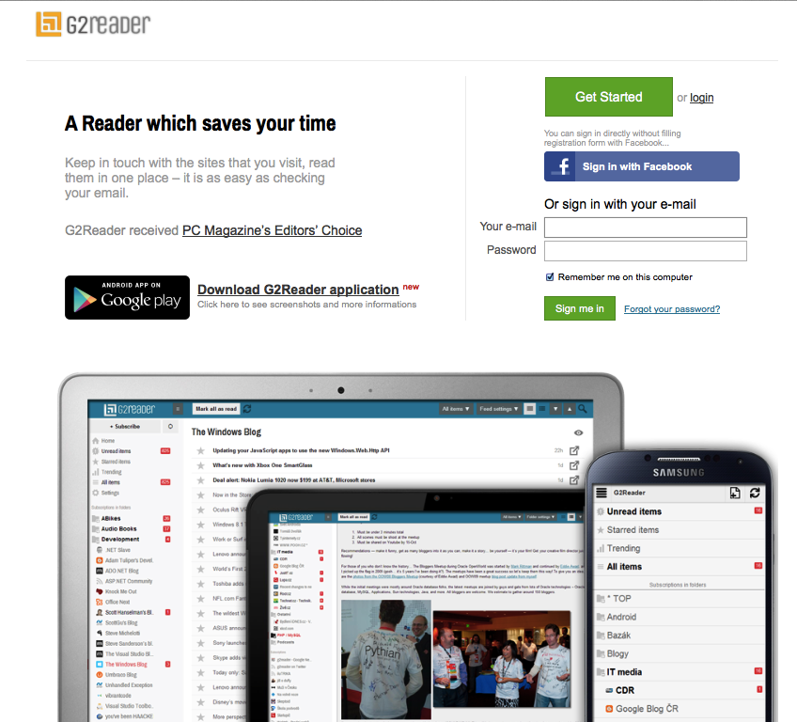
Curate with G2Reader - PC & Android

Slide 106
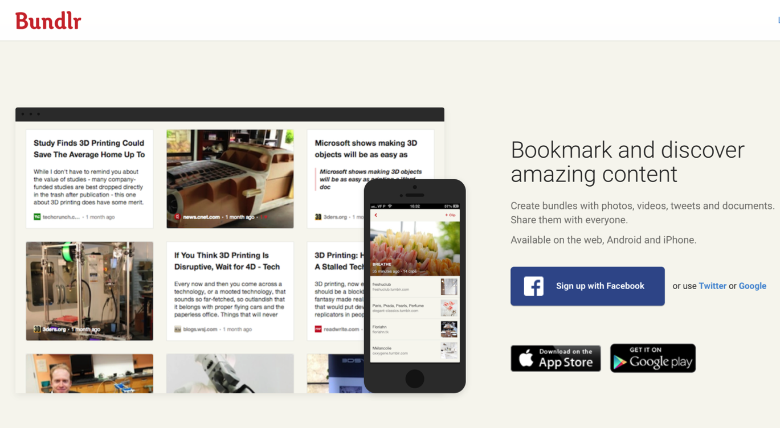
Curate with Social Bookmarking

Slide 107
Research Checklist
People: teachers, mentors/guides, program leaders, small group leaders, guest presenters
Community programs: churches, agencies, organizations,
Educational institutions: colleges, seminaries, educational organizations
Retreat and spiritual life centers, monasteries
Regional and national denominational programs, events, websites
Museums
Books (with study guides) & E-books
Apps
Audio podcasts & audio learning programs
Videos & Video learning programs
Online courses & online activities
Television shows
Organizational websites
Resource center websites

Slide 108
Evaluation Criteria
Biblical content and interpretation
Theological content and emphasis
Developmental appropriateness
Ethnic-Cultural appropriateness
Inclusive of diversity
Respect for diverse ways of learning
Appearance and visual appeal
Ease-of-Use
Quality of Experience
Applicable: Able to be incorporated into daily and home life

Slide 109
Curating Religious Content
Research & Organize Resources
Identify Potential Resources for Programming
Evaluate Resources
Select & Connect Resources to programming

