Slide 1

Reimaging faith formation for the 21st Century
Presenter:
John Roberto

Slide 2
Not Just an Era of Change but a Change of Eras

Slide 3

Accelerating change
The world is now changing at a rate at which the basic systems, structures, and cultures built over the past century cannot keep up with the demands being placed on them. Incremental adjustments to how you manage and strategize, no matter how clever, are not up to the job. You need something very new to stay ahead in a age
of tumultuous change and growing uncertainties.
(John Kotter, Accelerate: Building Strategic Agility
for a Faster-Moving World

Slide 4
Four Perspectives on our changing world
Social
Generational
Religious/Spiritual
Educational

Slide 5
4 Big Adaptive Challenges
Increasing diversity throughout American society in the length of the lifespan, in generational identities, in family structures and marriage patterns, and in the ethnic makeup of America
Rise of new digital technologies that are reshaping society, and the emergence of a connected, networked society
Dramatic changes and increasing diversity in the religious beliefs, practices, and affiliation of Americans
Decline in religious transmission from generation to generation

Slide 6
Life Span Diversity
0-10
50s
20s
30s
40s
60s
70s
80s
90s
11-19

Slide 7
Five Generation Diversity
iGeneration (2000-
Millennials (1980-99)
Generation X (1961-1979)
Builders (before 1946)
Baby Boomers (1946-60)
Relationship to Institutions
Relationship to Authority
Family Relationships
Work-Life Balance
Communication Style
Technology Usage
Learning Style
Spiritual Expression
Worship Style

Slide 8
Family Diversity
Married Couples with no children
Married Couple with Children (biological family)
Married Couple with Children (blended family)
Single Parent with Children
Unmarried Couple with Children
Unmarried Couple without Children
Same Sex Couple with Children (married / unmarried)
Same Sex Couple without Children (married / unmarried)
Grandparents & Parents with Children
Grandparents as Primary Caregivers
Parents with Single Young Adults Living at Home

Slide 9
Spiritual-Religious Diversity
The Unaffiliated
The
Spiritual
The Occasional
The
Active

Slide 10
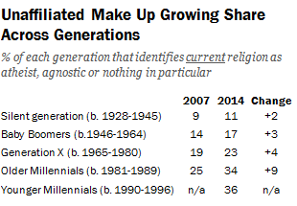

Slide 11
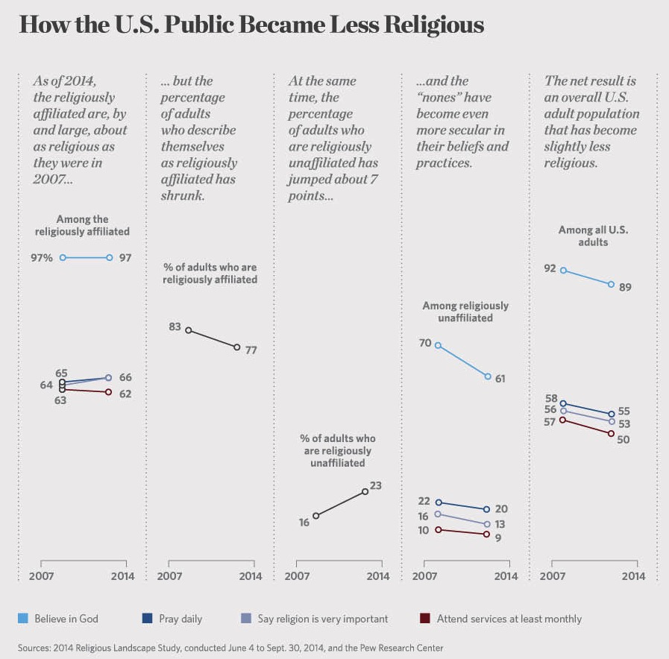

Slide 12


Youth & Young Adults
Youth (teens)
Abiders Adapters Assenters Avoiders Atheists
20% 20% 31% 24% 5%
Emerging Adults (20s)
Committed Selected Spiritually Religiously Religiously Irreligious Traditionalists Adherents Open Indifferent Disconnected
15% 30% 15% 25% 5% 10%

Slide 13
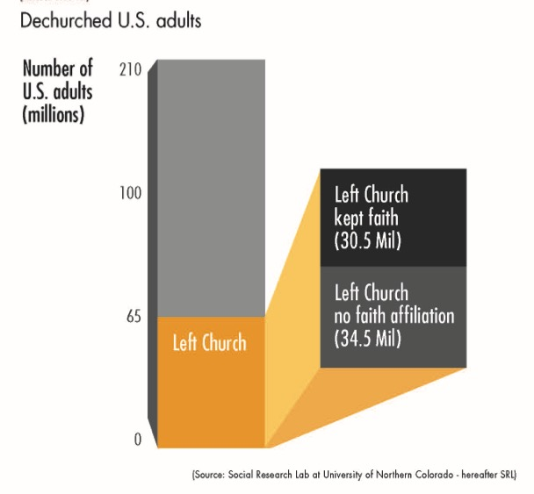
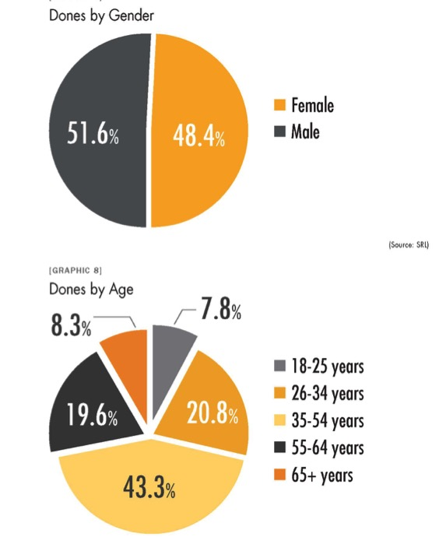
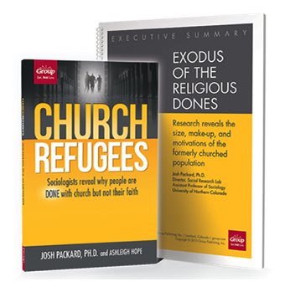
The Rise of the “dones”

Slide 14
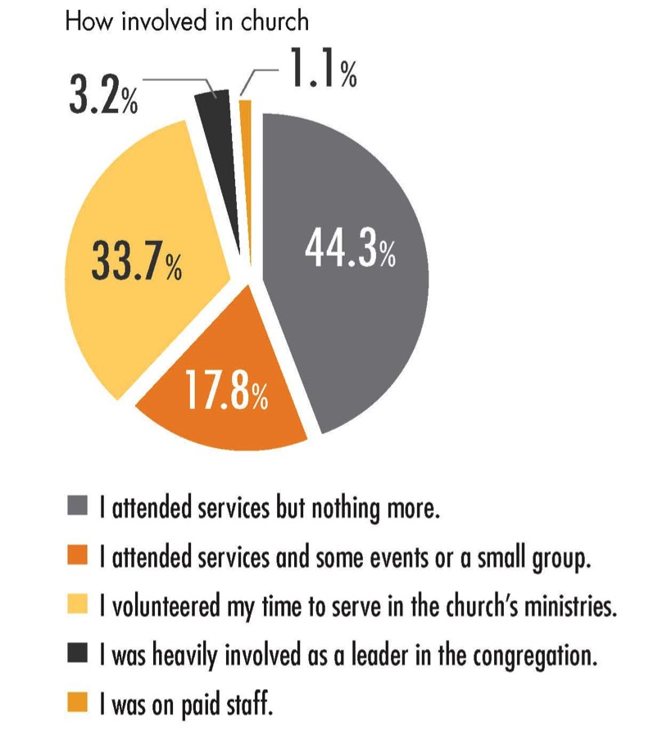

Slide 15
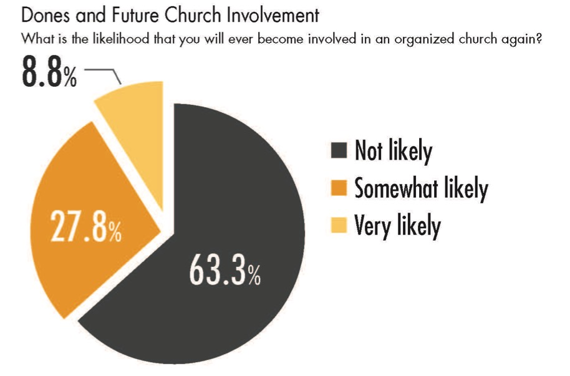
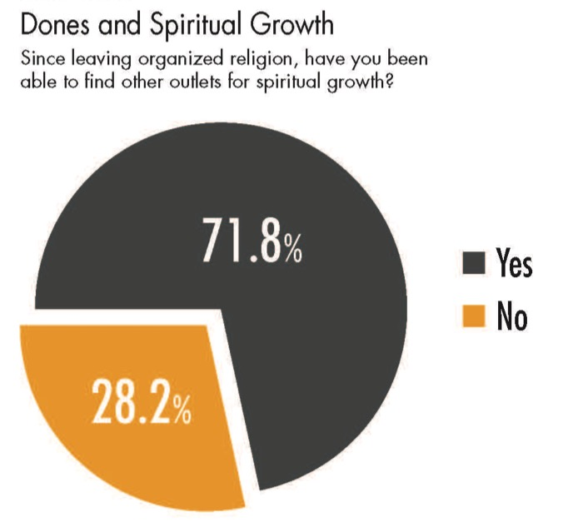

Slide 16
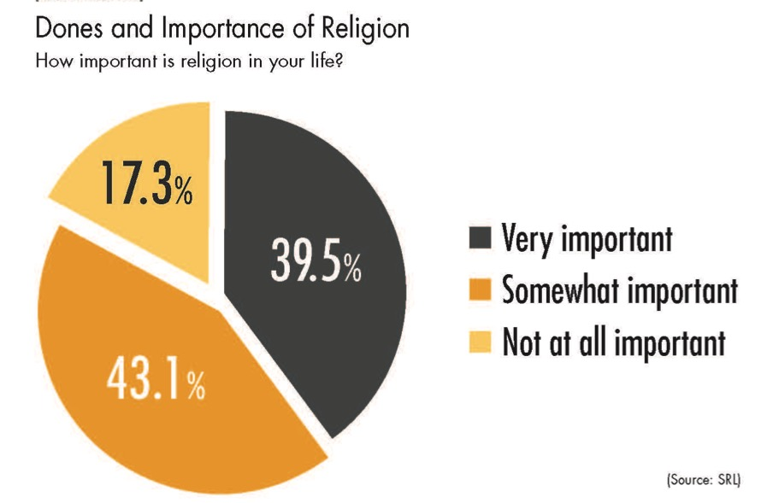
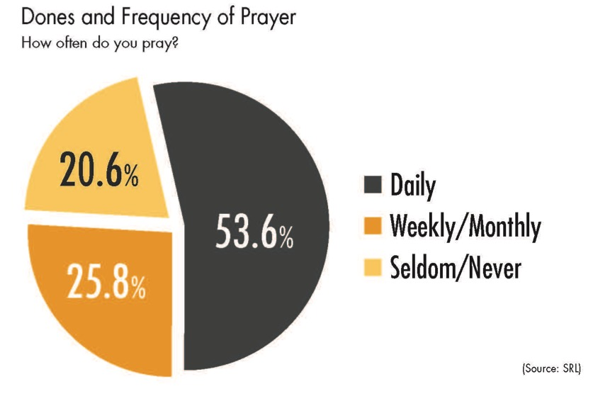

Slide 17
Reasons: leaving/Dissatisfaction
Church too judgmental
Church bureaucracy
Lecture style of preaching
Church is not where I encounter God
Social & political stances of the church
Church is not where I find community
Couldn’t find a church that was welcoming
I wanted to be more involved in living out God’s calling in my life

Slide 18
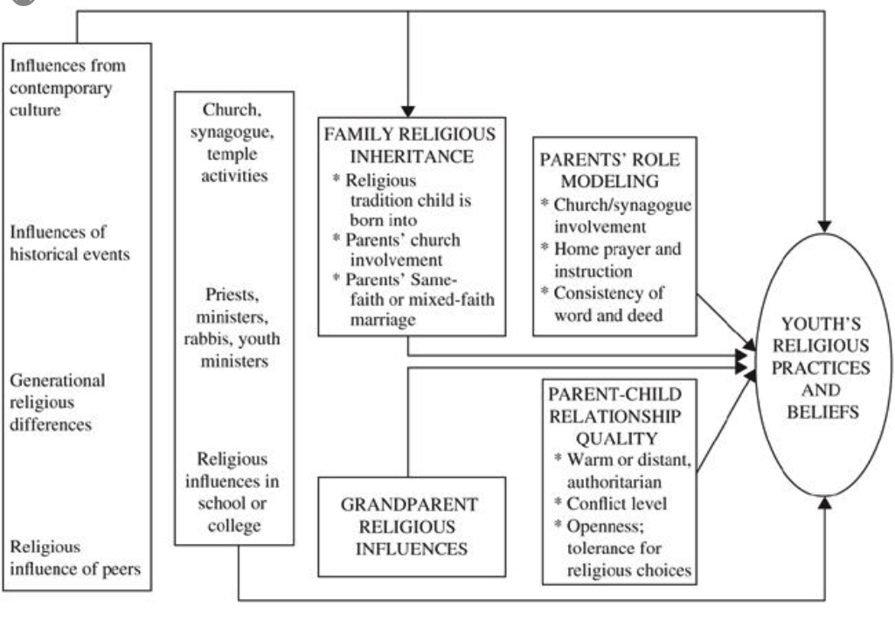

Religious Transmission

Slide 19
Religious Transmission
Value & religious transmission is primarily a family affair. Families can transmit a religious faith tradition or not.
Keys:
  Family Religious Inheritance
  Grandparents
  Parental Role Modeling
  Parent-Child Relationship

Slide 20
Why These Trends will continue
Younger generations more unaffiliated and less involved in faith communities
Older generations more affiliated and more involved and supportive
Generational transition: as younger generations replace the older generations there will be fewer engaged and more unaffiliated

Slide 21
Why These Trends will continue
Declining levels of family religious transmission and faith practice at home are a result of non-affiliation.
    1st generation & 2nd generation
If the pattern continues, expect higher levels of non-affiliation and lower levels of church involvement in younger families.

Slide 22
Why these trends will continue
Increase in individualism – more focus on the self, less on others and society. Religious affiliation is low when the culture is high in individualism and low in social support.
Increase in religious pluralism—questioning or minimizing of all faiths.
Increase in diversity

Slide 23
Religion is not going away anytime soon, regardless of how people may identify themselves. But business as usual among existing religious institutions will not stem the losses we are seeing.
(Richard Flory, USC)
(http://religiondispatches.org/u-s-christianity-is-dead-long-live-u-s-christianity)

Slide 24





Slide 25


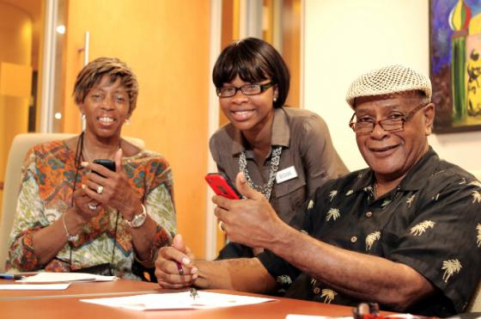
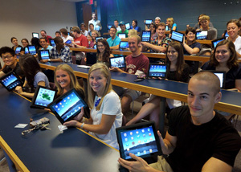

Slide 26


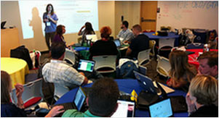
A shift from education to learning anywhere, anytime.
A shift from consumption of information to participatory learning.
A shift from institutions to networks.

Slide 27
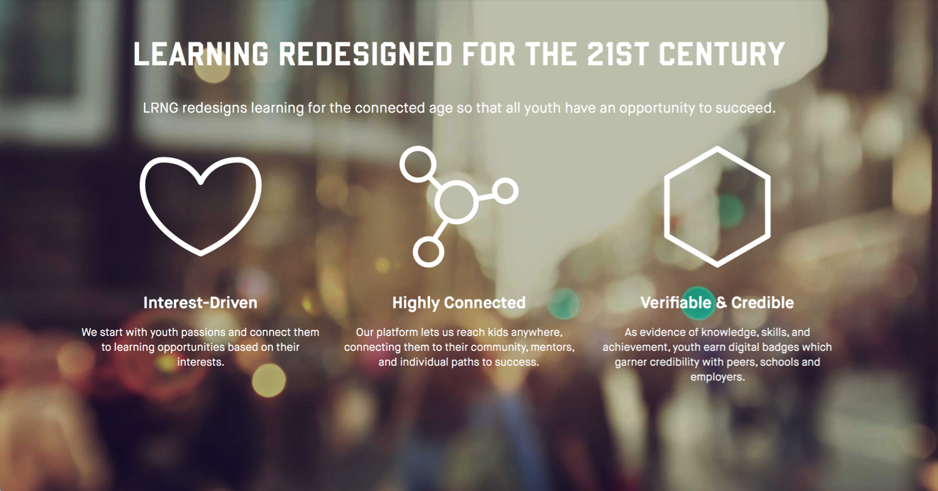

Slide 28
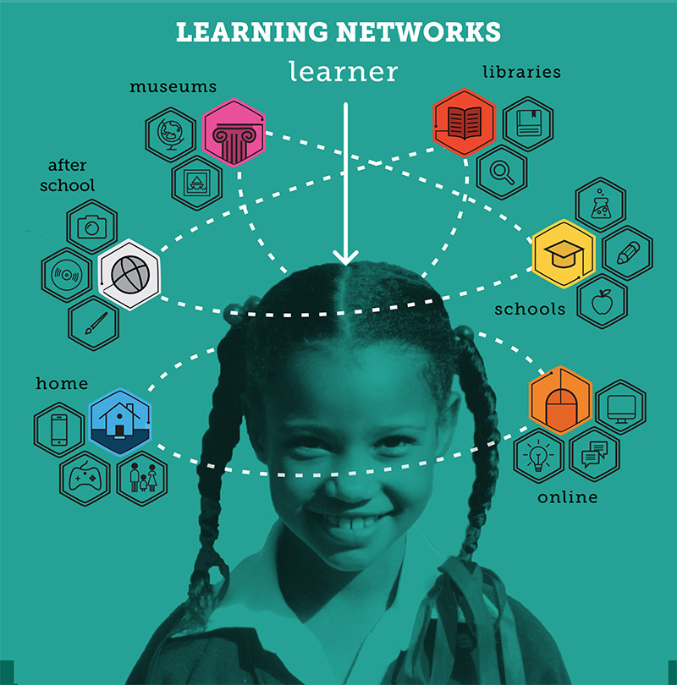

Slide 29
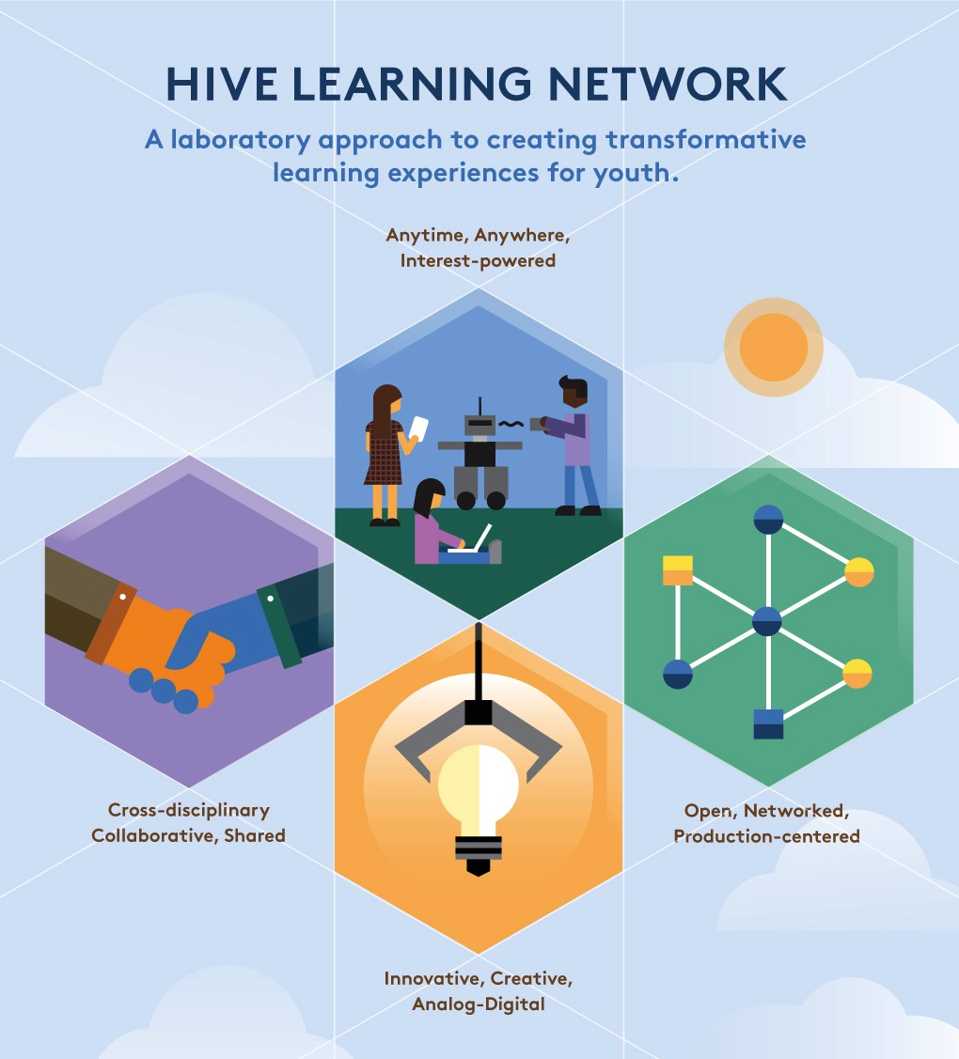

Slide 30
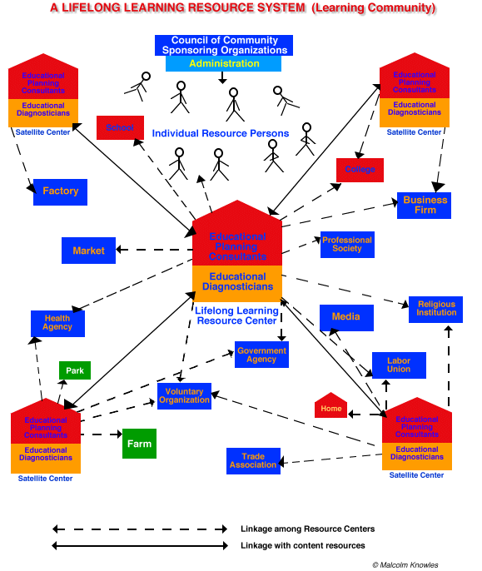

Slide 31
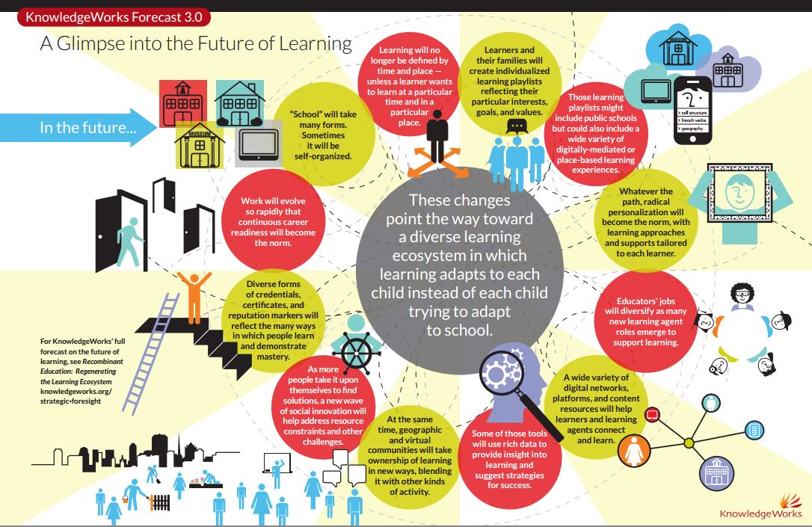

Slide 32
Imagining a new future
The Ecosystem
The Network

Slide 33
The “Old” Faith Forming Ecosystem
Church
Family
Ethnic Traditions
Community
Religious School or Sunday School

Slide 34
Building a New Faith Forming Ecosystem
Intergenerational Faith Community
Age Group/Generational Faith Formation
Family Faith Formation
Missional Faith Formation
Online & Digitally-Enabled Faith Formation

Slide 35
Faith Formation Networks
A network of relationships, content, experiences, & resources. . . .
Offering a variety of content, methods, formats, and delivery systems (online & physical settings) to address the diverse life tasks and situations, needs and interests, and spiritual and faith journeys of people.
Offering content and experiences that is responsive to the diverse religious and spiritual needs of people today—from the spiritually committed and engaged to the spiritual but not religious and the unaffiliated.
Offering multiple environments to address people’s busy lives and providing more ways to participate: self-directed, mentored, at home, in small groups, in large groups, church-wide, in the community, and in the world.

Slide 36
Comprehensive Faith Formation
GROWTH IN FAITH
Caring Relationships
Rituals & Milestones
Church Year Seasons
Worshipping
Learning the Tradition
Praying
Spiritual Formation
Reading the Bible
Serving Working for Justice Caring for Creation

Slide 37
Faith Formation Networks
Faith Community
Content Area
Content Area
Content Area
Content Area
Content Area
Content Area
Caring Relationships
Celebrating the Seasons
Celebrating Rituals & Milestones
Learning the Christian Tradition
Praying & Spiritual Formation
Reading the Bible
Serving, Working for Justice, & Caring for Creation
Worshipping God
Life Stage Issues
Missional

Slide 38
Faith Enrichment
Sunday Worship
Adult Faith Formation Network
Grand-parents
Spiritual Enrichment
Life Issues & Milestones
Scripture Enrichment
Liturgical Seasons
Service & Mission
Discovering Faith

Slide 39
Sample Themes –Adults
Dealing with retirement
Making life plans, finances, health
Becoming a grandparent
Making a difference in the community and world
Incorporating family changes and transitions
New ways of living and relating as a married couple
Caring for aging parents
Taking time to read the Bible and learn more about my faith
Growing spiritually and exploring spirituality for the 2nd half of life
Connecting with people my age; talking about things that matter to us
Dealing with loss

Slide 40
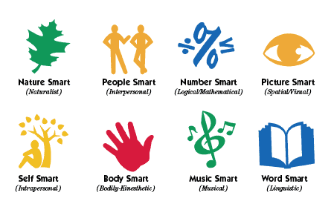
Faith Formation Playlists
Variety of Environments: Self-directed, mentored, at home, in small groups, in large groups, church-wide, in the community, and in the world.
Variety of Ways
to Learn

Slide 41
Adult Faith Formation Playlist
Spiritual Enrichment
Online Courses
Retreats
Small Group Bible Study
Spiritual Book of the Month
Spiritual Practices Series
Apps & E-newsletters
Day at the Monastery
Online Prayer & Spirituality
Resource
Resource
Resources
Resources
Resource
Resource
Resource
Resource

Slide 42
Adult Faith Formation Playlists
Playlists are thematic learning plans that integrate a variety of ways to learn, multiple learning environments, and online and physical spaces—from which people can create their own faith formation plan.
Example: Spiritual Enrichment for Adults
Theme: “Spiritual Practices”
Spiritual Practices Course (5 sessions at church in one month)
Spirituality Over 50 Book Group (variety of times & places)
Online Daily Devotion Resources
Online Prayer Practices Resources
Online Course or Retreat with a Spiritual Master
Online Retreat

Slide 43
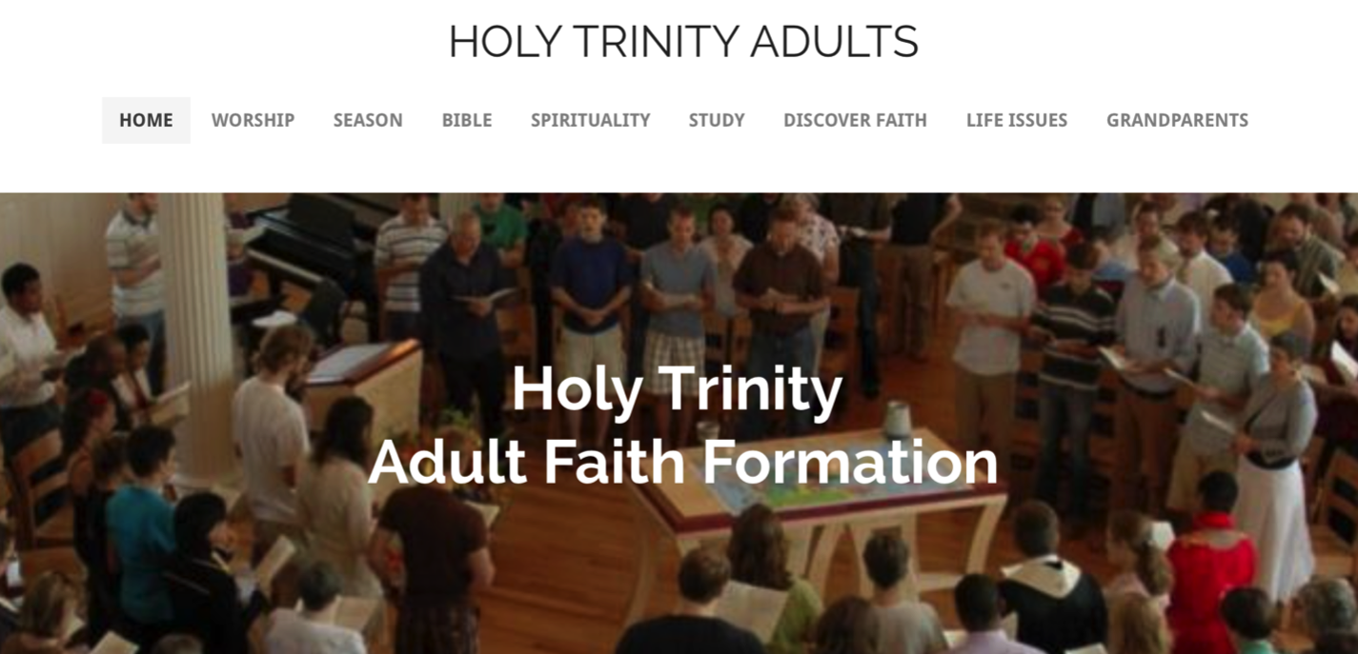
Adult Faith Formation Website

Slide 44
Family Faith Formation Network
For Parents
Seasons of the Year
Sunday Worship
@ Home
Reading the Bible
Serving
Growing as a Family
Learning the Faith
Celebrating Rituals & Milestones
Children’s Programs
Praying & Growing Spiritually

Slide 45
Faith Formation Playlists
Playlists are thematic learning plans that integrate a variety of ways to learn, multiple learning environments, and online and physical spaces—from which people can create their own plan.
Example: Just for Parents
The "Just for Parents" programming offers a variety of ways for you to enhance and enrich your knowledge and skills:
"First Wednesdays" Webinar Series - without leaving your home!
Learn More About Your Children
Book Groups: The Secrets of Happy Families by Bruce Feiler
Online Video: "Parenting for the Long Haul"

Slide 46

Family Faith Formation Website

Slide 47
3 Seasons of Programming
Fall Season:
Sept 1 – Jan 1
Winter/Spring Season: Jan 1 – May 1
Summer Season:
May 1 – Sept 1
Fall
Winter-Spring
Summer

Slide 48
Seasonal Plan & Calendar
Content Area (examples) |  | Programming | & Dates
 | Month 1 | Month 2 | Month 3 | Month 4
Scripture Enrichment
Faith Enrichment
Spiritual Enrichment
Service & Mission
Life Issues

Slide 49
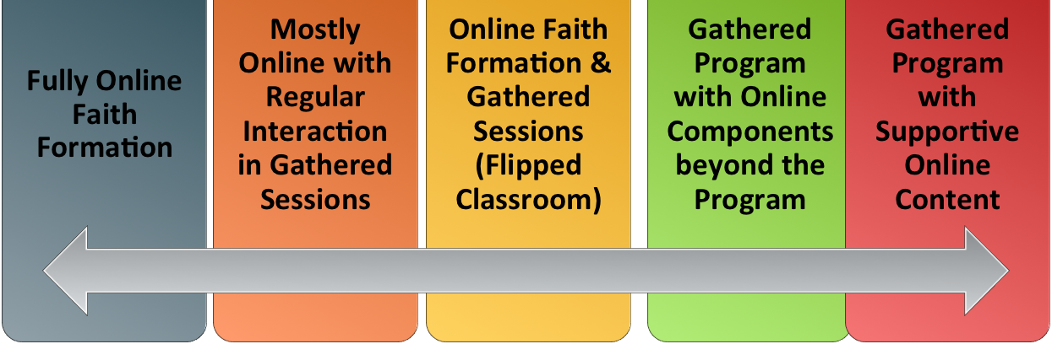
Digitally enabled learning

Slide 50
Gathered using Online Content
A gathered program using online content from websites, videos from YouTube or other video sites, and blogs and other social media. With an abundance of high quality digital content, this first option is the easiest way to bring the digital world into a gathered program.

Slide 51
Gathered with Online Content
Connecting church programs or events with online content that extends and deepens the experience through learning, prayer, ritual, action, etc.
  Sunday worship & church year feasts and seasons
  Intergenerational & family programs
  Children, youth, and adult classes & programs
  Extended programs: mission trips, retreat experiences, and vacation Bible school, summer camp

Slide 52
Gathered with Online Content
Church Event or Program
At Home & Daily Life

Slide 53
Gathered with Online Content
Event or Program
TALK
Conversation Activities
LEARN
Read
Listen
Watch
ACT
Practices
Service
Projects
PRAY
Devotions Bible Reading Daily Prayer
SHARE
Facebook
Video
Projects

Slide 54
Example: Sunday Worship
Church Life ➔ | Daily & Home Life | ⬅ Online Life
Experience of Worship in the Congregation Sunday worship and lectionary Church year feasts and seasons Church rituals: baptism, communion, funerals, etc. | Experience of Sunday worship, rituals, and church year seasons in daily life Reflecting on the sermon and readings at home Practices: Lectio, etc. Application to daily living | Online worship, church year, and lectionary resources on the church’s faith formation website Lectionary commentaries online Video reflections and commentary Online activities and projects

Slide 55
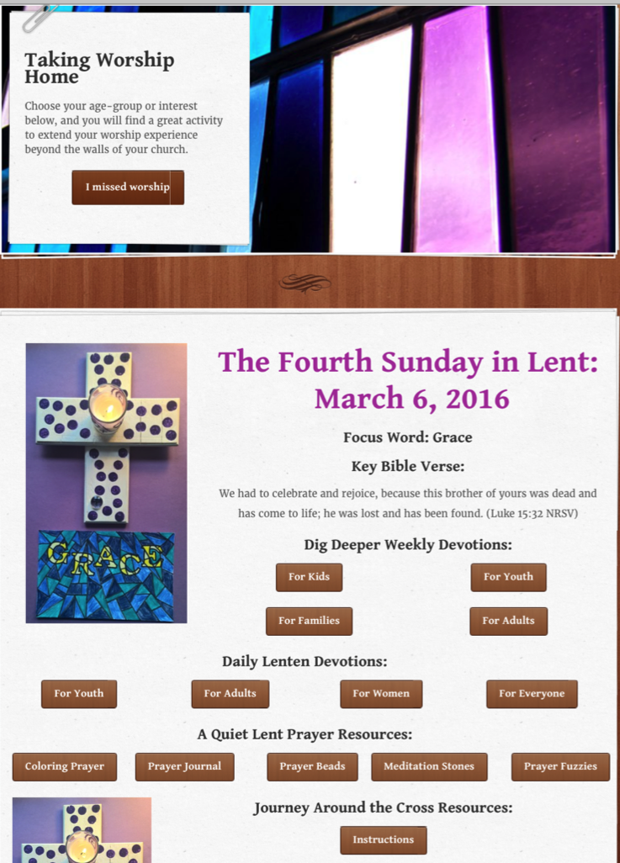
Sunday Worship
Tri-Saints Lutheran Church, NE

Slide 56
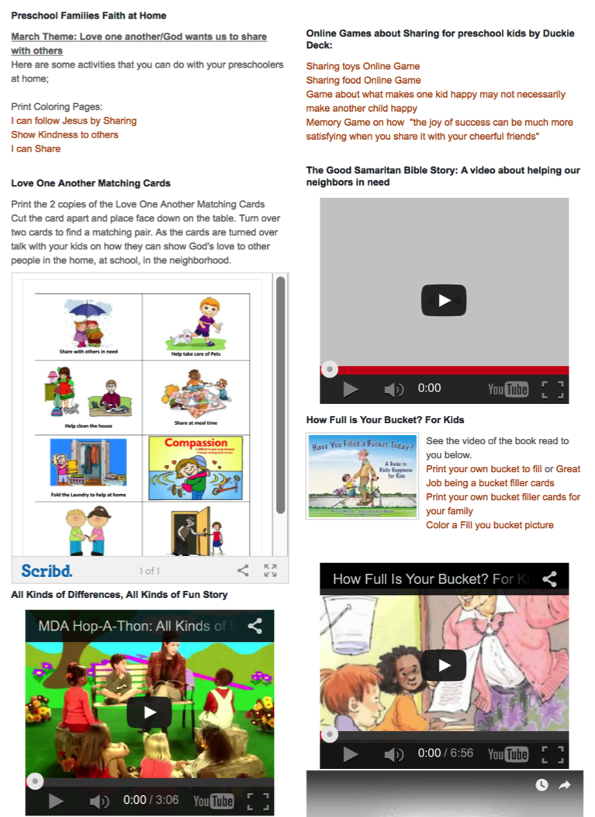
Preschool Faith Formation @ Home
First Church
Simsbury, CT

Slide 57
Online and Gathered
Flip the classroom or program by creating a digital platform to provide the content that people would learn in the gathered setting in an online learning space using print, audio, video, and more. And then transform the gathered program using interactive activities, discussion, project-based learning, and practice and demonstration.
Flip children’s programming: At home learning with parents (print, video, online); in-class application with activities, project-centered learning
Flip confirmation programming

Slide 58
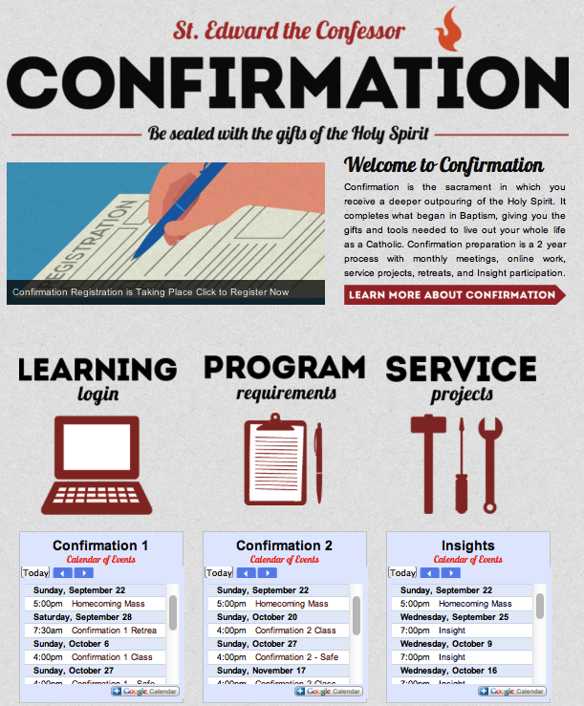
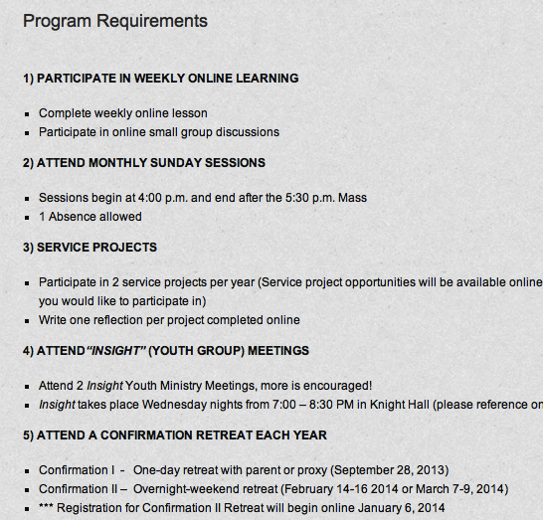
Online and Gathered

Slide 59
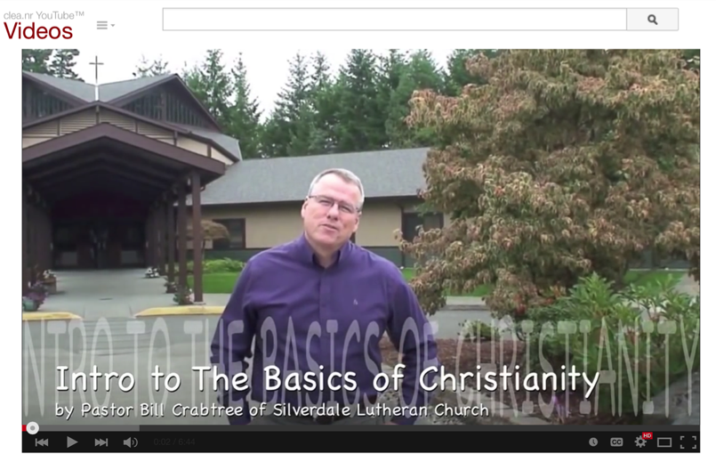

Slide 60
Mostly Online
Utilizing the digital platform as the primary learning setting and providing opportunities for interaction in gathered settings.
Parent webinar programs delivered to parents at home in four-month semesters: three webinars + a parent gathering
Online learning resources for self-study or small group study, and gathering at the conclusion to share their insights.
Online Bible study where groups can meet regularly in a physical setting or virtually on Skype or Google+ Hangout.
Selected online courses and activities from colleges, seminaries, and religious organization for individualized learning with the option for a mentor or small group.

Slide 61
Fully Online
The rise of high quality and easily accessible online religious content—courses, activities, print and e-books, audio and video programs, and content-rich websites—has made designing online faith formation feasible.
Online Bible and theology courses, video programs, webinars for individual study
Online prayer & spirituality center where people can access daily prayer reflections and devotions, offer prayer intentions, pray for others, learn about spiritual practices, download prayer activities, etc.
Online parent resource center
Online retreat experience

Slide 62
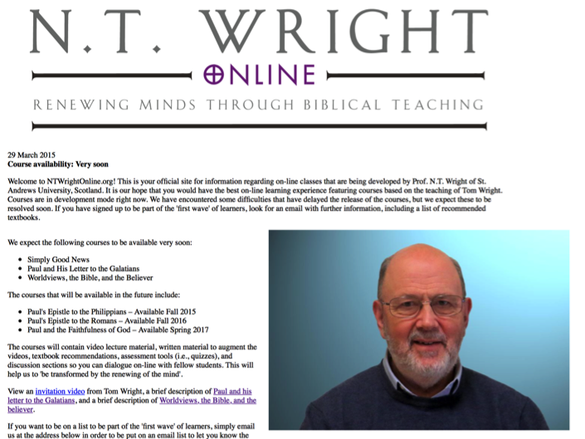

Online Courses
N.T. Wright Online – Bible Courses
Church Next Online Adult Faith Formation

Slide 63
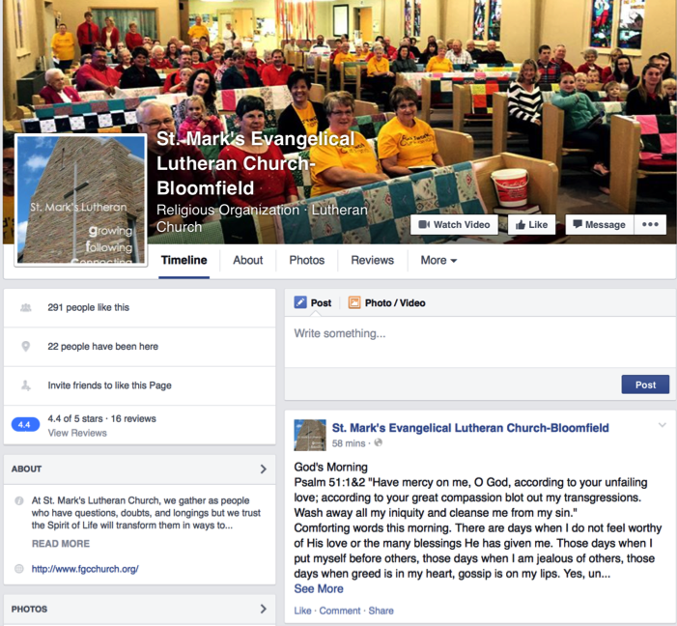
St. Mark’s
Daily Devotion

Slide 64
Example: 40-Day Lent Curriculum
Church Life ➔ | Daily & Home Life | ⬅ Online Life
Ash Wednesday Lenten Sunday liturgies Stations of the Cross Lenten prayer Lenten retreat Lenten service Lenten soup suppers | Fasting Praying Service/Almsgiving Lectionary reflection Family activities | Lenten learning resources Lenten calendar Daily Lenten prayer Weekly table prayer Video resources Online retreat experience

Slide 65
Intergenerational

Slide 66
Intergenerational Faith Formation
How to become intentionally intergenerational in church life & faith formation as the foundation for lifelong faith formation and discipleship?

Slide 67
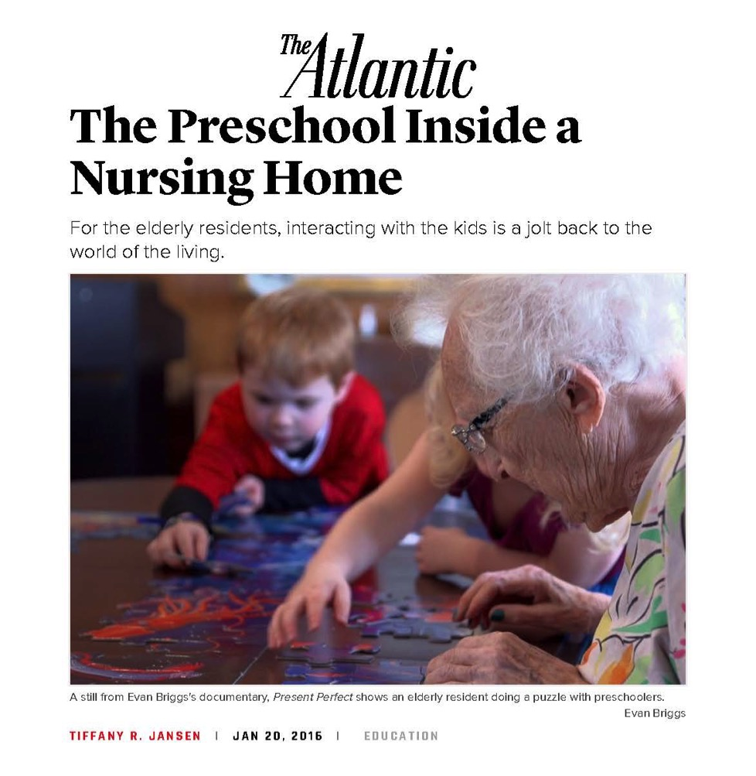

Slide 68
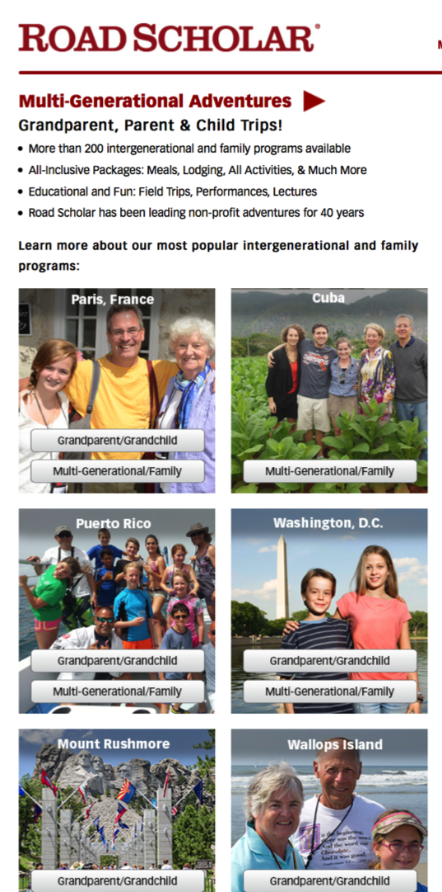

Slide 69
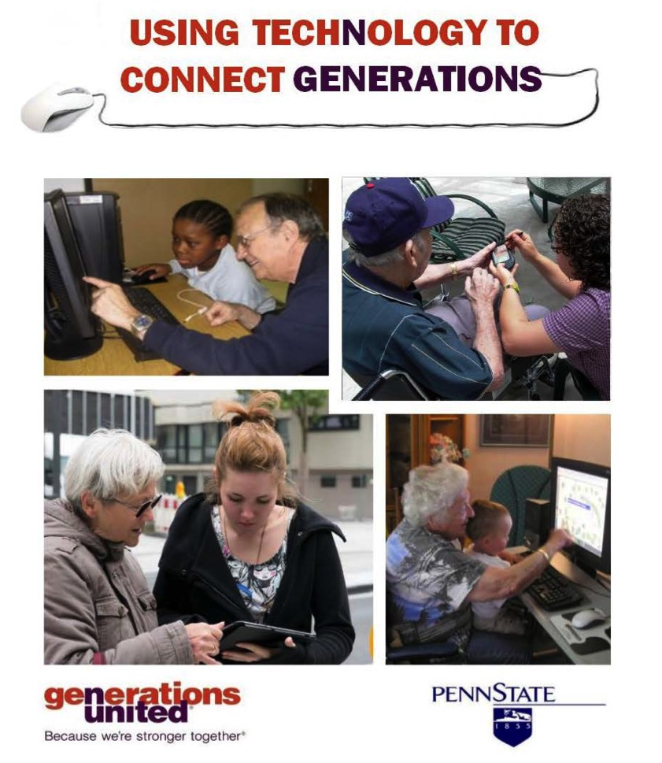

Slide 70
Intentionally Intergenerational
Caring Relation-ships
Celebrating
Learning
Praying
Serving
Create IG Experiences at Church
Infuse IG Experiences & Relationships into
Existing Ministries/Programs
Connect Generations in Church Life

Slide 71
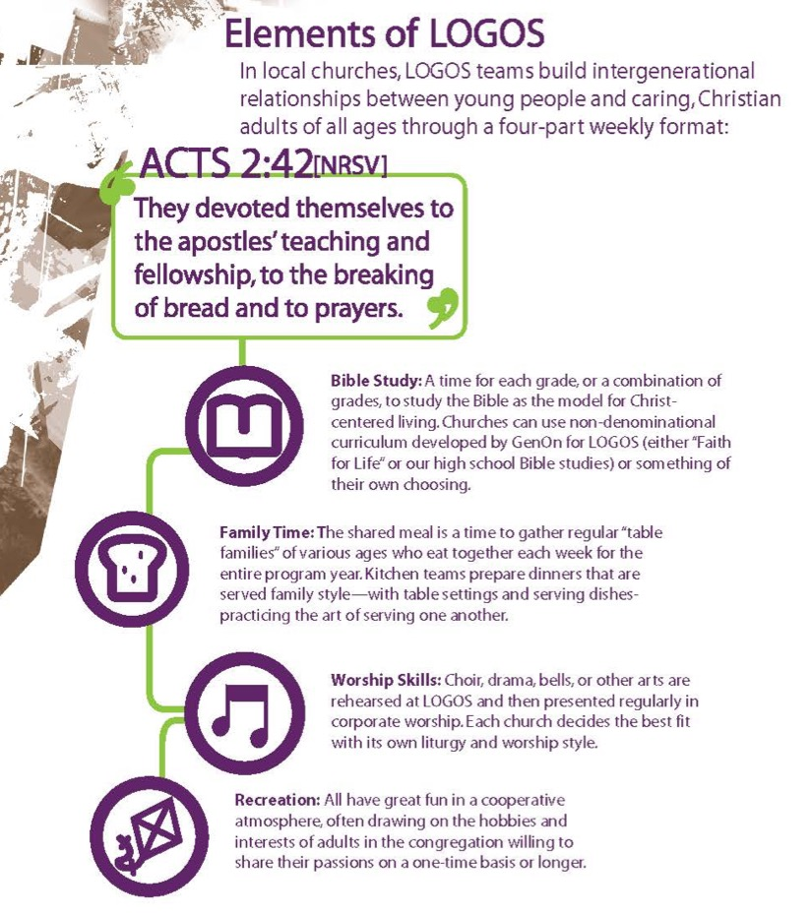
Elements of LOGOS
Bible Study
Family Time
Worship Skills
Recreation
GenOn Ministries
www.genonministries.org

Slide 72
Intentionally Intergenerational
Intergenerational Worship
Intergenerational Learning
Intergenerational Prayer & Spiritual Formation
Intergenerational Social Events
(arts festivals, music and concerts, drama)
Intergenerational Service & Mission Trips
Intergenerational Retreats & Camps
Intergenerational Mentoring
Intergenerational Leadership

Slide 73
Family

Slide 74
Family Faith Formation
How to equip, resource, and support families as the center of faith formation?
Transmitting faith from generation to generation
Nurturing family faith at home – faith practices
Building strong families – family assets
Equipping & supporting parents & grandparents – formation

Slide 75
Religious Transmission

Slide 76
Families at the Center
Church Life & Ministries
Family
Faith Transmission
Faith Forming Practices
Family Development
Parent Formation

Slide 77
Family Faith Formation
Through the day: meal times, car times, morning and bedtime, exits and entries, family sharing times
Through the year: church year seasons, rituals and celebrations
Through the lifecycle: milestones & rites of passage
Through key family moments – good times and hard times, times of joy and sorrow
Through life issues and life skills: parenting, decision-making, financial planning, communication, and more

Slide 80
Family Faith Formation
Family and intergenerational learning programs, as well as parent-child/teen programs
Family faith formation around life-cycle milestones
Family teen service projects
At-home resources to develop family faith practices
Focus on parents—parent faith formation and parental training
A family faith formation website as an online leaning and resource center; Facebook (or other social media) as a connection and community

Slide 81
Lifelong

Slide 82
Lifelong Faith Formation
Age group and generational faith formation addresses the unique life tasks, needs, interests, and spiritual journeys of people at each stage of life.
Intergenerational Faith Community
Children & Parents
Youth & Parents
Young Adults
Mid-life Adults
Mature Adults
Older Adults

Slide 84
Curriculum for lifelong faith formation
GROWTH IN FAITH
Caring Relationships
Rituals & Milestones
Church Year Seasons
Worshipping
Learning the Tradition
Praying
Spiritual Formation
Reading the Bible
Serving Working for Justice Caring for Creation

Slide 85
Lifelong Faith Formation
Networks
A network of relationships, content, experiences, & resources. . . .
Offering a variety of content, methods, formats, and delivery systems (online & physical settings) to address the diverse life tasks and situations, needs and interests, and spiritual and faith journeys of people.
Offering content and experiences that is responsive to the diverse religious and spiritual needs of people today—from the spiritually committed and engaged to the spiritual but not religious and the unaffiliated.
Offering multiple environments to address people’s busy lives and providing more ways to participate: self-directed, mentored, at home, in small groups, in large groups, church-wide, in the community, and in the world.

Slide 86
Curriculum for lifelong faith formation
GROWTH IN FAITH
Caring Relationships
Rituals & Milestones
Church Year Seasons
Worshipping
Learning the Tradition
Praying
Spiritual Formation
Reading the Bible
Serving Working for Justice Caring for Creation

Slide 87
Faith Formation Networks
Faith Community
Content Area
Content Area
Content Area
Content Area
Content Area
Content Area
Caring Relationships
Celebrating the Seasons
Celebrating Rituals & Milestones
Learning the Christian Tradition
Praying & Spiritual Formation
Reading the Bible
Serving, Working for Justice, & Caring for Creation
Worshipping God
Life Stage Issues
Missional

Slide 88
Faith Enrichment
Sunday Worship
Adult Faith Formation Network
Grand-parents
Spiritual Enrichment
Life Issues & Milestones
Scripture Enrichment
Liturgical Seasons
Service & Mission
Discovering Faith

Slide 89
Adult Faith Formation Website

Slide 90
Family Faith Formation Network
For Parents
Seasons of the Year
Sunday Worship
@ Home
Reading the Bible
Serving
Growing as a Family
Learning the Faith
Celebrating Rituals & Milestones
Children’s Programs
Praying & Growing Spiritually

Slide 91
Family Faith Formation Website

Slide 92
3 Seasons of Programming
Fall Season:
Sept 1 – Jan 1
Winter/Spring Season: Jan 1 – May 1
Summer Season:
May 1 – Sept 1
Fall
Winter-Spring
Summer

Slide 93
Family Faith Formation Playlists
Playlists are thematic learning plans that integrate a variety of ways to learn, multiple learning environments, and online and physical spaces—from which people can create their own plan.
Example: Just for Parents
The "Just for Parents" programming offers a variety of ways for you to enhance and enrich your knowledge and skills:
"First Wednesdays" Webinar Series - without leaving your home!
Learn More About Your Children
Book Groups: The Secrets of Happy Families by Bruce Feiler
Online Video: "Parenting for the Long Haul"

Slide 94
Family Faith Formation Website

Slide 95
3 Seasons of Programming
Fall Season:
Sept 1 – Jan 1
Winter/Spring Season: Jan 1 – May 1
Summer Season:
May 1 – Sept 1
Fall
Winter-Spring
Summer

Slide 96
Seasonal Plan & Calendar
Content Area (examples) |  | Programming | & Dates
 | Month 1 | Month 2 | Month 3 | Month 4
Scripture Enrichment
Faith Enrichment
Spiritual Enrichment
Service & Mission
Life Issues

Slide 97
Missional

Slide 98
Missional Faith Formation
Missional faith formation expands and extends the church’s presence through outreach, connection, relationship building, and engagement with people where they live—moving faith formation out into the community.
Moving worship & faith formation into the community
Opening programs to everyone
Life skills: parenting, careers, training, mentoring
Small group programs on a variety of topics
Community-wide service
Community events: arts, music, theater

Slide 99
Missional Faith Formation
Missional faith formation provides pathways for people to consider or reconsider the Christian faith, to encounter Jesus and the Good News, and to live as disciples in a supportive faith community.

Slide 100
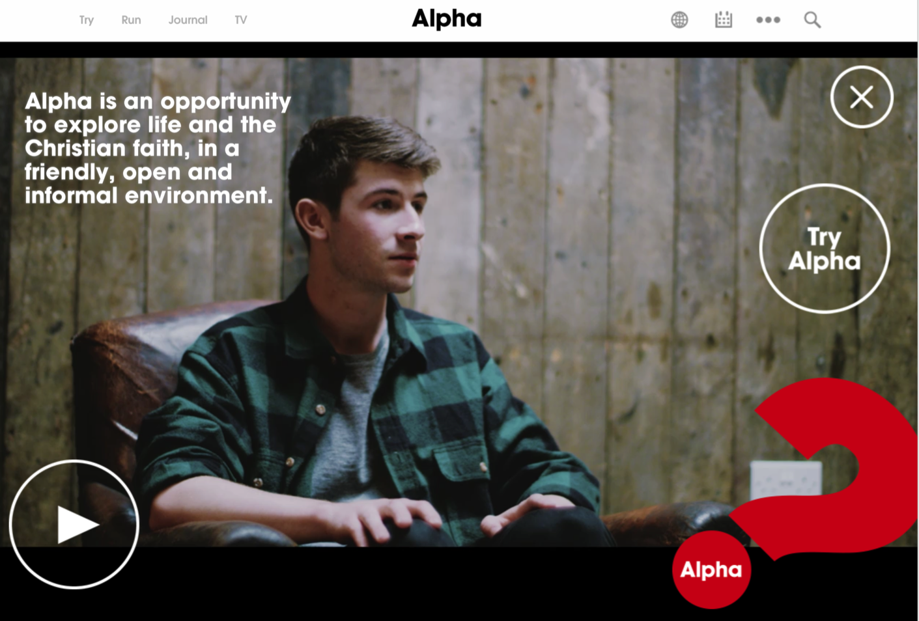

Slide 101
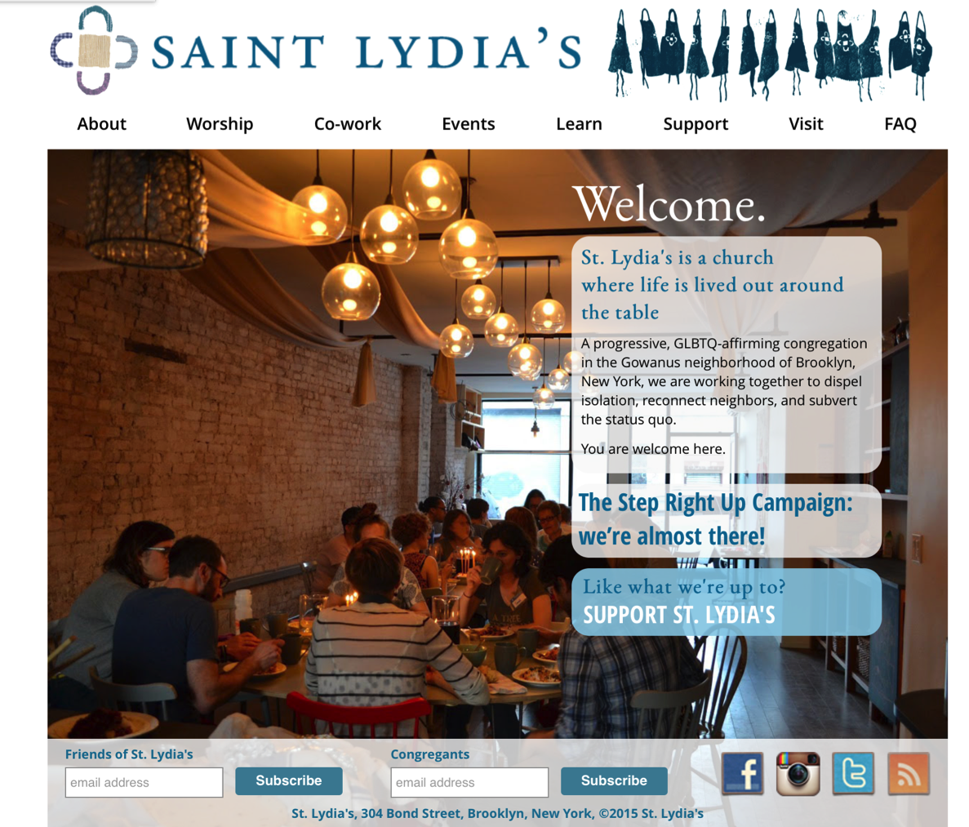

Slide 102
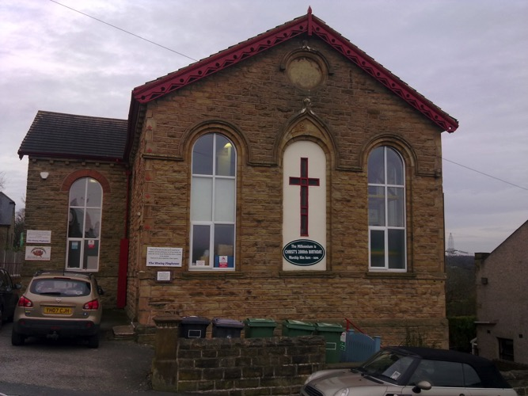
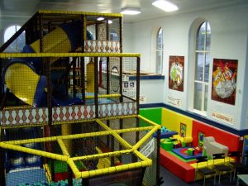
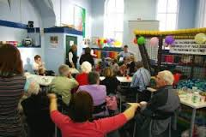
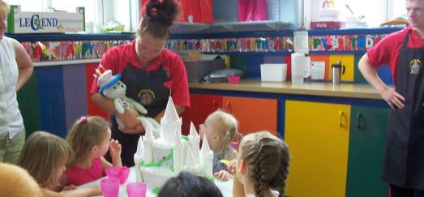
Wesley Playhouse UK

Slide 103

Online & Digitally Enabled

Slide 104

Missional Outreach

Slide 105

Missional Outreach
Invitation & Mentoring
Step 1. Prepare church leaders
Step 2: 40-day preparation for community members (study, prayer, worship, small groups)
Step 3: Invitation to one person & four-week small group experience with “taste & see” church experiences

