Slide 1
March 2016 Workshop
Center for Congregations
John Roberto
LifelongFaith Associates

Slide 2
March Workshop Topics
Reports from each church: projects and websites
Facilitating change: key steps to make change last
Website design and formatting; developing learning playlists
Evaluating faith formation programming and website content and design; using Google Analytics to assess website usage
Promoting the online resources and programming; connecting online with gathered programming
Connecting social media and the faith formation website
Learning how to find and curate digital faith formation resources
Preparing for summer 2016 programming

Slide 3


Resources
Website
www.ReimagingFaithFormation.com
Book

Slide 4
Faith Formation Networks
A network of relationships, content, experiences, and resources. . . .
Offering content and experiences to respond to the diverse religious and spiritual needs of people today—from the spiritually committed and engaged to the spiritual but not religious and the unaffiliated.
Offering a variety of content, methods, formats, and delivery systems (online & physical settings) to address the diverse life tasks and situations, needs and interests, and spiritual and faith journeys of people.
Offering multiple environments to address people’s busy lives and providing more ways to participate: self-directed, mentored, at home, in small groups, in large groups, church-wide, in the community, and in the world.

Slide 5
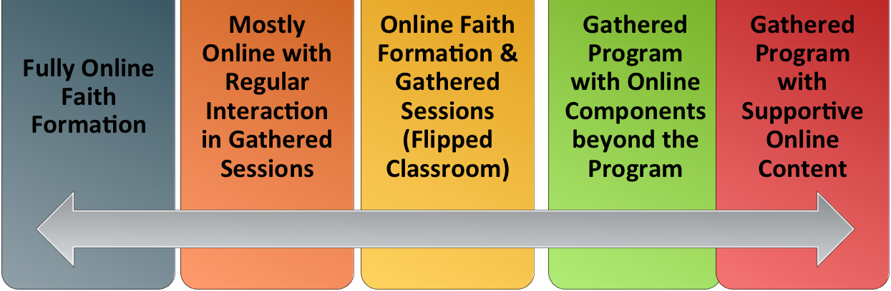
Faith Formation Networks
Digitally-Enabled
Blending gathered community settings with online learning environments and utilizing the abundance of digital media and tools for learning and faith formation

Slide 6
Design Network Themes
Caring Relationships
Celebrating the Seasons
Celebrating Rituals & Milestones
Learning the Christian Tradition
Praying & Spiritual Formation
Reading the Bible
Serving, Working for Justice, & Caring for Creation
Worshipping God
Missional
Life Stage Issues
Faith Community
Content Area
Content Area
Content Area
Content Area
Content Area
Content Area

Slide 7
Faith Forming Processes
GROWTH IN FAITH
Caring Relationships
Rituals & Milestones
Church Year Seasons
Worshipping
Learning the Tradition
Praying
Spiritual Formation
Reading the Bible
Serving Working for Justice Caring for Creation

Slide 8
Faith Enrichment
Sunday Worship
Adult Faith Formation Network
Grand-parents
Spiritual Enrichment
Life Issues & Milestones
Scripture Enrichment
Liturgical Seasons
Service & Mission
Discovering Faith

Slide 9
Family Faith Formation Network
For Parents
Seasons of the Year
Sunday Worship
@ Home
Reading the Bible
Serving
Growing as a Family
Learning the Faith
Celebrating Rituals & Milestones
Children’s Programs
Praying & Growing Spiritually

Slide 10
Digitally Enabled Faith Formation

Slide 11
Gathered using Online Content
A gathered program using online content from websites, videos from YouTube or other video sites, and blogs and other social media. With an abundance of high quality digital content, this first option is the easiest way to bring the digital world into a gathered program.

Slide 12
Gathered with Online Content
Connecting church programs or events with online content that extends and deepens the experience through learning, prayer, ritual, action, etc.
  Sunday worship & church year feasts and seasons
  Intergenerational & family programs
  Children, youth, and adult classes & programs
  Extended programs: mission trips, retreat experiences, and vacation Bible school, summer camp

Slide 13
Gathered with Online Content
Church Event or Program
At Home & Daily Life

Slide 14
Gathered with Online Content
Event or Program
TALK
Conversation Activities
LEARN
Read
Listen
Watch
ACT
Practices
Service
Projects
PRAY
Devotions Bible Reading Daily Prayer
SHARE
Blog Facebook
Video
Projects

Slide 15
Example: Sunday Worship
Church Life ➔ | Daily & Home Life | ⬅ Online Life
Experience of Worship in the Congregation Sunday worship and lectionary Church year feasts and seasons Church rituals: baptism, communion, funerals, etc. | Experience of Sunday worship, rituals, and church year seasons in daily life Reflecting on the sermon and readings at home Practices: Lectio, etc. Application to daily living | Online worship, church year, and lectionary resources on the church’s faith formation website Lectionary commentaries online Video reflections and commentary Online activities and projects

Slide 16
Online and Gathered
“Flip the classroom or program” by creating a digital platform to provide the content that people would learn in the gathered setting in an online learning space using print, audio, video, and more. And then transform the gathered program using interactive activities, discussion, project-based learning, and practice and demonstration.
    Flip children’s programming: At home learning with parents (print, video, online); in-class application with activities, project-centered learning
    Flip confirmation programming
    Develop a online justice and service center

Slide 17
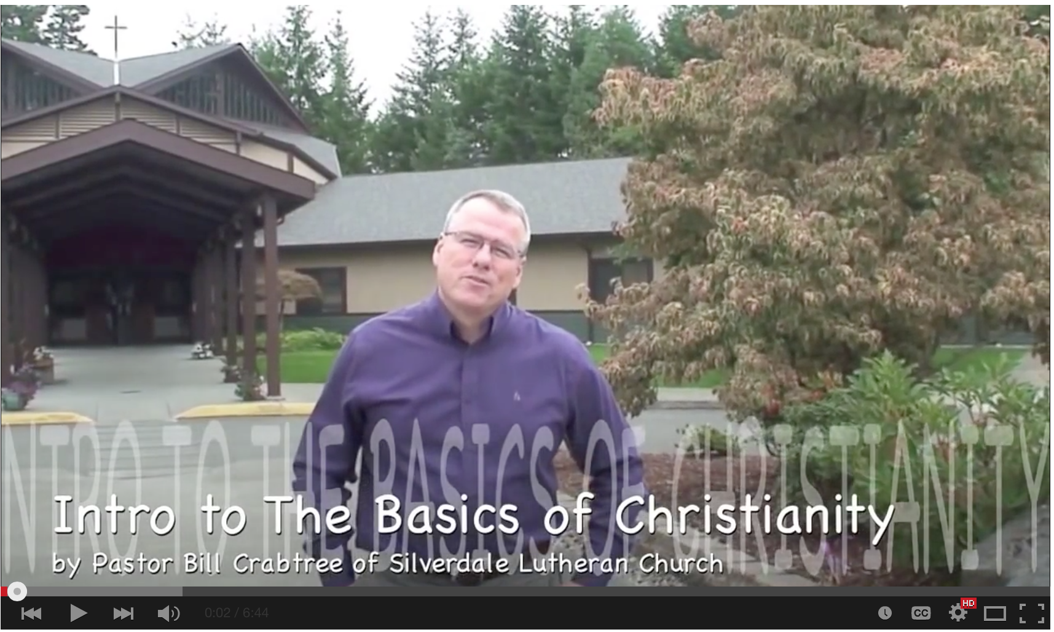
Online and Gathered

Slide 18
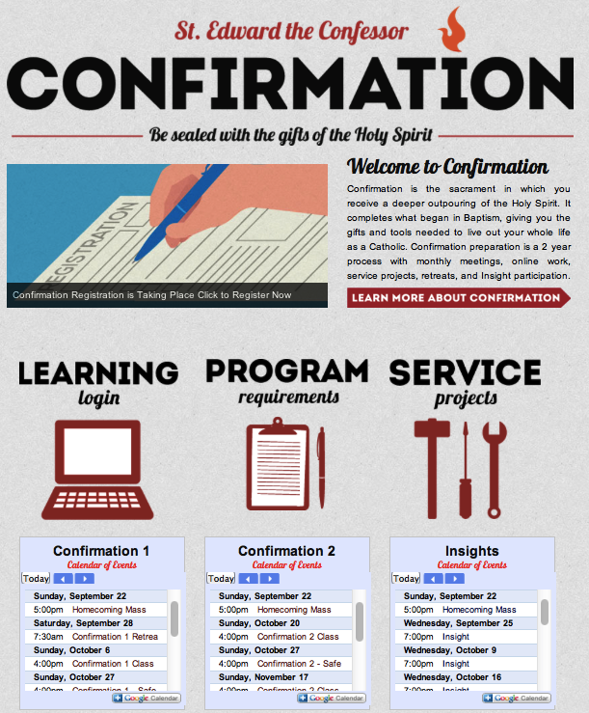
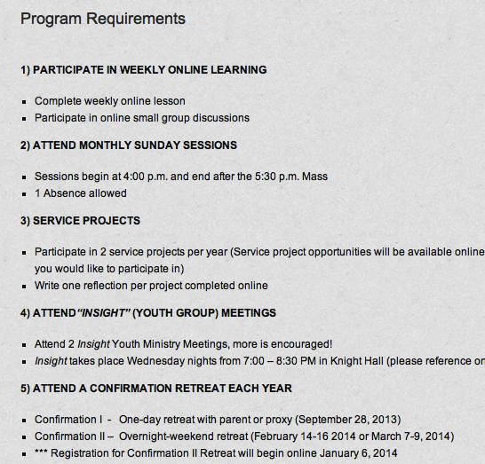
Online and Gathered

Slide 19
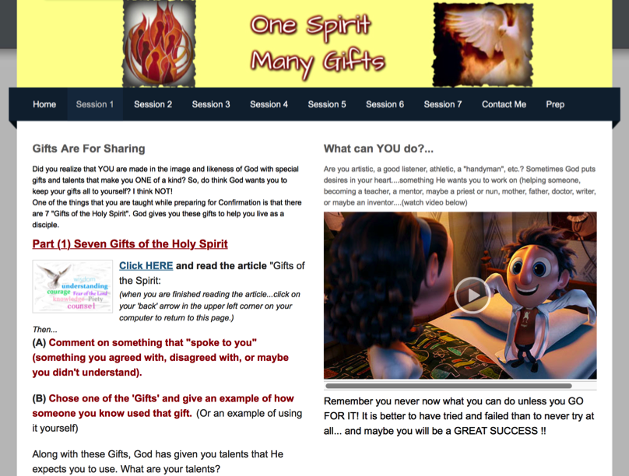
Online and Gathered

Slide 20
Mostly Online
Utilizing the digital platform as the primary learning setting and providing opportunities for interaction in gathered settings.
  Parent webinar programs delivered to parents at home in four-month semesters: three webinars + a parent gathering; three more webinars + a parent gathering.
  Online learning resources for self-study or small group study, and gathering at the conclusion to share their insights.
  Online Bible study where groups can meet regularly in a physical setting or virtually through Skype or a Google+ Hangout.
  Selected online courses and activities from colleges, seminaries, and religious organization for individualized learning with the option for a mentor or small group gathering.

Slide 21
Fully Online
The rise of high quality and easily accessible online religious content—courses, activities, print and e-books, audio and video programs, and content-rich websites—has made designing online faith formation feasible.
  Online Bible and theology courses, video programs, webinars for individual study
  Online prayer and spirituality center where people can access daily prayer reflections and devotions, offer prayer intentions, pray for others, learn about spiritual practices, download prayer activities for the home
  Online parent resource center
  Online retreat experience

Slide 22
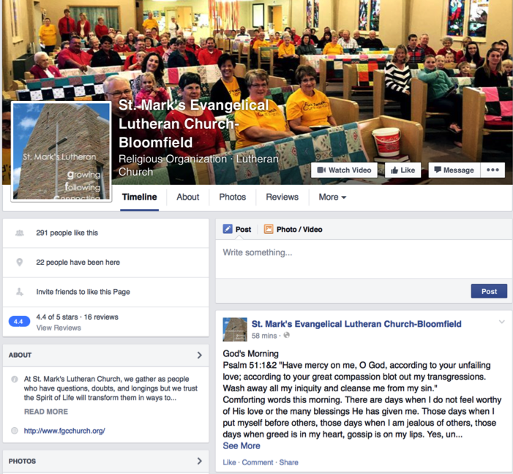
St. Mark’s
Daily Devotion

Slide 23
Example: 40-Day Lent Curriculum
Church Life ➔ | Daily & Home Life | ⬅ Online Life
Ash Wednesday Lenten Sunday liturgies Stations of the Cross Lenten prayer Lenten retreat Lenten service Lenten soup suppers | Fasting Praying Service/Almsgiving Lectionary reflection Family activities | Lenten learning resources Lenten calendar Daily Lenten prayer Weekly table prayer Video resources Online retreat experience

Slide 24
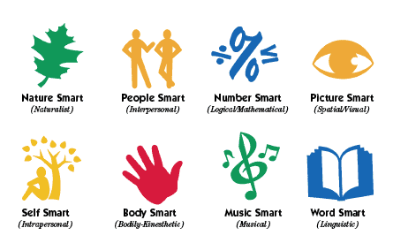
Faith Formation Playlists
Variety of Environments: Self-directed, mentored, at home, in small groups, in large groups, church-wide, in the community, and in the world.
Variety of Ways to Learn

Slide 25
Faith Formation Playlists
Digitally-Enabled: Blending gathered community settings with online learning environments and utilizing the abundance of digital media and tools for learning and faith formation

Slide 26
Developing a Playlist
Theme or Content Area
Activity 1
Resource
Resource
Activity 3
Resource
Resource
Activity 2
Resource
Resource

Slide 27
Family Faith Formation Network
For Parents
Seasons of the Year
Sunday Worship
@ Home
Reading the Bible
Serving
Growing as a Family
Learning the Faith
Celebrating Rituals & Milestones
Children’s Programs
Praying & Growing Spiritually

Slide 28
Family Faith Formation Playlist
Playlists are thematic learning plans that integrate a variety of ways to learn, multiple learning environments, and online and physical spaces—from which people can create their own plan.
Example: Just for Parents
The "Just for Parents" programming offers a variety of ways for you to enhance and enrich your knowledge and skills:
"First Wednesdays" Webinar Series - without leaving your home!
Learn More About Your Children
Book Groups: The Secrets of Happy Families by Bruce Feiler
Online Video: "Parenting for the Long Haul"

Slide 29
Adult Faith Formation Playlist
Spiritual Enrichment
Online Courses
Retreats
Small Group Bible Study
Spiritual Book of the Month
Spiritual Practices Series
Apps & E-newsletters
Day at the Monastery
Online Prayer & Spirituality
Resource
Resource
Resources
Resources
Resource
Resource
Resource
Resource

Slide 30
Adult Faith Formation Playlist
Playlists are thematic learning plans that integrate a variety of ways to learn, multiple learning environments, and online and physical spaces—from which people can create their own faith formation plan.
Example: Spiritual Enrichment for Adults
Theme: “Spiritual Practices”
Spiritual Practices Course (5 sessions at church in one month)
Spirituality Over 50 Book Group (variety of times & places)
Online Daily Devotion Resources
Online Prayer Practices Resources
Online Course or Retreat with a Spiritual Master
Online Retreat
Website: http://holytrinityadults.weebly.com

Slide 31
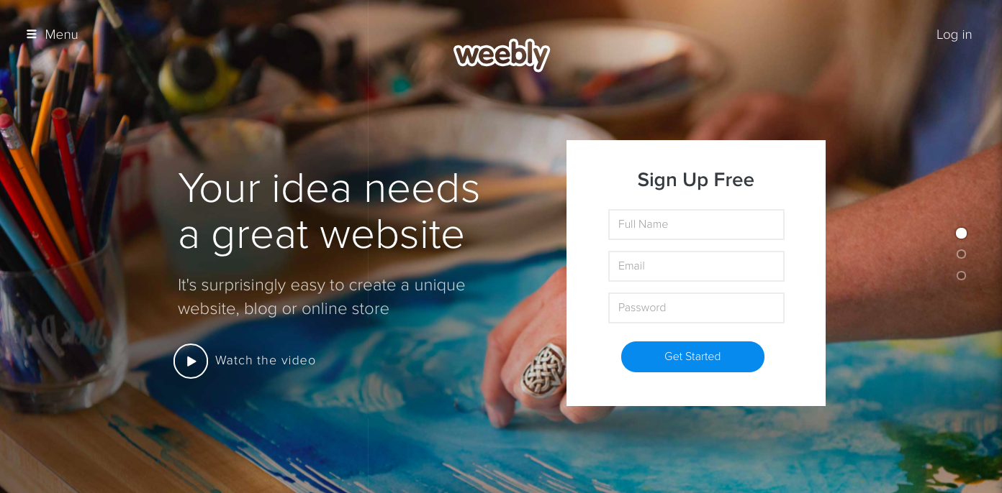
Digital Platform
Other Platforms
www.wordpress.org www.wix.com www.squarespace.com

Slide 32

Things to Remember…
Don’t make the user think—make web pages self-explanatory so the user hardly has any perceived effort to understand them, for example, clear choice of labels, clearly “clickable” items, simple search.
People generally don’t read web pages closely; they scan, so design for scanning rather than reading.
Create a clear visual hierarchy and menu system (main menu, submenus).
Make it very clear how to navigate the site, with clear “signposts” on all pages.
Omit needless words.
The home page needs the greatest design care to convey site identity and mission.
Promote user goodwill by making the typical tasks easy to do, make it easy to recover from errors, and avoid anything likely to irritate users.

Slide 33
Test the Plan & Website
Let your user experience the network online. Show don’t tell. Let them review the website and the programming. Just the minimum context so they understand what to do. (Have computers or tablets available for people to use or ask them to bring a device.)
Have them talk through their experience, e.g., “Tell me what you are thinking as you are doing this.”
Actively observe. Watch how they use (and misuse!) the website. Don’t immediately “correct” what your user is doing.
Follow up with questions, such as: “Show me why this would (or would not) work for you.” “Can you tell me more about how this made you feel?” “Why? “ “Do you find things that interest you and connect with your life?” “Are there things you would have liked to see?”

Slide 34
Launch the Network
Be sure to pay careful attention to the titles and descriptions so that they capture people’s interests. Develop descriptions that are positive in tone, indicate clearly the content or focus of an activity.
Describe how your offerings respond to something within the lives of people. Highlight the relationship between the content and the particular spiritual or religious needs, interests, passions, concerns, or life issues of people.
Describe the 2-3 benefits of participating or engaging in faith formation.
Explain to people how to use the Network and how to access the activities and resources.

Slide 35
Promotion Ideas
Connect to (or extend from) a gathered event.
Use personalized invitations.
Establish a Facebook page for faith formation for announcements, updates, stories and photos from people engaged in faith formation, etc.
Use Twitter to announce updates, events, and invite reflections from people on their experiences.
Send email or e-newsletters to targeted groups (use a service like Constant Contact, Mail Chimp, Flocknote).
Provide ways to share experiences using blogs, Twitter, Facebook: videos, reports, photos, etc.

Slide 36
Connect to Social Networks
Our social network is made up of all the people we’re connected to, all the people they are connected to, all the people they are connected to, and so on.
You
Your Friends
Your Friends
Your Friends’ Friends
Your Friends’ Friends
Your Friends’ Friend’s Friends
Your Friends’ Friend’s Friends
Your Friends’ Friend’s Friends
Your Friends’ Friends
Your Friends’ Friends

Slide 37
Step 9. Evaluate Programming

Slide 38
Evaluation
Level 1: Reaction: How do participants react to the program, or better, what is the measure of their satisfaction?
Level 2: Learning: To what extent has learning occurred?
Level 3: Behavior: The what extent has behavior changed as a result of the program?
Level 4: Results: To what extent have results occurred because of the program?

Slide 39
Seasonal Planning
Fall Season:
September 1 – January 1
Winter/Spring Season: January 1 – May 1
Summer Season:
May 1 – September 1
Fall
Winter-Spring
Summer

