Slide 1
Digitally-Enabled & Online Faith Formation
John Roberto www.LifelongFaith.com

Slide 2
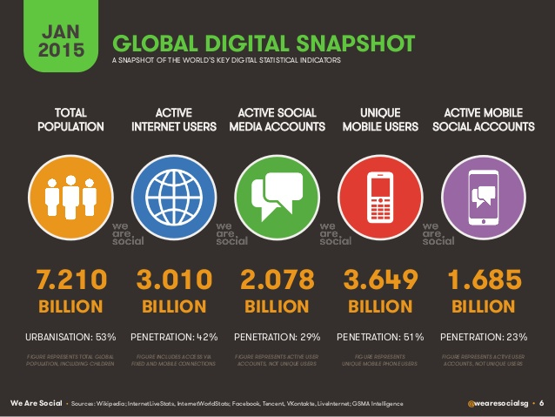

Slide 3
Triple Revolution
Internet Revolution
Mobile Revolution
Social Media Revolution
Information is now. . .
Portable
Personal
Participatory

Slide 4
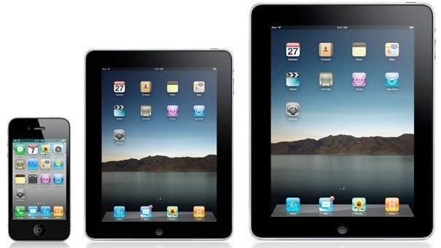
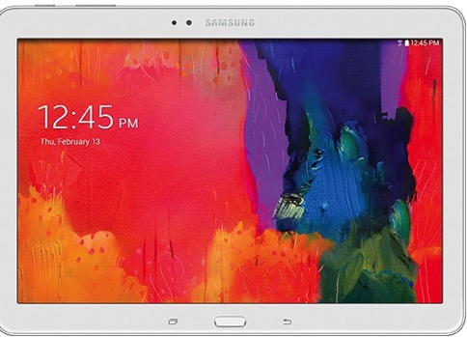
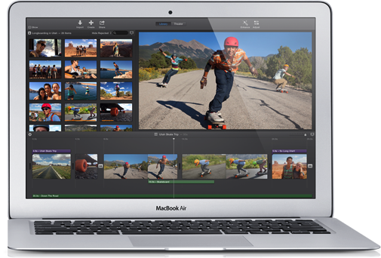
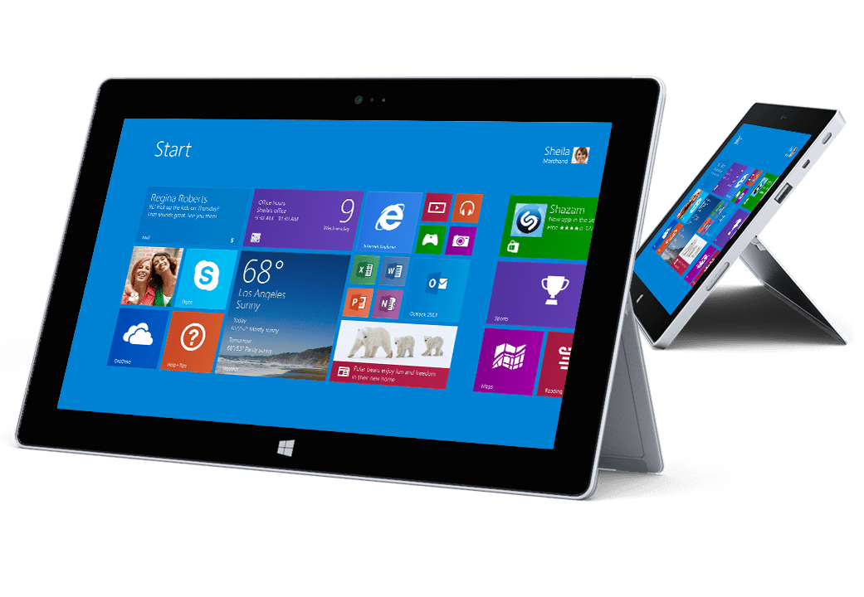

Slide 5
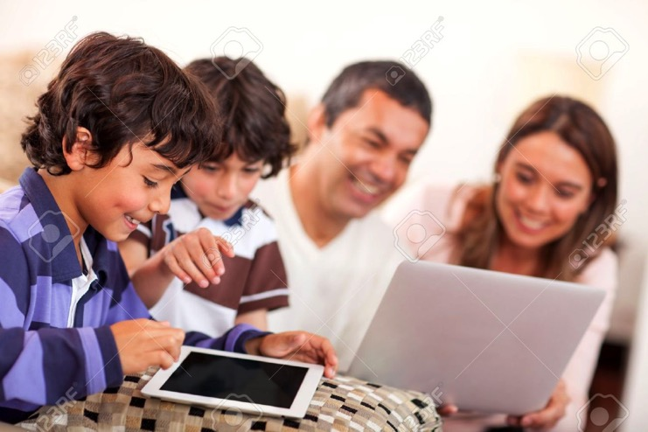
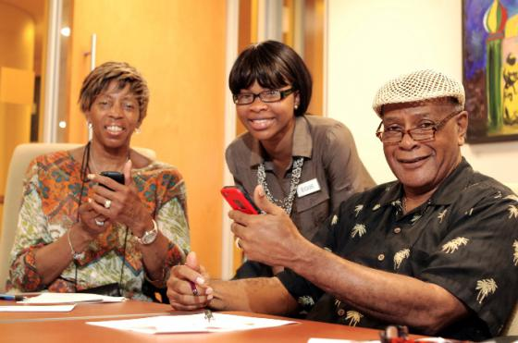
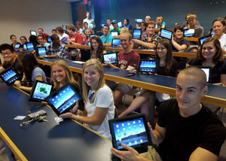

Slide 7
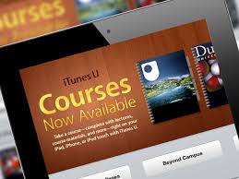

Slide 8
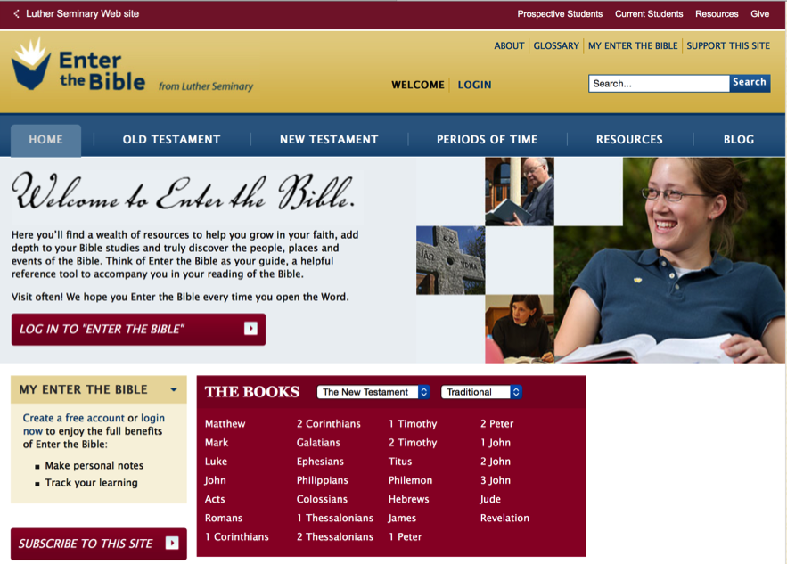
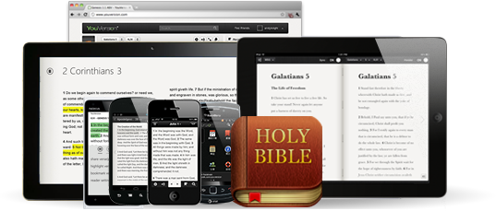
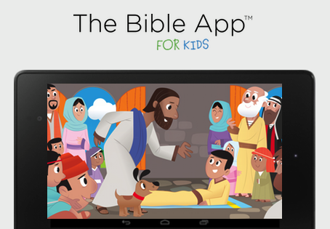

Slide 9
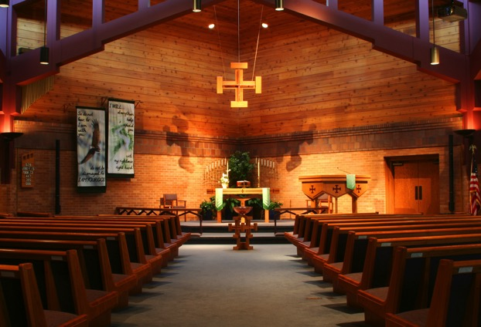
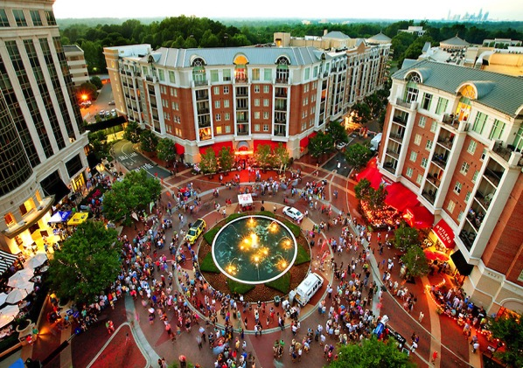

Slide 10
Digitally-Enabled Faith Formation
We now have the technology, online platforms, and digital content to:
engage people with a wide variety of faith forming content for all ages - anytime, any place
extend church events into people’s daily lives via online content and experiences
connect faith formation in gathered settings with faith formation in online settings
offer a variety of online faith formation content, experiences, and courses for self-study and small group study

Slide 11
Digitally-Enabled Faith Formation
Fully Online Faith Formation
Mostly Online with Regular Interaction in Gathered Sessions
Online Faith Formation & Gathered Sessions (Flipped Classroom)
Gathered Program with Supportive Online Content
Gathered Program with Online Components beyond the Program

Slide 12
Gathered with Online Content
A gathered program using online content from websites, videos from YouTube or other video sites, and blogs and other social media. With an abundance of high quality digital content, this first option is the easiest way to bring the digital world into a gathered program.

Slide 13
Gathered and Online Content
Connecting church programs or events with online content that extends and deepens the experience through learning, prayer, ritual, action, etc.
Sunday worship & church year feasts and seasons
Intergenerational & family programs
Children, youth, and adult classes & programs
Extended programs: mission trips, retreat experiences, and vacation Bible school, summer camp

Slide 14
Church Event or Program
At Home & Daily Life

Slide 15
Event or Program
TALK Conversation Activities
LEARN Read Listen Watch
ACT Practices Service Projects
PRAY Devotions Bible Reading Daily Prayer
SHARE Blog Facebook Video Projects

Slide 16
Example: Sunday Worship
Church Life ➔ | Daily & Home Life | ⬅ Online Life
Experience of Worship in the Congregation Sunday worship and lectionary Church year feasts and seasons Church rituals: baptism, communion, funerals, etc. | Experience of Sunday worship, rituals, and church year seasons in daily life Reflecting on the sermon and readings at home Practices: Lectio, etc. Application to daily living | Online worship, church year, and lectionary resources on the church’s faith formation website Lectionary commentaries online Video reflections and commentary Online activities and projects

Slide 17
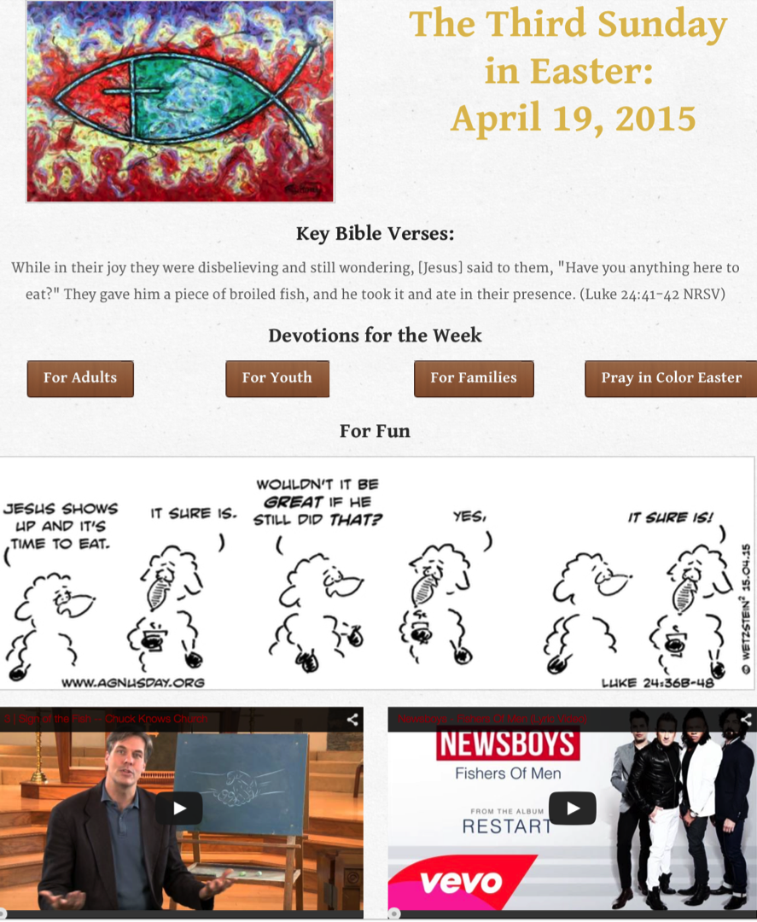

Slide 18
Example: 40-Day Lent Curriculum
Church Life ➔ | Daily & Home Life | ⬅ Online Life
Ash Wednesday Lenten Sunday liturgies Stations of the Cross Lenten prayer Lenten retreat Lenten service Lenten soup suppers | Fasting Praying Service/Almsgiving Lectionary reflection Family activities | Lenten learning resources Lenten calendar Daily Lenten prayer Weekly table prayer Video resources Online retreat experience

Slide 19
Online and Gathered
“Flip the classroom or program” by creating a digital platform to provide the content that people would learn in the gathered setting in an online learning space using print, audio, video, and more. And then transform the gathered program using interactive activities, discussion, project-based learning, and practice and demonstration.

Slide 20
Online and Gathered
Flip children’s programming: At home learning with parents (print, video, online); in-class application with activities, project-centered learning
Flip confirmation programming
Develop a online justice and service center

Slide 24
Mostly Online
Offering opportunities for individuals, families, and small groups to utilize the digital platform as their primary learning setting and provide opportunities for regular interaction in face-to-face, gathered settings or in a web conference format, such as a Google+ Hangout.
Parent webinar programs delivered to parents at home in four-month semesters: three webinars followed by a parent gathering at church; three more webinars and concluding with a parent gathering at church.

Slide 25
Mostly Online
Online learning resources for self-study or small group study, and gathering at the conclusion to share their insights with others who participated.
Online Bible study where groups can meet regularly in a physical setting or virtually through Skype or a Google+ Hangout for sharing their learning.
Selected online courses and activities from colleges, seminaries, and religious organization for individualized learning with the option for a mentor or small group gathering.

Slide 26
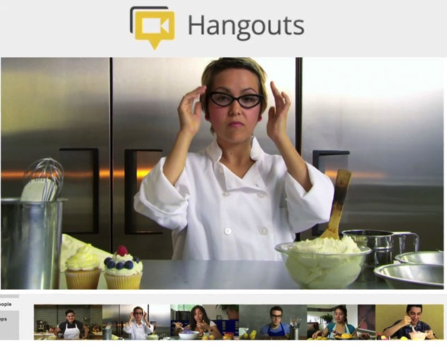
Web Conferencing
Online Course, Small Group, Workshop, or 1-1 Mentoring
Broadcast a Presentation
Record the Presentation

Slide 27
Fully Online
The rise of high quality and easily accessible online religious content—courses, activities, print and e-books, audio and video programs, and content-rich websites—has made designing online faith formation feasible.
Online Bible and theology courses, video programs, webinars for individual study

Slide 28
Fully Online
Online prayer and spirituality center where people can access daily prayer reflections and devotions, offer prayer intentions, pray for others, learn about spiritual practices, download prayer activities for the home
Online parent resource center with the best knowledge, practices, and tools for parenting (print, audio, video)
Online retreat experience

Slide 29
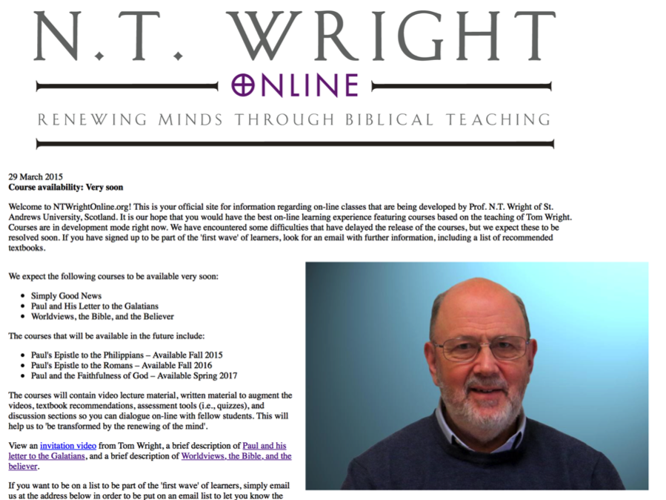

Slide 30
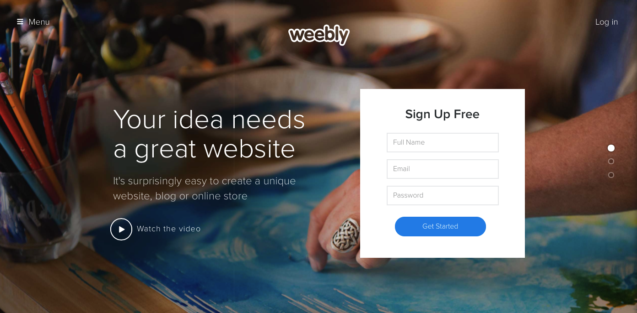
Digital Platform
Other Platforms
www.wordpress.org www.wix.com www.squarespace.com

Slide 31
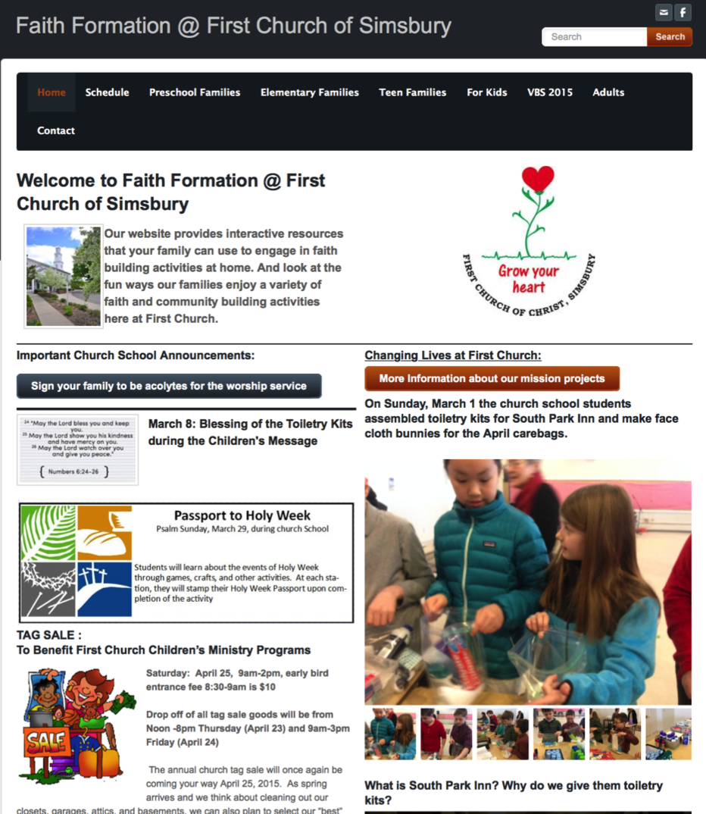

Slide 32
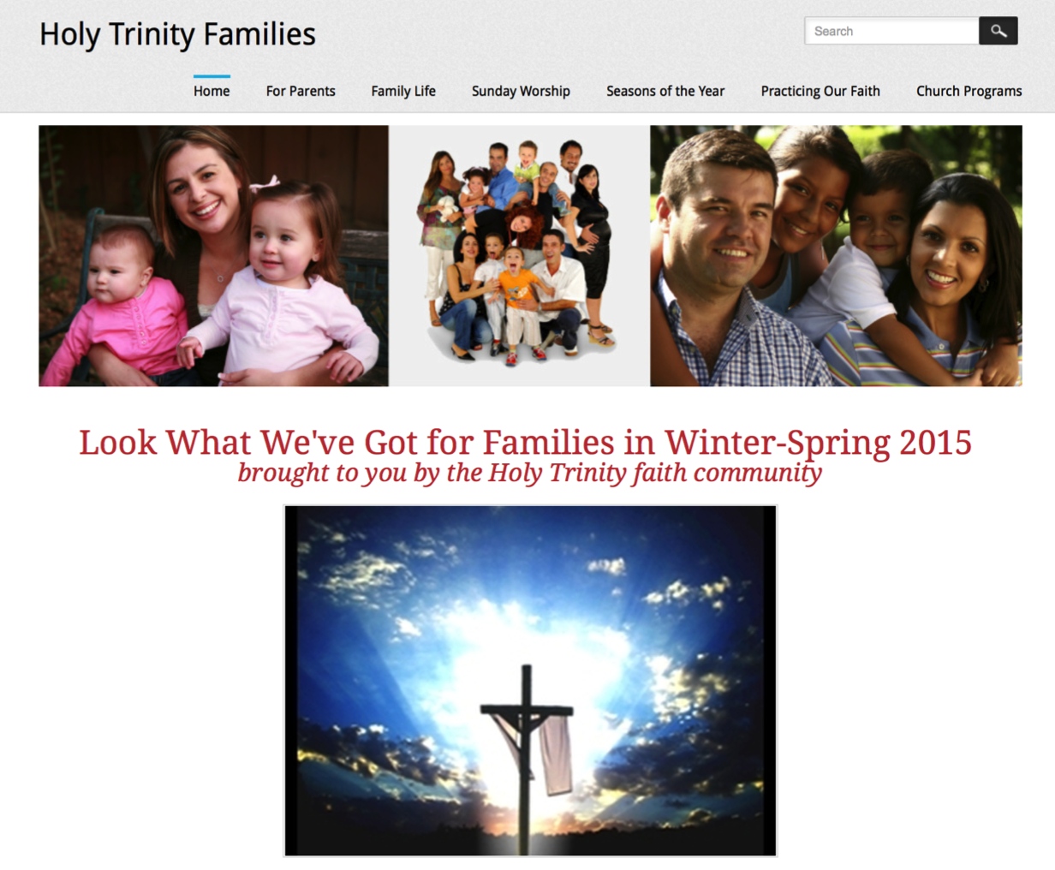

Slide 33
