Slide 1



Faith Formation in a Missional Age
John Roberto, LifelongFaith Associates

Slide 2
Faith Formation in a Missional Age
Changing World, Adaptive Faith Formation
Envisioning 21st Century Faith Formation
Bringing the Vision to Life

Slide 3
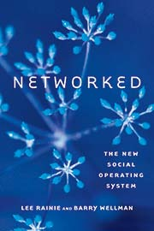



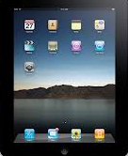
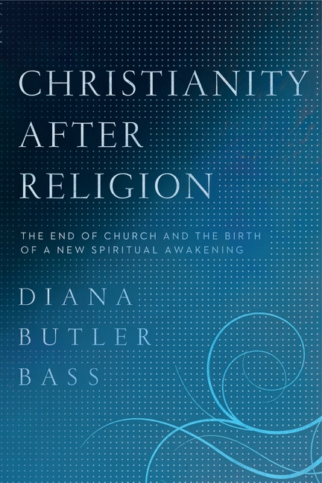



We are living in a historical moment of transformations in religion, technology,
generations, culture & society.

Slide 4
We are living in the midst of a convergence of forces moving us toward a new model.
21st Century Faith Formation
Diversity of Religious Belief & Practice
Generational Change
Millennials & iGeneration
New Models of Learning
New Digital Technologies
Abundance of Resources

Slide 5



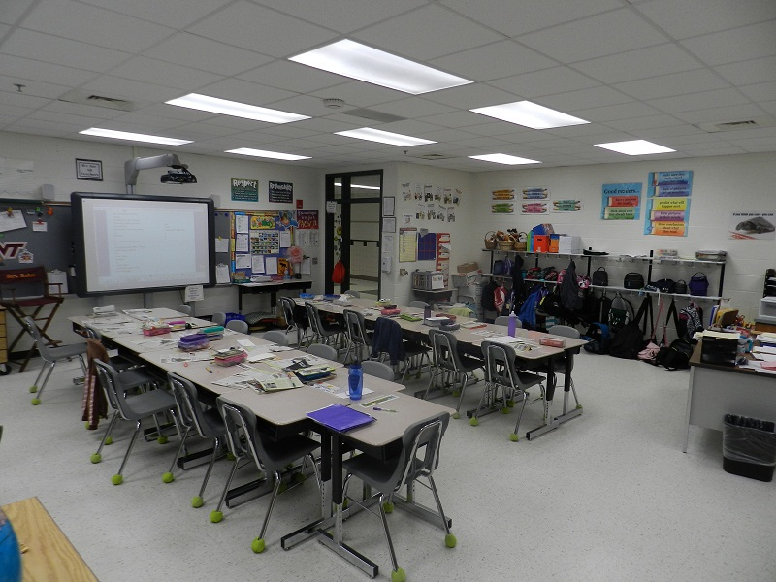
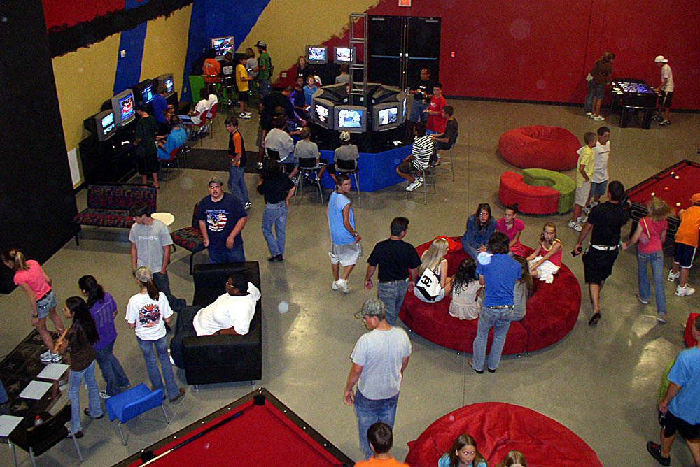
The changing world is putting tremendous pressure on the effectiveness of older models of faith formation.

Slide 6
21st Century Faith Formation
We need new models of faith formation & learning suited to this historic moment, and not simply enhancements or makeovers of existing models that were developed in the 19th and 20th century.

Slide 7
A New Model Needs to Address
Diversity: The spiritual and religious diversity of all young people & the parents
Networked & Connected Society: The rise of social networks and connected learning
A Lifelong Approach: 10 Decades of Faith Formation
Discipleship: An understanding of discipleship in a connected, networked, digital 21st century world

Slide 8
1. Diversity

Slide 9

Religious Diversity
20% of Americans claim no religious affiliation
32% of 18-29 year olds
18% of 18-39 year olds say that are “spiritual, but not religious”

Slide 10
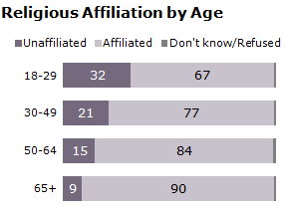

Slide 11
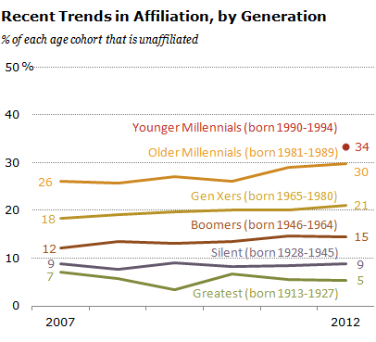

Slide 12
Religious Diversity
According to Pew Research, Americans do not generally become more affiliated as they move through the life cycle from young adulthood through marriage, parenting, middle age and retirement.

Slide 13
Religious Diversity
With few exceptions the unaffiliated say they are not looking for a religion that would be right for them. Overwhelmingly, they think that religious organizations are too concerned with money and power, too focused on rules and too involved in politics.

Slide 14
Religious Diversity
The number of religiously unaffiliated is growing . . . .
    because of Americans who rarely go to services are more willing than in the past to drop their religious attachments altogether.
    because of generational replacement, the gradual supplanting of older generations by newer ones.

Slide 15
Religious Diversity
Vibrant Faith
& Active Engagement in the Community
Minimal Engagement with Faith and the Community
Not Religiously Affiliated
Spiritual but Not Religious

Slide 16
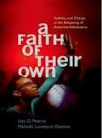
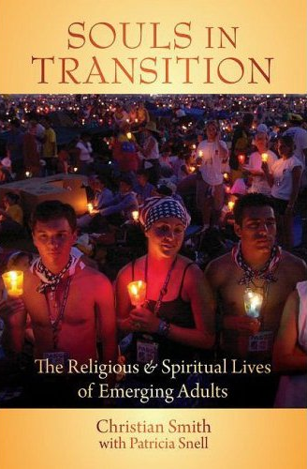
Religious Diversity
Youth (teens)
Abiders Adapters Assenters Avoiders Atheists
20% 20% 31% 24% 5%
Emerging Adults (20s)
Committed Selected Spiritually Religiously Religiously Irreligious Traditionalists Adherents Open Indifferent Disconnected
15% 30% 15% 25% 5% 10%

Slide 17
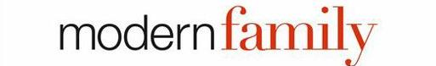


Family Diversity
The 1950s Family
The 2010s Family

Slide 18
Family Diversity
 | A Family | Not a Family
Married Coupled with Children | 99 | 1
Married Couple without Children | 88 | 10
Single Parent with Children | 86 | 12
Unmarried Couple with Children | 80 | 18
Same-Sex Couple with Children | 63 | 34
Same-Sex Couple without Children | 45 | 52
Unmarried Coupled without Children | 43 | 54
Pew Research, 2011

Slide 19
New Models Will Need to. . . .
Move away from a reliance on “one size fits all” programs
Develop differentiated, personalized, & customized faith formation around the diversity of people’s lives & faith
Create personalized pathways for discipleship & faith growth
Address spiritual and religious diversity by offering a wide variety of religious content & experiences

Slide 20
2. Connected & Networked

Slide 21

A Connected, Networked World
EMBEDDED

Slide 22

A Connected, Networked World
EMBEDDED
SOCIAL NETWORKS

Slide 23
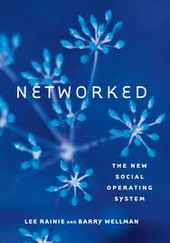
Connected & Networked World
The Triple Revolution
Social Network Revolution
Internet Revolution
Mobile Revolution
It is a network of both relationships and information & knowledge.

Slide 24
Connected, Networked World
The Social Network, Internet, and Mobile Revolutions are coming together to shift people’s social lives away from densely knit family, neighborhood, and group relationships toward more far-flung, less tight, more diverse personal networks.

Slide 25
Networked Individualism
Networked Individualism
The three revolutions have made possible the new social operating system – Networked Individualism. The hallmark of networked individualism is that people function more as connected individuals and less as embedded group members.

Slide 26
Networked Individuals
Individual
Life Stage
Work
Sports & Activities
Interests
Shared Experiences
Family & Friends
Education

Slide 27
Information is Woven Into Our Lives
Mobile is the needle, Social Networks are the thread
Mobile…
Moves information with us
Makes information accessible ANYTIME and ANYWHERE
Puts information at our fingertips
Magnifies the demand for timely information
Makes information location-sensitive
Social Networks…
Surround us with information through our many connections
Bring us information from multiple, varied sources
Provide instant feedback, meaning and context
Allow us to shape and create information ourselves and amplify others’ messages

Slide 28







Connected, Networked Technologies

Slide 29
Connected, Networked Learning
Young people today have the world at their fingertips in ways that were unimaginable just a generation ago. World renowned lectures, a symphony of voices and opinions, and peer-to-peer learning opportunities are all a click away.
Youth can not only access a wealth of knowledge online, they can also be makers, creators, participants and doers engaged in active and self-directed inquiry.

Slide 30
A Connected Model
Diversity of Religious & Spiritual Needs
Personalized & Customized Pathways for Growth
A Variety of
Faith Formation Content & Experiences, People & Resources

Slide 31

Youth Faith Formation
Network
Service Projects Mission Trips
Parent-Teen Relationships
Prayer &
Spiritual Formation
Leadership
Peer Relationships
Adolescent Life Issues
Bible Study & Religious Learning
Inter-generational Connections

Slide 32

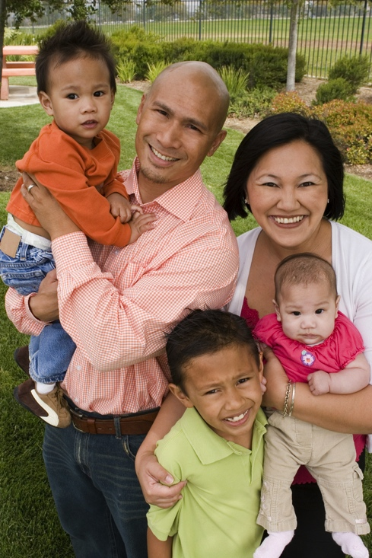
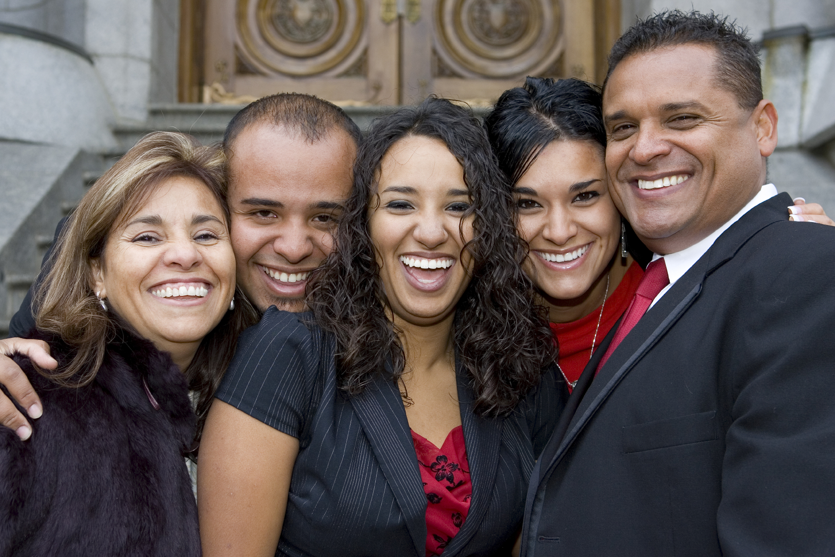
#3. Becoming Lifelong

Slide 33
10 Decades of Lifelong Faith Formation
0-10
50s
20s
30s
40s
60s
70s
80s
90s
11-19

Slide 34
1st Third of Life Faith Formation
Build the Foundations
Explore the World
Create Fresh Expressions
Socialization & faith practices
Whole family & intergenerational faith formation
High quality, diverse faith formation experiences
Exploring & discerning
Guides & mentors
Parent formation
Engaging in creating fresh expressions of faith and spirituality
Embodying these expressions in new forms of communal life

Slide 35
Factors Promoting Faith Growth
The combination of the following factors makes an enormous difference in religious outcomes during emerging adulthood:
  the teenager’s parental religion
  importance of faith
  prayer
  Scripture reading
  lack of religious doubts
  personal religious experiences
  having supportive nonparent adults in the church
These most influential factors make differences of sizeable magnitude in substantive outcomes.

Slide 36
Factors Promoting Faith Growth
Approximately 70% of youth who at some time or other before mid-emerging adulthood commit to live their lives for God, the vast majority appear to do so early in life, apparently before the age of 14.
Most make their first commitments to God as children or during the preteen or very early teen years.
Many religious trajectories followed in the course of life’s development seemed to be formed early in life.

Slide 37

First Decade: Foundations
  Religious socialization through the congregation & family. . . .
  Internalization of faith practices
  Whole family learning
  Immersion into the faith life of the church community with robust intergenerational experiences of worship, learning, & service
  Parent faith formation: growing in faith, modeling the Christian faith, and teaching their children

Slide 38
First Third Faith Formation
Praying
Caring Conversation
Reading the Bible
Celebrating Rituals
Serving Others
Learning & Applying Faith to Daily Life

Slide 39

Second Decade: Exploration
Exploration experiences & discernment
  An adventure of local and global explorations into the Bible, Christian tradition, worship, justice, service, ministry, leadership. . . .
  Informed and trustworthy adults who serve as tour guides and companions on the journey of exploration
  Youth as the creators of religious content and experiences

Slide 40

Second Decade: Exploration
Churches and families wanting to instill deep faith in youth should help them build a web of relationships with committed and caring adults.
Becoming a 5:1 Church
5 Adults to 1 Young Person
in
Worship, Teaching, Mentoring, Rituals, & Community Life

Slide 41

Second Decade: Exploration Experiences
Global Church
Local Church Life & Ministries:
Worship
Service
Leadership
Pastoral Care
Inquiry Learning: Bible, Christian beliefs, history and tradition
World Religions
Online Learning Resources:
People
Audio & Video
Conferencing
Virtual Tours
Ministry & Leadership Apprenticeships

Slide 42
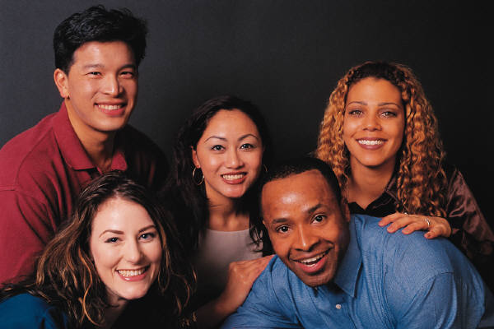
Third Decade: Fresh Expressions
A living & learning laboratory to create fresh expressions of the Christian faith that both honor the tradition and reflect the millennial generation’s perspectives.
Fresh expressions of the Biblical message, Christian teachings & practices, spiritual disciplines, worship, art and music, mission to the world, church community. . . .
A generational faith community that embodies these expressions & is still connected to the intergenerational church community

Slide 43
4. Discipleship
Becoming disciples of Jesus Christ in a connected, networked, digital world

Slide 44
21st Century Discipleship
What does it mean to be a follower of Jesus in a connected, networked, “post-modern,” technological world?
How do we understand the life, teachings, and praxis of Jesus in a 21st century world?
How do we practice the way of Jesus in a 21st century world?
How can we apprentice and mentor the younger generations in discipleship?

Slide 45
Faith as a Way of Life
The central challenge for pastoral ministry today concerns the most important mark of good ministry: the ability effectively to mediate faith as an integral way of life to persons, communities, and cultures.
(Miroslav Volf)

Slide 46
Faith as a Way of Life
. . . . the faith that people embrace is, arguably, shaping their lives less and less. For the most part, the faith seems not so much an integral way of life as an energizing and consoling aura added to the business of a life shaped by factors other than faith.
(Miroslav Volf)

Slide 47
Faith as a Way of Life
The smorgasbord culture is a challenge for communities of faith. But the main problem may be that communities of faith have not found effective ways to offer a compelling vision of an integral way of life that is worth living. Many people are seeking precisely that.
(Miroslav Volf)

Slide 48
A New Model Needs to Address
A Diverse World
A Networked & Connected Society
A Lifelong Approach—10 Decades of Life
21st Century Discipleship

Slide 49
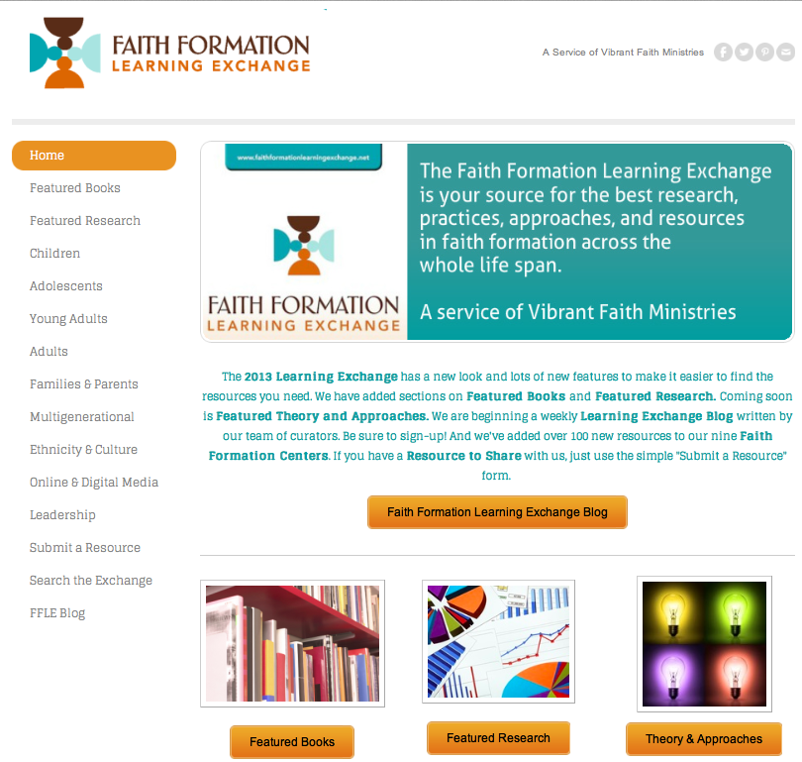
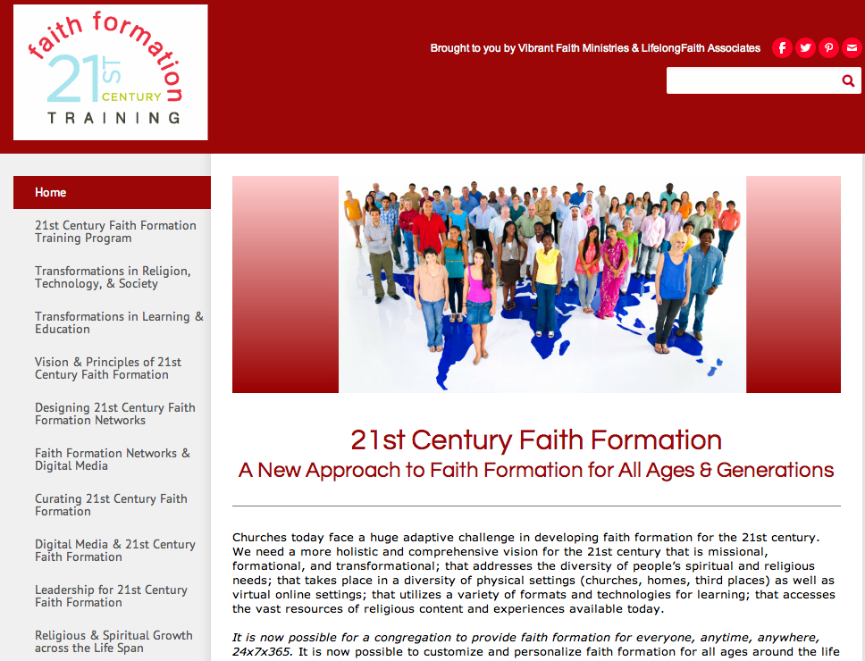

Slide 50
On the Threshold of a New Era in Faith Formation

