Slide 1



Slide 2
John Roberto
LifelongFaith Associates jroberto@lifelongfaith.com www.LifelongFaith.com www.ReimagineFaithFormation.com
SeasonsofAdultFaith.com
FamiliesattheCenter.com

Slide 3

www.ReimagineFaithFormation.com

Slide 4
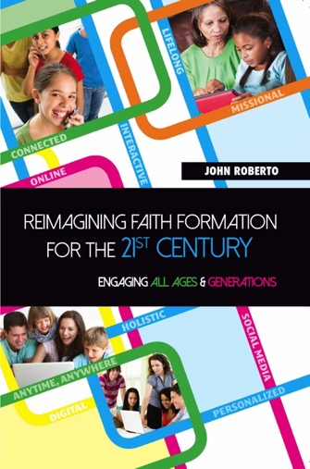
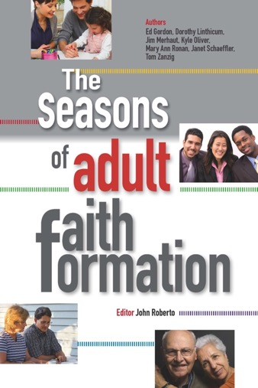
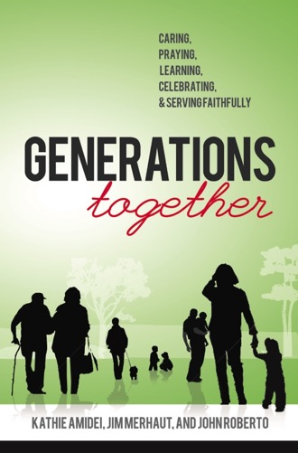
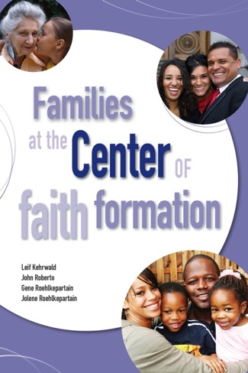
Lifelong Faith Books
$6 discount (shipping)
Coupon Code: Fordham

Slide 5
Not Just an Era of Change but a Change of Eras

Slide 6

Exploring Trends

Slide 7

Life Span Diversity
0-10
50s
20s
30s
40s
60s
70s
80s
90s
11-19

Slide 8

Five Generation Diversity
iGeneration (2000-
Millennials (1980-99)
Generation X (1961-1979)
Builders (before 1946)
Baby Boomers (1946-60)

Slide 9

Family Diversity
Married Couple + No Children
Married Couple + Children (biological or blended)
Single Parent + Children
Unmarried Couple + Children or No Children
Same Sex Couple + Children or No Children
Multigenerational Family (young adult, grandparents)
Grandparents as Primary Caregivers

Slide 10
Spiritual-Religious Diversity
The Unaffiliateds
The
Spirituals
The Occasionals
The
Actives

Slide 11
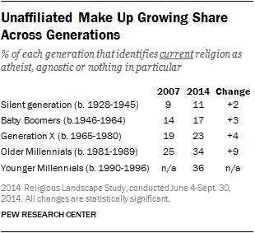
Spiritual-Religious Diversity

Slide 12
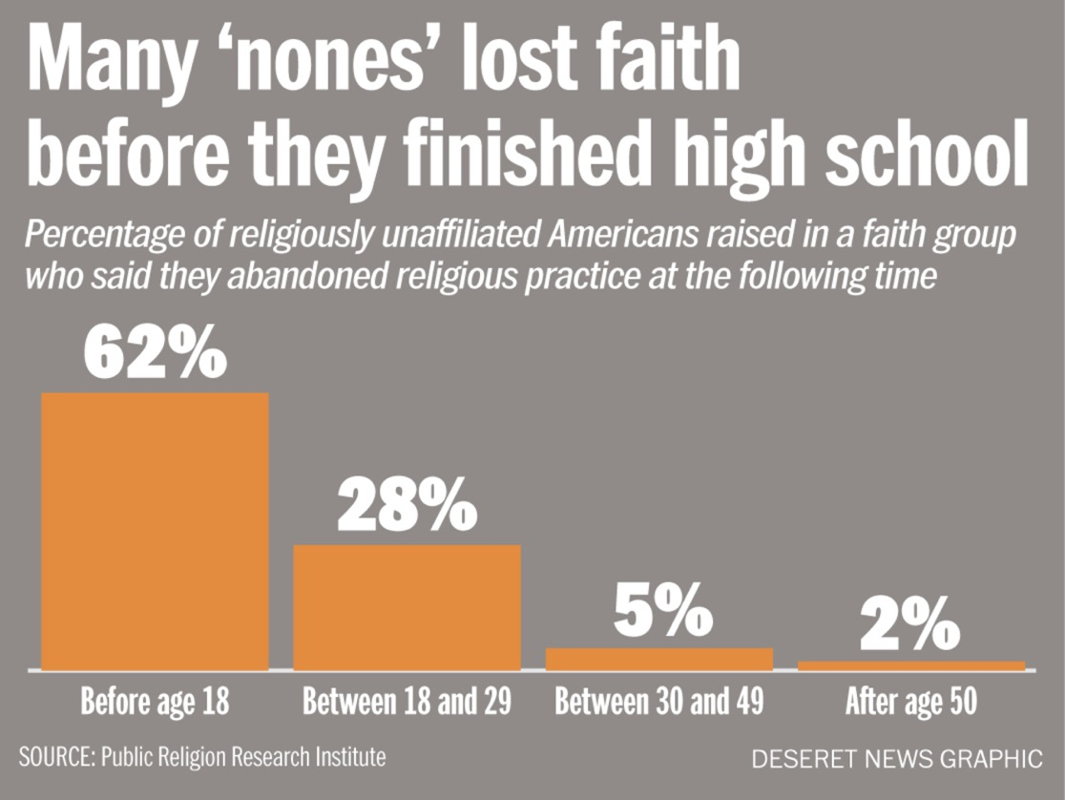
Spiritual-Religious Diversity

Slide 13
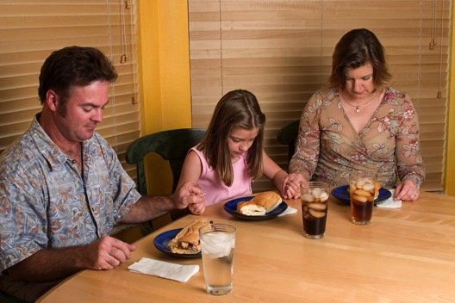
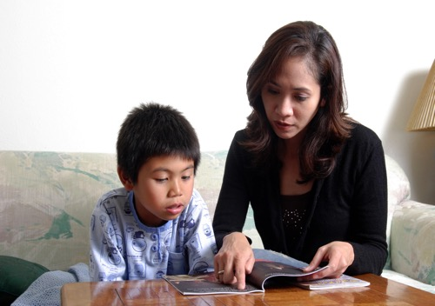
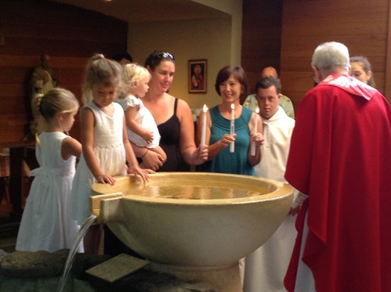
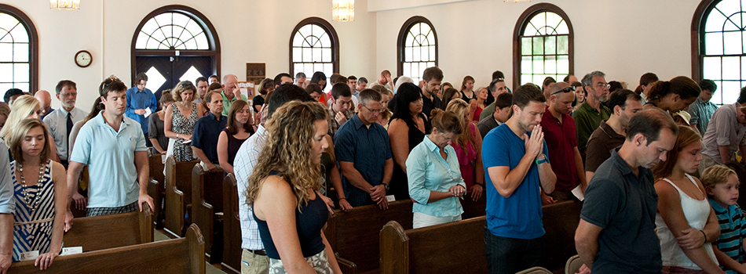
Decline in Religious Socialization

Slide 14
Decline in Religious Practice
Significant indicators, such as religious identification as a Christian, worship attendance, marriages and baptisms in the church, and changing generational patterns, point to a decline in family religious socialization across all denominations.
There is also a decline in religious traditions and practices at home. Gen X and Millennial parents often lack the religious literacy and religious experiences necessary for faith transmission.

Slide 15
The Adaptive Challenges of
21st Century Faith Formation
Ten decades of the life cycle
Five unique generational identities
Diverse family forms and styles
Diverse spiritual-religious identities of people
Decline in religious transmission (at home) and decline in participation in church life and programs

Slide 16
Reimaging. . . .
An Ecological View

Slide 17
An Ecological View of Faith Formation
1900s-1970s
Church
Family
Ethnic Tradition
Community

Slide 18
Faith Forming Ecosystem
Missional
Digitally enabled & connected
Inter-generational
Digitally enabled & connected
Family
Digitally enabled & connected
Life Cycle:
children, youth, young adults, midlife adults, mature adults, older adults
Digitally enabled & connected

Slide 19
Holistic Vision of Faith Formation
A way of the head (inform) demands a discipleship of faith seeking understanding and belief with personal conviction, sustained by study, reflecting, discerning and deciding, all toward spiritual wisdom for life.
A way of the heart (form) demands a discipleship of right relationships and right desires, community building, hospitality and inclusion, trust in God’s love, and prayer and worship.
A way of the hands (transform) demands a discipleship of love, justice, peace-making, simplicity, integrity, healing, and repentance.
(Thomas Groome)

Slide 20
Episcopal Church
(The Charter for Lifelong Christian Formation)
“Christian faith formation is a lifelong journey with Christ, in Christ, and to Christ. Lifelong Christian faith formation is lifelong growth in the knowledge, service and love of God as followers of Christ and is informed by scripture, tradition and reason.”
God Invites All People – into the Christian life
God Inspires All People – to worship, study Scripture, to learn, to serve
God Transforms All People – to do the work of Jesus, be a loving and witnessing community, prophetic action

Slide 21
Roman Catholic
National Directory for Catechesis
Christ’s method of formation was accomplished by diverse yet interrelated tasks. His example is the most fruitful inspiration for effective catechesis today because it is integral to formation in the Christian faith. Faith must be known celebrated, lived, and expressed in prayer. So catechesis comprises six fundamental tasks, each of which is related to an aspect of faith in Christ.
Promote Knowledge of the Faith
Liturgical Education
Moral Formation
Teaching to Pray
Education for Community Life
Missionary Initiative

Slide 22
A Comprehensive View:
Eight Faith Forming Processes
GROWTH IN FAITH
Caring Relationships
Rituals & Milestones
Church Year Seasons
Worshipping
Learning the Tradition
Praying
Spiritual Formation
Reading the Bible
Serving Working for Justice Caring for Creation

Slide 23


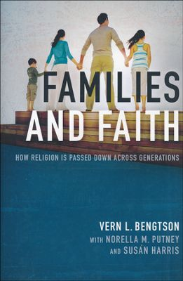
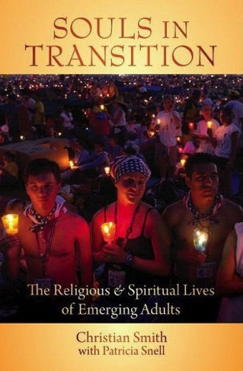
Several Key Research Studies

Slide 24
Intergenerational
Connect the generations
Infuse intergenerational relationships & experiences
Create intergenerational experiences

Slide 25
Communities of Practice
We invite people into the way of life that embodies God’s love, justice, compassion, and reconciliation, by being, doing, and thinking about it together. The best curriculum for forming children, youth, and anyone else in Christian faith is guided participation in a community of practice where people are vibrantly, passionately, risking themselves together in lives of faith in a world crying out for the love of Christ.
(Joyce Mercer)

Slide 26
Communities of Practice
Guided participation in a community of practice puts a premium on both participation and practice. . . . We become Christian, taking on the identity of one who is a disciple of Jesus, by acting the way Christians act, and by talking the way Christians talk. Over time through practice, even our hearts and minds are formed in this way of life.
(Joyce Mercer)

Slide 27
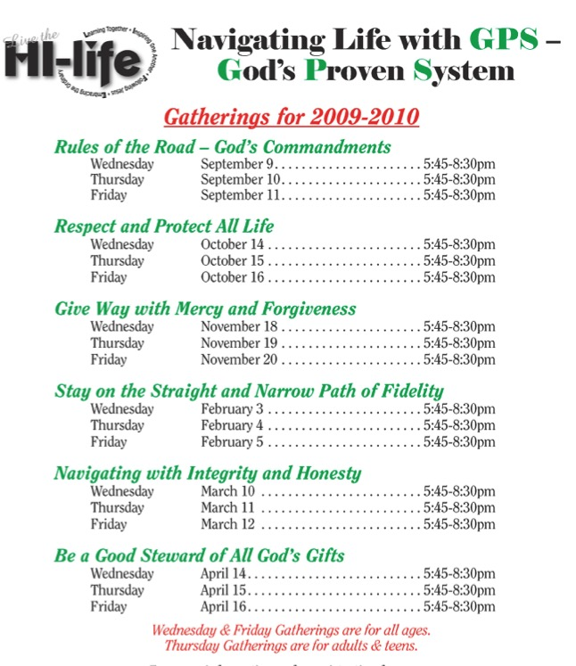
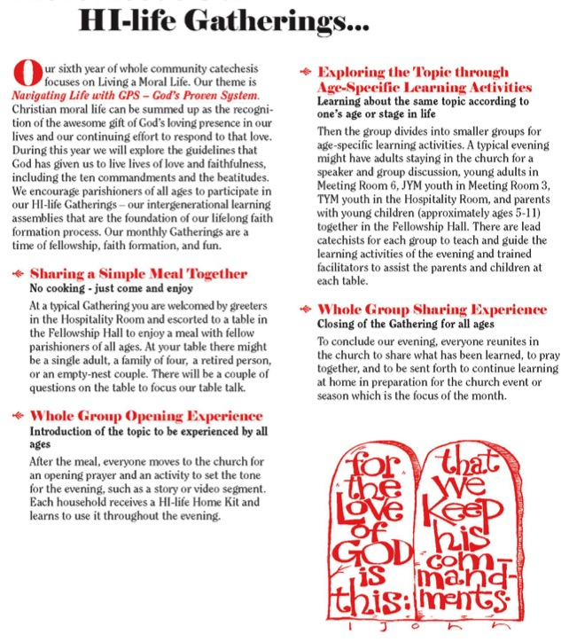
Intergenerational Learning

Slide 28
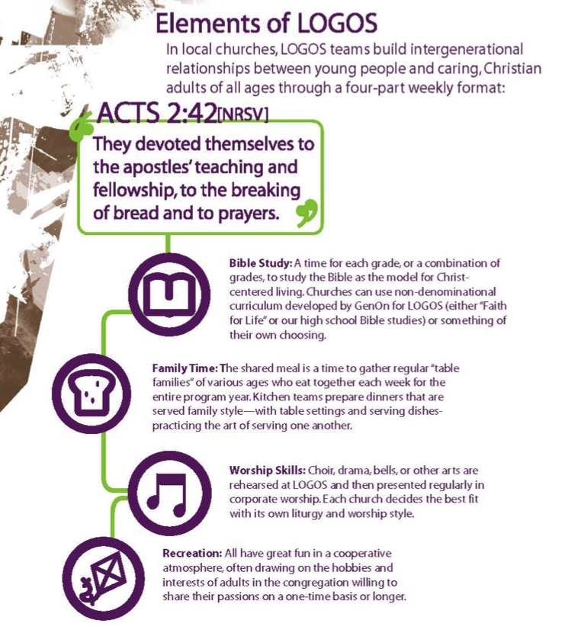
Intergenerational Learning
Bible Study
Family Time
Worship Skills
Recreation
GenOn Ministries

Slide 29

Intergenerationally: Learning
A flexible, relaxed arrival time with drinks and snacks
Creative exploration of a Bible story/theme through creative experiences for people of different learning styles and of all ages. Children and adults are not separated and are encouraged to explore the story/theme together
A short but explicit time of worship with story, music and prayers that builds on the creative exploration.
A generous welcome and hospitality is expressed through a delicious home-cooked, sit-down meal with others

Slide 30
Connect Intergeneration & Age-Specific
Preparation:
knowledge & practices for participating fully
Guided Participation:
in the events of church life & the Christian Faith
Reflection:
on the experience and living its meaning in daily life

Slide 31
Connect Intergenerational & Age-Specific
Worship
  Learn about worship and how to worship
  Experience Sunday worship with the faith community
  Live the Sunday worship experience at home and in daily life
Bible
  Learn about the Bible and how to read it, interpret it, and apply it
  Experience the Bible at Sunday worship and at home
  Develop their own practice of Bible study and reading.

Slide 32
Connect Intergenerational & Age-Specific
Christian Tradition
  Learn about Jesus and the Christian tradition
  Experience the life of Jesus and the tradition through participation in the lectionary and church year feasts and seasons
  Live the Christian faith today at home and in daily life
Service & Justice
  Learn about the justice issues of our day and the biblical and church teachings on justice, service, and care for creation
  Experience acts of justice and service with the faith community—locally and globally
  Engage in the practices of serving those in need, caring for creation, and working for justice

Slide 33
Enhance Intergenerational Relationships
Incorporate intergenerational dialogues into programming
Develop mentoring relationships
Involve the community in praying for each generation,
Organize social and recreational activities that build intergenerational relationships
“Intergenerationalize” age-group programming
Integrate intergenerational programming into an age-group program plan and calendar
Offer service projects and mission trips for all ages
Offer simple, one-time intergenerational experiences: arts, music/concerts, drama, social events, service projects, sports, educational experiences

Slide 34
Families at the Center
The Family-at-the Center Approach recognizes that parents and the family are the most powerful influence for virtually every child and youth outcome—personal, academic, social, and spiritual-religious; and that parents are the most important influence on the social and religious lives of children, youth, and emerging adults.
Given the central role of families in shaping the lives of children and youth, the value of engaging, supporting, and educating families should be self-evident to all of us.
Schools & Churches
Family & Parents
Community

Slide 35
Family Makes a Difference in Faith Growth
Parents’ personal faith and practice
Parent-child relationship: close, warm
Parents’ modeling and teaching a religious faith
Parents’ involvement in church life and Sunday worship
Grandparents’ religious influence & relationship
Religious tradition a child is born into
Parents of the same faith
Family conversations about faith
Family religious practices: prayer, reading the Bible, service to others, celebrating holidays/rituals

Slide 36

Family Faith Formation
God in Everyday Life
Faith Practices at Home
Milestones
Seasonal Events
Encountering God in the Bible
Intergenerational Connections
Strong Family Life
Parents & Grandparents as Faith Formers

Slide 37

Discovering God in Everyday Life

Slide 38
Forming Faith through Milestones
  Birth / Baptism
  Starting School Year
  First Communion
  Receiving a first Bible
  Confirmation
  Graduation (HS, College)
  Engagement
  Wedding
  Retirement
  Death / Funeral

Slide 39
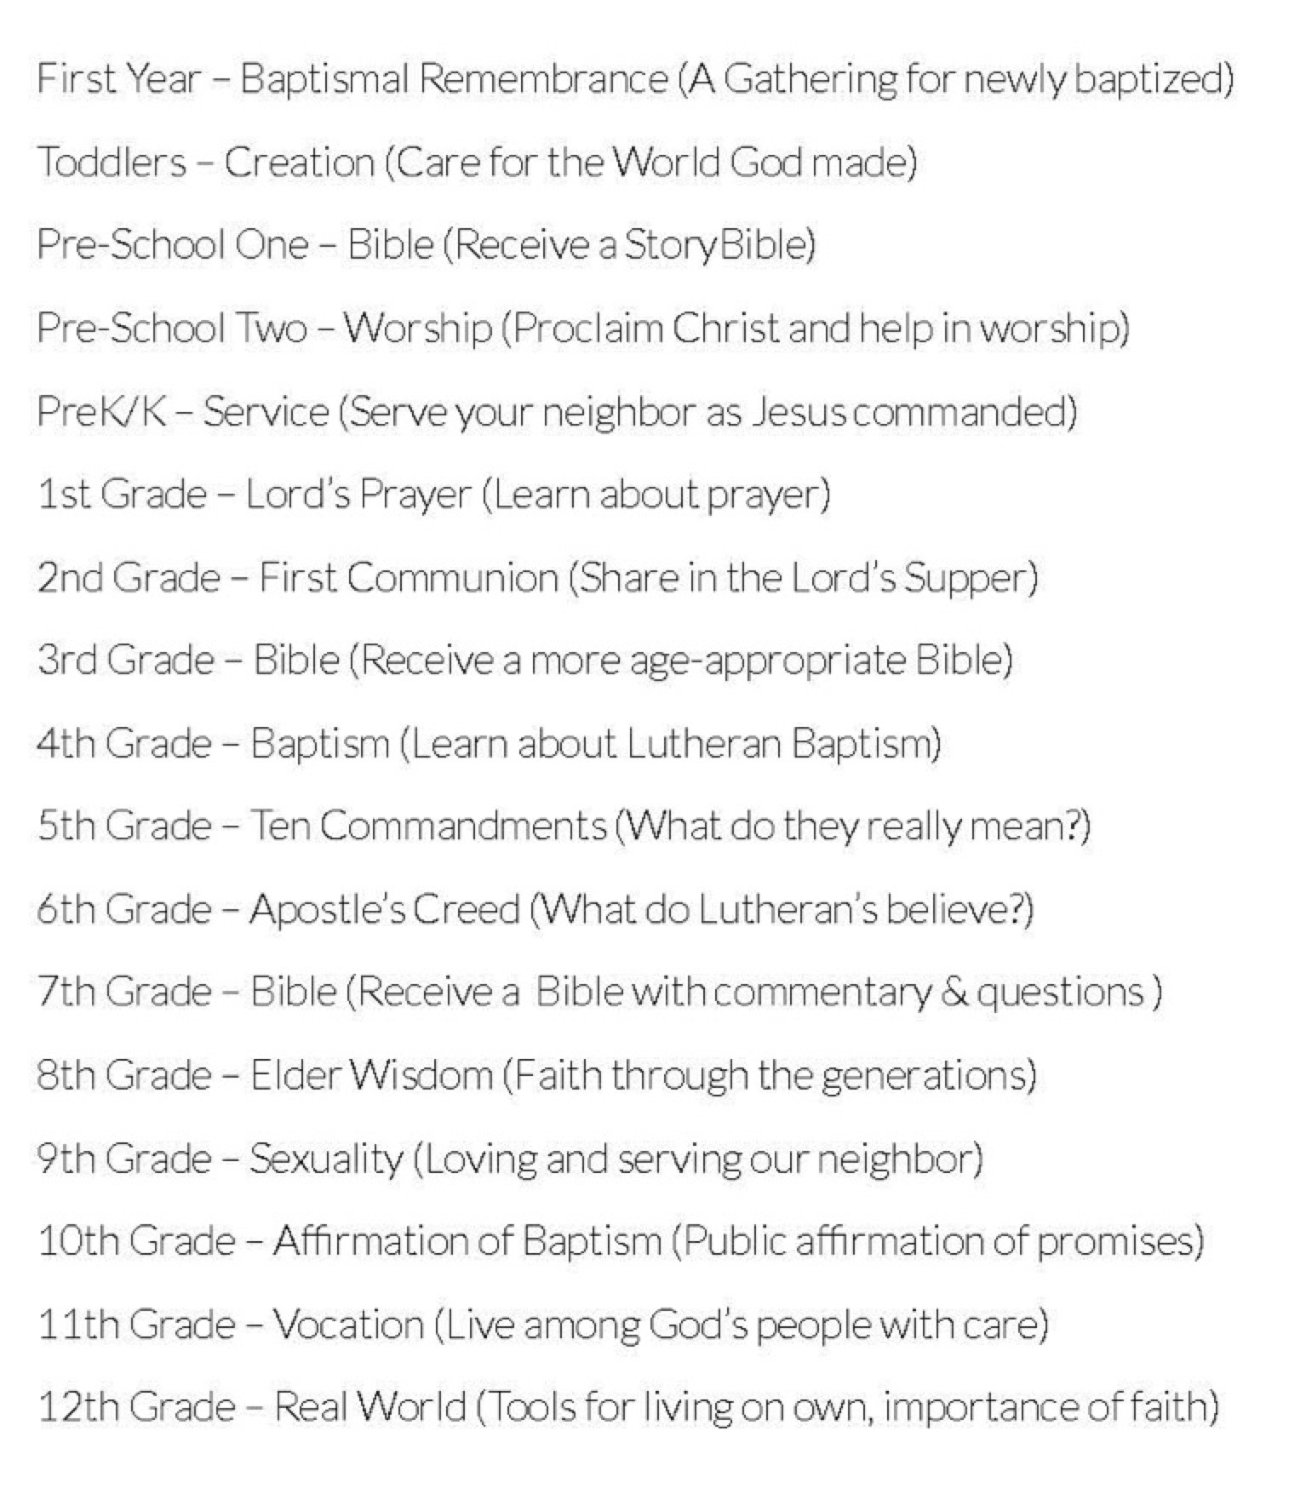

Forming Faith through Milestones

Slide 40
Developing a Strong Family Life
Family Assets – Search Institute

Slide 41
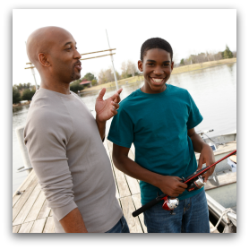

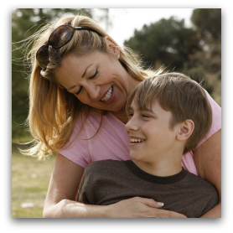


Developing a Strong Family Life
Developmental Relationships – Search Institute
Express Care
Challenge Growth
Provide Support
Share Power
Expand Possibilities

Slide 42
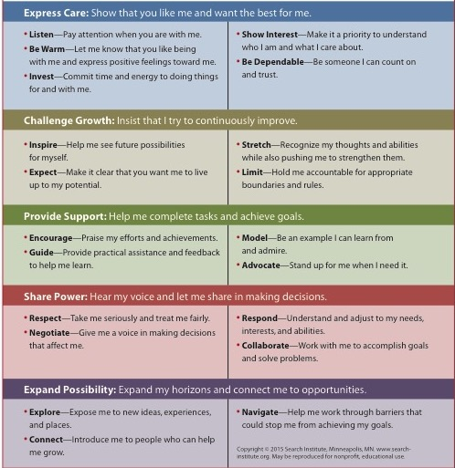

Slide 43
Life Cycle Faith Formation
Age group and generational faith formation addresses the unique life tasks, needs, interests, and spiritual journeys of people at each stage of life.
Intergenerational Faith Community
Children & Parents
Youth & Parents
Young Adults
Mid-life Adults
Mature Adults
Older Adults

Slide 44
Life Cycle Faith Formation
Children
Teens
Caring Relationships
Caring Relationships
Caring Relationships
Young Adults
Church Year Feasts & Seasons
Learning the Tradition
Prayer & Spiritual Formation
Reading the Bible
Rituals & Milestones
Service & Working for Justice
Worship
Church Year Feasts & Seasons
Learning the Tradition
Prayer & Spiritual Formation
Reading the Bible
Rituals & Milestones
Service & Working for Justice
Worship
Church Year Feasts & Seasons
Learning the Tradition
Prayer & Spiritual Formation
Reading the Bible
Rituals & Milestones
Service & Working for Justice
Worship

Slide 45
Lifelong Cycle Formation
Midlife Adults
Mature Adults
Caring Relationships
Caring Relationships
Caring Relationships
Older Adults
Church Year Feasts & Seasons
Learning the Tradition
Prayer & Spiritual Formation
Reading the Bible
Rituals & Milestones
Service & Working for Justice
Worship
Church Year Feasts & Seasons
Learning the Tradition
Prayer & Spiritual Formation
Reading the Bible
Rituals & Milestones
Service & Working for Justice
Worship
Church Year Feasts & Seasons
Learning the Tradition
Prayer & Spiritual Formation
Reading the Bible
Rituals & Milestones
Service & Working for Justice
Worship

Slide 46
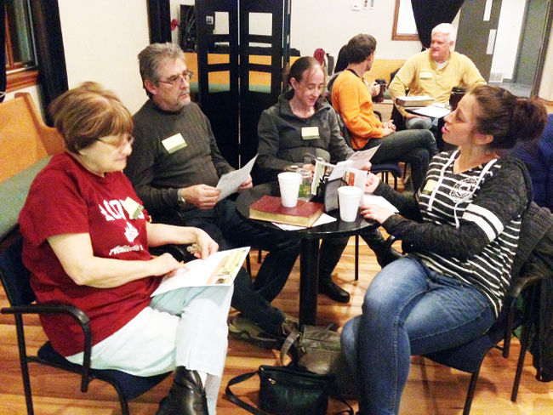
Missional Faith Formation
Expand and extend the church’s presence through outreach, connection, relationship building, and engagement with people where they live—moving faith formation out into the community.
Provide pathways for people to consider or reconsider the Christian faith, to encounter Jesus and the Good News, and to live as disciples in a supportive faith community.

Slide 47
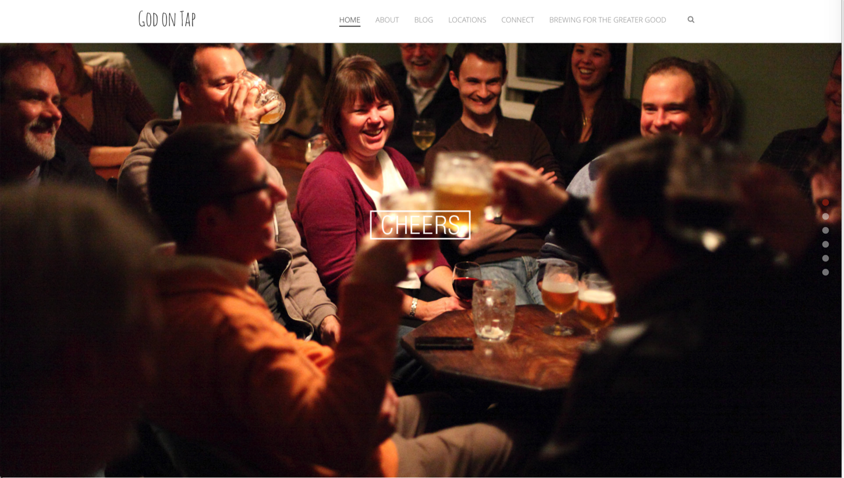
God on Tap

Slide 48
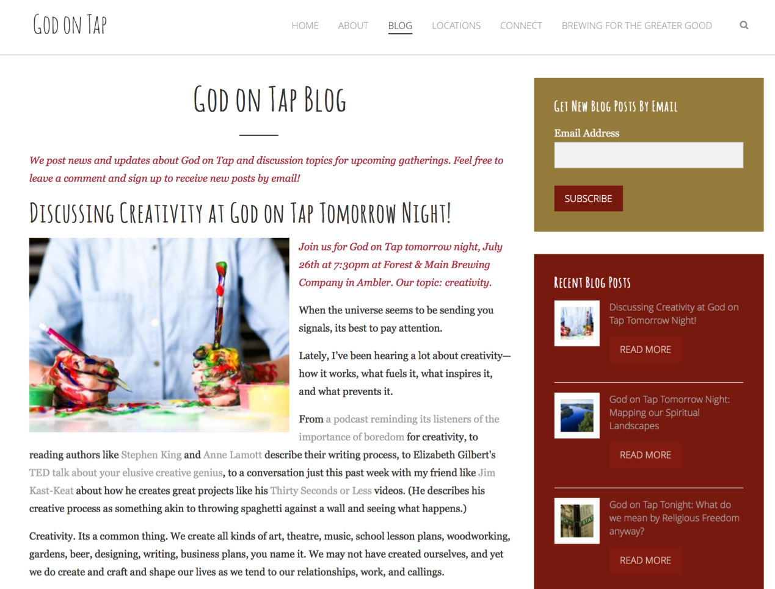

Slide 49
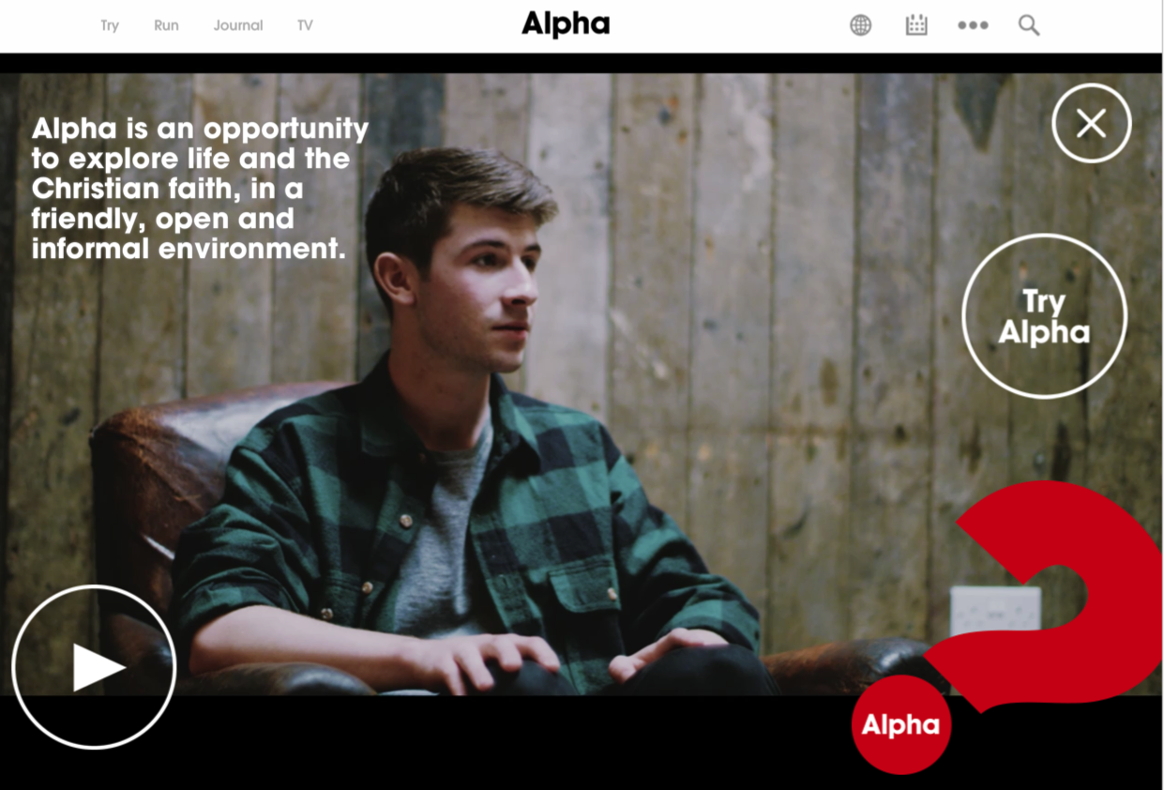
Alpha Course

Slide 50
Alpha: Pathways to Christian Faith
Introduction Dinner: Is there more to life than this?
Week 1: Who is Jesus?
Week 2: Why did Jesus die?
Week 3: How can we have faith?
Week 4: Why and how do I pray?
Week 5: Why and how should I read the Bible?
Week 6: How does God guide us?
Week 7: How can I resist evil?
Week 8: Why & how should we tell others?
Week 9: Does God heal today?
Week 10: What about the Church?
Weekend: Who is the Holy Spirit?

Slide 51
Reimagining. . .
A Network view

Slide 52
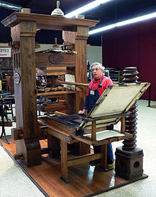
The Print Era (1500s - )

Slide 53
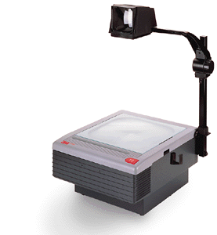
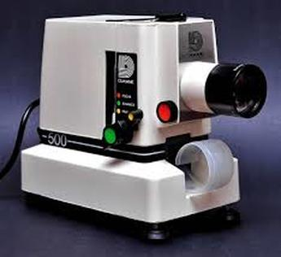
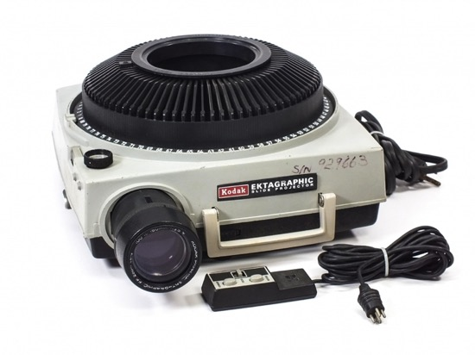
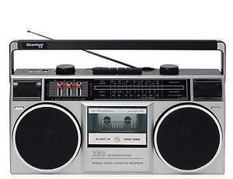
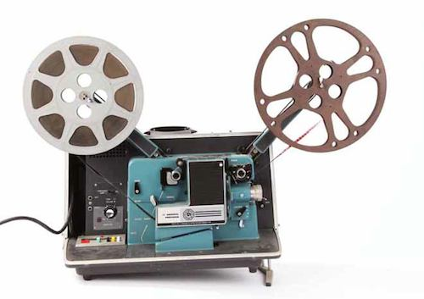
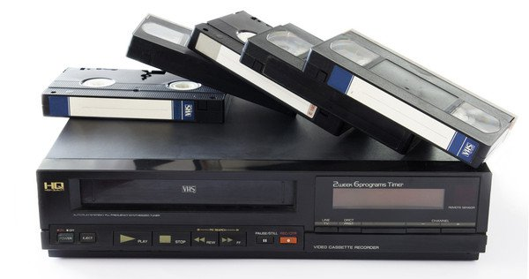
The Multimedia Era (1960s - )

Slide 54
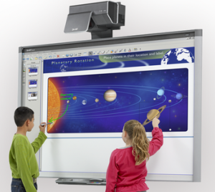



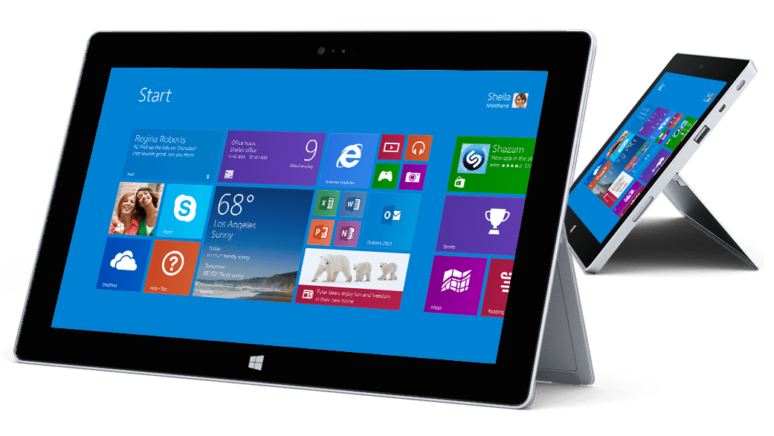
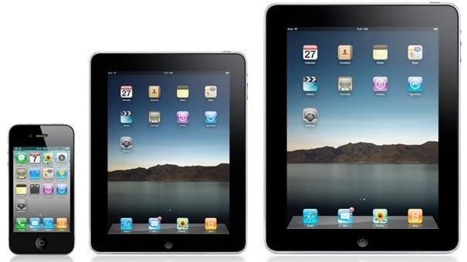
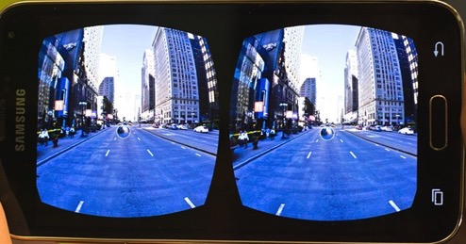
The Digital Era (2000s -)

Slide 55
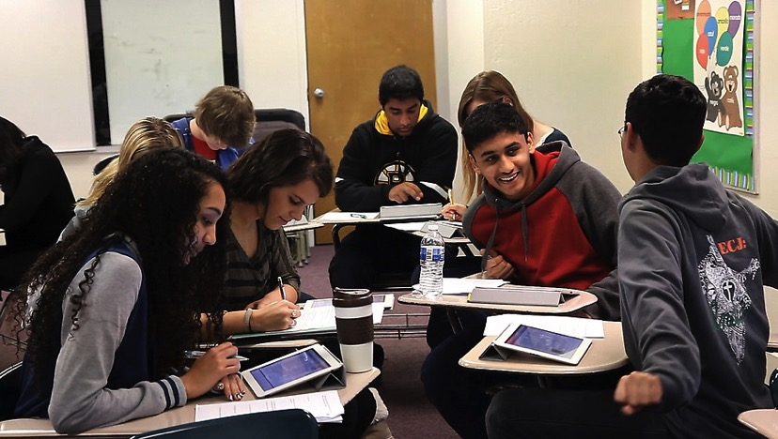

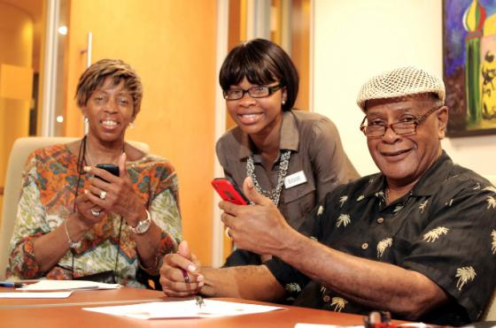


Slide 56

A shift from education to learning anywhere, anytime.
A shift from consumption of information to participatory learning.
A shift from institutions to networks.

Slide 57
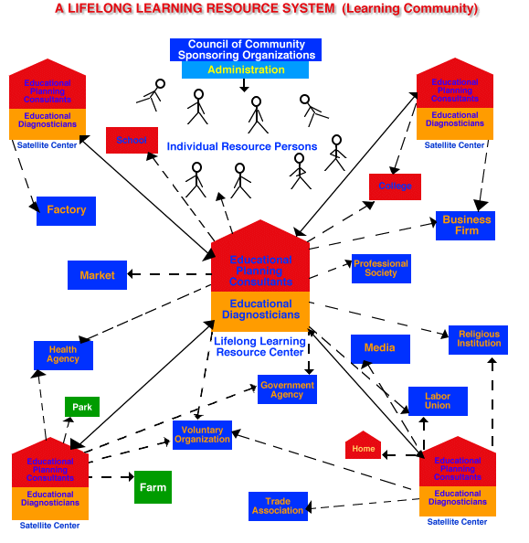
Malcolm Knowles
Learning Community 1970s

Slide 58
Thinking Like a Network
A variety of relationships, content, experiences, and resources
New methods: immersive, multimedia, multi-sensory, highly visual, participatory, experiential
New formats: episodic, micro-learning, on demand, mobile, 24x7,
New digital media and digital platforms: websites, apps, video, podcasts, social media
Multiple environments: self-directed, mentored, at home, in small groups, in large groups, church-wide, in the community, and in the world.

Slide 59
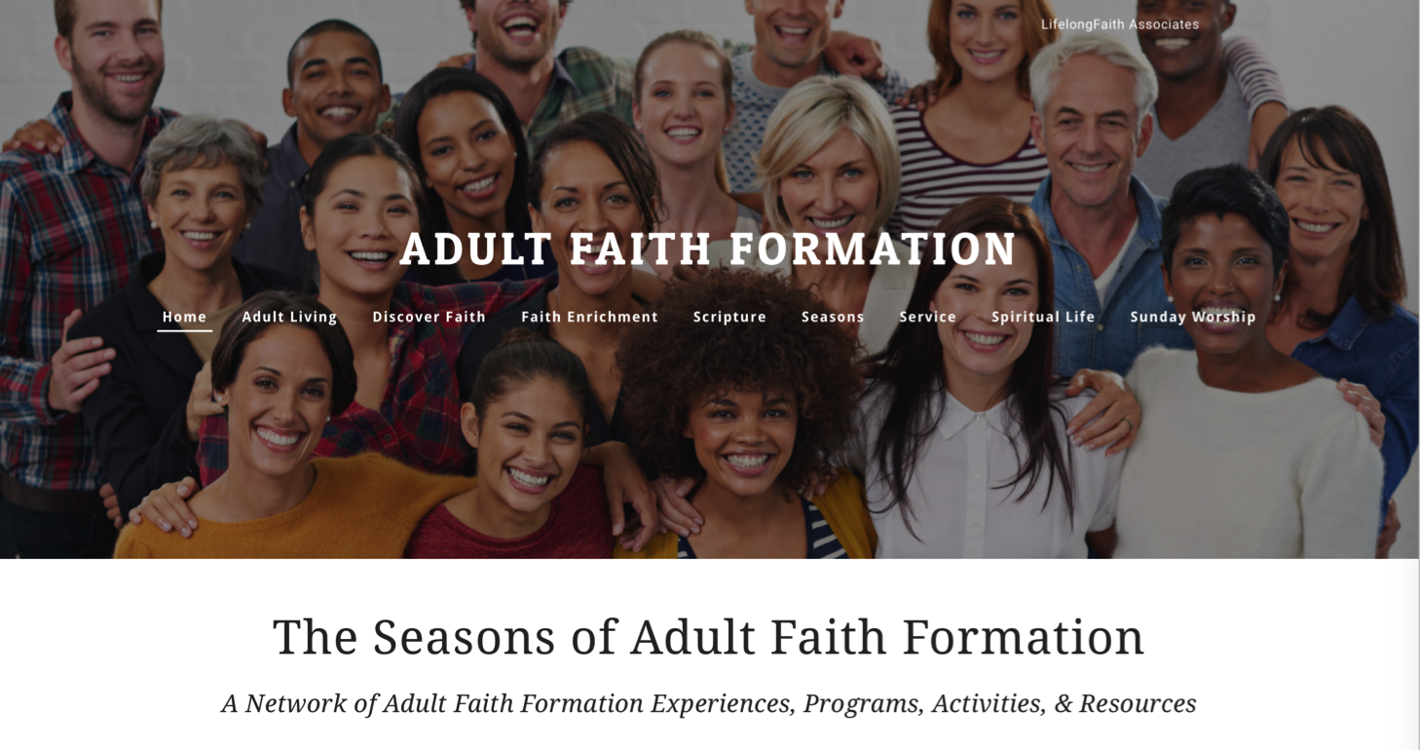
Adult Faith Formation Network

Slide 60
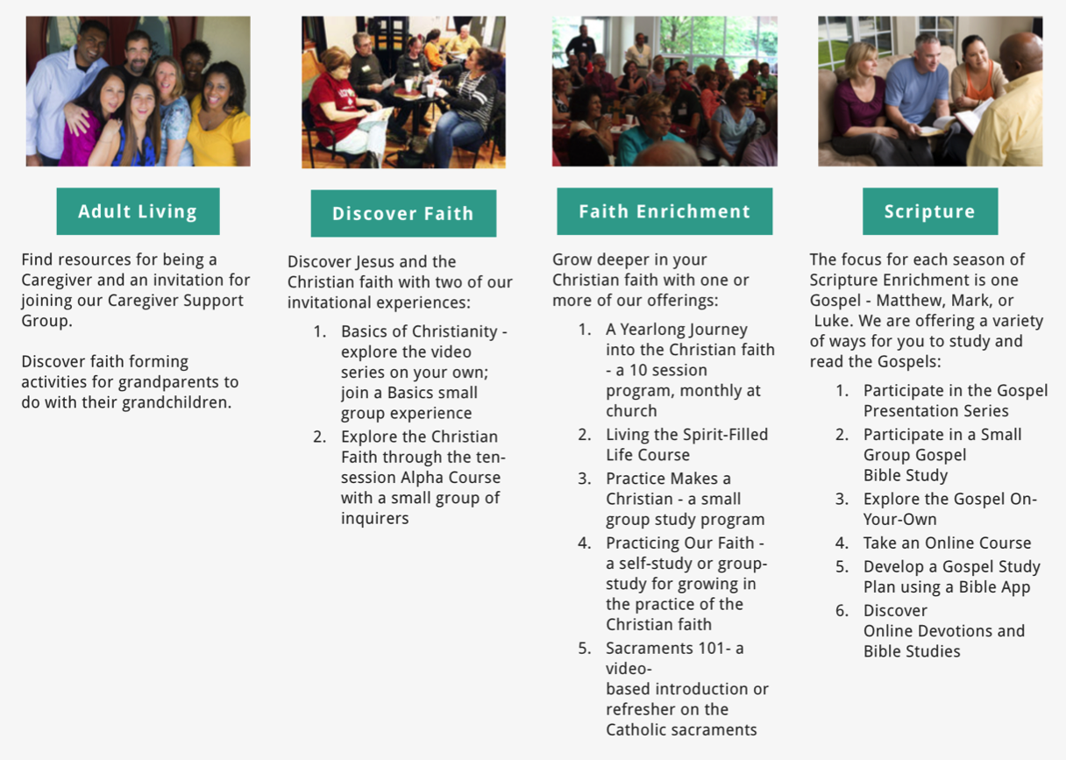
Playlists of Content & Experiences

Slide 61
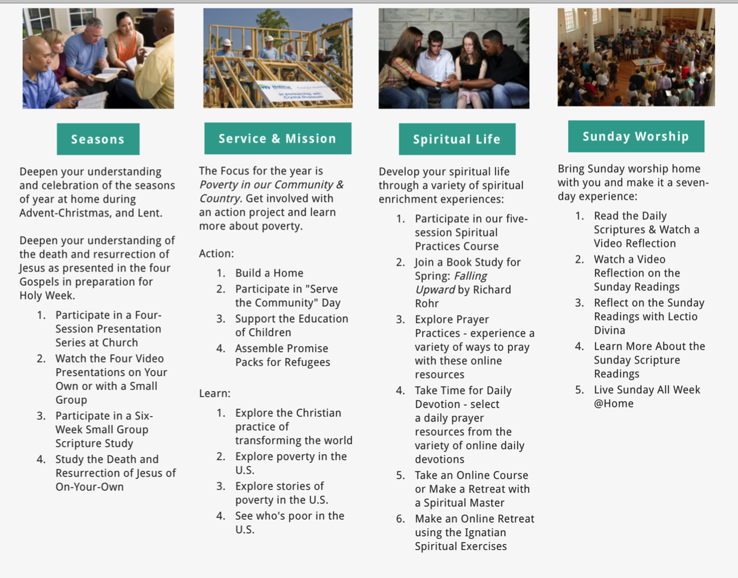

Slide 62
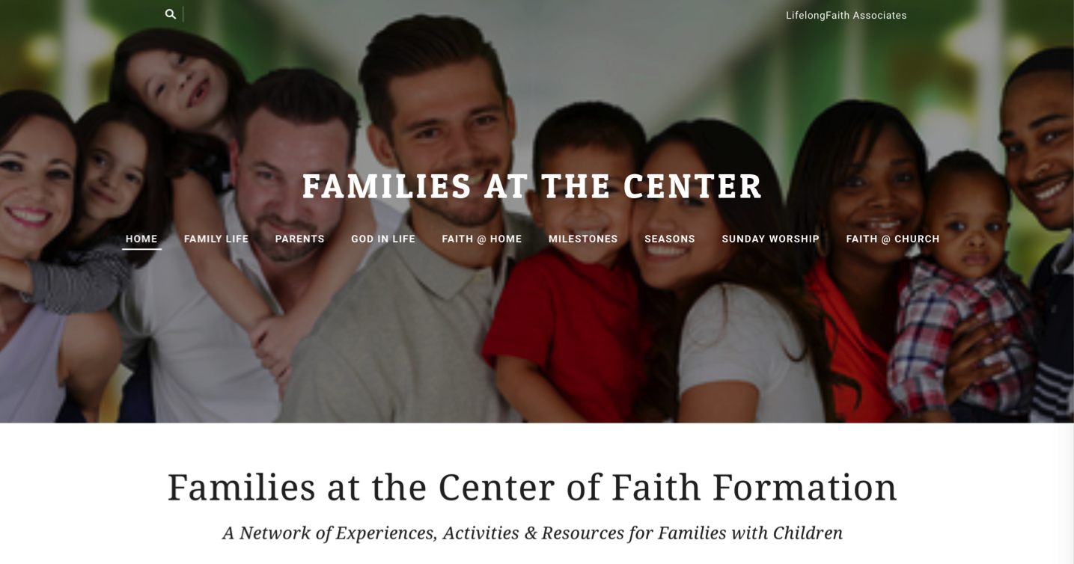
Family Faith Formation Network

Slide 63
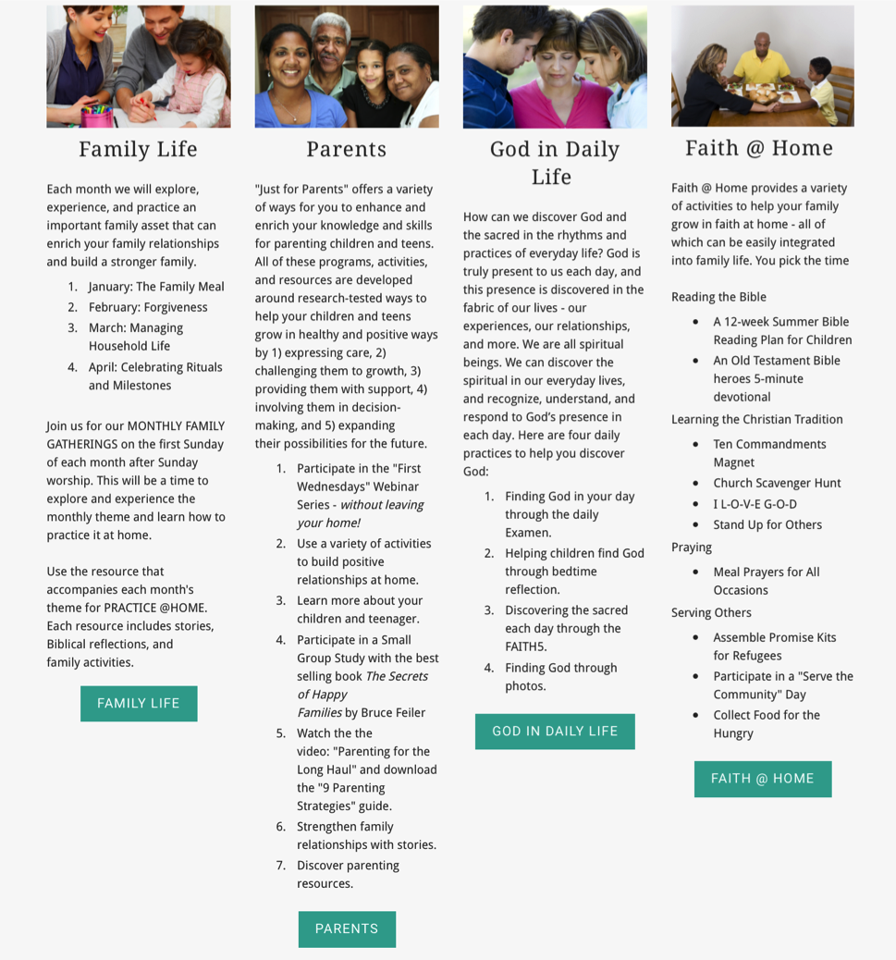

Slide 64
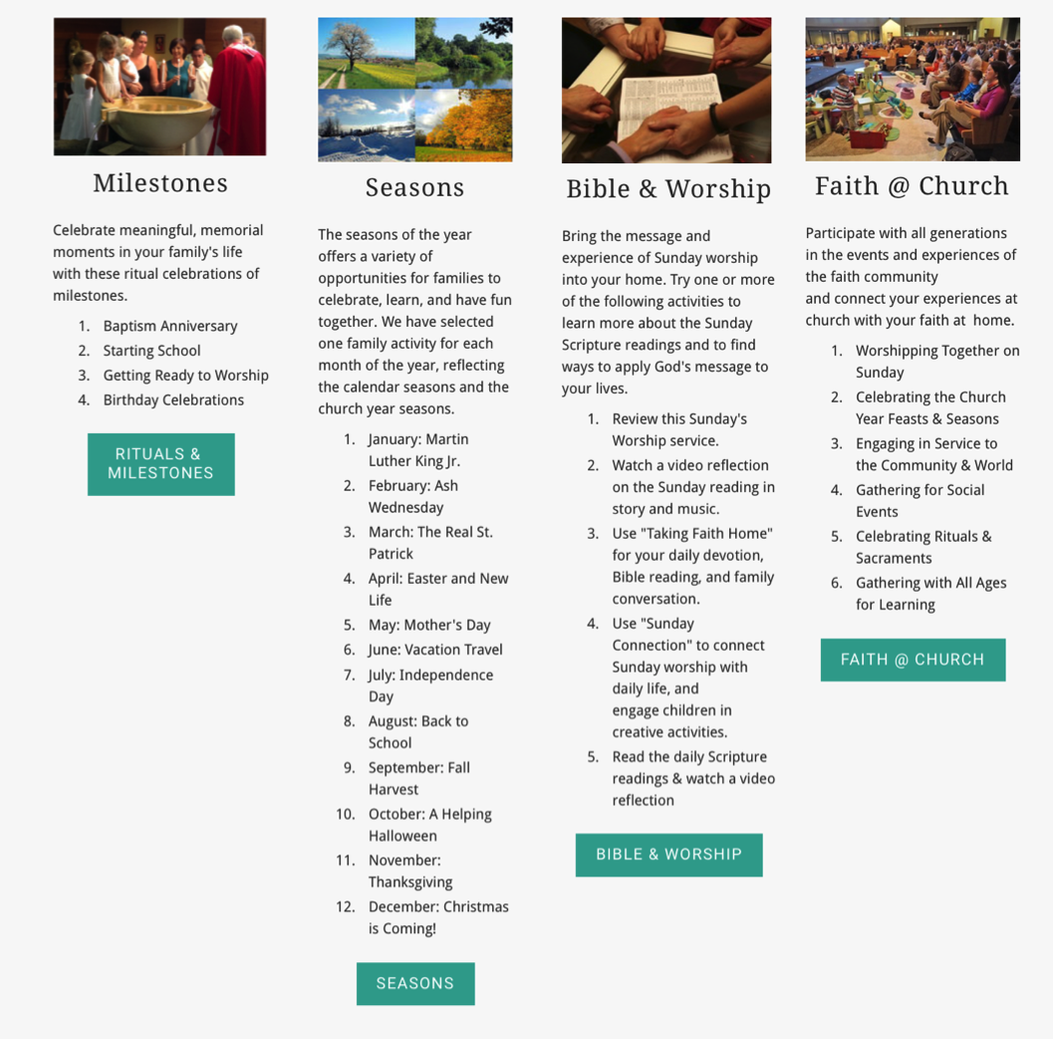

Slide 65
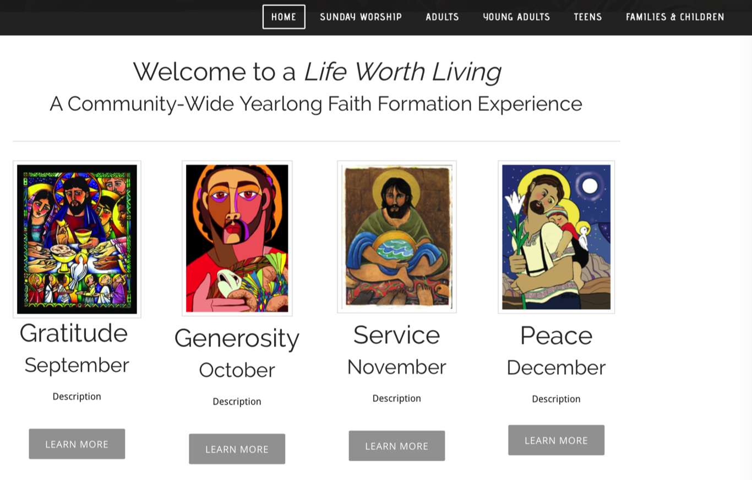
Whole Community Network

Slide 66
Personalizing Faith Formation
1. Assessing Learning Needs & Competencies
2. Working with a Mentor to Develop a Plan
3. Finding Programs and Resources
4. Engaging in Learning
5. Sharing with the Others
6. Reflecting on Growth and Identifying New Needs

Slide 67
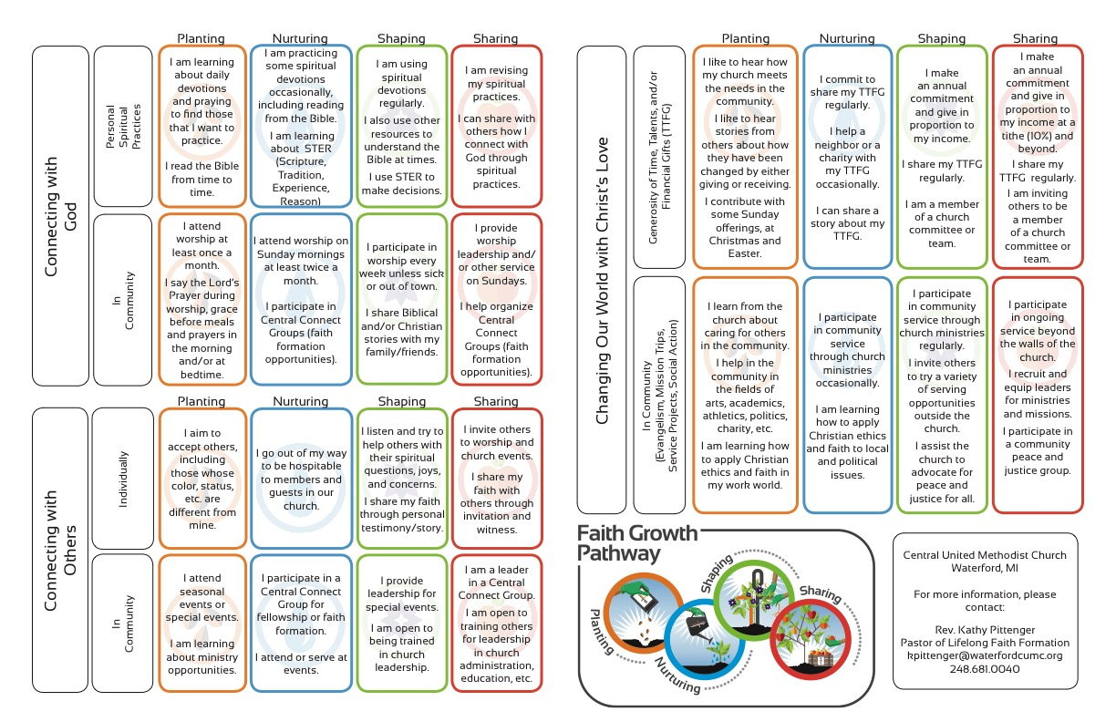

Slide 68
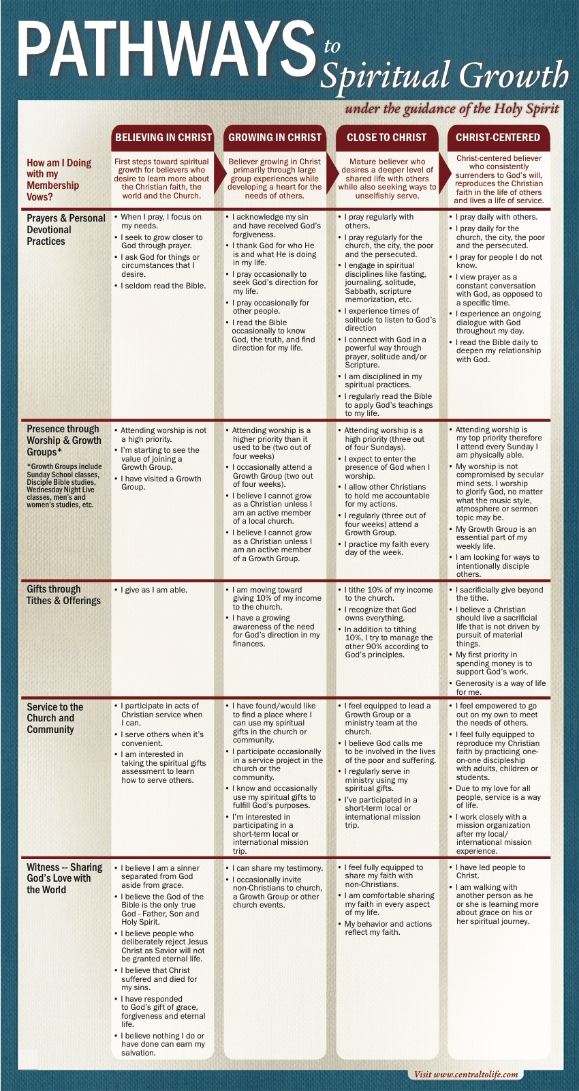

Slide 69
Spiritual-Religious Identities
The Unaffiliateds
The
Spirituals
The Occasionals
The
Actives

Slide 70
Personalizing - Pathways
Program
Path 1
Mentors/Small Groups
Resources
Path 2
Mentors/Small Groups
Path 3
Resources
Resources
Mentors/Small Groups

Slide 71
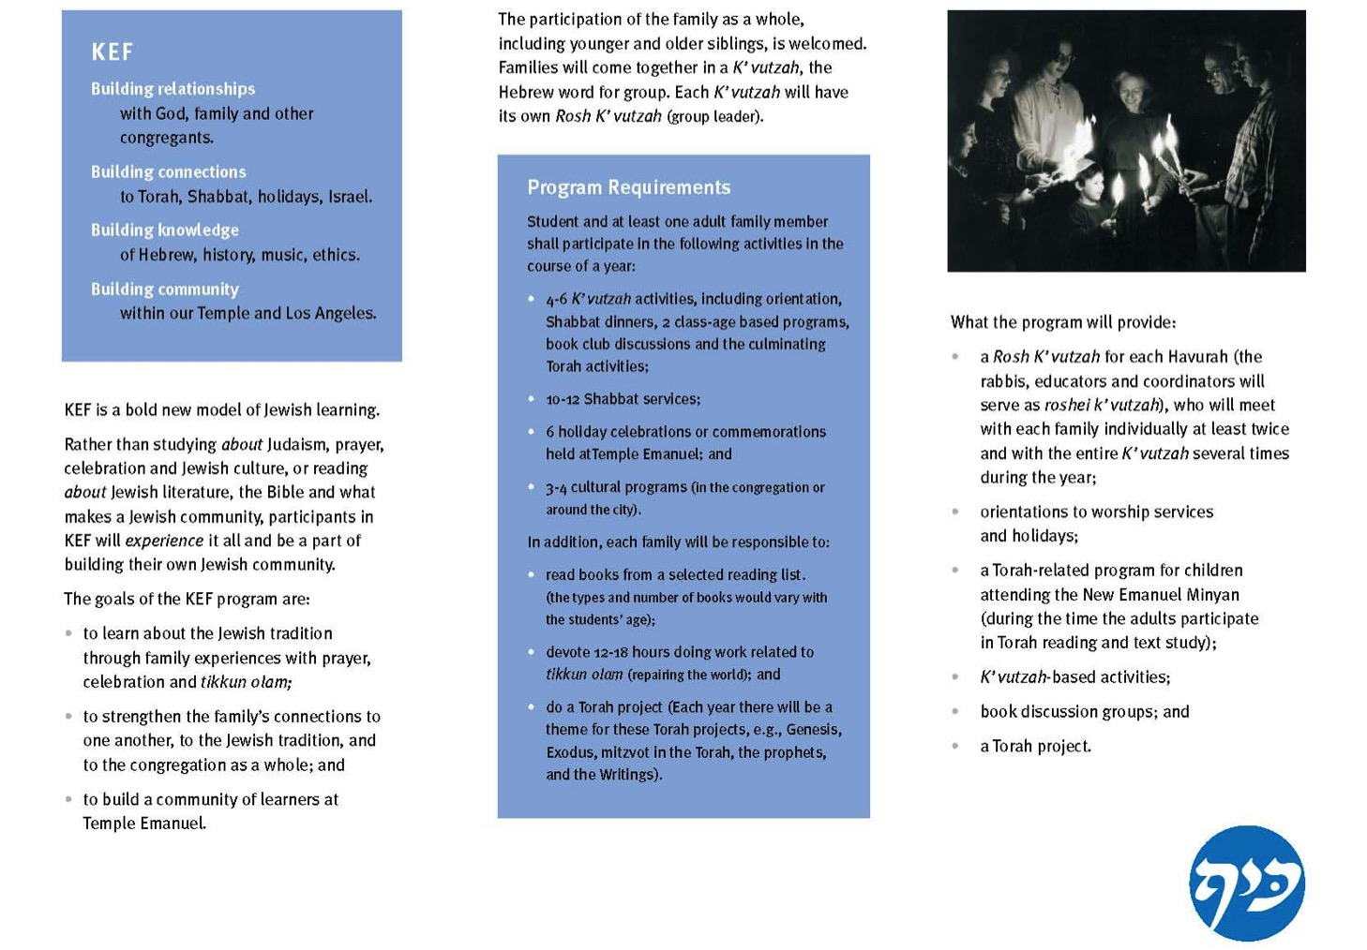

Slide 72


Slide 73
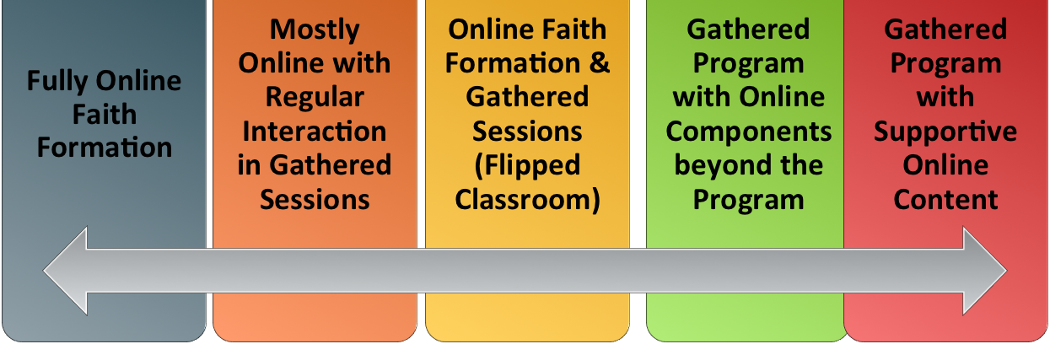
Digitally Enabled & Digitally Connected Faith Formation

Slide 74
Extend the Event
Church or School Event or Program
At Home & Daily Life

Slide 75
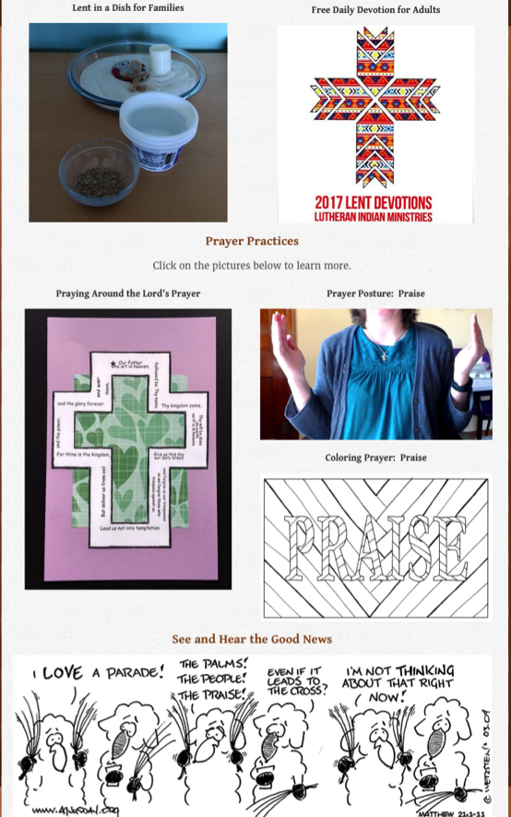
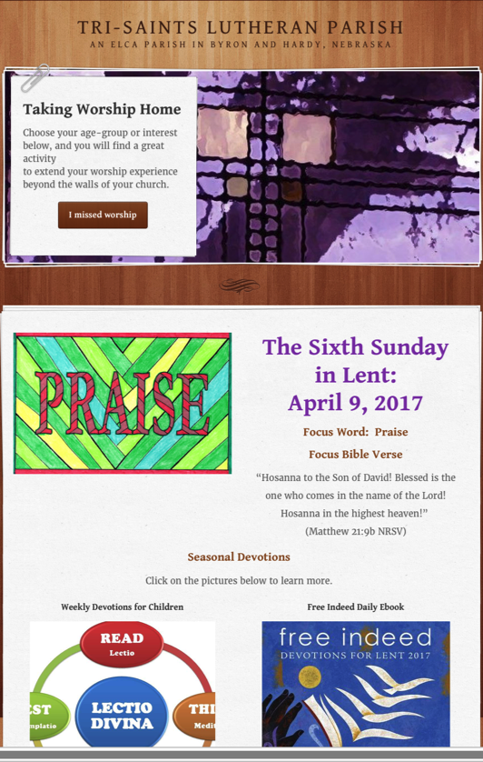

Sunday Worship
Tri-Saints Lutheran Church

Slide 76
Website
Digital Content to Extend & Deepen Event
Social Media
Interaction
Multiple Formats
Offering the Event in New Formats
Communication
Demonstration
Connection
Event

Slide 77
Build on an Event/Experience
(Sacraments, VBS, Mission Trip, and much more)
Preparing
Experiencing
Living
How will you sustain/extend the event?
How will you design the event?
What types of experiences, programming, activities, and resources will you develop to prepare people for the event?
How will you engage age groups, families, and the faith community?
What types of experiences, programs, activities, and resources will you offer people?

Slide 78
Celebrating Milestones: Baptism
Church
Home
Mentors/Coaches
Parent preparation
Family gathering
Ritual
Intergenerational connection
Celebration of Baptism
Reunion
Baptismal anniversaries
Caring conversations and storytelling
Celebrating rituals
Learning
Praying
Reading the Bible
Serving
Worshipping together

Slide 79
Flip the Model
@ Home / Daily Life
Exploring the Content
- print, audio, video, activities
@ The Program
Applying the Content:
Create – Practice - Perform - Participate

Slide 80

Christian Initiation & New Member Formation

Slide 81


Confirmation

Slide 82

Integrate Online and Gathered

Slide 83
Online 40-Day Lent Curriculum
Church ➔ | Daily & Home | ⬅ Online
Ash Wednesday Lenten Sunday liturgies Stations of the Cross Lenten prayer Lenten retreat Lenten service Lenten soup suppers | Fasting Praying Service/Almsgiving Lectionary reflection Family Lenten activities | Lenten learning resources Lenten calendar Daily Lenten prayer Weekly table prayer Video resources Online retreat experience

Slide 84



Online Prayer

Slide 85

Pastoral Care

Slide 86




Online Learning

Slide 87
Emerging Roles of Faith Formation Leaders
Balancing Both Roles
|---------------------------------------------------------------------------------------------------------|
Current Roles
Emerging Roles
Developing religious content
Designing programming
Managing programming
Teaching/Facilitating programming
Designing faith forming environments—architecture
Designing Digital Platforms for faith forming content
Curating religious content and experiences

