Slide 1
Reimaging Ministry & Faith Formation in a Digital World

Slide 2
Technologies Create transformation

Slide 3
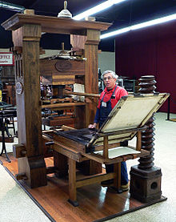
The Print Era (1500s - )

Slide 4
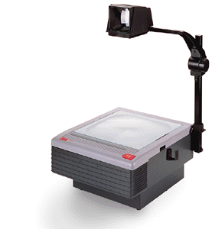
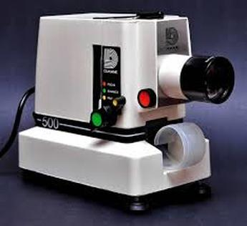
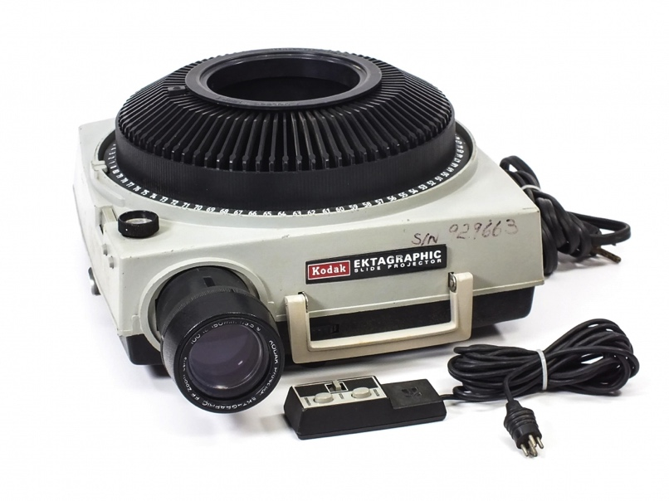
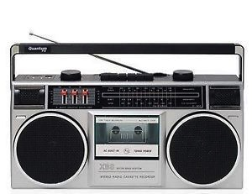
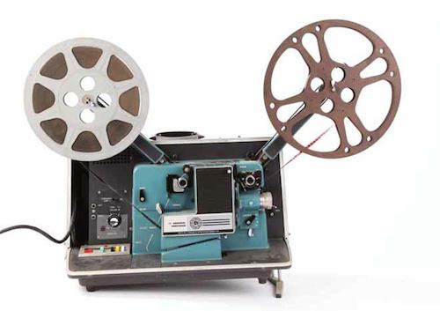
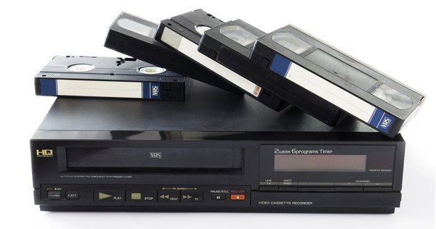
The Multimedia Era (1960s - )

Slide 5
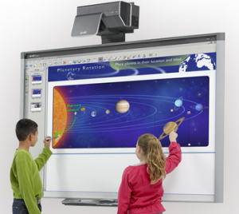
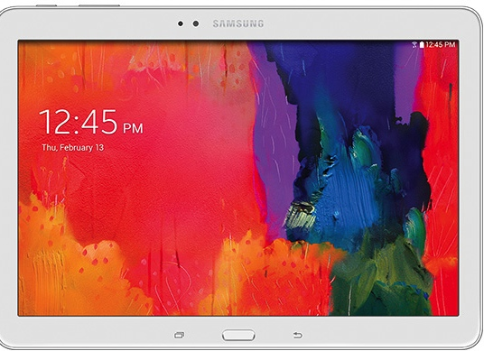
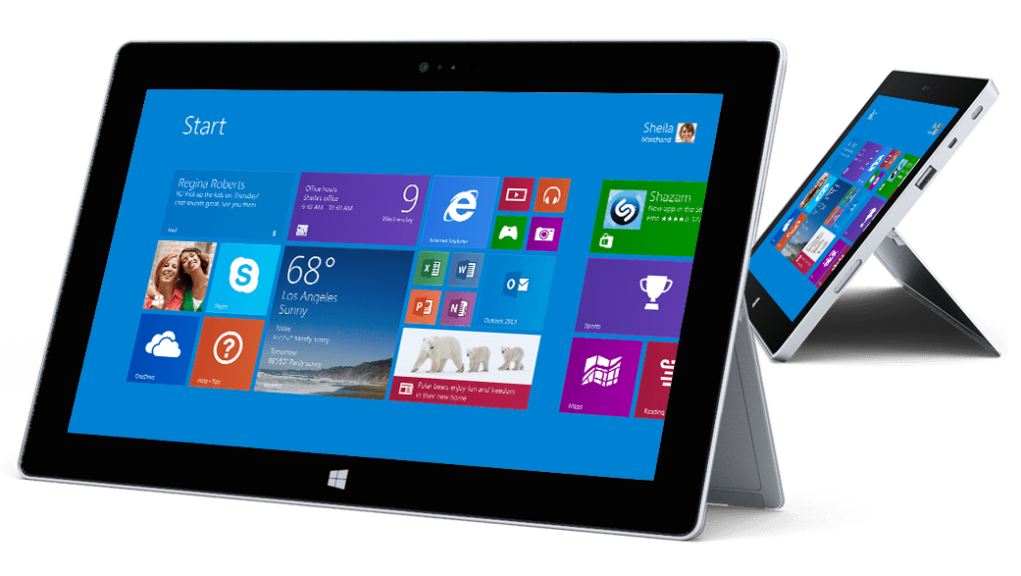
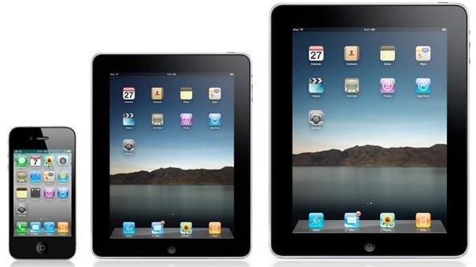
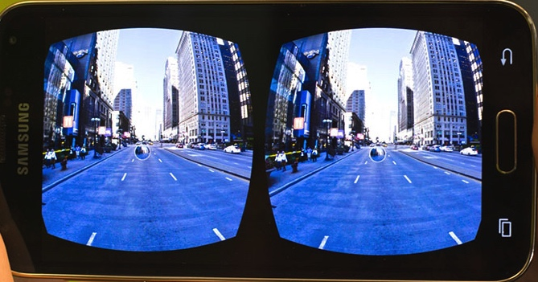
The Digital Era (2000s -)

Slide 6
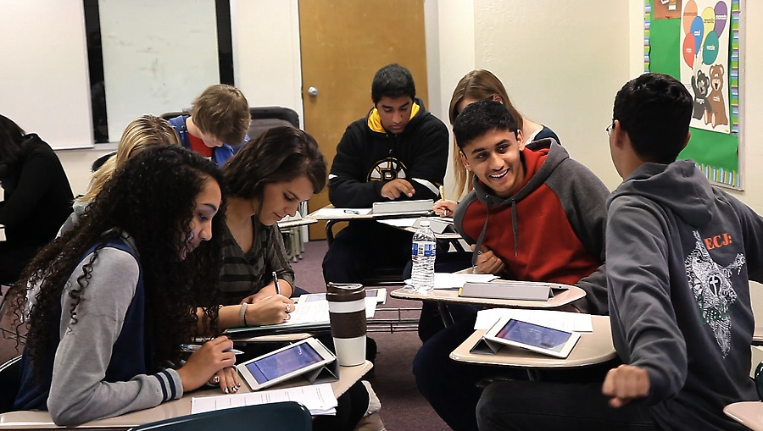
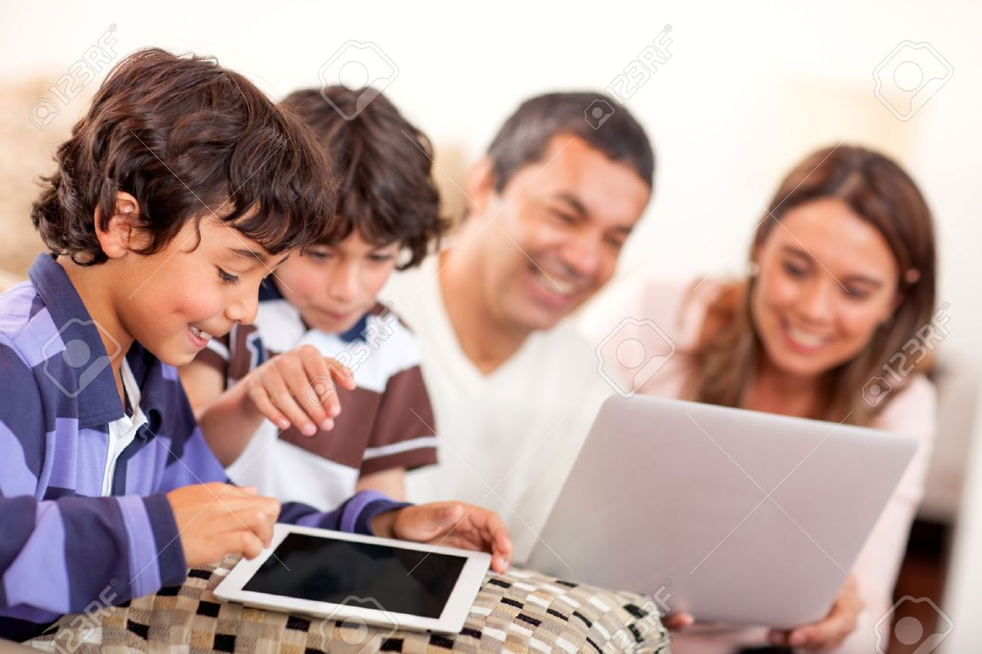
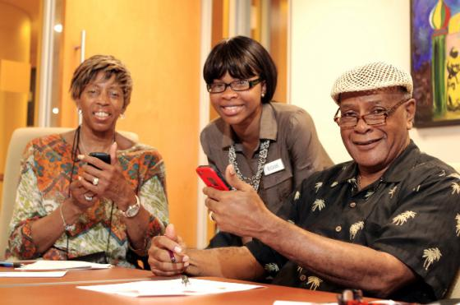

Slide 7
The Digital Era (2000s -)

Slide 8
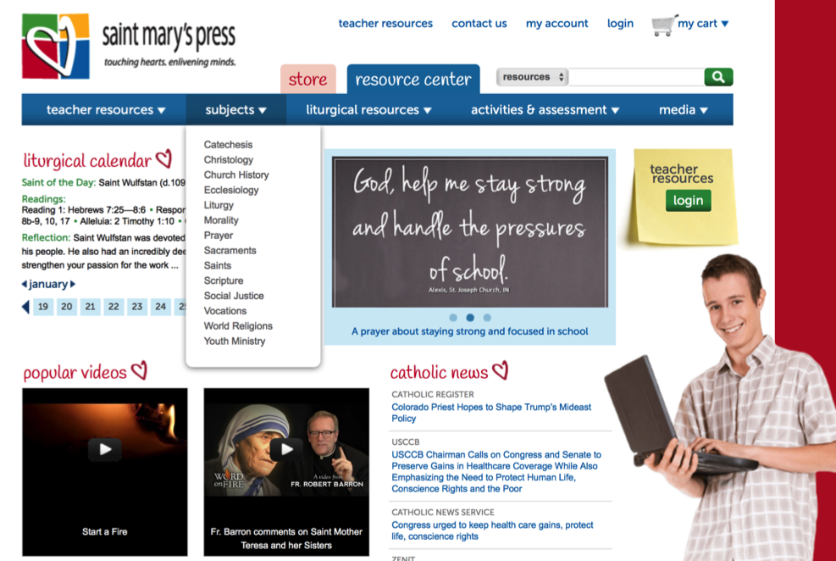
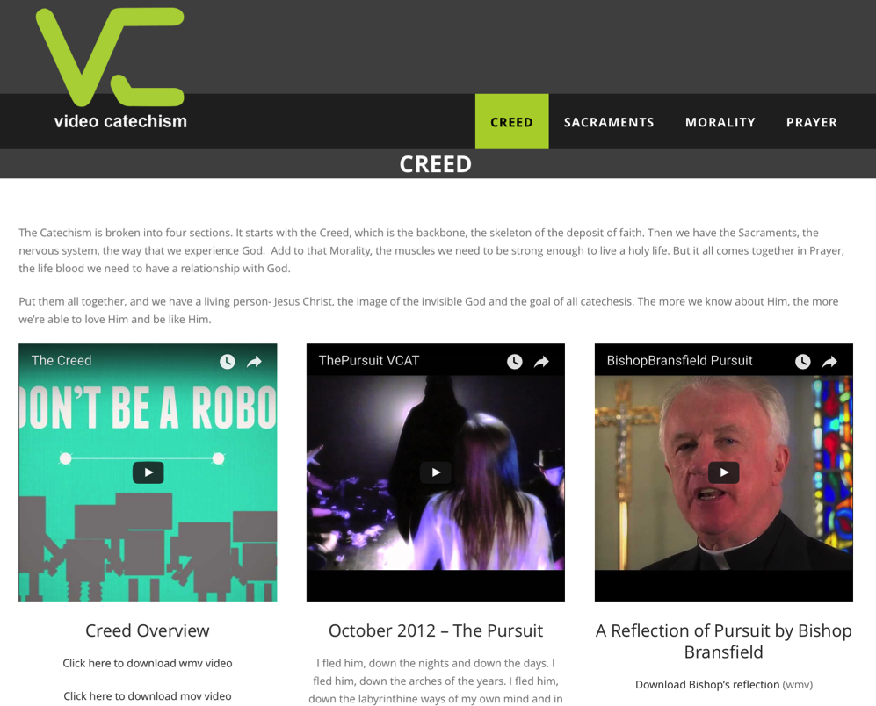
The Digital Era (2000s)

Slide 9
The Triple Revolution
Internet Revolution
Mobile Revolution
Social Media Revolution
Information is now. . .
Portable
Personal
Participatory

Slide 10
If you know that . . . .
People have the technology and know how to use it.
People are connected with each other and reachable.
People have time in their busy lives to connect, participate, and interact in online experiences and communities.
People are already engaged in learning online.
People are already engaged with others online in spiritual experiences.
People have access to an abundance of content – in all types of media formats – on demand, just in time, available 24x7, and often free!
How would you do ministry and faith formation?

Slide 11
Transformation of Learning & Faith Formation

Slide 12
A shift from education to learning anywhere, anytime.
A shift from consumption of information to participatory learning.
A shift from institutions to networks.

Slide 13
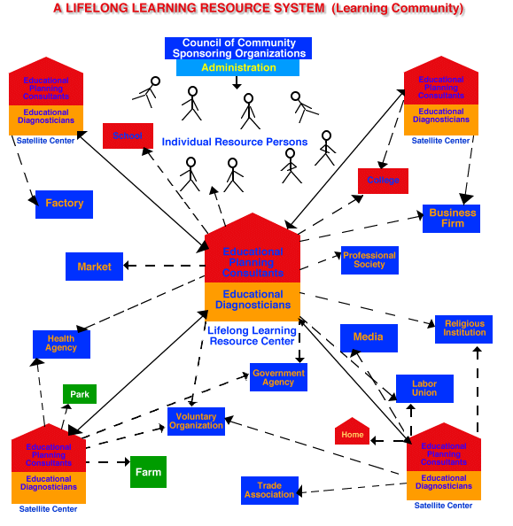
Malcolm Knowles Learning Community 1970s

Slide 14
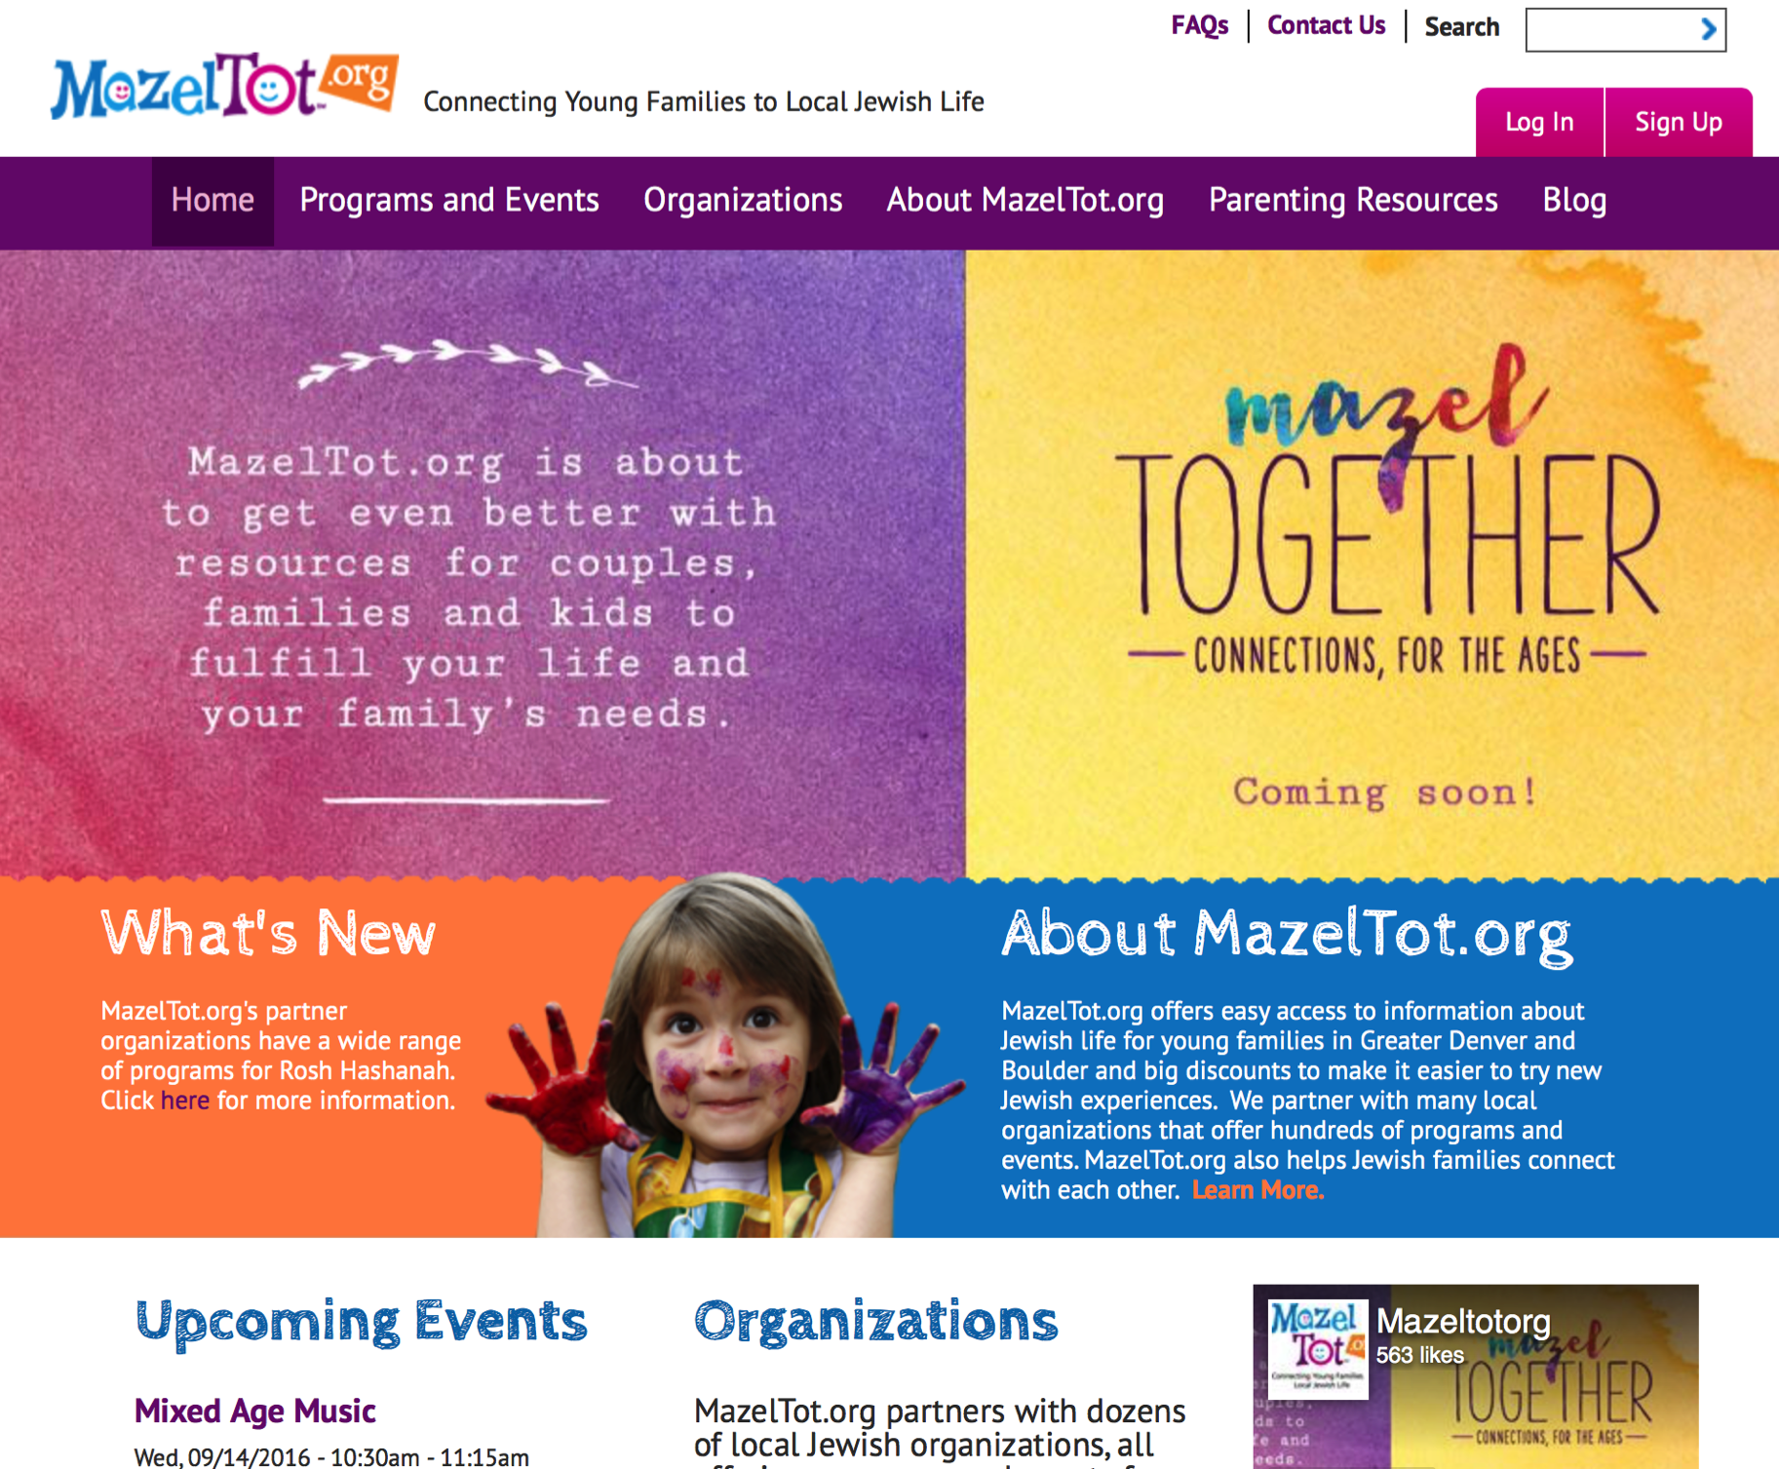

Slide 15
“Teachers, books, movies, music, journals…and the like that are valuable across loose networks of spiritual affiliation not only provide Nones with content—ideas, inspirations, and suggestions for more authentic living. They also allow Nones to imagine a wider community of like-minded people and, through digital social networking especially, to connect with them with greater ease and regularity than would have been possible in the past.”
Elizabeth Drescher
Choosing Our Religion: The Spiritual Lives of America’s Nones

Slide 16
Transformation of Learning & Faith Formation & Parish Life
Person-centered
Immersive Environments
Participatory & Experiential
Visual & Multi-Media & Multi-Sensory
Abundant Content, Accessible On Demand
Digitally-Enabled & Digitally Connected
Episodic Engagements
Micro-Learning
Personalized
Seamless Learning across Multiple Platforms

Slide 17
Digitally Enabled & Digitally Connected Parish Life, Ministry, & Faith Formation

Slide 18
Emerging Roles of Faith Formation Leader
Balancing Both Roles
|---------------------------------------------------------------------------------------------------------|
Current Roles
Emerging Roles
Developing religious content
Designing programming
Managing programming
Teaching/Facilitating programming
Designing faith forming environments—architecture
Designing Digital Platforms for faith forming content
Curating religious content and experiences

Slide 20
#1. Networks of Faith Formation

Slide 21
Playlists of Content & Experiences

Slide 23
Family Faith Formation Network

Slide 24
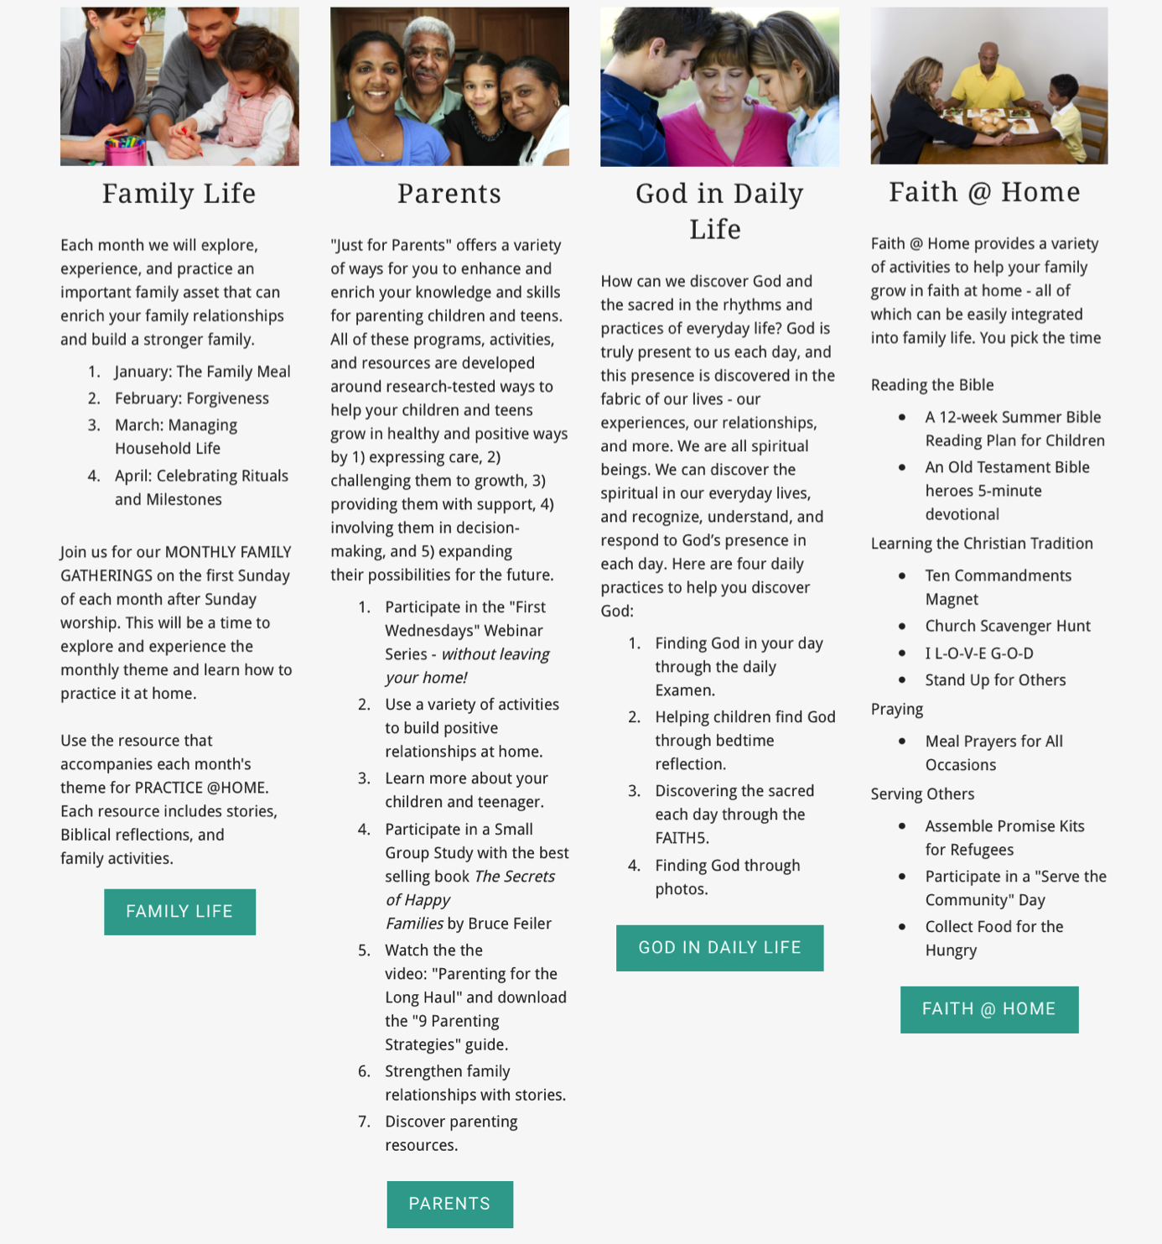

Slide 25
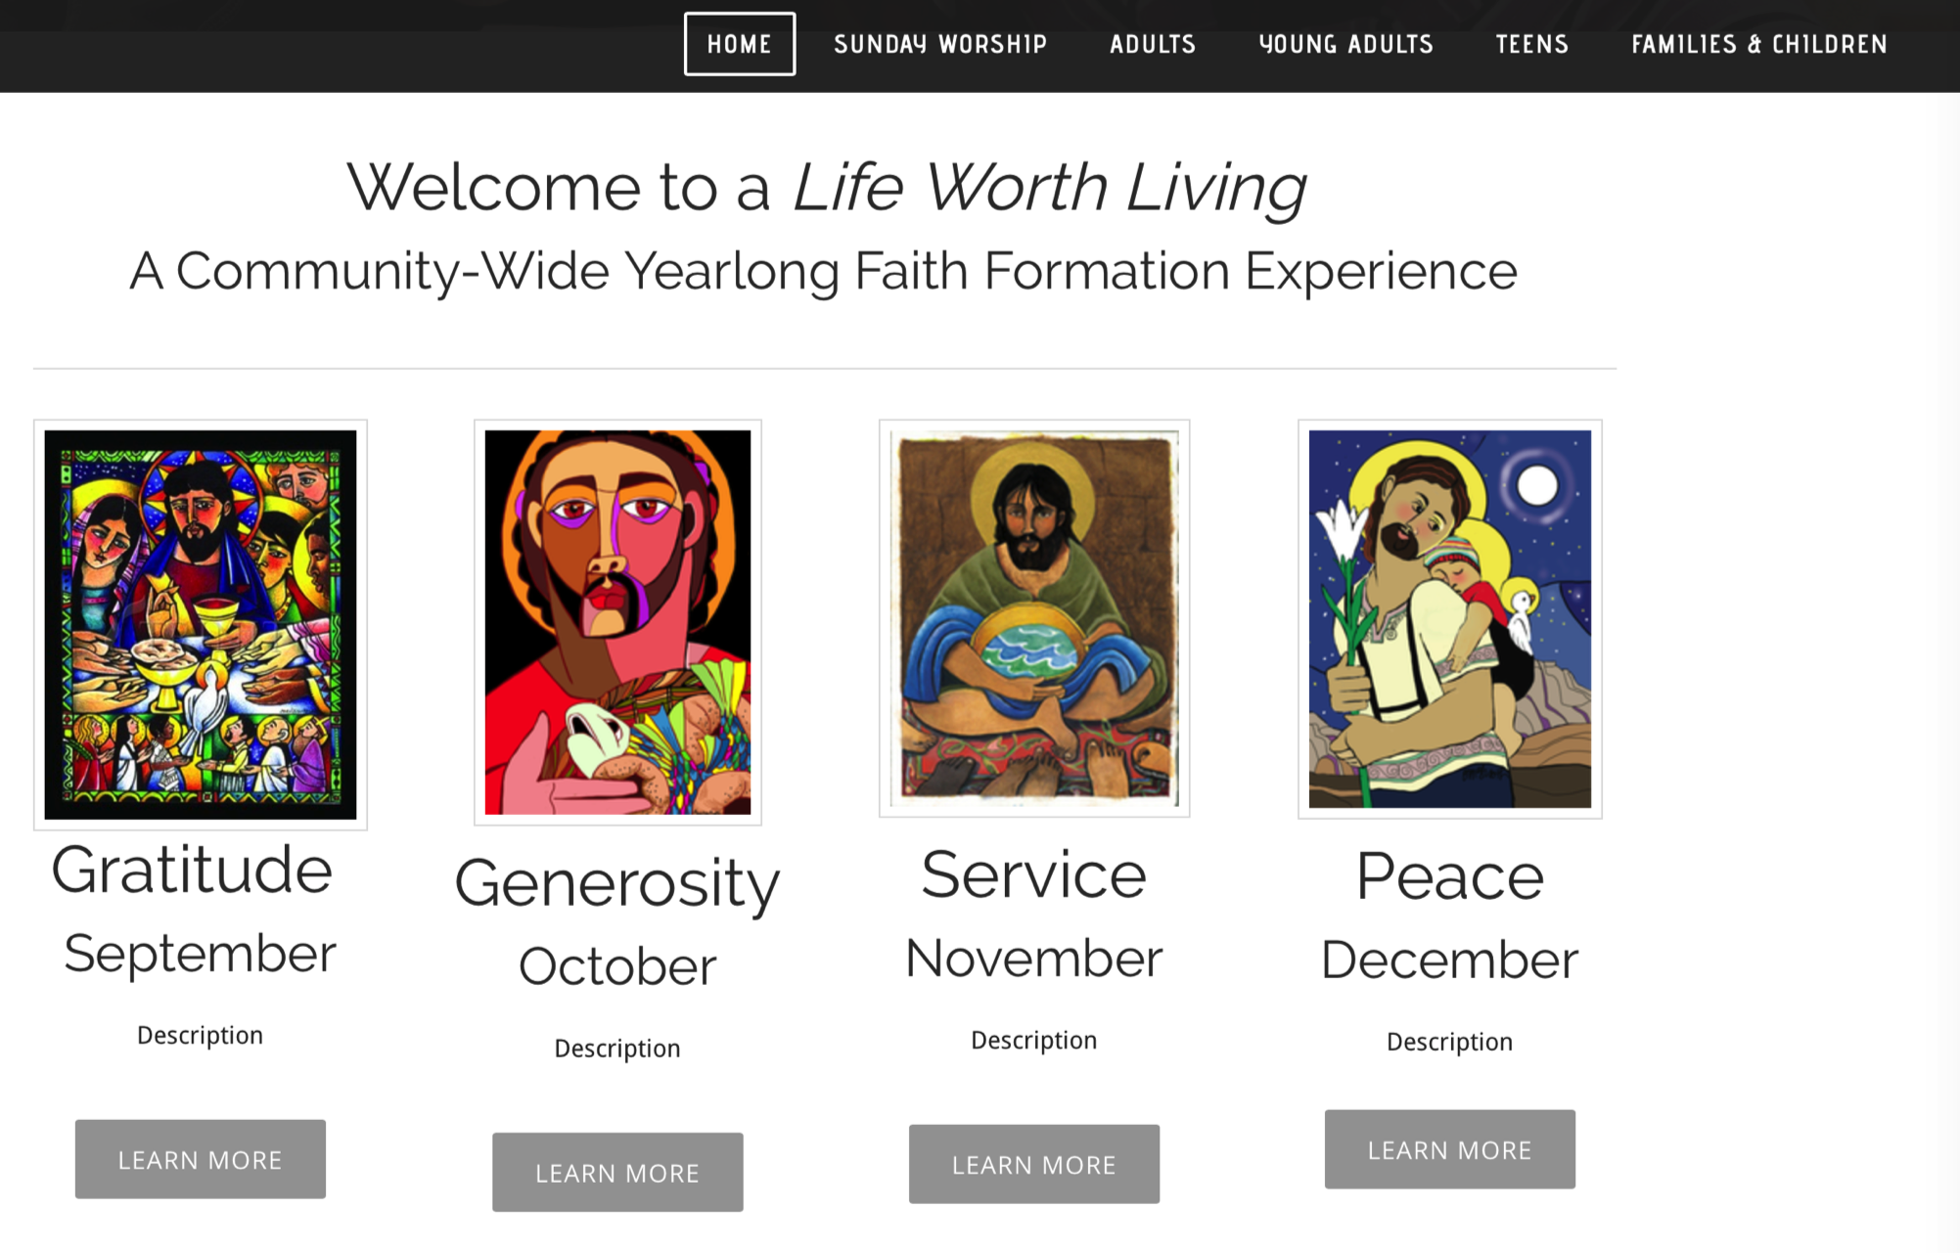
Whole Community Network

Slide 26
Network Seasons
Fall Season:
September 1 – January 1
Winter/Spring Season: January 1 – May 1
Summer Season:
May 1 – September 1
Fall
Winter-Spring
Summer

Slide 27
Connected System
Website
Social Media
Communication

Slide 28
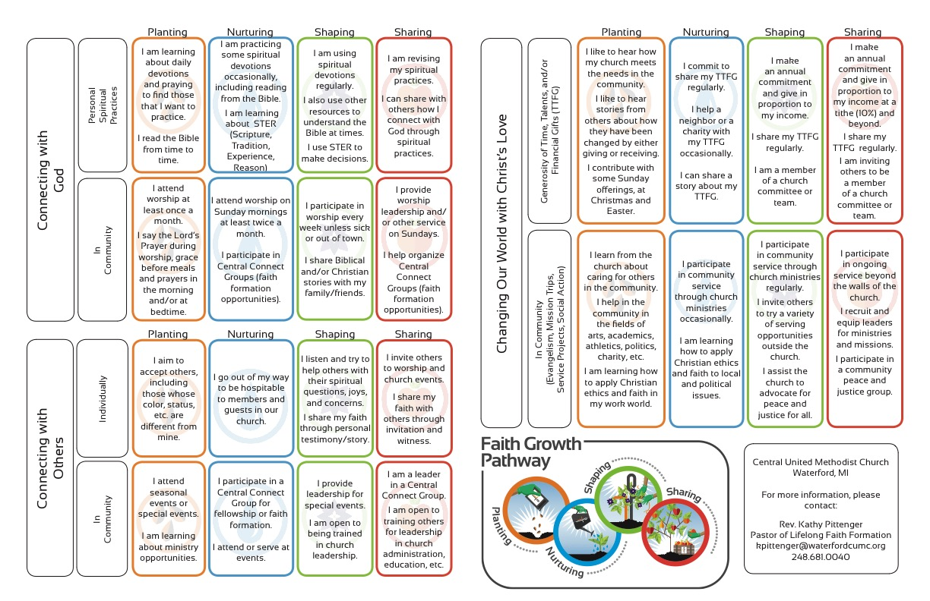
#2. Personalized

Slide 29
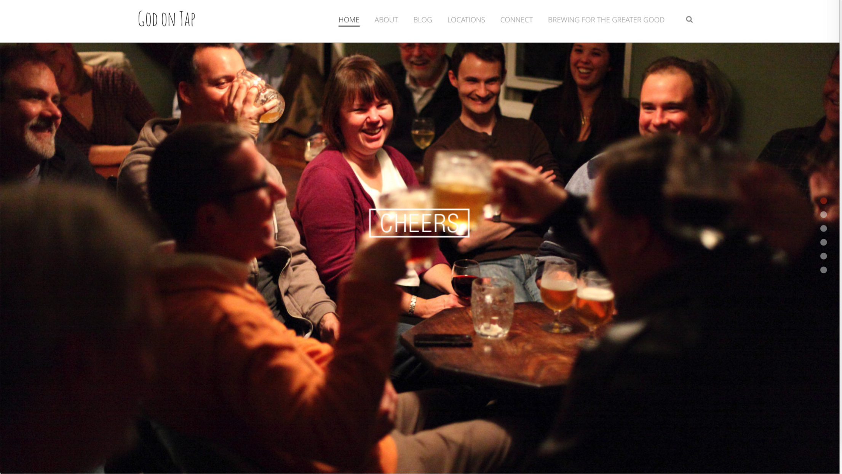
#3. Missional

Slide 30
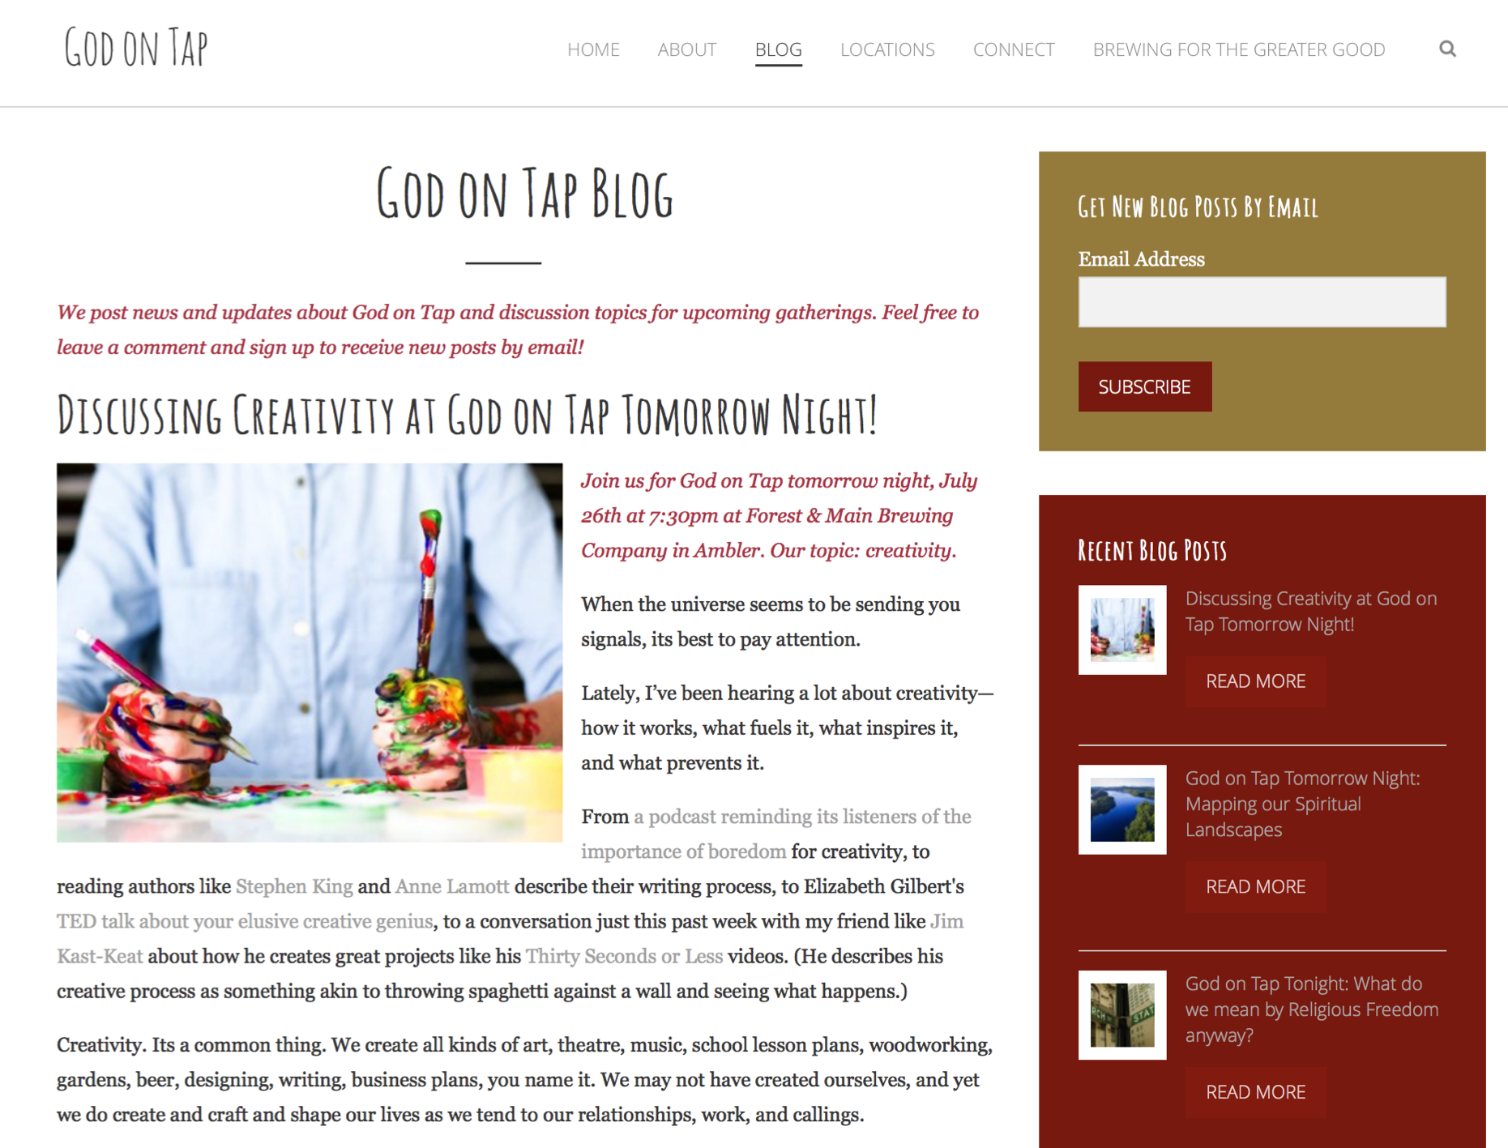

Slide 31
#4. Extend the Event
Church Event or Program
At Home & Daily Life

Slide 32
Website
Digital Content to Extend & Deepen Event
Social Media
Interaction
Multiple Formats
Offering the Event in New Formats
Communication
Demonstration
Connection
Event

Slide 33
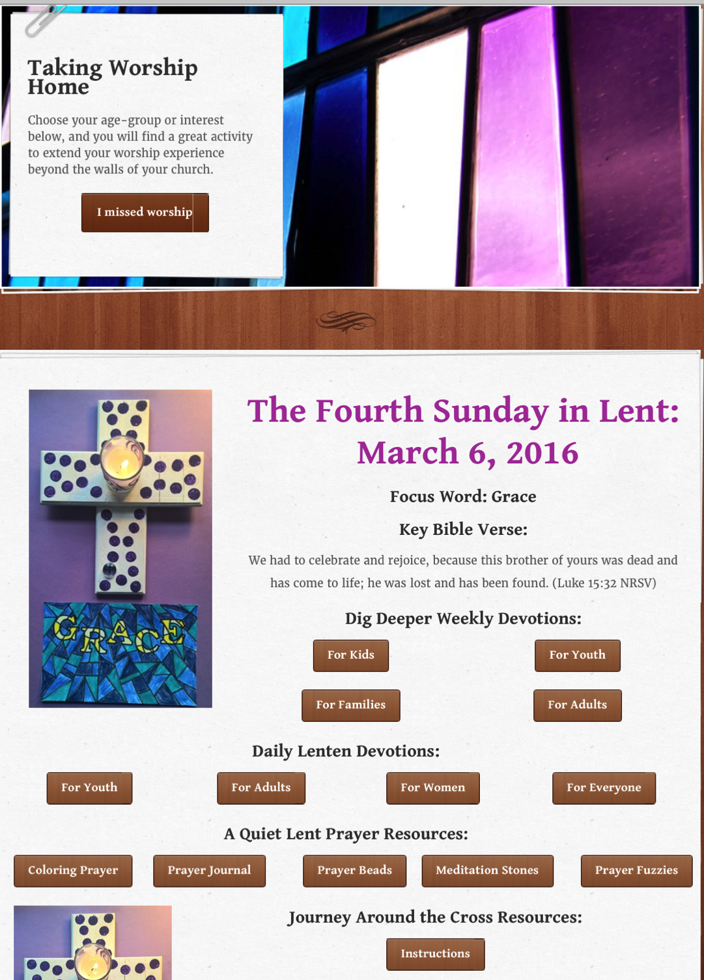
Sunday Worship Tri-Saints Lutheran Church, NE

Slide 34
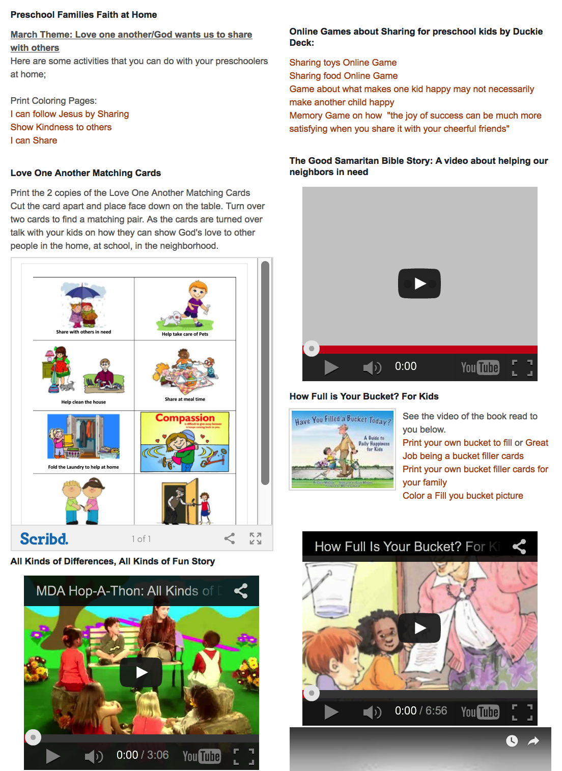
Preschool Faith Formation @ Home First Church Simsbury, CT

Slide 35
#5. Build on an Event/Experience (Sacraments, VBS, Mission Trip, and much more)
Baptism
Preparing
Experiencing
Living
Forming faith in the young family:
Celebration of Baptism
Learning
Mentor/coach
Rituals
Family gatherings
Reading Bible
Prayer
Rituals and milestones
Learning
Caring conversations
Parent formation
Prayers from the Community
Parent faith forming skills

Slide 36
#3. Celebrating Milestones: Baptism
Church
Home
Mentors/Coaches
Parent preparation
Family gathering
Ritual
Intergenerational connection
Celebration of Baptism
Reunion
Baptismal anniversaries
Caring conversations and storytelling
Celebrating rituals
Learning
Praying
Reading the Bible
Serving
Worshipping together

Slide 37
#6. Flip the Model
@ Home / Daily Life
Exploring the Content - print, audio, video, activities
@ The Program
Applying the Content: Create – Practice - Perform - Participate

Slide 38
Christian Initiation & New Member Formation

Slide 39
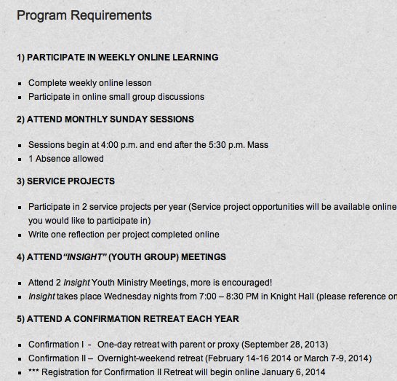
Confirmation

Slide 40
#7. Integrate Online and Gathered

Slide 41
#8. Online 40-Day Lent Curriculum
Church ➔ | Daily & Home | ⬅ Online
Ash Wednesday Lenten Sunday liturgies Stations of the Cross Lenten prayer Lenten retreat Lenten service Lenten soup suppers | Fasting Praying Service/Almsgiving Lectionary reflection Family Lenten activities | Lenten learning resources Lenten calendar Daily Lenten prayer Weekly table prayer Video resources Online retreat experience

Slide 42
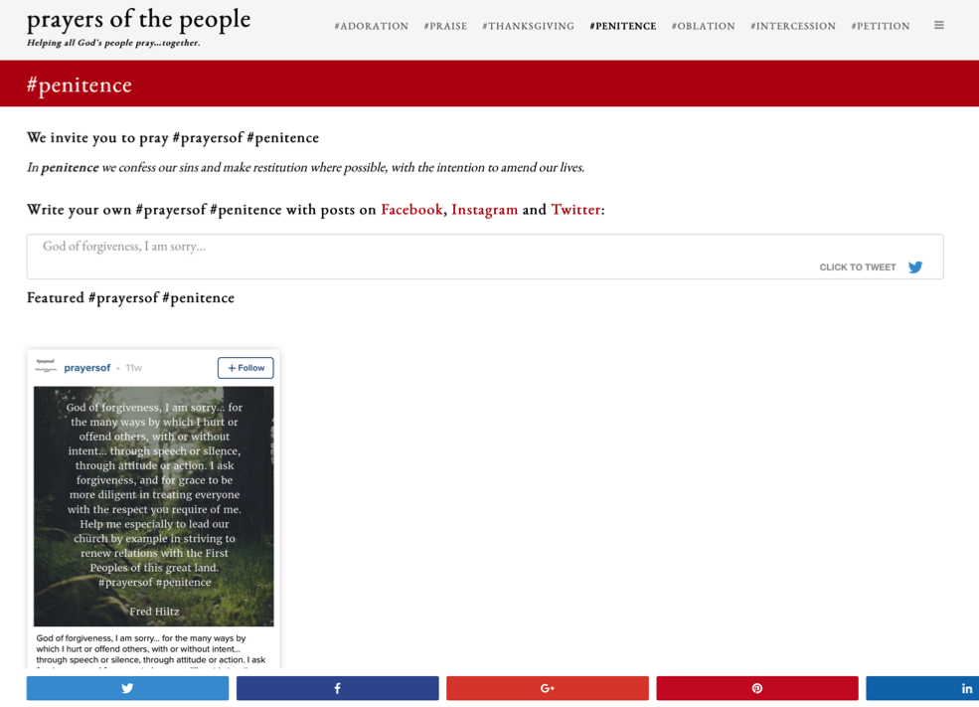
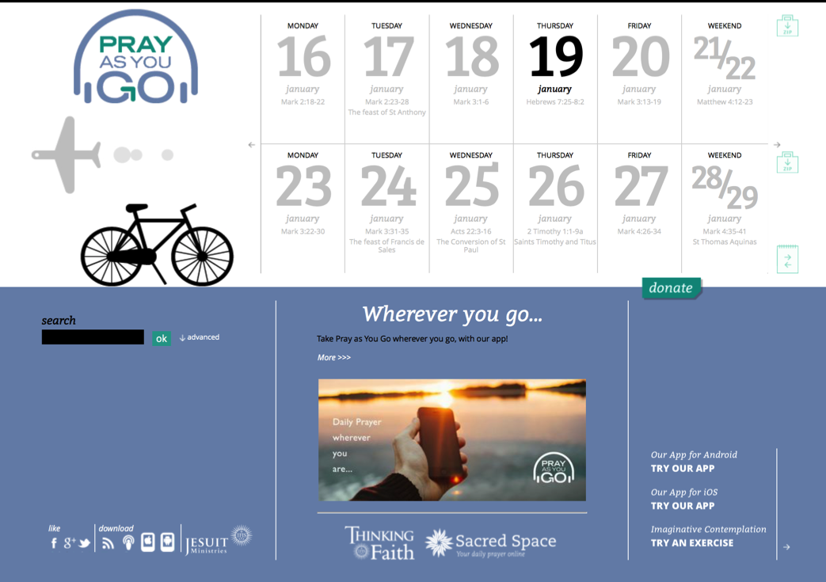
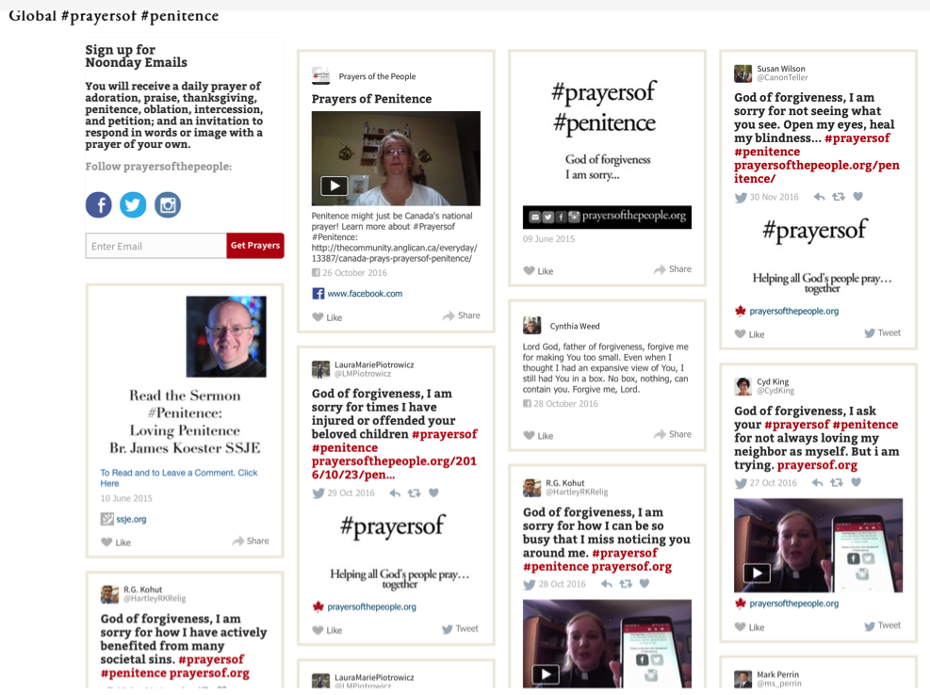
#8. Online Prayer

Slide 43
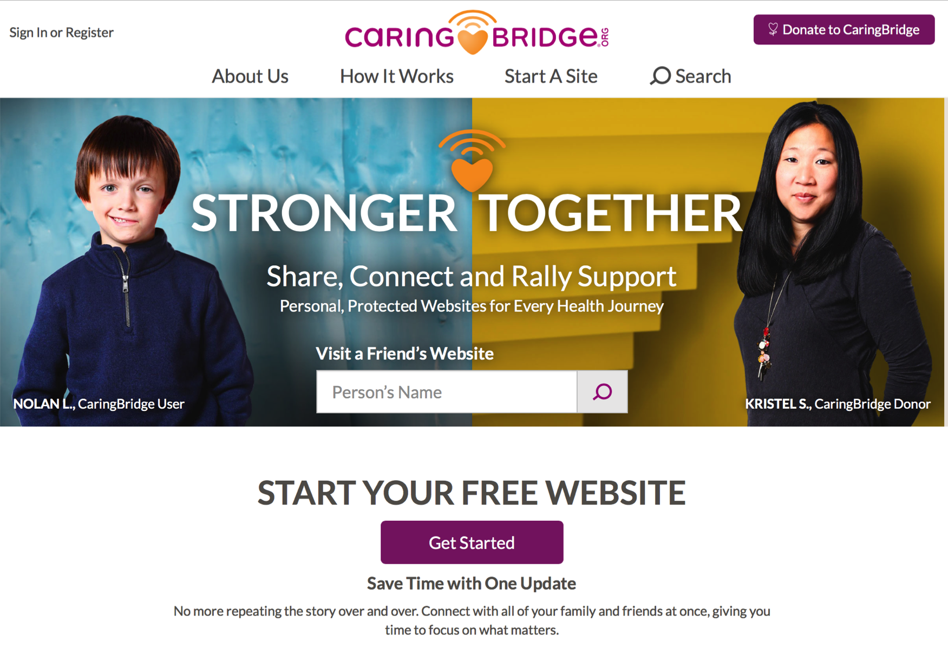
#10. Pastoral Care

Slide 44
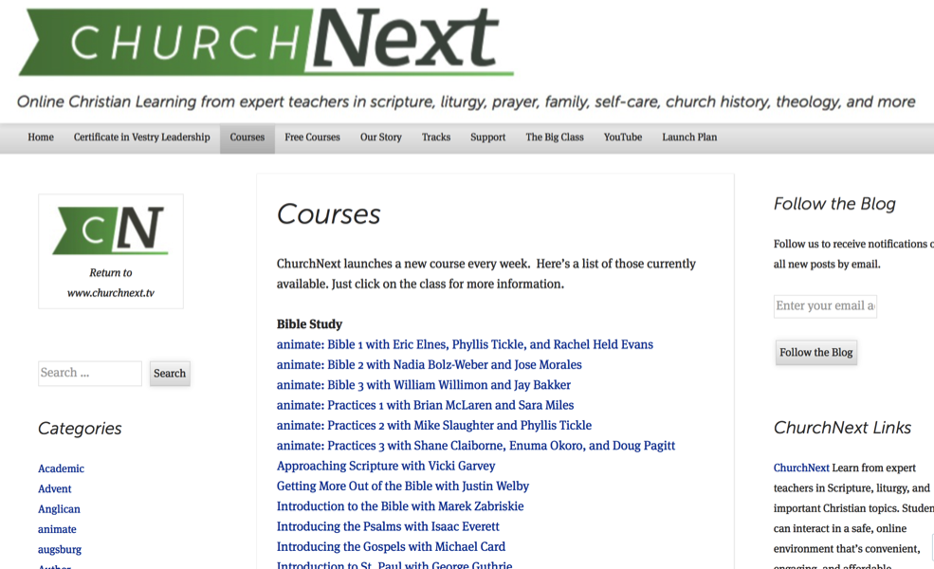
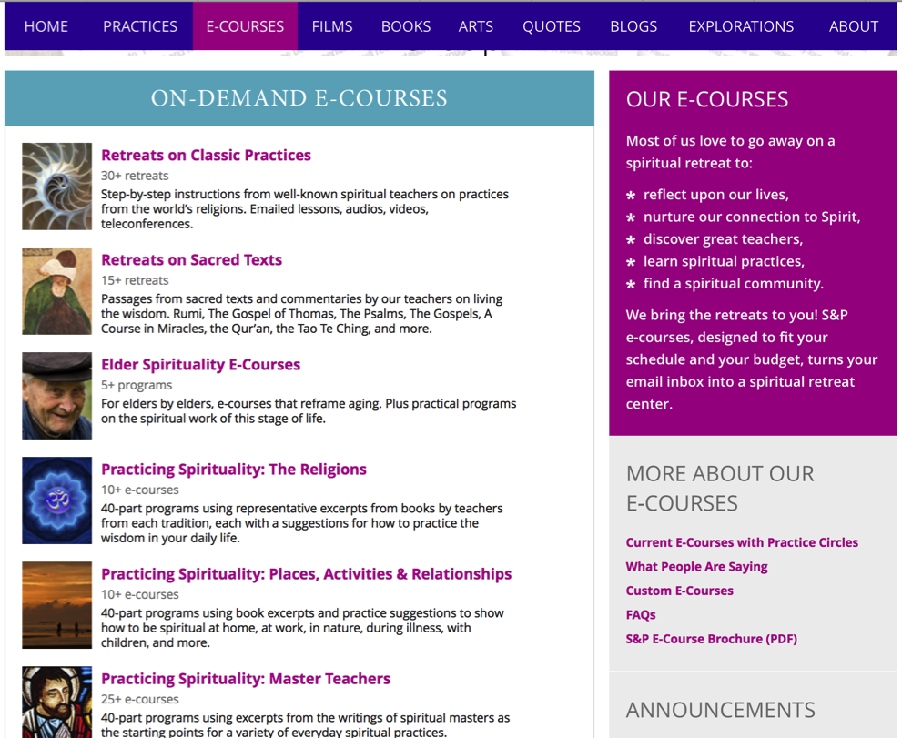
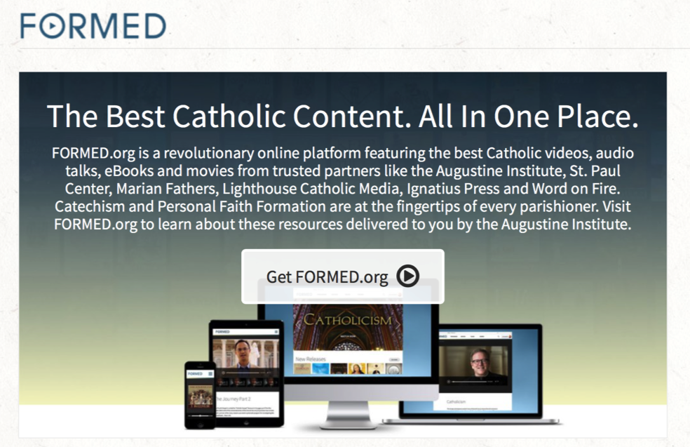
#11. Online Learning

Slide 45
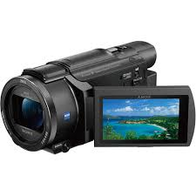
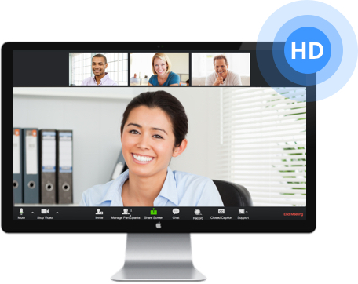
#12. Video Programming & Library
Stream live presentations at church
Offer webinars as an alternative to a church-based program
Record live presentations and webinars to create a home-grown library of video content
Develop multiple versions of a program:
design and conduct a gathered program – record it
Edit the video in segments
Design individual, mentored, or small group study with a guide and resources

Slide 46
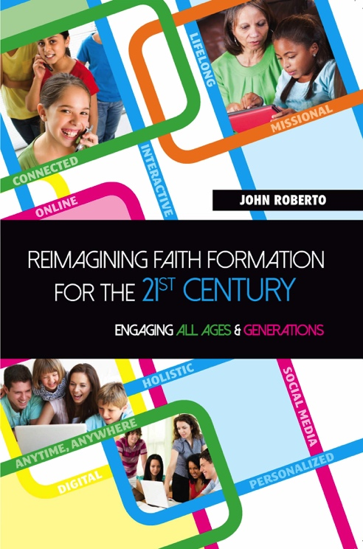
Lifelong Faith Books

