Slide 1
Jim Merhaut
www.CoachingToConnect.com
www.JDEicherAndTheGoodnights.com
Notes:
Introduce self, website, family.

Slide 2
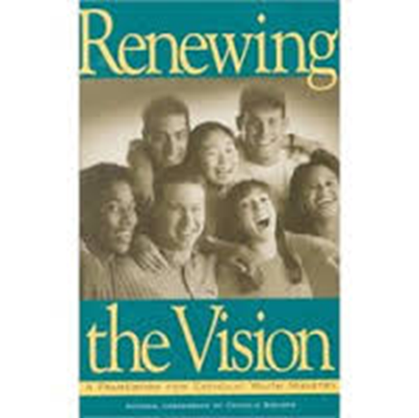
Youth Ministry with an Intergenerational Context:
“Adolescents need to experience the faith at home and participate in the Lord’s mission with their families.”
“The church should be a place where young people are welcomed, grow in Jesus Christ, and minister side by side with the adults of the community.”
“Young people are more likely to gain a sense of identity in the community if they are regarded as full-fledged members.”
“Ministry with adolescents recognizes that the family has the primary responsibility for the faith formation of young people and that the church community shares in it.”
“Ministry with adolescents recognizes the importance of the intergenerational faith community in sharing faith and promoting healthy growth in adolescents…. Age specific programs can be transformed into intergenerational programming and new intergenerational programs that incorporate young people can be developed.”
Notes:
Working in church administration when this dropped onto my desk.
“Adolescents need to experience the faith at home and participate in the Lord’s mission with their families.”
“The church should be a place where young people are welcomed, grow in Jesus Christ, and minister side by side with the adults of the community.”
“Young people are more likely to gain a sense of identity in the community if they are regarded as full-fledged members.”
“Ministry with adolescents recognizes that the family has the primary responsibility for the faith formation of young people and that the church community shares in it.”
“Ministry with adolescents recognizes the importance of the intergenerational faith community in sharing faith and promoting healthy growth in adolescents…. Age specific programs can be transformed into intergenerational programming and new intergenerational programs that incorporate young people can be developed.”

Slide 3
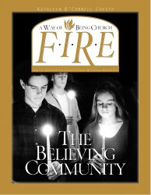
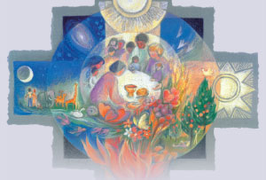
1997-2003: St. Michael Church, Canfield, OH
1997 – Developed a Pilot Program with F.I.R.E. – one group with 7 families
1998 Expanded FIRE to 40 families
1999 – Developed a home faith formation program
2003 – 25% of families choosing family faith formation
2003 – Generations of Faith – All faith formation becomes family/intergenerational
Notes:
FIRE Pilot in 1997
Led to 7 new groups in 1998 – 40 families
Developed DCC in 1999
2003 GOF – That was the death nail for classroom faith formation at St. Michael and they’ve never turned back.
Spent the last ten years experimenting with numerous other ways to experience intergenerational Christian community, which brings us to today. Today, I’m thrilled and extremely hopeful to have so many dedicated intergenerational practitioners and supporters in one place with one purpose.
Hot off the presses diocesan survey:
The number one faith formation priority = Family faith formation
The dead last faith formation priority = Catholic schools
I really believe the time is ripe for a transformation in the way churches practice ministry. Age segregation has created more problems than it has solved and we need a new model for the 21st century. Let’s do this!

Slide 4
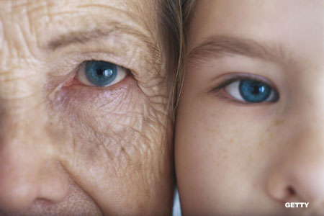
Reflection 2
All initial training for all worship ministers of every age is done together.
Three objectives for the one-hour training session:
To introduce ministers and their dreams for worship to each other
To introduce the ministries
To introduce the meaning of worship leadership
Notes:
I am doing consulting and extensive ministry training for a 1200 household Catholic church in Austintown, Ohio. One of the identified needs at this church was the need to engage more youth in worship ministries. Their worship ministries fall into the following categories:
Music ministry
Lector
Eucharistic Minister
Usher
Greeter
Altar Server
The church already had children ministering as altar servers, but there were not children or teens in any of the other ministry areas except for one 15-year-old girl who was a greeter.
All of these ministry areas did all of their training separately from each other.
The new model:
All initial training for all worship ministers of every age is done together. We developed a one-hour session in which we accomplish three things:
introduce ministers and their dreams for worship to each other,
introduce the ministries,
and introduce the meaning of worship leadership.

Slide 5
Reflection 3
Principles 5, 6, 7, 9, 11, 14
The generations are mutually beneficial!
Notes:
mutual benefits that the generations offer to each other developmentally and spiritually as the generations teach each other and learn from each other.

Slide 6
The Plural Body -1 Corinthians 6:19
Do you not know that your body is a temple of the Holy Spirit within you?
Do you (Gk plural)
not know that your (Gk plural and therefore collective) body
is a temple of the Holy Spirit within you (Gk plural)?
Paul spells this out more explicitly in 1 Corinthians 12 - Body of Christ imagery.
Notes:
-American individualism blocks us from appreciating the original intention of this Bible passage.
-1st century mindset is always communal. You are nothing without the context of your community.
-John Pilch, Cultural World of Jesus, Cycle B, pg. 57
-You cannot be a full human self apart from a diverse experience of community.
-The image of God is not complete without everyone.
-Participation helps you find yourself.
-Youth Min Research 5/1 ratio of non-parent adult/teen

Slide 7
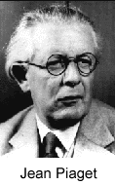
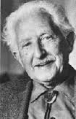
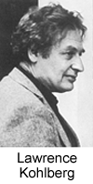
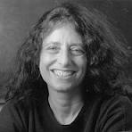
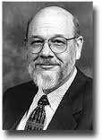
20th Century Developmental Theories
Jean Piaget – Cognitive Development
Erik Erikson – Psycho-social Development
Lawrence Kohlberg – Moral Development (boys)
Carol Gilligan – Moral Development (girls)
James Fowler – Faith Development
Notes:
The Mistake: We began separating people into their developmental stages to help them become expert in the stage of life they were experiencing. None of these theorists envisioned this age-segregated result.
In churches there are a number of things that drive us to separate the generations:
Misuse of developmental theory
Copying schools
Individualism
Church Growth strategies (separate the age groups… they’ll have more fun and join your church)

Slide 8
Benefits of Intergenerationality
Generativity (Erikson)
Holding Environment (Kegan)
Prayer Maturity (Holly Allen)
Youth Ministry Works Better (Martinson, Black, Roberto)
Young people feel more at home in church (Search Institute)
Notes:
FOR ADULTS: That’s not what the theorists intended (Erikson’s concept of generativity is a core life task that calls for attention to the generations behind you as a dynamic for healthy adult development.
Robert Kegan, Harvard Psychologist, coined the term “Holding Environment” People should be held comfortably enough in their developmental stage so as to experience the fullness of it, but not comfortably enough that they want to stay there forever.
When persons of a generation are regularly in the presence of persons of the next generations, the presence of the elders both comforts and nudges.
Consistent with Piaget’s idea the cognitive development is both natural and spurred on by social interaction.
HOLLY ALLEN: Children from churches that intentionally promote intergenerational relationships express a deeper prayer life than children from churches that separate the children from adults for programming. They refer to God more often in conversation. They refer to prayer as meaningful more often in conversation. They describe God in relationship terms rather than exclusively in knowledge terms.
The National Study, The Spirit & Culture of Youth Ministry, listed the top characteristic of the best youth ministry programs as intergenerational. A strong youth group came in second. Kids who go to college from intentionally intergenerational churches do better in all of the major social and faith indicators than do kids from churches that kept them separated for programming.
FOR EVERYONE: Young people who develop personal relationships with at least five adults from church feel very connected to their church and they show more respect for older people while older people become more comfortable with teens and children. (Tell the story of Susan, “I don’t do children!” pre-Appalachia.

Slide 9
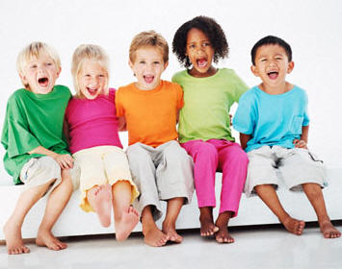
Matthew 18:3
“Truly I tell you, unless you change and become like children, you will never enter the kingdom of heaven.”
Notes:
Adults need to be in the presence of children to capture a glimpse of what kingdom living is like.

Slide 10
Reflection 4
Envision the future

Slide 11
SA
F
P
F
S
S
c
c
S
S
Key:
S = spouse
P = parent & no living spouse
SA = single adult
F = friend or extended family
C = child
c
Notes:
The entire diagram is a symbol of an intergenerational small group.
Blue circles represent families (various kinds of families), not necessarily households.
The orange lines represent the relational connections in families. The thicker the line, the more significant is the relationship in terms of what we know about family stability.
The thickness of the relational connection lines show priority of relationship.
The diagram represents the complexity of family realities today and the need for not only us to understand different kinds of families but to use family groupings in ministry as a way to help families appreciate and love families that are different from their own.

Slide 12
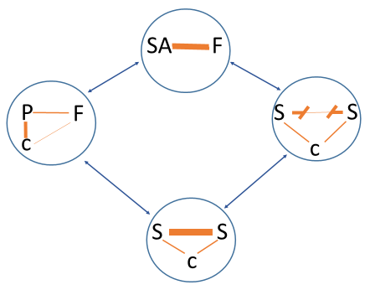
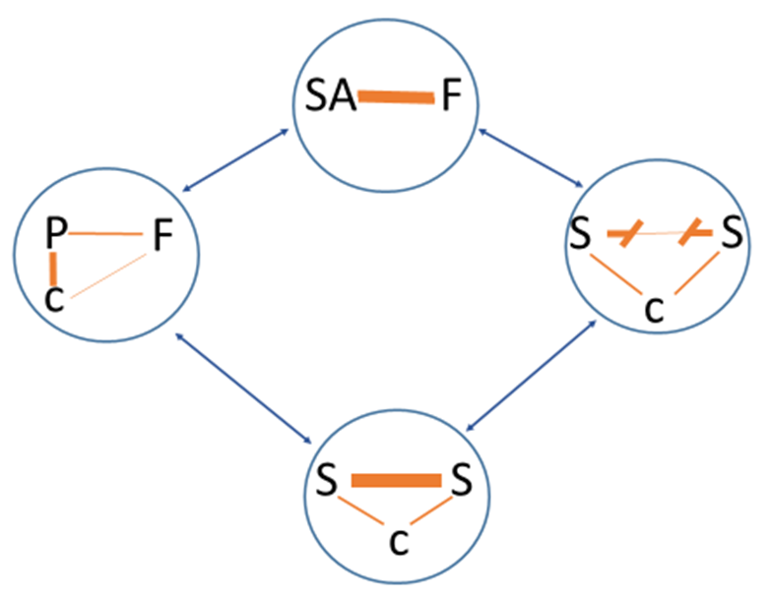
Grouping with common characteristics and diverse characteristics creates an effective holding environment (Kegan). The common characteristics between like-families makes the holding environment comfortable enough to encourage exploration. The diversity squeezes the holding environment and encourages each family type to think beyond itself and grow from the diverse perspectives that are shared in the group.
Notes:
What would happen if you doubled this group to maximize the benefits of the peer experience within a diverse intergenerational context?

Slide 13
Small and Diverse Igen Groups
Why are diverse relationships important?
What blocks the motivation to pursue diverse relationships?
How can we facilitate diversity in our groupings?
How can we think about family groups as microcosms for the church?
Why is small beautiful?
How can we facilitate the small group within a large church?
Notes:
Just take a look at these questions quietly for a moment and jot down any thoughts that you might want to share later in your small groups.

Slide 14
Reflection 5 - Strategies
Context for Strategies
Theory: Values drive commitment – James Kouzes and Barry Posner
Goal: To inspire intergenerationality in the body of Christ through the known values of each generation.

Slide 15
VALUES DRIVE COMMITMENT
acceptance - affection - attentiveness - balance - beauty - belonging - cautiousness - changing - character - clarity commitment - community - competition -control - courage - creativity - detachment - determination - effectiveness - empowerment - enjoyment - entertainment - excellence - expertise - fairness - faith - family - fidelity - generosity - gentleness - happiness - health - honesty - hopefulness - hospitality - humility - imagination - investigation - joyfulness - justice - kindness knowing - laughter - leading - learning - mastery - mindfulness - modeling - order - oversight - patience - peace - people - power - practicality - preparedness - quality - relationship - results - rigor - safety - simplicity - sincerity - teaching - teamwork - thankfulness - tranquility - trust - truth - unity - usefulness - vision - volunteering - wellness - winning - wonder - zeal
Notes:
Depending upon who you talk to, there are anywhere from 150-400 words in the English language that represent distinct values.
Look at this very small sampling to get us all on the same page in terms of what we are talking about when we say values.
Pick one that is very important to you and apply it in your own mind as I develop the theoretical concept that values drive commitment.
OPTIONAL DISCUSSION
Select one that is very important to you.
Pair up with one other person. Describe what your value is and why it is important.
Rules for talker:
Describe what the value is
Describe why it is important to you
Describe how you would like to see this value nurtured by your organization
Rules for Listener:
No judgmental remarks
Only ask clarifying questions
Signal when you think you understand
Feedback to your parter in summary form what you understand

Slide 16
VALUES DRIVE COMMITMENT
Clarity of Organizational Values | High | 4.87 | 6.26
 | Low | 4.90 | 6.12
 |  | Low | High
 |  | Clarity of Personal Values
Notes:
As people report being more clear about organizational values, their reported commitment to the organization (scale of 1-7) does not increase or decrease in a statistically significant way.
As people report being more clear about their personal values, their reported level of commitment to the organization increases dramatically.
See pages 35-38 in The Truth about Leadership (Kouzes and Posner)

Slide 17
The Millennial Difference
When things get difficult in an organization (voluntary or employment) Baby Boomers stay and complain, Millennials just leave.
Churches cannot afford to ignore the values of this upcoming generation.

Slide 18
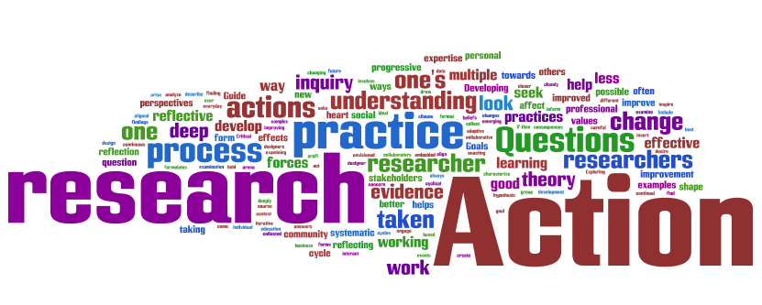
Strategies to Build Commitment by Connecting with Values
Focus groups, especially for underserved populations
Soft research: Keep track of your conversations
Surveys/Questionnaires of church members and non-members
Study and discuss generational research
Know the news and the trends
Notes:
Build your programs from the ground up. Start with their values, not the church’s values, and draw lines of meaning from what they value to what the church values.

