Slide 1
The Future of Intergenerational Christian Formation: A National Symposium
Kathie Amidei

Slide 2
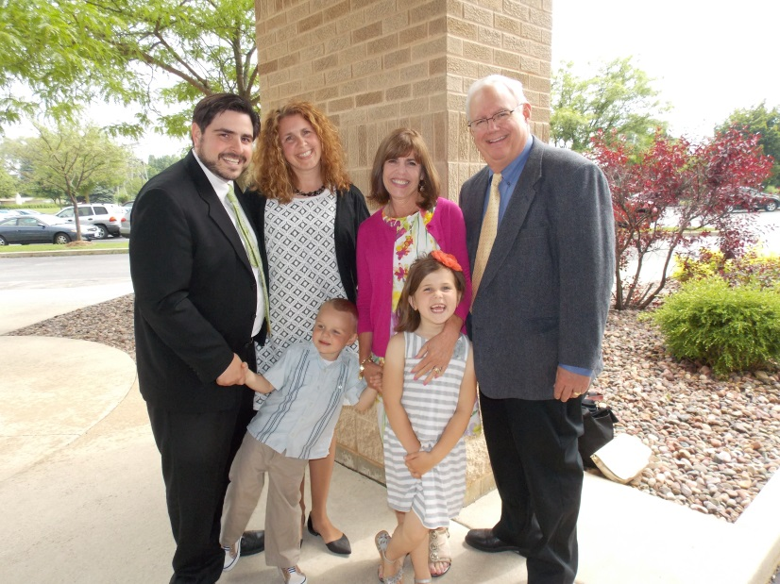
Session 1. The Growth and Development of Intergenerational Ministry
My Story
Where I started
What happened
How it changed me
And a child shall lead me!

Slide 3
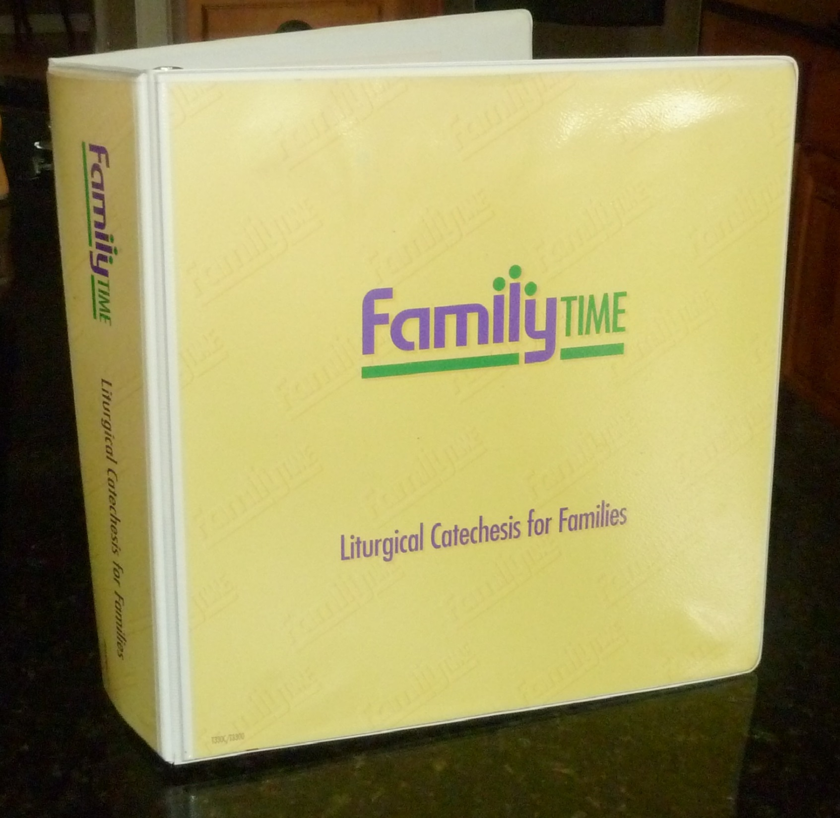

Slide 4
What allowed me to change my perspective…
Developmental Perspective: awareness that content can be delivered in a variety of way
Church setting that encouraged innovation: being an open minded community
Commitment to excellence and effectiveness
Willingness to assess if this is happening
Grace

Slide 5
Session 2. Models of Intergenerational Ministry and Faith Formation
From:
My Story
To:
A Story about Intergenerational Faith Formation

Slide 6
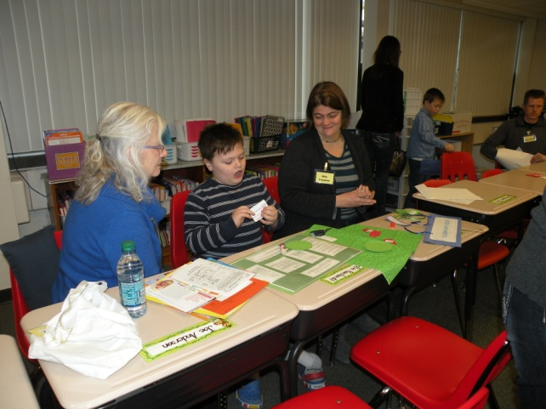
Comprehensive Faith Formation Model
What exactly is a Comprehensive Family Program?
It includes 4 key components:
1) Social/Community Building Time
2) Grade Level Classes & Adult sessions
3) Family Activity Session
4) Community/Family Prayer
During the grade level classes, children and youth are taught by volunteer catechists. Curriculum is comprehensive and systematic/ grade specific curriculum based on curriculum protocol
During the Family Activity Session the parents are involved in teaching their children faith through active learning curriculum
Parents are teachers and learners in this model

Slide 7
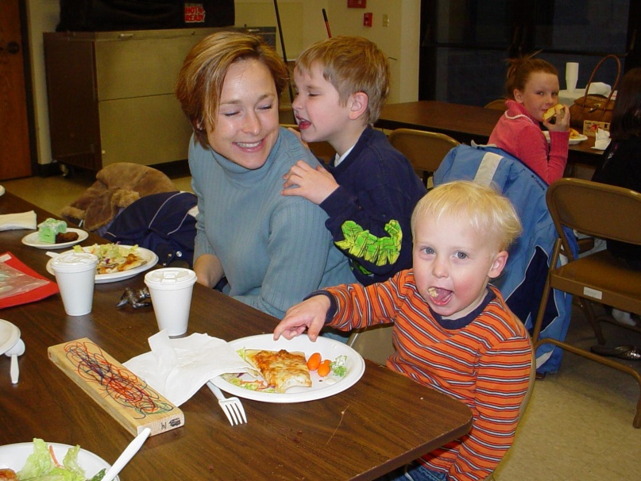
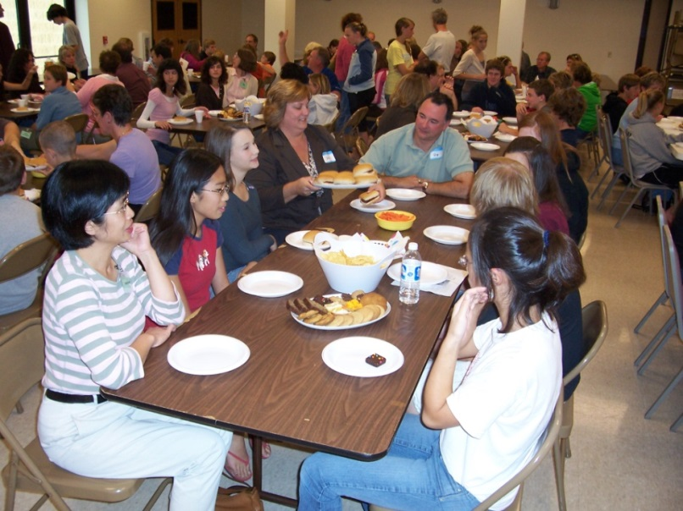
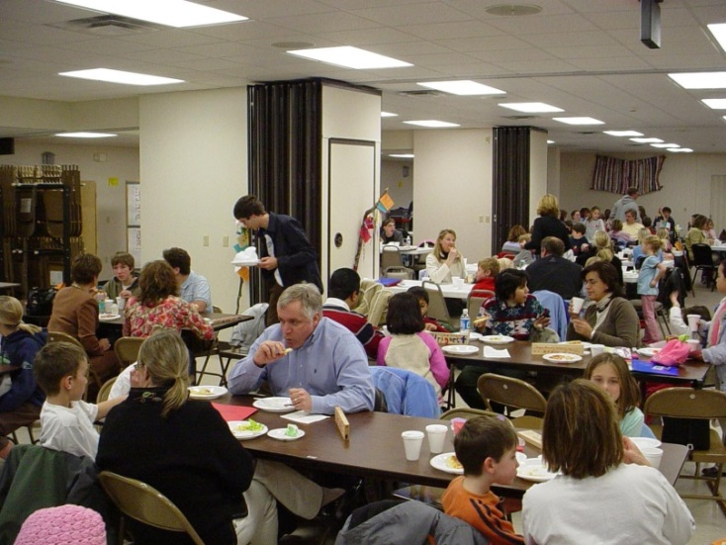
Components
1) Social/Community Building Time

Slide 8
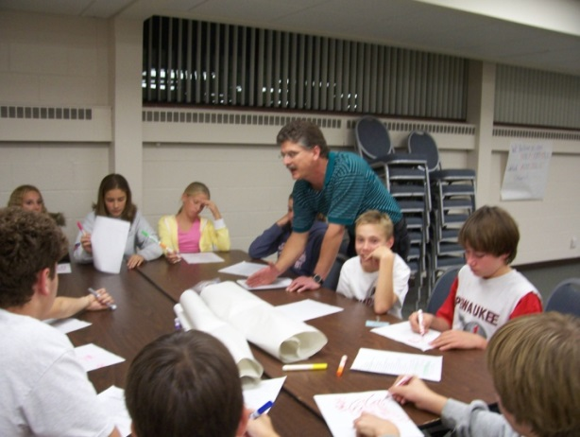
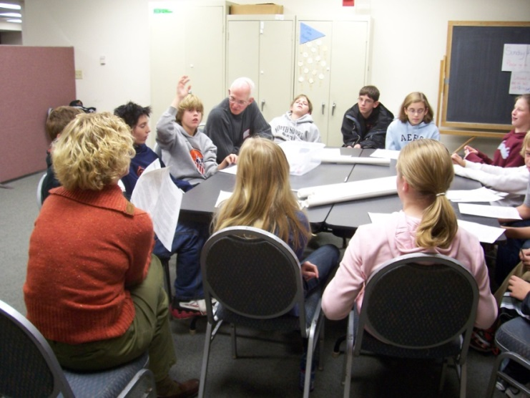
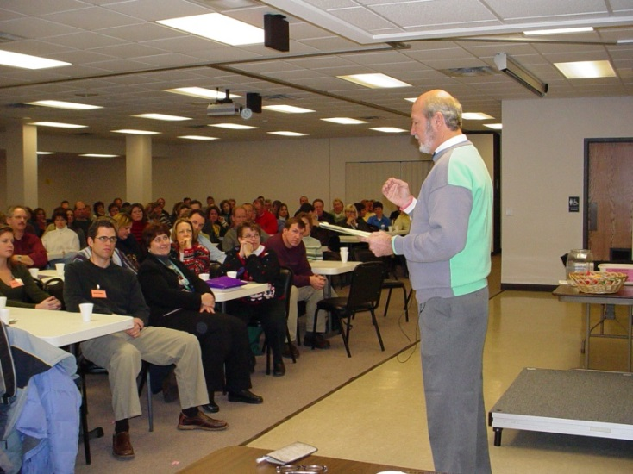
Components
2) Age Level for Preschool- Adult Sessions

Slide 9
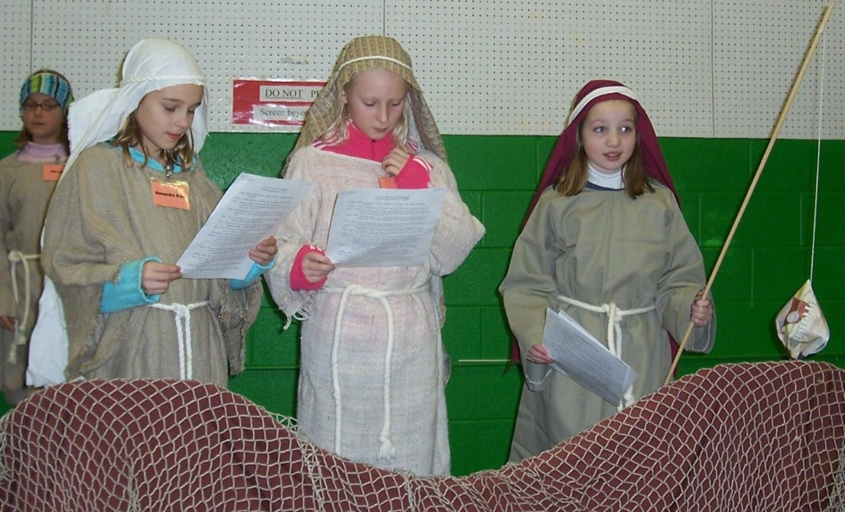
Components
3) Family Activity Session

Slide 10
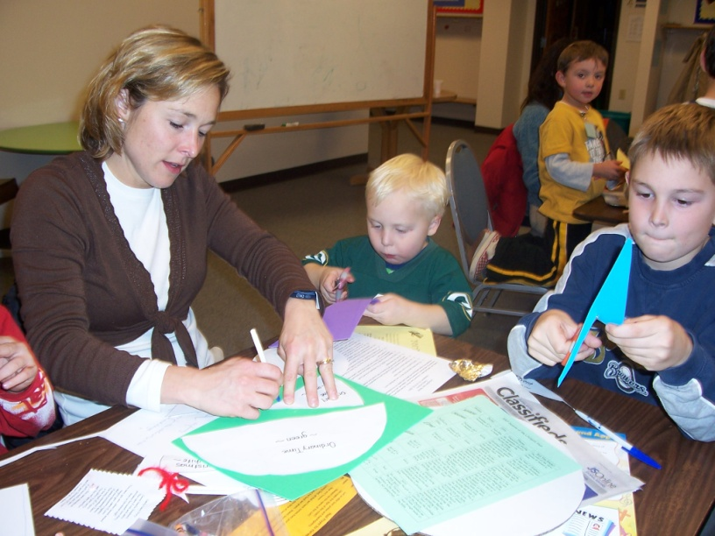
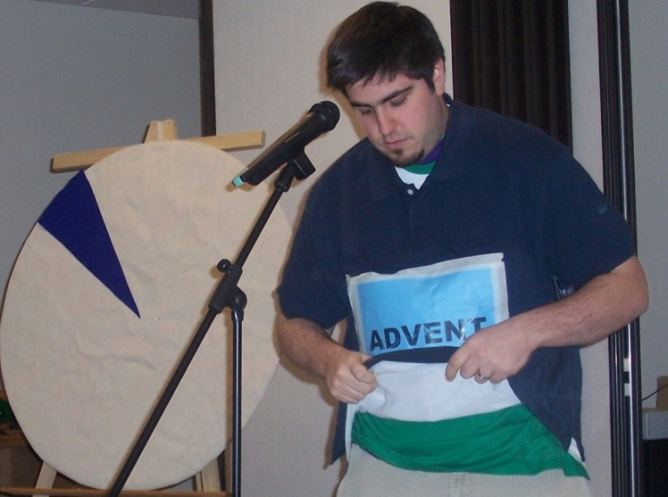
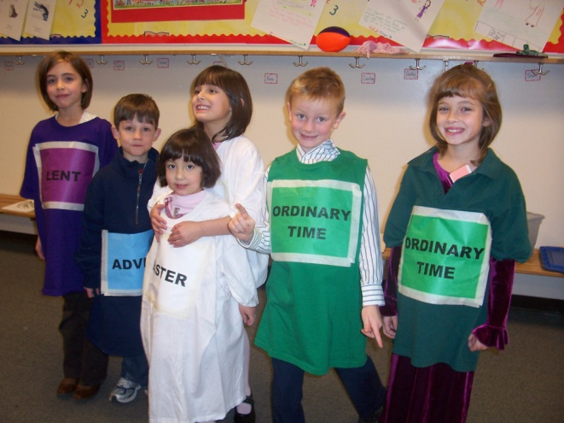
3) Family Activity Session

Slide 11
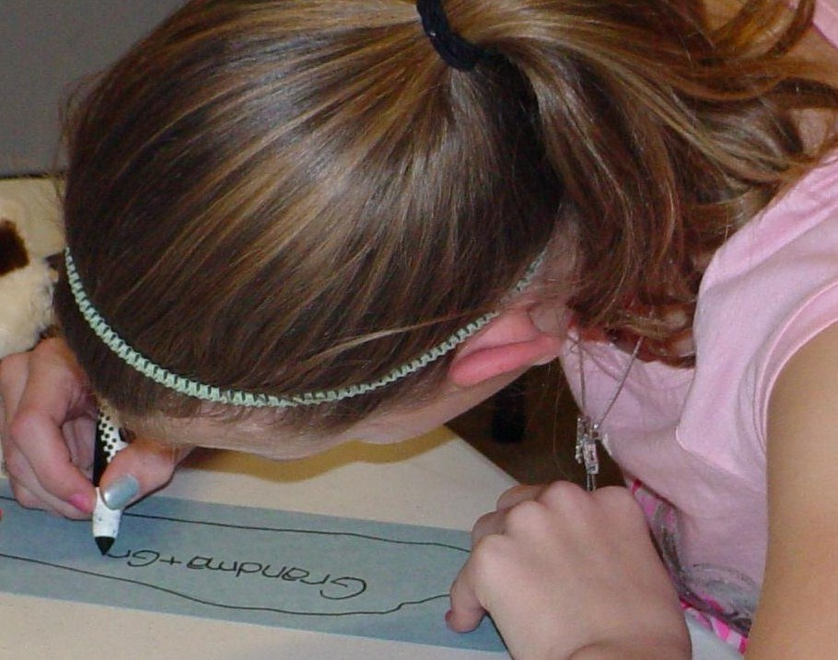
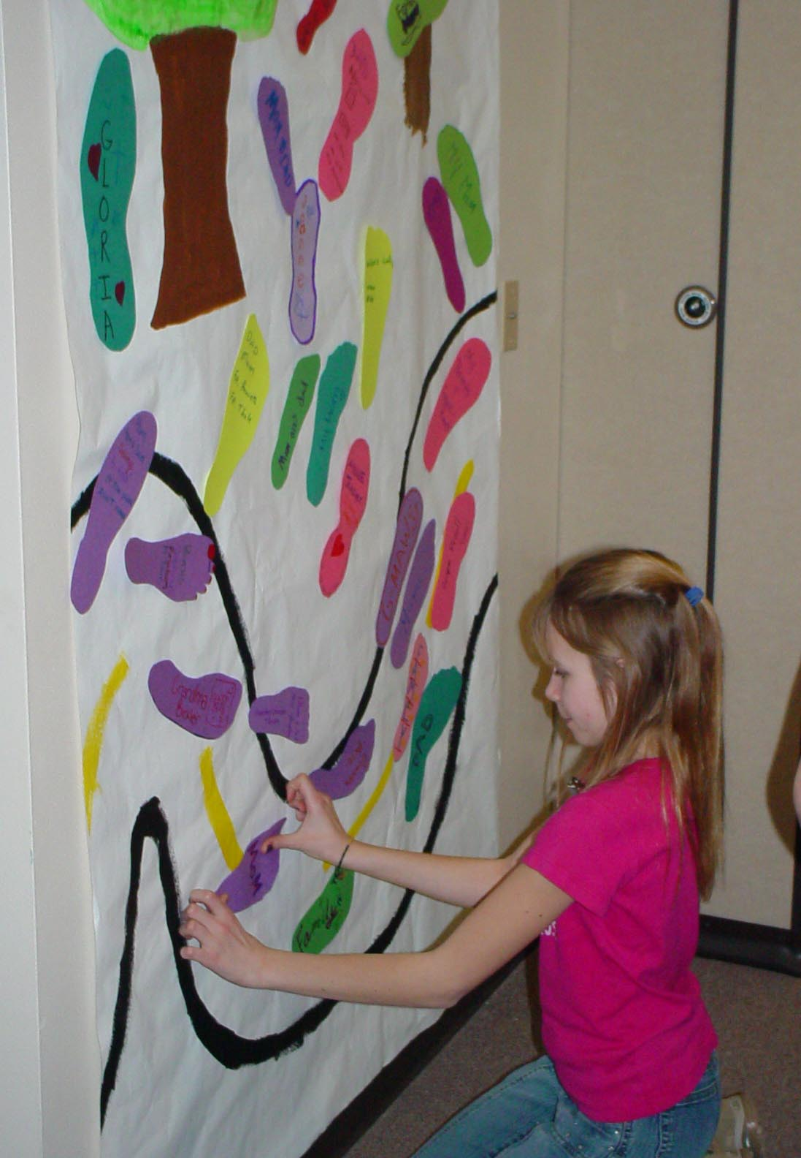
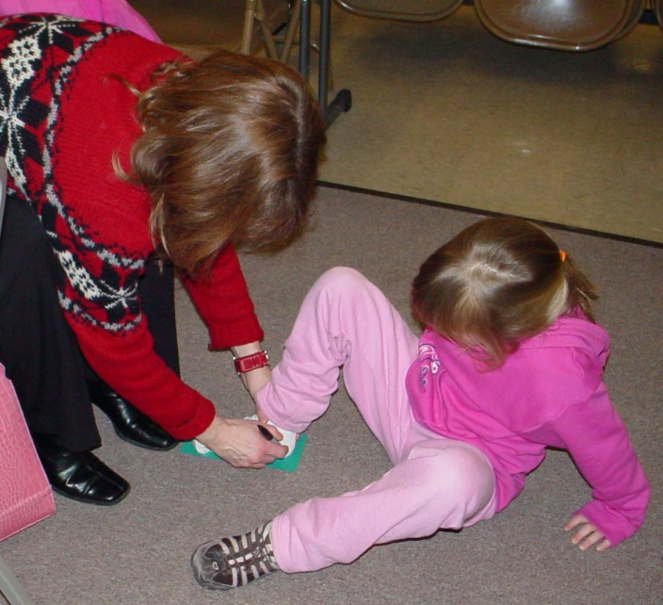
3) Family Activity Session

Slide 12
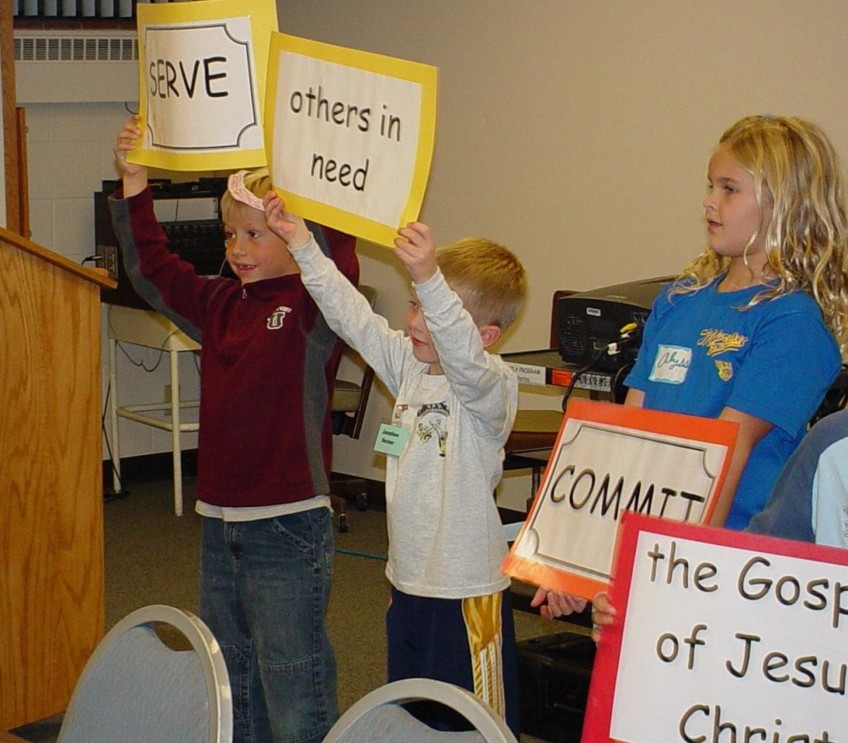
3) Family Activity Session

Slide 13
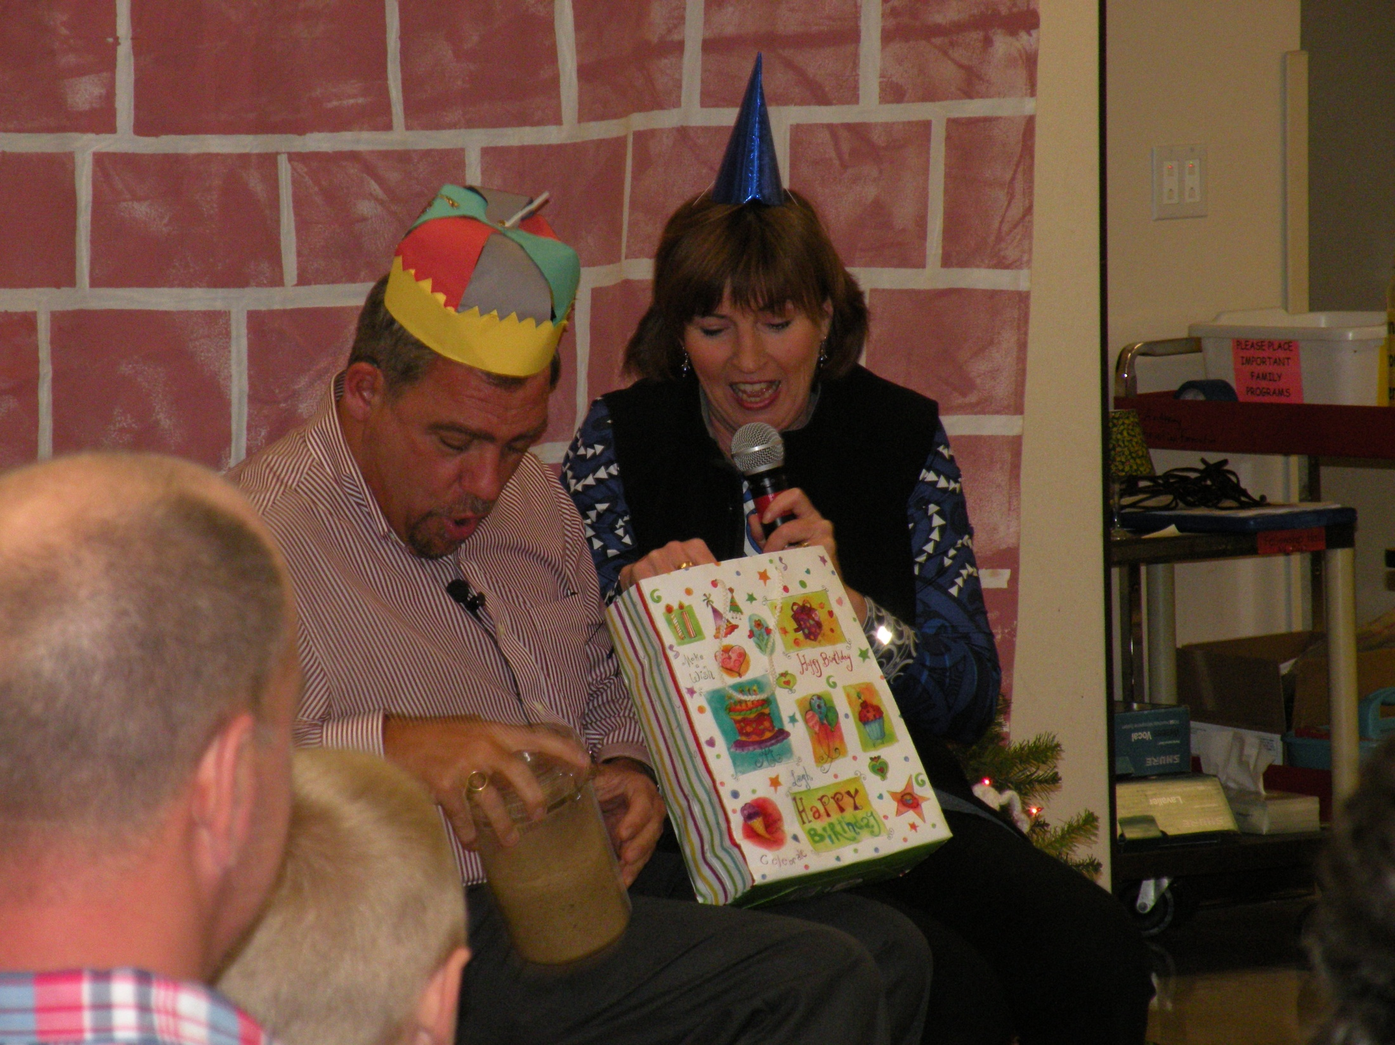
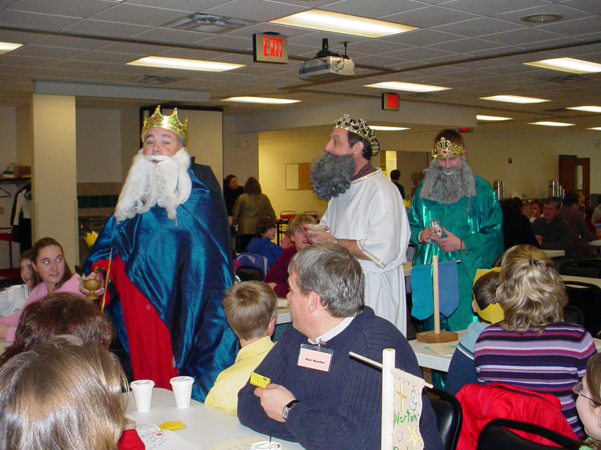

Slide 14
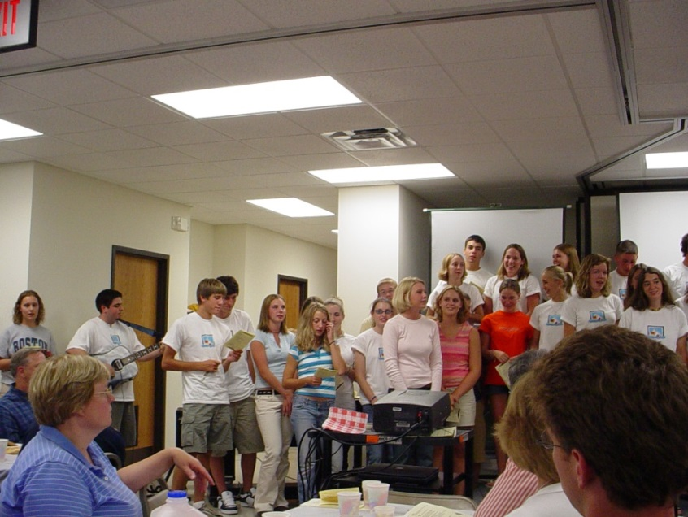
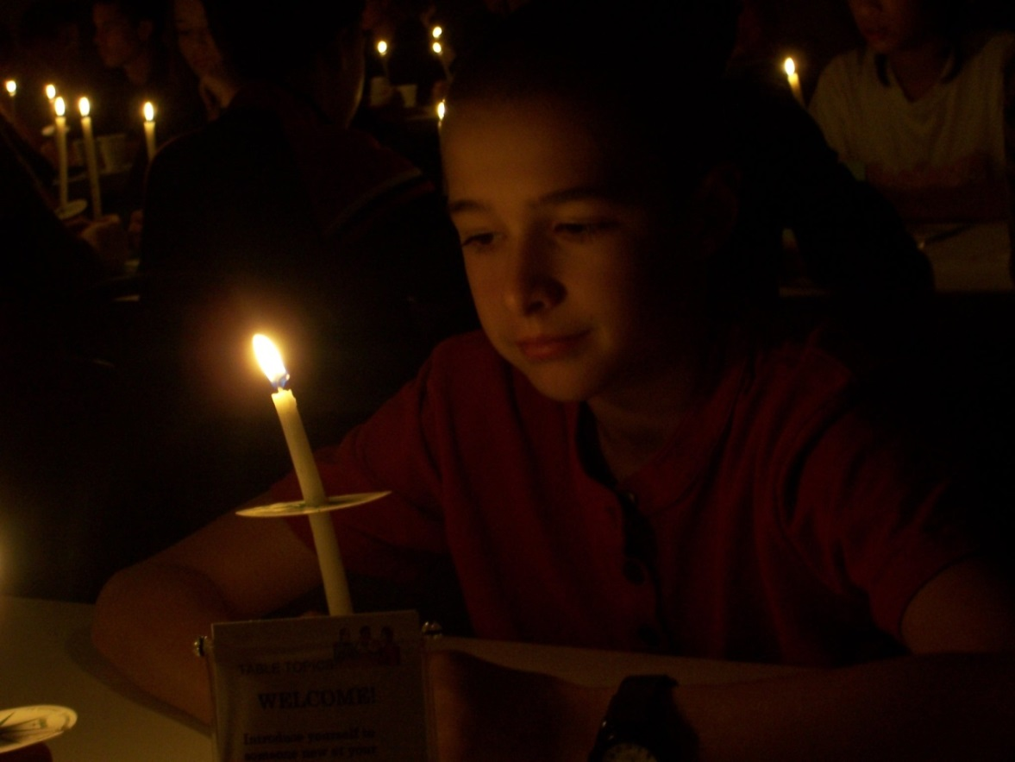
4) Community/Family Prayer

Slide 15
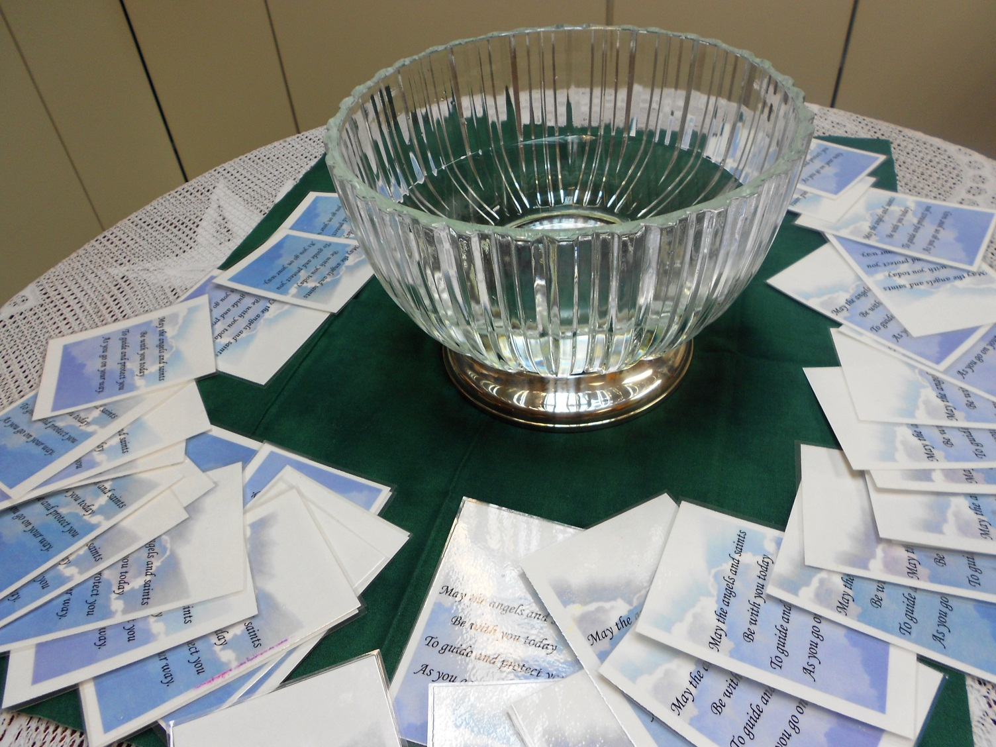
Notes:
One simple new practice of blessing your children and modeling that and encouraging them to do it at home.
We do this at Baptism and now all intergenerational gatherings.
Cindi Petre. Morgan Smith.

Slide 16
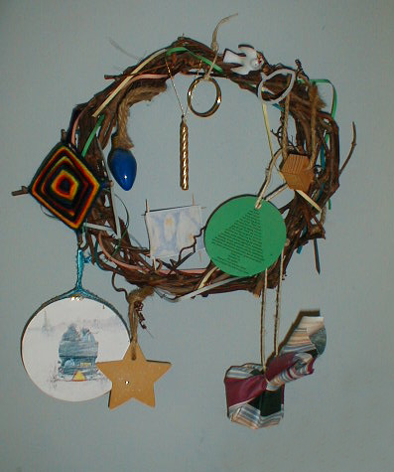

Slide 17
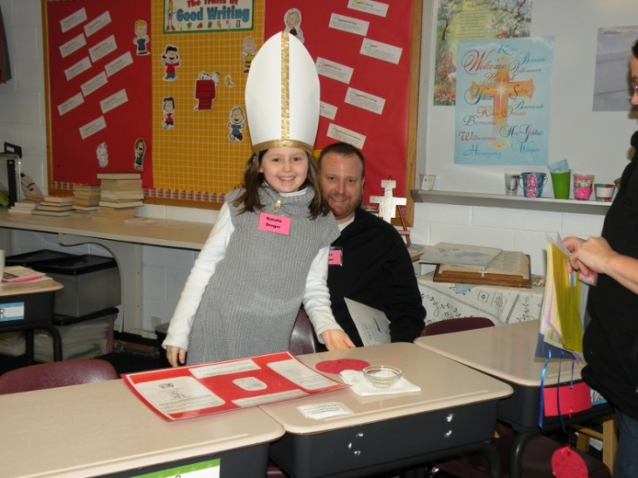
La Petite Model
What is the La Petite Family Program?
This model differs from the traditional model; on alternating sessions, parents spend the entire time with their children, working at learning centers, or the entire time in a small group discussion while their children are in class.

Slide 18
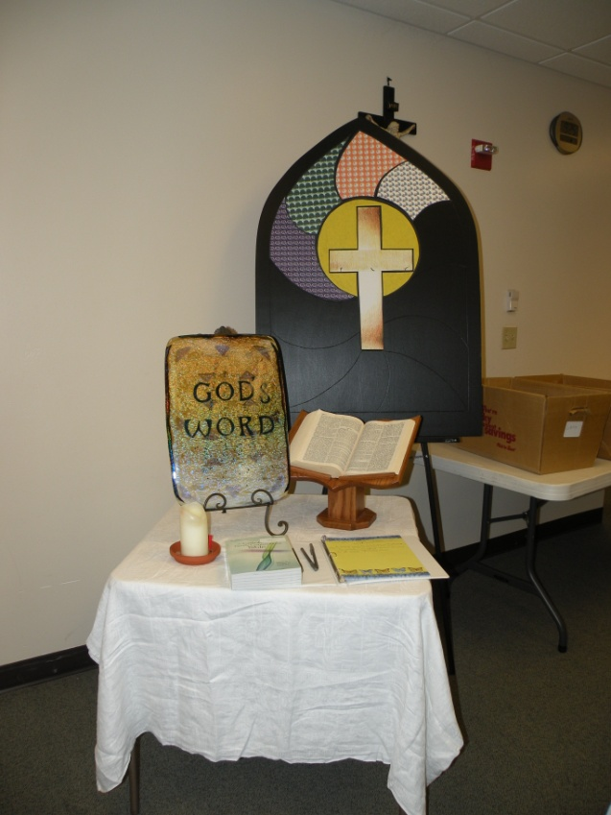
Centers

Slide 19
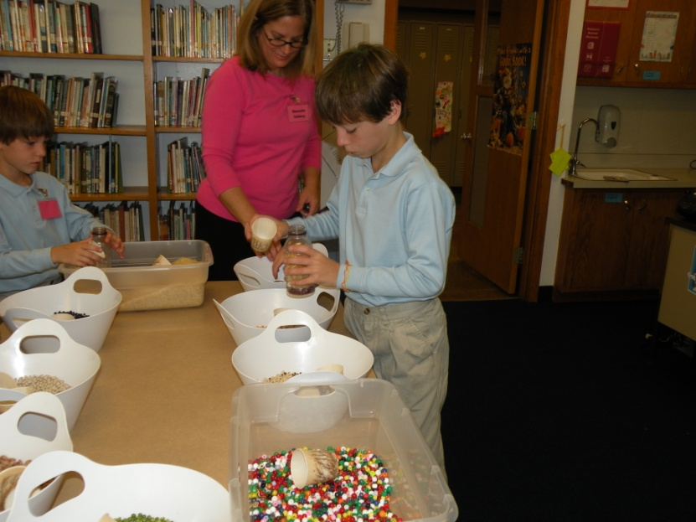
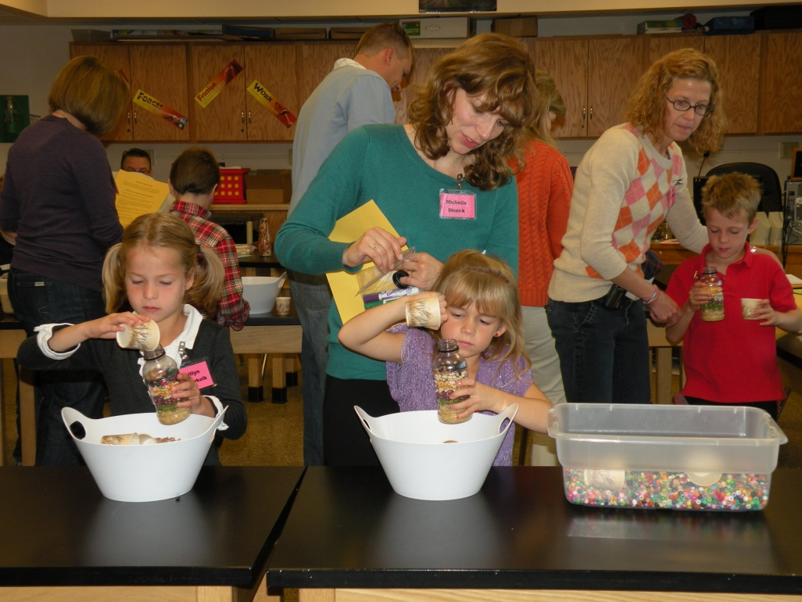
Centers

Slide 20
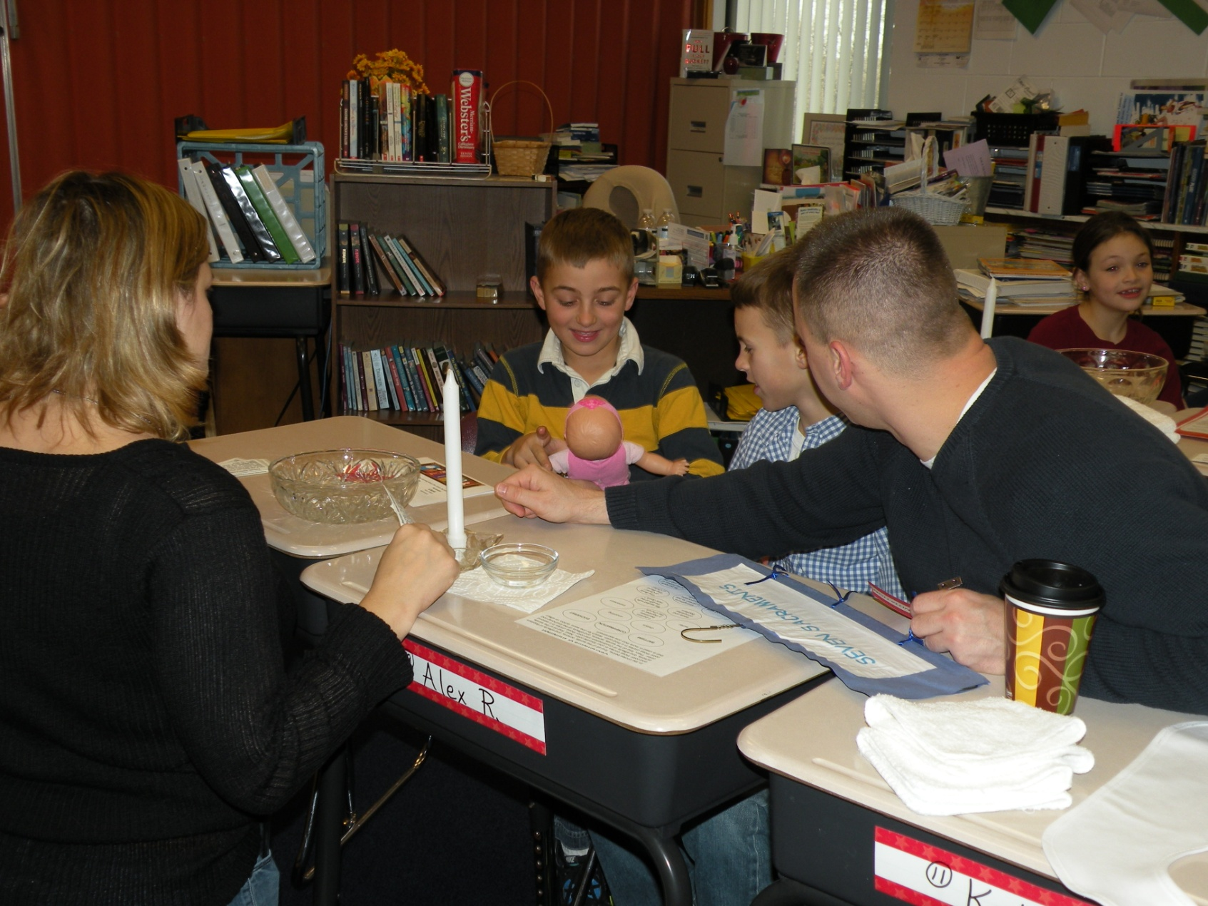

Slide 21
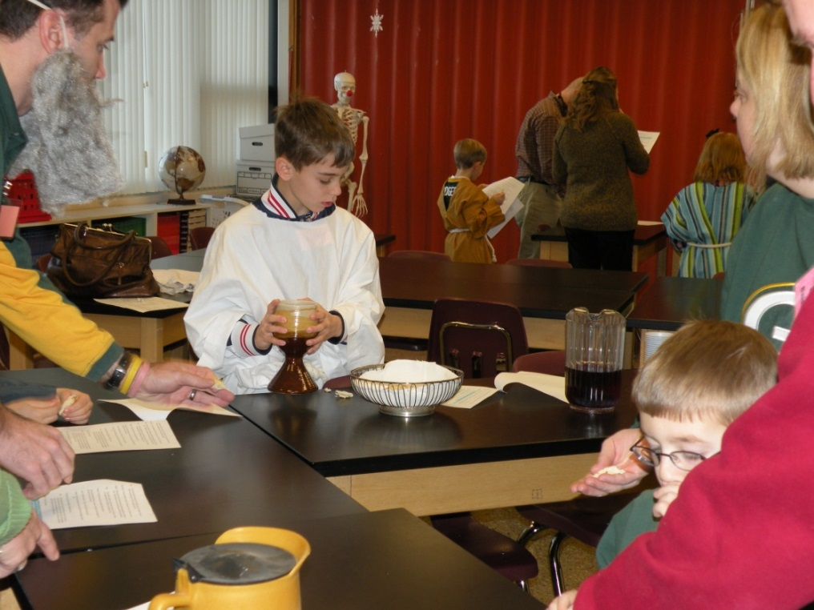
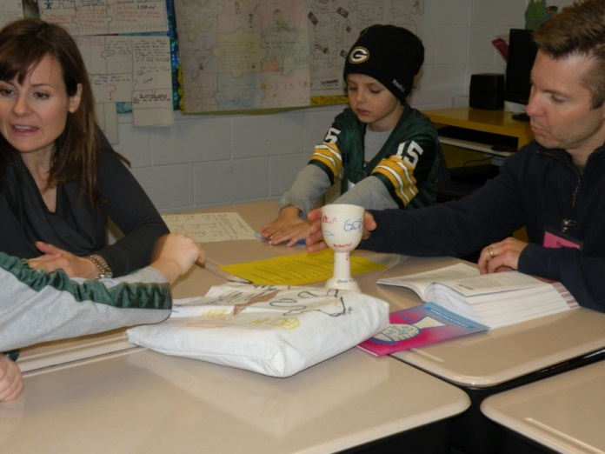
The Mass

Slide 22
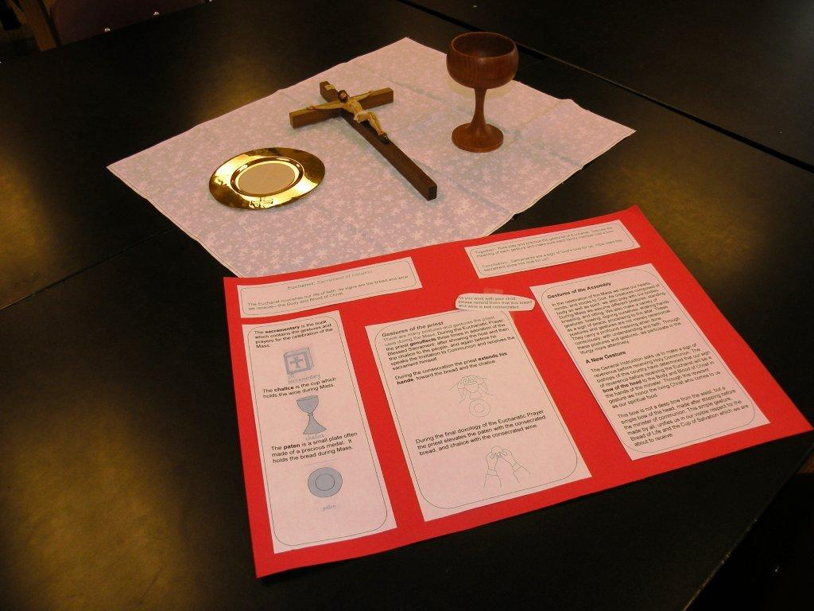

Slide 23
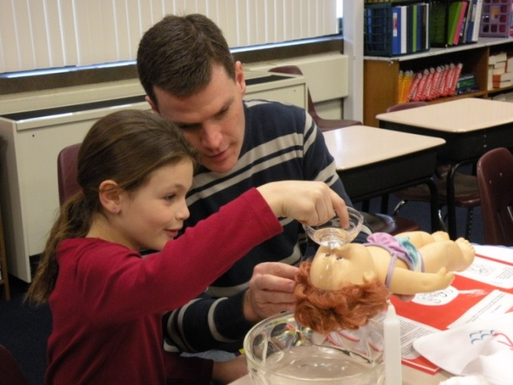
Why do parents respond to these models?
They want to be involved in their children’s faith formation
Want more information on what is happening in class
They hunger for more faith development too, but time is limited!

Slide 24
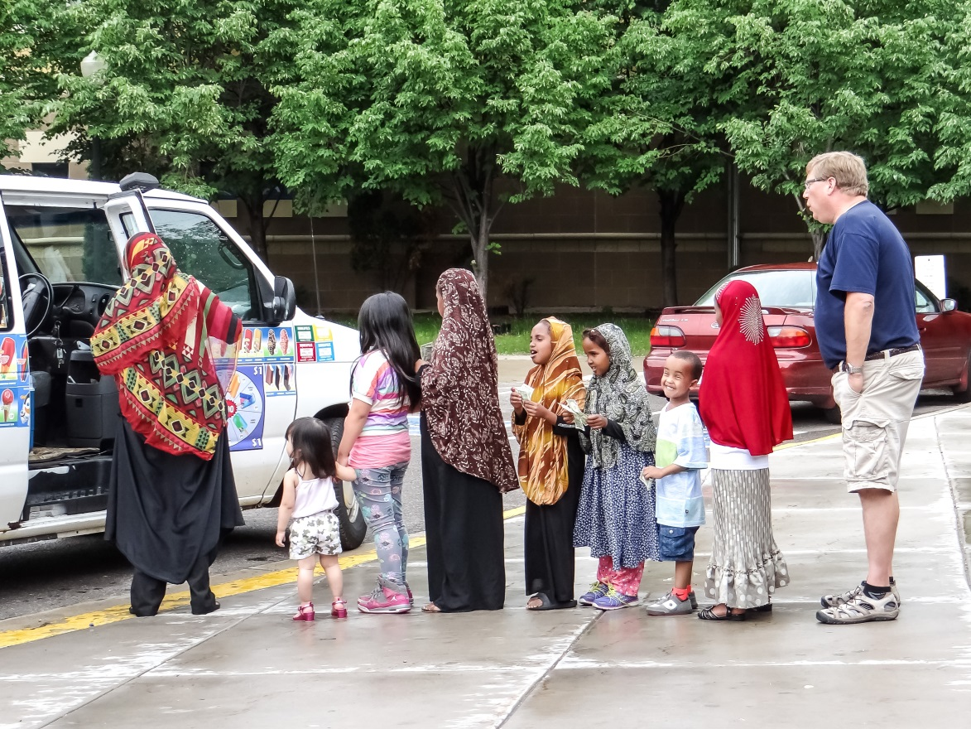
Session 3 Principles for Intergenerational Ministry
Culture/ Climate

Slide 25
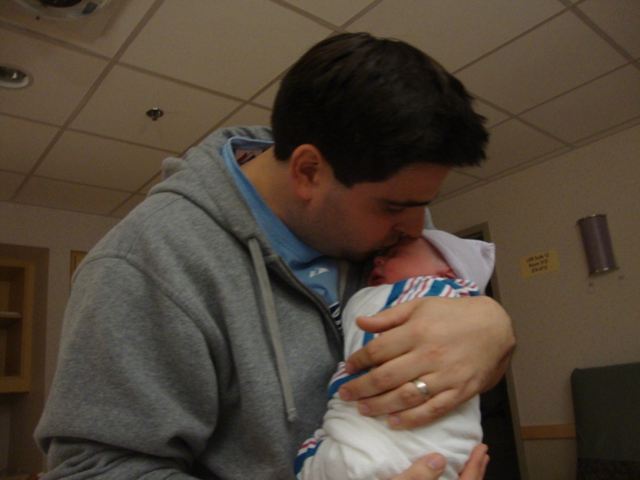
From Generation to Generation: A Case Study on Factors in Family and Faith Community Impacting Faith Development
\
Kathleen Troy Amidei
Cardinal Stritch University
June 18, 2012

Slide 26
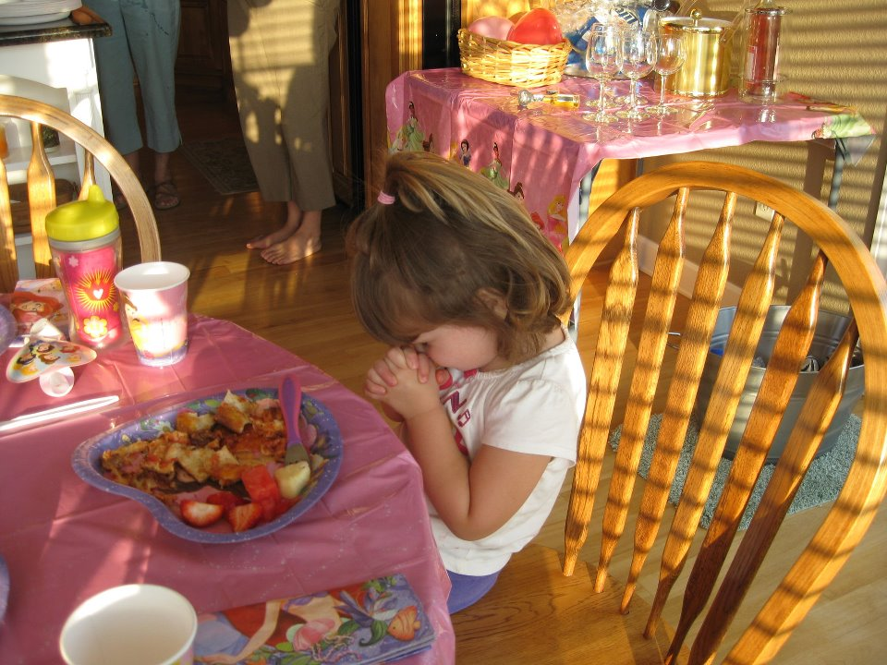
This childhood religious awakening which takes place in the family is irreplaceable… Indeed, family catechesis precedes… accompanies and enriches all forms of catechesis. (GDC, # 226)
Notes:
The Church so simply and eloquently reminds us

Slide 27
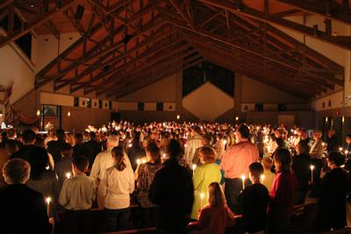
Partnership Family and Faith Community
The faith community is proposed as a source, locus and means of catechesis. (GDC# 158)
And… parents are the primary educators of faith. (GDC # 255)
Notes:
The Church also reminds us the family is in partnership with the faith community in this vocation.
The faith community is a vehicle for catechesis, integral to the process. Being a believer requires us to come together. This study sought to look at the partnership from the lens of the parent perspective involved in the parish community.
Being a believer requires one to come together with “the community of disciples” and join with “the faith of the Church” (GDC #37)
GDC Community#158, 253, 254. Family # 226, 255

Slide 28
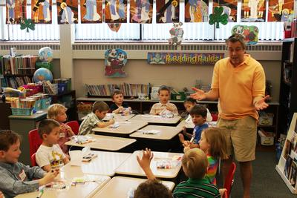
What’s the Problem?
Transmission of the Catholic faith presents more challenges than in previous generations
Notes:
Well, the Transmission of the Catholic faith may present more challenges than in previous generations
For American Catholics in generations prior to Vatican II (mid-1960’s) formation occurred in centralized ethnically and religiously similar communities where this faith tradition was passed on through the general culture with its homogeneous values and common practices, within experiences in daily life and especially through strong parish churches and parish schools and after-school religious instruction programs.
Religious instruction occurring within the larger church community provided a strong dimension of religious formation as well as informal formation taking place in the home.
Bishop Sklba ~ learned faith through osmosis

Slide 29
Family
Church Community
Faith Development through Life Span
Purpose of the Study
Faith Formation
(School and Formation Programs)
Notes:
To explore the intersection of faith formation- through school and formation programs, through family and through church community to learn more about how faith is, formed, developed and passed on within the context of family and church community and in the present American Catholic culture.

Slide 30
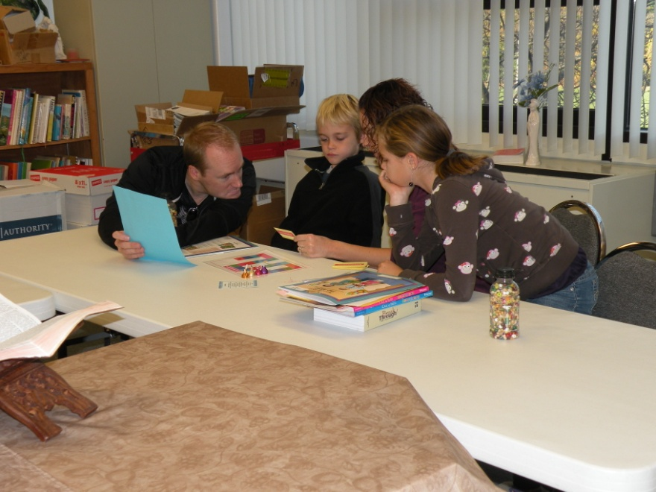
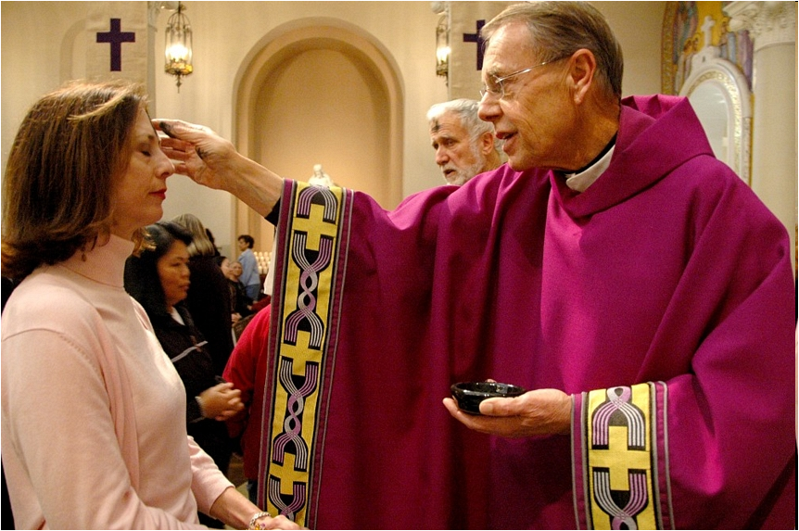
The Research Question:
What factors, occurring in the family and faith community, are perceived to impact faith development?

Slide 31
Case Study Research Approach
Consecutive Triangulation Mixed Methods
Qualitative:
* Confirmatory focus groups
Parents (5) / Young Adults (1)
* Individual Interviews
Staff (11)
Quantitative:
* Survey of perceptions of personal and family faith formation
School Parents and Family Program Parents

Slide 32
Top Ranked Factors Perceived to Impact FAMILIES’ Faith Development in Combined Parent Group
1 | Warm loving environment of our home
2 | Adhering to our moral beliefs
3 | The faith of the mother in family
4 | Reliance on faith in crisis or traumatic events
5 | Warm welcoming environment of our church
6 | The faith of the father in family
7 | Attending Mass regularly
8 | Praying together as a family
9 | Participation in the Sacraments
10 | Sacramental preparation sessions
11 | Sense of belonging to a faith community
12 | Church's teachings about beliefs and morals
13 | Family discussions about faith
Notes:
The picture closely mirrored that of the formation of personal faith in a number of ways. When groups differed, it again followed the pattern such that school parents consistently weighted certain items higher than family program parents.
Second,
not only did school and family program parents rank order the factors most influential on their family’s faith similarly, many were the same as those perceived to affect their personal faith formation. This finding was further supported by the analyses of the data which compared parents’ ratings of the factors that influenced their personal to their family’s faith development. Table 32 reviews, the ranked top factors determined by both school and family program parents as having greatest impact on family faith formation.

Slide 33
Findings from Analyses Pertaining to Ages of Children on Family Faith Development
Parents of Younger Children | Parents of Older Children
Physical building of church | Service
Personal prayer | Faith Development Opportunities
Praying together as a family | Youth Ministry
Music & art at church
Intergenerational Sessions of FP
Spiritual Reading/Scripture
Notes:
Comparison, Y O C. Younger compared to older. Two of the three samples 2 of 3 sample groups rated that item higher.
These are the factors that parents of Y children and O children rated higher.
One exception FP with O and Y children local spiritual leaders higher than parents of Y or O children. (Straddled the fence) remained in between how they perceived the factors, not statistically lower or higher. Parents are pretty good at dividing their attention of different age children. Data was analyzed in a one way between subjects ANOVA.

Slide 34
Findings from Gender Analyses
Women and men ranked factors similarly
When differed women rated factors higher than men
One exception men rated their own impact (faith of the father) on family faith development higher than women rated the item
Notes:
Women and men ranked factors similarly
When they differed women rated factors higher than men (1 – 6 scale)
With one exception men rated their own impact (faith of the father) on family faith development higher than women rated the item Women almost all factors were rated higher by women than men

Slide 35
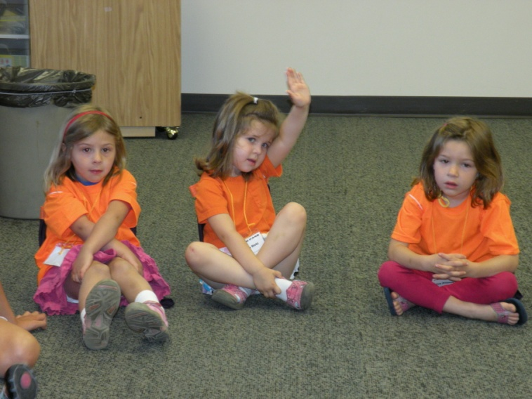
Factors Considered in Constructs of:
Climate~
The tenor of relationships, feelings, formal and informal
Practices~
Patterns of behavior and rituals in the Catholic
Christian faith
Culture ~
Deep culture of underlying identity, beliefs and values
Notes:
Constructs: Concepts/ Theories/ Paradigms /Ideas
Culture is the invisible flow of beliefs that gives meaning to what we say and do.
“ The web of significance in which we are all suspended.” (Geertz) The shared larger connecting values, beliefs, morals that have endured historically and theologically, mitigated, negotiated and defined local faith community and the larger Church to which it is connected
Climate Formal and informal feelings. Attitudes and feelings that characterize the environment. More transient. Norms. Expectations. Milieu. Overall atmosphere. Friendly? Supportive? Safe? Negative? Positive?
Practices~ refer to actions such as religious ritual, prayer, and serving
patterns of behavior and rituals in the Catholic Christian faith
Faith is not something we believe and then practice. Rather we practice faith and in doing so come to understanding

Slide 36
Factors Impacting Families’ Faith Development Related to Constructs
Connecting Climate | Practices of Faith | Religious Identity and Culture
The sense of belonging and being part of a faith community such as this parish | Attending Mass on a regular basis | Reliance on faith in a traumatic crisis or event (such as loss)
The warm welcoming environment in our church | Participating in the Sacraments | Adhering to our moral beliefs
The warm loving environment of your home | Service opportunities (such as meal programs, mission trips, church volunteering) | The faith of the mother in our family
 | Family discussions about faith | The Church’s teaching about beliefs and morals

Slide 37
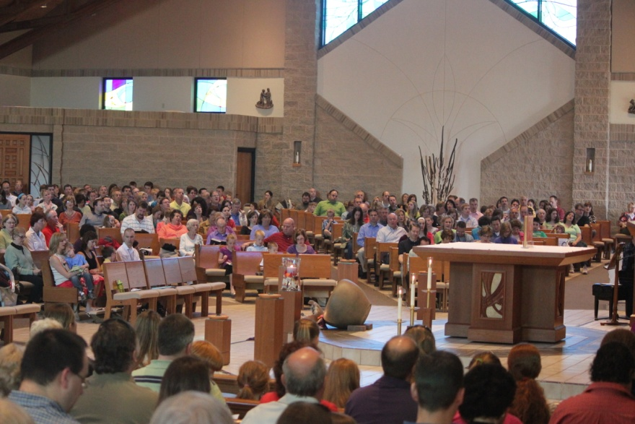
Climate/Practices of Faith
Climate initially and continually connects people to a community of faith
Practices of faith root and strengthen faith
Notes:
The impact of a sense of belonging resulting from affiliation of a primary or micro-community, the warm welcoming environment and cultivation of relationships and friendships all relate to the climate that initially and continually connects people to a community of faith.
Practices of faith, especially the significance revealed of regular participation in the ritual worship of the Eucharistic Celebration of the Mass and to some extent all of the Sacraments, reflect the value of encouraging the repetitive practice or worship, prayer as conduits of strengthening faith and allowing faith to mature.

Slide 38
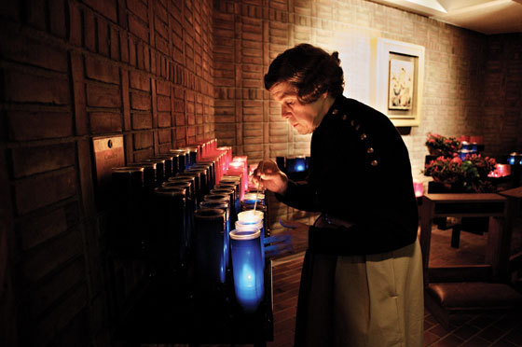
Climate Practices lead to… Culture of Faith
At some point climate and practices mature into a culture of something deeper, more profound, more personal, more internal.
Notes:
Service learning opportunities develop and are offered as an integrated dimension of faith development, the climate becomes more positive and meaningful and the ethos of service is internalized.
At some point climate and practices mature into a culture of something deeper, more profound, more personal, more internal.

Slide 39
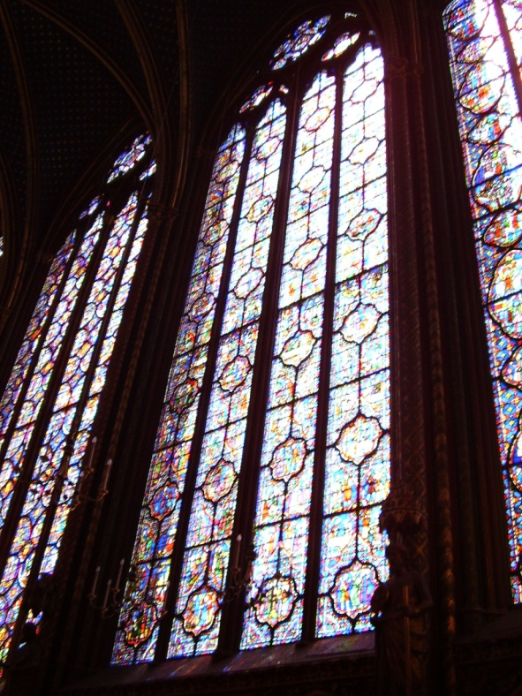
Most interesting finding was high ranking of reliance on faith in difficult times, crisis or traumatic events, such as loss and adhering to moral beliefs
Motivated families to engage
in faith community and practices of faith
Parents lacked conscious awareness of these deep desires, hungers, longings and fears
Notes:
With the insight provided from the focus groups and staff interviews this seems to point to a key understanding of what motivated families to engage in a faith community and in practices of faith. It also appeared that parents lacked conscious awareness of these deep desires, hungers, longings and fears. The Oblate priest, Father Ronald Rohlheiser, OMI, discussed this in his book, “The Holy Longing”. He describes, “… a desire that lies at the center of our lives, the marrow of our bones, and in the deep recesses of the soul” (1999, p. 3). Naming and analyzing this desire lies at the heart of poetry, art, philosophy, psychology and religion. We seek peace, the opposite of this restlessness, longing and loneliness that lies at the heart of the human experience and the true force that drives us

Slide 40
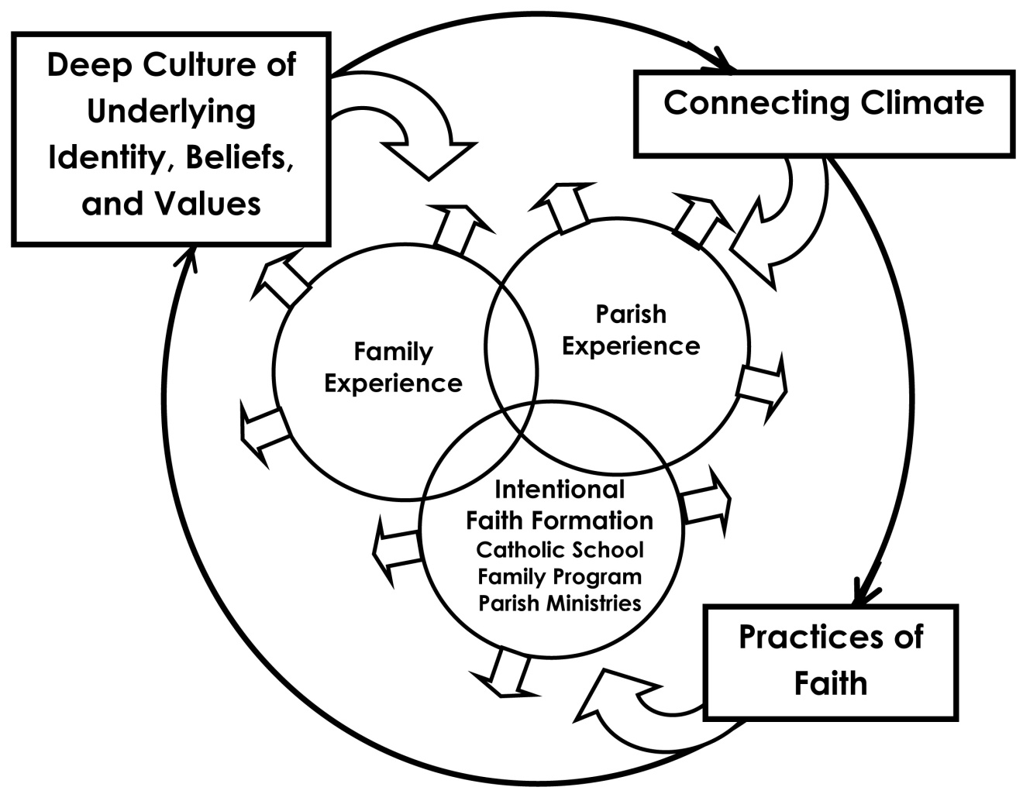
Theory of Faith Development Representing its Cyclical, Developmental, and Multidimensional Nature

Slide 41
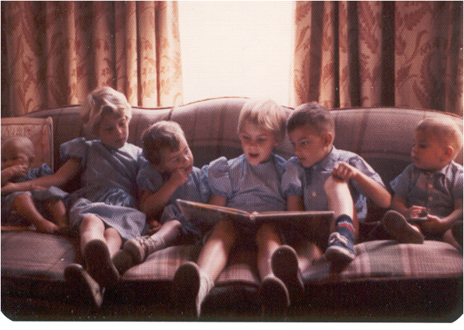
Connecting leads to belonging
Belonging leads to believing
Practicing faith leads to identity
Notes:
My friend said to me:
What I learn from this is we need to be intentional about what we want our children to learn about God, and intentional in ways they will connect to God. We should not expect our children to come to faith through osmosis. Example not osmosis.
Don’t underestimate the importance of simple participating in Mass on a regular basis.
He said as a Mom or Dad no one told him this is significant. This is important.

Slide 42
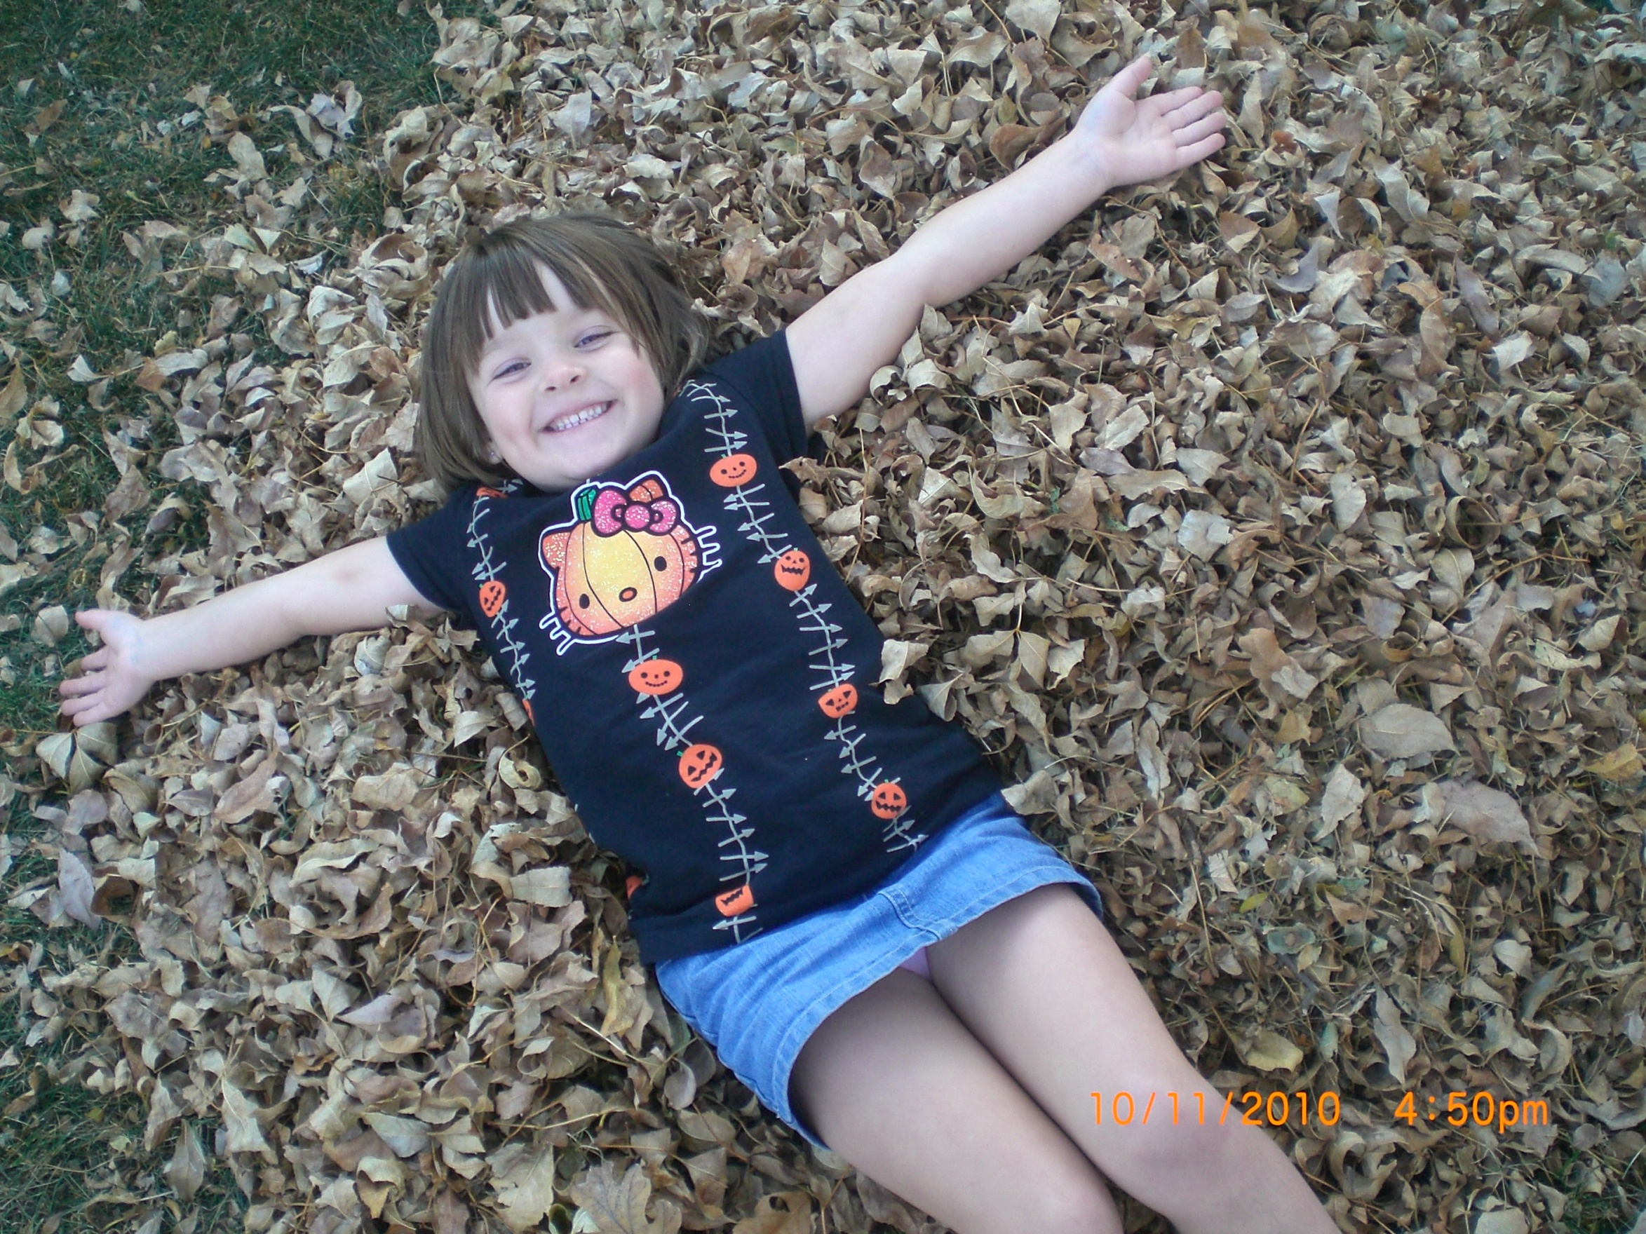
Creating Climate for Faith Formation!
Climate addresses the issues of emotional ease
Questions to ask about your environment:
How do I feel when I am here?
Do I have a positive or negative attitude when interacting here?
Do I perceive this faith community as friendly, caring, safe?
Do I feel welcome, accepted or judged and unsafe?
Notes:
Climate refers to how people perceive the general environment of the congregation and it leaders, how people understand how they “fit” in the community, and how they feel when they are interacting with the community. Climate is a critical factor in producing a positive outcome in intergenerational faith formation.

Slide 43
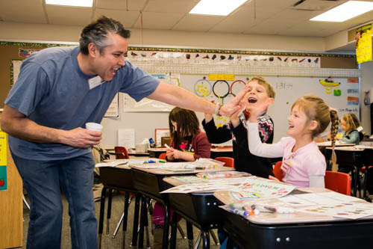
Attend to Climate Continually
Call people by name
Personal Interviews
Email “We missed you” message & activity
Social opportunities:
Service opportunities:
Celebrate Spiritual Milestones:

Slide 44
A Family’s Spiritual Resources are Strengthened by:
Feeling welcome, known, cared about
(The importance of caring, faithful adults in child/ teen’s life)
Feeling a part of something bigger than themselves:
Catechetical Programs
Family Involvement in Church
Retreats
Sacramental Prep
Bible Camp
Donut Sunday
Notes:
Feeling welcome, known, cared about in your family and in a faith community a part of something bigger than themselves:
Family Program

Slide 45
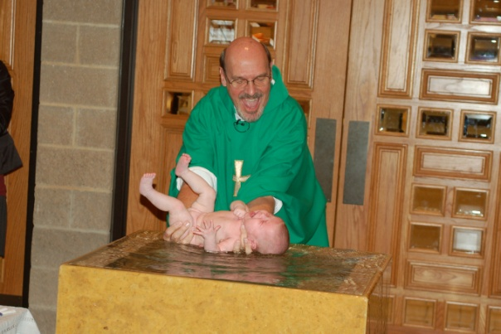
Nurturing faith is a multifaceted, complex, cyclical, process
Factors related to climate need to be attended to and respected
Factors related to practices root and strengthen faith and allow one
to enter more deeply into the mystery of faith
Factors related to culture speak to the holy longing and are the
deepest motivations to know and have a relationship with God
Notes:
Spirituality is not optional. Every person is created with that dimension. It is either life-giving or destructive.
It is not about rationally picking certain spiritual activities, certain prayers, rituals, books… good as all that might be…
It is what we do with the great desire of our heart and the habits and disciplines we use to shape that desire that forms our basic spirituality.
In nurturing a families faith development we help to raise their awareness of the inner drive for meaning in their busy lives
Spirituality is awareness of God’s Presence in all aspects of one’s life…to be aware of God’s Presence in all things the joys and sorrows. As Carl Jung said, “Bidden or not God is present”

Slide 46
Session 4

Slide 47
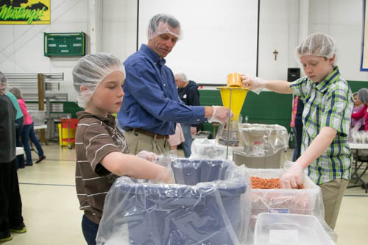
Session 4 Envisioning the Future of Intergenerational Ministry and Faith Formation
Service Learning as a Methodology

Slide 48
In serving those in need, we serve the Lord. And in seeking justice and peace, we witness to the reign of God in our midst. (USCCB)

Slide 49
Service Learning: A Project with a Purpose
Apprenticeship to becoming a Christian
Job description of follower of Jesus
Internalize Christian beliefs into values
Develops more accurate and well rounded worldview
Appropriate Faith Formation at any age

Slide 50
Benefits for Children and Youth
Tend to internalize values of empathy and caring for others
(Littlepage, 2003; Roehlkepartain, Naftali & Musegades, 2001; Stukas, 1999)
Serving then becomes a way of life
(Jaalandoni& hume, 2001; Littlepage, 2003)
Youth who said their parents “Spend a lot of time helping others” are almost twice as likely themselves to serve others
(Roehlkepartain, 2003)
(61%/ 36%)

Slide 51
Benefits to Parents
Gives parents an opportunity to spend high quality time with their children (Roehlkepartain, et al, 2004)
Develop interpersonal skills, increased civic participation, better mental health, improved health outcomes.
(Grimm, Spring, & Dieetz, 2007; Wilson & Musick, 2000)

Slide 52
Benefits for Families
Quality time together, learn about their community, parents are positive role models for their children
(McKaughan, 1997)
Heightens sense of family well-being, reduces social isolation, develops skills, increase parenting skills
(Family Strengthening Policy Center, 2006)

Slide 53
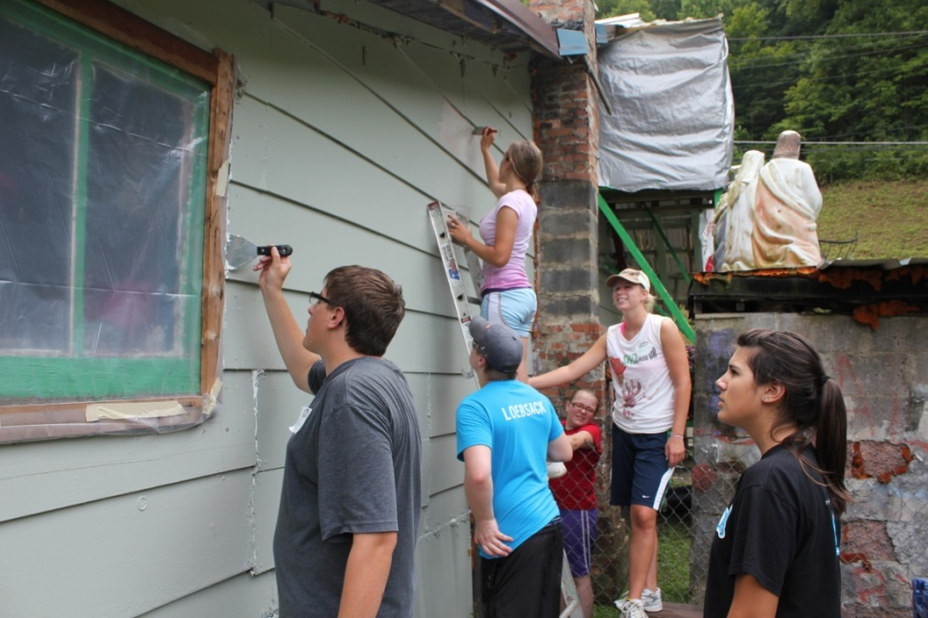
Spiritual Resources are Strengthened by:
Learning what a Christian is by serving
Notes:
Service learning opportunities develop and are offered as an integrated dimension of faith development, the climate becomes more positive and meaningful and the ethos of service is internalized.

Slide 54
Session 6 Implementing Strategies for the Future
Encouraging the Heart

Slide 55
The Leadership Challenge
Model the Way
Inspire a Shared Vision
Challenge the Process
Enable others to act
Encourage the heart

Slide 56
What is Encouraging the Heart?
Set clear standards
Expect the best
Pay attention
Personalize recognition
Tell the story
Celebrate together
Set the example

Slide 57
Encouraging the Heart
What is Encouraging the Heart?
They don't care how much you know until they know how much you care." -Theodore Roosevelt

