Slide 1


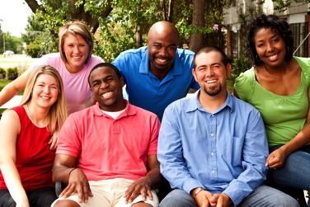
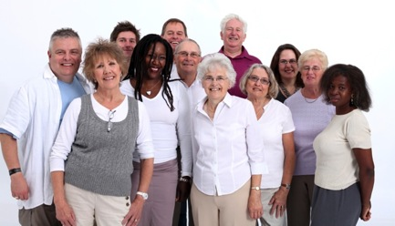
Part 2. 21st Century Faith Formation
John Roberto, LifelongFaith Associates

Slide 2
To download the PowerPoint Presentation go to:
“Presentations”
on
www.LifelongFaith.com

Slide 3
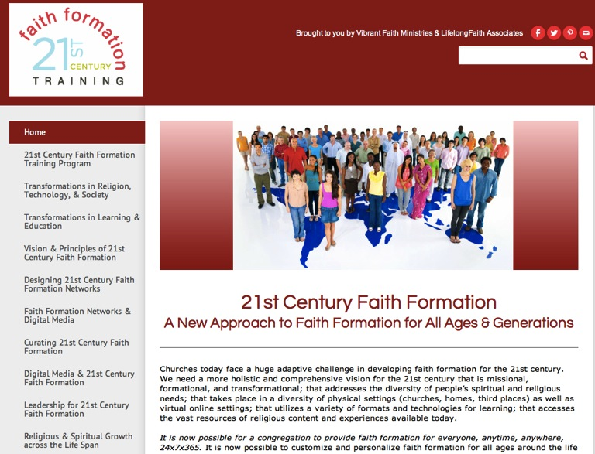

Slide 4
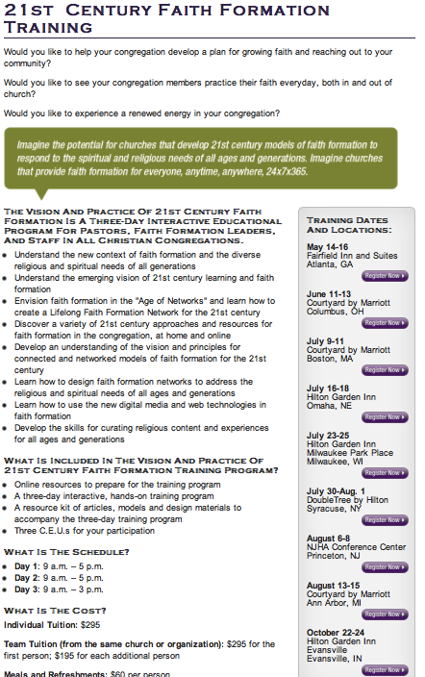
If need a scholarship, just email me for details:
jroberto@lifelongfaith.com
www.vibrantfaith.org/faith-formation-training.html

Slide 5
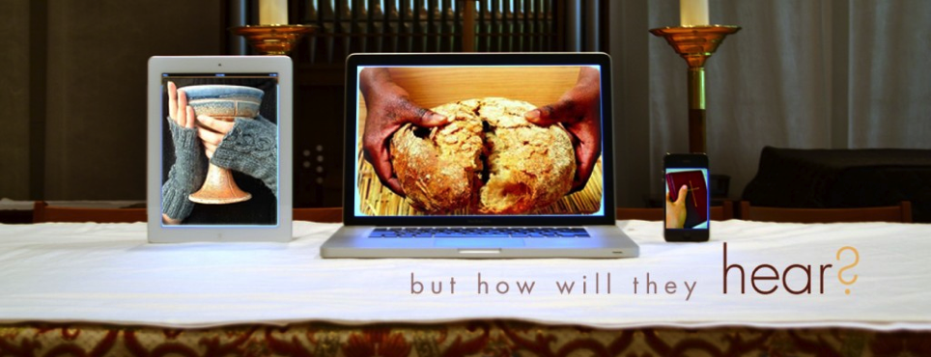
21st Century Faith Formation

Slide 6
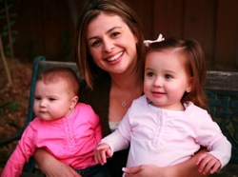






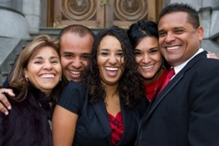
We Can Now Provide Faith Formation for
Everyone!
Lifelong & Lifewide

Slide 7
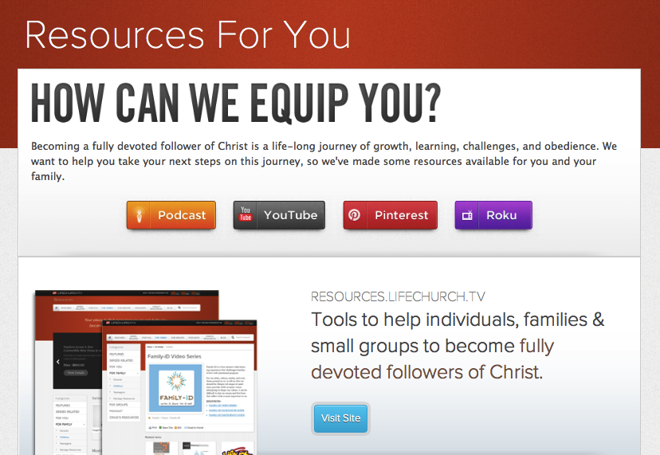

Slide 8
Vision of Faith Formation
Churches want faith formation that helps people. . .
  grow in their relationship with God throughout their lives
  live as disciples of Jesus Christ at home, in the workplace, in the community and the world
  develop an understanding of the Bible and their faith tradition
  deepen their spiritual life and practices
  engage in service and mission
  relate the Christian faith to life today
  participate in the life and ministries of the faith community

Slide 9
New Faith Formation Ecosystem
Yesterday: Culture
Today: Network
Church
Home
Ethnic Culture
School (Religious)
Church
Home
Online/Virtual
Social Networks
Community

Slide 10
21st Century Faith Formation
We need new models of faith formation & learning suited to this historic moment, and not simply enhancements or makeovers of existing models that were developed in the 19th and 20th century.

Slide 11
Buckminster Fuller
You never change things by fighting the existing reality. To change something, build a new model that makes the existing model obsolete.

Slide 12
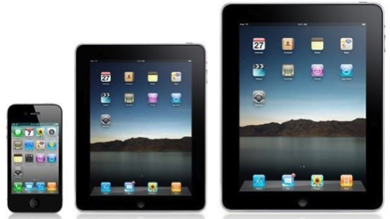
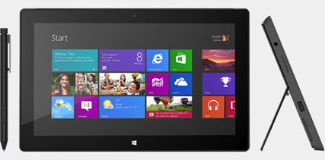


New Mobile Technologies

Slide 13











New Digital Tools

Slide 14
New Digital Resources

Slide 15
21st Century Faith Formation
Diversity of Religious & Spiritual Needs
Personalized & Customized Pathways for Growth
Variety of
Content Experiences People & Resources
Anytime, Anywhere
24 x 7 x 365

Slide 16
21st Century Faith Formation
We can now reimagine where, when, and how faith formation & learning take place.
It is now possible to provide faith formation for everyone, anytime, anywhere, 24 x 7 x 365.
It is now possible to customize and personalize faith formation around the life tasks and issues, interests, religious and spiritual needs, and busy lives of people.

Slide 17
21st Century Faith Formation
It is now possible to engage people in a wide diversity of programs, activities, and resources that incorporate a variety of ways to learn—on your own, with a mentor, at home, in small groups, in large groups, in the congregation, and in the community and world—delivered in physical gathered settings and virtual online settings.
It is now possible to connect people to each other—in physical places and virtual spaces.

Slide 18
21st Century Faith Formation
Fully online with options for face-to-face interaction in physical settings. | Mostly or fully online with regular interaction in physical settings. | Online platform that delivers most of the program with support, mentoring, and small groups. | Programs in physical settings guided by a leader with online components. | Programs in physical settings with online resources to supplement the program.

Slide 19
21st Century Faith Formation
We are moving from. . .
One Size Fits All
Faith Formation & Church Programming
to
Networks of Personalized & Customized Faith Formation
- - -
From: People being where we are (church)
To: Faith formation being where people are!

Slide 20

21st Century Faith Formation
Creating Networks of Personalized & Customized Faith Formation Activities & Resources
focusing on addressing people’s spiritual and religious diversity by offering a wide variety of religious content and experiences
Young Adults
Mid-Life Adults
Adolescents & Families
Children & Families
Older Adults
Mature Adults

Slide 21

Children & Families
Network
Parent Faith Formation
Parenting Education &
Support Groups
Whole Family Programs
Milestones
Mentors for Parents
Faith Practices @Home: Bible, Prayer, Rituals. Service
Children’s Program
Bringing Sunday Worship Home
Intergenera- tional Experiences
Vacation Bible School/Camp

Slide 22
Intergenerational Connections
Intergenerational Community Life & Events (arts festivals, music and concerts, drama)
Intergenerational Mentoring (Reverse Mentoring)
Intergenerational Service
Intergenerational Learning
Intergenerational Retreats & Camps
Intergenerational Leadership
“Intergenerationalize” Programs

Slide 23
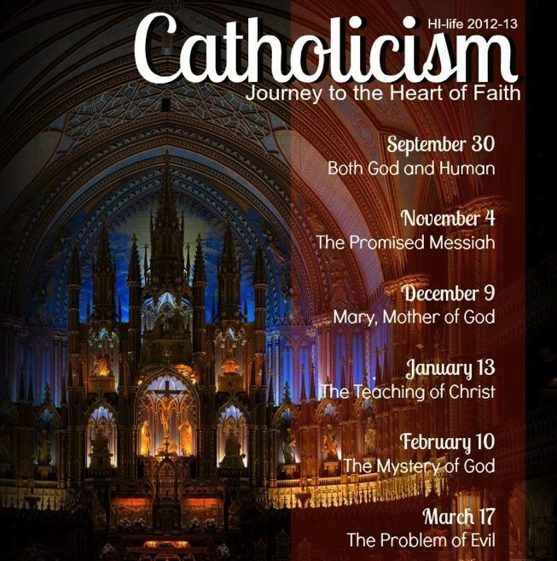

Slide 24
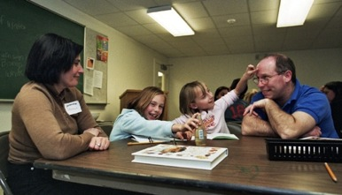
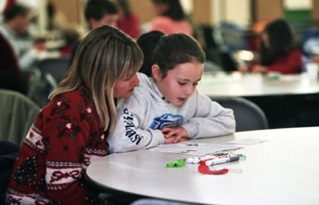
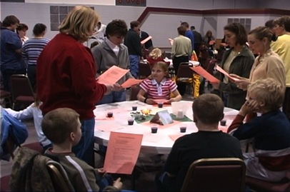
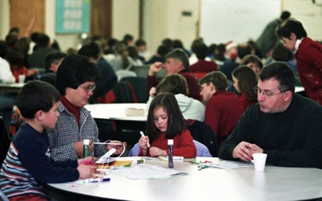
Whole Family Learning

Slide 25
Targeting the Diversity
Occasional Participation and Variable Spiritual Commitment | Vibrant Faith & Active Engagement
Not Religious Affiliated | Religious But Not Spiritual

Slide 26
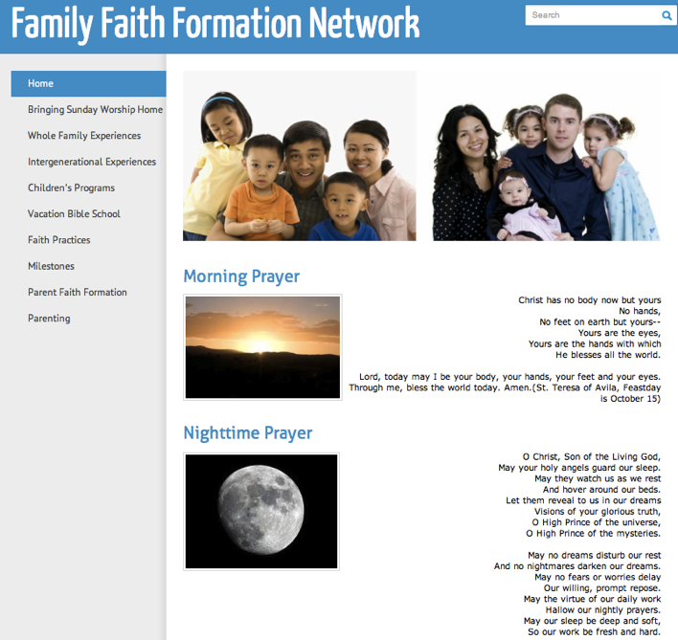

Slide 27
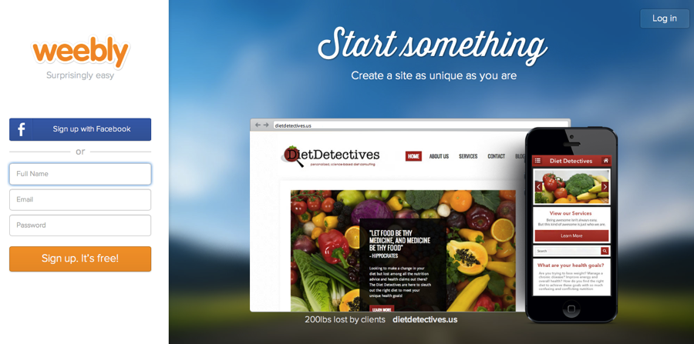
Online Platform: Weebly.com

Slide 28
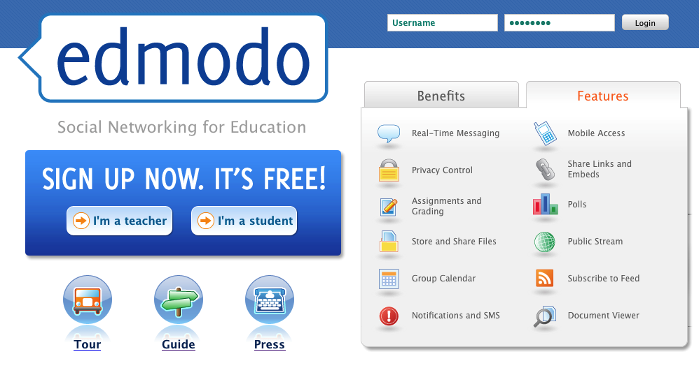
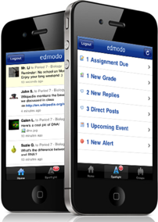
Online Learning Platform

Slide 29
Children & Families
Network
Parent Faith Formation
Parenting Education &
Support Groups
Whole Family Programs
Milestones
Mentors for Parents
Faith Practices @Home: Bible, Prayer, Rituals. Service
Children’s Program
Bringing Sunday Worship Home
Intergenera- tional Experiences
Vacation Bible School/Camp

Slide 30
“Programming” a Content Area
Content Area
Activity 1
Resource
Resource
Activity 2
Resource
Resource
Activity 2
Resource
Resource

Slide 31
Faith Practices
@ Home
Daily Devotion
Resources
Serving Others
Resources
Reading the Bible
Resources
Caring Conversations
Resources
Church Year Seasonal
Learning about Faith
Resources
Resources
Rituals
Resources
Children & Families
Network

Slide 32
Faith Formation Content
Church Programs & Activities
Community Programs & Activities
People Resources
Print Resources
Audio & Video Resources
Art, Drama, and Music Resources
Online Content: Websites, Blogs, Video
Online Education: Webinars, Courses
Apps & Digital Resources

Slide 33
“Programming” a Families & Children Network
Differentiate faith formation content
Flip the classroom to engage children (and parents)
Extend and deepen gathered experiences with online content - children’s program, VBS, Sunday Worship
Offer online courses & webinars for parents
Offer a program or small group gathering in different locations: at church, at home, in community settings
Offer blended programs & experiences – online and gathered, e.g., milestones at church and home
Provide online church year & calendar faith forming activities
Provide online resources & apps; recommend family-appropriate media – films, video games, apps, books

Slide 34
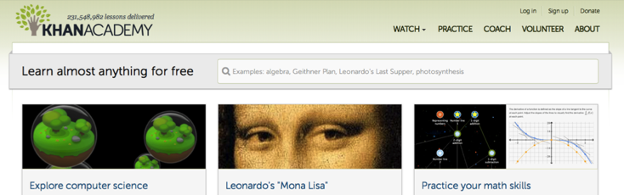
Imagine Flipping the Classroom
“Flipping the classroom” so that children and teens are doing project-centered learning with their parents or peers—accessing content online through the network website and connecting via a secure social network such as Edmodo AND then refocusing “class time” on practicing, demonstrating, and performing.

Slide 35
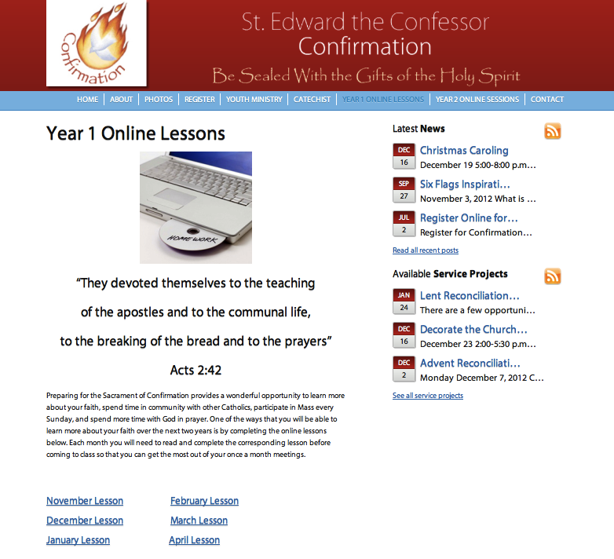

Slide 36
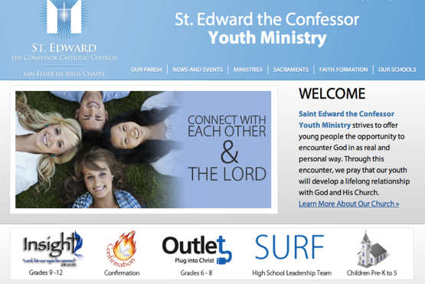
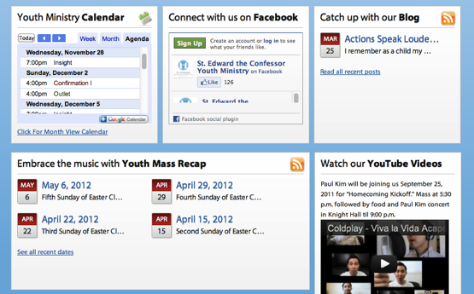

Slide 37
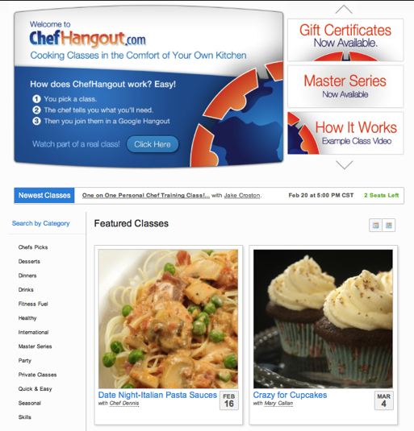
Imagine Online, Interactive, Visual Learning

Slide 38


Slide 39
Imagine Streaming & Recording Content for Wider Use
Stream it Live
Watch on Your Own
Use it in a Small Group
Put in the Online Library

Slide 40
Imagine Differentiated Faith Formation
Core Content & Experiences for Everyone
Content & Activities for People of Vibrant Faith & Active Engagement
Content & Activities for Spiritual but Not Religious
Content & Activities for People Who Are Participate Occasional

Slide 41
Imagine Extending Events & Programs
Extend a gathered event or program with online content and activities.
Worship
Mission Trip
Children or Youth Program
Vacation Bible School
Event or Program
TALK Conversation Questions
LEARN
Watch a Video Listen to a Talk Read a Story
LIVE
Action Project
PRAY
Devotions, Bible Reading, Table Prayer
SHARE
Write a Blog Entry Create & Share a Video or Project

Slide 42
Imagine Sunday Worship – All Week
Sunday Worship
Share It
Blog/Facebook Question
After Worship Sharing
@Home Conversation Activity
Live It
Living the Message Daily
Living Christian Practices
Service/Mission Idea
Action Project
Study It
“Taking Faith Home”
Sermon Video + Study Guide
Daily Readings
Scripture Commentaries Online Bible Study
Pray It
Weekly Table Prayer
Praying with the Saints
AM & PM Prayer
Lectio Divina

Slide 43
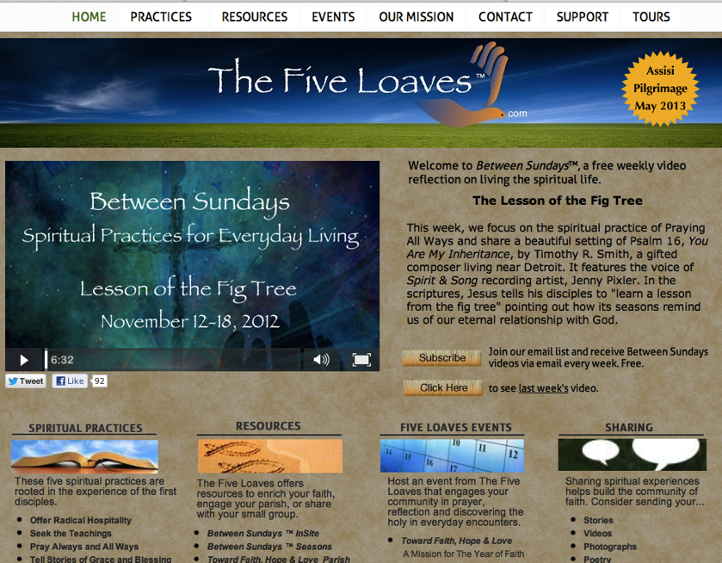

Slide 44
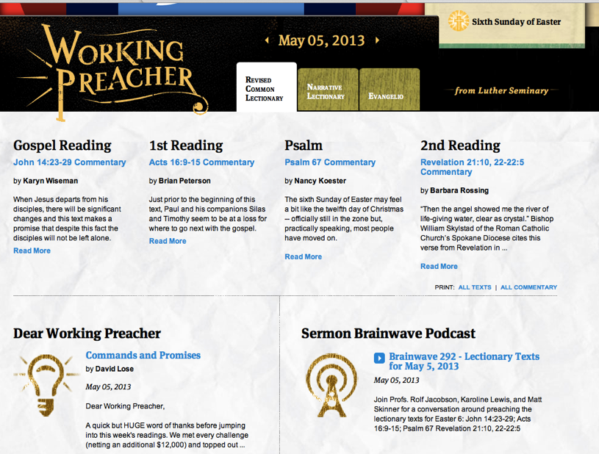

Slide 45
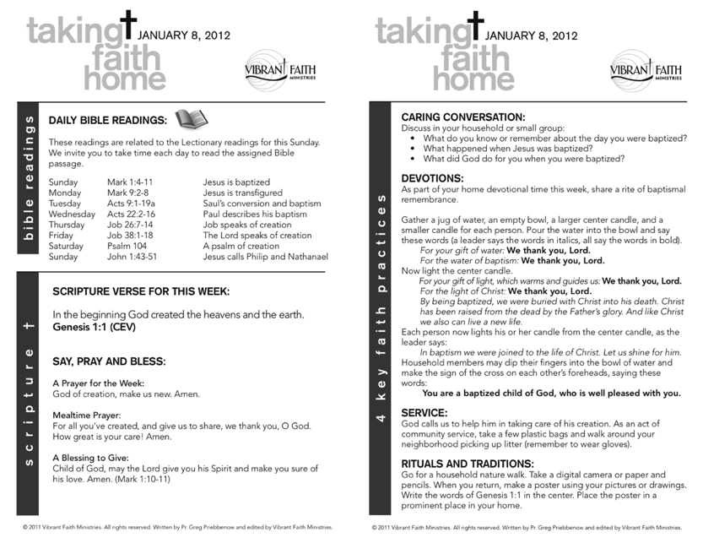

Slide 46
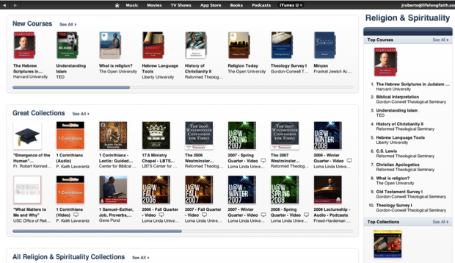
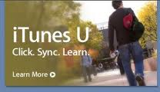
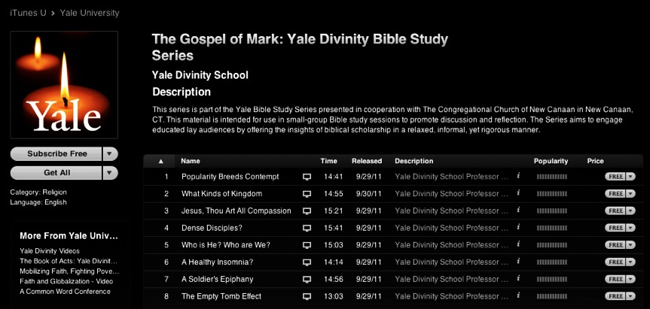
Imagine Online Courses for Every Adult – Anytime, Anywhere, Any Interest

Slide 47

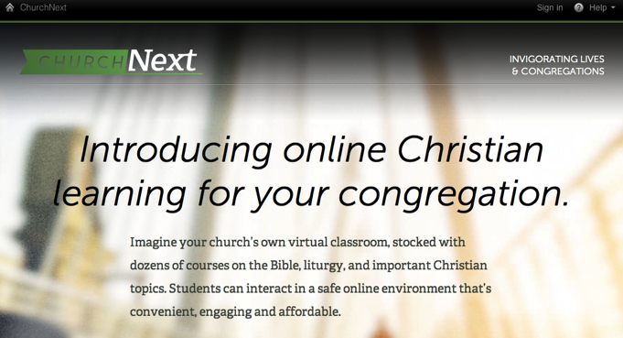

Slide 48
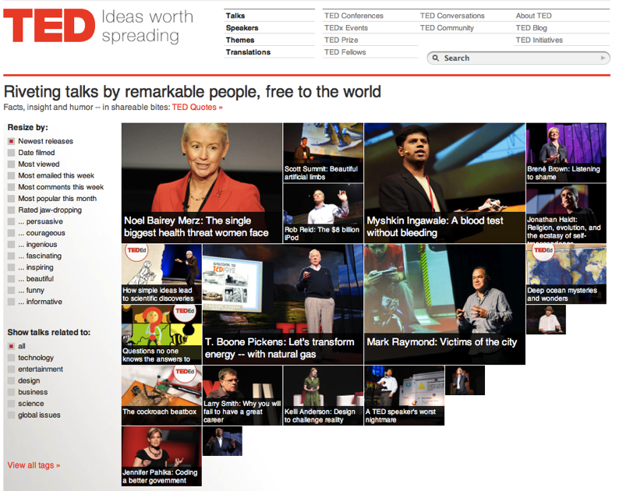

Slide 49
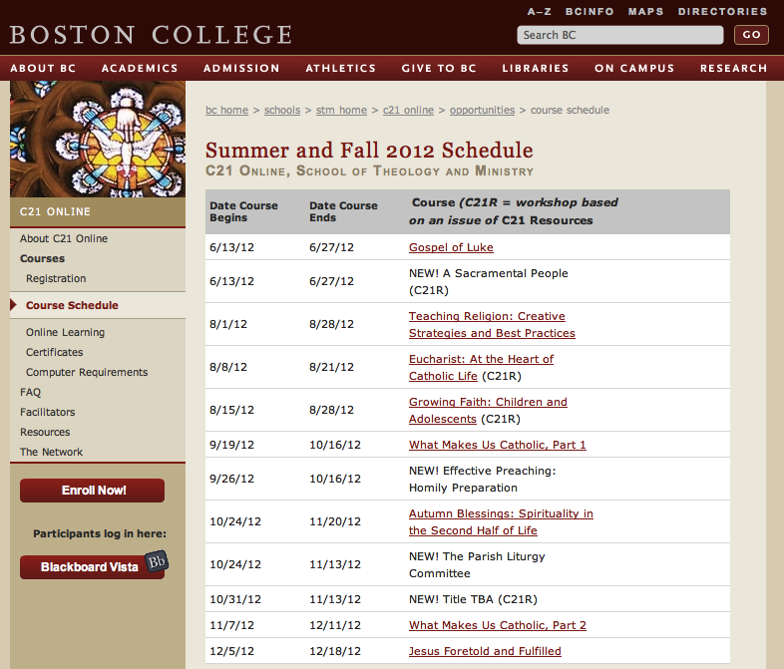

Slide 50
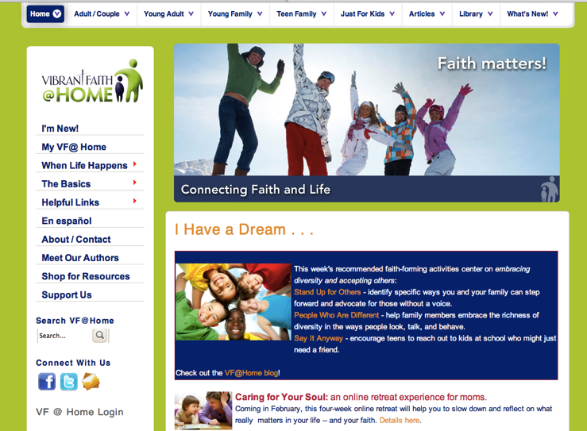
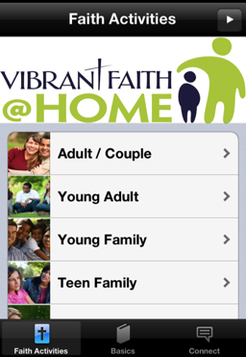
Imagine Faith Forming Activities for Everyone, Anytime, Anywhere

Slide 51
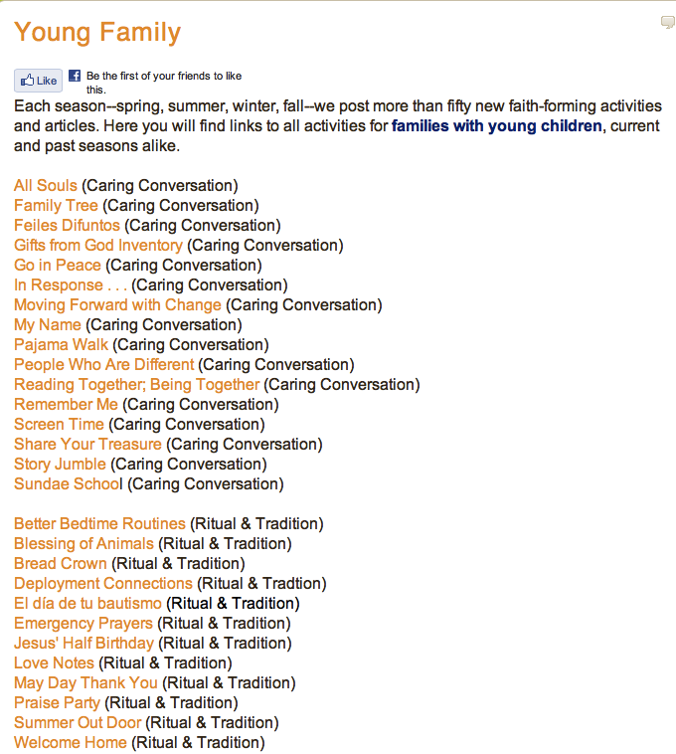
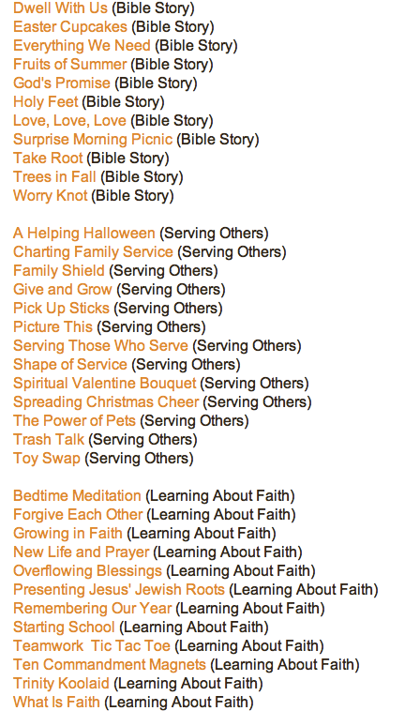

Slide 53


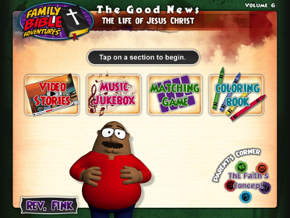

Slide 54
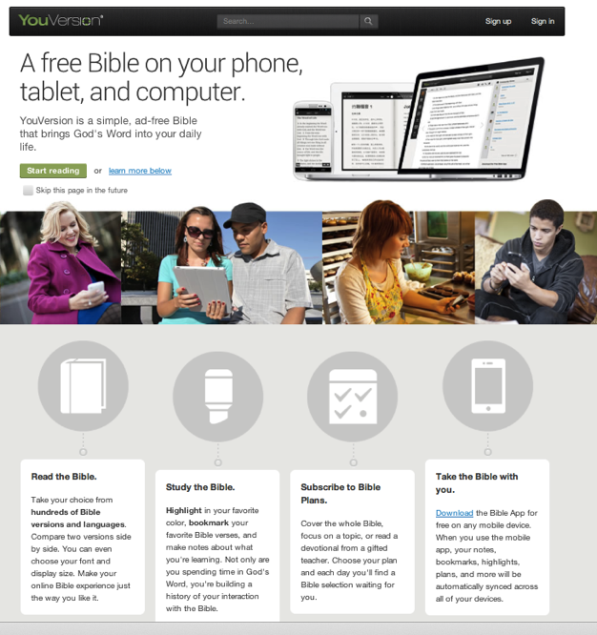

Slide 55


Slide 56
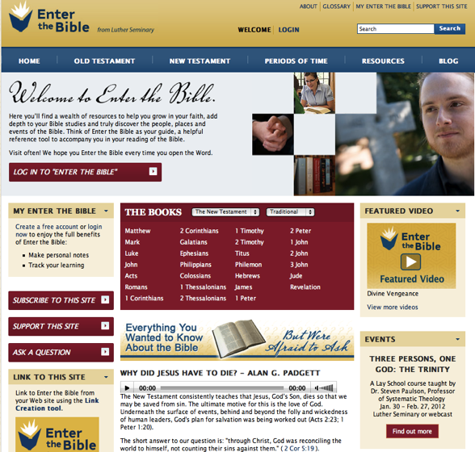
Imagine Online Resource Centers – Rich in Content

Slide 57
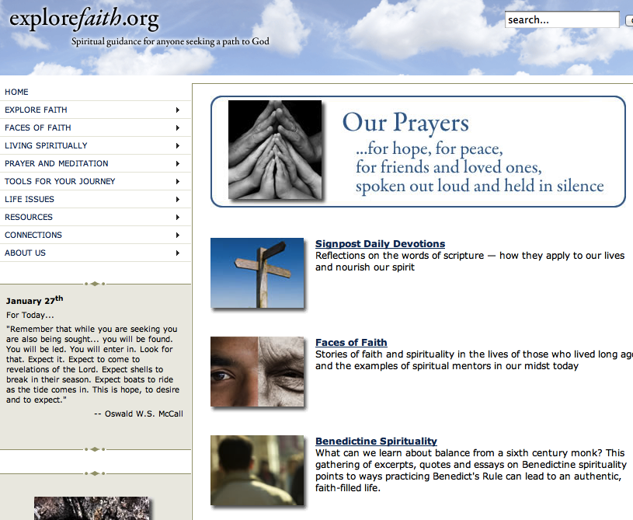

Slide 58
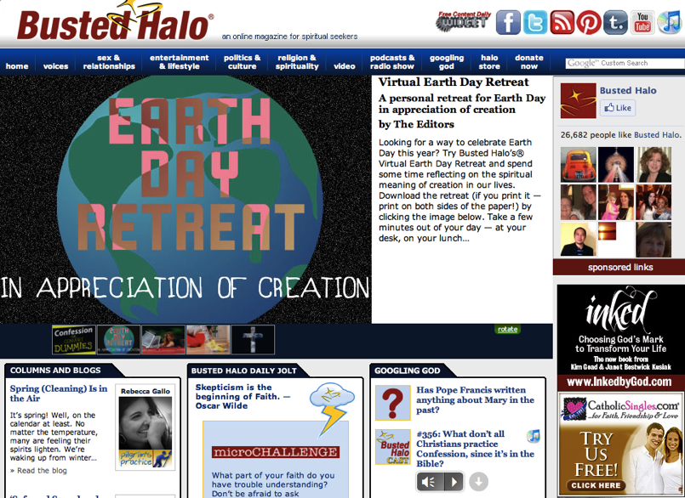

Slide 59
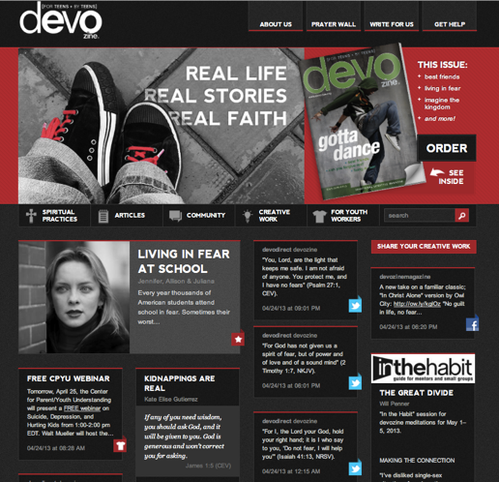
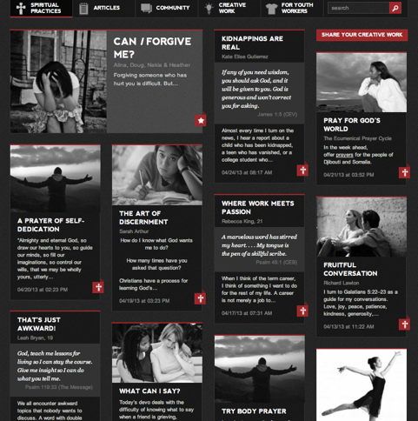

Slide 60
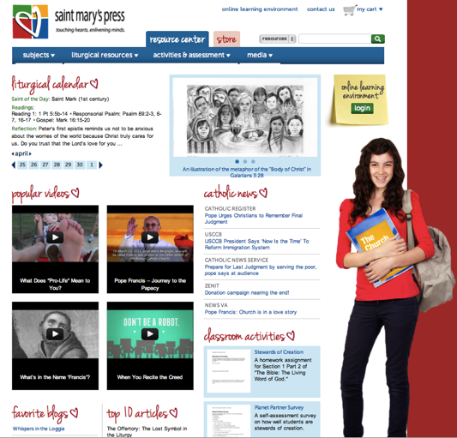
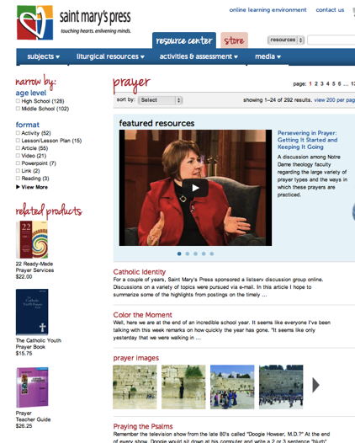

Slide 61
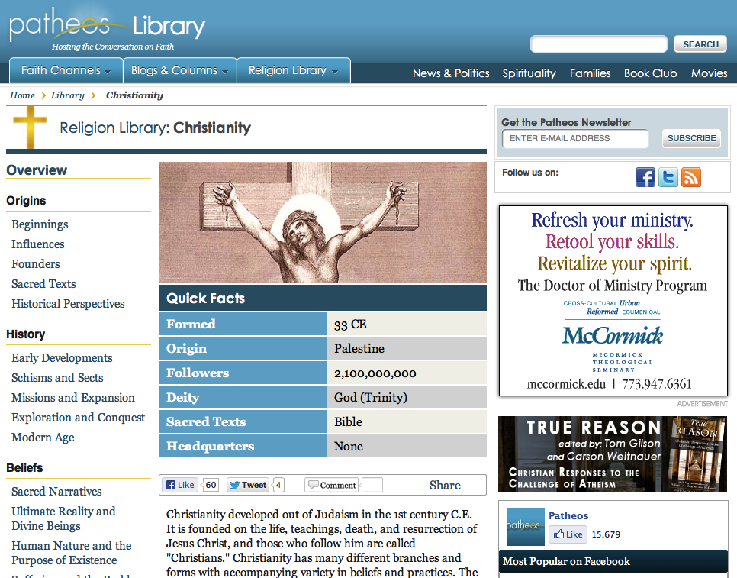

Slide 62
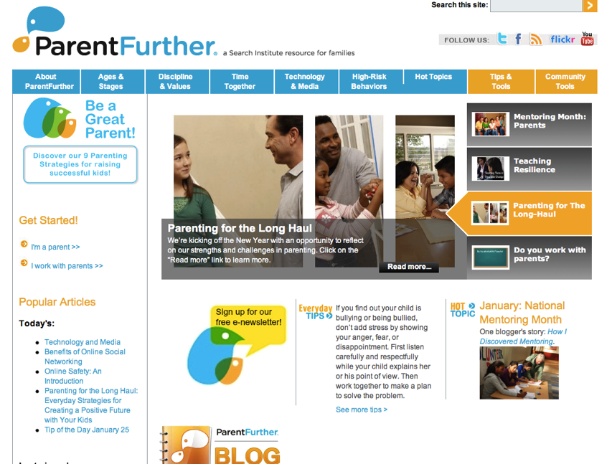

Slide 63
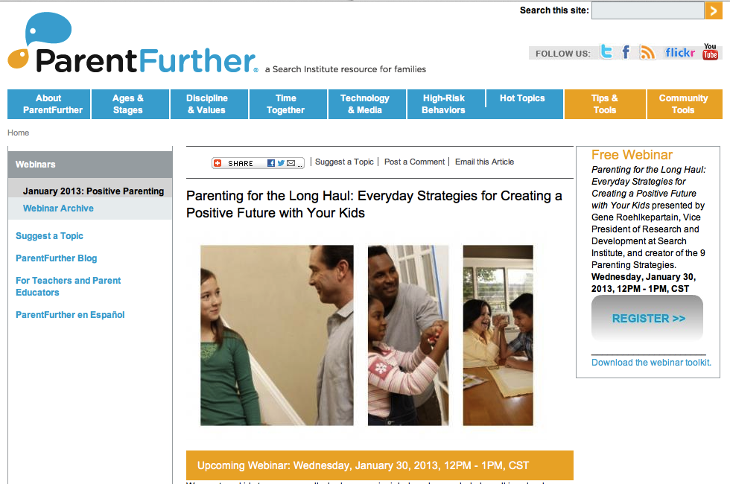

Slide 64
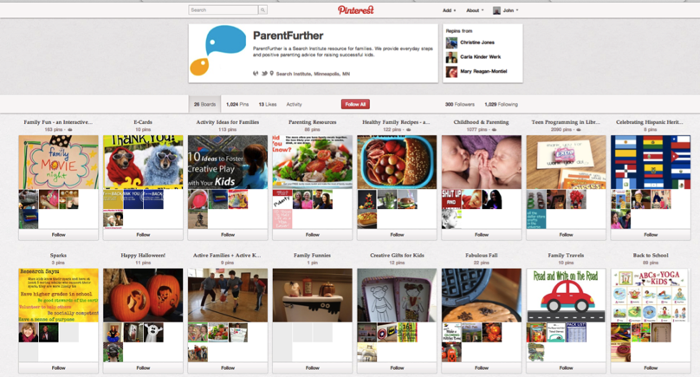


Slide 65


Slide 66


Slide 67


Imagine a Spiritual Resource Center
Online prayer center where people find daily prayer experiences, offer prayer intentions, pray for others, learn about spiritual practices, and more.

Slide 68


Slide 69


Slide 70


Slide 71



Slide 72





Slide 73



Slide 74





Justice & Service Resources
Justice and service resources where people can learn about social issues, explore Biblical and church teaching on justice, and find ways to act together through local & global projects.

Slide 75


Slide 76


Slide 77


Slide 78



Slide 79




Slide 80
Milestones
Birth/Baptism & Baptism Anniversaries
Welcoming Young Children to Worship
Starting School: Elementary, Middle, HS
Blessing Backpacks
First Communion
Receiving a first Bible
Confirmation
Mission Trips
Graduations

Slide 83



The Wesley Playhouse
Community Center
www.freshexpressions.org.uk/stories/playhouse

Slide 84
Personalize Faith Formation
Guide individuals and families in discerning their spiritual and religious needs and creating personal plans for faith growth and learning.
Personalized pathways for discipleship & faith growth. . . .
  Guide people in discerning their religious and spiritual needs
  Equip people with the resources and tools to learn and grow at their own pace
  Provide mentoring and support for the journey

Slide 85
Personalize Faith Formation
Assessing Spiritual Growth
Working with a Mentor/Guide
Finding Resources on the Network
Engaging in Formation
Sharing with the Community
Reflecting on Growth & New Needs

Slide 86


Slide 87


Slide 88

Youth Faith Formation
Network
Service Projects Mission Trips
Youth Network
Parent-Teen Activities & Resources
Prayer &
Spiritual Formation
Youth Leadership
Youth Group
Adolescent Life Issues
Bible Study & Religious Learning
Intergener-ational Connections
Parent Faith Formation
Parent Education & Support Groups
Milestones
Confirmation Program

Slide 89


Slide 90
Spiritual Growth for Baby Boomers
Online Courses
Retreats
Small Group Bible Study
Trip to the Holy Land (with Road Scholar)
Spiritual Book of the Month Club
Monthly Spiritual Practices Series
Sunday Worship
Apps & E-newsletters
Day at the Monastery
Online Prayer & Spirituality
Spiritual Seeker Program
Third Place Spiritual Conversations
Resource
Resource
Resource
Resources
Resources
Resource
Resource
Resource
Resource
Resource
Resource
Adults

Slide 91

Baby Boomer Adult Network
(Re)Discovering Faith
Justice, Service, Mission
Scripture Enrichment
Intergenerational Experiences & Connections
Family & Grandparents
Faith Enrichment
Spiritual Enrichment
Mature Adult Life Issues, Transitions, & Milestones
Sunday Worship through the Week
Peer Connections
Blog
Social Media

Slide 92


Slide 93
Prayer & Spiritual Life
Daily Devotion
Resources
Prayer Group
Resources
Spiritual Mentoring
Resources
Spiritual Practices Course
Resources
Retreat
Day at the Monastery
Online Prayer Intentions
Resources
Resources
Youth

