Slide 1
Part One Reimagining faith formation for the 21st Century
John Roberto
jroberto@lifelongfaith.com www.LifelongFaith.com

Slide 2
Part 1. Adaptive Challenges

Slide 3
Adaptive Challenges We Face
Changing People
Life-Span Diversity
Generational Diversity
Family Diversity
Religious & Spiritual Diversity
Ethnic Diversity

Slide 4
We Are More Diverse

Slide 5
Generational Diversity
Generational Differences
Relationship to Institutions
Relationship to Authority
Family Relationships
Work-Life Balance
Communication Style
Technology Usage
Learning Style
Religious Expression
Worship Style
Millennials (1980-99)
Generation X (1961-79)
Baby Boomers (1946-60)
Builders (pre 1946)
iGeneration (2000 - )

Slide 6
Life Span Diversity
0-10
50s
20s
30s
40s
60s
70s
80s
90s
11-19

Slide 7
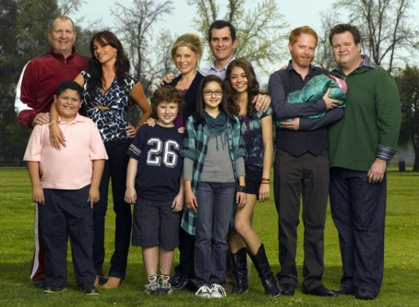
Family Diversity
The 1950s Family
The 2010s Family

Slide 8
Family Diversity
Married Couple with Children (original biological family)
Married Couple with Children (blended family)
Single Parent with Children
Unmarried Couple with Children
Unmarried Couple without Children
Same Sex Couple with Children (married or unmarried)
Same Sex Couple without Children (married or unmarried)
Grandparents & Parents with Children (3-generational)
Grandparents as Primary Caregivers
Parents with Single Young Adults Living at Home

Slide 9
Religious Diversity
Receptive to Organized Religion
Scenario 3 Unaffiliated & Uninterested
Scenario 1 Vibrant Faith & Active Engagement
Scenario 4 Variable Commitment & Occasional Participation
Scenario 2 Spiritual but Not Religious
Low Hunger & Commitment to Spiritual Life
High Hunger & Commitment to Spiritual Life
Resistant to Organized Religion

Slide 10
Religious Diversity
Not Religiously Affiliated
Spiritual but Not Religious
Minimal Engagement with Faith and Community
Vibrant Faith & Active Engagement

Slide 11
Digital Abundance
Abundance of Digital Content
Abundance of Mobile Technologies
Abundance of Digital Tools
Digital World

Slide 12
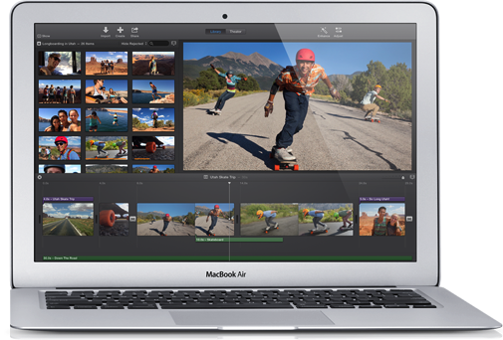
Mobile Technologies

Slide 13
Social Networking Tools

Slide 14
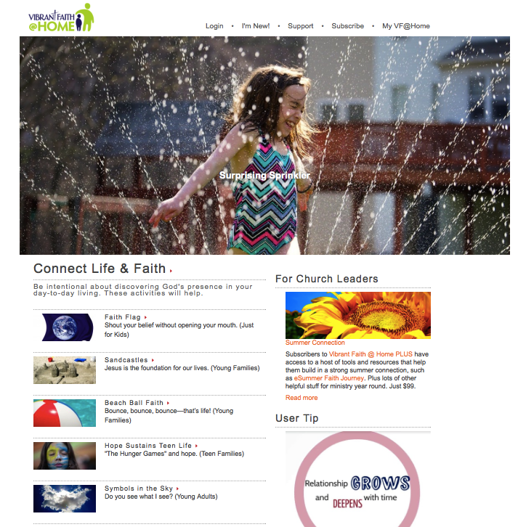
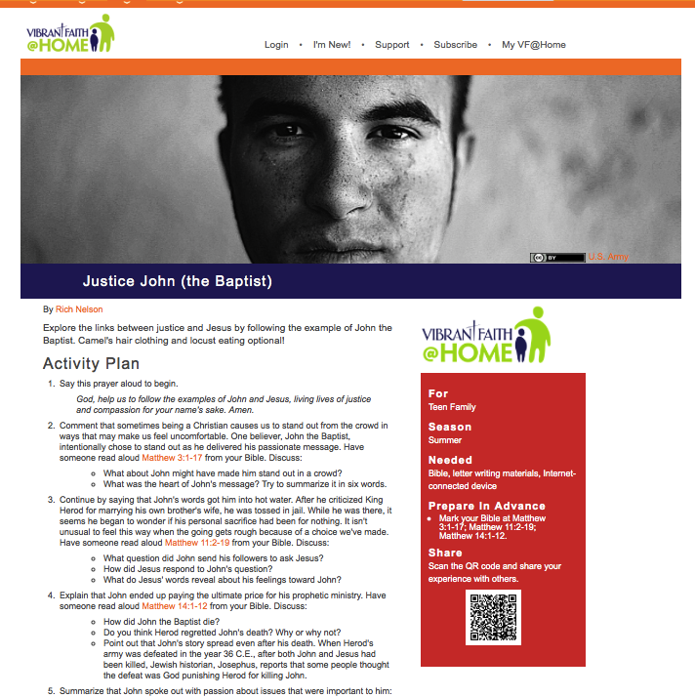
Digital Content

Slide 15
Mobile Revolution
Mobile devices have fundamentally changed the relationship between information, time, & space.
Information is now PORTABLE, PARTICIPATORY, PERSONAL
Information will find you through social networking. “If news is important it will find its way to me.”
People turn to their social networks to help them evaluate new information they encounter.
People have become content creators – when they discover content they will share it with their broad network.
Reciprocal sharing is the way people build their social capital and reputations.

Slide 16
Adaptive Challenge: Social Life
Embedded
Social Networks

Slide 17
Adaptive Challenge: Social Life
Group-Centered Life
Network-Centered Life
Church
Home
Ethnic Culture
Neighborhood

Slide 18
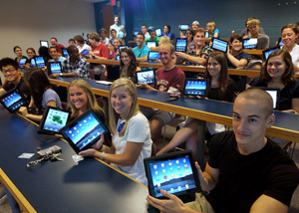
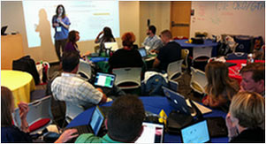
Adaptive Challenges: Education
A shift from education to learning anywhere, anytime.
A shift from consumption of information to participatory learning.
A shift from institutions to networks.

Slide 19
Shifts in Education
A shift from education to learning. Education is what institutions do, learning is what people do. Digital media enable learning anywhere, anytime; formal learning must be mobile and just in time.
A shift from consumption of information to participatory learning. A new system of learning must be peer-based and organized around learners’ interests, enabling them to create as well as consume information.
A shift from institutions to networks. In the digital age, the fundamental operating and delivery systems are networks, not institutions such as schools, which are a node on a young person’s network of learning opportunities. People learn across institutions, so an entire learning network must be supported.

Slide 20
The world is now changing at a rate at which the basic systems, structures, and cultures built over the past century cannot keep up with the demands being placed on them. Incremental adjustments to how you manage and strategize, not matter how clever, are not up to the job. You need something very new to stay ahead in a age of tumultuous change and growing uncertainties.
(John Kotter, Accelerate: Building Strategic Agility for a Faster-Moving World

Slide 21
Part 2. 21st Century Faith Formation

Slide 22
Twin Challenges
Foster, Support, Encourage, Equip for… intergenerational religious transmission through the family and congregation
Connect with, Build relationships with, Engage with the … Religiously unaffiliated and the spiritual but not religious by expanding our reach and our “campus” to the wider world

Slide 23
Faith Formation Goals
Churches want faith formation that helps people. . .
grow in their relationship with God throughout their lives
live as disciples of Jesus Christ at home, in the workplace, in the community and the world
develop an understanding of the Bible and their faith tradition
deepen their spiritual life and practices
engage in service and mission
relate the Christian faith to life today
participate in the life and ministries of the faith community

Slide 24
Holistic Faith & Formation
A way of the head (inform) demands a discipleship of faith seeking understanding and belief with personal conviction, sustained by study, reflecting, discerning and deciding, all toward spiritual wisdom for life.
A way of the heart (form) demands a discipleship of right relationships and right desires, community building, hospitality and inclusion, trust in God’s love, and prayer and worship.
A way of the hands (transform) demands a discipleship of love, justice, peace-making, simplicity, integrity, healing, and repentance.
(Thomas Groome)

Slide 25
Faith Forming Processes
GROWTH IN FAITH
Caring Relationships
Rituals & Milestones
Church Year Seasons
Worshipping
Learning the Tradition
Praying
Spiritual Formation
Reading the Bible
Serving Working for Justice Caring for Creation

Slide 26
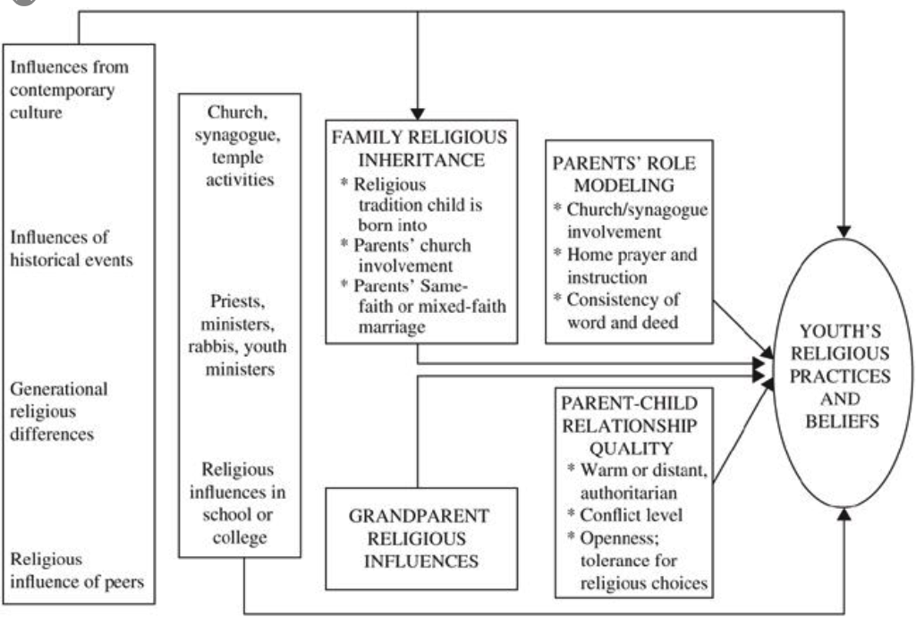
Religious Transmission

Slide 27
Factors Promoting Faith Growth
The combination of the following factors makes an enormous difference in religious outcomes during emerging adulthood:
the teenager’s parental religion
importance of faith
prayer
Scripture reading
lack of religious doubts
personal religious experiences
having supportive nonparent adults in the church
These most influential factors make differences of sizeable magnitude in substantive outcomes.

Slide 28
Factors Promoting Faith Growth
Parental Influence: The single most important social influence on the religious and spiritual lives of children and adolescents (and emerging adults) is their parents.
Embedded Family Religious Practices: Effective religious socialization comes about through specific religious activities that are firmly intertwined with the daily habits of family life.

Slide 29
Faith Forming Processes
GROWTH IN FAITH
Caring Relationships
Rituals & Milestones
Church Year Seasons
Worshipping
Learning the Tradition
Praying
Spiritual Formation
Reading the Bible
Serving Working for Justice Caring for Creation

Slide 30
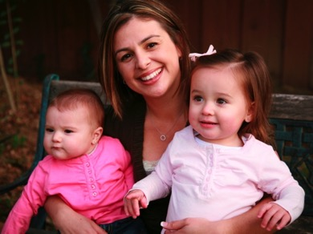
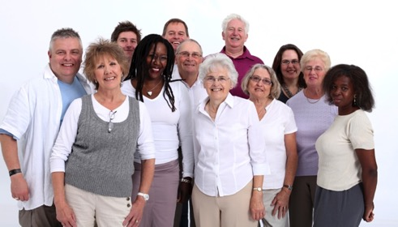
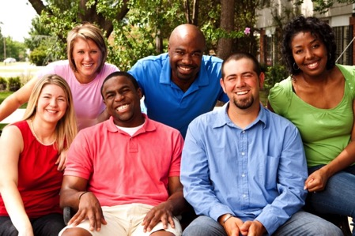
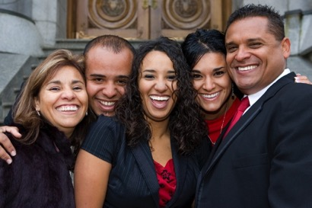
Lifelong & Lifewide Faith Formation for Everyone!

Slide 31
Lifelong Faith Formation
0-10
50s
20s
30s
40s
60s
70s
80s
90s
11-19

Slide 32
Lifewide Faith Formation
Holistic & Comprehensive
From. .. .
Faith
Life
To. .. .
Life
Faith

Slide 33
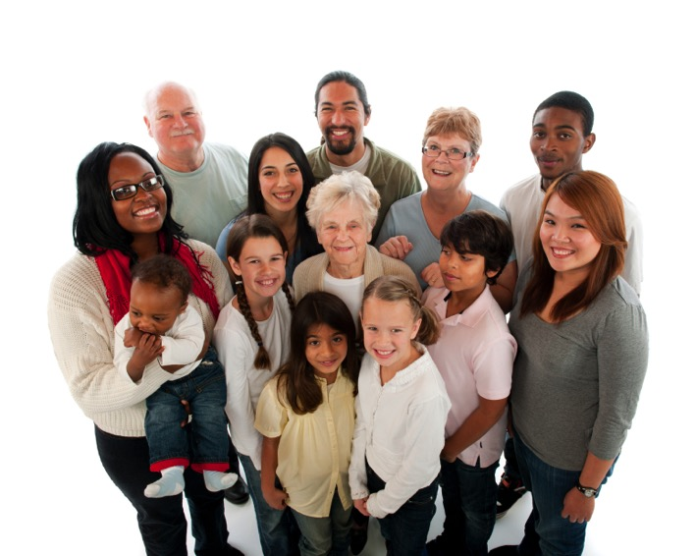
Intergenerational & Generational

Slide 34
Family
Parents
Grandparents
Church Community
Intergenerational
Relationships
Church Life
& Programs

Slide 35
Missional

Slide 36
Missional
Receptive to Organized Religion
Scenario 3 Unaffiliated & Uninterested
Scenario 1 Vibrant Faith & Active Engagement
Scenario 4 Variable Commitment & Occasional Participation
Scenario 2 Spiritual but Not Religious
Low Hunger & Commitment to Spiritual Life
High Hunger & Commitment to Spiritual Life
Resistant to Organized Religion

Slide 37
3. 21st Century Approach

Slide 38
Twin Challenges
Foster, Support, Encourage, Equip for… intergenerational religious transmission through the family and congregation
Connect with, Build relationships with, Engage with the … Religiously unaffiliated and the spiritual but not religious by expanding our reach and our “campus” to the wider world

Slide 39
Developing a New Operating System

Slide 40
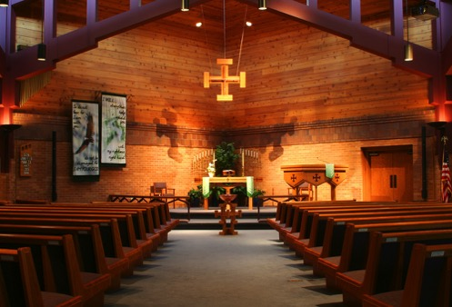
Old Operating System

Slide 41
Transformation
Group-Centered Life
Network-Centered Life
Church
Home
Ethnic Culture
Neighborhood

Slide 42
New Operating System: Network
Intergenerational Faith Community
Older Adults
Children & Parents
Mature Adults
Young Adults
Mid-Life Adults
Adolescents & Parents

Slide 43
At the Center: Intergenerational
Intergenerational Church
Caring
Celebrating
Learning
Praying
Serving

Slide 44
Intergenerational: Caring Community
Cultivating caring relationships across generations in the congregation and community, becoming a life-giving spiritual community of faith, hope, and love.
Intergenerational Caring Conversations
Intergenerational Community Building
Intergenerational Relationships in Existing Programs
Intergenerational Storytelling
Intergenerational Relationships through Mentoring

Slide 45
Intergenerational: Celebrating
Worshiping God together through Sunday worship, rituals, sacraments, and the liturgical seasons that involves all of the ages and generations.
Intergenerational Sunday Worship
Whole Community Sacramental Celebrations
Milestones throughout Life
Church Year Feasts & Seasons

Slide 46
Intergenerational: Learning
Engaging all ages and generations together in learning experiences that teach scripture and the Christian tradition, informing and forming disciples of all ages in Christian identity.
Intergenerational Learning (James White)
In-Common All Ages Experiences
Parallel Learning
Contributive Occasions
Interactive Sharing
Incorporating the Five Elements
Weekly, Bi-Weekly, and Monthly Models
Small Group & Large Group Models

Slide 47
Intergenerational: Learning
Incorporating Intergenerational Learning in Church Life
Age Group Programming
Sacramental and Milestone Celebrations
Church Year Feasts & Seasons
Vacation Bible School
Mission Trips & Service Projects
Retreat and Camp Experiences

Slide 48
Intergenerational: Praying
Nurturing the spiritual life of the whole community through the congregation’s prayer services, rituals, and blessings throughout the year.
Intergenerational Formation in Spiritual Practices
Intergenerational Prayer Stations
Intergenerational Prayer Partners & Spiritual Guides
Intergenerational Prayer Groups

Slide 49
Serving
Involving all ages and generations in service and mission to the world, especially to the poor and vulnerable, and in the works of justice and advocacy.
Intergenerational Mission Trips
Churchwide Service Day
Intergenerational Monthly Project
Intergenerational Service Nights
Intergenerational Service Projects

Slide 50
New Operating System: Network
Connected
Features
Diversity of faith formation experiences
Targeted to religious and spiritual needs
Tailored to people’s busy lives
Multiple formats
Anytime - 24x7x365
Anywhere - Mobile
Online Life
Church Life
Daily & Home Life
Community Life

Slide 51
New Operating System: Network
Age Group
Family
All Ages
Online Activities & Resources
On Your Own & Small Groups
Community Programs, Events, & Activities
Large Group: Course, Workshop, Retreat
Church Life & Events
At Home

Slide 52
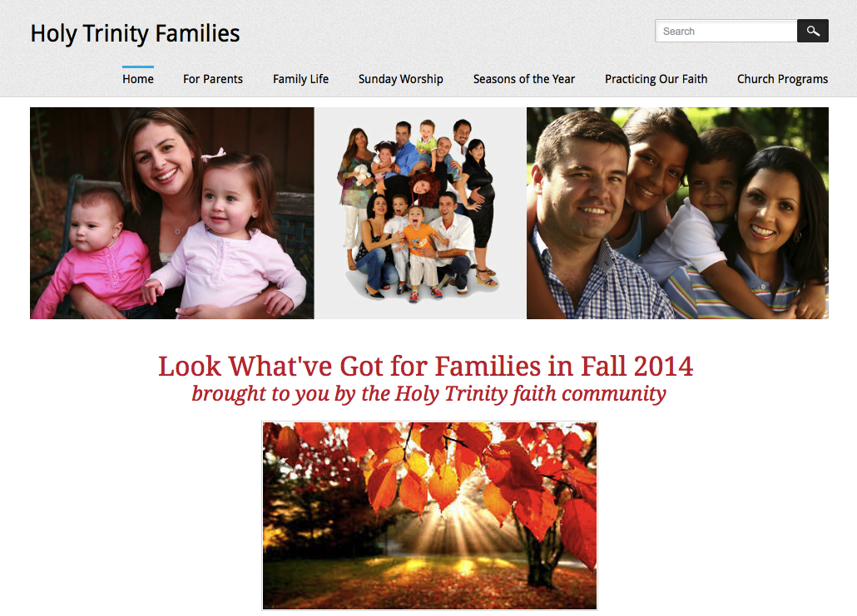
New Operating System: Network

Slide 53
Baptism
Mentors
Prayer, Rituals, Bible, Family Conversation, Service
Parent Faith Formation & Parenting Skills
Milestones
Faith Practices @ Home
Workshops Courses Online Resources Support Groups
Family Learning Programs
Baptism Anniversary, First Prayers, Start of School
Church Gatherings Small Groups Workshops
Parent/Family Online Resource Center
Families in the First Decade of Life

Slide 54
Families with Children
Faith
Formation
Network
Intergenerational Experiences with the Whole Faith Community
For Parents
Seasons of the Year
Milestones
Practicing Our Faith
Sunday Worship @ Home
Family Life
Children’s Programs & Events

Slide 55
Family Faith Formation Network

Slide 56
Adult
Faith Formation
Network
Faith Enrichment
Sunday Worship through the Week
Intergenerational Experiences & Connections
Service & Mission
Spiritual Enrichment
Scripture Enrichment
Life Issues
Discovering Faith
Grand-parents

Slide 57
Adult
Faith Formation
Network
Spiritual Enrichment
Online Courses
Retreats
Small Group Bible Study
Spiritual Book of the Month Club
Monthly Spiritual Practices Series
Apps & E-newsletters
Day at the Monastery
Online Prayer & Spirituality
Resource
Resource
Resources
Resources
Resource
Resource
Resource
Resource

Slide 58
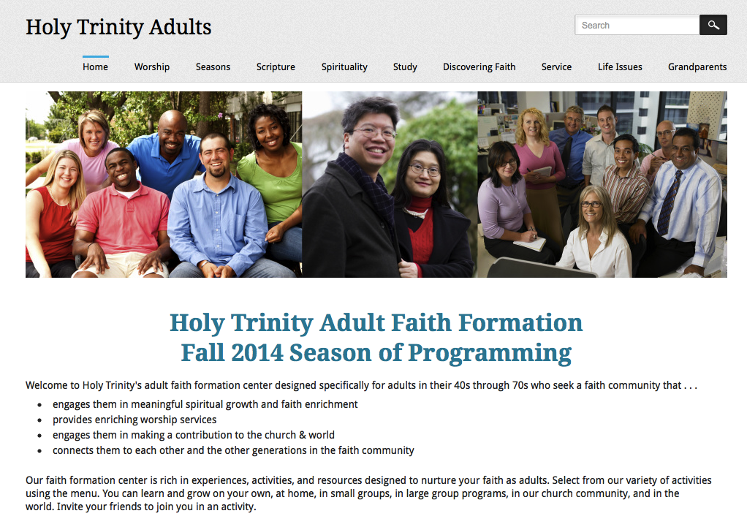
Adult Faith Formation Network

Slide 59
Three Seasons of Programming
Fall Season: September 1 – January 1
Winter/Spring Season: January 1 – May 1
Summer Season: May 1 – September 1
Fall
Winter-Spring
Summer

Slide 60
Connected & Blended Faith Formation
Online Faith Formation
Mostly Online with Regular Interaction in Gathered Sessions
Online Faith Formation & Gathered Sessions (Flipped Classroom)
Gathered Program with Supportive Online Content
Gathered Program with Online Components beyond the Program

Slide 61
Connected Faith Formation
Online Life
Church Life
Daily & Home Life
Community Life

Slide 62
Connected Faith Formation
Church Life ➔ Daily & Home Life via Online Life
Online Life ➔ Daily & Home Life ➔ Church Life
Community Life ➔ Daily/Home Life via Online Life
Online Life ➔ Church Life ➔ Daily & Home Life

Slide 63
Church ➔ Daily/Home via Online
Sunday worship
Church year feasts and seasons
Sacrament and ritual celebrations
Children, teen, or family programming
VBS and summer camp
Mission trips and service projects
Retreat experiences
. . . . and more

Slide 64
Connected Faith Formation: Worship
Church Life ➔ | Daily & Home Life | ⬅ Online Life
Experience of Worship in the Congregation Sunday worship and lectionary Church year feasts and seasons Church rituals: baptism, communion, funerals, etc. | Experience of Sunday worship, rituals, and church year seasons in daily life Reflecting on the sermon and readings at home Practices: Lectio, etc. Application to daily living | Online worship, church year, and lectionary resources on the church’s faith formation website Lectionary commentaries online Video reflections and commentary Online activities and projects

Slide 65
Connected Faith Formation: Lent
Church Life ➔ | Daily & Home Life | ⬅ Online Life
Ash Wednesday Lenten Sunday liturgies Stations of the Cross Lenten prayer Lenten retreat Lenten service Lenten soup suppers | Fasting Praying Service/Almsgiving Lectionary reflection Family activities | Lenten learning resources Lenten calendar Daily Lenten prayer Weekly table prayer Video resources Online retreat experience

Slide 66
Flipped Classroom

Slide 67
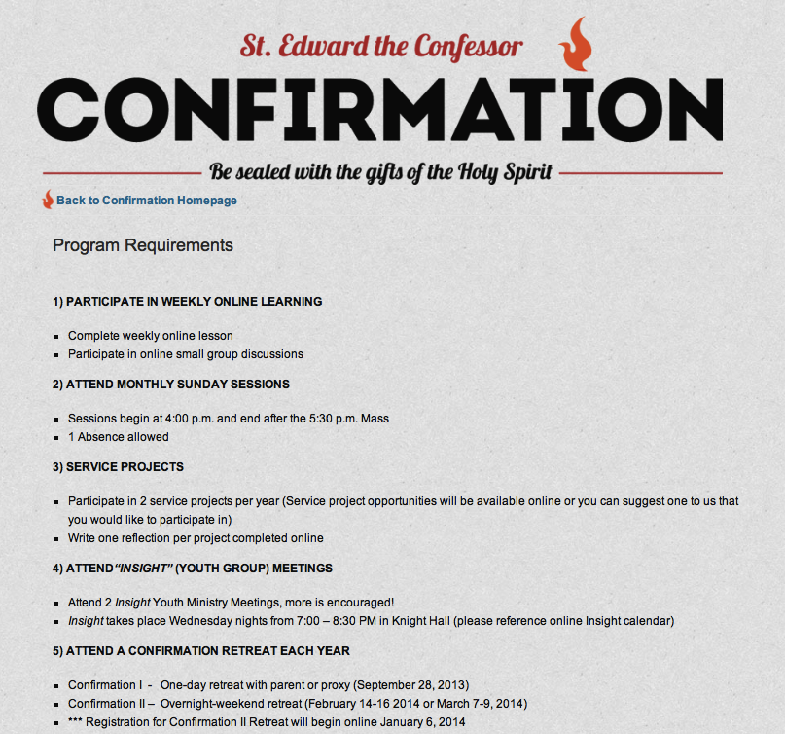
Flipped Classroom

Slide 68
Personalized
Resource
Resource
Resource
Resource
Resource
Resource

Slide 69
Personalized Faith Formation
Personalized pathways for discipleship & faith growth. . . .
Guide people in discerning their religious and spiritual needs
Equip people with the resources and tools to learn and grow at their own pace
Provide mentoring and support for the journey

Slide 70
Faith Growth Plan
Create expectations for participation in faith formation and church life by providing a seasonal/yearly growth plan with a variety of options for experiencing the Christian faith through community life. For example:
Sunday worship
Church year feasts and seasons
Service/mission projects
Retreat experience
Faith practices @ home, e.g. reading the Bible, praying, rituals, and more

Slide 71
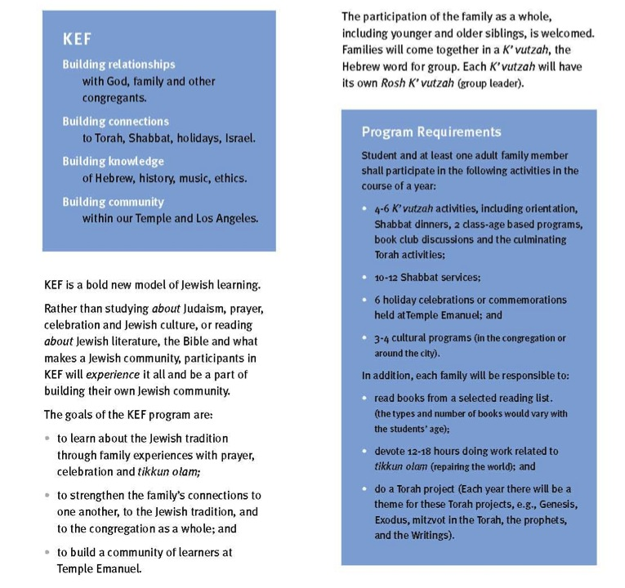

Slide 72
Emerging Roles
Current Roles
Emerging Roles
Developing religious content
Designing programming
Managing programming
Teaching/Facilitating programming
Designing learning environments—architecture
Curating religious content and experiences

Slide 73
Curated Faith Formation
Curating Content & Experiences
Church Programs & Activities
Denominational Resources
Community Programs & Activities
People Resources
Print, Audio, Video Resources
Art, Drama, Music
Websites, Courses, Blogs
Apps & Digital Resources

Slide 74
How do I get rid of the fear?
Alas, this is the wrong question.
The only way to get rid of the fear is to stop doing things that might not work, to stop putting yourself out there, to stop doing work that matters.
No, the right question is, "How do I dance with the fear?"
Fear is not the enemy. Paralysis is the enemy.
(Seth Godin)

Slide 75
You never change things by fighting the existing reality.
To change something, build a new model that makes the existing model obsolete.
Buckminster Fuller

