Slide 2
John Roberto LifelongFaith Associates jroberto@lifelongfaith.com www.LifelongFaith.com SeasonsofAdultFaith.com FamiliesattheCenter.com WholeCommunityFaithFormation.weebly.com

Slide 3
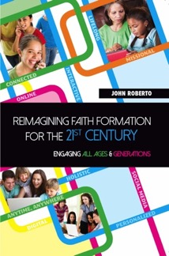
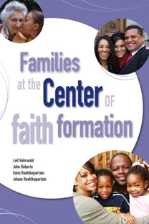
Lifelong Faith Books

Slide 4
A Faith Forming Ecology
Digitally Enabled and Connected
Faith Forming Ecology
Inter-genera-tional
Family
Life Cycle
Missional
Digitally Enabled and Connected
Digitally Enabled and Connected
Digitally Enabled and Connected

Slide 5
Key Concept: Adaptive Challenges

Slide 6
Life Span Diversity
0-10
50s
20s
30s
40s
60s
70s
80s
90s
11- 19

Slide 7
The Seasons of Life
Seasons of Life
Life Issues
Young Children
Older Children
Young Adolescents
Older Adolescents
Young Adults (20s-30s)
Midlife Adults (40s-mid 50s)
Mature Adults (mid 50s–75)
Older Adults (75+)
Physical & Cognitive Changes
Developmental Tasks
Family Life Cycle
Faith Development
Spiritual-Religious Identities
Generational Characteristics

Slide 8
Five Generation Diversity
iGeneration (2000-
Millennials (1980-99)
Generation X (1961-1979)
Builders (before 1946)
Baby Boomers (1946-60)

Slide 9
Generations
iGeneration (2000-
Millennials (1980-99)
Generation X (1961-1979)
Builders (before 1946)
Baby Boomers (1946-60)
Relationship to Institutions
Relationship to Authority
Family Relationships
Work-Life Balance
Communication Style
Technology Usage
Learning Style
Spiritual Expression
Worship Style

Slide 10
Family Diversity
Married Couple + No Children
Married Couple + Children (biological or blended)
Single Parent + Children
Unmarried Couple + Children or No Children
Same Sex Couple + Children or No Children
Multigenerational Family (young adult, grandparents)
Grandparents as Primary Caregivers

Slide 11
Families Today
Diversity of family structures and a variety of living arrangements from 0-18 years old
Pressures of work and finances; 70% of mothers work outside home
Increasing complexity of family life, managing/balancing time and commitments
New generation of parents: Millennial parents & young Gen X
Decline in religious practice at home, and decline in participation and affiliation in churches
Decline in faith transmission and practice at home

Slide 12
A Diversity of Spiritual Religious Identities
Not Spiritual, Not Religious
Unaffiliateds
The Spiritual but Not Religious
Uninvolved
Faith & Engagement – one among many priorities
Occasionals
Faith & Engagement at the Center of Life
Actives

Slide 13
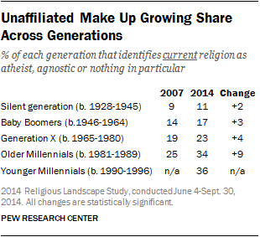
Spiritual-Religious Diversity

Slide 14
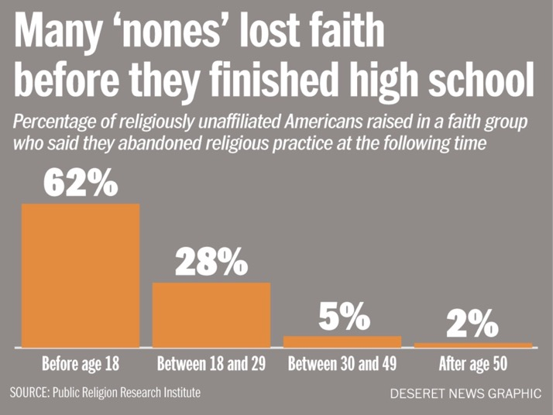
Spiritual-Religious Diversity

Slide 15
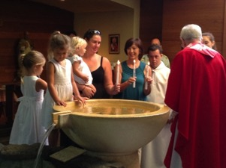
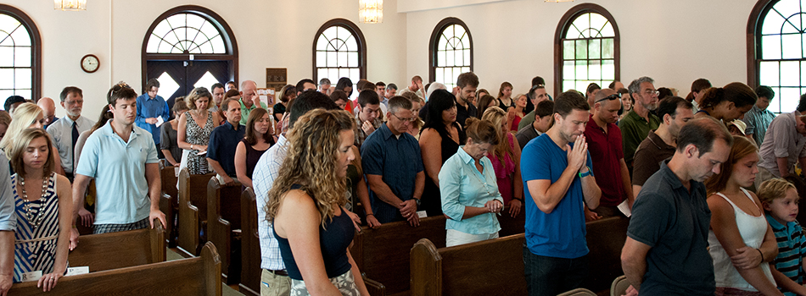
Decline in Religious Socialization & Practice

Slide 16
Digital Transformation

Slide 17
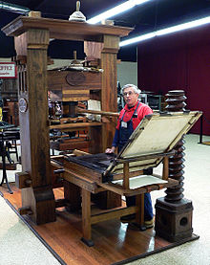
Technological Revolution: The Print Era (1500s - )

Slide 18
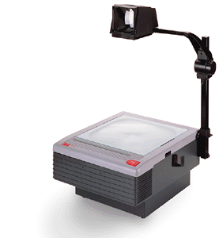
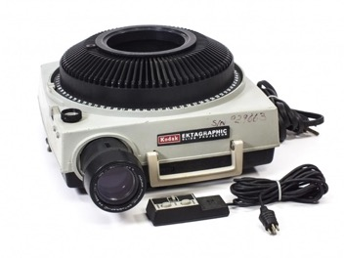
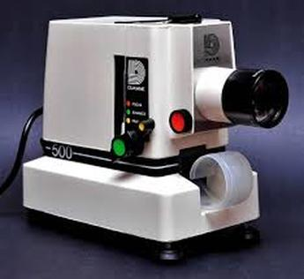
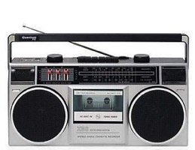
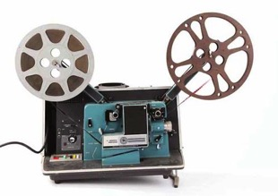
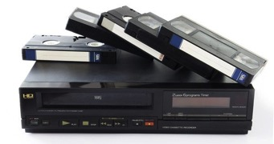
Technological Revolution: The Multimedia Era (1960s - )

Slide 19
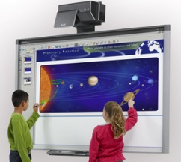
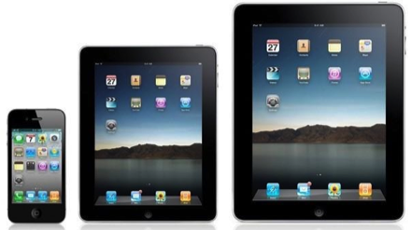
Technological Revolution: The Digital Era (2000s -)

Slide 20
Technological Revolution: The Digital Era (2000s -)

Slide 21
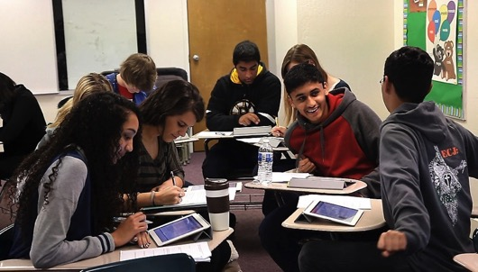
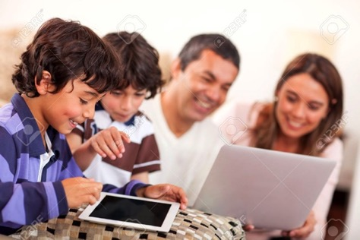
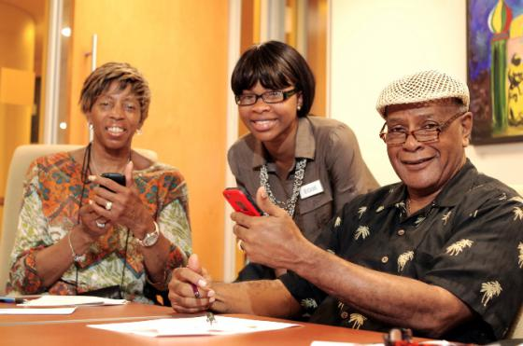

Slide 22
Digital Culture
Digital culture is transforming every aspect of life.
People have the technology and know how to use it.
People have time in their busy lives to connect, participate, and interact in online experiences and communities.
People are already engaged in online learning and online spiritual experiences.
People have access to an abundance of content – in all types of media formats – on demand, just in time, available 24x7, and often free!

Slide 23
The Adaptive Challenges of 21st Century Faith Formation
Ten decades of the life cycle
Five unique generational identities
Diverse family forms and styles
Diverse spiritual-religious identities of people
Decline in religious transmission and practice at home and decline in participation in church life and programs
Digital culture: new technologies and media create transformation in every aspect of life

Slide 24
Key Concept: Life Cycle - Maturing in Faith
Addressing the unique life tasks, needs, interests, and spiritual journeys of people at each stage of life.

Slide 25
Focus on Maturing in Faith: Toward What Ends Are We Working
Youth
Midlife Adults
Children
Young Adults
Mature Adults
Older Adults

Slide 26
Maturing in Faith
Christian faith formation is a lifelong journey with Christ, in Christ, and to Christ.
Lifelong Christian faith formation is lifelong growth in the knowledge, service and love of God as followers of Christ and is informed by scripture, tradition and reason.
(The Charter for Lifelong Christian Formation)

Slide 27
Maturing in Faith
Every person is well-equipped to be growing in faith, be theologically conversant, and be active in the global mission of the church.
Faith Formation can then be understood and defined as “an engaged process of learning and practice integrated throughout all aspects of congregational and daily life.”
(United Church of Christ, “Foundations, Findings, and Futures,” 2012)

Slide 28
Maturing in Faith
The definitive aim of catechesis is to put people not only in touch, but also in communion and intimacy, with Jesus Christ. Starting with the "initial” conversion of a person to the Lord, moved by the Holy Spirit through the primary proclamation of the Gospel, catechesis seeks to solidify and mature this first adherence. It proposes to help those who have just converted "to know better this Jesus to whom he has entrusted himself: to know his 'mystery', the kingdom of God proclaimed by him, the requirements and comments contained in his Gospel message, and the paths that he has laid down for anyone who wishes to follow him.”
(Roman Catholic, General Directory for Catechesis, 80)

Slide 29
Maturing in Faith: Holistic
A way of the head (inform) demands a discipleship of faith seeking understanding and belief with personal conviction, sustained by study, reflecting, discerning and deciding, all toward spiritual wisdom for life.
A way of the heart (form) demands a discipleship of right relationships and right desires, community building, hospitality and inclusion, trust in God’s love, and prayer and worship.
A way of the hands (transform) demands a discipleship of love, justice, peace-making, simplicity, integrity, healing, and repentance.
(Thomas Groome)

Slide 30
Maturing in Faith: Holistic (Roman Catholic, National Directory for Catechesis)
Christ’s method of formation was accomplished by diverse yet interrelated tasks. His example is the most fruitful inspiration for effective catechesis today because it is integral to formation in the Christian faith. Faith must be known celebrated, lived, and expressed in prayer. So catechesis comprises six fundamental tasks, each of which is related to an aspect of faith in Christ.
Promote Knowledge of the Faith – Teach the “basics” of the faith as revealed in the signs of creation, Sacred Scripture, Catholic tradition and human experience.
Liturgical Education – Teach about the form and meaning of the liturgy and the sacraments and help individuals prepare their minds and hearts to enter into these mysteries of our faith.

Slide 31
Maturing in Faith: Holistic (Roman Catholic, National Directory for Catechesis)
Moral Formation – Teach the moral teachings of the Church which are the fulfillment of the Commandments.
Teaching to Pray – Teach that a “climate of prayer” and participation in prayer invites individuals into a personal relationship with Jesus Christ.
Education for Community Life – Teach that the human person needs to live in society. Society is not optional, but a requirement of human nature.
Missionary Initiative – Teach that all Christian service is an expression of love and is performed by Christians for the purpose of building up the Kingdom of God on earth.

Slide 32
Focus on Maturing in Faith
Search Institute, 1988
Spirit & Culture of YM, 2005
Trusting and believing
Seeking spiritual growth
Integrating faith and life
Holding life-affirming values
Experiencing the fruits of faith
Nurturing faith in community
Advocating for social change
Acting and serving
Seeking Spiritual Growth
Possessing a Vital Faith
Practicing Faith in Community
Making the Christian Faith a Way of Life
Living a Life of Service
Possessing a Positive Spirit
Exercising Moral Responsibility

Slide 33
Focus on Maturing in Faith
Sustaining a personal relationship with Jesus Christ supported through regular prayer, faith sharing and Bible reading.
Making the Christian faith a way of life by integrating their beliefs into the conversation, decisions, and actions of daily life.
Possessing a vital faith and being aware of God present and active in their own life, the lives of others, and the life of the world.

Slide 34
Focus on Maturing in Faith
Seeking spiritual growth by actively pursuing questions of faith, learning what it means to believe in God, and what it’s like to be a disciple of Jesus Christ.
Living a life of service by caring for others, reaching out those in need, and addressing injustice in the world.
Sharing the Good News through words and actions, through Christian stewardship and working for peace, justice and human dignity.

Slide 35
Focus on Maturing in Faith
Participating fully, consciously, actively and regularly in the ritual and worship life of the faith community.
Articulating the fundamental teachings of the Christian faith and demonstrating a commitment to learning and growing in this faith.
Exercising moral responsibility by applying Christian ethics, virtues, principles, values, and social teaching to moral decision-making, life situations, and in interactions with the larger culture.

Slide 36
Focus on Maturing in Faith
Practicing faith in Jesus Christ, privately and publicly, through participation in the congregation’s worship, ministries, and leadership.
Discerning and using their gifts to actively belong to and participate in the life and mission of the Christian community.
Exploring God’s call to vocation through prayer, reflection, and discernment.
Possessing a positive spirit with loving and hopeful attitudes toward others and life, convinced that they can make the world a better place.

Slide 37
Maturing in Faith
We need to focus faith formation on the essential characteristics of lifelong growth in Christian faith and discipleship. These characteristics would incorporate knowing and believing, relating and belonging, practicing and living. With a lifelong vision of maturing faith we could address each characteristic in developmentally-appropriate ways at each stage of life.

Slide 38
Maturing in Faith
For example: if “sustaining a personal relationship with Jesus Christ supported through regular prayer, faith sharing and Bible reading” was one of these faith maturing characteristics, the task of faith formation would be to ask how we can accomplish this with children, youth, young adults, midlife adults, mature adults, and older adults. In this approach we would build our “curriculum” around the people and the faith maturing characteristics.

Slide 39
Multiple Ways to Foster Faith Maturing
Maturing in Faith
Approach
Approach
Approach
Approach
Approach

Slide 40
Key Concept: Faith Forming Environments
Intergenerational
Family
Peers
Children & Adolescents

Slide 41
Forming Faith: Intergenerational
Utilize intergenerational events
Connect the generations
Infuse intergenerational into existing programs
Create intergenerational new programs & experiences (learning, service, community life)

Slide 42
Intergenerational Learning Process
Preparation: knowledge & practices for participating fully
Guided Participation: in the events of church life & the Christian Faith
Reflection: on the experience and living its meaning in daily life

Slide 43
Intergenerational Faith Formation
Example: If we are creating a plan for children’s faith formation, we need to consider how we will:
engage children in faith community experiences with all generations (including worship)
equip parents to share faith at home and build families of faith practice.
build relationships with and engage children and parents who are not involved in the faith community (e.g., baptized but not engaged).
Then we can identity the unique age-group experiences we need to provide children.

Slide 44
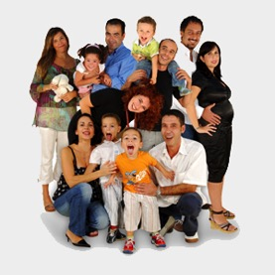
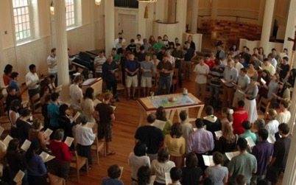
Forming Faith: Family
Primary Influence on transmission of religious faith and practice: Parents & Family
Day-to-day religious practices of the family and the ways parents model their faith and share it in conversation, collaboration, and exposure to outside religious opportunities
Secondary Influence: The Congregation and Significant Adults

Slide 45
Parental Influence
Parent Role
Sponsor of the Faith point of access between church home
Gatekeeper of the Faith control over how much and what sorts of religious content their children encounter
Interpreter of the Faith meaningful embodiment of the Christian faith in the lives of children

Slide 46
Family Faith Formation
Family Faith at Home
Family Engagement in the Intergenerational Faith Community
Family Life & Parent Formation

Slide 47
Family Faith Formation
God in Everyday Life
Faith Practices at Home
Milestones
Seasonal Events
Encountering God in the Bible
Intergenerational Connections
Strong Family Life
Parents & Grandparents as Faith Formers

Slide 48
Family Faith Formation Plan
Young Children
Older Children
Young Adolescents
Older Adolescents
Family Faith @ Home
God in Everyday Life
Faith Practices
Milestones
Intergenerational Faith Community
Seasonal Events
Bible through the Year
Intergenerational Connections & Experiences
Family Life & Parent/Grandparent Formation
Strong Family Life
Parents & Grandparents as Faith Formers

Slide 49
The Seasons of Life
Seasons of Life
Life Issues
Young Children
Older Children
Young Adolescents
Older Adolescents
Young Adults (20s-30s)
Midlife Adults (40s-mid 50s)
Mature Adults (mid 50s–75)
Older Adults (75+)
Physical & Cognitive Changes
Developmental Tasks
Family Life Cycle
Faith Development
Spiritual-Religious Identities
Generational Characteristics

Slide 50
Generations
iGeneration (2000-
Millennials (1980-99)
Generation X (1961-1979)
Builders (before 1946)
Baby Boomers (1946-60)
Relationship to Institutions
Relationship to Authority
Family Relationships
Work-Life Balance
Communication Style
Technology Usage
Learning Style
Spiritual Expression
Worship Style

Slide 51
Key Concept: 21st Century Learning

Slide 52
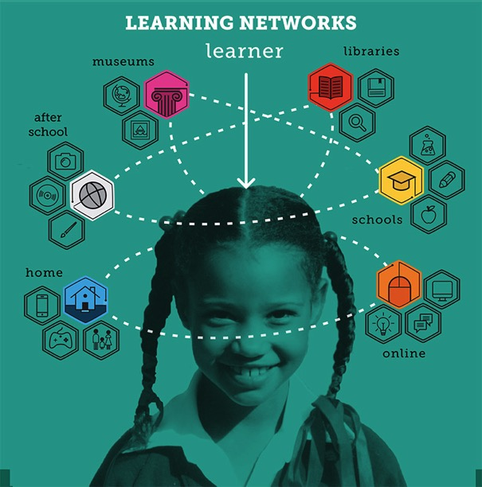

Slide 53
21st Century Learning Characteristics
Personalized
Individualized
Immersive learning environments
Interactive
Engaged
Participatory
Experiential
Visual and multimedia
Multi-Sensory
Abundant content, on demand
Episodic experiences
Micro-learning
Practice-Performance-Feedback
Seamless Learning across multiple platforms
Production-centered

Slide 54
Transforming Our Approach
Providing an abundance of content & experiences developed around the needs and lives of adults available on demand, 24x7
Using multiple environments: independent, mentored, at home/daily life, small group, large group, church-wide, and in the world
Building a digital platform that integrates all faith formation content and experiences seamlessly
Using digitally-connected strategies to enhance and expand all faith formation programming
Designing episodic engagements and micro-learning experiences
Creating personalized pathways for adult faith formation

Slide 55
Virtual Learning Academy

Slide 56
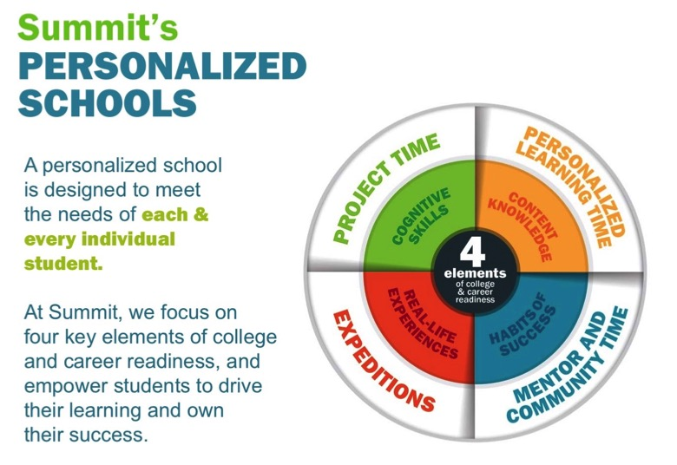
Summit Schools

Slide 57
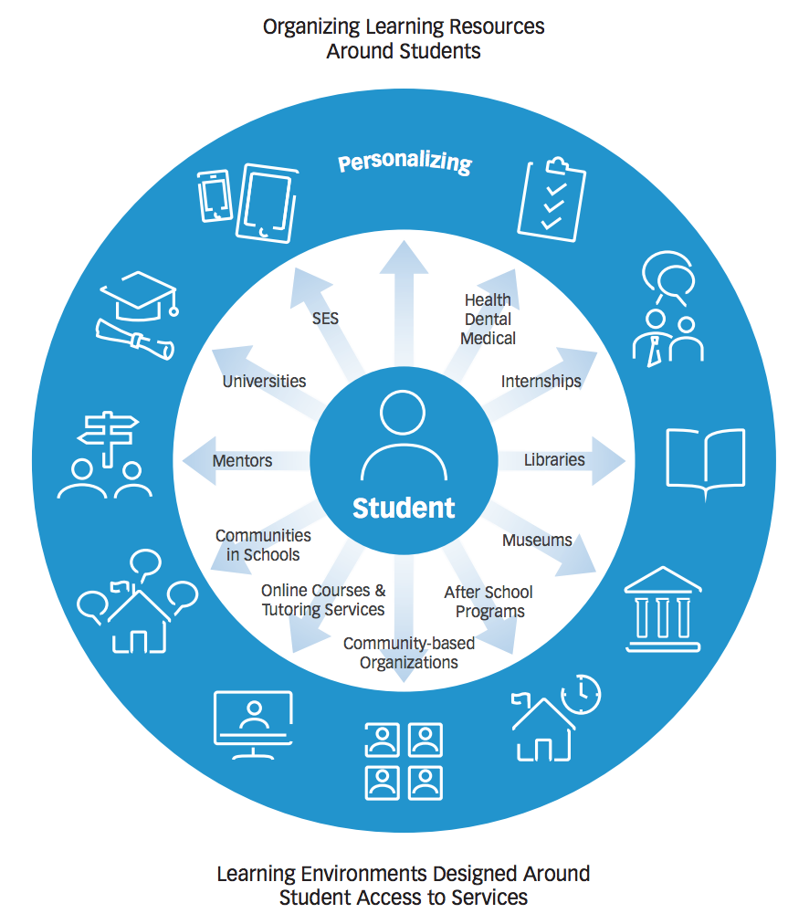
Personalizing Learning
Personalized learning is tailoring learning for each student’s strengths, needs and interests— including enabling student voice and choice in what, how, when and where they learn— to provide flexibility and supports to ensure mastery of the highest standards possible.

Slide 58
A Faith Forming Ecology
Digitally Enabled and Connected
Faith Forming Ecology
Inter-genera-tional
Family
Life Cycle
Missional
Digitally Enabled and Connected
Digitally Enabled and Connected
Digitally Enabled and Connected

Slide 59
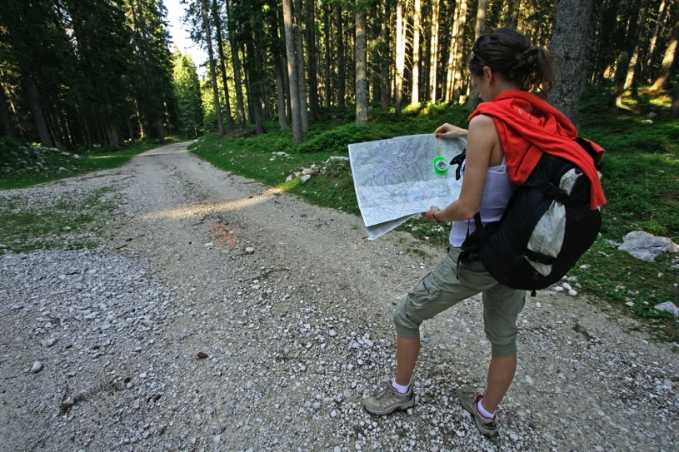
Key Concept: Personalized Faith Pathways

Slide 60
Personalizing Faith Formation
We need to tailor faith formation to the individual journeys of children, youth, young adults, adults, and families in order to address their increasing spiritual and religious diversity and life stage needs.
One of the latest educational innovations is personalized learning, i.e., tailoring the educational environment—the what, when, how and where people learn—to address the individual needs and interests of each person.
To personalize faith formation we need to create “faith growth pathways” that use the faith maturing characteristics and, with the help of a mentor or small group, guide people in discerning their faith growth needs.

Slide 61
A Diversity of Spiritual Religious Identities
Not Spiritual, Not Religious
Unaffiliateds
The Spiritual but Not Religious
Uninvolved
Faith & Engagement – one among many priorities
Occasionals
Faith & Engagement at the Center of Life
Actives

Slide 62
Personalized Pathways of Faith Growth
Pathways
Vibrant
Variety of Experiences & Activities
Occasional
Variety of Experiences & Activities
Uninvolved
Unaffiliated
Variety of Experiences & Activities

Slide 63
Multiple Ways to Foster Faith Maturing
Maturing in Faith
Approach
Approach
Approach
Approach
Approach

Slide 64
Personalizing Faith Formation
For example, if we took the characteristic “seeking spiritual growth by actively pursuing questions of faith, learning what it means to believe in God, and what it’s like to be a disciple of Jesus Christ” we could provide a tool that helps them discover their faith growth needs using a continuum from “exploring” to “getting started” to “making progress” to “going deeper” with short illustrations for each one.
In this approach we would then develop a personalized faith growth plan—or what educators are now calling “playlists”—of content (print, audio, video, online) and direct experiences to address their needs.

Slide 65
Pathways Discernment
Through our baptism, we are called to join Christ in the “River of Life”, a life-long journey of discipleship. The following journey markers will help you identify where you are on this journey and to select programs and experiences that move you along the river. Whether you are “checking it out” or “leading others”, we want to accompany you on this journey!
Check it Out (Come and See): You are standing at the shore. You are looking for a place to belong and have questions about what is going on in the water. You are invited to join in…
Step in the Water (Belonging): You have stepped into the water. You are developing relationships and enjoying life as part of the church community. Find a place to belong…
Get in the Boat (Exploring): You are invited into the raft with others. You are becoming equipped with tools for the journey. You are excited to learn and discover more about your faith and are exploring a deeper relationship with Christ. Explore your faith…
Navigate the Waters (Owning): You are rowing hard, investing in your own spiritual growth. Your eyes are on the water ahead. You are a committed disciple of Christ, have a personal relationship with God and are an active member in the life of the church community. Your faith informs your decisions, actions and attitudes. Grow by…
Lead Others (Living): You have become an experienced guide. You’re inviting, equipping, and leading others on the journey. You continue to explore new waters in your own faith. Live your faith by…

Slide 66
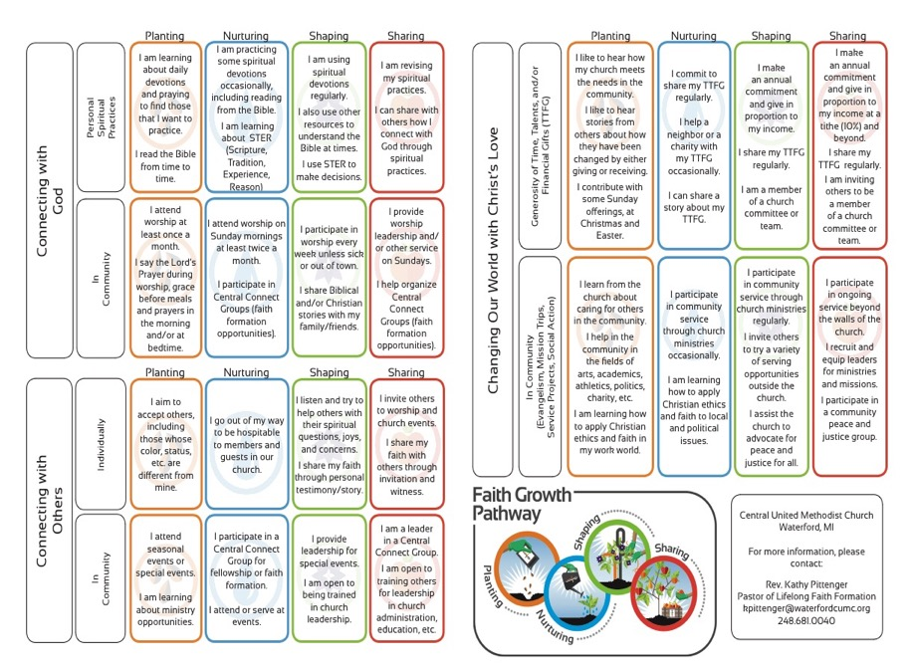

Slide 68
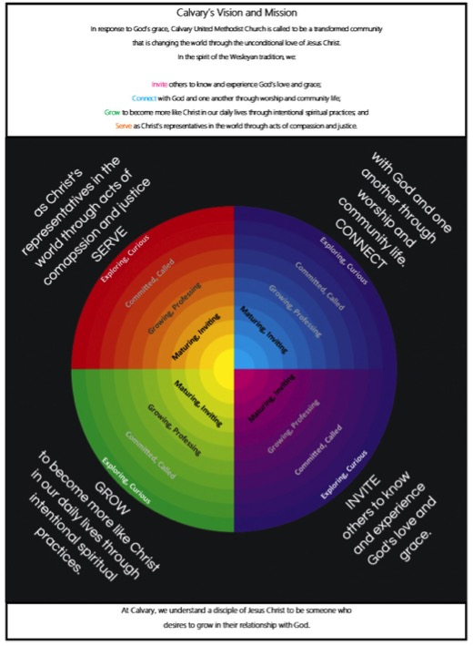

Slide 69
Key Concept: Playlists for Learning

Slide 70
Learning Playlists
A learning playlist is a curated group of digital and local learning experiences and resources (e.g. videos, websites, books, games, articles, etc.).
A playlist weaves together these learning experiences into a sequenced pathway centered on a common theme.
Playlists broaden opportunities to engage in cohesive, interest-driven connected learning experiences that combine a variety of ways to learning: peer settings, family settings, intergenerational settings, community/world settings, and online settings.
Playlists create a rich network of experiences for learners.

Slide 71
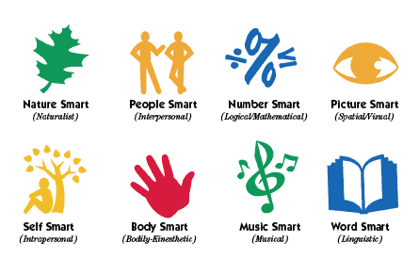
Faith Formation Playlists
Variety of Environments: Self-directed, mentored, at home, in small groups, in large groups, church-wide, in the community, and in the world.
Variety of Ways
to Learn

Slide 72
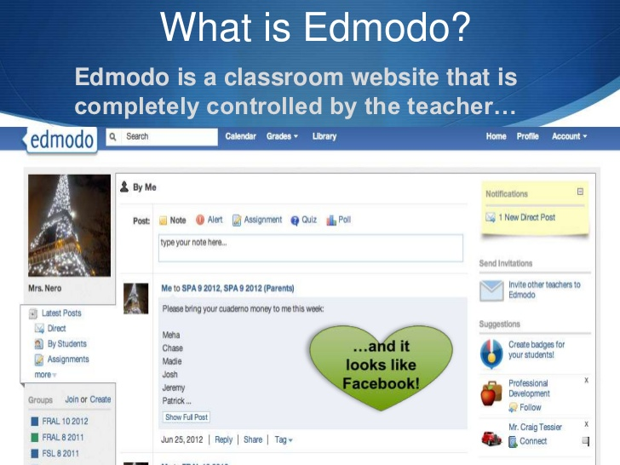

Slide 73
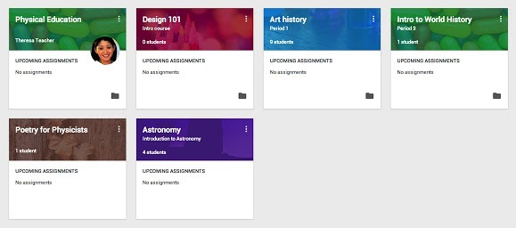
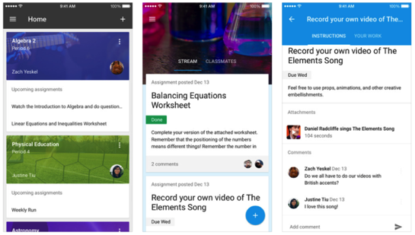

Slide 74
Playlists

Slide 75
Create Playlist
Faith Maturing Characteristic:
Characteristic / Goals
Faith Pathway (example)
Getting Started
Making Progress
Going Deeper
Faith Forming Experiences
Content
Settings
Methods
Peers/Mentors/Guides
Demonstration of Growth

Slide 76
Faith Forming Plan
Faith Maturing Characteristic | Intergenerational | Family & Parents | Peer

Slide 77
Playlist Plan: Activities & Experiences Characteristic: __________________________
Getting Started | Making Progress | Going Deeper

Slide 78
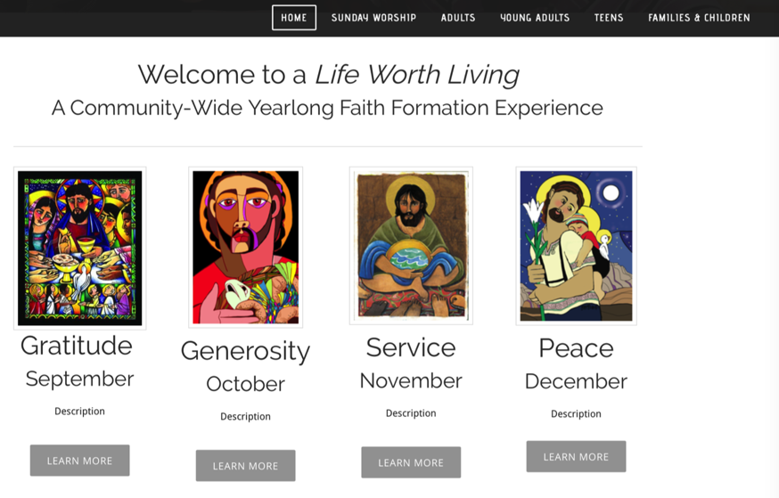

Slide 79
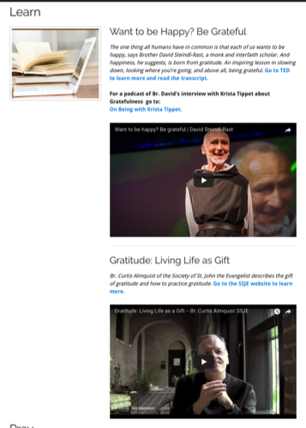
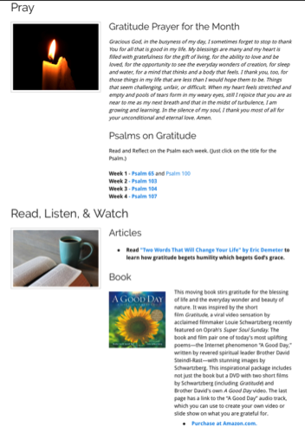
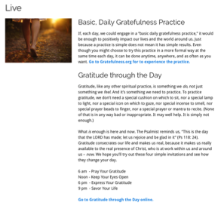
Playlists of Content & Experiences
Learn
Pray
Read, Listen, Watch
Live

Slide 81
Playlists of Content & Experiences

Slide 83
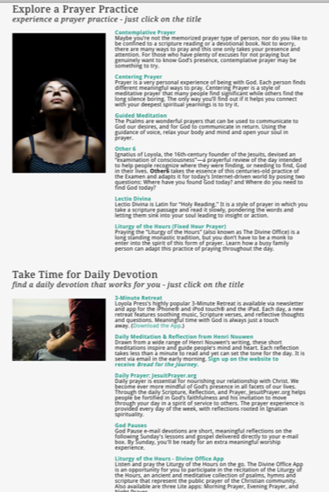
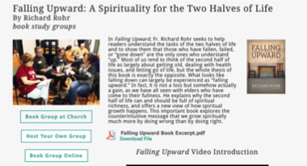

Slide 84
Family Faith Formation Network

Slide 85
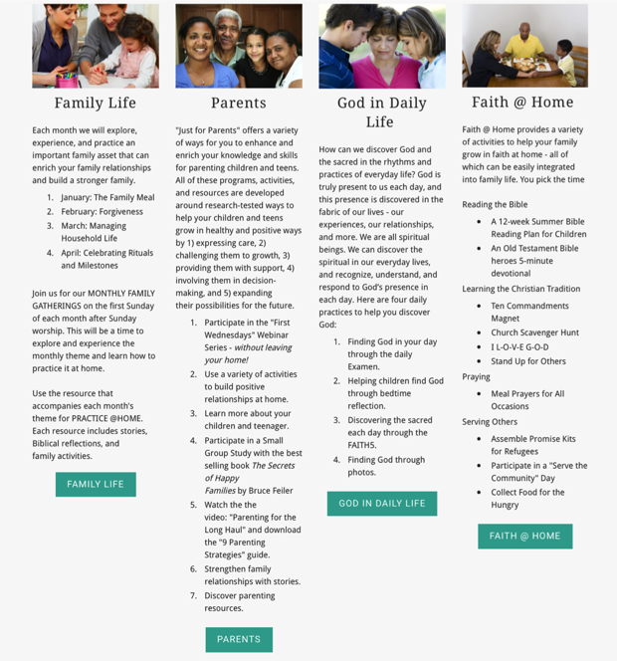

Slide 86
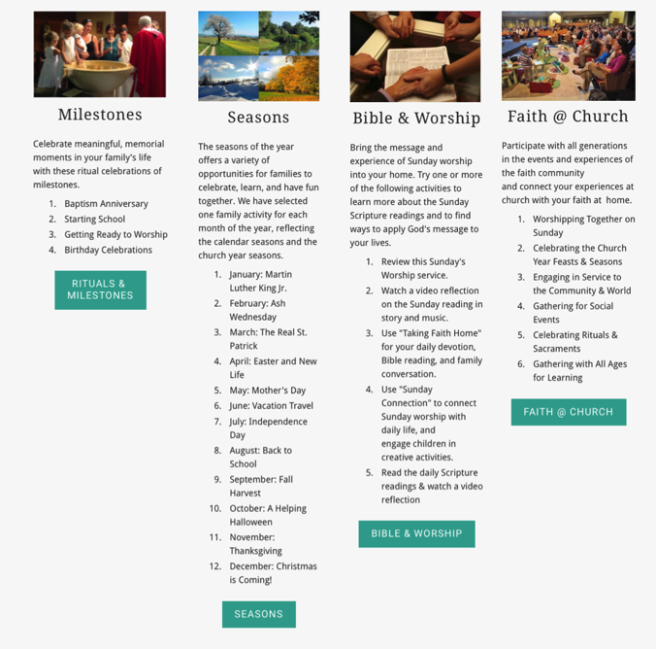

Slide 87
Playlists of Content & Experiences
If you were to use a Playlist approach to develop the faith of families with young children….
Getting Started Families (little faith experience)
Growing Families (somewhat connected to faith community)
Going Deeper Families (involved and practicing)
How would you engage the parents?
How would you engage the children and whole family?

Slide 88
Playlists of Content & Experiences
If you were to use a Playlist approach for first communion…
Getting Started Children (little to no faith forming experiences)
Growing Children (some faith forming experiences)
Going Deeper Children (involved and practicing)
What would faith formation look like with these three “types” of children?
What would parent and family faith formation look like?

Slide 89
Playlists of Content & Experiences
If you were to use a Playlist approach for confirmation…
Getting Started Adolescents (little to no faith forming experiences since childhood)
Growing Adolescents (some faith forming experiences in childhood)
Going Deeper Adolescents (involved and practicing)
What would faith formation look like with these three “types” of adolescents?
What would parent and family faith formation look like?

Slide 90
Transforming Our Role
Balancing Both Roles
|---------------------------------------------------------------------------------------------------------|
Current Roles
Emerging Roles
Developing religious content
Designing programming
Managing programming
Teaching/Facilitating programming
Designing faith forming environments—architecture
Designing Digital Platforms for faith forming content
Curating religious content and experiences

Slide 91
New Leadership Roles
We are becoming learning architects who design and/or identify environments which can become settings for faith formation, e.g., homes, workplaces, coffee shops, online communities, and more. We can design content and experiences to “deliver” to that setting.
We are becoming designers of digital platforms (websites, social media) where people can connect with each other, access content, engage in learning activities, and more. These platforms provide 24x7 faith formation.
We are becoming curators of religious content and experiences. When there is an abundance of content, our role shifts from creator to curator. Curators are engaged in finding and identifying high quality content in all formats, matching it with the needs of people, providing the content on a digital platform (and often in gathered settings), and engaging people with the content.

Slide 92
Key Concept: Curating Faith Formation

Slide 93
What is Content Curation (Beth Kanter)
Content curation is the process of sorting through the vast amounts of content on the web and presenting it in a meaningful and organized way around a specific theme.
The work involves sifting, sorting, arranging, and publishing information.
A content curator picks the best content that is important and relevant to share with their community.
It isn’t unlike what a museum curator does to produce an exhibition: They identify the theme, they provide the context, they decide which paintings to hang on the wall, how they should be annotated, and how they should be displayed for the public.

Slide 94
Curating Religious Content
Research & Organize Resources
Identify Potential Resources for Programming
Evaluate Resources
Select & Connect Resources to programming

Slide 95
Develop Trusted Sources
Blogs Newsletters Websites
Denominations Curated Websites Religious Organizations
6-8 “Expert” Resource People

Slide 96
Develop a Research Checklist
People: teachers, mentors/guides, guest presenters
Community programs: churches, agencies, organizations,
Educational institutions: colleges, seminaries
Retreat and spiritual life centers, monasteries
Denominational programs, events, websites
Museums
Books (with study guides) & E-books
Apps
Audio podcasts & audio learning programs
Videos & video learning programs
Online courses & online activities
Television shows
Organizational websites
Resource center websites

Slide 97
Develop Evaluation Criteria
Biblical content and interpretation
Theological content and emphasis
Developmental appropriateness
Ethnic-Cultural appropriateness
Inclusive of diversity
Respect for diverse ways of learning
Appearance and visual appeal
Ease-of-Use
Quality of Experience
Applicable: Able to be incorporated into daily and home life

Slide 98
Digital Faith Formation Strategies

Slide 99
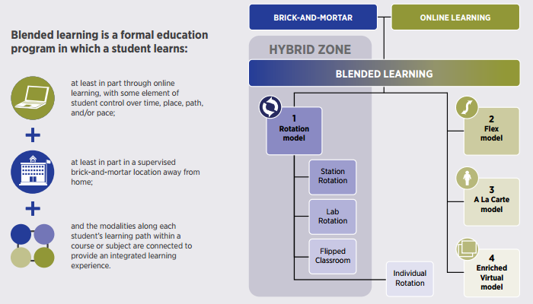
Blended Learning

Slide 100
Digitally Enabled & Digitally Connected Faith Formation

Slide 101
Extend the Event
Church or School Event or Program
At Home & Daily Life

Slide 102
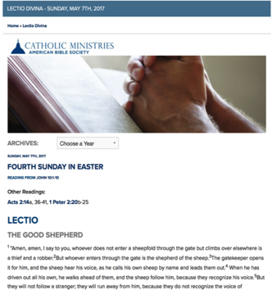
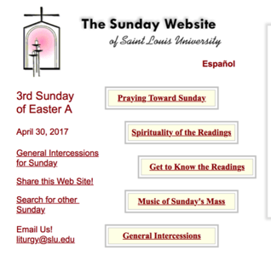
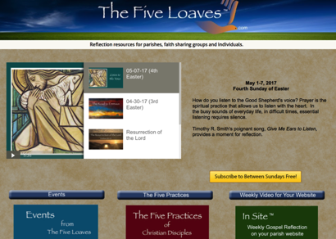
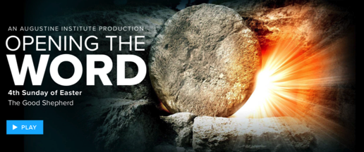
Sunday Worship
Learning
Praying
Reading the Bible: Daily Readings
Living

Slide 103
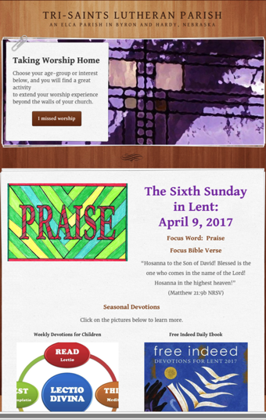
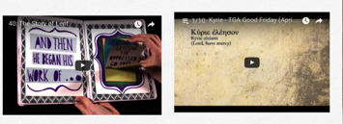
Sunday Worship Tri-Saints Lutheran Church

Slide 104
One Event/ Program, Multiple Formats
Multiple Formats
Digital Content to Extend & Provide New Ways to Experience
Social Media
Interaction
Communication
Demonstration
Connection
Gathered
Website
Small Group
Independent
Online
Event/Program

Slide 105
Build on an Event/Experience
Preparing
Experiencing
Living
How will you sustain/extend the event?
How will you design the event?
What types of experiences, programming, activities, and resources will you develop to prepare people for the event?
How will you engage age groups, families, and the faith community?
What types of experiences, programs, activities, and resources will you offer people?

Slide 106
Celebrating Milestones: Baptism
Church
Home
Mentors/Coaches
Parent preparation
Family gathering
Ritual
Intergenerational connection
Celebration of Baptism
Reunion
Baptismal anniversaries
Caring conversations and storytelling
Celebrating rituals
Learning
Praying
Reading the Bible
Serving
Worshipping together

Slide 107
Flip the Model
@ Home / Daily Life
Exploring the Content - print, audio, video, activities
@ The Program
Applying the Content: Create – Practice - Perform - Participate

Slide 108
Christian Initiation & New Member Formation

Slide 109
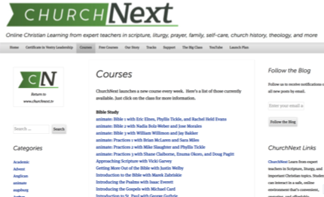
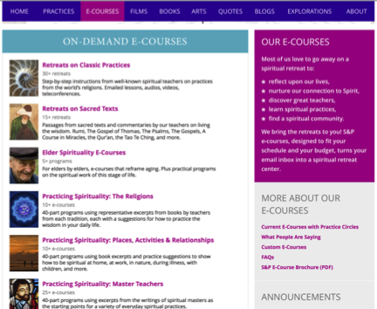
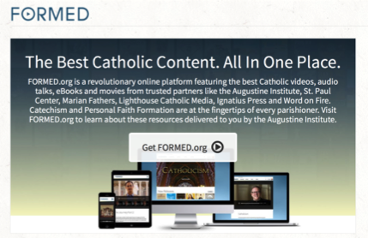
Flip the Model

Slide 110
Flip Christian Initiation

Slide 111
Our Confirmation preparation program has two components: Once a month in-person classes and an online study. The online study is a place for students to develop their faith weekly by completing multi-media lessons which include videos, reading, Saint reflections, multiple-choice questions and online small group discussions. Each small group has their own online space to discuss faith topics, ask questions, and pray for one another. By having both in person classes and an online study we hope to help families learn more about their faith while respecting the many demands for their time.

Slide 112
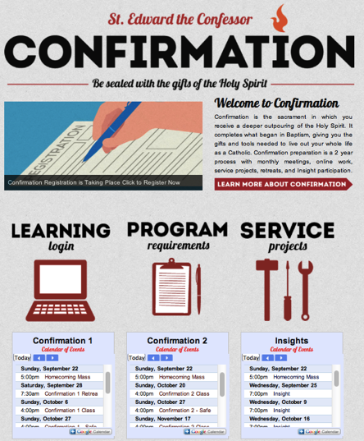
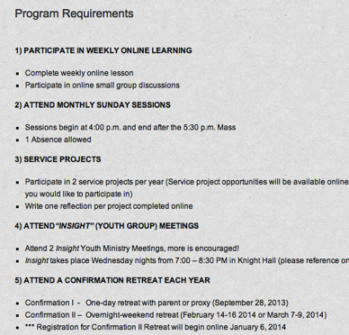
Confirmation

Slide 113
Integrate Online and Gathered

Slide 115
Integrate Online and Gathered

Slide 117
Online 40-Day Lent Curriculum
Church ➔ | Daily & Home | ⬅ Online
Ash Wednesday Lenten Sunday liturgies Stations of the Cross Lenten prayer Lenten retreat Lenten service Lenten soup suppers | Fasting Praying Service/Almsgiving Lectionary reflection Family Lenten activities | Lenten learning resources Lenten calendar Daily Lenten prayer Weekly table prayer Video resources Online retreat experience

Slide 118
Online Prayer

Slide 119
Pastoral Care

