Slide 1
Reimagining faith formation for the 21st century
Presenter: John Roberto

Slide 2
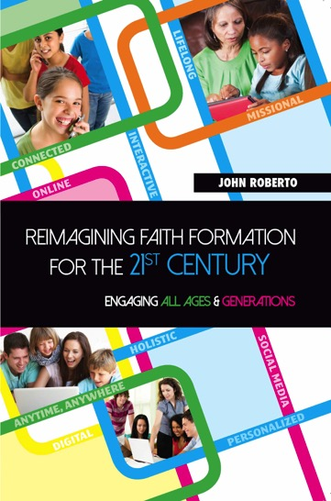
Resources
Website
www.ReimagingFaithFormation.com
Book

Slide 3
4 Big Adaptive Challenges
Increasing diversity throughout American society in the length of the lifespan, in generational identities, in family structures and marriage patterns, and in the ethnic makeup of America
Dramatic changes and increasing diversity in the religious beliefs, practices, and affiliation of Americans
Decline in religious transmission from generation to generation
Rise of new digital technologies that are reshaping society, and the emergence of a connected, networked society

Slide 4
Diversity
Diversity
Life-Span Diversity
Generational Diversity
Family Diversity
Ethnic Diversity

Slide 5
Religious Diversity
Not Religiously Affiliated
Spiritual but Not Religious
Minimal Engagement with Faith and Community
Vibrant Faith & Active Engagement

Slide 6
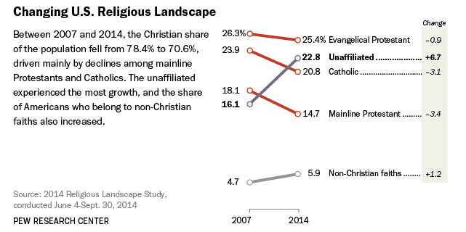

Slide 7
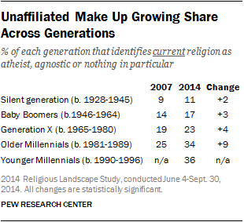

Slide 8
Youth & Young Adult Religiosity
Youth (teens)
Abiders Adapters Assenters Avoiders Atheists
20% 20% 31% 24% 5%
Emerging Adults (20s)
Committed Selected Spiritually Religiously Religiously Irreligious Traditionalists Adherents Open Indifferent Disconnected
15% 30% 15% 25% 5% 10%

Slide 9
SBNR Types
Dissenters
Casuals - “religious practice makes me feel better”
Explorers - spiritual tourists
Seekers - searching for a spiritual home
Immigrants - moved to a new spiritual “land”

Slide 10
Impact of Changes (CARA Catholic Family Study, 2015)
Do any of your children currently attend…
A Catholic elementary or middle school: 8%
A Catholic high school: 3%
A parish-based Catholic religious education program: 21%
A youth ministry program: 5%
None of the above: 68%

Slide 11
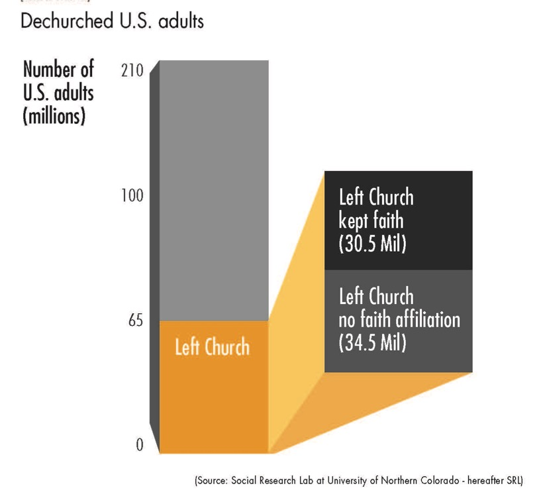
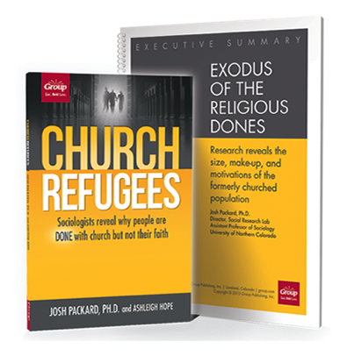
Rise of the Dones

Slide 12
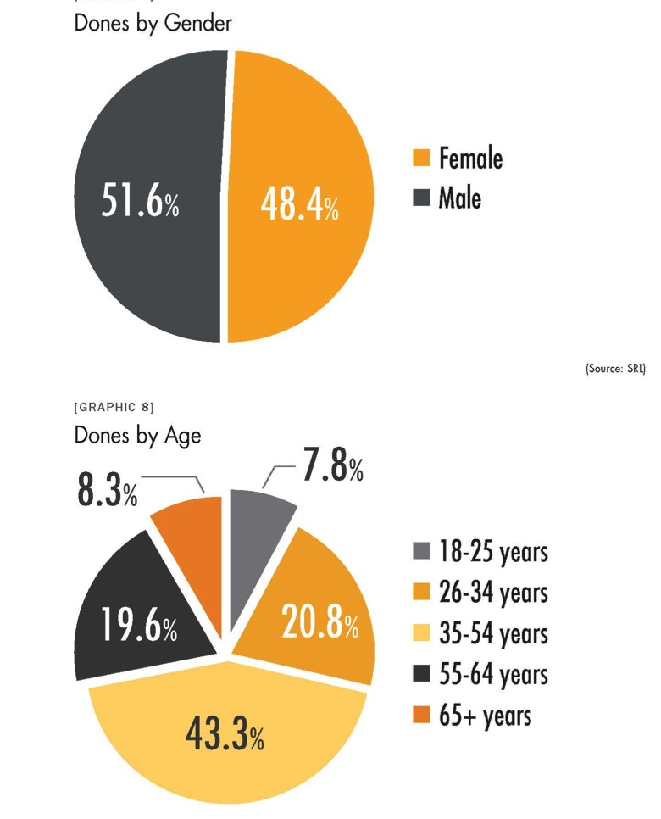

Slide 13
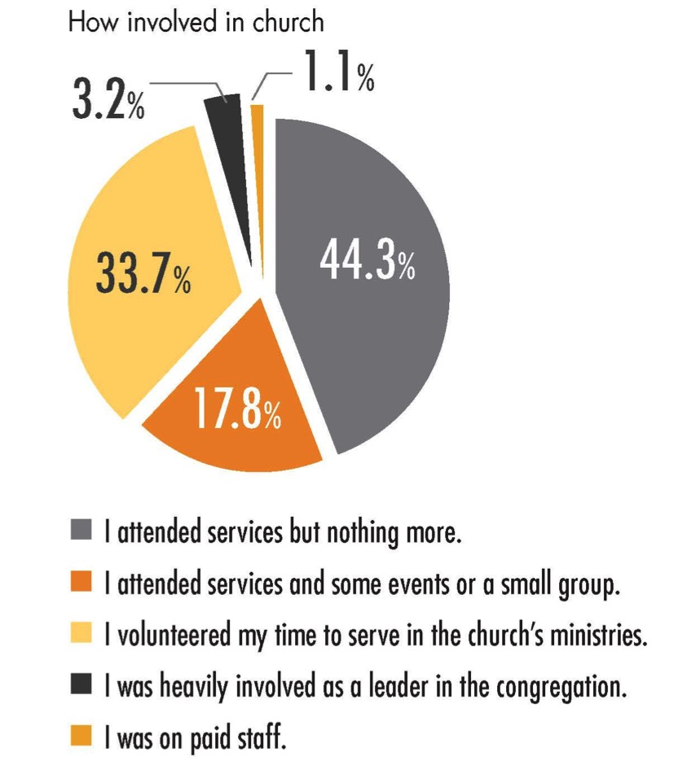

Slide 14
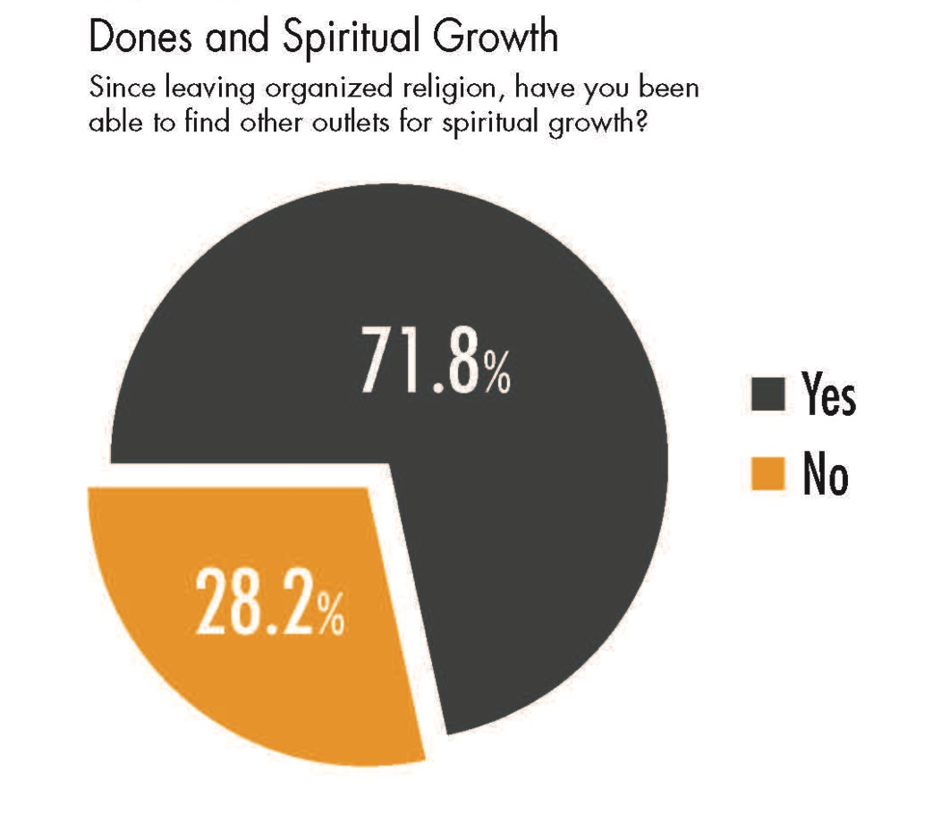

Slide 15
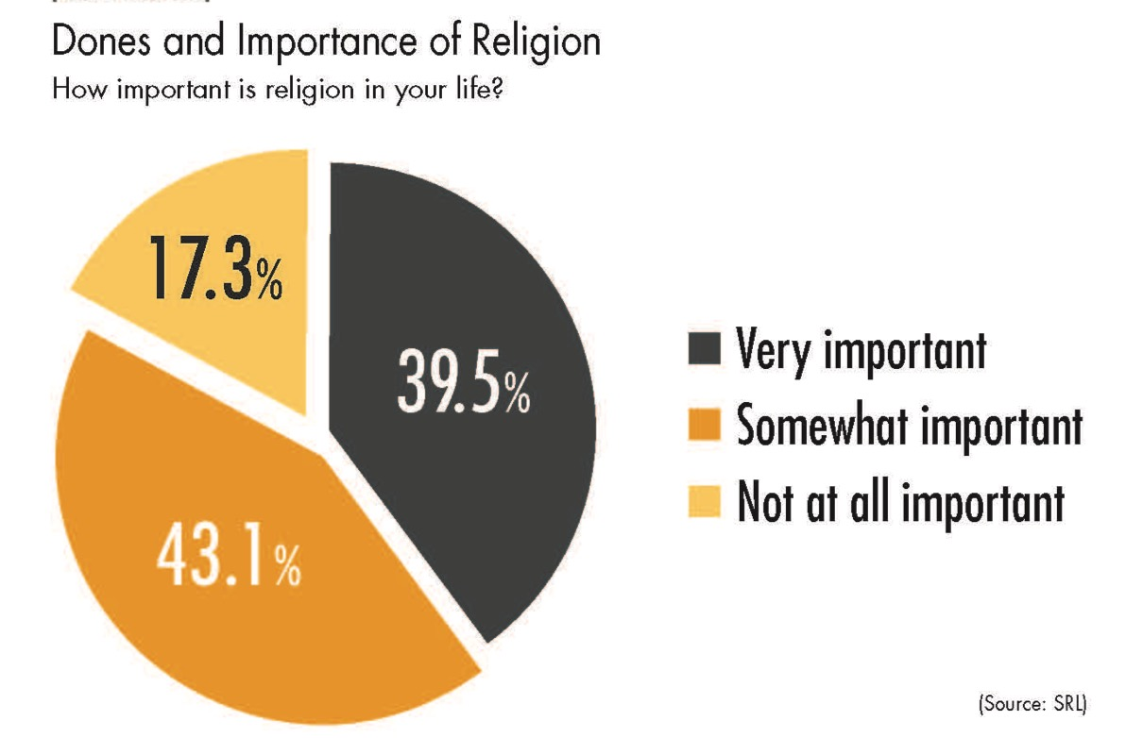

Slide 16
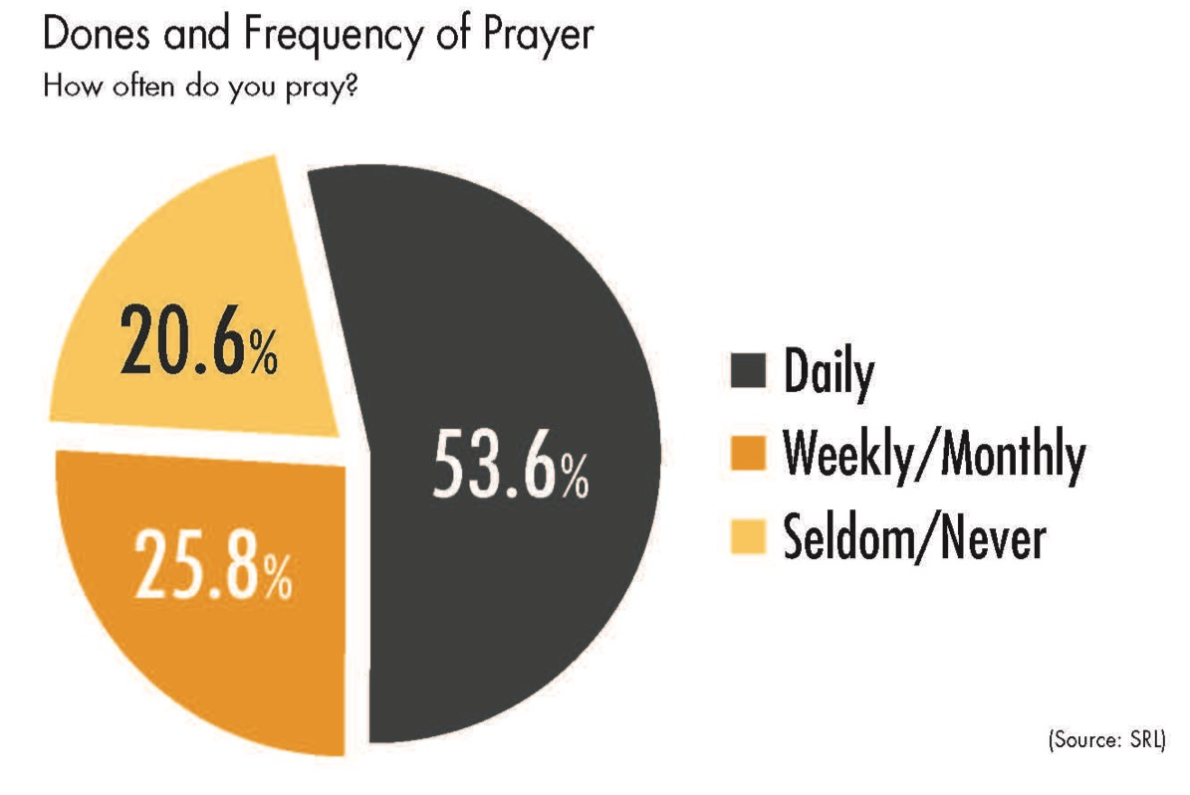

Slide 17
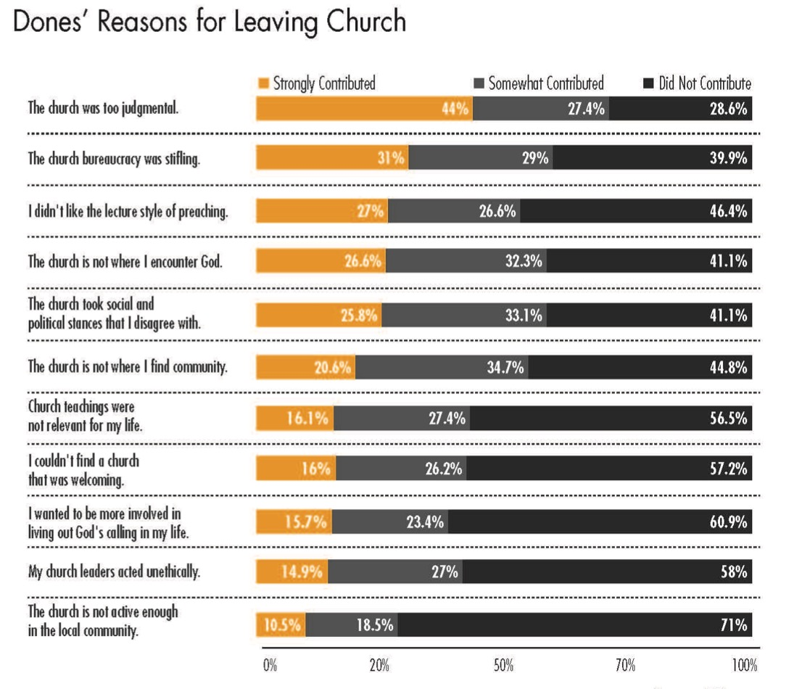

Slide 18
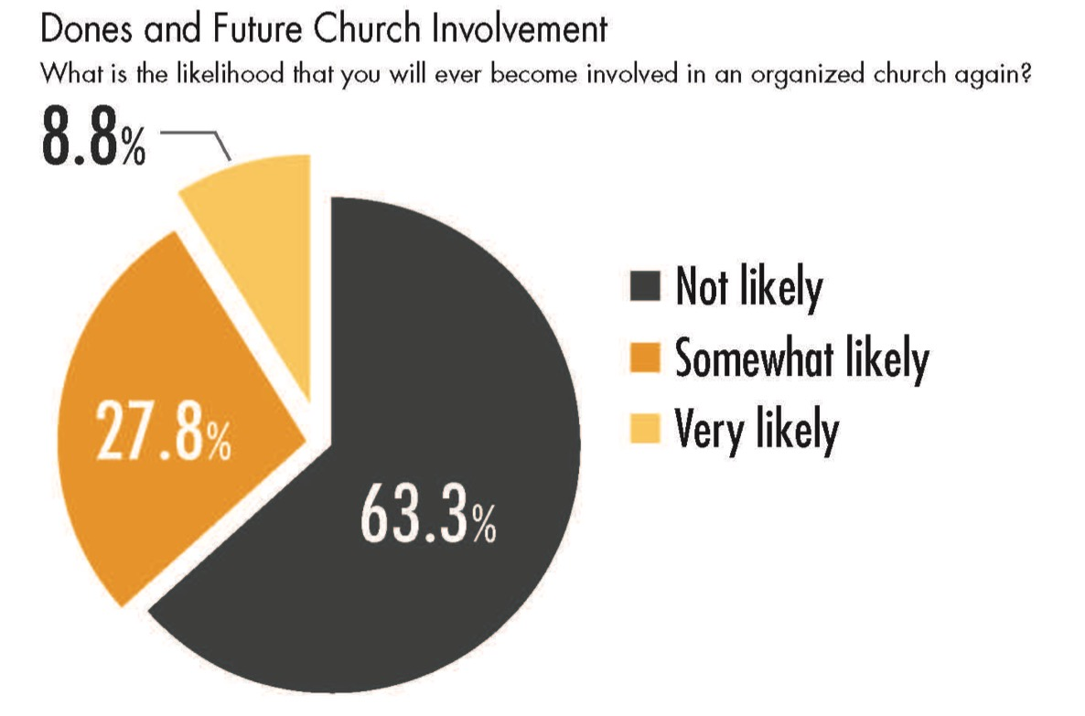

Slide 19
Analysis
Younger generations are more unaffiliated and less involved in faith communities.
Older generations are more affiliated and more involved and supportive.
As younger generations replace the older generations there will be fewer engaged and more unaffiliated individuals and families.

Slide 20
Analysis
40% of the “no religion in particular” say religion is “very” or “somewhat” important in their lives
The overwhelming majority of religiously unaffiliated believe in God.
People “leaving” is less about people “losing their religion” than dissatisfaction with available institutional options.
Young generations seem allergic to large-scale institutions that demand not only spiritual allegiance but financial commitment. None of these things are “religion” for these people.

Slide 21
Analysis
Religion is not going away anytime soon, regardless of how people may identify themselves. But business as usual among existing religious institutions will not stem the losses we are seeing.
(Richard Flory, USC)
(http://religiondispatches.org/u-s-christianity-is-dead-long-live-u-s-christianity)

Slide 22
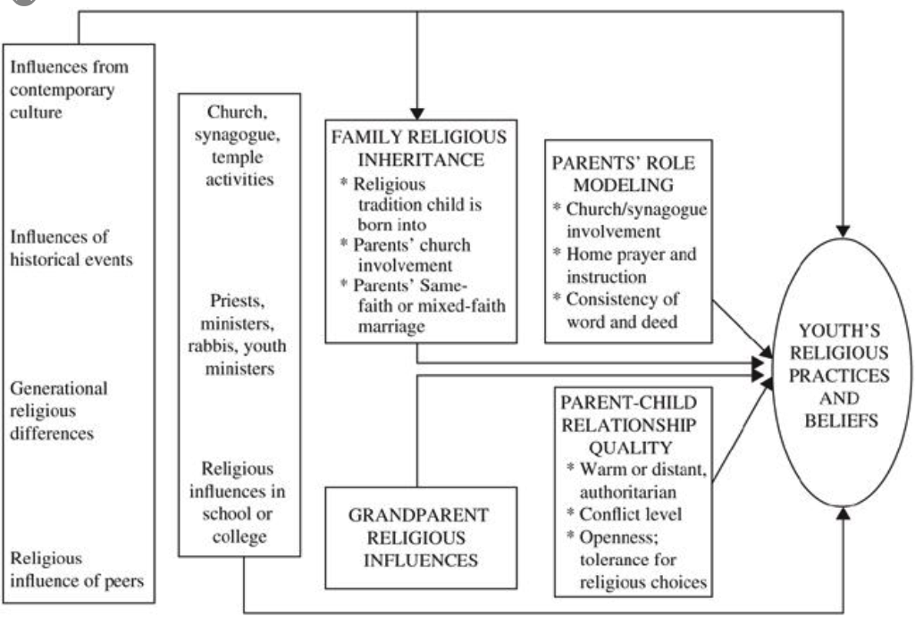
Religious Transmission

Slide 23
Analysis
Religious transmission is a family affair.
Families can transmit a particular religious faith tradition or not.
Declining levels of family religious transmission and faith practice at home are a result of non-affiliation—1st generation and 2nd generation non-affiliated families.
If the pattern continues, expect higher levels of non-affiliation and lower levels of church involvement in younger families.

Slide 24
Concluding Thought
The world is now changing at a rate at which the basic systems, structures, and cultures built over the past century cannot keep up with the demands being placed on them. Incremental adjustments to how you manage and strategize, not matter how clever, are not up to the job. You need something very new to stay ahead in a age of tumultuous change and growing uncertainties.
(John Kotter, Accelerate: Building Strategic Agility for a Faster-Moving World

Slide 25
A Faith Forming Ecosystem for the 21st Century

Slide 26
Ecosystem
A system, or group of interconnected elements, formed by the interaction of a community of organisms with their environment
Science defines an ecosystem as being a community where organisms interact with one another and with their physical environment.
Every organism has a role to fulfill and there must be a harmonious balance between all aspects of the ecosystem in order for the organisms to flourish and evolve.

Slide 27
The “Old” Faith Forming Ecosystem
Church
Family
Ethnic Traditions
Community
Religious School or Sunday School

Slide 28
A New Faith Forming Ecosystem
Intergenerational Faith Community
Age Group/Generational Faith Formation
Family Faith Formation
Missional Faith Formation
Online & Digitally-Enabled Faith Formation

Slide 29
Holistic Faith & Lifelong Formation
Faith formation is a lifelong journey of discipleship—a process of experiencing, learning, and practicing the Christian faith as we seek to follow Jesus and his Way in today’s world.
Way of the Head – a discipleship of faith seeking understanding
Way of the Heart – a discipleship of relationships and community
Way of the Hands – a discipleship of transforming the world

Slide 30
Holistic Faith & Lifelong Formation
A way of the head (inform) demands a discipleship of faith seeking understanding and belief with personal conviction, sustained by study, reflecting, discerning and deciding, all toward spiritual wisdom for life.
A way of the heart (form) demands a discipleship of right relationships and right desires, community building, hospitality and inclusion, trust in God’s love, and prayer and worship.
A way of the hands (transform) demands a discipleship of love, justice, peace-making, simplicity, integrity, healing, and repentance.
(Thomas Groome)

Slide 31
Eight Faith Forming Processes
GROWTH IN FAITH
Caring Relationships
Rituals & Milestones
Church Year Seasons
Worshipping
Learning the Tradition
Praying
Spiritual Formation
Reading the Bible
Serving Working for Justice Caring for Creation

Slide 32
Intergenerational Faith Formation
Intergenerational faith formation and whole community faith experiences are at the center of faith formation – engaging all ages and generations in the life and events of church life and the Christian faith and participation in intergenerational faith experiences.
How to become intentionally intergenerational in church life & faith formation as the foundation for lifelong faith formation and discipleship?

Slide 33
Intergenerational Faith Formation
Throughout Scripture there is a pervasive sense that all generations were typically present when faith communities gathered for worship, for celebration, for feasting, for praise, for encouragement, for reading of Scripture, in times of danger, and for support and service. . . . To experience authentic Christian community and reap the unique blessings of intergenerationality, the generations must be together regularly and often—infants to octogenarians.
(Allen and Ross, Intergenerational Christian Formation)

Slide 34
Intergenerational Faith Formation
Caring: Community building activities, storytelling, mentoring, social events
Celebrating: Sunday Worship, whole community sacramental celebrations, milestones celebrations, church year feasts and seasons
Learning: Intergenerational learning programs (weekly, monthly, small group); incorporating intergenerational learning into age group programming
Praying: Community prayer experiences, intergenerational prayer groups, spiritual guides/mentors
Serving: Intergenerational service projects and mission trips, church-wide service days

Slide 35
Family Faith Formation
Congregations equip and strengthen families to become faith forming centers:
Transmitting faith from generation to generation
Nurturing family faith at home through the eight faith forming processes
Building strong families
Parent (and grandparent) formation
How to equip, resources, and support families as the center of faith formation through faith formation and church ministries?

Slide 36
Families at the Center
Church Life & Ministries
Family
Faith Transmission Faith Forming Practices Family Development Parent Formation

Slide 37
Life-Stage Faith Formation
Age group and generational faith formation addresses the unique life tasks, needs, interests, and spiritual journeys of people at each stage of life.
Intergenerational Faith Community
Children & Parents
Youth & Parents
Young Adults
Mid-life Adults
Mature Adults
Older Adults

Slide 38
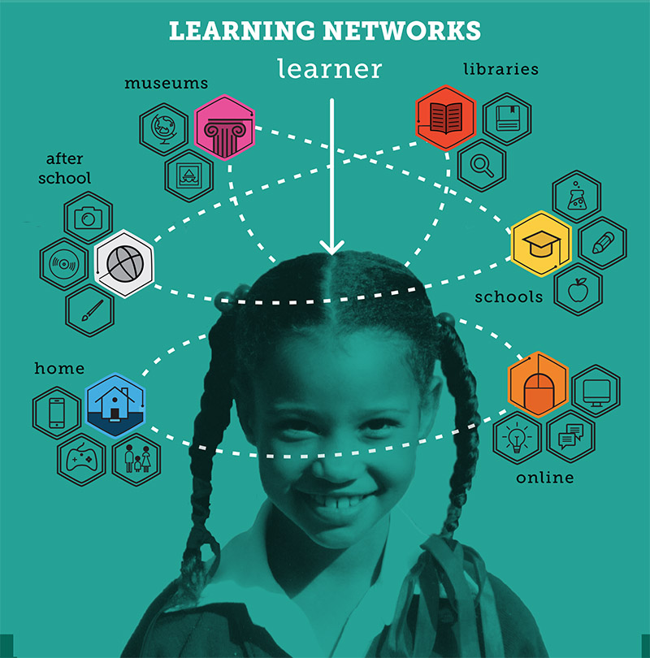

Slide 39
Curriculum: 8 Faith Forming Processes
GROWTH IN FAITH
Caring Relationships
Rituals & Milestones
Church Year Seasons
Worshipping
Learning the Tradition
Praying
Spiritual Formation
Reading the Bible
Serving Working for Justice Caring for Creation

Slide 40
Faith Formation Networks
A network of relationships, content, experiences, & resources. . . .
Offering a variety of content, methods, formats, and delivery systems (online & physical settings) to address the diverse life tasks and situations, needs and interests, and spiritual and faith journeys of people.
Offering content and experiences that is responsive to the diverse religious and spiritual needs of people today—from the spiritually committed and engaged to the spiritual but not religious and the unaffiliated.
Offering multiple environments to address people’s busy lives and providing more ways to participate: self-directed, mentored, at home, in small groups, in large groups, church-wide, in the community, and in the world.

Slide 41
Life-Stage Faith Formation
Digitally-Enabled
Blending gathered community settings with online learning environments and utilizing the abundance of digital media and tools for learning and faith formation

Slide 42
Missional Faith Formation
Missional faith formation expands and extends the church’s presence through outreach, connection, relationship building, and engagement with people where they live—moving faith formation out into the community. For example:
Moving worship & faith formation into the community
Opening programs to everyone
Life skills: parenting, careers, training, mentoring
Small group programs on a variety of topics
Community-wide service
Community events: arts, music, theater

Slide 43
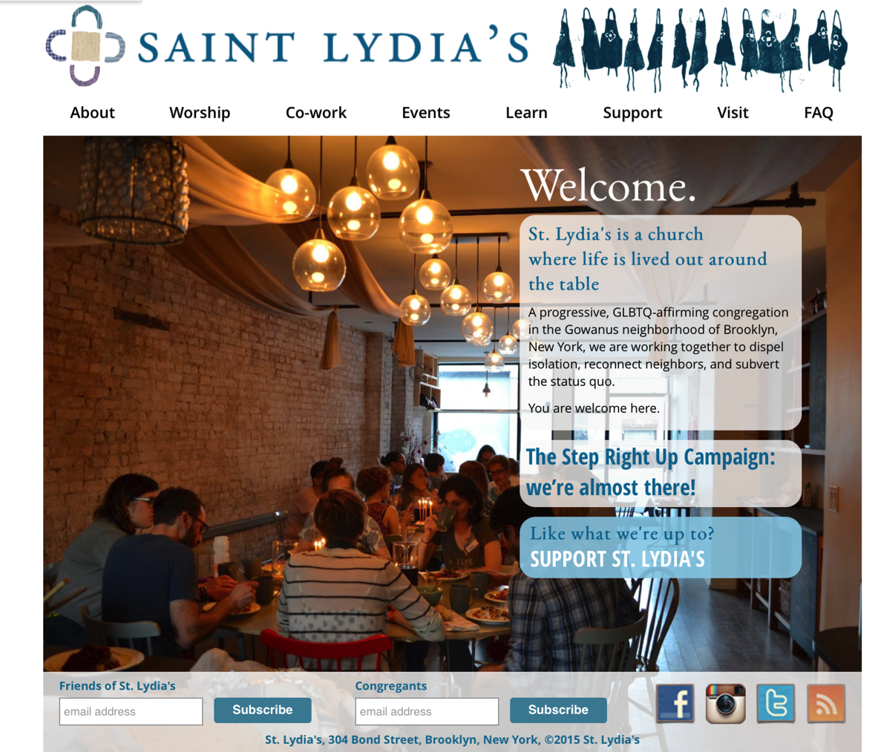

Slide 44
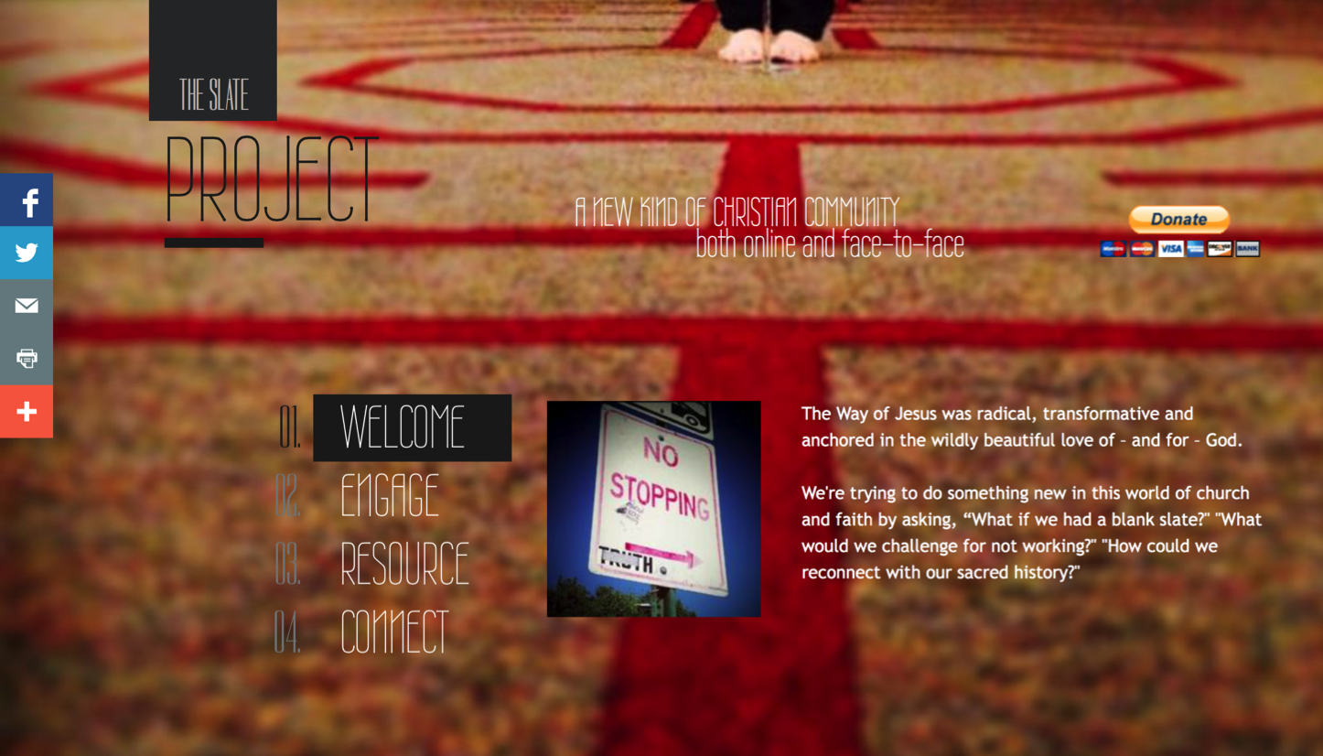

Slide 45
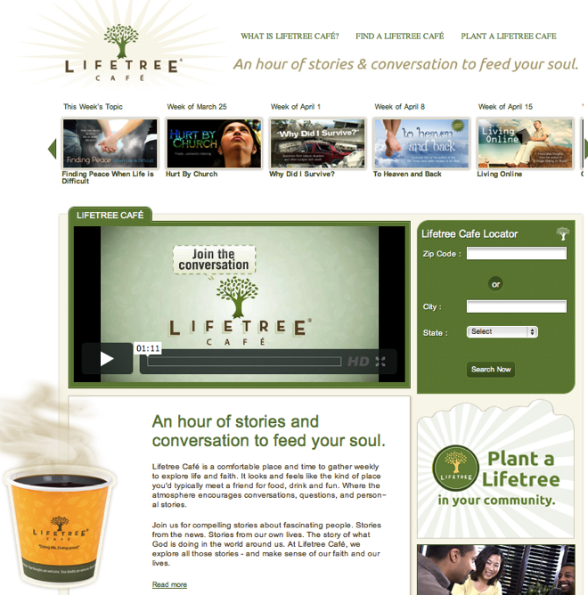
Missional Faith Formation
A Third Place gathering space in the community, offers hospitality, builds relationships, hosts spiritual conversations, provides programs and activities, and nourishes the spiritual life of people.

Slide 46
Missional Faith Formation
Missional faith formation provides pathways for people to consider or reconsider the Christian faith, to encounter Jesus and the Good News, and to live as disciples in a supportive faith community.

Slide 47
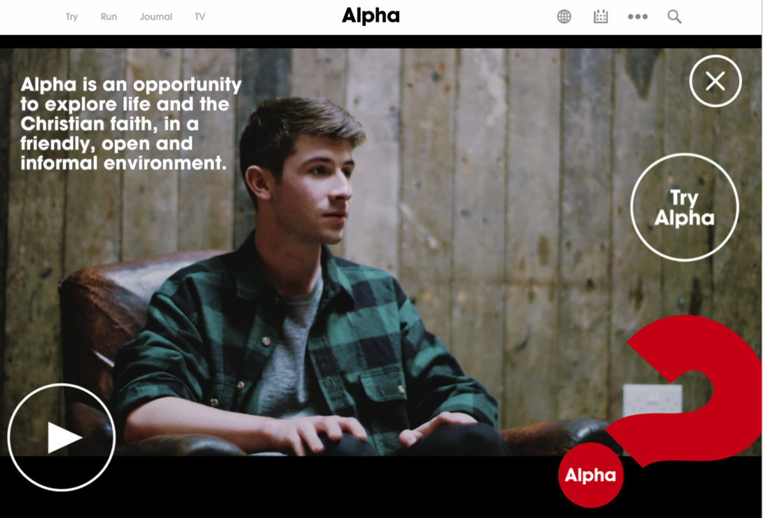
Missional Faith Formation

Slide 48
Missional Faith Formation

Slide 49
Programming 21st century faith formation
Presenter: John Roberto

Slide 50
Resources
Website
www.ReimagingFaithFormation.com
Book

Slide 52
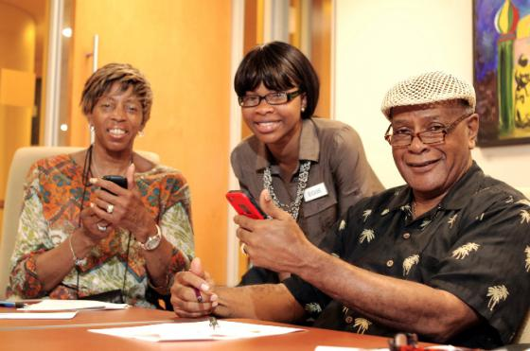
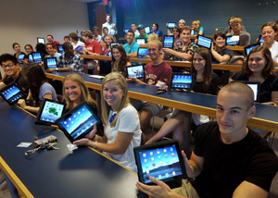

Slide 53
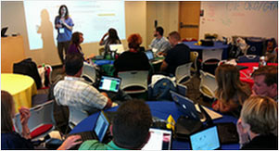
A shift from education to learning anywhere, anytime.
A shift from consumption of information to participatory learning.
A shift from institutions to networks.

Slide 55
Faith Formation Networks
A network of relationships, content, experiences, & resources. . . .
Offering a variety of content, methods, formats, and delivery systems (online & physical settings) to address the diverse life tasks and situations, needs and interests, and spiritual and faith journeys of people.
Offering content and experiences that is responsive to the diverse religious and spiritual needs of people today—from the spiritually committed and engaged to the spiritual but not religious and the unaffiliated.
Offering multiple environments to address people’s busy lives and providing more ways to participate: self-directed, mentored, at home, in small groups, in large groups, church-wide, in the community, and in the world.

Slide 56
Faith Formation Networks
Digitally-Enabled
Blending gathered community settings with online learning environments and utilizing the abundance of digital media and tools for learning and faith formation

Slide 57
Individual Faith Formation Network
Bible
Course
Online course
Book
Mentor
Video Program
Bible study group
Bible app
Audio book/podcast
Organize a study group

Slide 58
Faith Formation Networks
Caring Relationships
Celebrating the Seasons
Celebrating Rituals & Milestones
Learning the Christian Tradition
Praying & Spiritual Formation
Reading the Bible
Serving, Working for Justice, & Caring for Creation
Worshipping God
Life Stage Issues
Missional
Faith Community
Content Area
Content Area
Content Area
Content Area
Content Area
Content Area

Slide 59
Faith Forming Processes
GROWTH IN FAITH
Caring Relationships
Rituals & Milestones
Church Year Seasons
Worshipping
Learning the Tradition
Praying
Spiritual Formation
Reading the Bible
Serving Working for Justice Caring for Creation

Slide 60
Family Faith Formation Network
For Parents
Seasons of the Year
Sunday Worship @ Home
Reading the Bible
Serving
Growing as a Family
Learning the Faith
Celebrating Rituals & Milestones
Children’s Programs
Praying & Growing Spiritually

Slide 61
Service & Mission Trips
Adolescent Faith Formation Network
Prayer & Spiritual Formation
Youth Leadership
Youth Programs
Bible Study & Religious Learning
For Parents
Confirmation
Adolescent Life Issues
Family Life
Missional Outreach

Slide 62
Faith Enrichment
Sunday Worship
Adult Faith Formation Network
Grand-parents
Spiritual Enrichment
Life Issues & Milestones
Scripture Enrichment
Liturgical Seasons
Service & Mission
Discovering Faith

Slide 63
Sample Themes –Adults
Dealing with retirement
Making life plans, finances, health
Becoming a grandparent
Making a difference in the community and world
Incorporating family changes and transitions
New ways of living and relating as a married couple
Caring for aging parents
Taking time to read the Bible and learn more about my faith
Growing spiritually and exploring spirituality for the 2nd half of life
Connecting with people my age; talking about things that matter to us
Dealing with loss

Slide 64
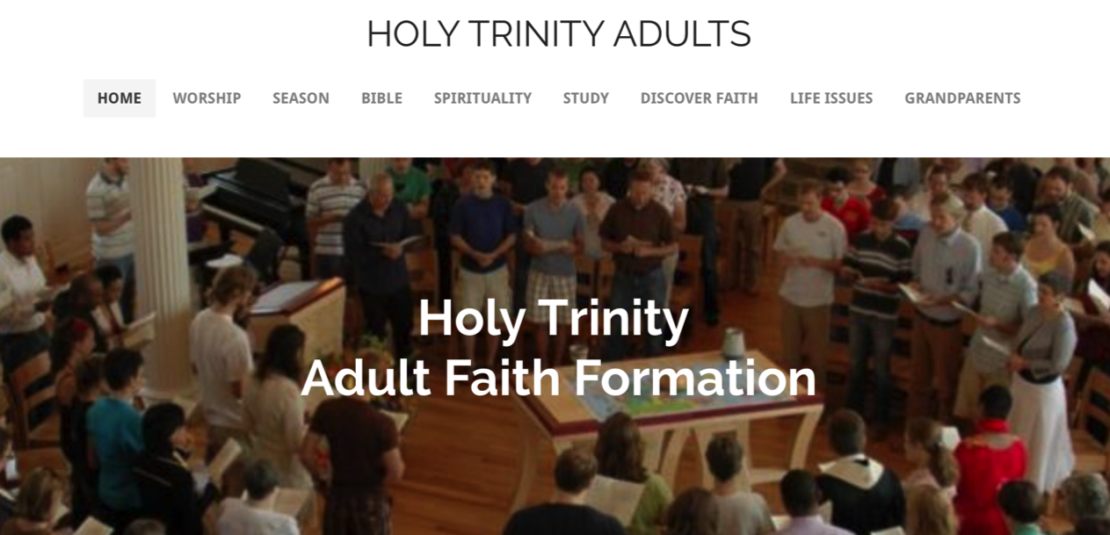
Adult Faith Formation Website

Slide 65
Faith Formation Playlists
Content Area
Activity 1
Resource
Resource
Activity 3
Resource
Resource
Activity 2
Resource
Resource

Slide 66
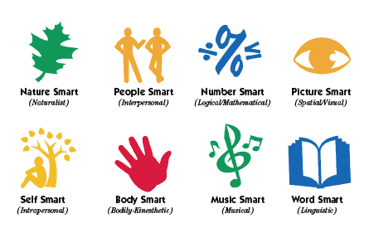
Faith Formation Playlists
Variety of Environments: Self-directed, mentored, at home, in small groups, in large groups, church-wide, in the community, and in the world.
Variety of Ways to Learn

Slide 67
Faith Formation Playlists
Digitally-Enabled: Blending gathered community settings with online learning environments and utilizing the abundance of digital media and tools for learning and faith formation

Slide 68
Adult Faith Formation Playlist
Spiritual Enrichment
Online Courses
Retreats
Small Group Bible Study
Spiritual Book of the Month
Spiritual Practices Series
Apps & E-newsletters
Day at the Monastery
Online Prayer & Spirituality
Resource
Resource
Resources
Resources
Resource
Resource
Resource
Resource

Slide 69
Faith Formation Playlists
Playlists are thematic learning plans that integrate a variety of ways to learn, multiple learning environments, and online and physical spaces—from which people can create their own faith formation plan.
Example: Spiritual Enrichment for Adults
Theme: “Spiritual Practices”
Spiritual Practices Course (5 sessions at church in one month)
Spirituality Over 50 Book Group (variety of times & places)
Online Daily Devotion Resources
Online Prayer Practices Resources
Online Course or Retreat with a Spiritual Master
Online Retreat
Website: http://holytrinityadults.weebly.com

Slide 70
Family Faith Formation Playlist
Seasons of the Year:
Monthly Event
Prayers & Devotion
Resources
Service Ideas
Resources
Bible Passages
Resources
Caring Conversations
Resources
Learning about the Event
Resources
Rituals
Resources

Slide 71
Adolescent Faith Formation Playlist
Prayer &
Spiritual Life
Weekly Devotion
Resources
Prayer Group
Resources
Spiritual Mentoring
Resources
Spiritual Practices Course
Resources
Retreat
Day at the Monastery
Online Prayer Intentions
Resources
Resources

Slide 72
3 Seasons of Programming
Fall Season:
Sept 1 – Jan 1
Winter/Spring Season: Jan 1 – May 1
Summer Season:
May 1 – Sept 1
Fall
Winter-Spring
Summer

Slide 73
Seasonal Plan & Calendar
Content Area (examples) |  | Programming | & Dates
 | Month 1 | Month 2 | Month 3 | Month 4
Scripture Enrichment
Faith Enrichment
Spiritual Enrichment
Service & Mission
Life Issues

Slide 74
Digitally-Enabled Strategies

Slide 75
Gathered using Online Content
A gathered program using online content from websites, videos from YouTube or other video sites, and blogs and other social media. With an abundance of high quality digital content, this first option is the easiest way to bring the digital world into a gathered program.

Slide 76
Gathered with Online Content
Connecting church programs or events with online content that extends and deepens the experience through learning, prayer, ritual, action, etc.
Sunday worship & church year feasts and seasons
Intergenerational & family programs
Children, youth, and adult classes & programs
Extended programs: mission trips, retreat experiences, and vacation Bible school, summer camp

Slide 77
Gathered with Online Content
Church Event or Program
At Home & Daily Life

Slide 78
Gathered with Online Content
Event or Program
TALK Conversation Activities
LEARN Read Listen Watch
ACT Practices Service Projects
PRAY Devotions Bible Reading Daily Prayer
SHARE Blog Facebook Video Projects

Slide 79
Example: Sunday Worship
Church Life ➔ | Daily & Home Life | ⬅ Online Life
Experience of Worship in the Congregation Sunday worship and lectionary Church year feasts and seasons Church rituals: baptism, communion, funerals, etc. | Experience of Sunday worship, rituals, and church year seasons in daily life Reflecting on the sermon and readings at home Practices: Lectio, etc. Application to daily living | Online worship, church year, and lectionary resources on the church’s faith formation website Lectionary commentaries online Video reflections and commentary Online activities and projects

Slide 80
Online and Gathered
“Flip the classroom or program” by creating a digital platform to provide the content that people would learn in the gathered setting in an online learning space using print, audio, video, and more. And then transform the gathered program using interactive activities, discussion, project-based learning, and practice and demonstration.
Flip children’s programming: At home learning with parents (print, video, online); in-class application with activities, project-centered learning
Flip confirmation programming
Develop a online justice and service center

Slide 81
Online and Gathered

Slide 82
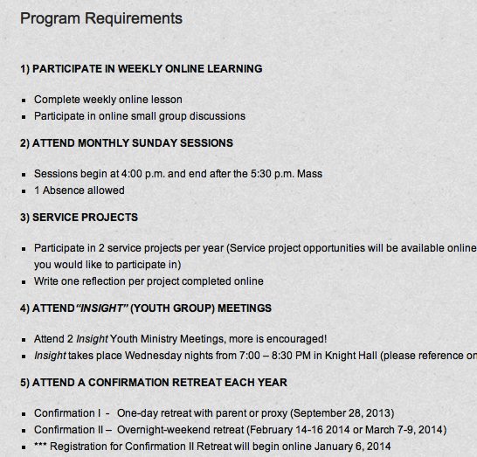
Online and Gathered

Slide 83
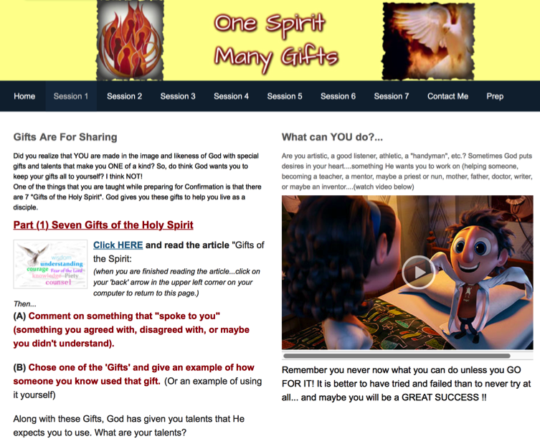
Online and Gathered

Slide 84
Mostly Online
Utilizing the digital platform as the primary learning setting and providing opportunities for interaction in gathered settings.
Parent webinar programs delivered to parents at home in four-month semesters: three webinars + a parent gathering; three more webinars + a parent gathering.
Online learning resources for self-study or small group study, and gathering at the conclusion to share their insights.
Online Bible study where groups can meet regularly in a physical setting or virtually on Skype or Google+ Hangout.
Selected online courses and activities from colleges, seminaries, and religious organization for individualized learning with the option for a mentor or small group.

Slide 85
Fully Online
The rise of high quality and easily accessible online religious content—courses, activities, print and e-books, audio and video programs, and content-rich websites—has made designing online faith formation feasible.
Online Bible and theology courses, video programs, webinars for individual study
Online prayer & spirituality center where people can access daily prayer reflections and devotions, offer prayer intentions, pray for others, learn about spiritual practices, download prayer activities, etc.
Online parent resource center
Online retreat experience

Slide 86
Example: 40-Day Lent Curriculum
Church Life ➔ | Daily & Home Life | ⬅ Online Life
Ash Wednesday Lenten Sunday liturgies Stations of the Cross Lenten prayer Lenten retreat Lenten service Lenten soup suppers | Fasting Praying Service/Almsgiving Lectionary reflection Family activities | Lenten learning resources Lenten calendar Daily Lenten prayer Weekly table prayer Video resources Online retreat experience

Slide 87
Build a Digital Platform
Other Platforms
www.wordpress.org www.wix.com www.squarespace.com

