Slide 1
Growth & Development of Intergenerational Faith Formation
The Future of Intergenerational Christian Faith Formation
October 9-11, 2014

Slide 2
Session 1. Growth & Development
Contributions to Intergenerational Faith Formation: Recent History
What We Have Seen and Heard – Holly, Jim, and Kathie
Storytelling in Generational Groups
Reporting to the Whole Group
Similarities and Differences across the Generations

Slide 3
Storytelling
How did you get involved in intergenerational ministry and faith formation? What motivated you?
How has intergenerational faith formation and ministry evolved in your congregation (or the churches you serve) since you became more intentional about intergenerationality?
What impact has intergenerational faith formation had on
the leaders
those who are participating
on the faith community as-a-whole

Slide 4
Groups
Builders (before 1946)
Early Boomers (1946-54)
Late Boomers (1954-62)
Generation X (1962-1979)
Millennials (1980-1999)

Slide 5
Foundations: Nelson, Westerhoff, Harris, Foster

Slide 6
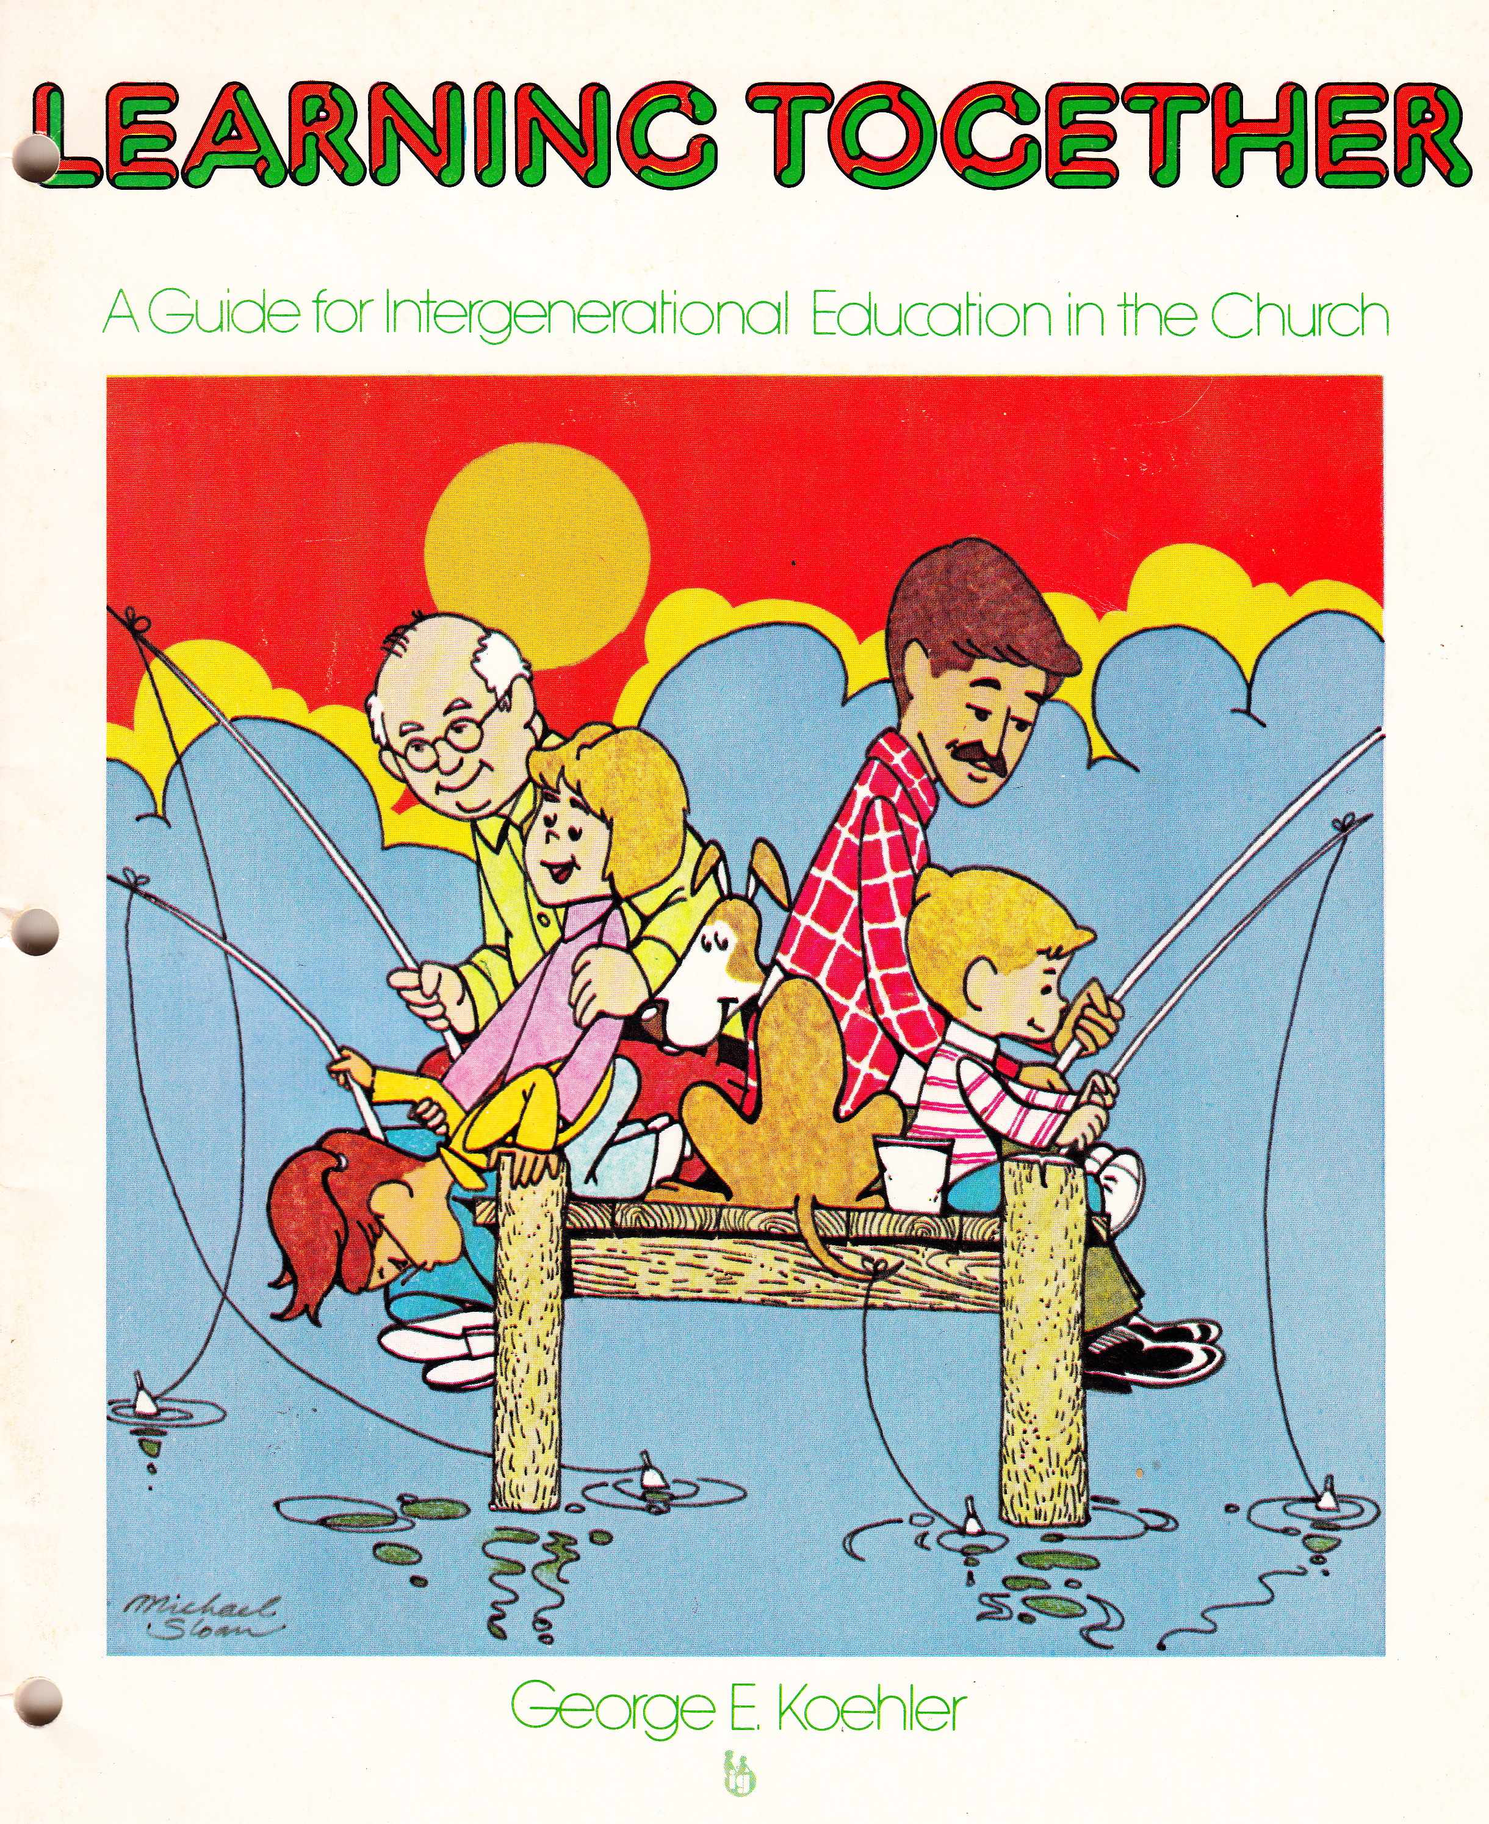
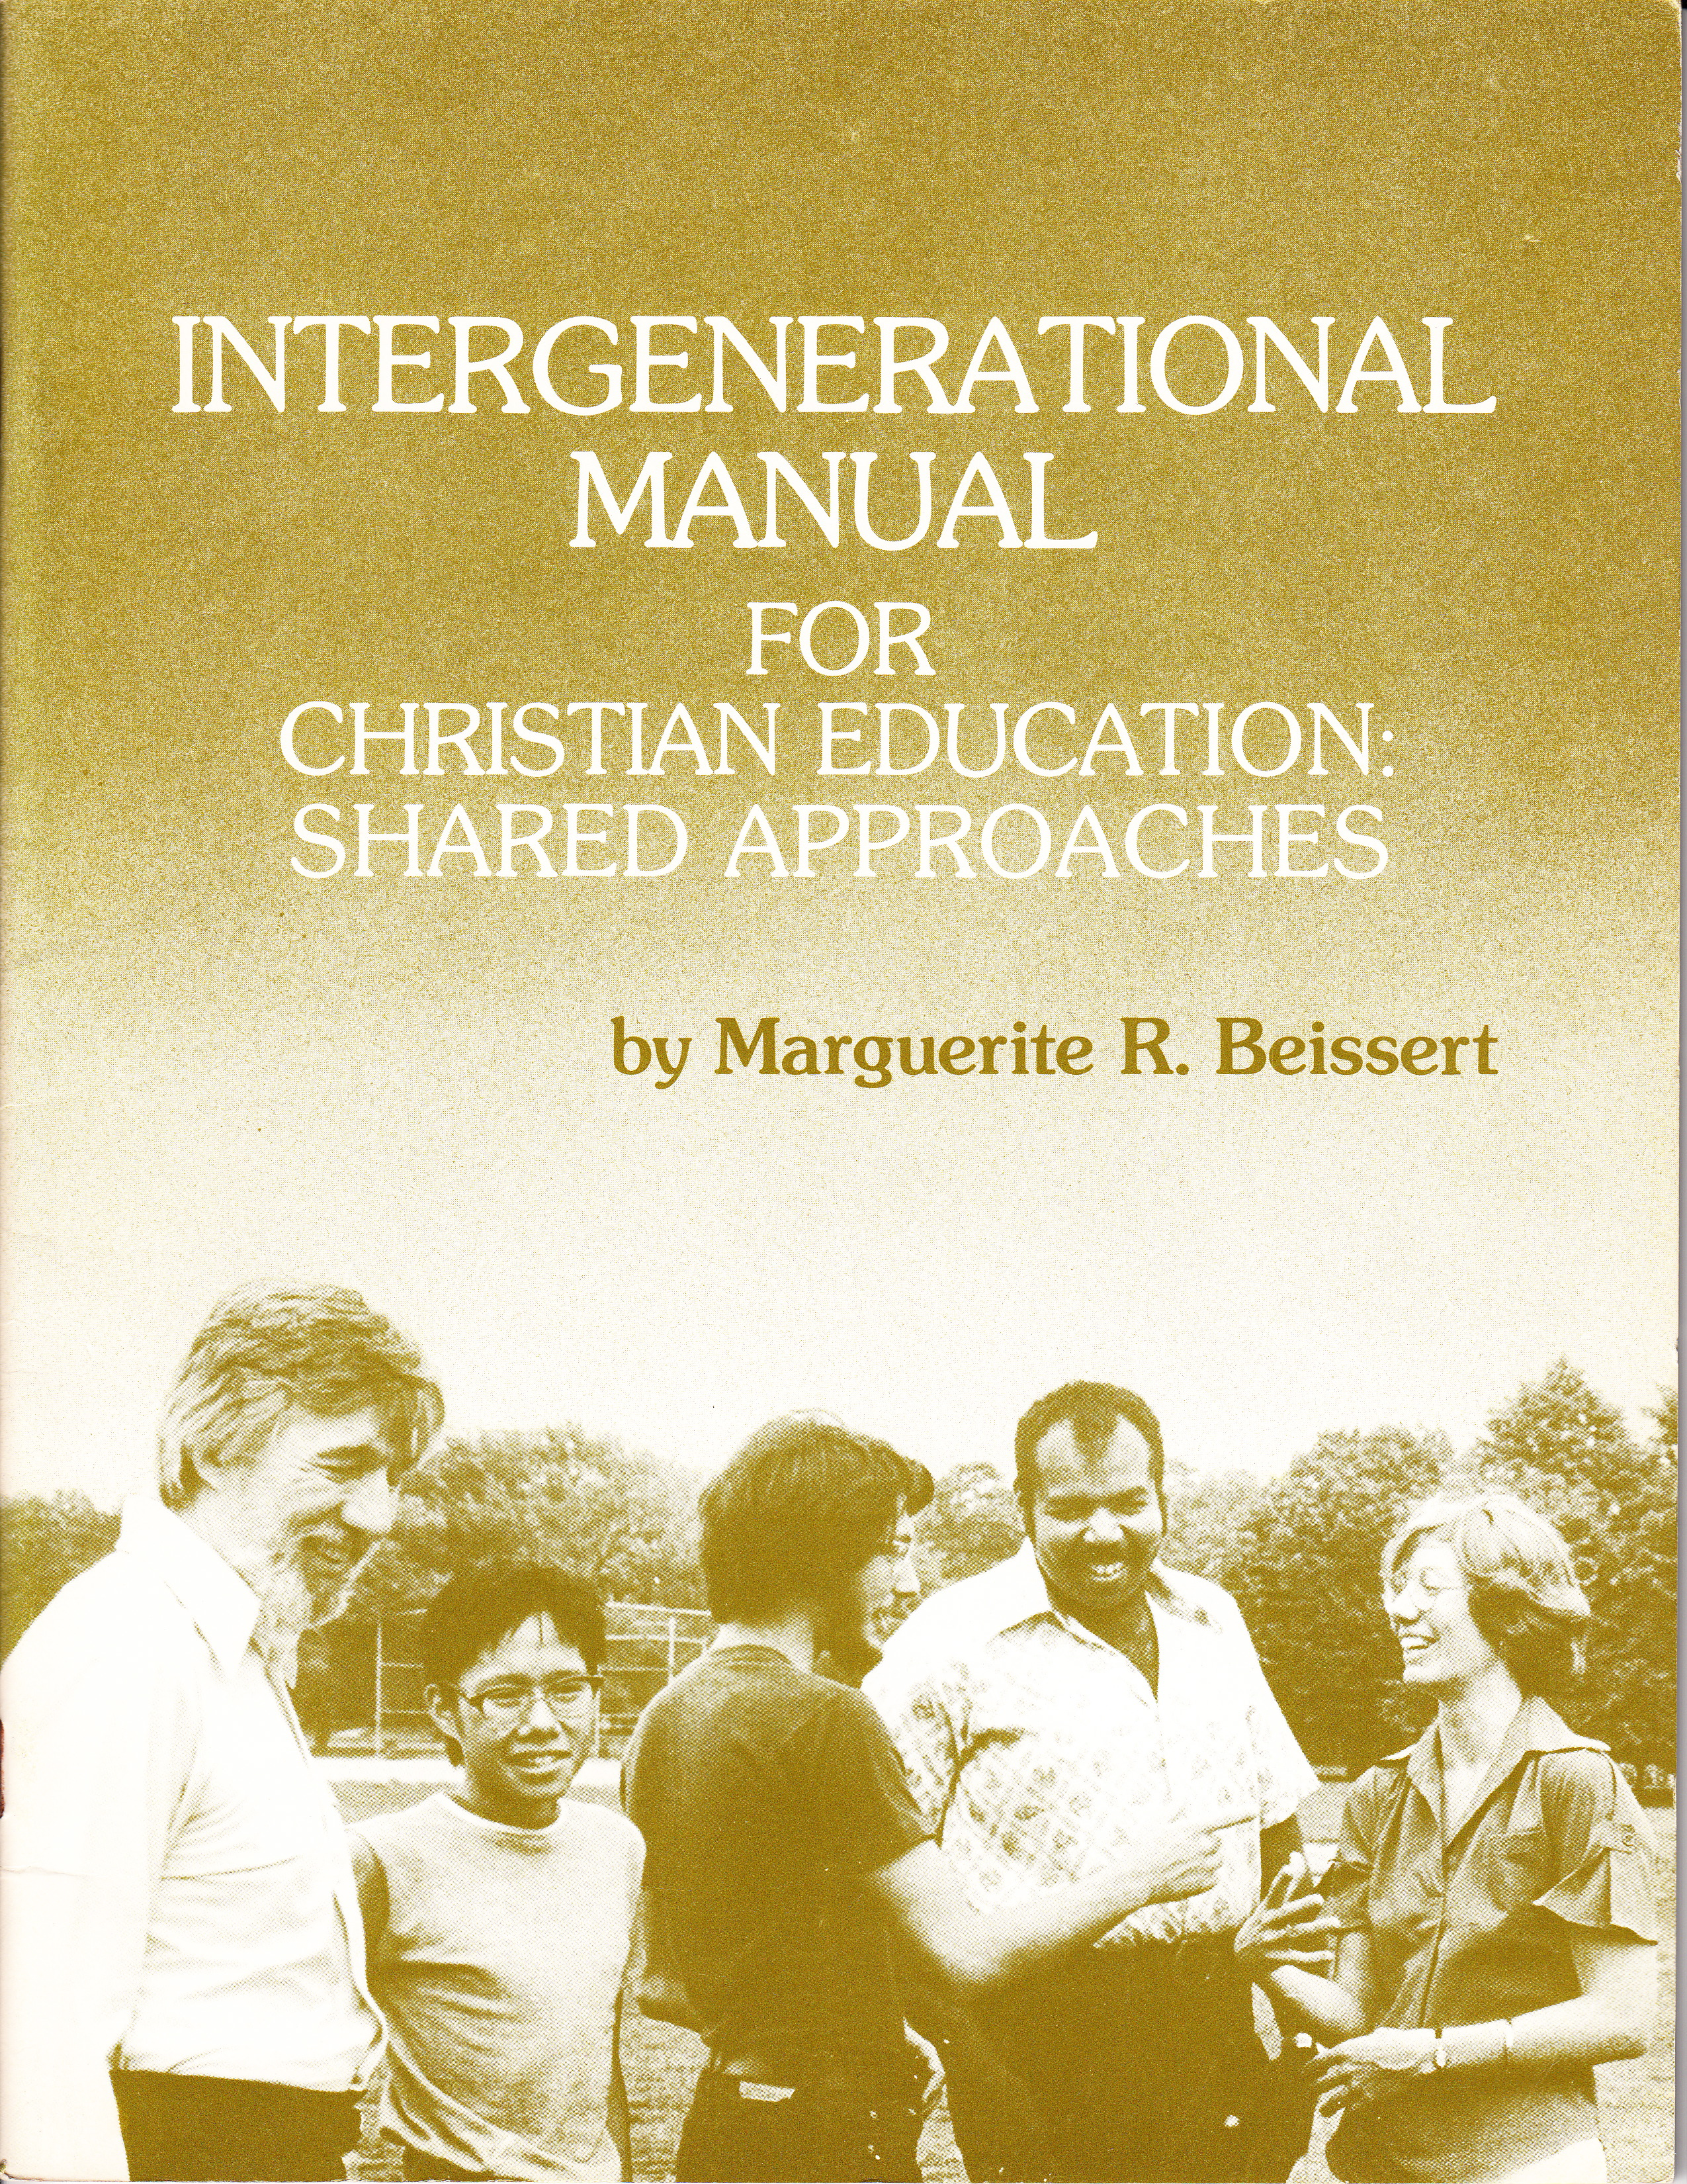
Intergenerational 1970s-80s

Slide 7
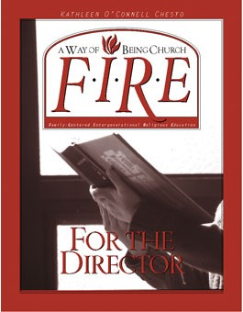
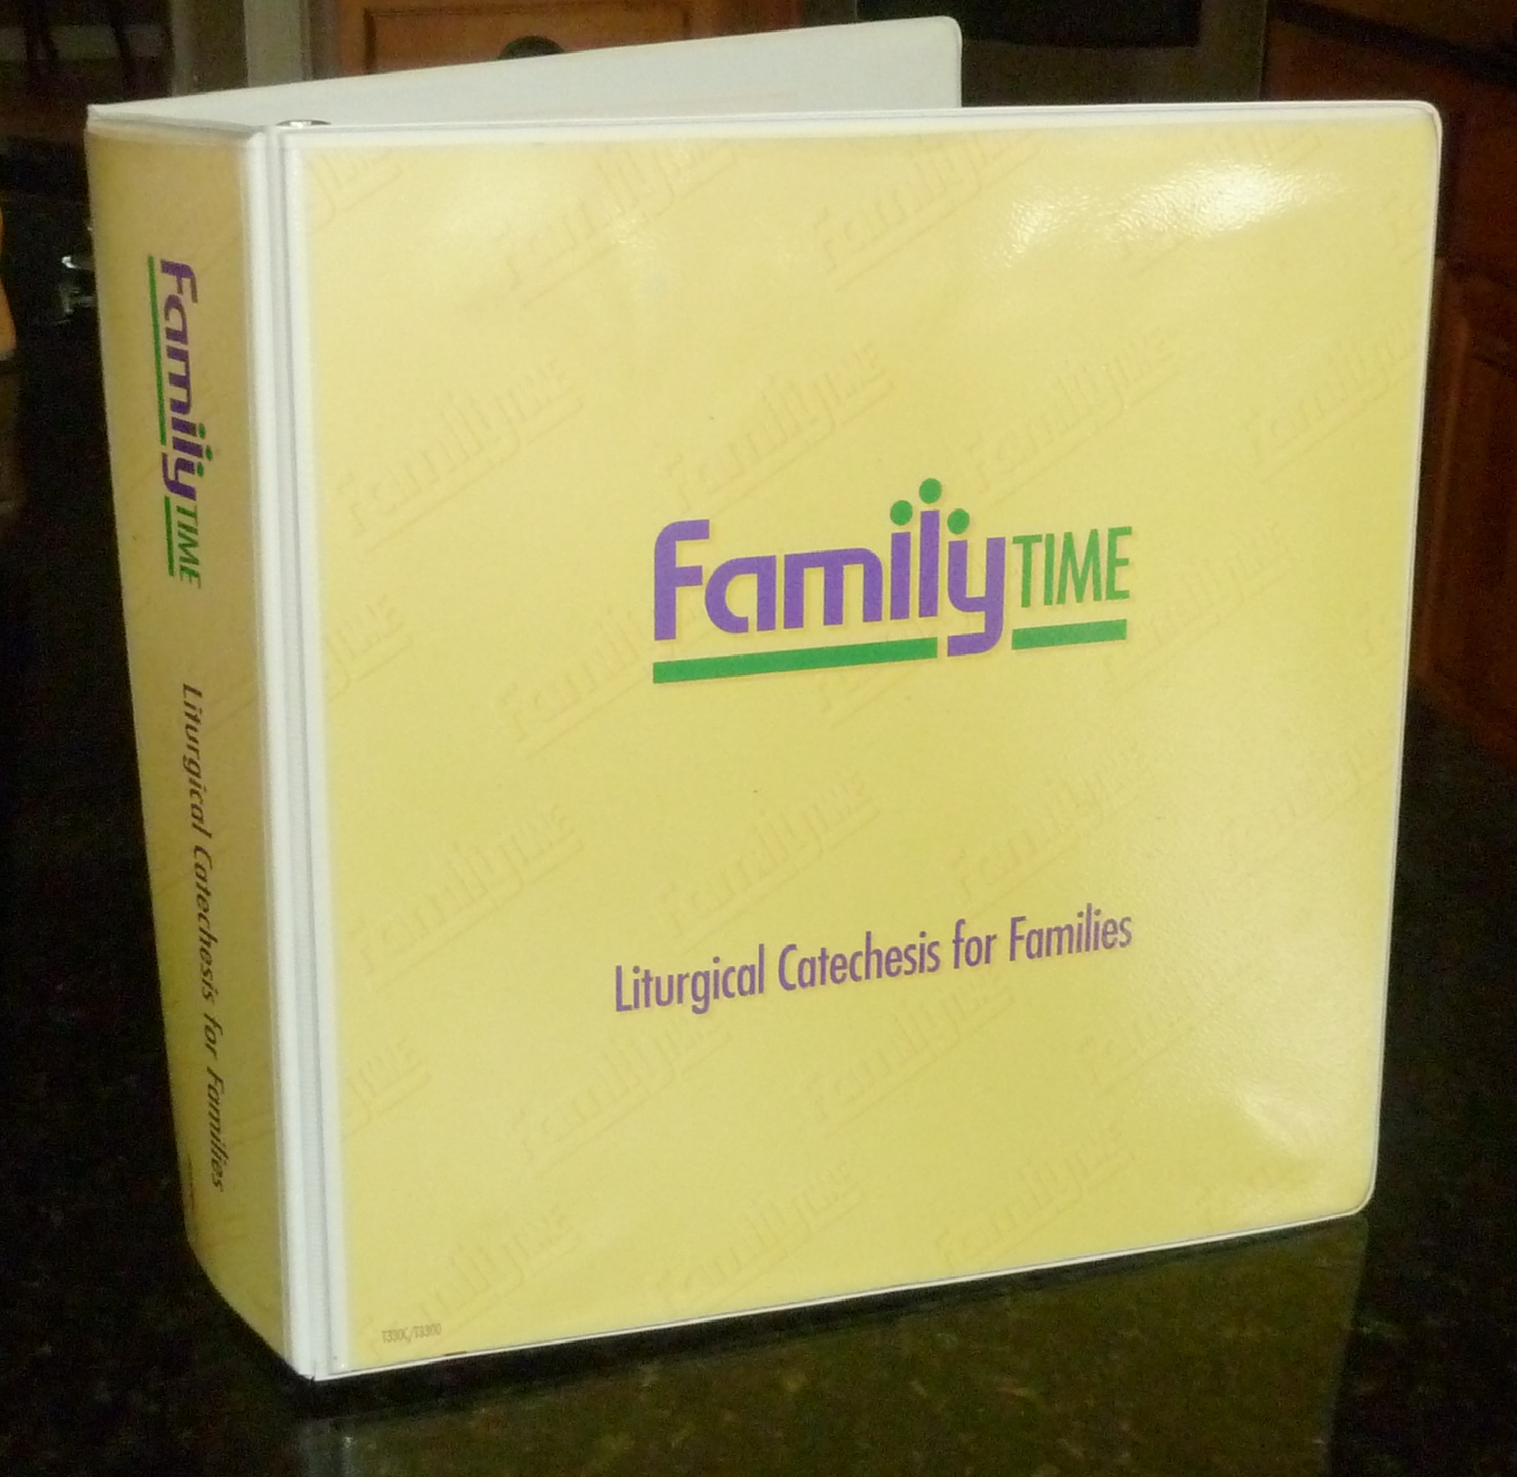
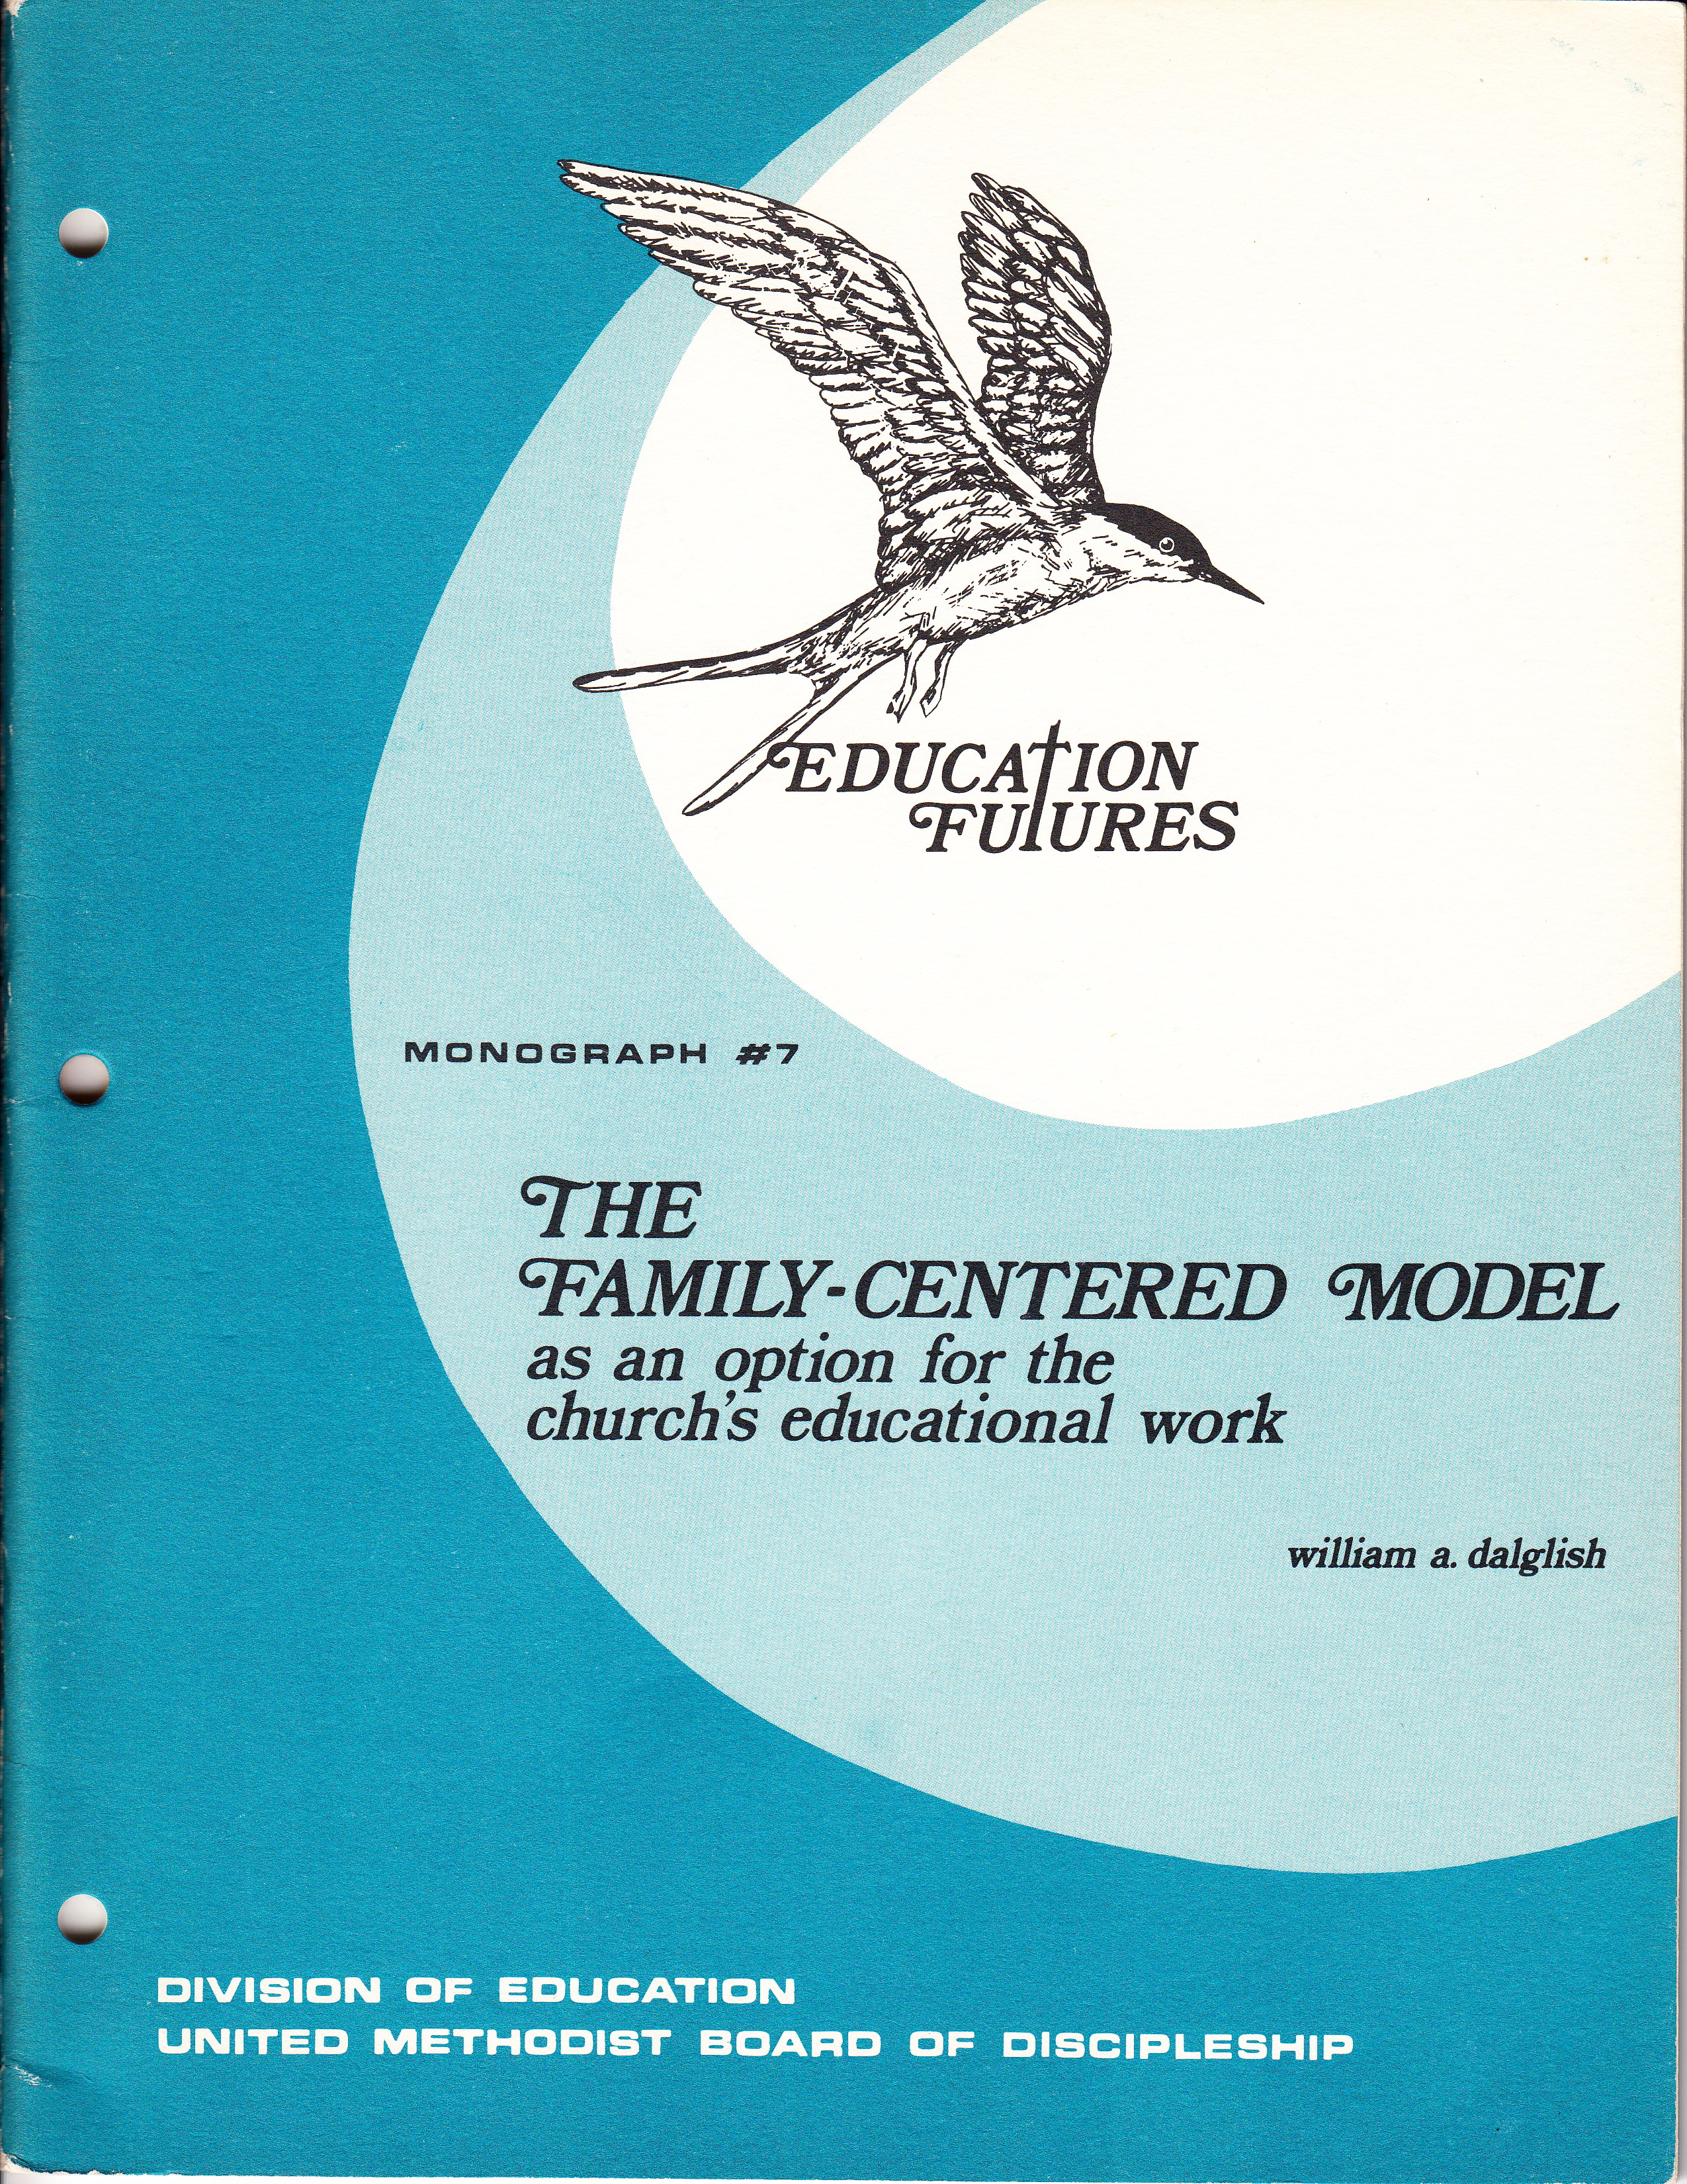
Family Faith Formation – 1970s-80s

Slide 8
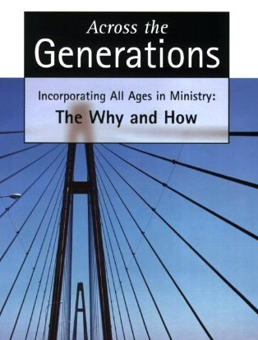
Intergenerational 1980s-2000s

Slide 9
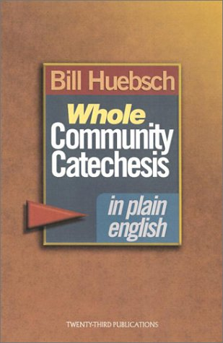
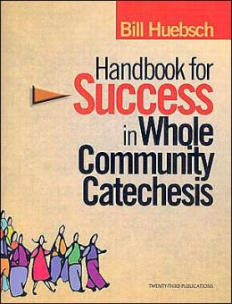
Intergenerational 1990s-2000s

Slide 10
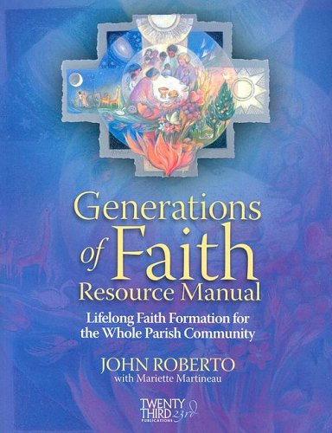
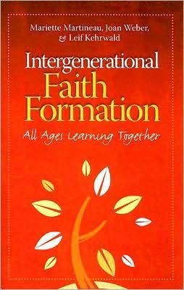
Intergenerational 1990s-2000s

Slide 11
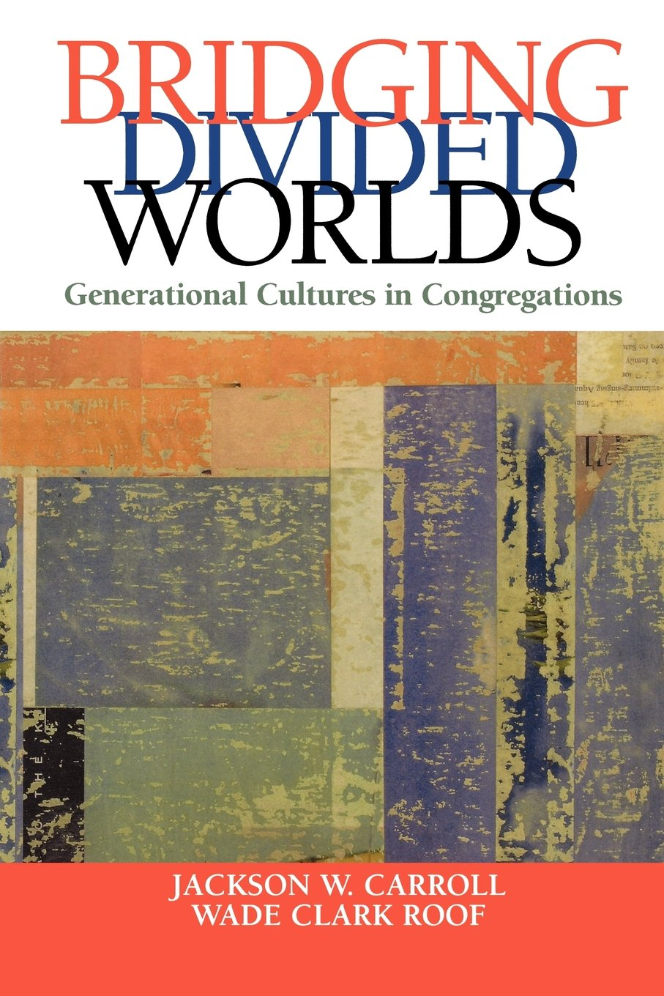
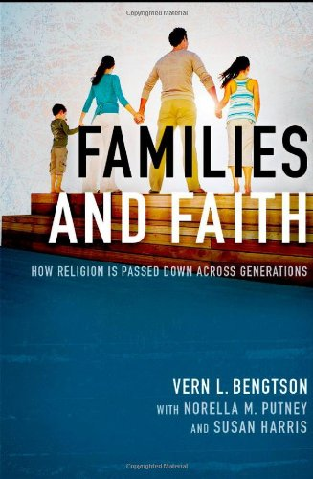
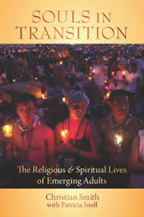
Research 2000s-

Slide 12
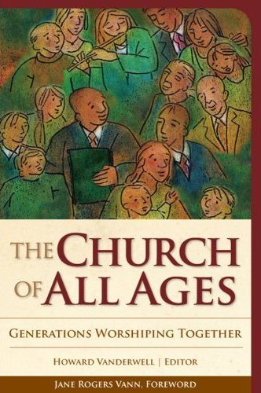
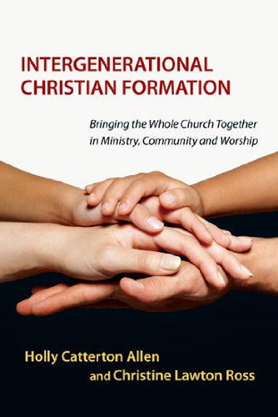
Intergenerational 2000s -

