Slide 1
Reimagining Faith Formation for the 21st Century
The Way of St. Paul
Diocese of New Jersey

Slide 2
The “Old” Faith Formation Ecosystem
Church
Family
Ethnic Traditions
Community
Religious School or Sunday School

Slide 3
A New Faith Forming Ecosystem
Intergenerational Faith Community
Age Group/Generational Faith Formation
Family Faith Formation
Missional Faith Formation
Online & Digitally-Enabled Faith Formation

Slide 4
Holistic Faith & Formation
“Christian faith formation is a lifelong journey with Christ, in Christ, and to Christ. Lifelong Christian faith formation is lifelong growth in the knowledge, service and love of God as followers of Christ and is informed by scripture, tradition and reason.”
(The Charter for Lifelong Christian Formation)

Slide 5
Holistic Faith & Formation
Faith formation is a lifelong journey of discipleship—a process of experiencing, learning, and practicing the Christian faith as we seek to follow Jesus and his Way in today’s world.

Slide 6
Holistic Faith & Formation
A way of the head (inform) demands a discipleship of faith seeking understanding and belief with personal conviction, sustained by study, reflecting, discerning and deciding, all toward spiritual wisdom for life.
A way of the heart (form) demands a discipleship of right relationships and right desires, community building, hospitality and inclusion, trust in God’s love, and prayer and worship.
A way of the hands (transform) demands a discipleship of love, justice, peace-making, simplicity, integrity, healing, and repentance.
(Thomas Groome)

Slide 7
Eight Faith Forming Processes
GROWTH IN FAITH
Caring Relationships
Rituals & Milestones
Church Year Seasons
Worshipping
Learning the Tradition
Praying
Spiritual Formation
Reading the Bible
Serving Working for Justice Caring for Creation

Slide 8
Intergenerational Community
Intergenerational faith formation and whole community faith experiences are at the center of faith formation – engaging all ages and generations in the life and events of church life and the Christian faith and participation in intergenerational faith experiences.

Slide 9
Throughout Scripture there is a pervasive sense that all generations were typically present when faith communities gathered for worship, for celebration, for feasting, for praise, for encouragement, for reading of Scripture, in times of danger, and for support and service. . . . To experience authentic Christian community and reap the unique blessings of intergenerationality, the generations must be together regularly and often—infants to octogenarians.
(Allen and Ross, 84)

Slide 10
Intergenerational Community
Form and deepen Christian identity and commitment in all ages
Shared experience of faith formation in community for all ages
Strengthen relationships, connections, and community across generations
Support families in living the Christian way of life at home and in the world
Equip parents/grandparents for transmitting faith at home

Slide 11
Intergenerational Community
Caring: Community building activities, storytelling, mentoring, social events
Celebrating: Sunday Worship, whole community sacramental celebrations, milestones celebrations, church year feasts and seasons
Learning: Intergenerational learning programs (weekly, monthly, small group); incorporating intergenerational learning into age group programming
Praying: Community prayer experiences, intergenerational prayer groups, spiritual guides/mentors
Serving: Intergenerational service projects and mission trips, church-wide service days

Slide 12
Life-Stage Faith Formation
Age group and generational faith formation addresses the unique life tasks, needs, interests, and spiritual journeys of people at each stage of life.
Intergenerational Faith Community
Children & Parents
Youth & Parents
Young Adults
Mid-life Adults
Mature Adults
Older Adults

Slide 13
Life Stage & Intergenerational
Learn with Peers
Experience in Community
Live the Learning
Reflect on Learning & Living

Slide 14
Life-Stage Faith Formation
Provides a variety of content, methods, formats, and environments to address the diverse life tasks and situations, needs and interests, and spiritual and faith journeys of children, teens, and adults.
Moving away from “one-size-fits-all” mentality

Slide 15
Life-Stage Faith Formation
Incorporate seven learning environments—
  Self-directed
  Mentored
  At home
  Small groups
  Large groups
  Church-wide
  Community & World

Slide 16
Family Faith Formation
Congregations equip families to become centers of learning, faith growth, and faith practice in 5 ways:
Nurturing family faith at home through eight faith forming processes
Building strong families by developing family assets: nurturing relationships, establishing routines, maintaining expectations, adapting to challenges, and connecting to the community.
Parent faith formation
Parenting for faith growth training
Parenting education

Slide 17
Eight Faith Forming Processes
GROWTH IN FAITH
Caring Relationships
Rituals & Milestones
Church Year Seasons
Worshipping
Learning the Tradition
Praying
Spiritual Formation
Reading the Bible
Serving Working for Justice Caring for Creation

Slide 18
Family Assets (Search Institute)

Slide 19
Family Faith Formation
Congregations equip families to become centers of learning, faith growth, and faith practice in 5 ways:
Parent faith formation
Parenting for faith growth training
Parenting education

Slide 20
Missional Faith Formation
Missional faith formation expands and extends the church’s presence through outreach, connection, relationship building, and engagement with people where they live—moving faith formation out into the community.
Missional faith formation provides pathways for people to consider or reconsider the Christian faith, to encounter Jesus and the Good News, and to live as disciples in a supportive faith community.

Slide 21
Missional Faith Formation
Missional faith formation expands and extends the church’s presence through outreach, connection, relationship building, and engagement with people where they live—moving faith formation out into the community.
  Moving worship and faith formation into the community
  Opening programs to everyone – VBS
  Life skills: parenting, careers, training, mentoring
  Small group programs on a variety of topics
  Community-wide service
  Community events: arts, music, theater

Slide 22


Slide 23
Online & Digitally-Enabled
Faith Formation
Faith formation is digitally-enabled—blending gathered community settings with online learning environments and utilizing the abundance of digital media and tools for learning and faith formation; and digitally-connected—linking intergenerational faith community experiences, peer experiences and programs , and daily/home life using online and digital media.

Slide 24
Digitally-Enabled Faith Formation
We now have the technology, online platforms, and digital content to:
engage people with a wide variety of faith forming content for all ages - anytime, any place
extend church events into people’s daily lives via online content and experiences
connect faith formation in gathered settings with faith formation in online settings
offer a variety of online faith formation content, experiences, and courses for self-study and small group study

Slide 25
Digitally-Enabled Faith Formation
Fully Online Faith Formation
Mostly Online with Regular Interaction in Gathered Sessions
Online Faith Formation & Gathered Sessions (Flipped Classroom)
Gathered Program with Supportive Online Content
Gathered Program with Online Components beyond the Program

Slide 26
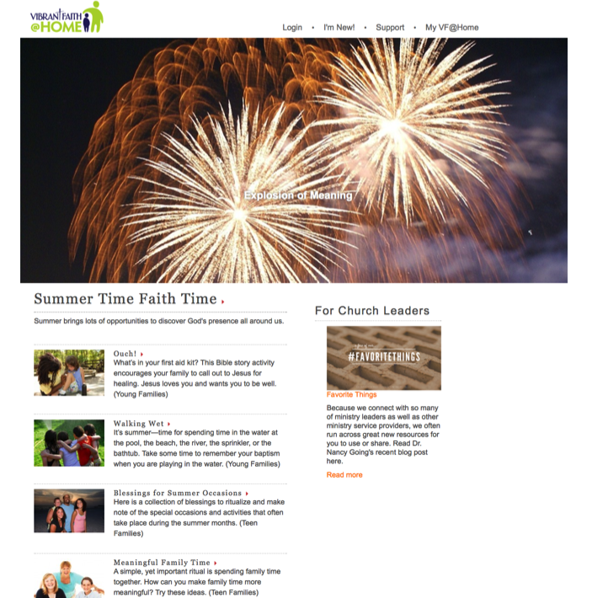

Slide 27

Digital Platform
Weebly.com Wordpress.org Wix.com Squarespace.com

Slide 28
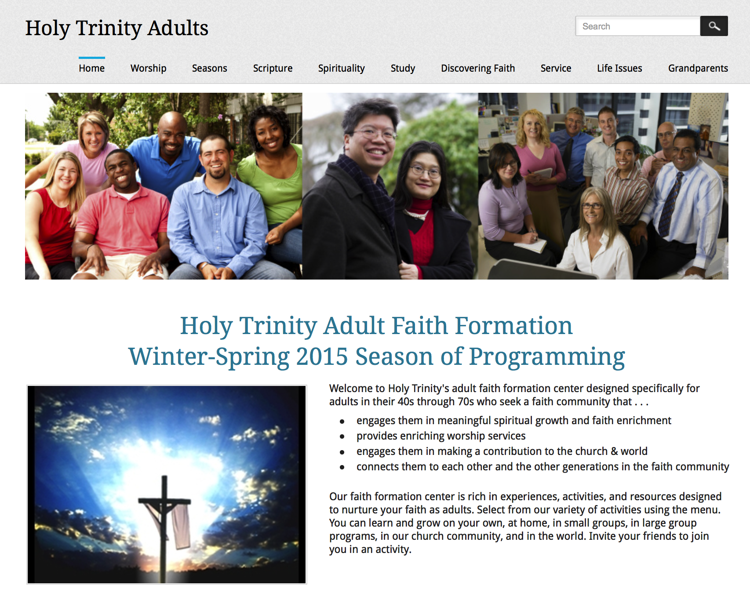

Slide 29
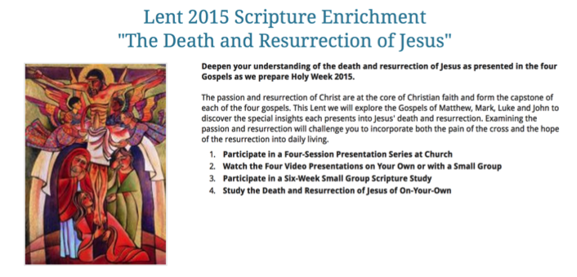

Slide 30
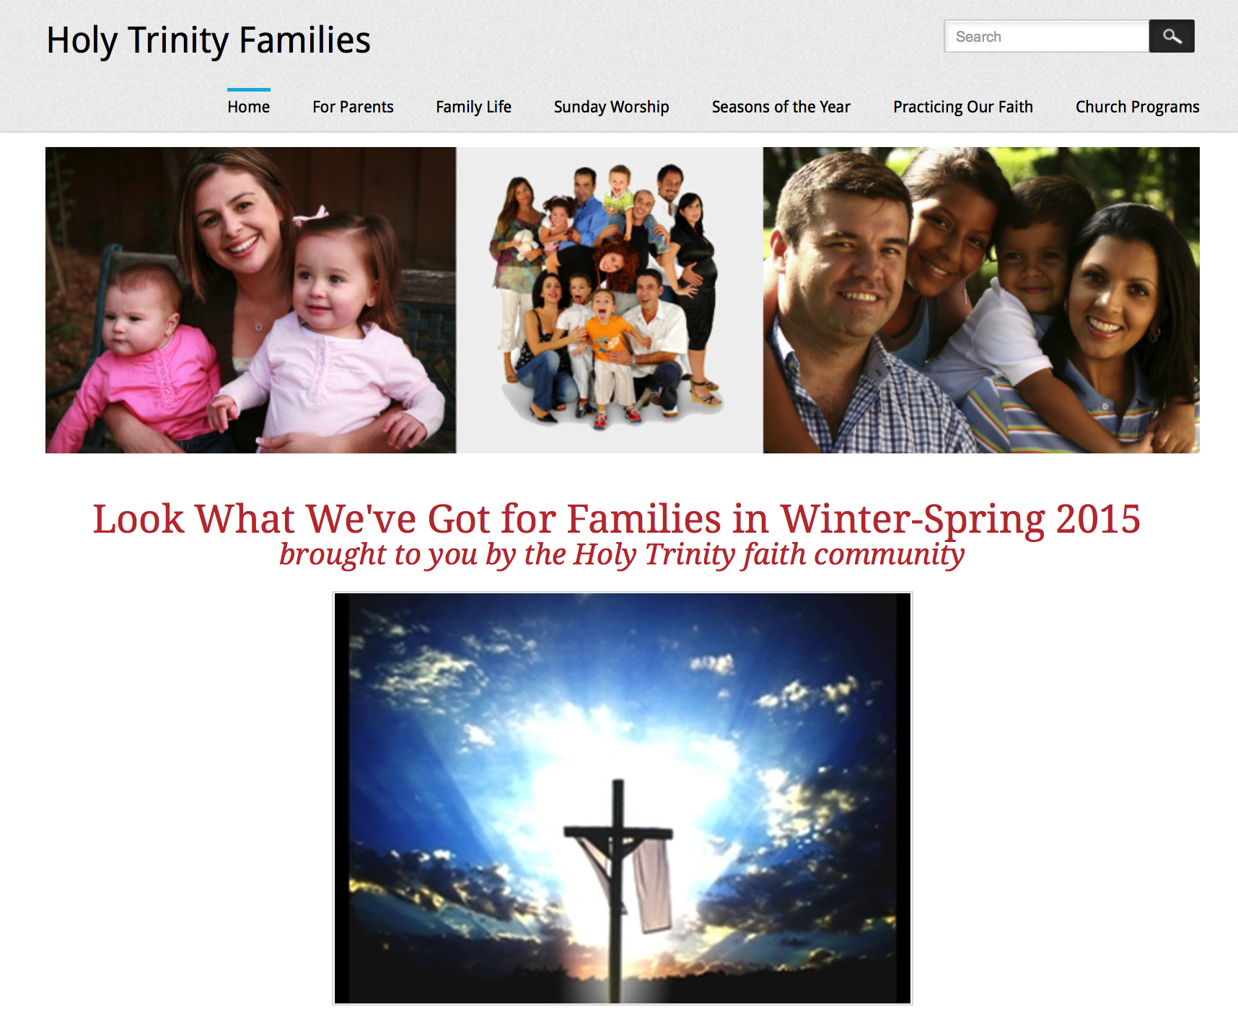

Slide 31
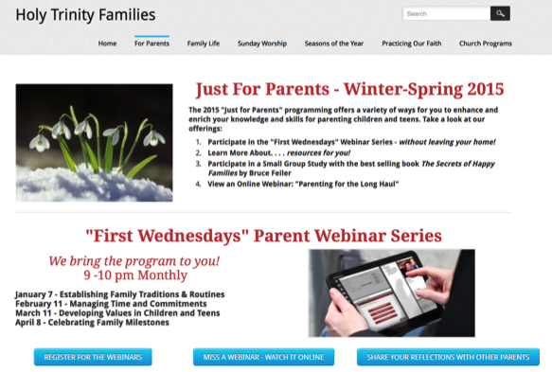
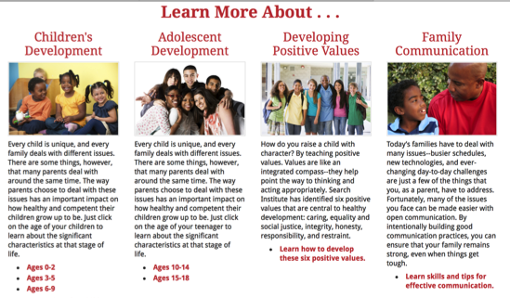

Slide 32
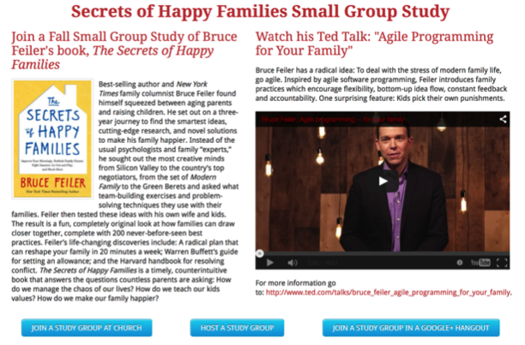
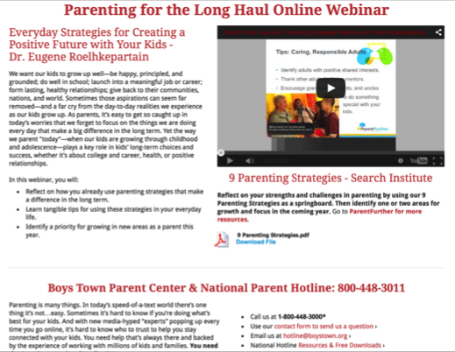

Slide 33
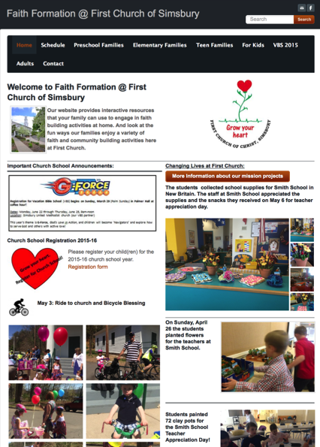
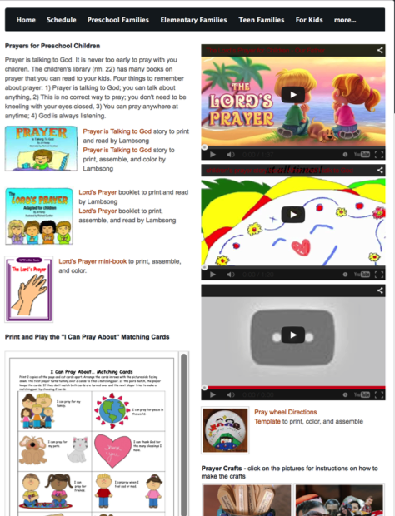

Slide 34
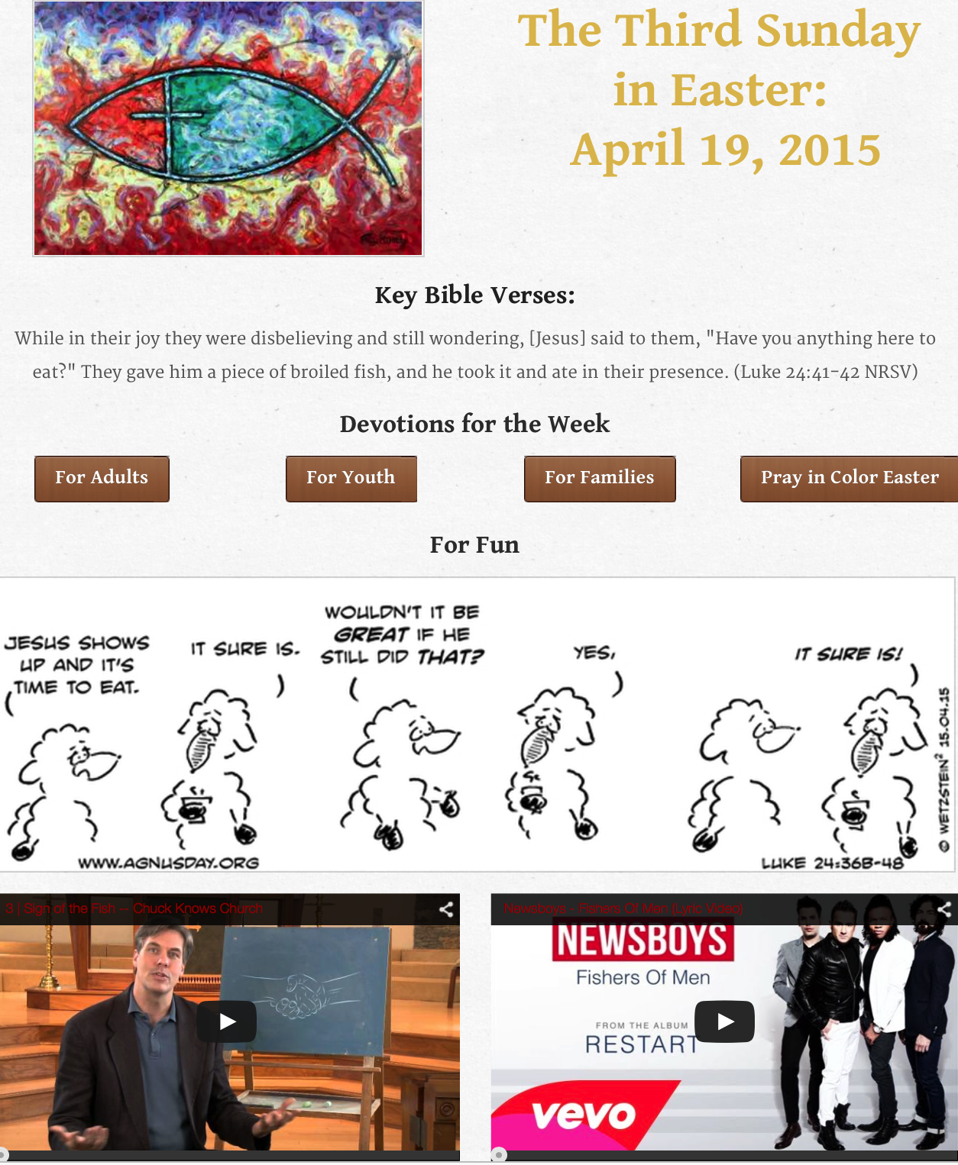

Slide 35
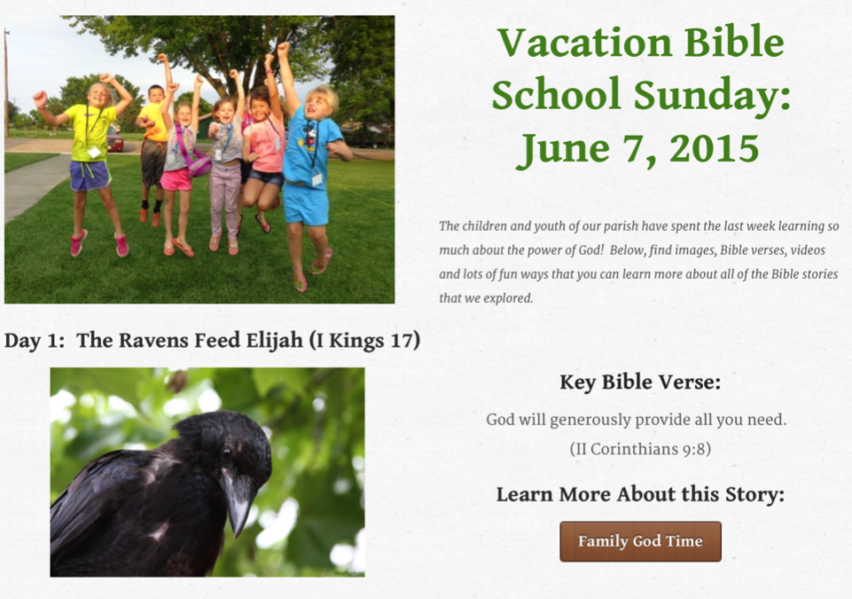
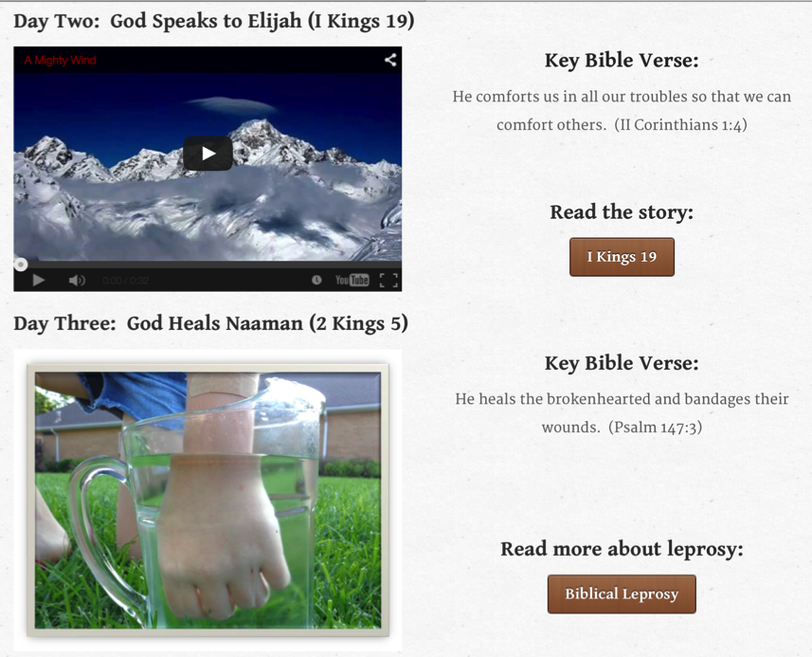
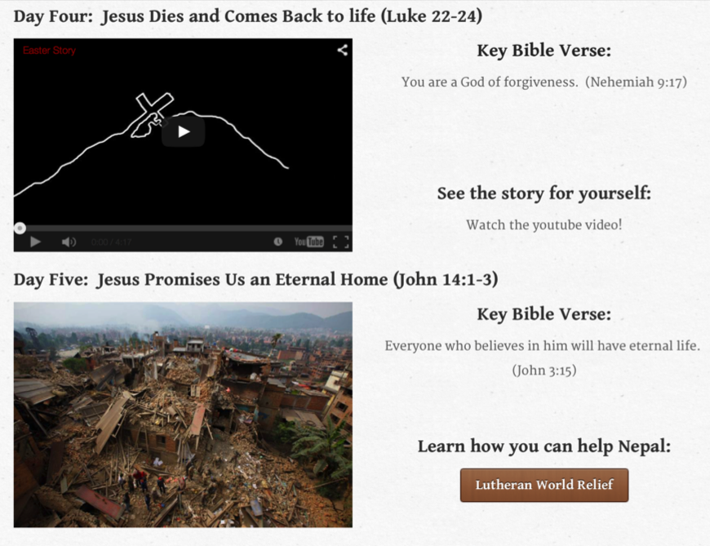

Slide 36
21st Century Faith Formation
What if we reimagined faith formation as a network of relationships, content, experiences, and resources—in physical places and online spaces?
To offer wide variety of engaging and interactive content and experiences in online and physical settings.
To offer content and experiences to respond to the diverse religious and spiritual needs of people today—from the spiritually committed and engaged to the spiritual but not religious and the unaffiliated.
To enable congregations to become centers for learning and faith growth by utilizing the best of the new digital technologies to bring an abundance of meaningful and engaging faith forming experiences—in the congregation and the world, and in a variety of media—to all people.

