Slide 1
John Roberto, LifelongFaith Associates (jroberto@lifelongfaith.com)
Designing 21st Century Faith Formation

Slide 2
Four-Scenario Faith Formation
Scenario 3 Unaffiliated & Uninterested
Scenario 1 Vibrant Faith & Active Engagement
Scenario 4 Uncommitted & Participating
Scenario 2 Spiritual but Not Religious

Slide 3
Approach 1. Targeting Audiences & Needs
Scenario #4 | Scenario #1
Scenario #3 | Scenario #2

Slide 4
Example: Targeting Audiences & Needs
Scenario #4 + Marriage & FF + Baptism & FF + Family faith formation in the 1st decade of life + Milestones faith formation + Pathways to deepen faith & engagement | Scenario #1 + Millennial Generation + Marriage & FF + Baptism & FF + Baby Boomers FF + Empowering people to share their faith
Scenario #3 + Third Place settings + Family life center + Events (movie nights, concerts, festivals) + Community-based ministry (service, recovery ministry) | Scenario #2 + Third Place settings + Targeting 20-30 year olds + Service: local - global + Spiritual formation + Pathways to deepen faith & engagement

Slide 5
Innovation Design Process Stanford School of Design
Empathize
Define
Ideate
Test
Prototype

Slide 6
Design Process for an New Initiative
Select a Target Group (or need)
Research
(Empathize)
Defined Spiritual & Religious Needs, Concerns & Interests
Generate Ideas
Create Prototypes to Pilot
Test the Prototypes
Evaluate, Improve, & Expand the Innovation

Slide 7
Target Audiences
Who are your target audiences?
What are their priority life tasks and concerns, interests, and spiritual and religious needs?

Slide 8
1 - Empathize
Empathy is the foundation of a human-centered design process. To empathize, we:
Observe. View users and their behavior in the context of their lives.
Engage. Interact with and interview users through both scheduled and short ‘intercept’ encounters.
Immerse. Experience what your user experiences.

Slide 9
Empathy Map
SAY What do you hear your target group saying? | DO What actions and behaviors do you notice in your target group?
THINK What might your target group be thinking? What does this tell you about their beliefs/convictions? | FEEL What emotions might your target group be feeling?

Slide 10
Empathy Map
Define Needs (verbs not nouns)
Identify Insights – to better respond to a design challenge

Slide 11
2 - Define
The define mode is when you unpack and synthesize your empathy findings into compelling needs and insights, and scope a specific and meaningful challenge. It is a mode of “focus” rather than “flaring.”
Two goals of the define mode are to develop a deep understanding of your users and the design space and, based on that understanding, to come up with an actionable problem statement: your point of view.

Slide 12
2 - Define
Your point of view should be a guiding statement that focuses on specific users, and insights and needs that you uncovered during the empathize mode.
More than simply defining the problem to work on, your point of view is your unique design vision that you crafted based on your discoveries during your empathy work. Understanding the meaningful challenge to address and the insights that you can leverage in your design work is fundamental to creating a successful solution.

Slide 13
2 – Define
In order to be truly generative, you must first craft a specific and compelling problem statement to use as a solution-generation springboard. As a test, a good point of view (POV) is one that:
Provides focus and frames the problem
Inspires your team
Provides a reference for evaluating competing ideas
Fuels brainstorms by suggesting “how might we” statements
Captures the hearts and minds of people you meet
Saves you from the impossible task of developing concepts that are all things to all people
Is something you revisit and reformulate as you learn by doing
Guides your innovation efforts

Slide 14
POV – Point of View
A point of view (POV) is your reframing of a design challenge into an actionable problem statement that will launch you into a generative ideation.
A good POV will allow you to ideate in a directed manner, by creating How We Might (HWM) questions based on your POV.
Most of all your POV captures your design vision.

Slide 15
POV – Point of View
A POV MADLIB
[USER] needs to [USER’S NEED]
because
[SURPRISING INSIGHT]

Slide 16
POV Want Ad
A point-of-view (POV) is your reframing of a design challenge into an actionable problem statement that will launch you into generative ideation. A POV Want Ad can be a good way to express your distilled findings in an intriguing format. The want ad format tends to accentuate a specific user, and her important character traits. Embed your user, his or her need, and your insights within the format of a want ad.

Slide 17
POV Want Ad
Format:
Descriptive characterization of a user
followed by “seeks” an ambiguous method to meet an implied need
plus additional flavor to capture your findings.
For example:
High-energy teenager seeks awesome social network. Interests should include issues of societal importance (e.g. how much parents suck and also why being a vegetarian might be cool). Willingness to “text” constantly during the school year is a MUST!

Slide 18
POV Want Ad
Example:
Time crunched, stressed and pressured families seek connections, support and guidance to develop a strong, healthy, value-centered family life where faith can be applied to daily needs. Must deal with contradiction that we want to feel welcome and involved, but don't bug me or take my time.

Slide 19
POV Want Ad
Examples:
A single energetic young adult seeks a social network. Desires a connection with others to get together and serve our community, hang out & have fun. Passionate about making a difference and doesn't want to be left on the sidelines.
--------
Highly motivated single young adults seek engaging faith-based social network that will help them navigate fast paced living in a hook-up town.

Slide 20
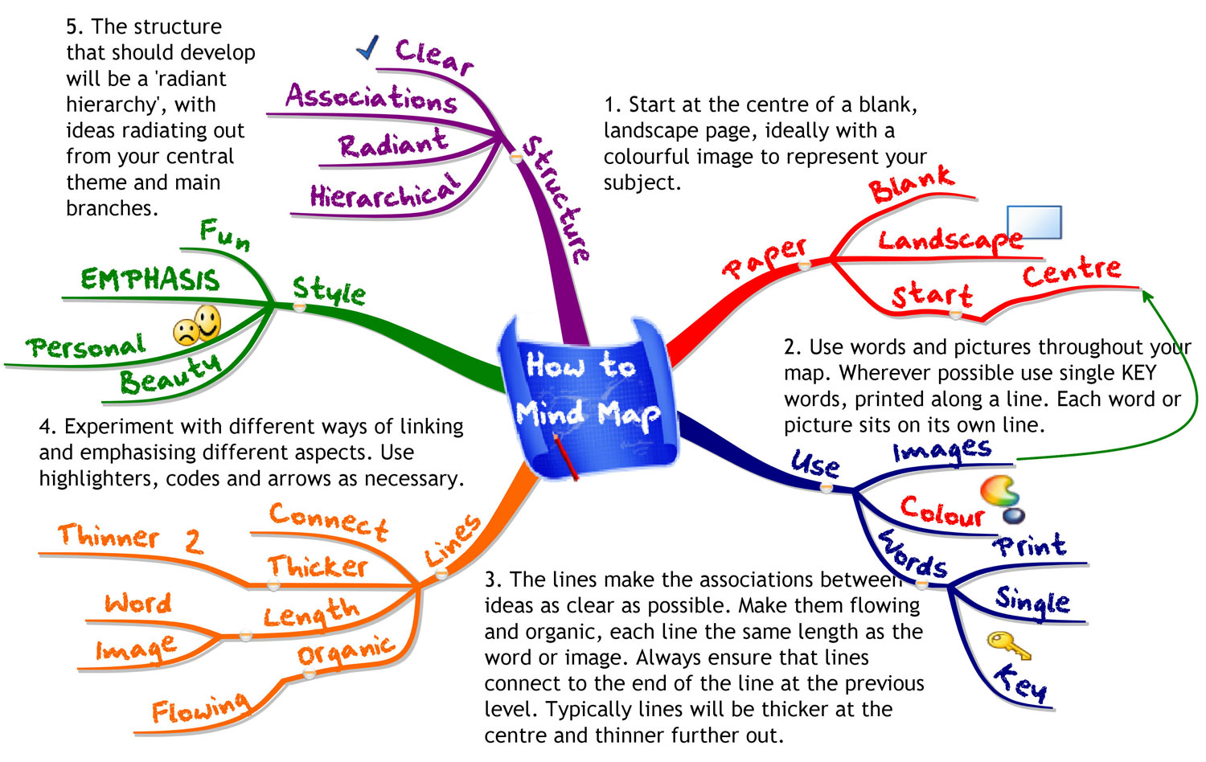
Generating Ideas: Mindmapping

Slide 21
A Network Approach
Faith Formation Network
Church Programs
Small Groups & Support Groups
Mentors
Social Media for Connection
User-Generated Content
Community Programs
Online Courses & Activities
Online Resources: Print, Audio, Video
Apps
Blogs
Video Conference
A Lifelong Faith Formation Network is a way to provide faith formation for everyone, anytime, anywhere, 24x7x365.

Slide 22
Baptism
Mentors
Prayer, Rituals, Bible, Family Conversation, Service
Parent Faith Formation & Parenting Skills
Milestones
Faith Practices @ Home
Workshops Courses Online Resources Support Groups
Family Learning Programs
Baptism Anniversary, First Prayers, Start of School
Church Gatherings Small Groups Workshops
Parent/Family Online Resource Center
Families in the First Decade of Life

Slide 23
4 - Prototype
Prototyping is getting ideas and explorations out of your head and into the physical world.
A prototype can be anything that takes a physical form – be it a wall of post-it notes, a role-playing activity, a space, an object, an interface, or even a storyboard. The resolution of your prototype should be commensurate with your progress in your project.
In early explorations keep your prototypes rough and rapid to allow yourself to learn quickly and investigate a lot of different possibilities.
Prototypes are most successful when people (the design team, the user, and others) can experience and interact with them. What you learn from those interactions can help drive deeper empathy, as well as shape successful solutions.

Slide 24
4 - Prototype
Traditionally prototyping is thought of as a way to test functionality. But prototyping is used for many
reasons, including these:
Empathy gaining: Prototyping is a tool to deepen your understanding of the design space and your user, even at a pre-solution phase of your project.
Exploration: Build to think. Develop multiple solution options.
Testing: Create prototypes (and develop the context) to test and refine solutions with users.
Inspiration: Inspire others (teammates, clients, customers, investors) by showing your vision.

Slide 25
4 - Prototype
We prototype to:
Learn. If a picture is worth a thousand words, a prototype is worth a thousand pictures.
Solve disagreements. Prototyping is a powerful tool that can eliminate ambiguity, assist in ideation, and reduce miscommunication.
Start a conversation. A prototype can be a great way to have a different kind of conversation with users.
Fail quickly and cheaply. Creating quick and dirty prototypes allows you to test a number of ideas without investing a lot of time and money up front.
Manage the solution-building process. Identifying a variable to explore encourages you to break a large problem down into smaller, testable chunks.

Slide 26
5- Test
Testing is the chance to refine our solutions and make them better. Prototype as if you know you’re right, but test as if you know you’re wrong.
To refine our prototypes and solutions. Testing informs the next iterations of prototypes. Sometimes this means going back to the drawing board.
To learn more about our user. Testing is another opportunity to build empathy through observation and engagement—it often yields unexpected insights.
To test and refine our POV. Sometimes testing reveals that not only did we not get the solution right, but also that we have failed to frame the problem correctly.

Slide 27
Innovation Design Process Stanford School of Design
Empathize
Define
Ideate
Test
Prototype

Slide 28
Design an Implementation Plan
What are the dates and times?
What is the location: physical/facility and/or online/website?
What are the implementation steps and target dates (timeline) for completing each step.
What resources will you need to implement the initiative.
How much will the initiative cost?
How many leaders will you need to implement the initiative, how you will find them, and how you will prepare them?

Slide 29
Parish Website: Planning Checklist
Who is the audience?
Planning—visit other sites.
Reflect on what you are: what are your core values and how do you want to say that?
Define a reasonable scope and get buy-in from stake-holders in the congregation.
Do an easy survey of your audience—what are they looking for, what do they expect?
Decide on the types of content to include (+ graphics).
Map out your basic navigation (7 buckets is about all a person can digest).
Pick the technology or platform.
Create the design.
Build your content .
Release the site.

Slide 31
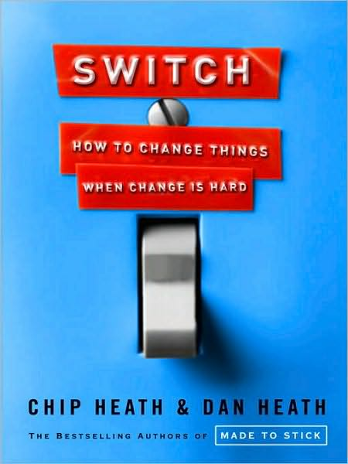
Facilitating Change

Slide 32
A Framework for Change
Direct the Rider (the conscious mind), eliminating what looks like resistance but is more often a lack of clarity by providing crystal-clear direction.
Following the bright spots: investigate what’s working and clone it.
Script the critical moves: don’t think big picture, think in terms of specific behaviors.
Point to the destination: change is easier when you know where you’re going and why it’s worth it.

Slide 33
A Framework for Change
Motivate the Elephant (the subconscious), eliminating what looks like laziness but is more often exhaustion by engaging emotions to get people on the same path as you.
Find the feeling: knowing something isn’t enough to cause change. Make people feel something.
Shrink the change: break down the change until it no longer spooks the Elephant.
Grow your people: cultivate a sense of identity and instill the growth mindset.

Slide 34
A Framework for Change
Shape the Path (the situation), eliminating what looks like a people problem but is more often a situation problem, by making the environment more conducive to the change you seek.
Tweak the environment: when the situation changes, the behavior changes. So change the situation.
Build habits: when behavior is habitual, it’s “free”—it doesn’t tax the Rider. Look for ways to encourage habits.
Rally the herd: behavior is contagious. Help it spread.

Slide 35
Making Change Stick
Understand and spell out the impact of the change on people.
Build an emotional and rational case for change.
Ensure that the entire leadership team is a role model for change.
Mobilize people to “own” and accelerate the change.
Embed the change in the fabric of the organization.

Slide 36
How Do We Make Change? (Transforming Congregational Education Project)
Substantial change takes time and does not proceed smoothly.
Take action and be ambitious: “boldly go…”
Vision, action, reflection, and conversation feed off one another to drive the process forward.
Getting the right people engaged and empowering them is critical. “Get the right people on the bus…”
The change process is powered by and largely about learning.
Quality outside assistance can help the process tremendously.
Because change is complex, a multi-pronged support system is needed.
Financial resources can help “lubricate” change.

Slide 38
Increasing a True Sense of Urgency
Strategy
Create action that is exceptionally alert, externally oriented, relentlessly aimed at winning, making some progress each and every day, and constantly purging low value-added activities—all by always focusing on the heart and not just the mind.

Slide 39
Increasing a True Sense of Urgency
Bring the Outside In
Reconnect internal reality with external opportunities and hazards
Bring in emotionally compelling data, people, video, sites, and sounds.

Slide 40
Increasing a True Sense of Urgency
2. Behave with Urgency Every Day
Never act content, anxious, or angry.
Demonstrate your own sense of urgency always in meetings, one-on-one interactions, memos, and email, and do so as visibly as possible to as many people as possible.

Slide 41
Increasing a True Sense of Urgency
3. Find Opportunity in Crises
Always be alert to see if crises can be a friend, not just a dreadful enemy, in order to destroy complacency
Proceed with caution, and never be naïve, since crises can be deadly.

Slide 42
Increasing a True Sense of Urgency
4. Deal with the NoNos
Remove or neutralize all the relentless urgency-killers, people who are not skeptics but are determined to keep a group complacent or, if needed, to create destructive urgency.

