Slide 1
Faith Formation for the 21st Century
John Roberto
LifelongFaith Associates
www.lifelongfaith.com
jroberto@lifelongfaith.com jrlifelong@gmail.com

Slide 2
Analyzing Trends Affecting Faith Formation Today

Slide 3
The Changing Landscape
No Religious Affiliation
Declining Church Participation
Increasing Diversity & Pluralism
Changing Marriage & Family Life
The Rise of Digital Media & the Internet
Spiritual, not Religious
Declining Religious Socialization
Aging Baby Boomers

Slide 5
No Religious Affiliation
15% of all Americans claim no religious affiliation
25% of all 18-29 years
10% drop in the number of Christians
The challenge to Christianity in the U.S. does not come from other religions but from a rejection of all forms of organized religion.

Slide 6
Spiritual but not Religious
Today, 18% of 18-39 year olds say that are “spiritual, but not religious” compared to only 11% a decade ago.

Slide 7
Sticky Faith: From High School to College

Slide 8
Sticky Faith: Key Finding
Churches and families overestimate youth group graduates’ readiness for the struggles ahead with dire consequences for the faith.
Only one in seven high school seniors report feeling prepared to face the challenges of college life with few ready for the intensity of the college experience: loneliness, the search for new friends, being completely on their own for the first time, and the sudden availability of partying.
One pervasive struggle for college students is finding a new church, as evident by the 40 percent of freshman who report difficulty doing so. Young people retrospectively report that the first two weeks of their college freshman year set the trajectory for their remaining years in school.

Slide 9
Participation in Churches
Declining worship attendance
Declining participation in celebration of sacraments & rites of passage

Slide 10
Diversity & Pluralism
Diversity of ethnic cultures & nationalities
No single authority exercises supremacy; no single belief or ideology dominations
Tapestry of religious and spiritual alternatives and choices

Slide 11
Family Life
Delaying marriage
Having fewer children and later in life
Decreasing number of children in two-parent households
Increasing number of unmarried couples living together

Slide 12
Family Religious Socialization
Parent Influence: The single most important social influence on the religious and spiritual lives of adolescents is their parents.
Embedded Family Religious Practices: Effective religious socialization comes about through specific religious activities that are firmly intertwined with the daily habits of family life

Slide 13
Family Socialization
The single most important influence on the religious and spiritual lives of children, teens, and emerging adults is their parents.
Faith
Parental Faith
Parental Modeling & Teaching
Prayer
Scripture Reading

Slide 14
Family Socialization
Children and teenagers “teenagers with seriously religious parents are more likely that those without such parents to have been trained in their lives to think, feel, believe, and act as serious religious believers, and that that training “sticks” with them even when the leave home and enter emerging adulthood”
(Souls in Transition: The Religious & Spiritual Lives of Emerging Adults by Christian Smith with Patricia Snell)

Slide 15
Baby Boomers
Every day for the next 19 years, about 10,000 Boomers will turn 65.
A new stage of life between adult midlife – typically focused on career and child-rearing – and old age, traditionally marked by increasing frailty and decline. This new stage (60s-70s) is characterized by generally good health, relative financial stability, and an active, engaged lifestyle.

Slide 16
Digital Era
93% of teens & young adults are online
“Computer in your pocket” - increasing mobile access – iPhone
8-18 year olds spend on average 7½ hours a day with media

Slide 17
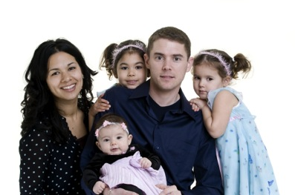
Generational Change

Slide 18
Generational Change
If only the youngest cohort in society changes (and then persists in that new direction throughout their own life cycle), society as whole changes inexorably but almost imperceptibly, like a massive supertanker changing course.
If the differences between one generation and the next are small, then generationally based social change will be real (and significant) but very slow.
If for some reason a younger generation deviates substantially from its predecessors, then the aggregate social change may be quick—significant over a few decades.

Slide 19
Trends & Shifts
Increasing number of “Nones”
Increasing number of “Spiritual but not Religious”
Accepting and embracing diversity: culturally, sexually, and in family structures
Declining participation in Sunday worship and sacraments/rites of passage (marriage, baptism)
Living together, marrying later, and having children later
Declining levels of family faith practice & socialization

Slide 20
Generational Change
Significant Generational Change began in the early 1990s among the younger generations and is influencing society and the older generations
These trends are having a significant impact on a Life Cycle approach to faith formation and church life, in general.
fewer marriages – marrying later –
fewer baptisms – fewer young families
lower Sunday worship attendance……..

Slide 21
Envisioning 4 Scenarios for the Future

Slide 22
4 Scenarios
Two Critical Uncertainties
Will trends in U.S. culture lead people to become more receptive to organized religion, and in particular Christianity or will trends lead people to become more resistant to organized religion and Christianity?
Will people’s hunger for and openness to God and the spiritual life increase over the next decade or will people’s hunger for and openness to God and the spiritual life decrease.

Slide 23
Faith Formation 2020 Matrix
Dominant Cultural Attitude toward Organized Religion
Receptive
Low High
People’s Hunger for God and the Spiritual Life
Resistant

Slide 24
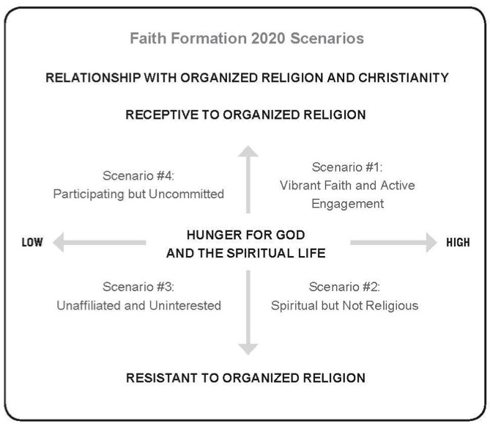
Four Scenarios for the Future

Slide 25
4 Scenarios for the Future
Scenario 3 Unaffiliated & Uninterested
Scenario 1 Vibrant Faith & Active Engagement
Scenario 4 Uncommitted & Participating
Scenario 2 Spiritual but Not Religious

Slide 26
Scenario #1
A world in which people of all ages and generations are actively engaged in a Christian church, are spiritually committed, and growing in their faith. People have found their spiritual home within an established Christian tradition and a local faith community that provides ways for all ages and generations to grow in faith, worship God, and live their faith in the world.
In most congregations the overwhelming majority of resources, energy, and leadership are directed toward faith formation with people in Scenario #1. The future of faith formation in Scenario #1 is being significantly impacted by a people by trends, e.g., people in their 20s & 30s leaving established Christian churches, and the decline in family religious socialization and practice at home.
Challenge: provide lifelong faith formation for all ages and generations, at home and at church, that develops vibrant faith, is continuous throughout life, and engages all people in the life and mission of the church community.

Slide 27
Scenario #4
A world in which people attend church activities, but are not actively engaged in their church community or spiritually committed. They may participate in significant seasonal celebrations and celebrate sacraments and milestone events (marriage, baptism). Some may even send their children to religious education classes. Their spiritual commitment is low and their connection to the church is more social and utilitarian than spiritual.
While receptive to an established church, their occasional engagement in church life does not lead them toward spiritual commitment.
Challenge: Provide faith formation that recognizes that belonging (engagement) leads to believing (spiritual commitment) and a more vibrant faith, and develop approaches for increasing people’s engagement with the church community and the Christian tradition. Craft faith formation around their spiritual and religious needs, and their relationship with the faith community.

Slide 28
Scenario #2
A world in which people are spiritually hungry and searching for God and the spiritual life, but most likely are not affiliated with organized religion and an established Christian tradition.
Some may join a nondenominational Christian church focused on their spiritual needs, while others may find an outlet for their spiritual hunger in small communities of like-minded spiritual seekers, in local or global acts of service, or in online spiritual resources and communities.
The Spiritual but Not Religious reflect a growing minority of the American population, especially among the eighteen- to thirty-nine-year-olds.
Challenge: Engage people where their live (physical and virtual communities), build relationships, engage in spiritual conversations, and offer programs and activities that nurture their spiritual growth.

Slide 29
Scenario #3
A world in which people experience little need for God and the spiritual life and are not affiliated with organized religion and established Christian churches. The Unaffiliated and Uninterested reject all forms of organized religion and reflect an increasing percentage of the American population, especially among 18-29 year-olds.
Challenge: Expanding the vision of faith formation to embrace the life worlds—and spiritual needs—of people in Scenario #2 and #3 who see little need for church, and the need for God and the spiritual life. Developing strategies and approaches for moving faith formation from the church campus into the world—to “plant” faith formation in the midst of their cultures and worlds, build relationships, and be witnesses to the Christian faith in the world today.

Slide 30
NSYR Research

Slide 31
Youth & Young Adult Religiosity
Youth
Abiders Adapters Assenters Avoiders Atheists
20% 20% 31% 24% 5%
---------------------------------------------------------------
Young Adult
Committed Selected Spiritually Religiously Religiously Irreligious
Traditionalists Adherents Open Indifferent Disconnected
15% 30% 15% 25% 5% 10%
---------------------------------------------------------------

Slide 32
Typology of Adolescent Religiosity
Abiders: highest levels of religiosity and practice: believe in God, pray regularly, engage in personal religious practice, attend services, serve others, think about the meaning of life; most likely to say their religion is the only true faith
Adapters: high levels of personal religiosity + accepting of other people’s faiths + attend religious services more sporadically
Assenters: believe in God and feel somewhat close to God, but they are minimally engaged with their faith and practice only occasionally. Religion is tangential to other aspects of their lives.
Avoiders: believe in God but have low levels of religious practice; God is distant, impersonal; and often don’t name a religious affiliation.
Atheists: don’t believe in God and don’t attend services.

Slide 33
Typology of Emerging Adult Religiosity
Committed Traditionalists: strong religious faith; articulate beliefs; actively practice. Personal commitment to faith is a significant part of their identities and moral reasoning, and they are at least somewhat regularly involved in some religious group
Selected Adherents: believe and perform certain aspects of their religious traditions but neglect and ignore others; more discriminating about what they are willing to adopt of their religious tradition’s beliefs and practices
Spiritually Open: not very committed to a religious faith but are nonetheless receptive to and at least mildly interested in some spiritual or religious matters.

Slide 34
Typology of Emerging Adult Religiosity
Religiously Indifferent: neither care to practice religion nor oppose it; simply not invested in religion either way; too distracted with and invested in other things in life and unconcerned with matters of faith to pay any real attention to religion.
Religiously Disconnected: have little to no exposure or connection to religious people, ideas, or organizations; neither interested in nor opposed to religion. Faith simply has not been a part of their lives in any significant way.
Irreligious: hold skeptical attitudes about and make critical arguments against religion generally, rejecting the idea of personal faith

Slide 35
Four-Scenario Thinking
Scenario 3 Unaffiliated & Uninterested
Scenario 1 Vibrant Faith & Active Engagement
Scenario 4 Uncommitted & Participating
Scenario 2 Spiritual but Not Religious

Slide 36
Scenario #4 + Marriage & FF + Baptism & FF + Family faith formation in the 1st decade of life + Milestones faith formation + Pathways to deepen faith & engagement | Scenario #1 + Millennial Generation + Marriage & FF + Baptism & FF + Baby Boomers FF + Empowering people to share their faith
Scenario #3 + Third Place settings + Family life center + Events (movie nights, concerts, festivals) + Community-based ministry (service, recovery ministry) | Scenario #2 + Third Place settings + Targeting 20-30 year olds + Service: local - global + Spiritual formation + Pathways to deepen faith & engagement

Slide 37
Targeting Religious & Spiritual Needs
Scenario #4 | Scenario #1
Scenario #3 | Scenario #2

Slide 38
Scenario #4 + Marriage & FF + Baptism & FF + Family faith formation in the 1st decade of life + Milestones faith formation + Pathways to deepen faith & engagement | Scenario #1 + Millennial Generation + Marriage & FF + Baptism & FF + Baby Boomers FF + Empowering people to share their faith
Scenario #3 + Third Place settings + Family life center + Events (movie nights, concerts, festivals) + Community-based ministry (service, recovery ministry) | Scenario #2 + Third Place settings + Targeting 20-30 year olds + Service: local - global + Spiritual formation + Pathways to deepen faith & engagement

Slide 39
Developing 21st Century Faith Formation

Slide 40
The Challenge of Adaptive Change
“The significant problems we face today cannot be solved at the same level of thinking we were at when we created them.”
Albert Einstein

Slide 41
Technical Problems
Technical problems (even though they may be complex) can be solved with knowledge and procedures already in hand.
Leadership would be an easy and safe undertaking if organizations and communities only faced problems for which they already knew the solutions. Everyday, people have problems for which they do, in fact, have the necessary know-how and procedures—technical problems.

Slide 42
Adaptive Challenges
Adaptive challenges require experiments, new discoveries, and adjustments from numerous places in the organization.
Without learning new ways—changing attitudes, values, and deep-seated behaviors—people cannot make the adaptive leap necessary to thrive in the new environment. Adaptive challenges call for changes of heart and mind—the transformation of long-standing habits and deeply held assumptions and values.
Leadership is “the activity of mobilizing people to tackle the toughest problems and do the adaptive work necessary to achieve progress.”
(Ronald Heifetz and Martin Linsky)

Slide 43
21st Century Faith Formation
What could a 21st century approach to faith formation look like?
How would we address the diversity of people’s religious and spiritual needs today?
How would we engage people? How would we reach people?
What technologies would we use?
What resources would we access?

Slide 44
The 20th Century: Age of the School

Slide 45
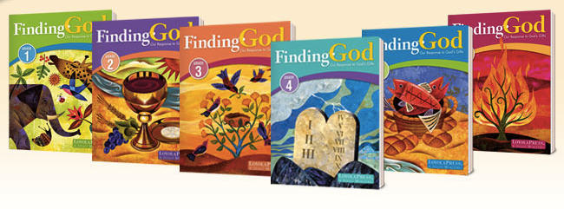
The 20th Century: Age of “Linear” Curriculum

Slide 46
21st Century: Age of the Network

Slide 47
A Network Approach
Faith Formation Network
Church Programs
Small Groups & Support Groups
Mentors
Social Media for Connection
User-Generated Content
Community Programs
Online Courses & Activities
Online Resources: Print, Audio, Video
Apps
Blogs
Video Conference

Slide 49
The New “Book” of the 21st Century

Slide 51
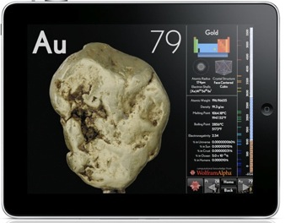

Slide 52
Significant Shift
Shifting from. . .
“One Size Fits All” Curriculum & Programming
to
A Network of Personalized & Customized Faith Formation Activities & Resources
focusing on addressing people’s spiritual and religious growth by offering a wide variety of religious content and experiences
“Differentiated Faith Formation”

Slide 53
A Network Approach
Faith Formation Network
Church Programs
Small Groups & Support Groups
Mentors
Social Media for Connection
User-Generated Content
Community Programs
Online Courses & Activities
Online Resources: Print, Audio, Video
Apps
Blogs
Video Conference
A Lifelong Faith Formation Network is a way to provide faith formation for everyone, anytime, anywhere, 24x7x365.

Slide 54
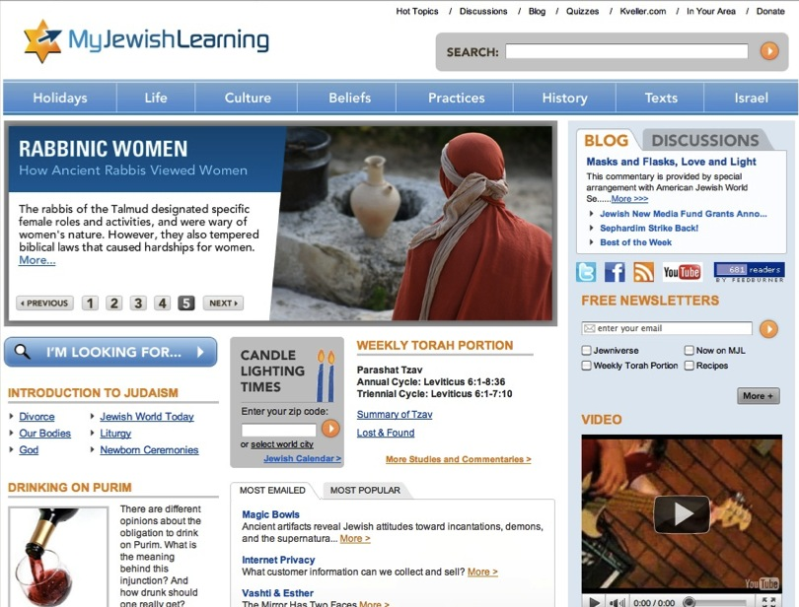

Slide 55
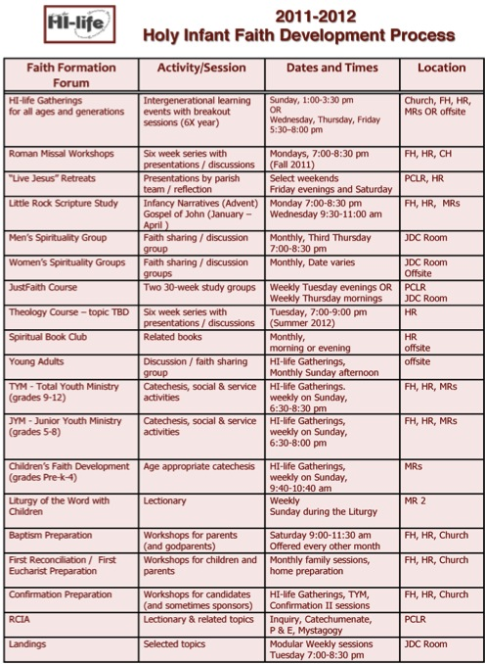

Slide 56
Features
Address the diverse spiritual and religious needs with a variety of content, programs, activities, and resources.

Slide 57
Features
Recognize that learning is a process of active inquiry with the initiative residing within the individual.

Slide 58
Features
Guide individuals and families in discerning their spiritual and religious needs and creating personal plans for faith growth and learning.

Slide 59
A Process for a Developing a Personalized Faith Growth Plan
Assessing Spiritual Growth
Working with a Mentor/Guide
Finding Resources on the Network
Engaging in Formation
Sharing with the Community
Reflecting on Growth and Identifying New Needs

Slide 61
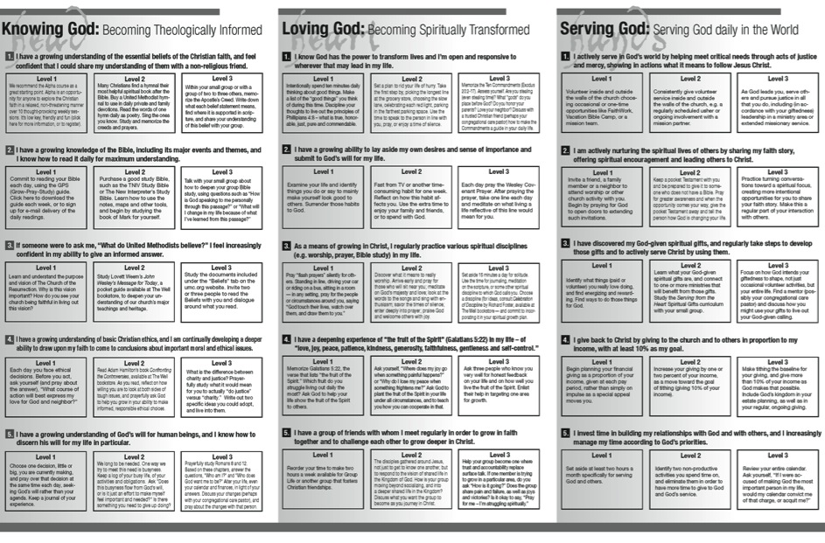

Slide 62
Features
Incorporate informal learning, as well as formal learning in faith formation.
FORMAL | LEARNING
classes & workshops speaker series online courses small group Bible study | self-study Bible study social networking faith-sharing groups
INTENTIONAL | UNEXPECTED
reading /watching a DVD mentoring service/mission activity program at the library or local bookstore | internet surfing watching a movie TV show shopping at a home improvement store
INFORMAL | LEARNING

Slide 63
Features
Utilize a variety of faith formation models to address the diverse life tasks, religious and spiritual needs, and interests of people:
on your own
at home
in small groups
in large groups
in the congregation
in the community and world

Slide 64
Diversify Faith Formation Models
Face-to-Face & Virtual
On Your Own
Small Group
Large Group
Mentored
Church Community
Community & World
@Home

Slide 65
Faith Formation Models
Face-to-Face
Virtual
On Your Own
Mentored
At Home
In Small Group
In Large Group
In Church
In Community & World
Activity
Activity
Activity
Spiritual & Religious Needs
Topics or Themes

Slide 66
Features
Offer programs and activities in face-to-face physical settings; in virtual, online settings, and in blended settings that combine both.
They can be offered only in physical locations, such as church facilities, homes, retreat centers, camps, and community settings
They can be offered only in virtual settings, such as an online course, collaborative wiki, and online resource center.
They can be offered in a blended approach, combining a gathering in a physical location with online delivery (activities, group projects, interaction) and some element of individual control over time, place, path, and/or pace.

Slide 67
Blended Approaches
Fully online program or activity with options for face-to-face interaction in physical settings. | Mostly or fully online program or activity with regular interaction and programming in physical settings. | An online platform that delivers most of the program or activities with leaders providing on-site support on a flexible and adaptive as-needed basis through in-person mentoring and small group sessions. | Programs and activities in physical settings guided by a leader with online components that extend beyond the program sessions. | Programs and activities in physical settings that include online resources to supplement the program content.

Slide 68
Features
Offer a variety of faith formation programs, activities, experiences, and resources to address the diverse ways people learn and grow in faith.

Slide 69
Features
Incorporate communities of practice to connect individuals and groups throughout the congregation.

Slide 70
Designing Examples of Networks in Practice

Slide 71
Building a Network: Diversifying FF Models
Whole Church Theme
On Your Own (Print, Audio, Video, Online Resources & Courses)
Family @Home (Online Resources)
Small Group Course (online & physical settings)
Adult 4-Week Lecture Series @ Church
(Videotaped & online)
Age Group Programs: Children & Youth

Slide 72
Building a Network Extending a Gathered Program
Gathered Program
Talk About It: Conversation Questions
Learn More: Watch a Video, Listen to a Talk, Read an Article
Live: Action Project for the Month
Pray Devotions, Bible Reading, Table Prayer
Family & Parents Center: How-to helps (video, audio, print) Family Faith Practices
Share What Your Learning: Write a Blog Entry, Create & Share a Video or Project

Slide 73
Building a Network: Extending Worship into Everyday Life
Sunday Worship
Share It Blog/Forum After Mass In Programs Family Conversation Activity
Live It Living the Message Daily Living Christian Practices Service Ideas for the Week
Study It Taking Faith Home Insert Homily Video + Study Guide Daily Readings Scripture Commentaries Online Bible Study
Pray It Weekly Table Prayer Praying with the Saints AM & PM Prayer

Slide 74
Building a Network: Differentiating Faith Formation
Core Content & Experiences
Option 1. Program (current model)
Option 2. Small Group Program
Option 2. Online Small Group Program using Skype
Option 3. Mentored
Option 4. Online Program (print & video) with Regular Check-in
Online Projects (everyone)
Social Networking Space for a Blog, Project Sharing

Slide 75
Example: Confirmation
All Youth
Sunday Worship
Service projects
Confirmation blog & online confirmation projects
Celebration of confirmation

Slide 76
Example: Confirmation
Scenario 1 (In-Depth Experience)
In-depth faith formation in theology, Bible, spirituality, and Christian practices offered in different formats, customized to the needs of the young people: small group program, online courses and resources, and mentors
Spiritual formation experience (retreat) on spiritual practices and disciplines
Whole group confirmation-specific content

Slide 77
Example: Confirmation
Scenario 4 (Foundations Experience)
Foundational program in Christian life essentials offered as a whole group experience, integrating confirmation-specific content
Experience of Christian practices and spiritual disciplines
Active participation in the activities of church life and ministries; apprenticeships with ministries and leaders to experience church life as “insiders”
Mentors to guide growth and participation in church life
Whole group confirmation-specific content

Slide 78
Example: Confirmation
Scenarios 2 and 3 (Exploration Experience)
Exploration experience to investigate the claims of the Christian faith in an informal, no pressure, non-judgmental, and friendly environment, offered in small group settings with a meal and including topics such as: Who is God? Who is Jesus? Why did Jesus die? Who is the Holy Spirit? How can we have faith? Why and how do I pray? Why and how should I read the Bible? How does God guide us? How can I resist evil? What about the Church? How can I make the most of the rest of my life?
Introductory experiences of Christian life through participating in Christian practices, service, worship, and so on.

Slide 79
Building a Network: Newly Married Couples
Faith Formation Before Marriage
Preparation for and Celebration of Marriage
Faith Formation After Celebration of Marriage

Slide 80
Discernment
Faith Formation
S1 Faith Growth Plan
S2 Faith Growth Plan
Mentors
Marriage Preparation
S3 Faith Growth Plan
Support Groups
Parish Website
Couples before Marriage

Slide 81
Marriage
Mentors
Prayer, Rituals, Bible Reading, Service, Faith Conversations
Faith Practices
Continuing Formation
Support Groups
Quarterly Couple Gatherings
Married Life Tasks & Issues
Courses, Workshops, Online Resources
Theology, Scripture, Spirituality
Newly Married Couples

Slide 82
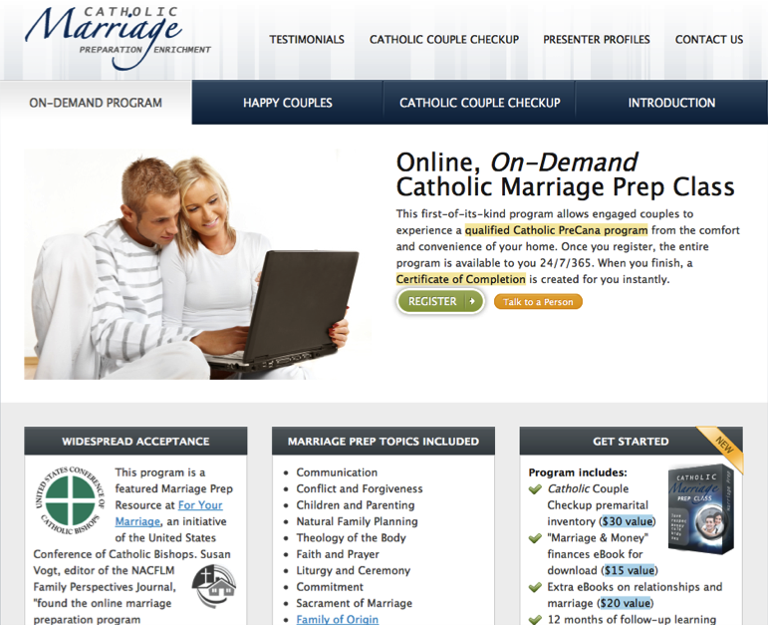

Slide 83
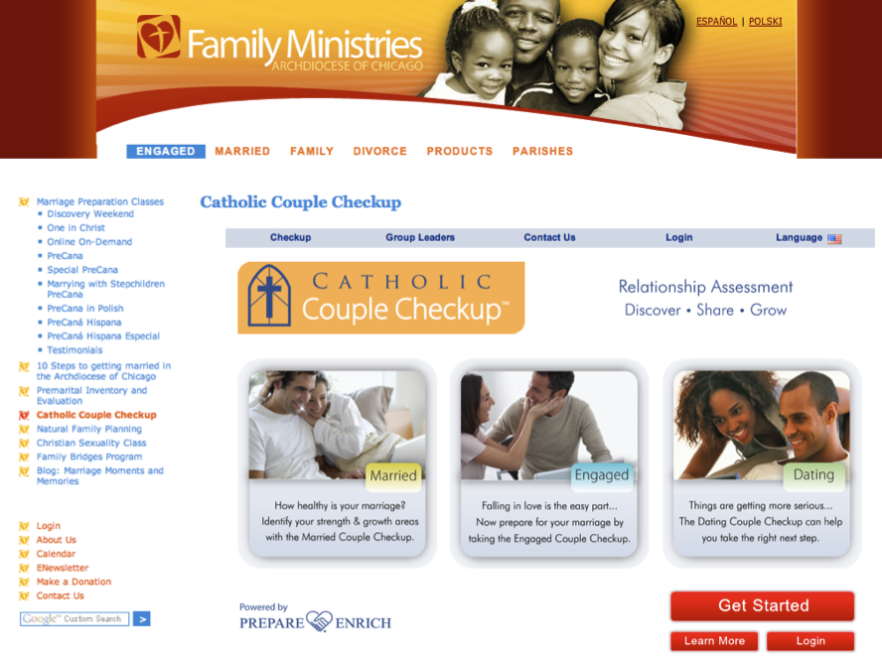

Slide 84
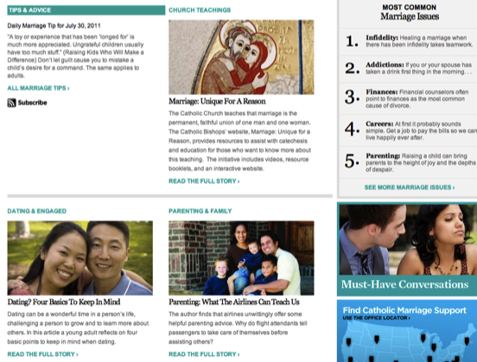
For Your Marriage

Slide 87
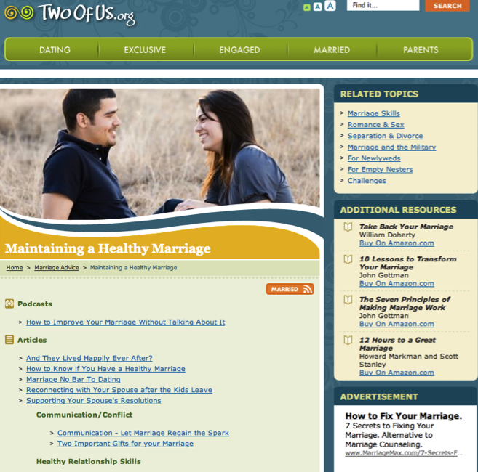

Slide 89
Building a Network: Young Families
Faith Formation Before Baptism
Preparation for and Celebration of Baptism
Faith Formation After Celebration of Baptism

Slide 90
Families in the First Decade of Life
Discernment
Parent Faith Growth Plans: S1, S2, S3, S4 Family Faith Growth Plans: S1, S2, S3, S4
Mentors
On Your Own At Home Small Group Large Group In Church In Community
Online Resource Center

Slide 91
Baptism
Mentors
Prayer, Rituals, Bible, Family Conversation, Service
Parent Faith Formation & Parenting Skills
Milestones
Faith Practices @ Home
Workshops Courses Online Resources Support Groups
Family Learning Programs
Baptism Anniversary, First Prayers, Start of School
Church Gatherings Small Groups Workshops
Parent/Family Online Resource Center
Families in the First Decade of Life

Slide 93
Milestones (Faith Stepping Stones)
Stone 1: Raising a Healthy Baby
physical, emotional and spiritual needs of infants and their parents; nightly blessing as a family faith practice.
Stone 2: Raising a Healthy Preschooler
physical, emotional and spiritual needs of preschoolers and their parents; add prayer to the nightly blessing as a faith practice

Slide 94
Milestones (Faith Stepping Stones)
Stone 3: Entry Into School
physical, emotional and spiritual needs of kindergarteners and their parents; share highs & lows with children and add it to their nightly prayers and blessing
Stone 4: My Bible
120 key verses in young readers’ Bibles; reading a Bible verse nightly, continue with highs & lows, prayer and blessing nightly

Slide 95
Faith Stepping Stones
Stone 5: Livin’ Forgiven
Passover to Lord’s Supper, with nightly confession and absolution added to the faith practices of Bible reading, highs & lows, prayer and blessing
Stone 6: Surviving Adolescence
theological reflection (i.e. setting the Bible verse and the highs & lows of the day together to ask “What is God saying to us today?”), adding to confession/ absolution, Bible reading, highs & lows, prayer and blessing continue

Slide 96
Faith Stepping Stones
Stone 7: Confirmation As Ordination
youth and parents look at their confession, their confirmation, and their call.
Stone 8: Graduation Blessing
seniors and their parents look back God’s blessings, look to the moment, and look to the future of their new callings

Slide 98
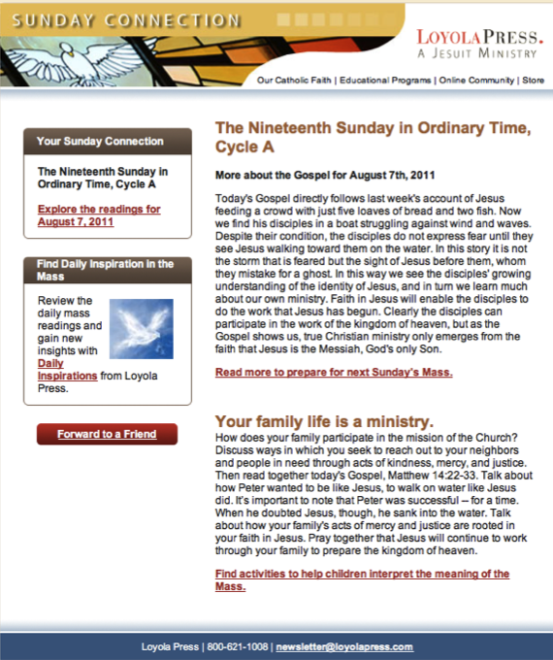

Slide 99
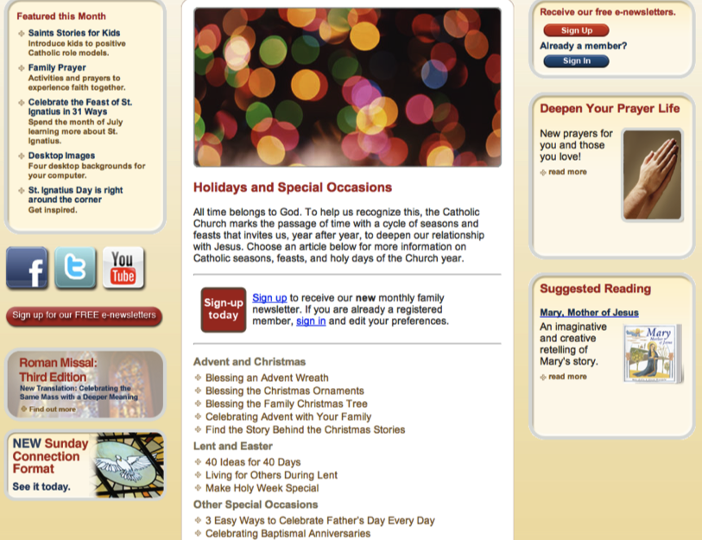

Slide 100
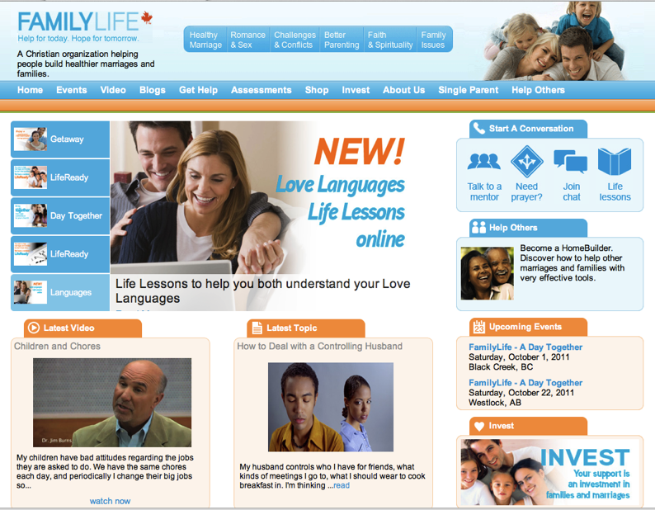

Slide 101
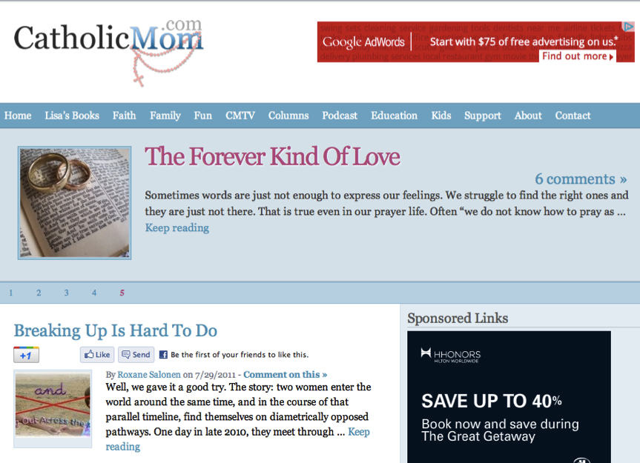

Slide 103
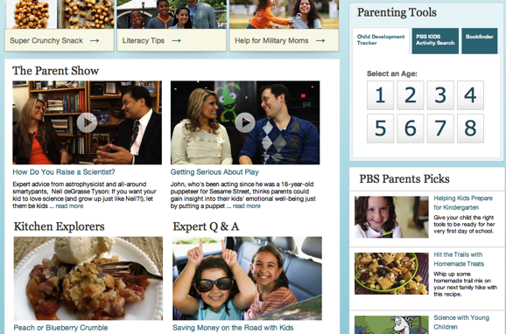

Slide 106
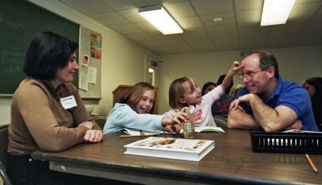
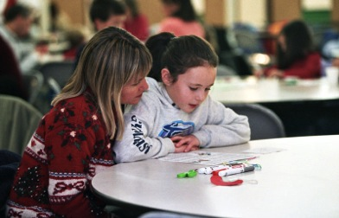
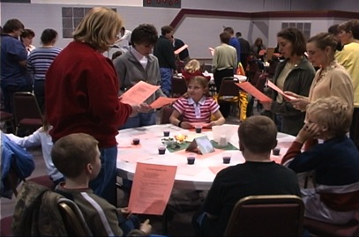
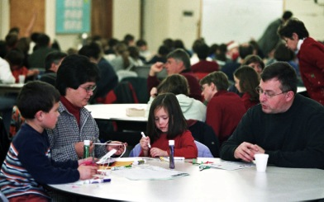
Family Faith Formation

Slide 107
Family Faith Formation
Meal and Community Building (30 minutes)
Part 1. Gathering and Prayer (10-15)
Part 2. All Ages Learning Experience (20-30)
Part 3. In-Depth Learning Experience (75-90)
Option 1. Whole Group (together)
Option 2. Age Group (parallel)
Option 3. Activity Center
Part 4. Sharing Learning Experiences and Home Application (15-20)
Part 5. Closing Prayer (5-10)

Slide 109
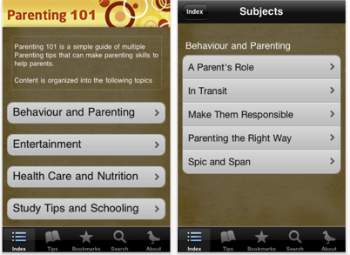
Apps

Slide 110
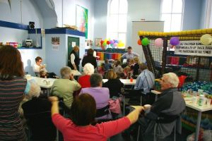
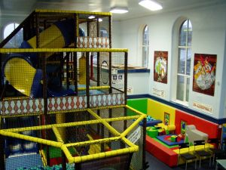
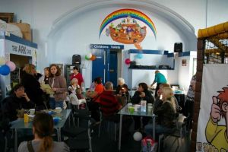
The Wesley Playhouse
Family Life Center

Slide 111
Building a Network Young Adult Faith Formation
Young Adult Faith Formation
Life Issues Workshops & Online Resources
Prayer & Spiritual Practices (online, small groups, retreats)
Third Place Café
Small Group Studies
Weekly Gathering & Worship
Justice & Service Projects (local and global)
Alpha Course
Cross-generational Experiences (worship, service, mentoring)
Social Network & Blog
Online Courses
Online Audio & Video Programs

Slide 112
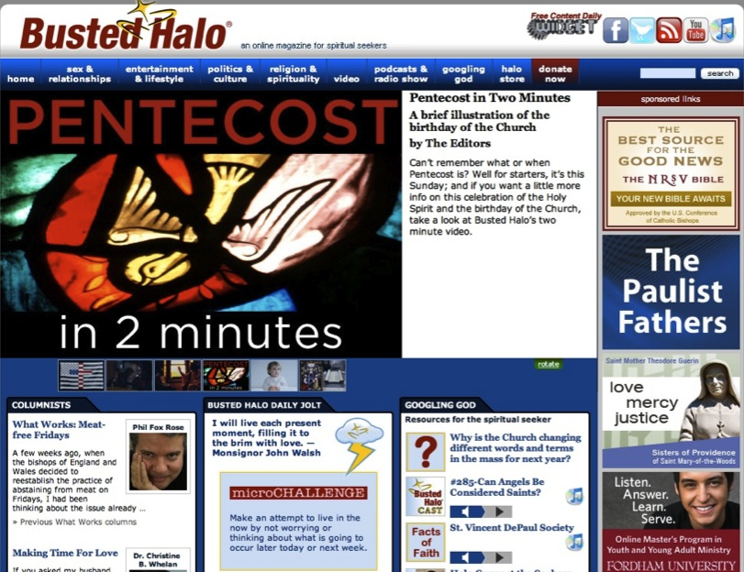

Slide 114
Building a Network: Adult Faith Formation
Adult Faith Formation
Online Courses
Audio & Video Programs
Books & Book Clubs
Life Transitions
Prayer & Spiritual Practices
Justice & Service
Small Group Studies
Life Tasks & Issues
Extended Learning Programs
Faith in Art Tours

Slide 115
iTunes U

Slide 116
Online Courses

Slide 117
Spiritual Formation
Lectio Divina
Scripture Reflection
Spiritual Reading
Contemplation
Praying with Art and Music
Fixed-hour Prayer
The Examen
Sabbath
Discernment
Fasting
Prayer Styles & Traditions

Slide 118
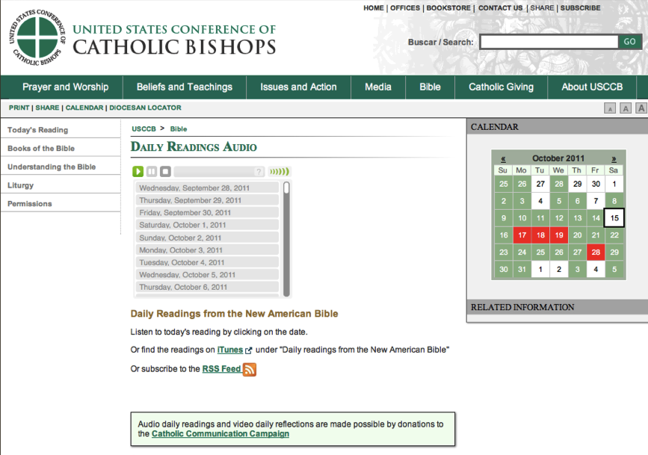

Slide 119
American Bible Society

Slide 120
Sunday Connection
Loyola Press

Slide 122
YouVersion Bible App

Slide 123
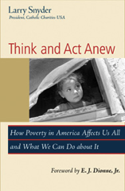
Bible Study, Small Groups

Slide 128
Service & Mission
local and global
“developmental” with increasing depth and scope:
introduction: several hours to a full day
short term: multi-day and local
weeklong and national mission trips
global expedition of one or more weeks

Slide 129
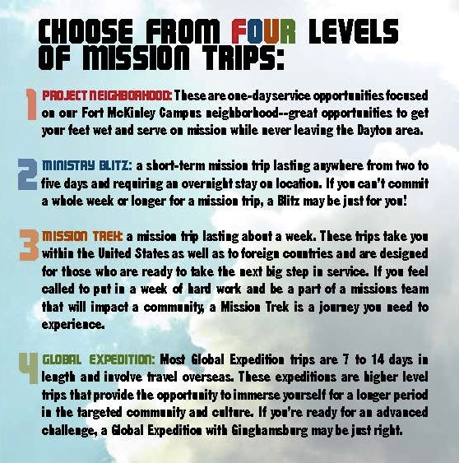

Slide 130
Third Place Faith Formation
Establish a Third Place gathering space in the community, that offers hospitality, builds relationships, hosts spiritual conversations, provides programs and activities, and nourishes the spiritual life of people.

Slide 131
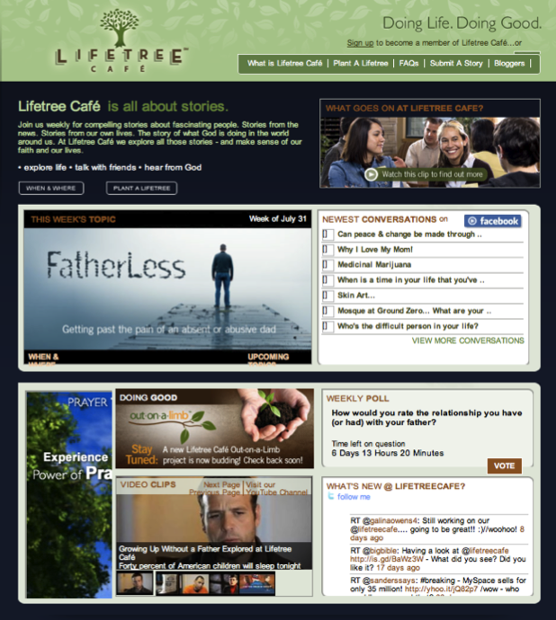

Slide 132
Example: Spiritual Seekers

Slide 133
Example: Spiritual Seekers
Introduction Dinner: Is there more to life than this?
Week 1: Who is Jesus?
Week 2: Why did Jesus die?
Week 3: How can we have faith?
Week 4: Why and how do I pray?
Week 5: Why and how should I read the Bible?
Week 6: How does God guide us?
Week 7: How can I resist evil?
Week 8: Why & how should we tell others?
Week 9: Does God heal today?
Week 10: What about the Church?
Weekend: Who is the Holy Spirit? What does the Holy Spirit do? How can I be filled with the Holy Spirit? How can I make the most of the rest of my life?

Slide 134
Example: Pathways
Our Lady of Soledad Catholic Parish
Mini-Retreat 101: “Catholics Alive!”
“What does it mean to be a follower of Christ?”
Mini-Retreat 201: “Alive and Growing Spiritually!”
maturing in the Catholic faith
Mini-Retreat 301: “Alive and Gifted!”
discerning how to serve God in ministry
Mini-Retreat 401: “Alive in the World!”
living as witnesses for Christ, as contagious Catholic Christians
Mini-Retreat 501: “Alive to Praise God!”
Catholic worship and the sacraments

Slide 135
Example: Pathways to a Deeper Faith
Spirituality: What’s the Buzz?
Who is Jesus?
Do We Need the Spirit?
Can I Accept God’s Mercy?
Can Mass Make My Life Meaningful?
The Church and Me

Slide 136
Apprenticeships in Discipleship
Apprenticeship Processes

Slide 137
Empowering the Community to Share their Faith

Slide 138
Empowering the Community to Share their Faith
Step One. Church Leader’s Study: Unbinding the Gospel
Step Two: All-Church Saturation Study: Unbinding Your Heart: 40 Days of Prayer & Faith Sharing.
six-week, church-wide, small group E-vent!
pray each day’s scripture and prayer exercise and work with a prayer partner
study a chapter of the book with their small group
worship with sermons, music, and prayers centered on the week’s chapter

Slide 139
Empowering the Community to Share their Faith
Step Three: An Experiment in Prayer and Community: Unbinding Your Soul.
a no-obligation experience of substantial spiritual discussion, prayer and community for people who aren’t connected with a church
church members invite their friends into a four-week small group experience with short study chapters, an individual prayer journal, prayer partner activities, and group exercises.

Slide 140
The Emerging Role of the Faith Formation Curator

Slide 141
Faith Formation Curator
Shifting from providing religious content and programming to curating religious content and experiences for all ages
A content curator is someone who continually finds, groups, organizes, and shares the best and most relevant content on a specific subject to match the needs of a specific audience.

Slide 142
Faith Formation Curator
What would you curate?
Congregational Programs & Activities
Community Programs & Activities
People Resources
Print Resources
Audio & Video Resources
Art, Drama, and Music Resources
Online Content: Websites, Courses, Blogs
Apps & Digital Resources

Slide 143
The Process of Curation
Research
Aggregate & Evaluate
Deliver
Communicate & Connect

Slide 144
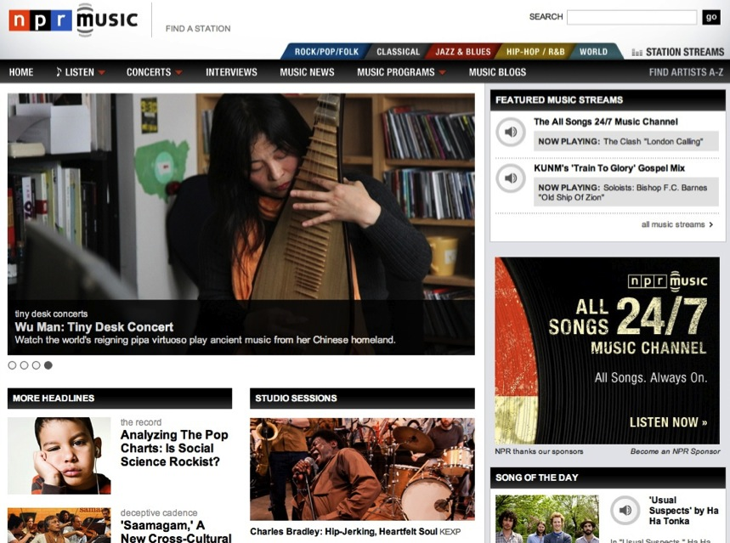

Slide 146
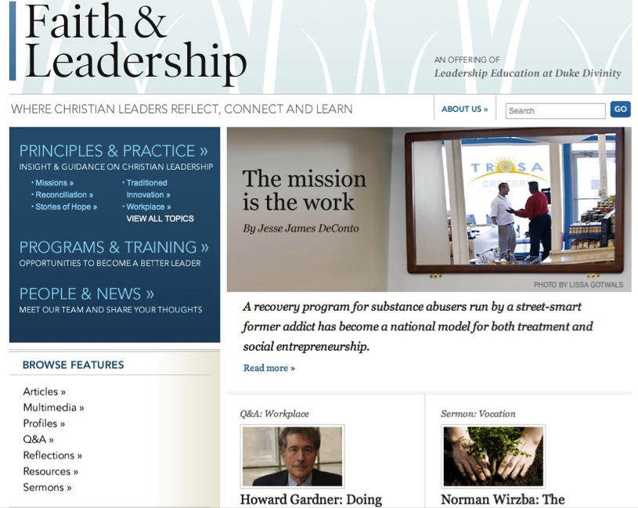

Slide 148
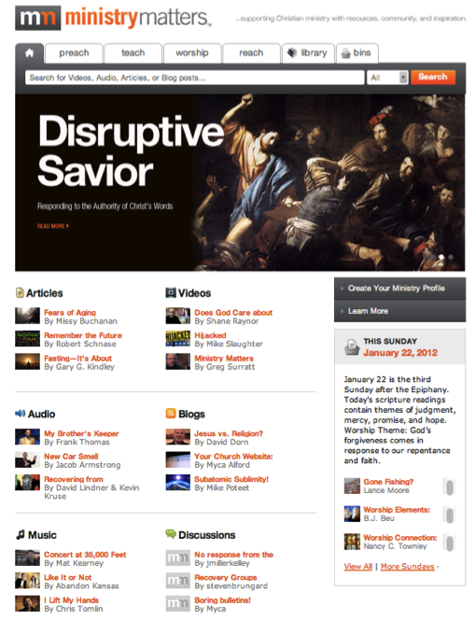

Slide 150
Design Process for an New Initiative
Select a Target Group (or need)
Research
(Empathize)
Defined Spiritual & Religious Needs, Concerns & Interests
Generate Ideas
Create Prototypes to Pilot
Test the Prototypes
Evaluate, Improve, & Expand the Innovation

