Slide 1
Faith Formation for the 21st Century
John Roberto
LifelongFaith Associates
www.lifelongfaith.com
jroberto@lifelongfaith.com jrlifelong@gmail.com

Slide 2
Topics
Significant driving forces influencing faith formation
Four scenarios for envisioning the future of faith formation in a congregation.
Application of the four scenarios to faith formation in a congregation
New role for faith formation leaders

Slide 3
Trends

Slide 4
The Changing Landscape
No Religious Affiliation
Declining Church Participation
Increasing Diversity & Pluralism
Changing Marriage & Family Life
The Rise of Digital Media & the Internet
Spiritual, not Religious
Declining Religious Socialization
Aging Baby Boomers

Slide 5
No Religious Affiliation
15% of all Americans claim no religious affiliation
25% of all 18-29 years

Slide 6
Spiritual but not Religious
Today, 18% of 18-39 year olds say that are “spiritual, but not religious” compared to only 11% a decade ago.

Slide 7
Participation in Churches
Declining worship attendance
Declining participation in celebration of sacraments & rites of passage

Slide 8
Diversity & Pluralism
Diversity of ethnic cultures & nationalities
No single authority exercises supremacy; no single belief or ideology dominations
Tapestry of religious and spiritual alternatives and choices

Slide 9
Family Life
Delaying marriage
Having fewer children and later in life
Decreasing number of children in two-parent households
Increasing number of unmarried couples living together

Slide 10
Family Religious Socialization
Parent Influence: The single most important social influence on the religious and spiritual lives of adolescents is their parents.
Embedded Family Religious Practices: Effective religious socialization comes about through specific religious activities that are firmly intertwined with the daily habits of family life

Slide 11
Family Socialization
The single most important influence on the religious and spiritual lives of children, teens, and emerging adults is their parents.
Faith
Parental Faith
Parental Modeling & Teaching
Prayer
Scripture Reading

Slide 12
Family Socialization
Children and teenagers “teenagers with seriously religious parents are more likely that those without such parents to have been trained in their lives to think, feel, believe, and act as serious religious believers, and that that training “sticks” with them even when the leave home and enter emerging adulthood”
(Souls in Transition: The Religious & Spiritual Lives of Emerging Adults by Christian Smith with Patricia Snell)

Slide 13
Baby Boomers
Every day for the next 19 years, about 10,000 Boomers will turn 65.
A new stage of life between adult midlife – typically focused on career and child-rearing – and old age, traditionally marked by increasing frailty and decline. This new stage (60s-70s) is characterized by generally good health, relative financial stability, and an active, engaged lifestyle.

Slide 14
Trends & Shifts
Increasing number of “Nones”
Increasing number of “Spiritual but not Religious”
Accepting and embracing diversity: culturally, sexually, and in family structures
Declining participation in Sunday worship and sacraments/rites of passage (marriage, baptism)
Living together, marrying later, and having children later
Declining levels of family faith practice & socialization

Slide 15
Generational Shifts
Significant Generational Change began in the early 1990s among the younger generations and is influencing society and the older generations
These trends are having a significant impact on a Life Cycle approach to faith formation and church life, in general.
fewer marriages – marrying later – fewer baptisms – fewer young families – lower Sunday worship attendance……..

Slide 16
Interpreting

Slide 17
4 Scenarios
Two Critical Uncertainties
Will trends in U.S. culture lead people to become more receptive to organized religion, and in particular Christianity or will trends lead people to become more resistant to organized religion and Christianity?
Will people’s hunger for and openness to God and the spiritual life increase over the next decade or will people’s hunger for and openness to God and the spiritual life decrease.

Slide 18
Faith Formation 2020 Matrix
Dominant Cultural Attitude toward Organized Religion
Receptive
Low High
People’s Hunger for God and the Spiritual Life
Resistant

Slide 19
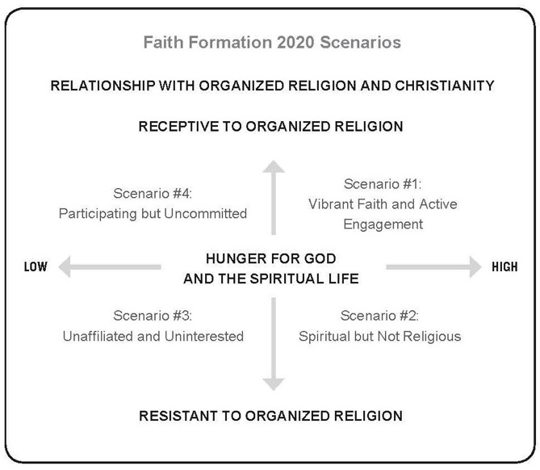
Four Scenarios for the Future

Slide 20
4 Scenarios for the Future
Scenario 3 Unaffiliated & Uninterested
Scenario 1 Vibrant Faith & Active Engagement
Scenario 4 Uncommitted & Participating
Scenario 2 Spiritual but Not Religious

Slide 21
Assessing
Viewed through the lens of the 4 Scenarios, who is being served by current faith formation programming?
Who is not?
Where are the greatest needs or gaps?
What are the priority areas for growth and improvement?

Slide 22
Scenario #4 + Marriage & FF + Baptism & FF + Family faith formation in the 1st decade of life + Milestones faith formation + Pathways to deepen faith & engagement | Scenario #1 + Millennial Generation + Marriage & FF + Baptism & FF + Baby Boomers FF + Empowering people to share their faith
Scenario #3 + Third Place settings + Family life center + Events (movie nights, concerts, festivals) + Community-based ministry (service, recovery ministry) | Scenario #2 + Third Place settings + Targeting 20-30 year olds + Service: local - global + Spiritual formation + Pathways to deepen faith & engagement

Slide 23
Changing

Slide 24
The Challenge of Adaptive Change
“The significant problems we face today cannot be solved at the same level of thinking we were at when we created them.”
Albert Einstein

Slide 25
Technical Problems
Technical problems (even though they may be complex) can be solved with knowledge and procedures already in hand.
Leadership would be an easy and safe undertaking if organizations and communities only faced problems for which they already knew the solutions. Everyday, people have problems for which they do, in fact, have the necessary know-how and procedures—technical problems.

Slide 26
Adaptive Challenges
Adaptive challenges require experiments, new discoveries, and adjustments from numerous places in the organization.
Without learning new ways—changing attitudes, values, and deep-seated behaviors—people cannot make the adaptive leap necessary to thrive in the new environment. Adaptive challenges call for changes of heart and mind—the transformation of long-standing habits and deeply held assumptions and values.
Leadership is “the activity of mobilizing people to tackle the toughest problems and do the adaptive work necessary to achieve progress.”
(Ronald Heifetz and Martin Linsky)

Slide 27
Emerging

Slide 28
21st Century Faith Formation
What could a 21st century approach to faith formation look like?
How would we address the diversity of people’s religious and spiritual needs today?
How would we engage people? How would we reach people?
What technologies would we use?
What resources would we access?

Slide 29
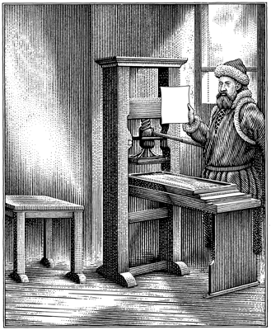
The Printing Press Johannes Gutenberg

Slide 30
The First Book

Slide 31
The New “Book”

Slide 34
4 Scenarios
Scenario 3 Unaffiliated & Uninterested
Scenario 1 Vibrant Faith & Active Engagement
Scenario 4 Uncommitted & Participating
Scenario 2 Spiritual but Not Religious

Slide 35
Significant Shift
Shifting from. . .
“One Size Fits All” Curriculum & Programming
to
A Network of Personalized & Customized Faith Formation Activities & Resources
focusing on addressing people’s spiritual and religious growth by offering a wide variety of religious content and experiences
“Differentiated Faith Formation”

Slide 36
Features
Address the diverse spiritual and religious needs with a variety of content, programs, activities, and resources.
Guide individuals and families in discerning their spiritual and religious needs and creating personal plans for faith growth and learning.

Slide 37
A Process for a Developing a Personalized Faith Growth Plan
Assessing Spiritual Growth
Working with a Mentor/Guide
Finding Resources on the Network
Engaging in Formation
Sharing with the Community
Reflecting on Growth and Identifying New Needs

Slide 39
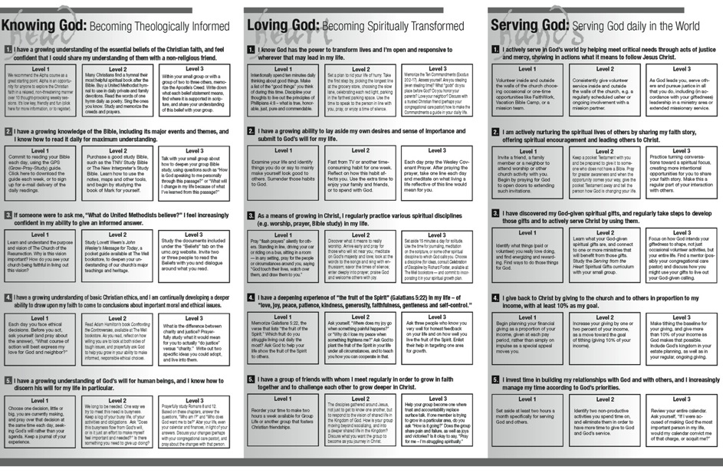

Slide 40
Features
Utilize a variety of faith formation models to address the diverse life tasks, religious and spiritual needs, and interests of people:
on your own
at home
in small groups
in large groups
in the congregation
in the community and world

Slide 41
Faith Formation Models
Face-to-Face & Virtual
On Your Own
Small Group
Large Group
Mentored
Church Community
Community & World
@Home

Slide 42
Faith Formation Models
Face-to-Face
Virtual
On Your Own
Mentored
At Home
In Small Group
In Large Group
In Church
In Community & World
Activity
Activity
Activity
Spiritual & Religious Needs
Topics or Themes

Slide 43
A Network Approach
Faith Formation Network
Church Programs
Small Groups & Support Groups
Mentors
Social Media for Connection
User-Generated Content
Community Programs
Online Courses & Activities
Online Resources: Print, Audio, Video
Apps
Blogs
Video Conference

Slide 44
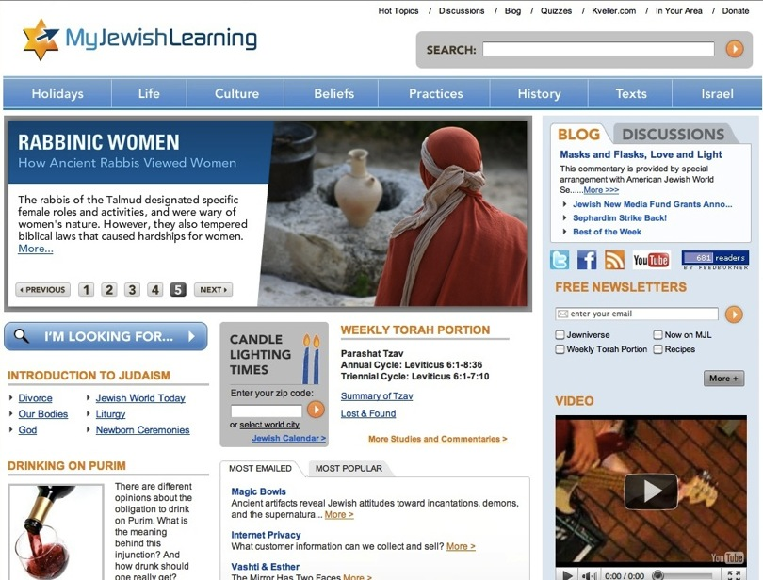

Slide 45
Extend Worship into Everyday Life
Sunday Worship
Share It Blog/Forum After Mass In Programs Family Conversation Activity
Live It Living the Message Daily Living Christian Practices Service Ideas for the Week
Study It Taking Faith Home Insert Homily Video + Study Guide Daily Readings Scripture Commentaries Online Bible Study
Pray It Weekly Table Prayer Praying with the Saints AM & PM Prayer

Slide 46
Transform a “One-Size-Fits-All Faith” into a Variety of Faith Formation Formats
Confirmation Content & Experiences
Option 1. Church Program (current model)
Option 2. Small Group Program
Option 2. Online Small Group Program using Skype
Option 3. Mentored
Option 4. Online Program (print & video) with Regular Check-in
Online Projects (everyone)
Social Networking Space for a Blog, Project Sharing, etc.

Slide 47
Process
Faith Formation Before Marriage
Preparation for and Celebration of Marriage
Faith Formation After Celebration of Marriage

Slide 48
Discernment
Faith Formation
S1 Faith Growth Plan
S2 Faith Growth Plan
Mentors
Marriage Preparation
S3 Faith Growth Plan
Support Groups
Parish Website
Couples before Marriage

Slide 49
Marriage
Mentors
Prayer, Rituals, Bible Reading, Service, Faith Conversations
Faith Practices
Continuing Formation
Support Groups
Quarterly Couple Gatherings
Married Life Tasks & Issues
Courses, Workshops, Online Resources
Theology, Scripture, Spirituality
Newly Married Couples

Slide 50
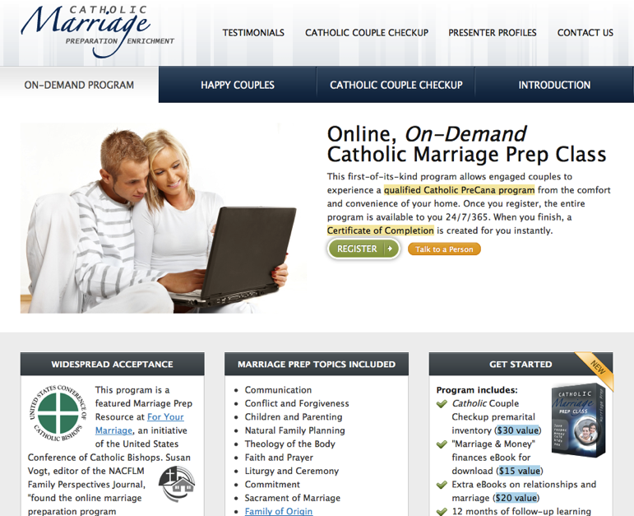

Slide 51
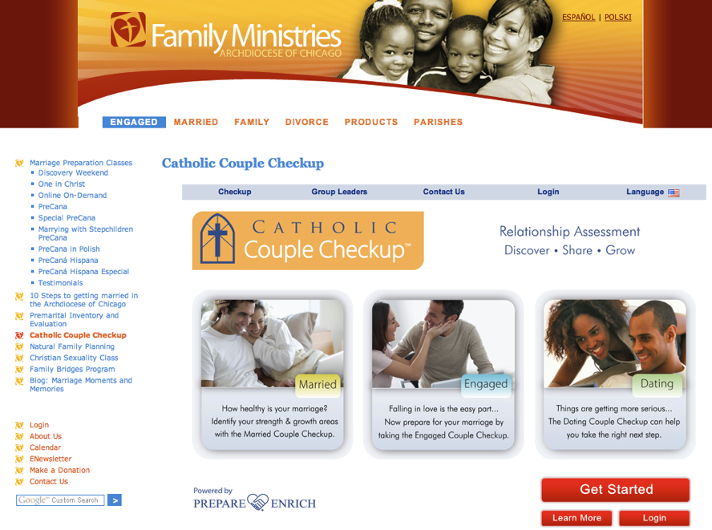

Slide 52
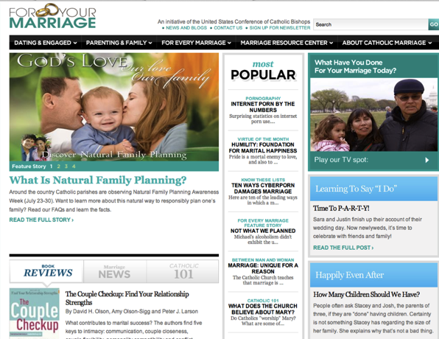
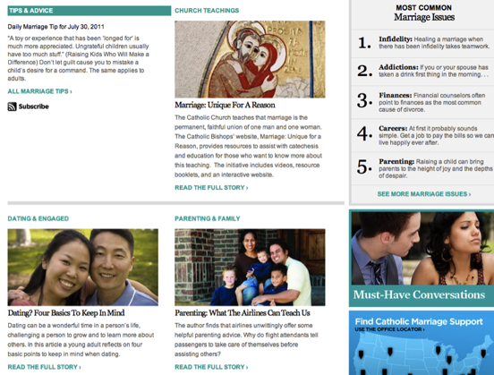
For Your Marriage

Slide 53
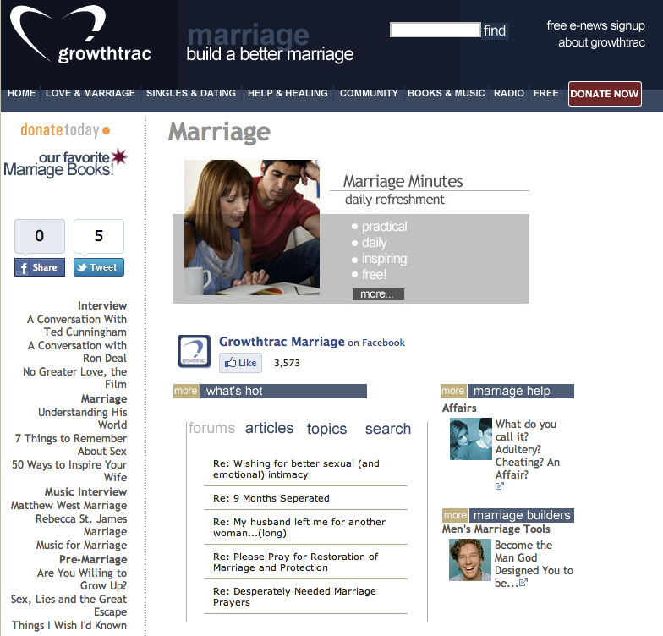

Slide 55
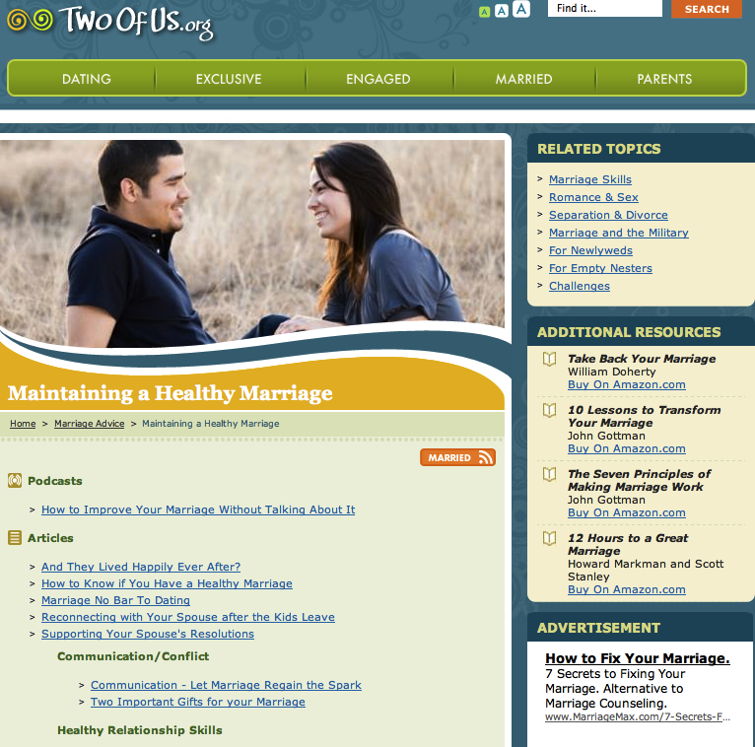

Slide 56
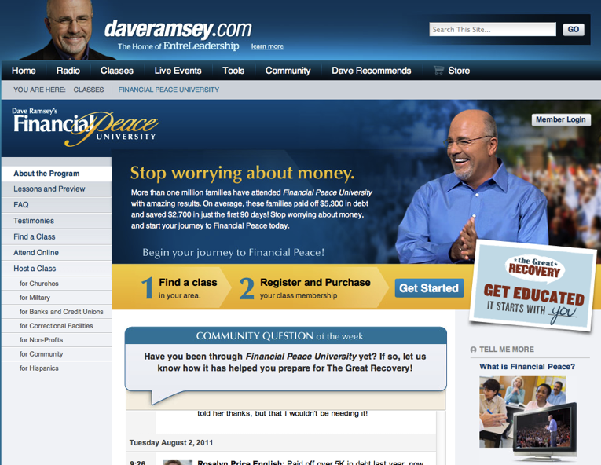

Slide 57
Process
Faith Formation Before Baptism
Preparation for and Celebration of Baptism
Faith Formation After Celebration of Baptism

Slide 58
Families in the First Decade of Life
Discernment
Parent Faith Growth Plans: S1, S2, S3, S4 Family Faith Growth Plans: S1, S2, S3, S4
Mentors
On Your Own At Home Small Group Large Group In Church In Community
Online Resource Center

Slide 59
Baptism
Mentors
Prayer, Rituals, Bible, Family Conversation, Service
Parent Faith Formation & Parenting Skills
Milestones
Faith Practices @ Home
Workshops Courses Online Resources Support Groups
Family Learning Programs
Baptism Anniversary, First Prayers, Start of School
Church Gatherings Small Groups Workshops
Parent/Family Online Resource Center
Families in the First Decade of Life

Slide 61
Milestones (Faith Stepping Stones)
Stone 1: Raising a Healthy Baby
physical, emotional and spiritual needs of infants and their parents; nightly blessing as a family faith practice.
Stone 2: Raising a Healthy Preschooler
physical, emotional and spiritual needs of preschoolers and their parents; add prayer to the nightly blessing as a faith practice

Slide 62
Milestones (Faith Stepping Stones)
Stone 3: Entry Into School
physical, emotional and spiritual needs of kindergarteners and their parents; share highs & lows with children and add it to their nightly prayers and blessing
Stone 4: My Bible
120 key verses in young readers’ Bibles; reading a Bible verse nightly, continue with highs & lows, prayer and blessing nightly

Slide 63
Faith Stepping Stones
Stone 5: Livin’ Forgiven
Passover to Lord’s Supper, with nightly confession and absolution added to the faith practices of Bible reading, highs & lows, prayer and blessing
Stone 6: Surviving Adolescence
theological reflection (i.e. setting the Bible verse and the highs & lows of the day together to ask “What is God saying to us today?”), adding to confession/ absolution, Bible reading, highs & lows, prayer and blessing continue

Slide 64
Faith Stepping Stones
Stone 7: Confirmation As Ordination
youth and parents look at their confession, their confirmation, and their call.
Stone 8: Graduation Blessing
seniors and their parents look back God’s blessings, look to the moment, and look to the future of their new callings

Slide 66
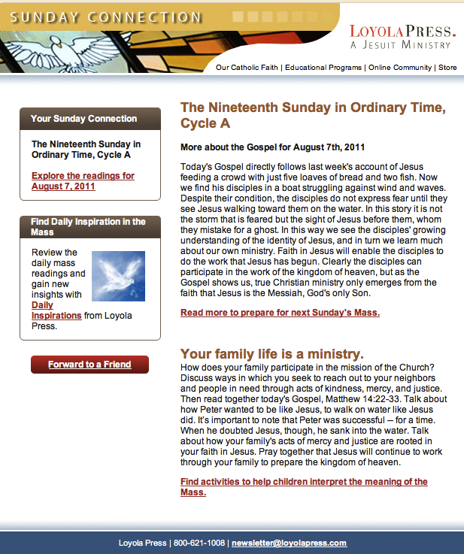

Slide 67
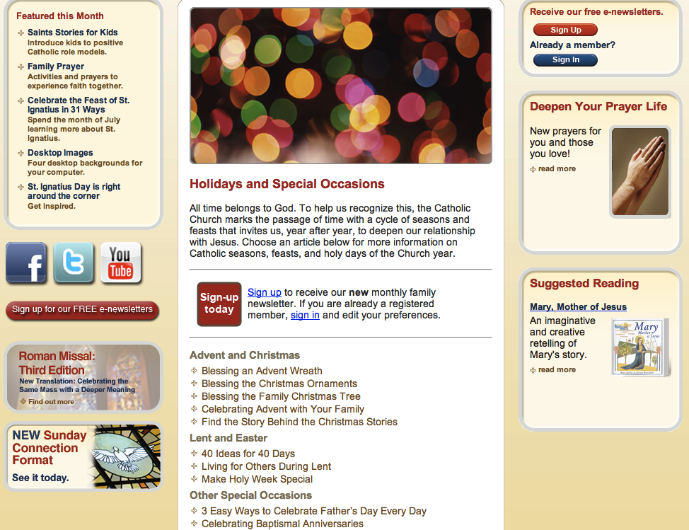

Slide 68
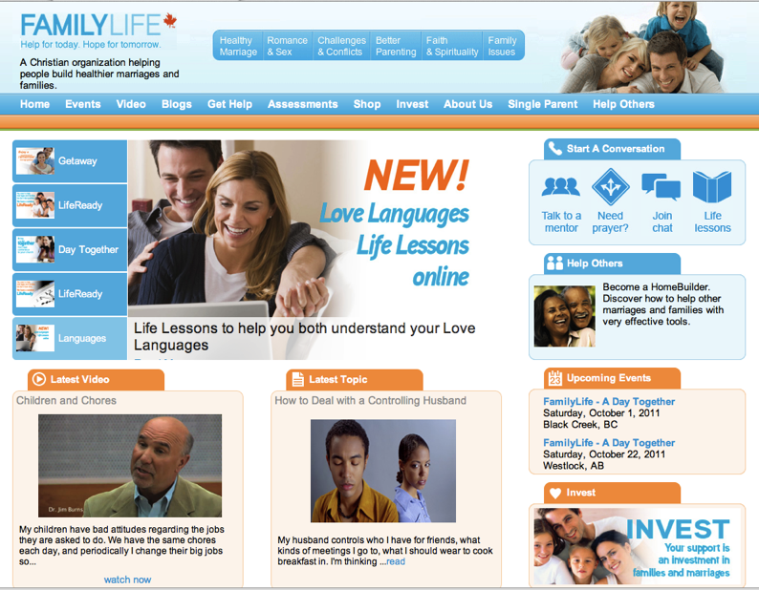

Slide 69
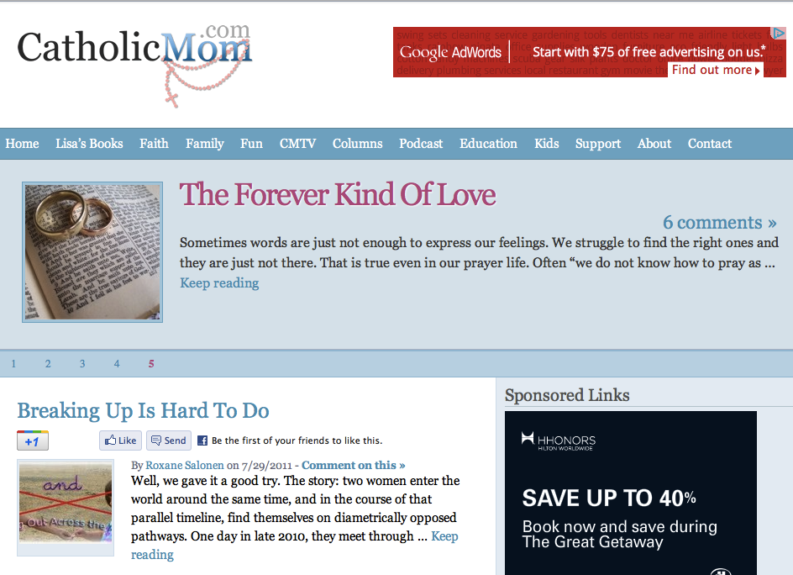

Slide 70
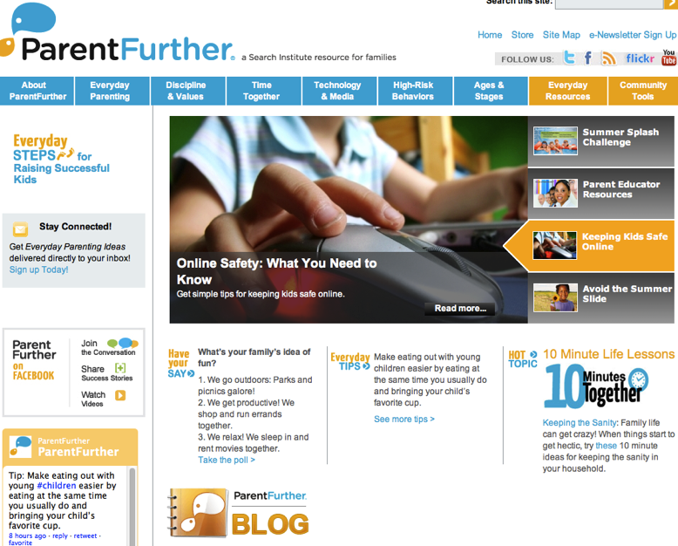

Slide 71
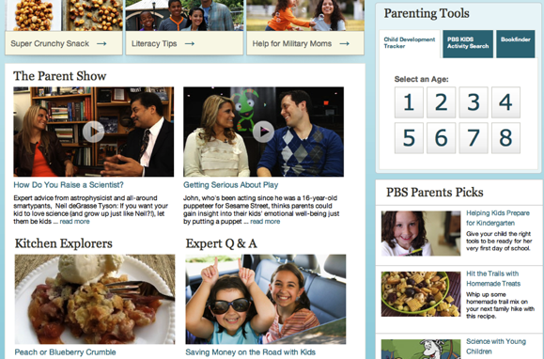

Slide 72
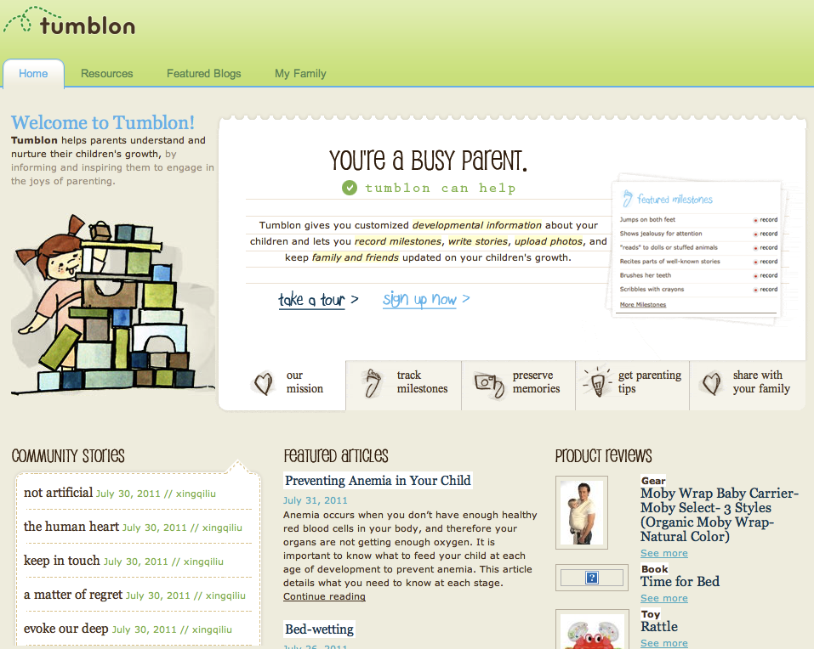

Slide 73
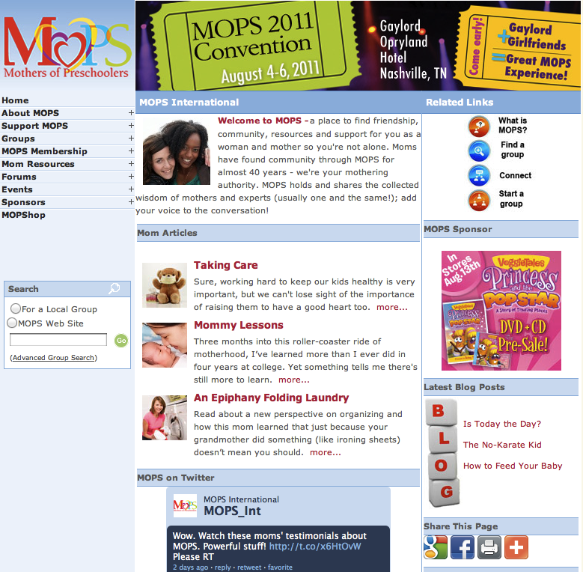

Slide 74
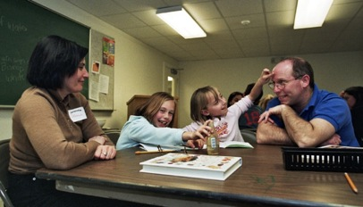
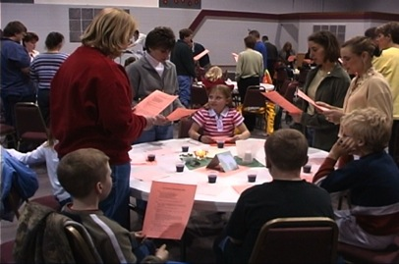
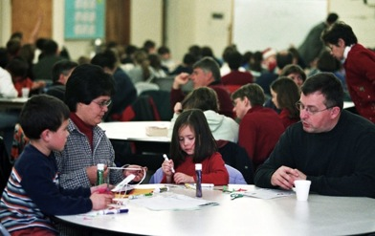
Family Faith Formation

Slide 75
Family Faith Formation
Meal and Community Building (30 minutes)
Part 1. Gathering and Prayer (10-15)
Part 2. All Ages Learning Experience (20-30)
Part 3. In-Depth Learning Experience (75-90)
Option 1. Whole Group (together)
Option 2. Age Group (parallel)
Option 3. Activity Center
Part 4. Sharing Learning Experiences and Home Application (15-20)
Part 5. Closing Prayer (5-10)

Slide 77
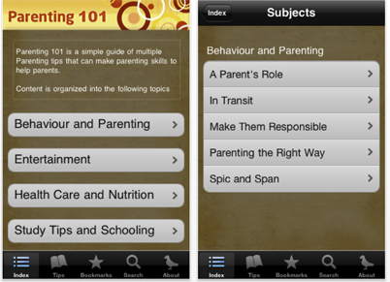
Apps

Slide 78
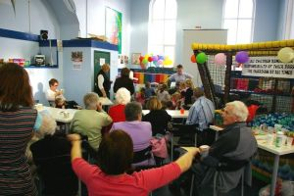
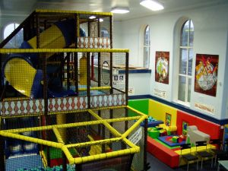
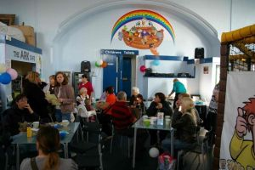
The Wesley Playhouse
Family Life Center

Slide 79
Comprehensive Adult Faith Formation
Adult Faith Formation
Online Courses
Audio & Video Programs
Books & Book Clubs
Life Transitions
Prayer & Spiritual Practices
Justice & Service
Small Group Studies
Life Tasks & Issues
Extended Learning Programs
Faith in Art Tours

Slide 80
iTunes U

Slide 81
Online Courses

Slide 82
Spiritual Formation
Lectio Divina
Scripture Reflection
Spiritual Reading
Contemplation
Praying with Art and Music
Fixed-hour Prayer
The Examen
Sabbath
Discernment
Fasting
Prayer Styles & Traditions

Slide 83
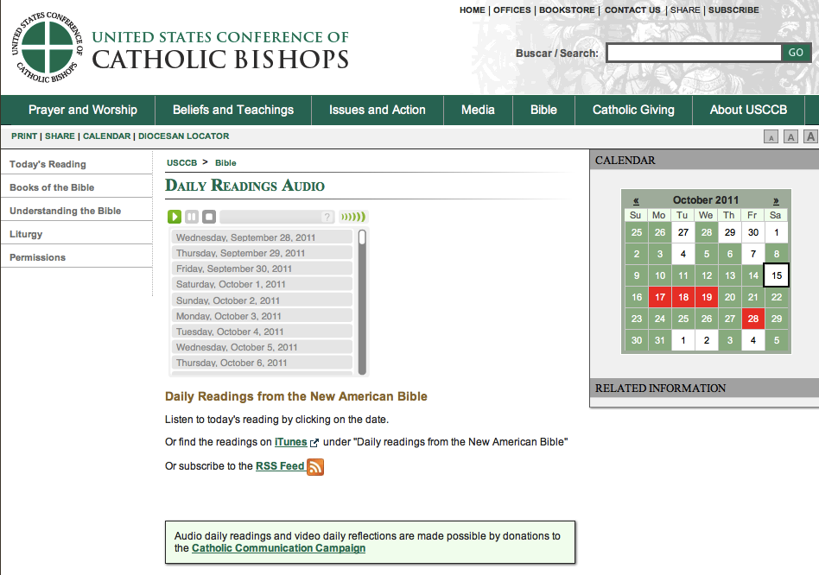

Slide 84
American Bible Society

Slide 85
Sunday Connection
Loyola Press

Slide 87
YouVersion Bible App

Slide 88
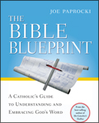
Bible Study, Small Groups

Slide 89
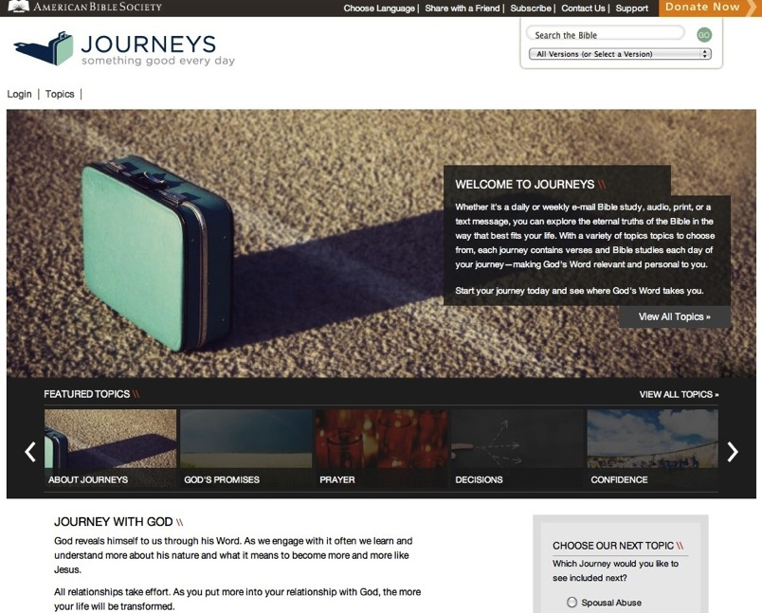

Slide 93
Service & Mission
local and global
“developmental” with increasing depth and scope:
introduction: several hours to a full day
short term: multi-day and local
weeklong and national mission trips
global expedition of one or more weeks

Slide 94
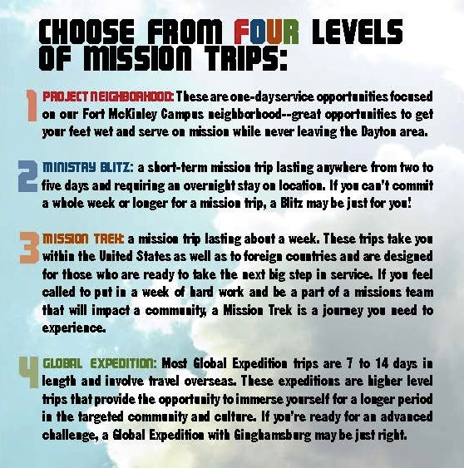

Slide 95
Third Place Faith Formation
Establish a Third Place gathering space in the community, that offers hospitality, builds relationships, hosts spiritual conversations, provides programs and activities, and nourishes the spiritual life of people.

Slide 96
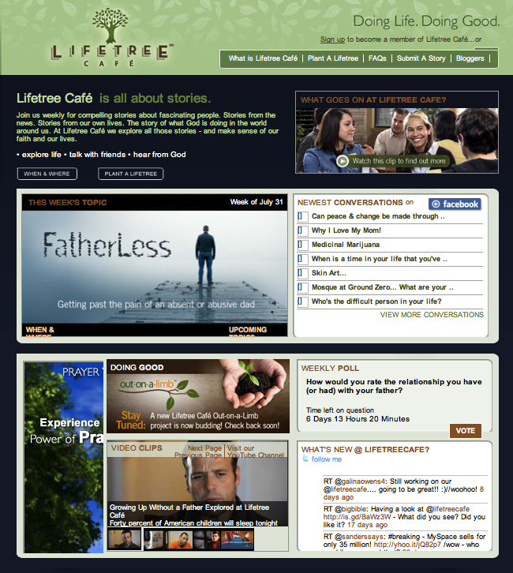

Slide 97
Example: Spiritual Seekers

Slide 98
Example: Spiritual Seekers
Introduction Dinner: Is there more to life than this?
Week 1: Who is Jesus?
Week 2: Why did Jesus die?
Week 3: How can we have faith?
Week 4: Why and how do I pray?
Week 5: Why and how should I read the Bible?
Week 6: How does God guide us?
Week 7: How can I resist evil?
Week 8: Why & how should we tell others?
Week 9: Does God heal today?
Week 10: What about the Church?
Weekend: Who is the Holy Spirit? What does the Holy Spirit do? How can I be filled with the Holy Spirit? How can I make the most of the rest of my life?

Slide 99
Example: Pathways
Our Lady of Soledad Catholic Parish
Mini-Retreat 101: “Catholics Alive!”
“What does it mean to be a follower of Christ?”
Mini-Retreat 201: “Alive and Growing Spiritually!”
maturing in the Catholic faith
Mini-Retreat 301: “Alive and Gifted!”
discerning how to serve God in ministry
Mini-Retreat 401: “Alive in the World!”
living as witnesses for Christ, as contagious Catholic Christians
Mini-Retreat 501: “Alive to Praise God!”
Catholic worship and the sacraments

Slide 100
Example: Pathways to a Deeper Faith
Spirituality: What’s the Buzz?
Who is Jesus?
Do We Need the Spirit?
Can I Accept God’s Mercy?
Can Mass Make My Life Meaningful?
The Church and Me

Slide 101
Apprenticeships in Discipleship
Apprenticeship Processes

Slide 102
Empowering the Community to Share their Faith

Slide 103
Empowering the Community to Share their Faith
Step One. Church Leader’s Study: Unbinding the Gospel
Step Two: All-Church Saturation Study: Unbinding Your Heart: 40 Days of Prayer & Faith Sharing.
six-week, church-wide, small group E-vent!
pray each day’s scripture and prayer exercise and work with a prayer partner
study a chapter of the book with their small group
worship with sermons, music, and prayers centered on the week’s chapter

Slide 104
Empowering the Community to Share their Faith
Step Three: An Experiment in Prayer and Community: Unbinding Your Soul.
a no-obligation experience of substantial spiritual discussion, prayer and community for people who aren’t connected with a church
church members invite their friends into a four-week small group experience with short study chapters, an individual prayer journal, prayer partner activities, and group exercises.

Slide 105
Illustrations of a Network Approach

Slide 106
Faith Formation with Young Adults
Young Adult Faith Formation
Life Issues Workshops & Online Resources
Prayer & Spiritual Practices (online, small groups, retreats)
Third Place Café
Small Group Studies
Weekly Gathering & Worship
Justice & Service Projects (local and global)
Alpha Course
Cross-generational Experiences (worship, service, mentoring)
Social Network & Blog
Online Courses
Online Audio & Video Programs

Slide 107
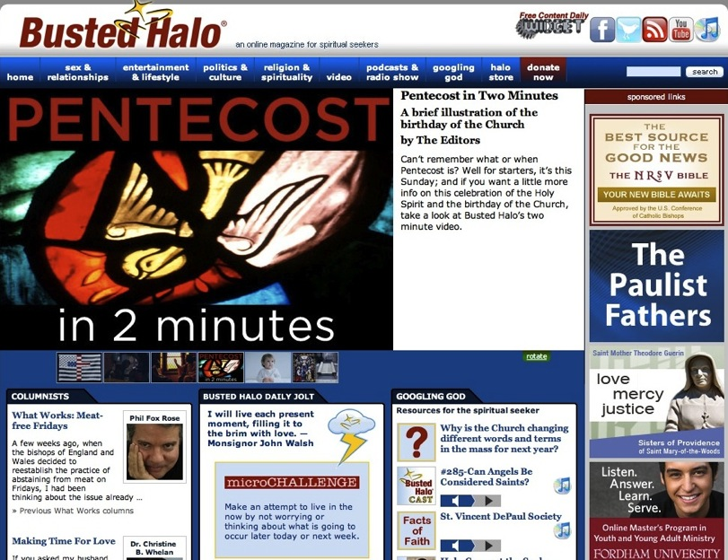

Slide 108
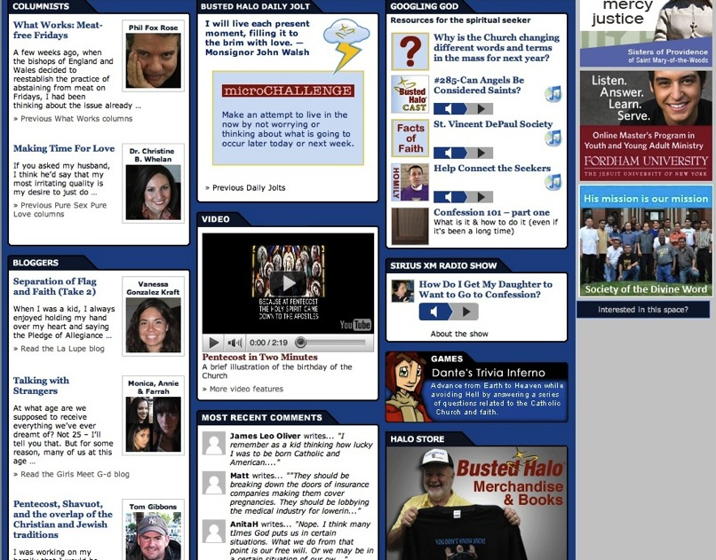

Slide 109
Offer Faith Formation on One Theme in a Variety of Formats
Whole Church Theme
On Your Own (Print, Audio, Video, Online Resources & Courses)
Family @Home (Online Resources)
Small Group Course (online & physical settings)
Adult 4-Week Lecture Series @ Church
(Videotaped & online)
Age Group Programs: Children & Youth

Slide 110
Extend Monthly Family or Intergenerational Faith Formation throughout the Month
Monthly Gathering
Talk About It: Conversation Questions
Learn More: Watch a Video, Listen to a Talk, Read an Article
Live It: Action Project for the Month
Pray: Prayers for the Month, Table Prayers on the Theme
Children Center: Projects, Activities, and Stories
Parents Center: How-to helps (video, audio, print)
Share What Your Learning: Write a Blog Entry, Create & Share a Video or Project

Slide 111
The Emerging Role of the Faith Formation Curator

Slide 112
Faith Formation Curator
Shifting from providing religious content and programming to curating religious content and experiences for all ages
A content curator is someone who continually finds, groups, organizes, and shares the best and most relevant content on a specific subject to match the needs of a specific audience.

Slide 113
Faith Formation Curator
What would you curate?
Congregational Programs & Activities
Community Programs & Activities
People Resources
Print Resources
Audio & Video Resources
Art, Drama, and Music Resources
Online Content: Websites, Courses, Blogs
Apps & Digital Resources

Slide 114
The Process of Curation
Research
Aggregate & Evaluate
Deliver
Communicate & Connect

Slide 115
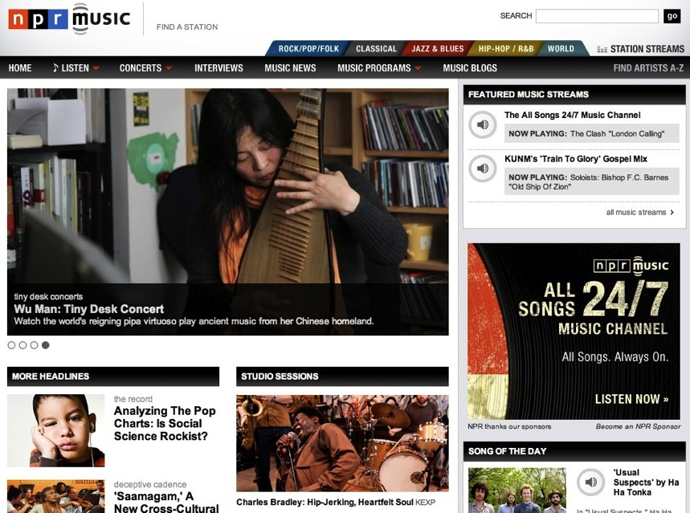

Slide 116
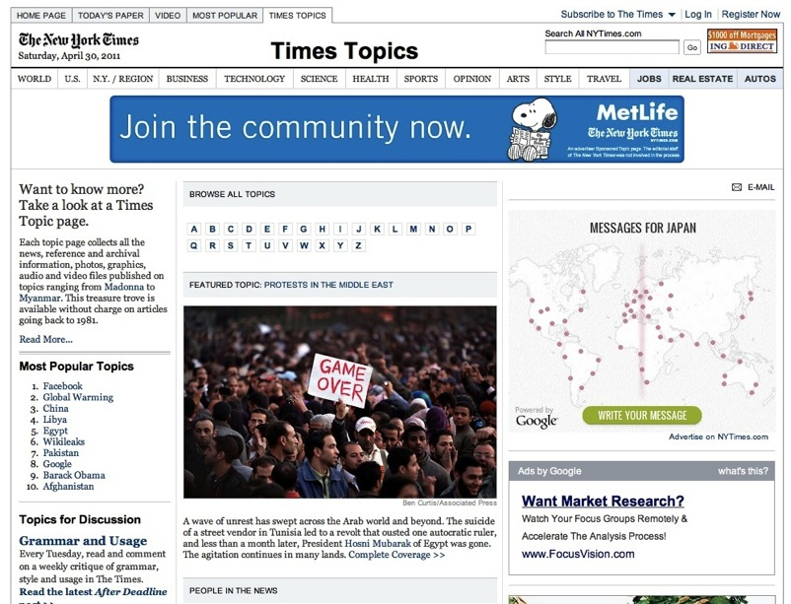

Slide 117
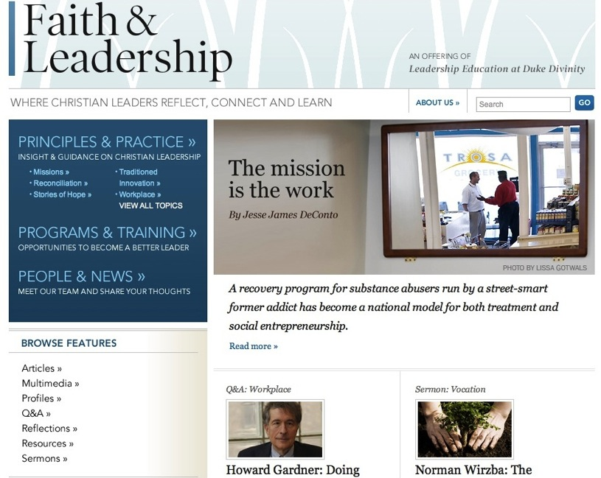

Slide 118
Designing Innovations

Slide 119
Design Process for an New Initiative
Select a Need or Target Group
Consult Strategies
Generate Ideas
Evaluate Ideas
Design an Implementation Plan
Pilot the Innovation
Scale-Up the Innovation

Slide 120
Designing a New Initiative
Step 1. Select a priority need.
Step 2. Consult the Faith Formation 2020 Strategies.
Step 3. Generate creative ideas.
Step 4. Evaluate the ideas.
Step 5. Design an implementation plan.
Step 5. Implement the initiative through small scale prototyping.
Step 6. Implement the initiative through small scale prototyping.
Step 7. Implement the initiative with a wider audience and continue evaluation and improvements.

Slide 121
Design Process
Step 1. Select a priority need.
Step 2. Consult the Faith Formation 2020 strategies & consult the resources you have available: people, parish, organizations, the community, print and media, online, etc.
Step 3. Generate creative ideas.
Step 4. Evaluate the ideas.

Slide 122
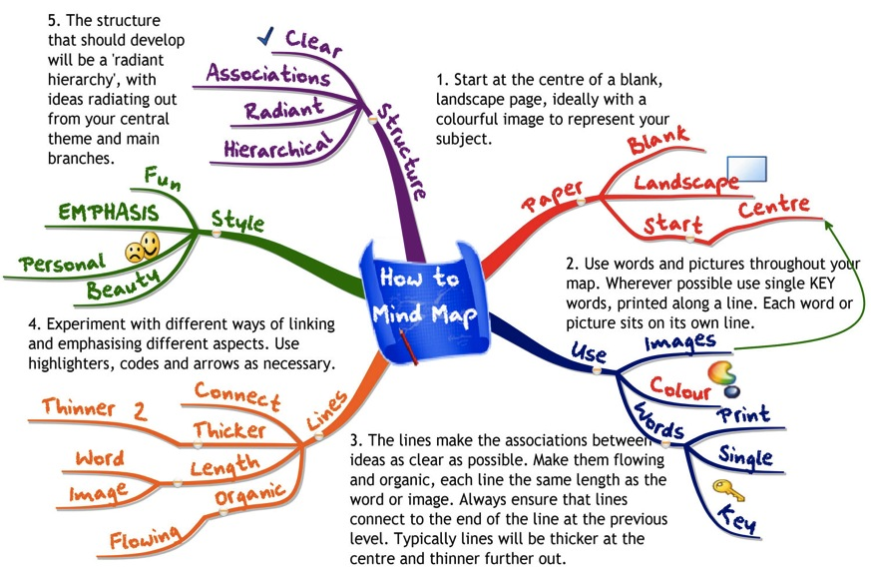
Generating Ideas

Slide 123
Design Process
Step 5. Design an implementation plan.
How many of the six faith formation models will be utilized?
What are the dates and times?
What is the location: physical/facility and/or online/website?
What are the implementation steps and target dates (timeline) for completing each step.
What resources will you need to implement the initiative.
How much will the initiative cost?
How many leaders will you need to implement the initiative, how you will find them, and how you will prepare them?

Slide 124
Design Process
Step 6. Implement the initiative through small scale prototyping.
Step 7. Implement the initiative with a wider audience and continue evaluation and improvements.
Develop an online faith formation center for connecting people to each other and to the resources of the Lifelong Faith Formation Network.

Slide 125
Parish Website: Planning Checklist
Who is the audience?
Planning—visit other sites.
Reflect on what you are: what are your core values and how do you want to say that?
Define a reasonable scope and get buy-in from stake-holders in the congregation.
Do an easy survey of your audience—what are they looking for, what do they expect?
Decide on the types of content to include (+ graphics).
Map out your basic navigation (7 buckets is about all a person can digest).
Pick the technology or platform.
Create the design.
Build your content .
Release the site.

