Slide 1
EMBRACE FAITH
NCCL 2012
Faith Formation in the 21st Century

Slide 2

America’s
religious landscape

Slide 3
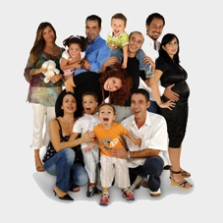
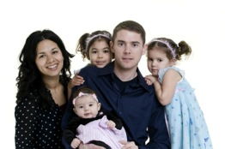

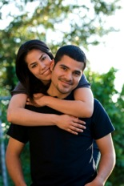
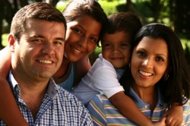


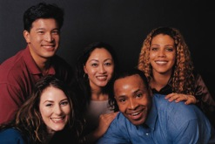

Generational Change

Slide 4
Generational Change
Increasing number of “Nones” – no religious affiliation
Increasing number of “Spiritual but not Religious”
Embracing diversity – cultural, ethnic, sexual
Changing families: growing diversity in family structures; marrying later and having children later; not marrying and having children
Declining participation in Sunday worship and sacraments (marriage, baptism)
Declining levels of family faith practice & socialization

Slide 5
Generational change
Significant Generational Change began in the early 1990s among the younger generations and is influencing society and the older generations.
These trends are having a significant impact on a Life Cycle approach to faith formation and church life, in general.

Slide 6
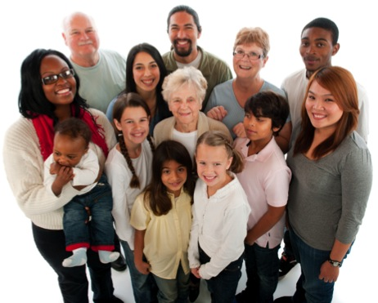
Diversity in the
Church community
Generational
Developmental
Ethnic & Cultural
Family Structures
Faith Practice &
Community
Engagement
Religious & Spiritual Needs

Slide 7
Developmental & Generational Diversity
Developmental
Children
Adolescents
Emerging Adults
Young Adults
Mid-Life Adults
Mature Adults
Older Adults
Generational
iGeneration
Millennials
Generation X
Baby Boomers
Builders

Slide 8
Diversity in Faith Practice & Religiosity
Not Religiously Affiliated
Spiritual but Not Religious
Minimal Engagement with Faith and Community
Vibrant Faith
& Active Engagement

Slide 9









While at the same time. . . .
New Technologies Emerge

Slide 10
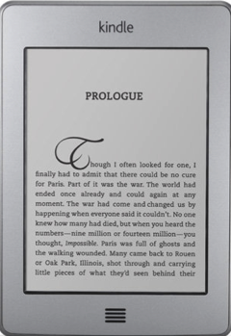
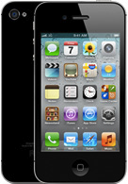
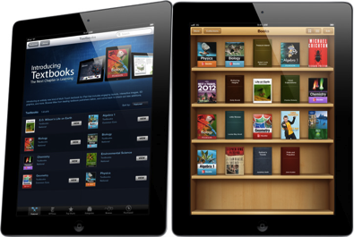

While at the same time. . . .
New Technologies Emerge

Slide 11
While at the same time. . . . adoption of new technologies
66%

Slide 12
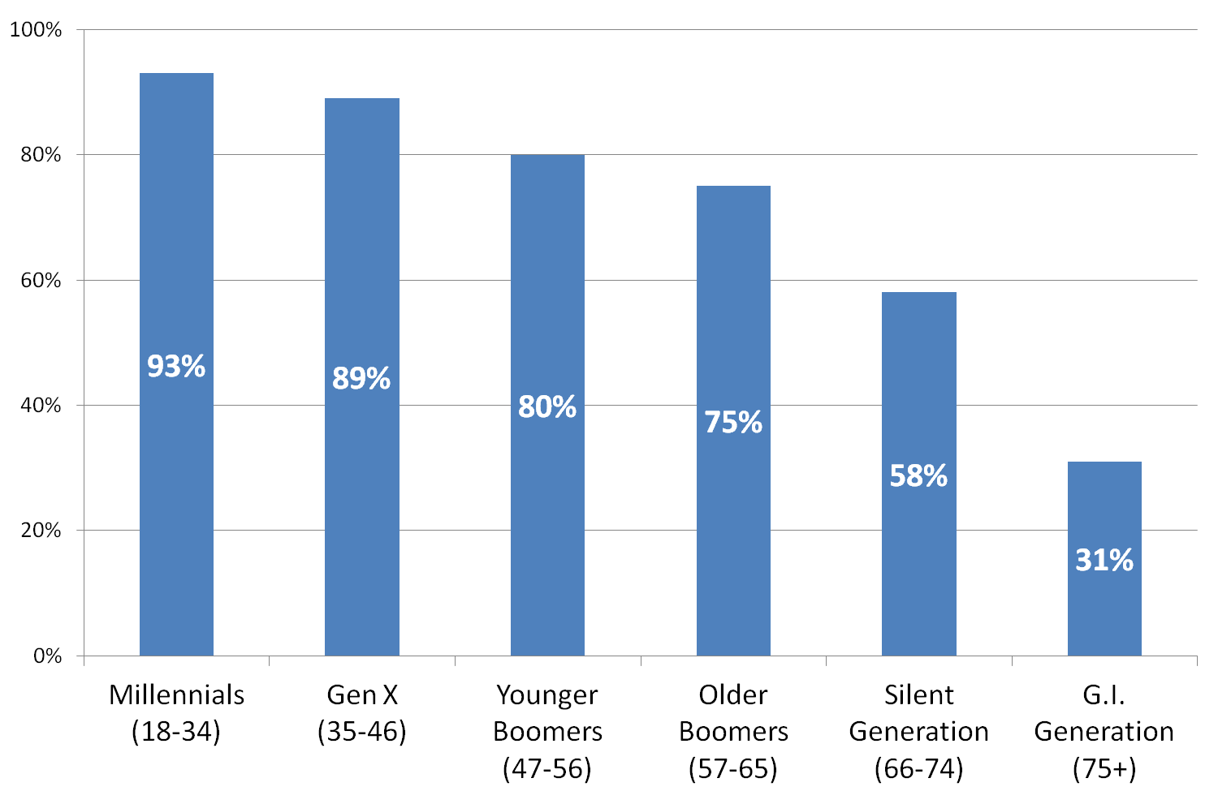
Increase in Internet users – 80%

Slide 13
Increase in Social networking – 52% of Adults
% of internet users

Slide 14
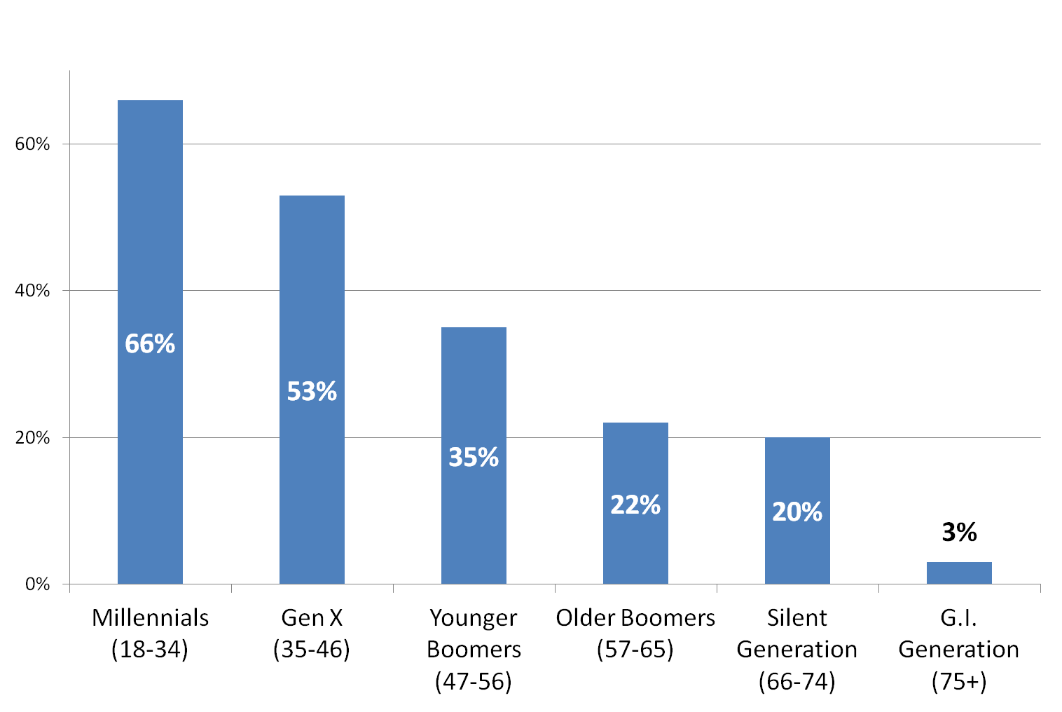
INCREASE IN Smartphones – 46%

Slide 15
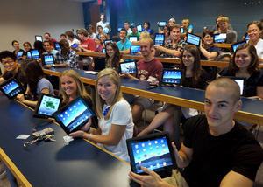
INCREASE IN Tablets
67 million iPads sold since 2010 when it was introduced.
Prediction: 665 million tablets by 2016
2012: 120 million tablets – a 100% increase over 2011.

Slide 16
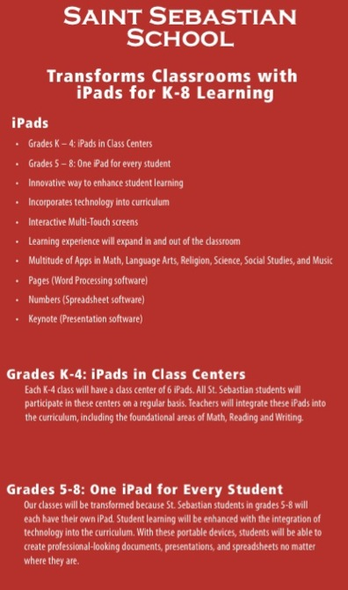
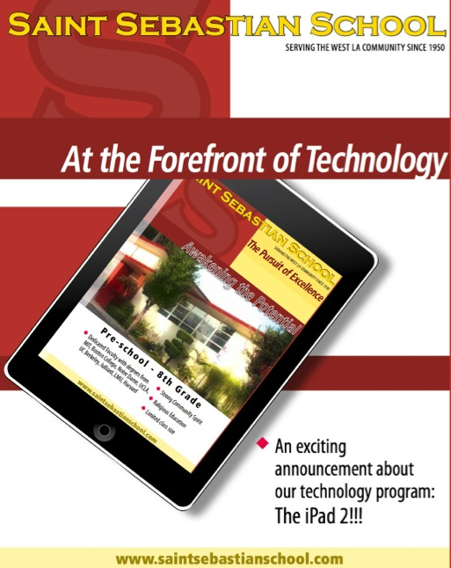

Slide 17
While at the same time. . . .
New Digital Resources

Slide 18
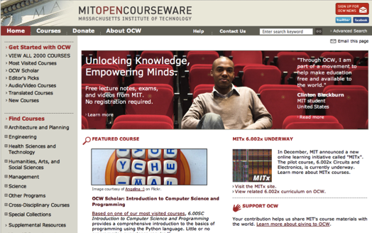
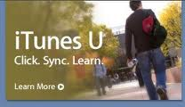

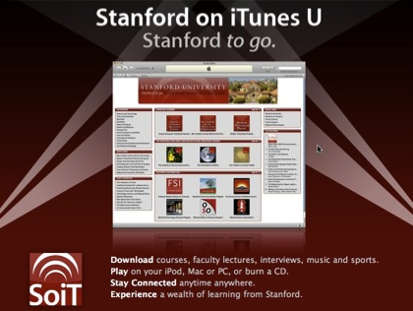

Slide 19
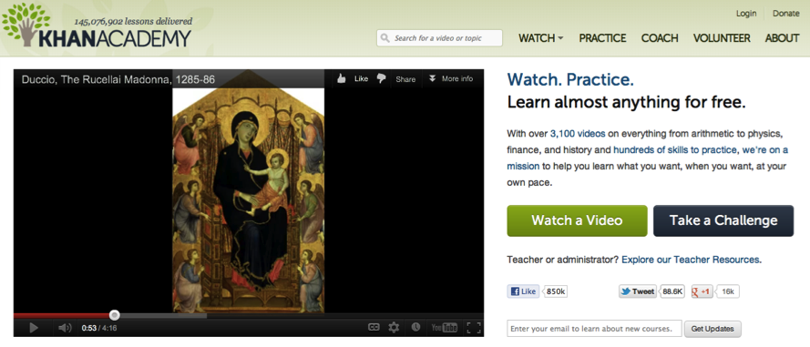
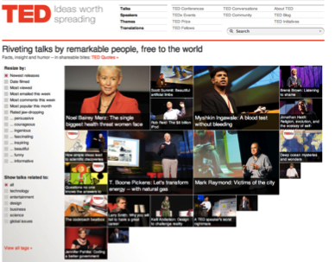
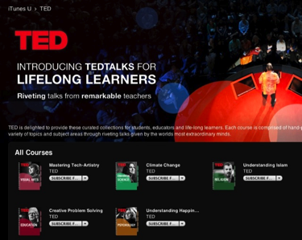

Slide 20
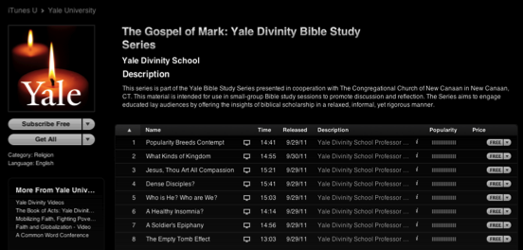
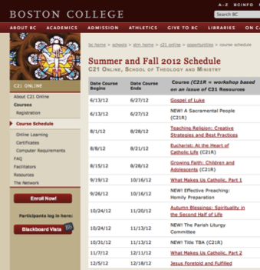

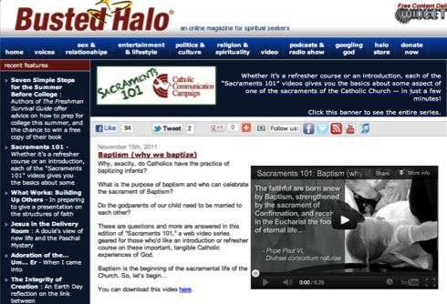



Slide 21
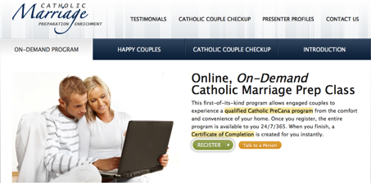
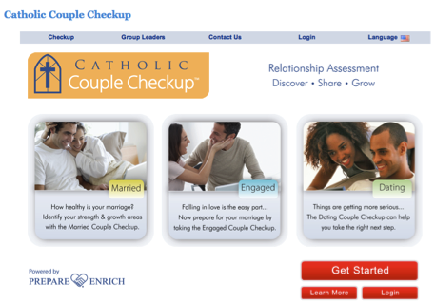

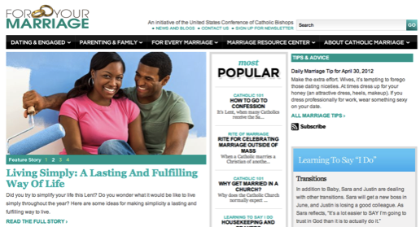

Slide 22
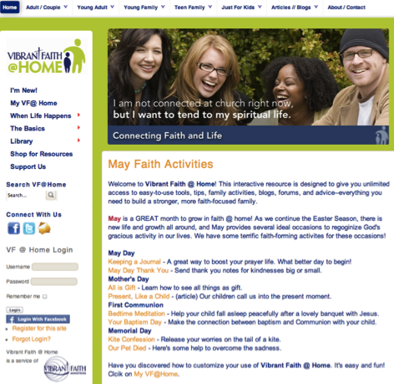
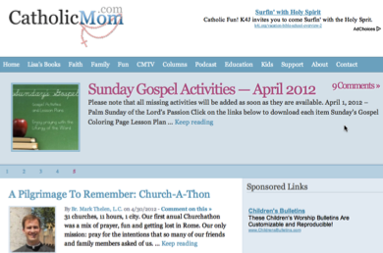
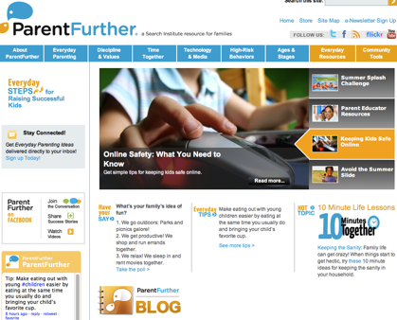
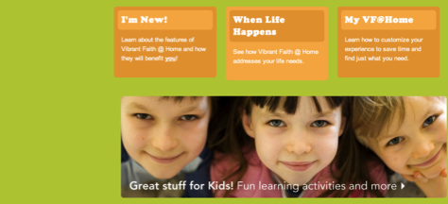

Slide 23


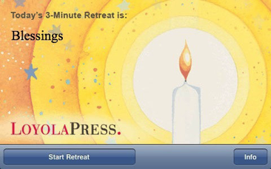
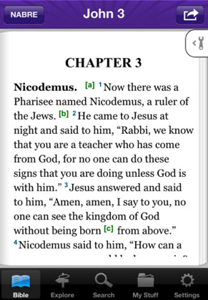
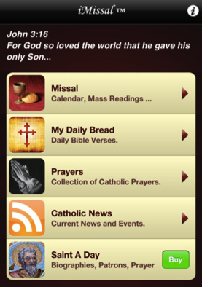


Slide 24
Fascinating convergence
21st Century Faith Formation
Growing Diversity
New Technologies
New Resources

Slide 25
It’s not a message problem!
It’s not a people problem!
It’s not a technology problem!
It’s not a resource problem!
It’s a delivery system problem –
the models we are using were created in a different era!
How do we provide 21st century faith formation?

Slide 26

Faith Formation in the Age of Networks

Slide 27
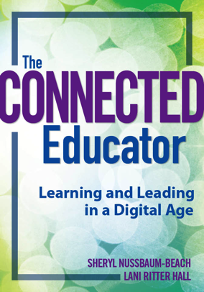
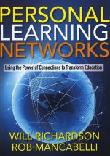
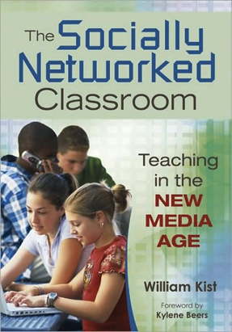


Slide 28


We are moving from the limitations of faith formation in a schooling, linear, textbook model with children and teens. . .
Grades 1-5
Grade 6-8
High School
Confirmation
???

Slide 29
to a Network model
Lifelong & LIfeWide
Instead of being the center of faith formation experiences, programs, classes, and books now become nodes on a much broader faith formation network that is lifelong and lifewide.
The shift to networks will be transformative in how we imagine and organize faith formation for
all ages and generations.

Slide 30

Learn the Bible
Bible Study @ Church
Online Course
Online Resource Center
Educational Program
- course
- conference
Books
Audio
Video
Online Community
- experts
- learners

Slide 31
a network model of faith formation
We are moving from. . .
One Size Fits All Curriculum & Programming
to
A Network of Personalized & Customized Faith Formation Activities & Resources
focusing on addressing people’s spiritual and religious diversity by offering a wide variety of religious content and experiences
Providing Differentiated Faith Formation

Slide 32
A network model of faith formation
We now have the models, resources, and technologies to. . .
Expand faith formation to address the diversity of people today – life tasks and issues, religious and spiritual needs
Deliver religious content and experiences to people wherever they are, 24 x 7 x 365
Engage people in a wide variety of experiences tailored to their needs, interests, spiritual journey, and busy lives
Connect people to each other – in physical places and virtual spaces

Slide 33
A Network Model
Faith Formation Network
Church Programs
Small Groups & Support Groups
Mentors
Social Media
User-Generated Content
Community Programs
Online Courses & Activities
Online Resources
Print, Audio Video
Apps
Blogs
A Lifelong Faith Formation Network provides faith formation for everyone, anytime, anywhere,
24 x 7 x 365.

Slide 34
A network Model
Physical & Virtual Settings
On Your Own
Small Group
Large Group
Mentored
Church Community
Community
& World
@ Home

Slide 35
Imagine the Possibilities for Lifelong & Lifewide Faith Formation
in a Network Model

Slide 36
Newly Married Couples
MENTORS
MARRIAGE PREP
- Online
- Gathered
FAITH GROWTH
- Programs
- Online Courses &
Resources
SMALL GROUPS
& Support Groups
SOCIAL NETWORK
MARRIAGE ENRICHMENT
- Workshops
- Online
-Retreats

Slide 37
Families in the First Decade of Life
BAPTISM
MENTORS
Prayer, Rituals, Bible, Family Conversation, Service
PARENT FORMATION & PARENTING SKILLS
MILESTONES
FAITH PRACTICES
@ HOME
Workshops Courses
Online Resources
Support Groups
FAMILY LEARNING PROGRAMS
Baptism Anniversary, First Prayers, Start of School
Church Gatherings
Small Groups
Workshops
ONLINE RESOURCE CENTER

Slide 38
Adult Faith Formation Network
Life Tasks & Transitions Programs
Book or Video Groups
Prayer,
Spiritual Practices,
Retreats
Justice, Service, Mission Trips
Small Group Studies
Extended Programs & Trips
Theology Programs
Sunday Worship Reflection
Online Courses & Resources
Social Networks & Blogs
Discovering Faith Programs

Slide 39
Differentiated Faith Formation
Core Content & Experiences for Everyone
Content & Activities for those of Vibrant Faith & Engagement
Content & Activities for Occasionals
Content & Activities for Spiritual but Not Religious

Slide 40
Networks around gatherings
Gathered Event
Small Groups
User-Generated Content
Online Courses & Activities
Online Resources
Print, Audio Video
@ Home Activities
Blogs & Social Media

Slide 41
New role for leaders:
The Faith Formation Curator
Curating religious content & experiences for all ages
A faith formation curator is someone who continually finds, groups, organizes, and shares the best and most relevant content and experiences on a specific subject to match the needs of a specific audience.

Slide 42
Faith Formation Curator
What would we curate?
Church Programs & Activities
Community Programs & Activities
People Resources
Print Resources
Audio & Video Resources
Art, Drama, and Music Resources
Online Content: Websites, Courses, Blogs
Apps & Digital Resources

Slide 43
The Process of Curation
Research
Aggregate & Evaluate
Deliver
Communicate & Connect

Slide 44
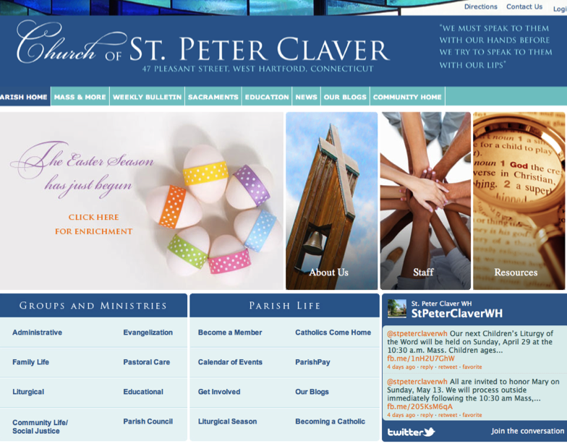

Slide 45
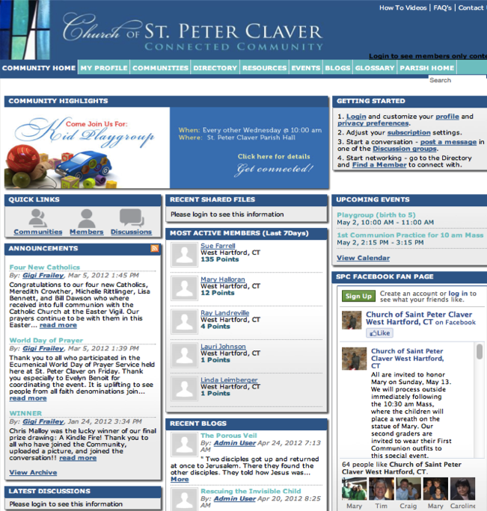

Slide 46
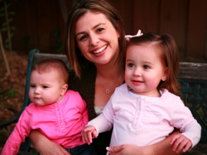

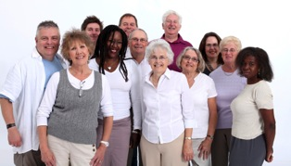


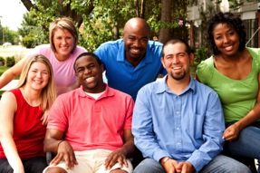

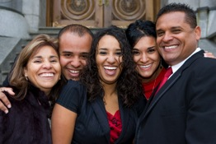
We Can Now Provide Faith Formation for
All Ages & Generations!

Slide 47
1000s of Faith Formation Networks
70 Million Catholics
Embracing Faith in the 21st Century
The Dawn of a New Era in Faith Formation

