Slide 1
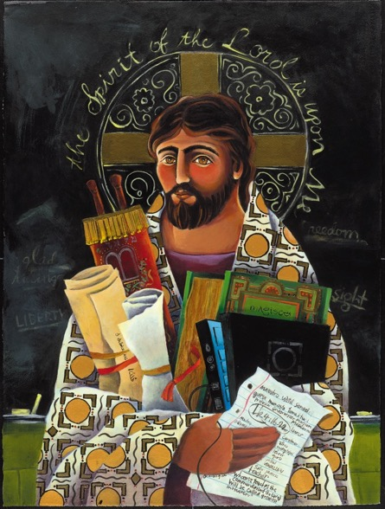
Presentation Forming Faithfully (Part 2)
John Roberto
jroberto@lifelongfaith.com www.LifelongFaith.com

Slide 3
Digitally-Enabled Faith Formation
Engage people with a wide variety of faith forming content for all ages - anytime, any place
Extend church events into people’s daily lives via online content and experiences
Connect faith formation in gathered settings with faith formation in online settings
Offer a variety of online faith formation content, experiences, and courses for self-study and small group study

Slide 4
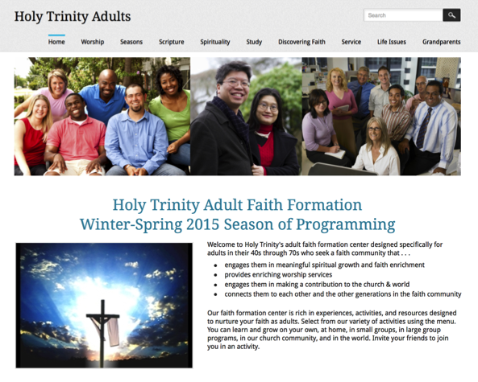

Slide 5
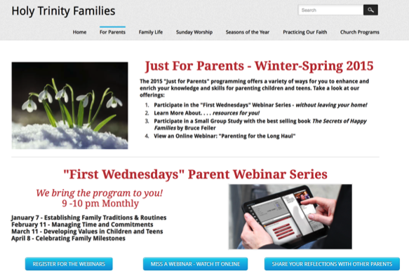
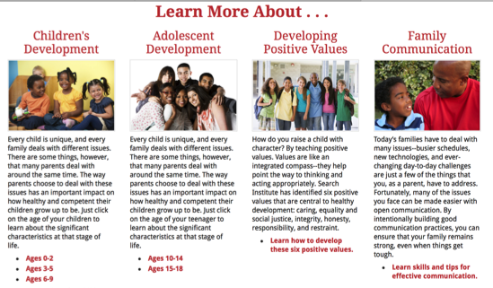

Slide 6
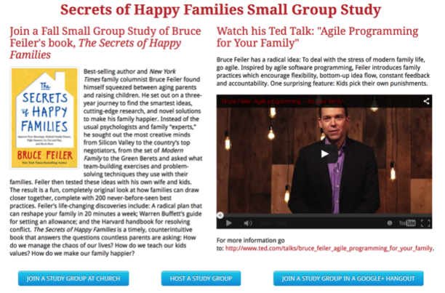
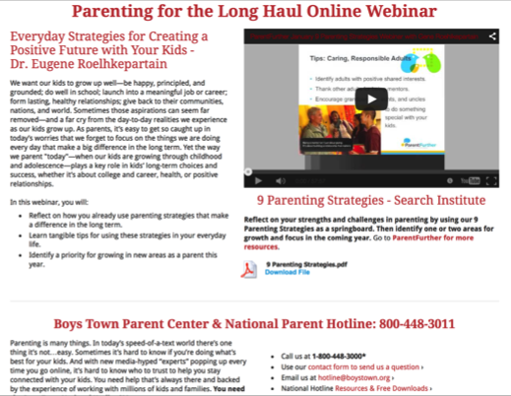

Slide 7
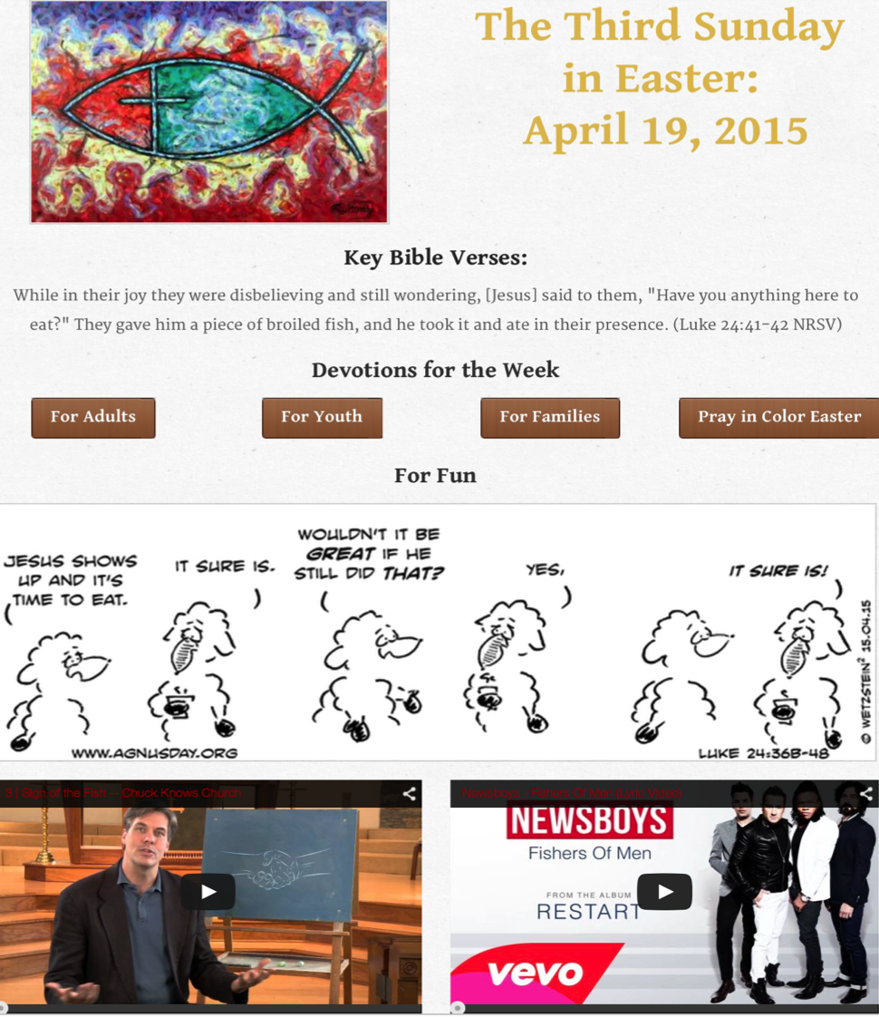

Slide 8
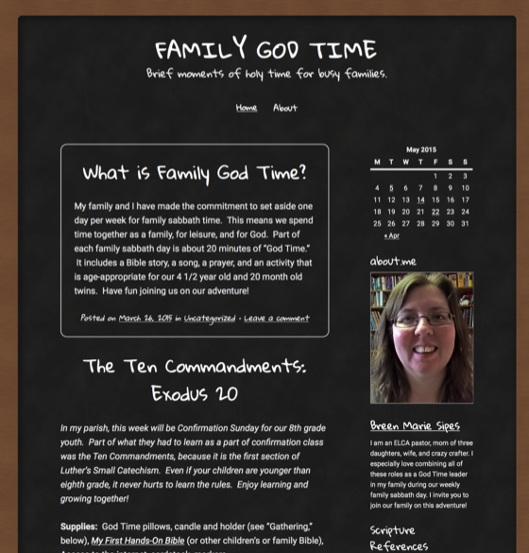
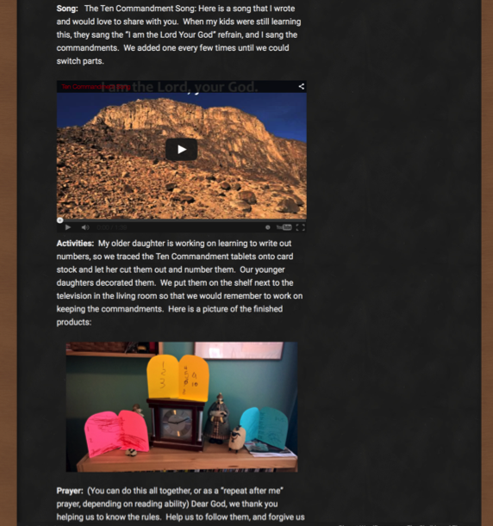

Slide 10
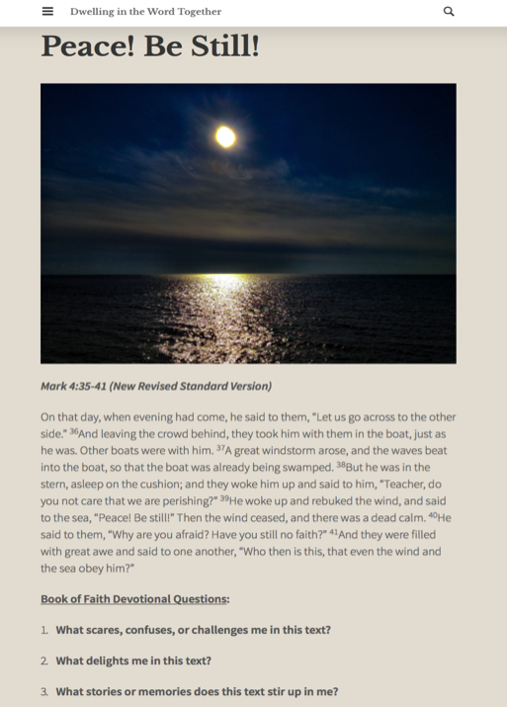
Tri-Saints
Lutheran Parish
Monthly
Bible Study

Slide 11
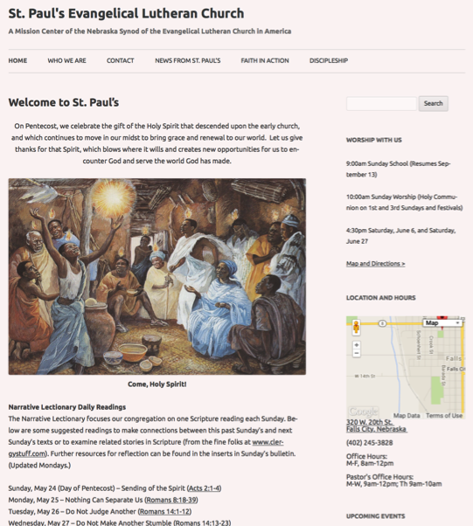
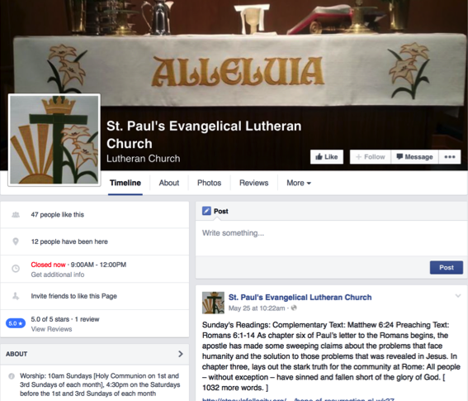

Slide 12
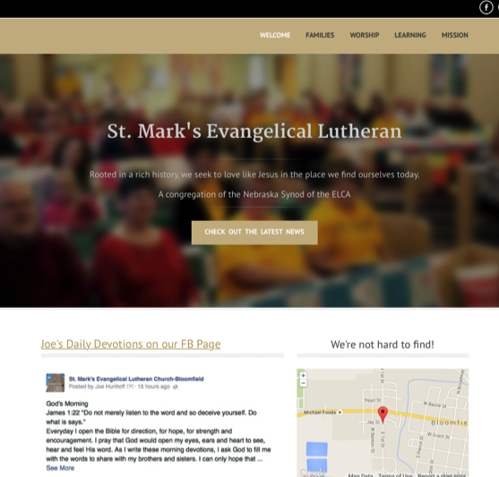

Slide 13
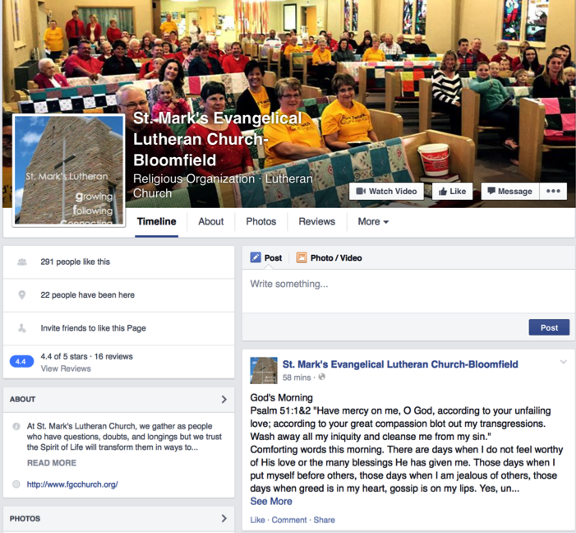
St Mark’s
Daily Devotion

Slide 14
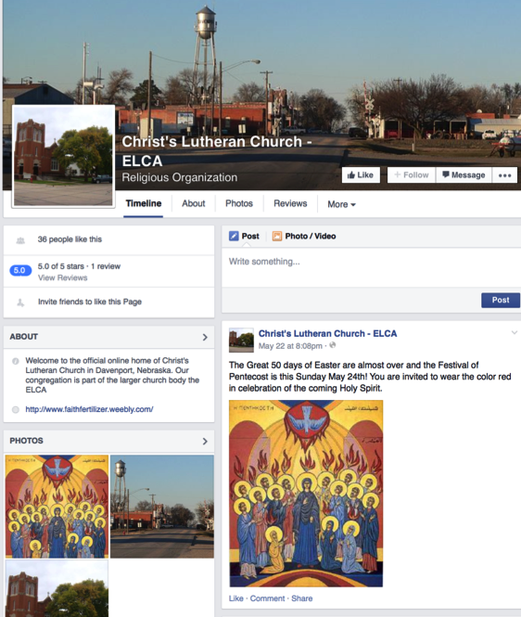

Slide 15
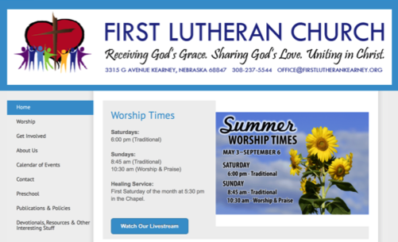
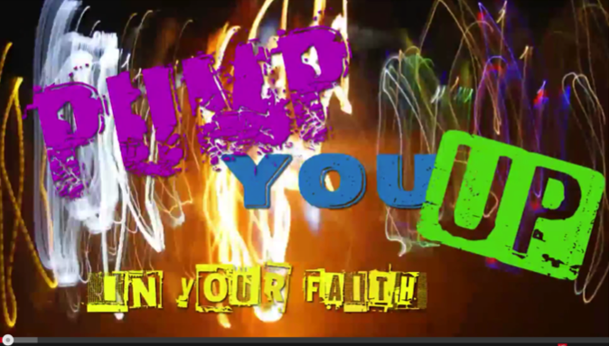
Lenten series on change with companion materials for families at home

Slide 16
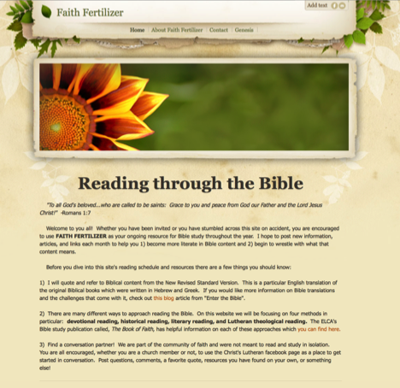
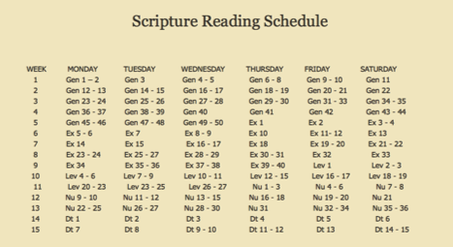
Christ's Lutheran Church, Davenport
St. James Lutheran Church, Edgar
As the pastor of two churches, I am unavailable to teach Sunday School classes, so I decided to try posting online study materials for reading through Scripture so that parishioners can access it on their own and choose to form their own groups if they wish.

Slide 17
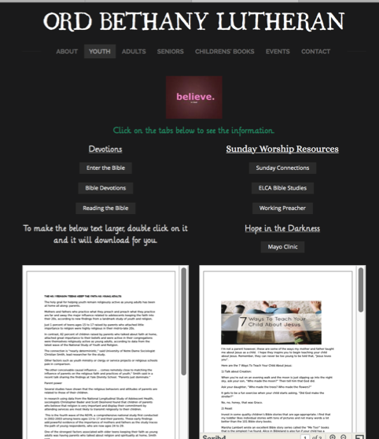
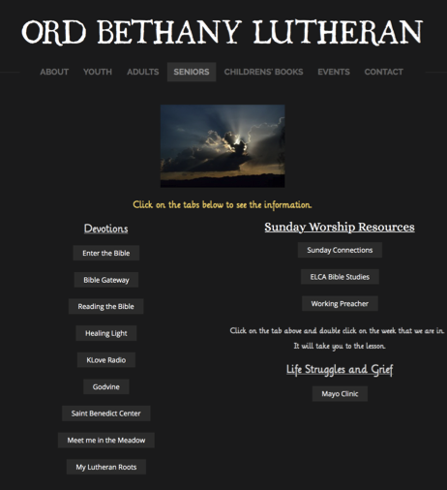
Ord Bethany Devotions
& Sunday Worship Resources

Slide 19
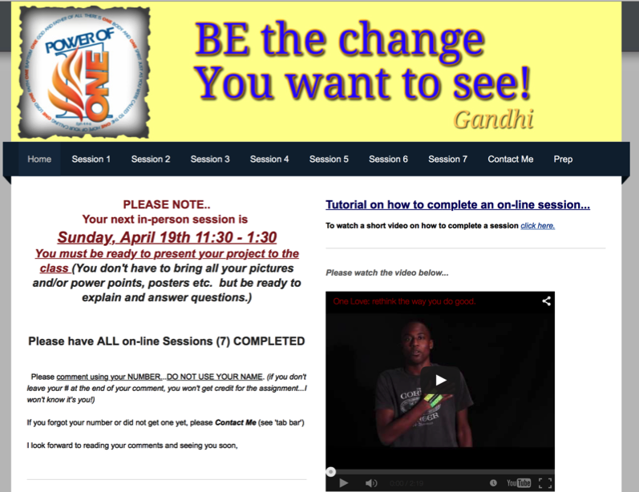

Slide 20
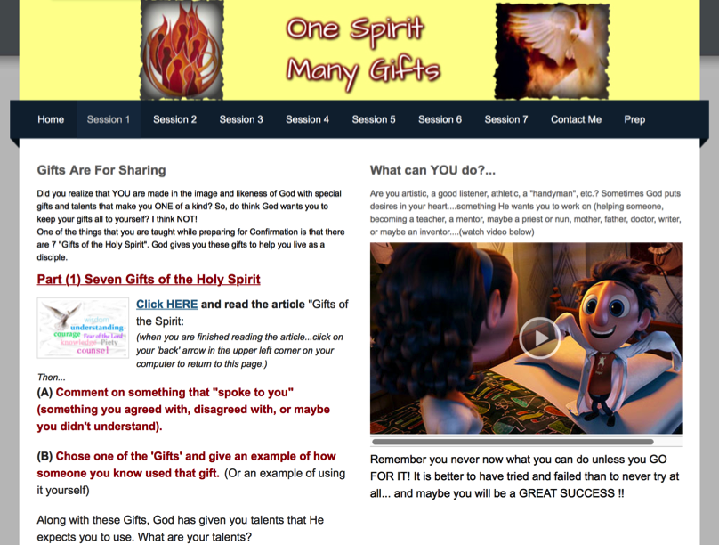

Slide 21
Comments from St. Paul’s, Fall City
We've seen people respond well to our expanded online ministry. The new website has generated much more traffic than our previous one - as much as 100x more each month - leading people to learn more about our congregation and increasing the number of first-time worshipers (and folks who have returned after extended absences).
Members and non-members alike have expressed their appreciation for the ability to access Sunday's sermons when they are unable to attend, for the daily text recommendations that connect them to Scripture between Sundays, and for seasonal devotional and informational items, particularly during Lent.

Slide 22
Comments from St. Paul’s, Fall City
We haven't been as successful at facilitating conversation online as we'd like, and that will probably be the next growing edge developing this aspect of our ministry, along with getting more people involved in the day-to-day task of keeping content fresh and interesting.
We're excited about the possibilities, and looking forward to seeing where the Spirit leads us to go next.
Andrew Chavanak, St. Paul's Ev. Lutheran Church
Falls City, Nebraska

