Slide 1
Family Faith Formation
John Roberto (jroberto@lifelongfaith.com)

Slide 2
Religious Transmission
“Emerging adults who grew up with seriously religious parents are through socialization more likely (1) to have internalized their parents religious worldview, (2) to possess the practical religious know-how needed to live more highly religious lives, and (3) to embody the identity orientations and behavioral tendencies toward continuing to practice what they have been taught religiously.”

Slide 3
Religious Transmission
“At the heart of this social causal mechanism stands the elementary process of teaching—both formal and informal, verbal and nonverbal, oral and behavioral, intentional and unconscious, through both instruction and role modeling. We believe that one of the main ways by which empirically observed strong parental religion produced strong emerging adult religion in offspring is through the teaching involved in socialization.”
(Souls in Transition: The Religious & Spiritual Lives of Emerging Adults by Christian Smith with Patricia Snell)

Slide 4
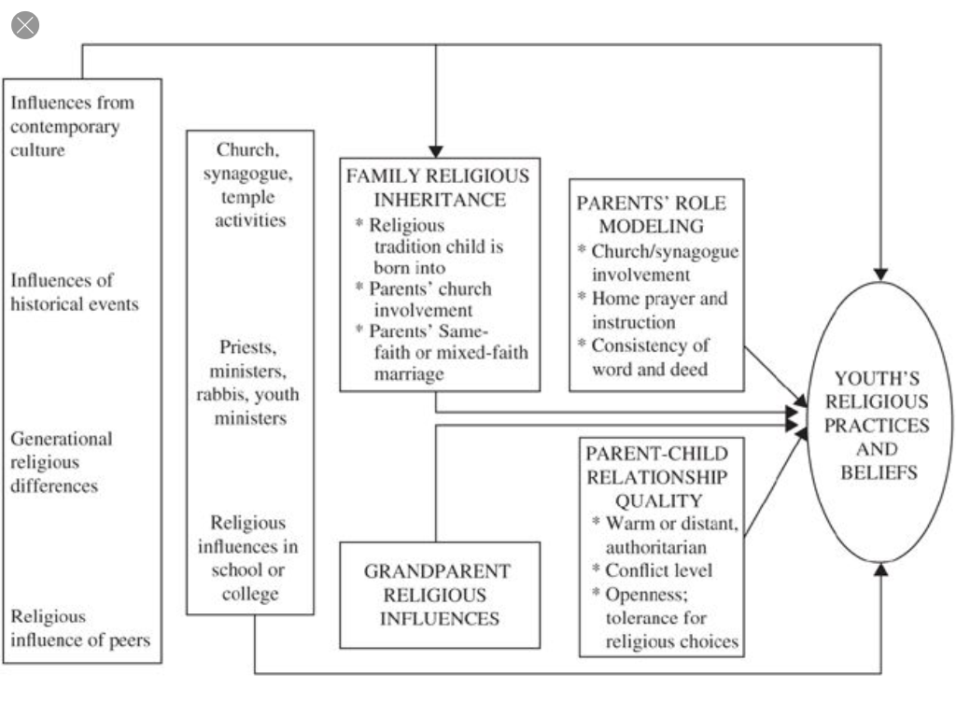
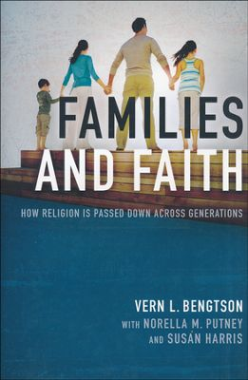
Religious Transmission

Slide 5
Family Faith Formation
Congregations equip families to become centers of learning, faith growth, and faith practice in five ways:
Nurturing family faith at home through eight faith forming processes

Slide 6
Eight Faith Forming Processes
GROWTH IN FAITH
Caring Relationships
Rituals & Milestones
Church Year Seasons
Worshipping
Learning the Tradition
Praying
Spiritual Formation
Reading the Bible
Serving Working for Justice Caring for Creation

Slide 7
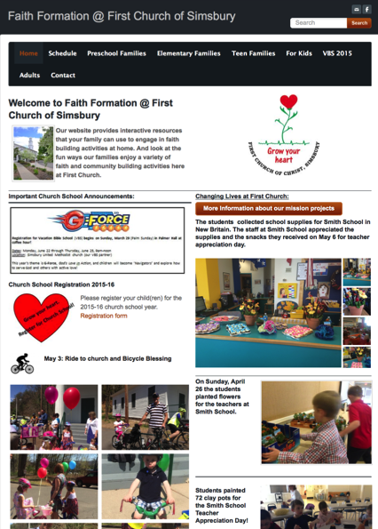
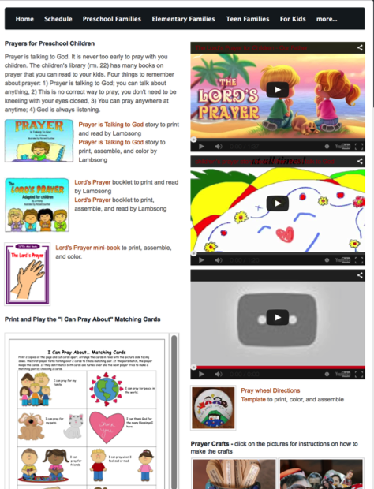

Slide 8


Slide 9
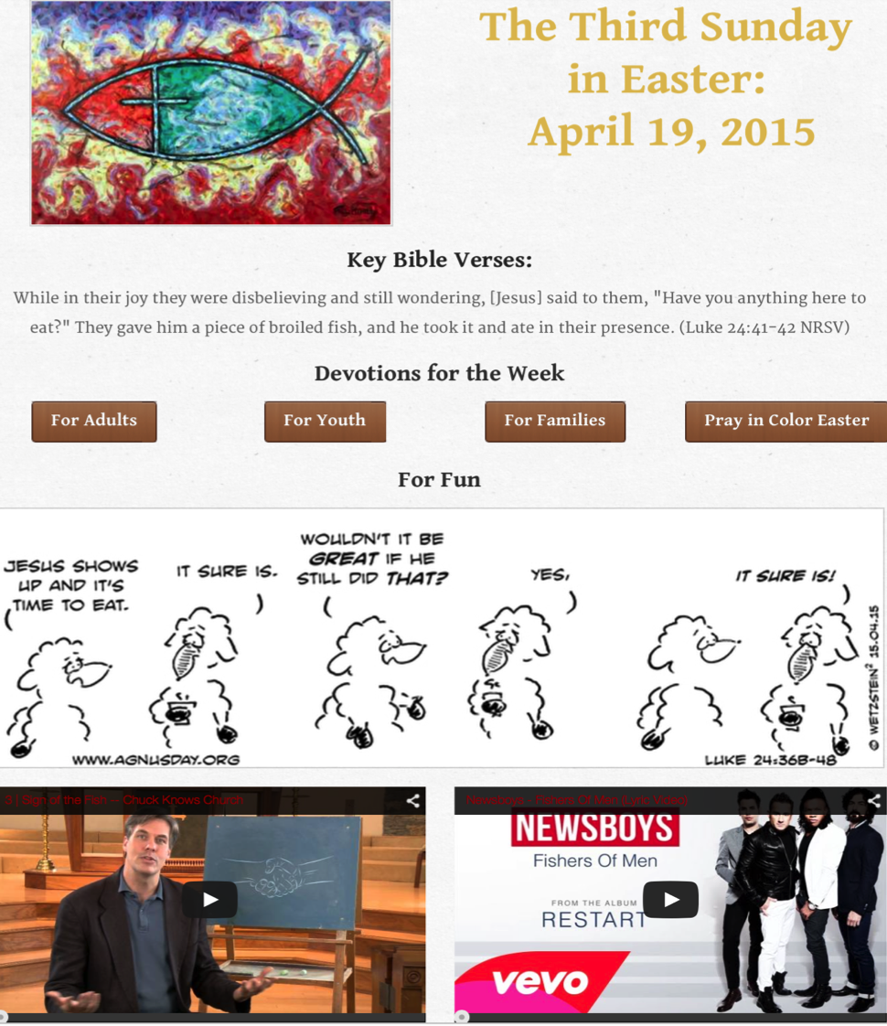

Slide 10

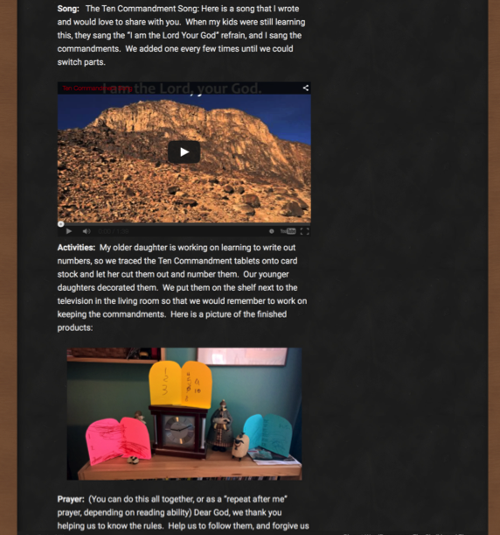

Slide 11
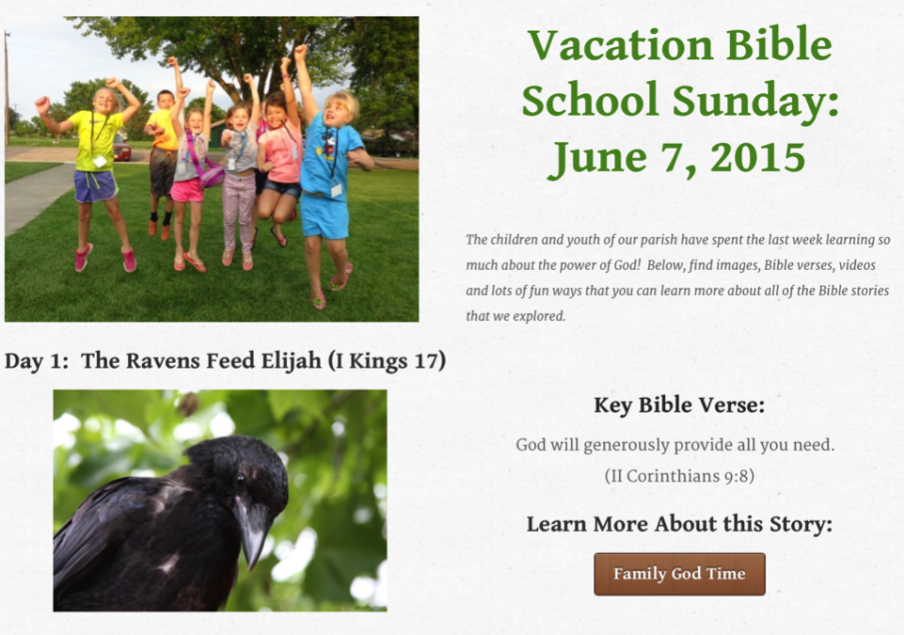
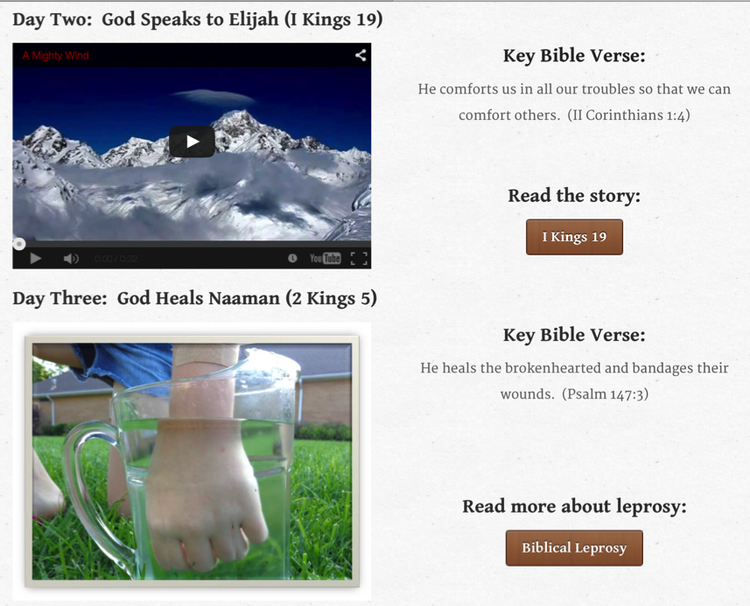
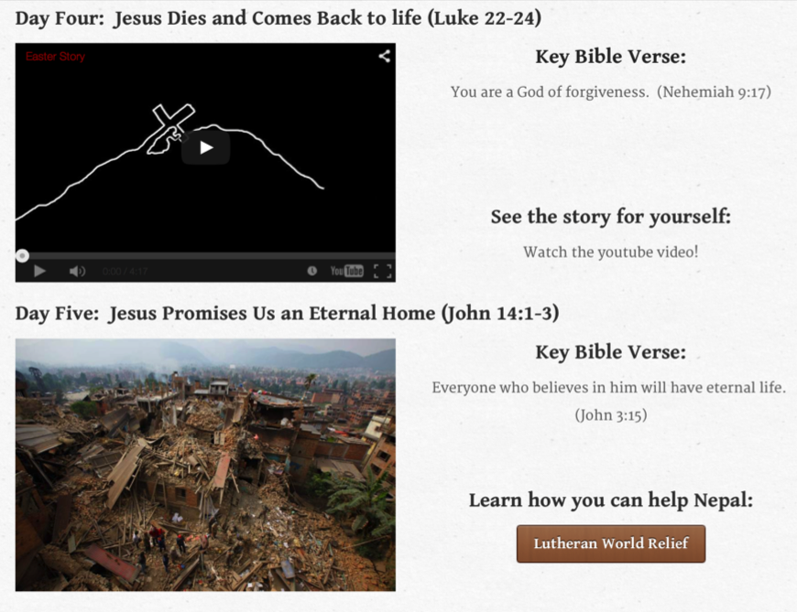

Slide 12
Family Faith Formation
Parent faith formation
Parenting for faith growth training
Parenting education
Building strong families by developing family assets: nurturing relationships, establishing routines, maintaining expectations, adapting to challenges, and connecting to the community.

Slide 13
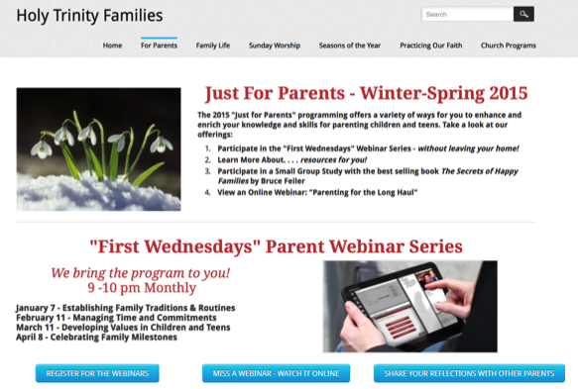
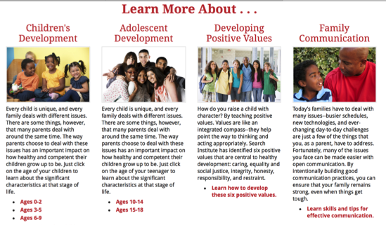

Slide 14

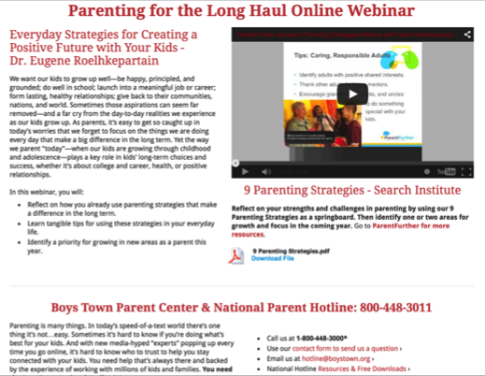

Slide 15
Family Assets (Search Institute)

