Slide 1
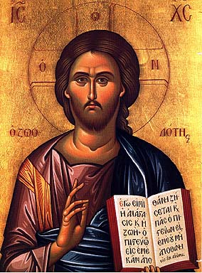
Approaches to Evangelization
2011 Clergy Conference

Slide 2
Opportunities for Evangelization
Evangelization, then, has different implications depending on our relationship to Jesus and his Church.
For those of us who practice and live our Catholic faith, it is a call to ongoing growth and renewed conversion.
For those who have accepted it only in name, it is a call to re-evangelization.
For those who have stopped practicing their faith, it is a call to reconciliation.

Slide 3
Opportunities for Evangelization
For children, it is a call to be formed into disciples through the family's faith life and religious education.
For other Christians, it is an invitation to know the fullness of our message.
For those who have no faith, it is a call to conversion to know Christ Jesus and thus experience a change to new life with Christ and his Church.
(Go and Make Disciples, U.S. Catholic Bishops)

Slide 4
Four-Scenario Faith Formation & Evangelization
Scenario 3 Unaffiliated & Uninterested
Scenario 1 Vibrant Faith & Active Engagement
Scenario 4 Uncommitted & Participating
Scenario 2 Spiritual but Not Religious

Slide 5
Opportunities for Evangelization
Through Faith Formation:
Whole Community & Intergenerational Faith Formation
Family Faith Formation
Through Sacraments, Milestones, & Rites of Passage
Through Sunday Worship
Through the Use of Digital & Web 2.0 Technologies
Through Targeted Initiatives
Evangelization with the “Spiritual but Not Religious” & the “Unaffiliated and Uninterested”
Evangelization with the “Participating Occasionally but Not Spiritually Committed”
Empowering People of Vibrant Faith to Share their Faith with Others

Slide 6
Presentations
Intergenerational/Whole Community Evangelization & Faith Formation
Parish Presentation: Sacred Heart, Southbury
Parish Presentation: St. Mark, West Hartford
Family Evangelization & Faith Formation
Parish Presentation: Assumption, Woodbridge
Evangelization & Faith Formation with Hispanic Communities
Parish Presentation: St. Rose, Meriden
Evangelization & Faith Formation using Web Technologies
Parish Presentation: St. Peter Claver, West Hartford

Slide 7
Think in the Four-Scenarios
Scenario 3 Unaffiliated & Uninterested
Scenario 1 Vibrant Faith & Active Engagement
Scenario 4 Uncommitted & Participating
Scenario 2 Spiritual but Not Religious

Slide 8
Empowering the Community to Share their Faith

Slide 9
Evangelization is…
“The heart of evangelism is having an alive relationship with God, being part of a church you love, and caring that people outside the church find what you’ve discovered.”
(Martha Grace Reese)

Slide 10
Empowering the Community to Share their Faith
Step One. Church Leader’s Study: Unbinding the Gospel
Step Two: All-Church Saturation Study: Unbinding Your Heart: 40 Days of Prayer & Faith Sharing.
six-week, small group program
pray each day’s scripture and prayer exercise and work with a prayer partner
study a chapter of the book with their small group
worship with sermons, music, and prayers centered on the week’s chapter

Slide 11
Empowering the Community to Share their Faith
Step Three: An Experiment in Prayer and Community: Unbinding Your Soul.
a no-obligation experience of substantial spiritual discussion, prayer and community for people who aren’t connected with a church
each church member invites 1 friend/family member into a four-week small group experience with short study chapters, an individual prayer journal, prayer partner activities, and group exercises
each church members invites their friend/family member to participate in church life (Sunday worship, programs, etc.)

Slide 12
Evangelization & Sunday Worship

Slide 13
Extend Worship into Everyday Life
Sunday Worship
Share It Blog/Forum After Mass In Programs Family Conversation Activity
Live It Living the Message Daily Living Christian Practices Service Ideas for the Week
Study It Taking Faith Home Insert Homily Video + Study Guide Daily Readings Scripture Commentaries Online Bible Study
Pray It Weekly Table Prayer Praying with the Saints AM & PM Prayer

Slide 14
Extend Worship into Everyday Life
Sunday Worship
Everyday Life

Slide 15
Creating Pathways for Spiritual Growth

Slide 16
Christianity 101

Slide 17
Christianity 101
Introduction Dinner: Is there more to life than this?
Week 1: Who is Jesus?
Week 2: Why did Jesus die?
Week 3: How can we have faith?
Week 4: Why and how do I pray?
Week 5: Why and how should I read the Bible?
Week 6: How does God guide us?
Week 7: How can I resist evil?
Week 8: Why & how should we tell others?
Week 9: Does God heal today?
Week 10: What about the Church?
Weekend: Who is the Holy Spirit? What does the Holy Spirit do? How can I be filled with the Holy Spirit? How can I make the most of the rest of my life?

Slide 18
Catholicism 101
Our Lady of Soledad Catholic Parish
Mini-Retreat 101: “Catholics Alive!”
“What does it mean to be a follower of Christ?”
Mini-Retreat 201: “Alive and Growing Spiritually!”
maturing in the Catholic faith
Mini-Retreat 301: “Alive and Gifted!”
discerning how to serve God in ministry
Mini-Retreat 401: “Alive in the World!”
living as witnesses for Christ, as contagious Catholic Christians
Mini-Retreat 501: “Alive to Praise God!”
Catholic worship and the sacraments

Slide 19
Catholicism 101
Paulist Evangelization Ministries
Spirituality: What’s the Buzz?
Who is Jesus?
Do We Need the Spirit?
Can I Accept God’s Mercy?
Can Mass Make My Life Meaningful?
The Church and Me

Slide 20
Catholicism 101

Slide 21
Sacraments

Slide 22
Baptism Process
Faith Formation with Parents before Baptism
Preparation for and Celebration of Baptism
Faith Formation After Celebration of Baptism

Slide 23
Baptism
Mentors
Prayer, Rituals, Bible, Family Conversation, Service
Parent Faith Formation & Parenting Skills
Milestones
Faith Practices @ Home
Workshops Courses Online Resources Support Groups
Family Learning Programs
Baptism Anniversary, First Prayers, Start of School
Church Gatherings Small Groups Workshops
Parent/Family Online Resource Center
Families in the First Decade of Life

Slide 26
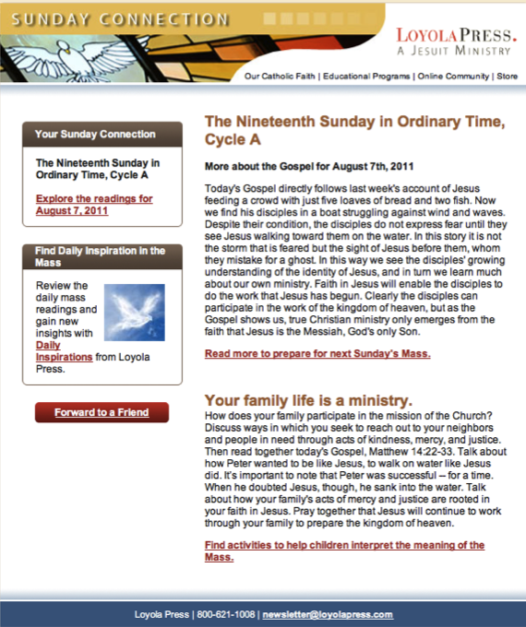

Slide 27
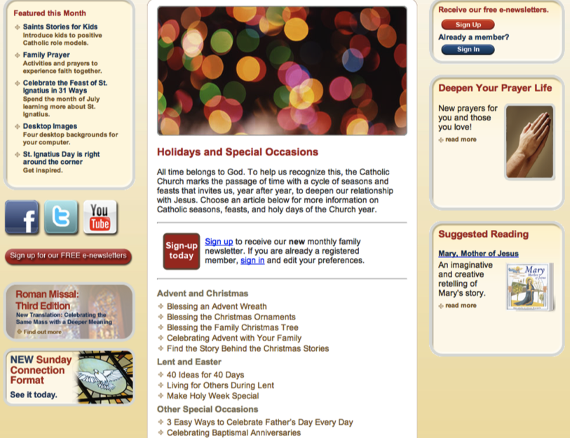

Slide 28
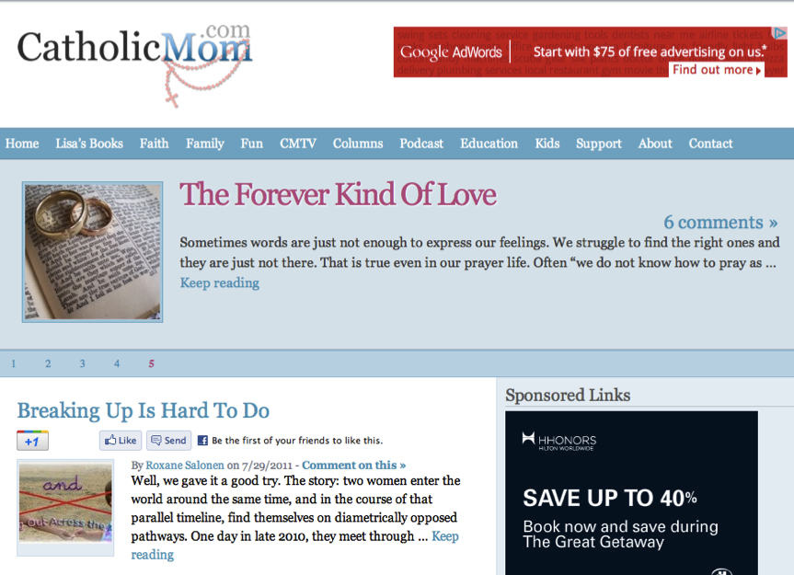

Slide 29
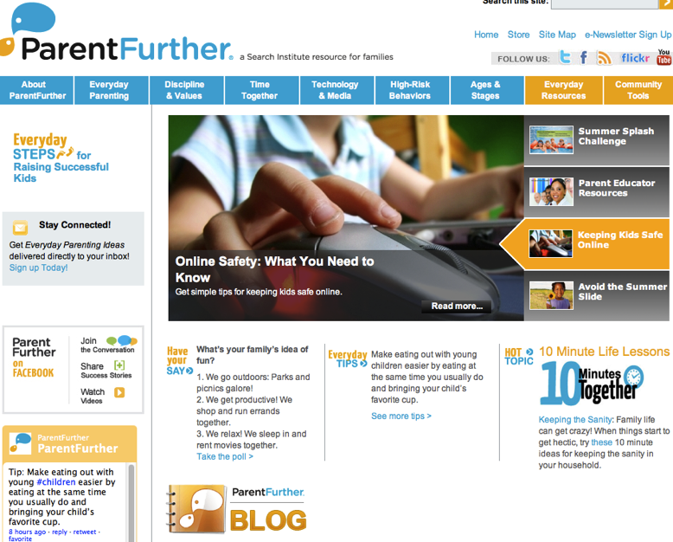

Slide 30
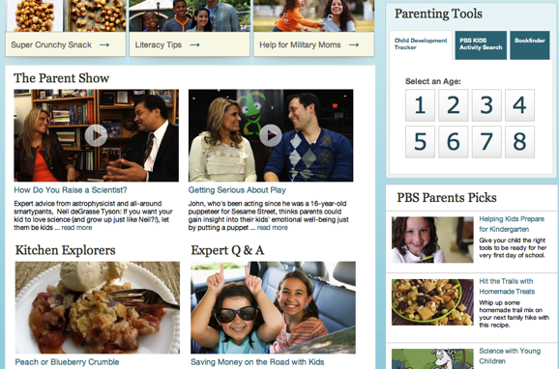

Slide 31
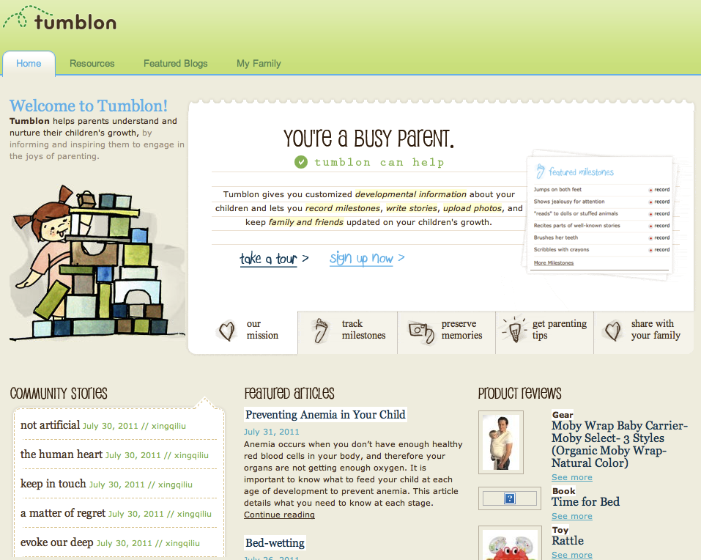

Slide 32
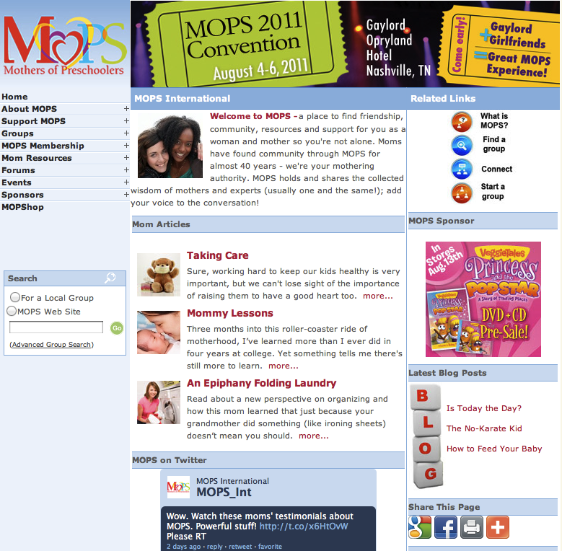

Slide 33
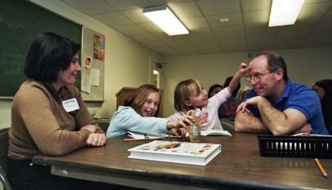
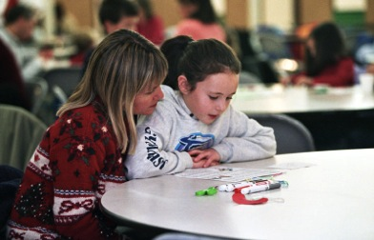
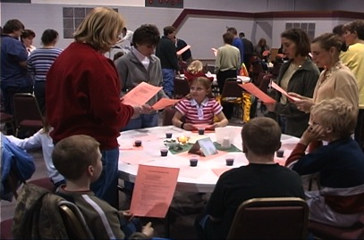
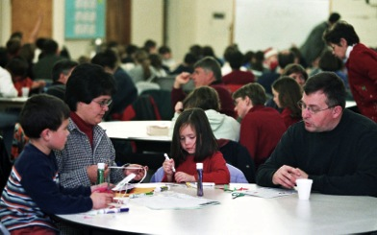
Family Faith Formation

Slide 34
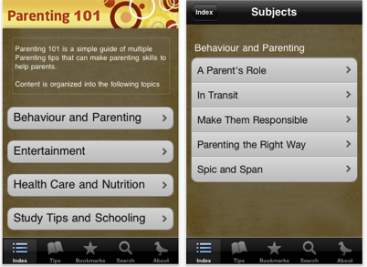
Apps

Slide 35
Eucharist Process
Early Childhood Faith Formation
Preparation for & Celebration of Eucharist
- Home & Parish
- Parent Faith Formation
Faith Formation after Sacramental Celebrations

Slide 36
Marriage Process
Faith Formation Before Marriage
Preparation for and Celebration of Marriage
Faith Formation After Celebration of Marriage

Slide 37
Marriage
Mentors
Prayer, Rituals, Bible Reading, Service, Faith Conversations
Faith Practices
Continuing Formation
Support Groups
Quarterly Couple Gatherings
Married Life Tasks & Issues
Courses, Workshops, Online Resources
Theology, Scripture, Spirituality
Newly Married Couples

Slide 38
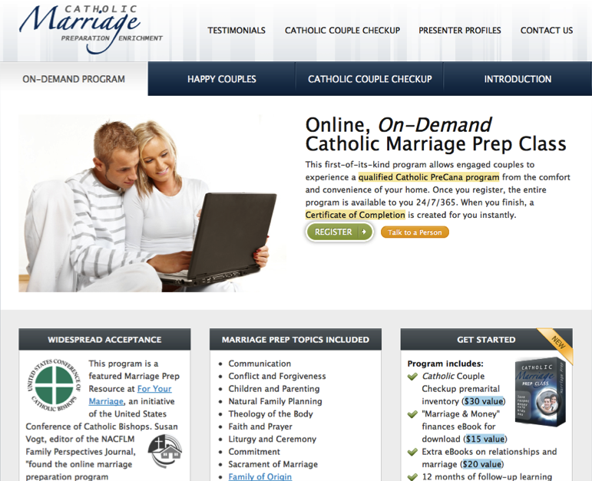

Slide 39
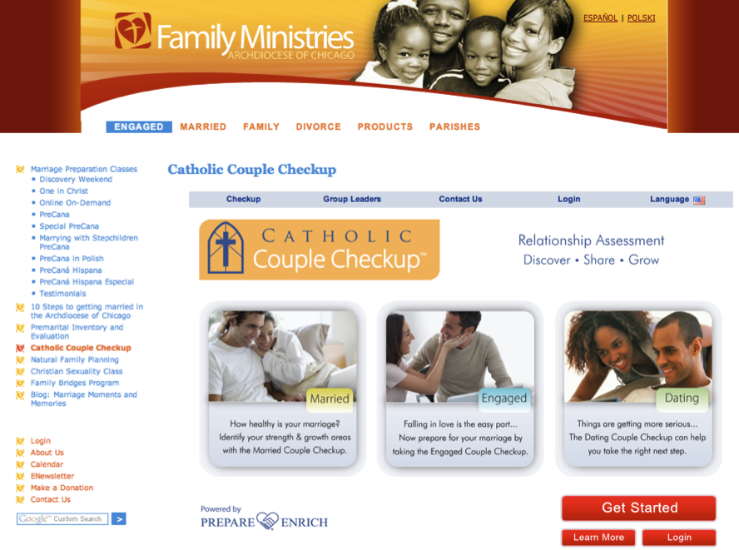

Slide 40
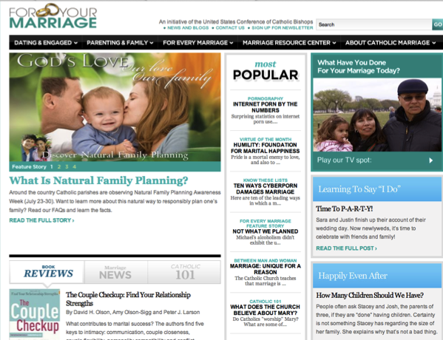
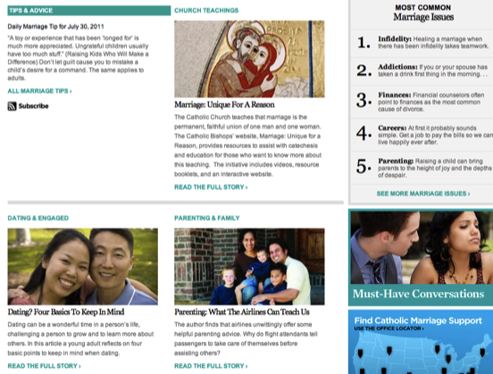
For Your Marriage

Slide 41
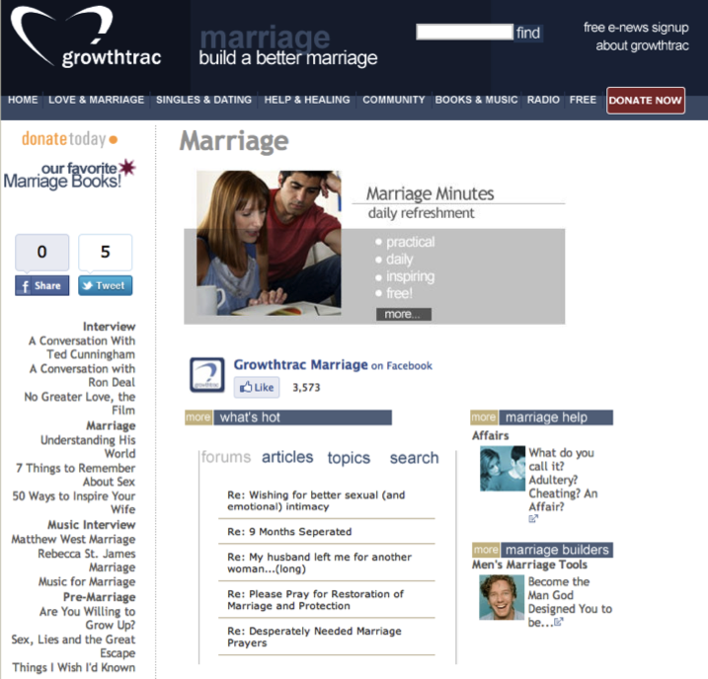

Slide 43
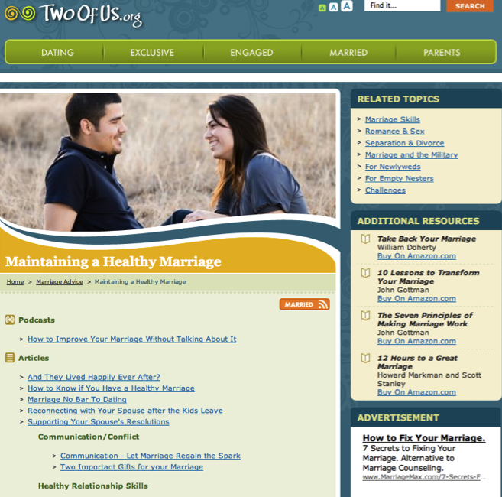

Slide 44
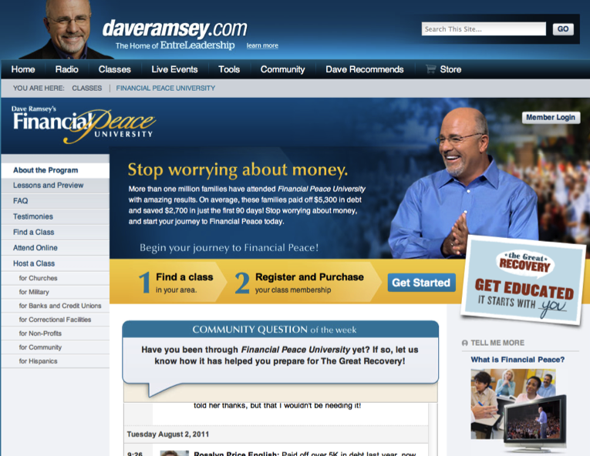

Slide 45
Example: Young Adult Faith Formation
Young Adult Faith Formation
Life Issues Workshops & Online Resources
Prayer & Spiritual Practices (online, small groups, retreats)
Third Place Café
Small Group Studies
Weekly Gathering & Worship
Justice & Service Projects (local and global)
Alpha Course
Cross-generational Experiences (worship, service, mentoring)
Social Network & Blog
Online Courses
Online Audio & Video Programs

Slide 47
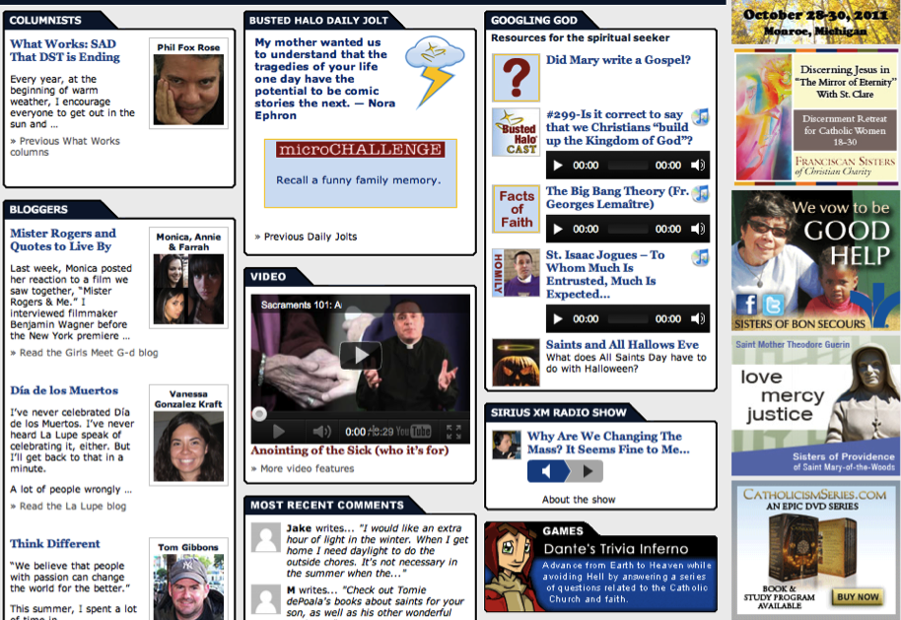

Slide 48
Example: Adult Faith Formation
Adult Faith Formation
Online Courses
Audio & Video Programs
Books & Book Clubs
Life Transitions
Prayer & Spiritual Practices
Justice & Service
Small Group Studies
Life Tasks & Issues
Extended Learning Programs
Faith in Art Tours

Slide 49
iTunes U

Slide 50
Online Courses

Slide 51
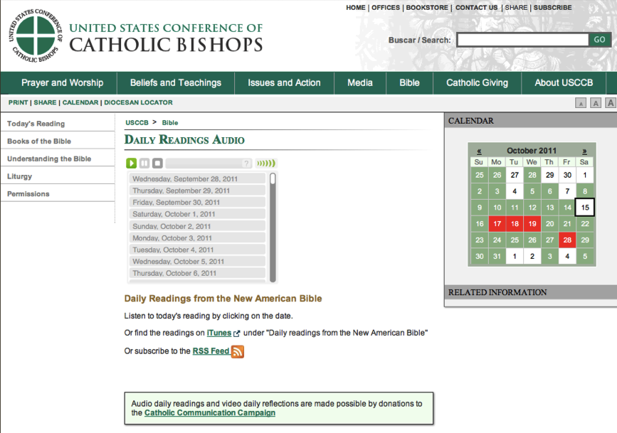

Slide 52
American Bible Society

Slide 53
Sunday Connection
Loyola Press

Slide 55
YouVersion Bible App

Slide 56
Bible Study, Small Groups

Slide 57
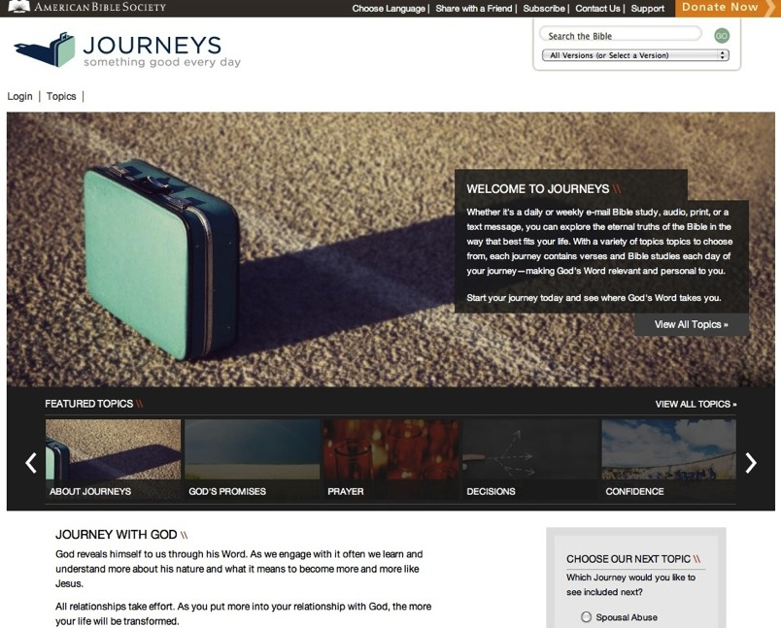

Slide 61
Service & Mission
Local and global
“Developmental” with increasing depth and scope:
introduction: several hours to a full day
short term: multi-day and local
weeklong and national mission trips
global expedition of one or more weeks

Slide 62
