Slide 1
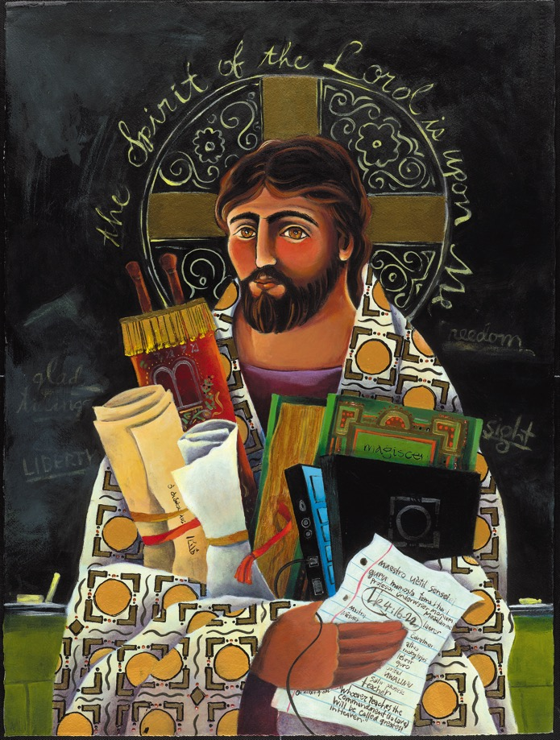
Reimagining faith formation for the 21st Century
John Roberto
jroberto@lifelongfaith.com www.LifelongFaith.com

Slide 2
Part 1. Adaptive Challenges

Slide 3
4 Big Adaptive Challenges
Increasing diversity throughout American society in the length of the lifespan, in generational identities, in family structures and marriage patterns, and in the ethnic makeup of America
Rise of new digital technologies that are reshaping society, and the emergence of a connected, networked society
Dramatic changes and increasing diversity in the religious beliefs, practices, and affiliation of Americans
Decline in religious transmission from generation to generation

Slide 4
Diversity
Diversity
Life-Span Diversity
Generational Diversity
Family Diversity
Ethnic Diversity

Slide 5
Life Span Diversity
0-10
50s
20s
30s
40s
60s
70s
80s
90s
11-19

Slide 6


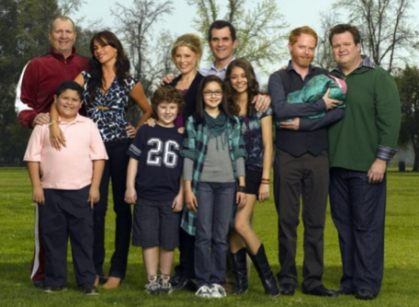
Family Diversity
The 1950s Family
The 2010s Family

Slide 7
Family Diversity
Married Couple with Children (original biological family)
Married Couple with Children (blended family)
Single Parent with Children
Unmarried Couple with Children
Unmarried Couple without Children
Same Sex Couple with Children (married or unmarried)
Same Sex Couple without Children (married or unmarried)
Grandparents & Parents with Children (3-generational)
Grandparents as Primary Caregivers
Parents with Single Young Adults Living at Home

Slide 8
Religious Transmission
Declining importance of religion and religious practice
Declining levels of family religious transmission and faith practice at home

Slide 9
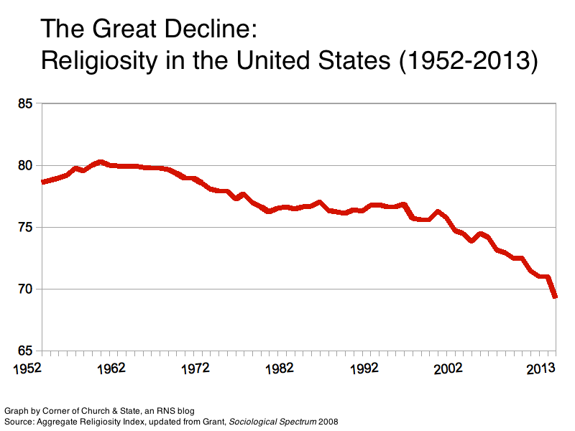

Slide 10
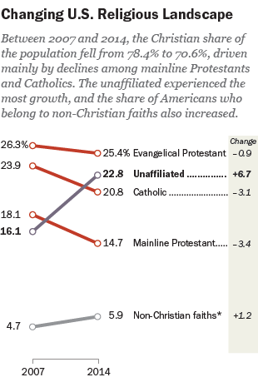

Slide 11
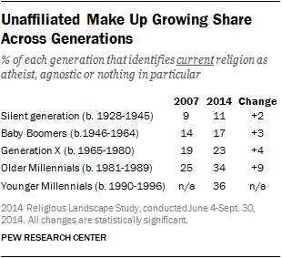

Slide 12
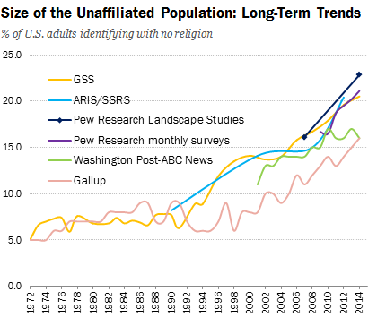

Slide 13
Religious Diversity
Not Religiously Affiliated
Spiritual but Not Religious
Minimal Engagement with Faith and Community
Vibrant Faith
& Active Engagement

Slide 14
Religious Transmission
“Emerging adults who grew up with seriously religious parents are through socialization more likely (1) to have internalized their parents religious worldview, (2) to possess the practical religious know-how needed to live more highly religious lives, and (3) to embody the identity orientations and behavioral tendencies toward continuing to practice what they have been taught religiously.”

Slide 15
Religious Transmission
“At the heart of this social causal mechanism stands the elementary process of teaching—both formal and informal, verbal and nonverbal, oral and behavioral, intentional and unconscious, through both instruction and role modeling. We believe that one of the main ways by which empirically observed strong parental religion produced strong emerging adult religion in offspring is through the teaching involved in socialization.”
(Souls in Transition: The Religious & Spiritual Lives of Emerging Adults by Christian Smith with Patricia Snell)

Slide 16
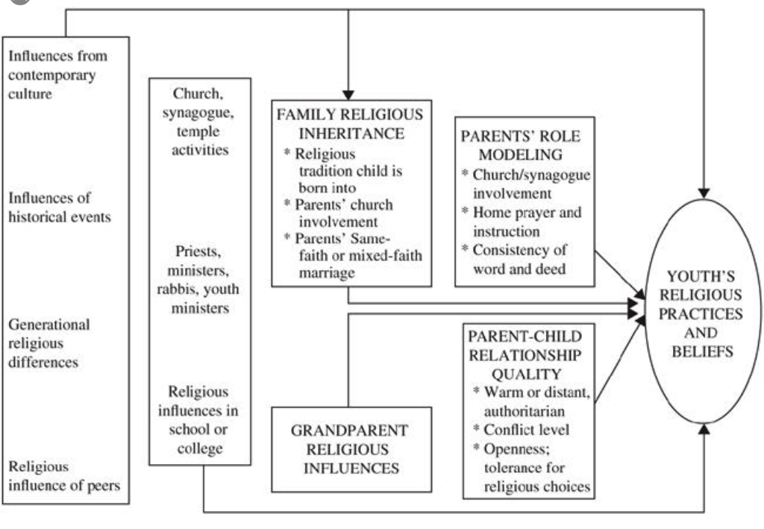
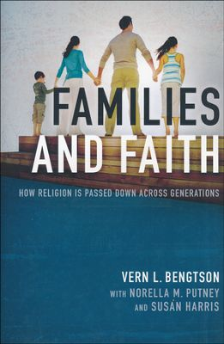
Religious Transmission

Slide 17
Concluding Thought
The world is now changing at a rate at which the basic systems, structures, and cultures built over the past century cannot keep up with the demands being placed on them. Incremental adjustments to how you manage and strategize, not matter how clever, are not up to the job. You need something very new to stay ahead in a age of tumultuous change and growing uncertainties.
(John Kotter, Accelerate: Building Strategic Agility for a Faster-Moving World

Slide 18
Part 2. The New Ecosystem

Slide 19
The “Old” Faith Formation Ecosystem
Church
Family
Ethnic Traditions
Community
Catholic School

Slide 20
A New Faith Forming Ecosystem
Intergenerational Faith Formation
Age Group/Generational Faith Formation
Family Faith Formation
Missional Faith Formation
Online & Digital Faith Formation

Slide 21
Holistic Faith & Formation
A way of the head (inform) demands a discipleship of faith seeking understanding and belief with personal conviction, sustained by study, reflecting, discerning and deciding, all toward spiritual wisdom for life.
A way of the heart (form) demands a discipleship of right relationships and right desires, community building, hospitality and inclusion, trust in God’s love, and prayer and worship.
A way of the hands (transform) demands a discipleship of love, justice, peace-making, simplicity, integrity, healing, and repentance.
(Thomas Groome)

Slide 22
Eight Faith Forming Processes
GROWTH IN FAITH
Caring Relationships
Rituals & Milestones
Church Year Seasons
Worshipping
Learning the Tradition
Praying
Spiritual Formation
Reading the Bible
Serving Working for Justice Caring for Creation

Slide 23
Eight Faith Forming Processes
Faith formation is developed around the eight faith forming processes—providing both a framework for a comprehensive curriculum with age groups, generations, and families; and the content—knowledge and practices—of the Christian faith.

Slide 24
Intergenerational Community
Intergenerational faith formation and whole community faith experiences are at the center of all faith formation networks, engaging all ages and generations in the life and events of church life and the Christian faith and participation in intergenerational faith experiences.

Slide 25
Throughout Scripture there is a pervasive sense that all generations were typically present when faith communities gathered for worship, for celebration, for feasting, for praise, for encouragement, for reading of Scripture, in times of danger, and for support and service. . . . To experience authentic Christian community and reap the unique blessings of intergenerationality, the generations must be together regularly and often—infants to octogenarians.
(Allen and Ross, 84)

Slide 26
Benefits
Form and deepen Christian identity and commitment as people develop relationships and actively participate in faith communities that teach, model, and live the Christian tradition and way of life.
Provide a curriculum for the whole community—Sunday worship, the lectionary and church year seasons, learning, service, ritual and sacraments, prayer, and more—that is a shared experience in faith and belonging for everyone.
Strengthen relationships, connections, and community across generations; enhance their sense of belonging in the faith community; and provide valuable adult role models for children and adolescents.

Slide 27
Benefits
Support families by surrounding them with a community of faith and engaging the whole family in a variety of faith-forming experiences together (caring relationships, celebrating, learning, praying, serving); and providing parents with opportunities to learn from Christians who are practicing their faith and raising faithful children.
Strengthen the ability (confidence and competence) of parents and grandparents to promote religious socialization at home; be role models of faithful practice; and engage in faith practices at home and develop warm, affirming, and unconditionally supporting relationships between parents (and grandparents) and their children, teens, and young adults.

Slide 28
Intergenerational Community
Caring: Community building activities, storytelling, mentoring, social events
Celebrating: Sunday Worship, whole community sacramental celebrations, milestones celebrations, church year feasts and seasons
Learning: Intergenerational learning programs (weekly, monthly, small group); incorporating intergenerational learning into age group programming
Praying: Community prayer experiences, intergenerational prayer groups, spiritual guides/mentors
Serving: Intergenerational service projects and mission trips, church-wide service days

Slide 29
Intergenerational Church Life
The feasts and seasons of the church year provide a natural rhythm and calendar to the curriculum: Advent and Christmas Seasons, Epiphany, Baptism of the Lord, Call of the Disciples, Ash Wednesday, Lenten Season, Holy Week, Easter, Easter Season, Pentecost, All Saints and All Souls, and remembrances of saints and holy people throughout the year
The Revised Common and Catholic Lectionaries provide a rich curriculum for the whole community with its three-year cycle of weekly readings from the Old Testament, Psalms, Epistles, and Gospels built around the seasons of the church year. The Narrative Lectionary is a four-year cycle of readings from September through following the biblical story, from Creation through the early Christian church.

Slide 30
Intergenerational Church Life
Ritual, milestone, and sacramental celebrations provide events rich in theological meaning and faith practice that celebrate the faith journey throughout life: baptism, confirmation, first Bible, first communion, graduation, marriage, funerals, and much more.
Acts of service and justice—locally and globally—provide a focus on mission to the world and put in action biblical and church teachings on service, justice, care for the earth.

Slide 31
Age Group Faith Formation
Age group and generational faith formation addresses the unique life tasks, needs, interests, and spiritual journeys of people at each stage of life.
Intergenerational Faith Community
Children & Parents
Youth & Parents
Young Adults
Mid-life Adults
Mature Adults
Older Adults

Slide 32
Eight Faith Forming Processes
GROWTH IN FAITH
Caring Relationships
Rituals & Milestones
Church Year Seasons
Worshipping
Learning the Tradition
Praying
Spiritual Formation
Reading the Bible
Serving Working for Justice Caring for Creation

Slide 33
Curriculum Planning
Process | IG | Young Child & Family | Older Child & Family | Young Adol & Family | Older Adol & Family
Caring Relationships
Church Year Feasts & Seasons
Learning the Tradition
Prayer & Spiritual Formation
Reading the Bible
Rituals & Milestones
Service & Working for Justice
Worship
Missional
Life Issues

Slide 34
Curriculum Planning
Process | IG | Young Adult | Midlife Adult | Mature Adult | Older Adult
Caring Relationships
Church Year Feasts & Seasons
Learning the Tradition
Prayer & Spiritual Formation
Reading the Bible
Rituals & Milestones
Service & Working for Justice
Worship
Missional
Life Issues

Slide 35
Life-Stage & Intergenerational
Learn about worship and how to worship; experience Sunday worship with the faith community and practice worshipping; and live the Sunday worship experience at home and in their daily lives.
Learn about the Bible and how to read it, interpret it, and apply it to their lives; experience the Bible at Sunday worship and at home; and develop their own practice of Bible study and reading.
Learn about Jesus and the Christian tradition—teachings, history, practices, what it means for life today, and how to live the Christian faith today; and experience the life of Jesus and the Christian tradition through participation in the events of church life, especially church year feasts and seasons.

Slide 36
Life-Stage & Intergenerational
Learn about prayer and spirituality and how to develop their spiritual lives through prayer and spiritual discipleship; experience the prayer life of the faith community; and develop their own practice of prayer and the spiritual disciplines.
Learn about the justice issues of our day and the biblical and church teachings on justice, service, and care for creation; experience acts of justice and service with the faith community—locally and globally; and engage in the practices of serving those in need, caring for creation, and working for justice—as individuals, with their peers, with their families, and with their church and other groups and organizations.

Slide 37
Life Stage & Intergenerational
Learn with Peers
Experience in Community
Live the Learning
Reflect on Learning & Living

Slide 38
Family Faith Formation
Congregations equip families to become centers of learning, faith growth, and faith practice in 5 ways:
Nurturing family faith at home through eight faith forming processes
Parent faith formation
Parenting for faith growth training
Parenting education
Building strong families by developing family assets: nurturing relationships, establishing routines, maintaining expectations, adapting to challenges, and connecting to the community.

Slide 39
Eight Faith Forming Processes
GROWTH IN FAITH
Caring Relationships
Rituals & Milestones
Church Year Seasons
Worshipping
Learning the Tradition
Praying
Spiritual Formation
Reading the Bible
Serving Working for Justice Caring for Creation

Slide 40
Family Assets (Search Institute)

Slide 41
Missional Faith Formation
Missional faith formation expands and extends the church’s presence through outreach, connection, relationship building, and engagement with people where they live—moving faith formation out into the community.
Missional faith formation provides pathways for people to consider or reconsider the Christian faith, to encounter Jesus and the Good News, and to live as disciples in a supportive faith community.

Slide 42
Missional Faith Formation
Missional faith formation expands and extends the church’s presence through outreach, connection, relationship building, and engagement with people where they live—moving faith formation out into the community.
  Moving worship and faith formation into the community
  Opening programs to everyone – VBS
  Life skills: parenting, careers, training, mentoring
  Small group programs on a variety of topics
  Community-wide service
  Community events: arts, music, theater

Slide 43
Online & Digitally-Enabled
Faith Formation
Faith formation utilizes the digital technologies and digital media to engage people with faith forming content anytime, any place, just-in-time; and that can extend and expand faith formation in physical, face-to-face settings into people’s daily lives through digital content and mobile delivery systems.

Slide 44
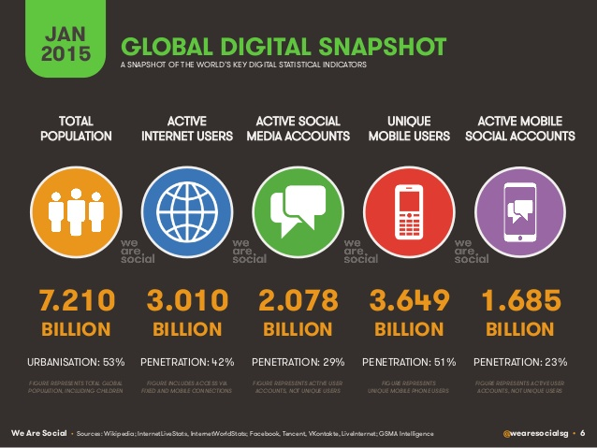

Slide 45
Triple Revolution
Internet Revolution
Mobile Revolution
Social Media Revolution
Information is now. . .
  Portable
  Personal
  Participatory

Slide 46
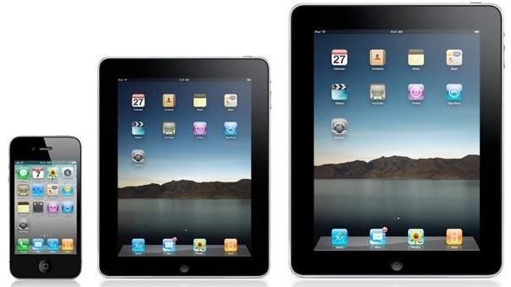


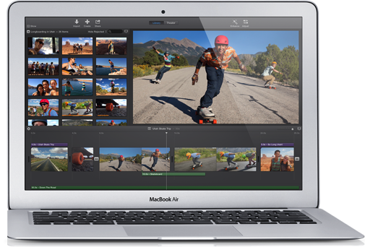


Slide 47


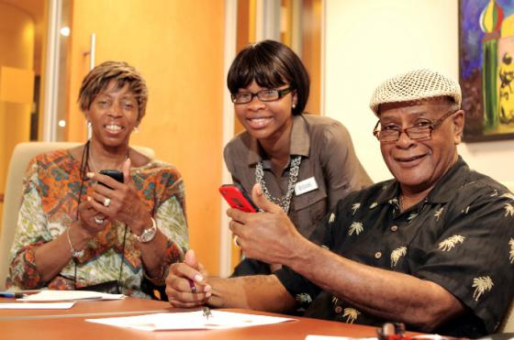
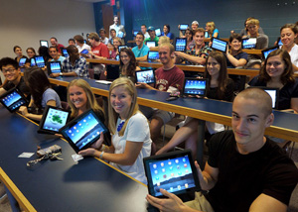

Slide 48












Slide 49

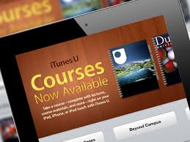



Slide 50
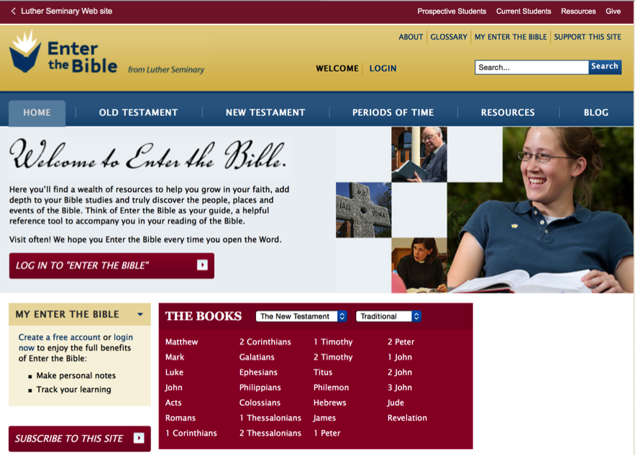
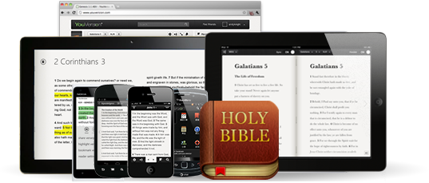
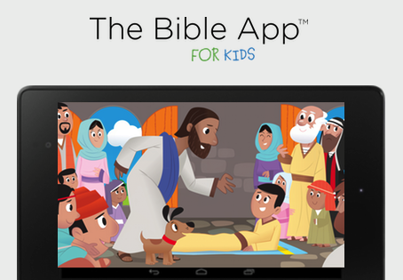

Slide 51
Part 3. Networked Learning

Slide 52
Learning in a Network
Bible
Course
Online course
Book
Mentor
Video Program
Bible study group
Bible app
Audio book/podcast
Organize a study group

Slide 53
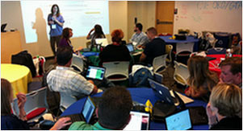
Learning in the 21st Century
A shift from education to learning anywhere, anytime.
A shift from consumption of information to
participatory learning.
A shift from institutions to networks.

Slide 54
21st Century Learning
What if learning adapted to each person instead of expecting each person to adapt to the school or the curriculum or the program?
Putting learners at the center
Enabling learners to be co-creators of their learning experiences
Connecting learning to life concerns and real world issues

Slide 55

Personalized Learning & Faith Growth
Resource
Resource
Resource
Resource
Resource
Resource

Slide 56
Personalized Faith Formation
Personalized pathways for discipleship & faith growth. . . .
Guide people in discerning their religious and spiritual needs
Equip people with the resources and tools to learn and grow at their own pace
Provide mentoring and support for the journey

Slide 57
The Flow of Personalized Learning
Discerning Learning Needs
Working with a Mentor/Guide
Finding Resources on the Network
Engaging in Formation in a Variety of Learning Environments
Sharing Learning with Others
Reflecting on Growth & Identifying New Needs

Slide 58


Slide 59
Networked Faith Formation
Faith formation provides a variety of experiences, programs, activities, resources, and social connections that are available anytime and anywhere, in physical places and online spaces, and conducted in variety of settings—self-directed, mentored, at home, in small groups, in large groups, church-wide, in the community, and in the world.
Faith formation incorporates digital platforms (websites) that integrate all of the content (programs, activities, resources), connect people to the content and to each other, provides continuity for people across different learning experiences, and is available anytime, anywhere, anyplace, 24x7x365.

Slide 60
Faith Forming Processes
GROWTH IN FAITH
Caring Relationships
Rituals & Milestones
Church Year Seasons
Worshipping
Learning the Tradition
Praying
Spiritual Formation
Reading the Bible
Serving Working for Justice Caring for Creation

Slide 61
Designing a Network: Content Areas
Caring Relationships
Celebrating the Seasons
Celebrating Rituals & Milestones
Learning the Christian Tradition
Praying & Spiritual Formation
Reading the Bible
Serving, Working for Justice, & Caring for Creation
Worshipping God
Missional
Life Issues
Life-Stage
Major Programs
Faith Community
Content Area
Content Area
Content Area
Content Area
Content Area
Content Area

Slide 62
Programming
Content Area
Activity 1
Resource
Resource
Activity 3
Resource
Resource
Activity 2
Resource
Resource

Slide 63
Families with Children
Faith
Formation
Network
Intergenerational Faith Community
For Parents
Faith Practices @ Home: Seasons of the Year
Sunday Worship
@ Home
Faith Practices @Home: Bible & Learning the Faith
Children’s Programs & Events
Faith Practices @Home: Rituals & Milestones
Faith Practices @ Home: Service
Family Life Assets
Missional / Discovering Faith

Slide 64
Faith Practices
@ Home
Daily Devotion
Resources
Serving Others
Resources
Reading the Bible
Resources
Caring Conversations
Resources
Church Year Seasonal
Learning about Faith
Resources
Resources
Rituals
Resources
Children & Families
Network

Slide 65
Adult
Faith Formation
Network
Faith Enrichment
Sunday Worship
Intergenerational Faith Community
Grand-parents
Spiritual Enrichment
Life Issues & Milestones
Scripture Enrichment
Liturgical Seasons
Service & Mission
Discovering Faith

Slide 66
Adult
Faith Formation
Network
Spiritual Enrichment
Online Courses
Retreats
Small Group Bible Study
Spiritual Book of the Month Club
Monthly Spiritual Practices Series
Apps & E-newsletters
Day at the Monastery
Online Prayer & Spirituality
Resource
Resource
Resources
Resources
Resource
Resource
Resource
Resource

Slide 67
Three Seasons of Programming
Fall Season: September 1 – January 1
Winter/Spring Season: January 1 – May 1
Summer Season: May 1 – September 1
Fall
Winter-Spring
Summer

Slide 68

Digital Platform
Other Platforms
www.wordpress.org www.wix.com www.squarespace.com

Slide 69
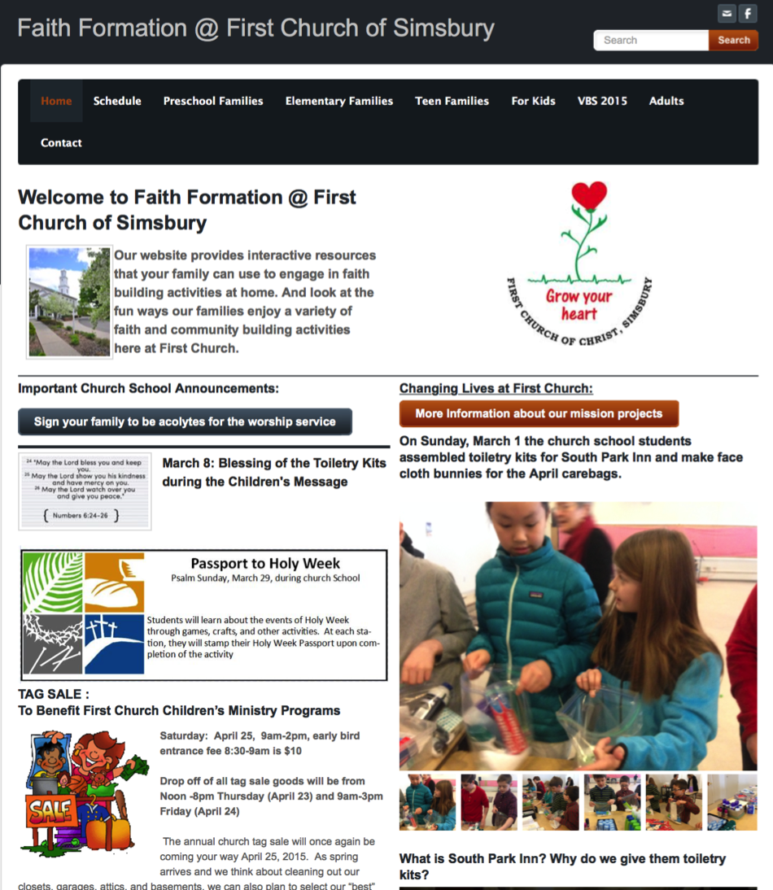

Slide 70
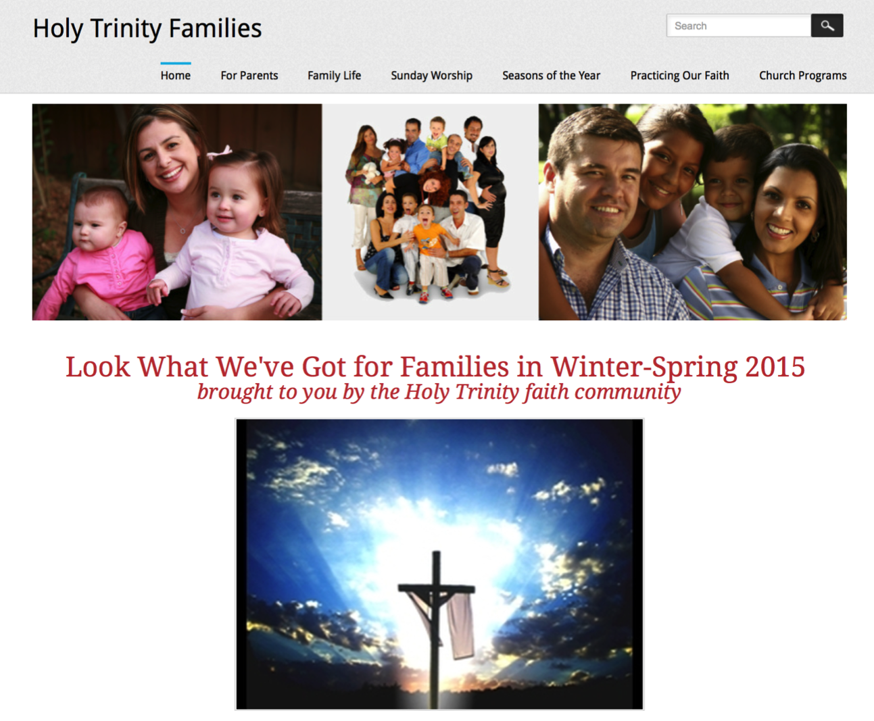

Slide 71
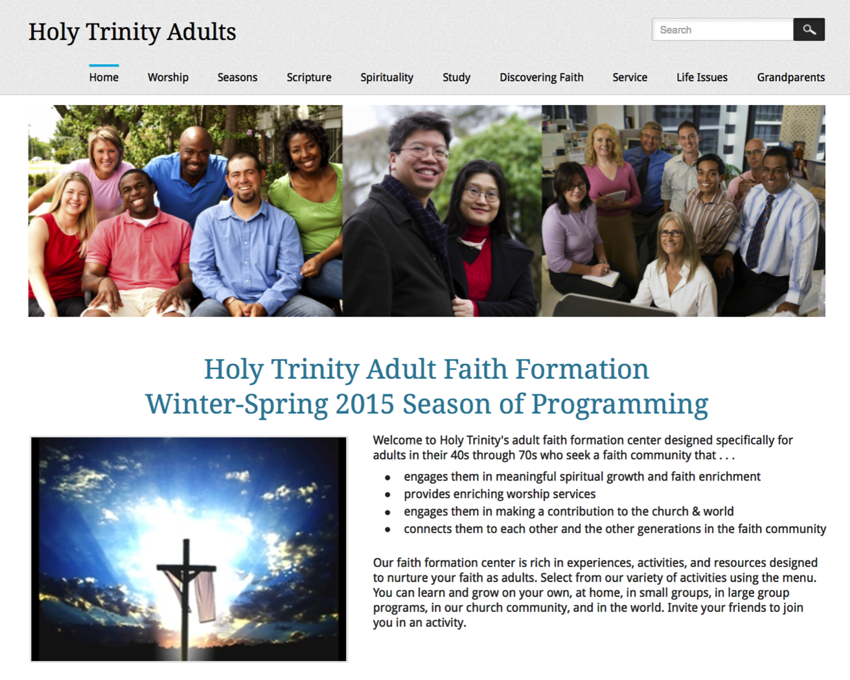

Slide 72
Curriculum Planning
Process | IG | Young Child & Family | Older Child & Family | Young Adol & Family | Older Adol & Family
Caring Relationships
Church Year Feasts & Seasons
Learning the Tradition
Prayer & Spiritual Formation
Reading the Bible
Rituals & Milestones
Service & Working for Justice
Worship
Missional
Life Issues

Slide 73
Curriculum Planning
Process | IG | Young Adult | Midlife Adult | Mature Adult | Older Adult
Caring Relationships
Church Year Feasts & Seasons
Learning the Tradition
Prayer & Spiritual Formation
Reading the Bible
Rituals & Milestones
Service & Working for Justice
Worship
Missional
Life Issues

Slide 74
Part 4. Digitally-Enabled Faith Formation

Slide 75
Digitally-Enabled Faith Formation
We now have the technology, online platforms, and digital content to:
engage people with a wide variety of faith forming content for all ages - anytime, any place
extend church events into people’s daily lives via online content and experiences
connect faith formation in gathered settings with faith formation in online settings
offer a variety of online faith formation content, experiences, and courses for self-study and small group study

Slide 76
Digitally-Enabled Faith Formation
Fully Online Faith Formation
Mostly Online with Regular Interaction in Gathered Sessions
Online Faith Formation & Gathered Sessions (Flipped Classroom)
Gathered Program with Supportive Online Content
Gathered Program with Online Components beyond the Program

Slide 77
Gathered with Online Content
A gathered program using online content from websites, videos from YouTube or other video sites, and blogs and other social media. With an abundance of high quality digital content, this first option is the easiest way to bring the digital world into a gathered program.

Slide 78
Gathered and Online Content
Connecting church programs or events with online content that extends and deepens the experience through learning, prayer, ritual, action, etc.
  Sunday worship & church year feasts and seasons
  Intergenerational & family programs
  Children, youth, and adult classes & programs
  Extended programs: mission trips, retreat experiences, and vacation Bible school, summer camp

Slide 79
Church Event or Program
At Home & Daily Life

Slide 80
Event or Program
TALK
Conversation Activities
LEARN
Read
Listen
Watch
ACT
Practices
Service
Projects
PRAY
Devotions Bible Reading Daily Prayer
SHARE
Blog Facebook
Video
Projects

Slide 81
Example: Sunday Worship
Church Life ➔ | Daily & Home Life | ⬅ Online Life
Experience of Worship in the Congregation Sunday worship and lectionary Church year feasts and seasons Church rituals: baptism, communion, funerals, etc. | Experience of Sunday worship, rituals, and church year seasons in daily life Reflecting on the sermon and readings at home Practices: Lectio, etc. Application to daily living | Online worship, church year, and lectionary resources on the church’s faith formation website Lectionary commentaries online Video reflections and commentary Online activities and projects

Slide 82
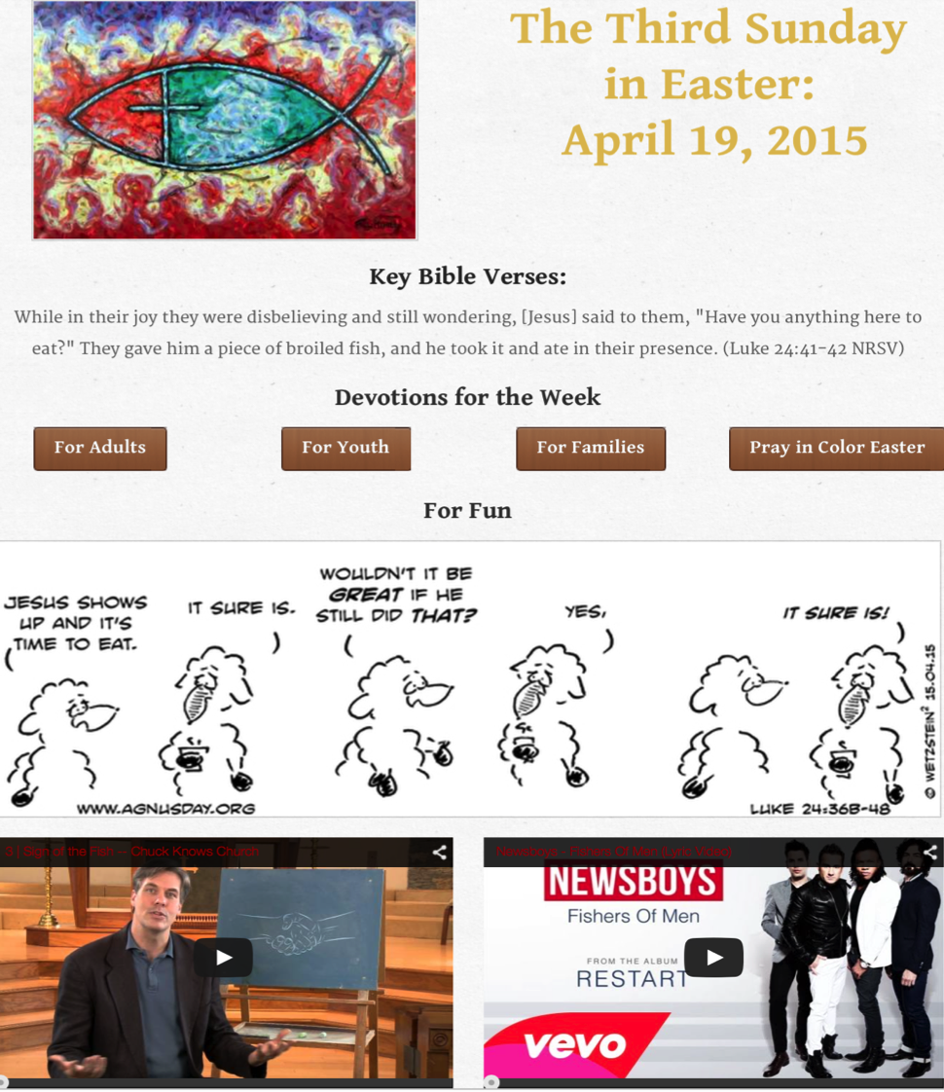

Slide 83
Example: 40-Day Lent Curriculum
Church Life ➔ | Daily & Home Life | ⬅ Online Life
Ash Wednesday Lenten Sunday liturgies Stations of the Cross Lenten prayer Lenten retreat Lenten service Lenten soup suppers | Fasting Praying Service/Almsgiving Lectionary reflection Family activities | Lenten learning resources Lenten calendar Daily Lenten prayer Weekly table prayer Video resources Online retreat experience

Slide 84
Online and Gathered
“Flip the classroom or program” by creating a digital platform to provide the content that people would learn in the gathered setting in an online learning space using print, audio, video, and more. And then transform the gathered program using interactive activities, discussion, project-based learning, and practice and demonstration.

Slide 85
Online and Gathered
  Flip children’s programming: At home learning with parents (print, video, online); in-class application with activities, project-centered learning
  Flip confirmation programming
  Develop a online justice and service center

Slide 86
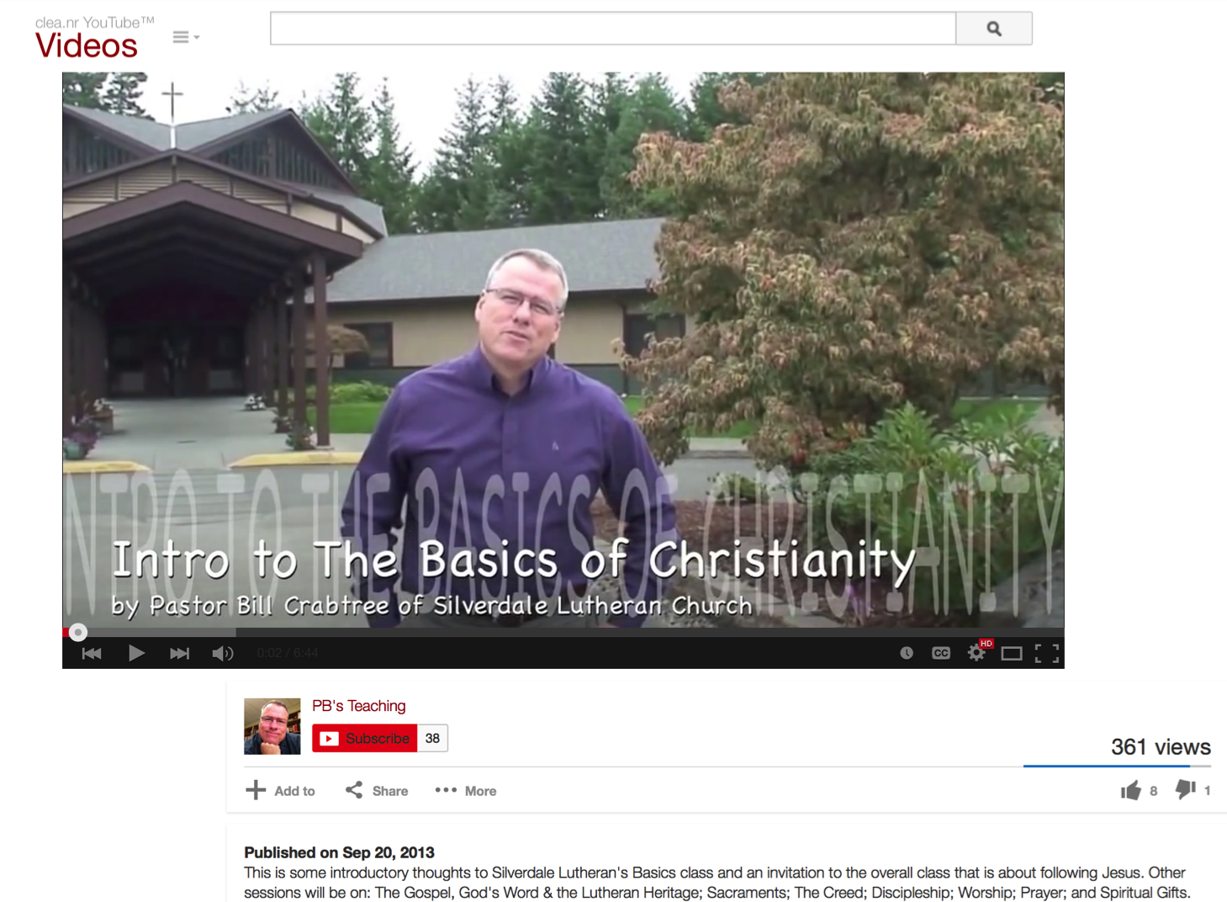

Slide 87
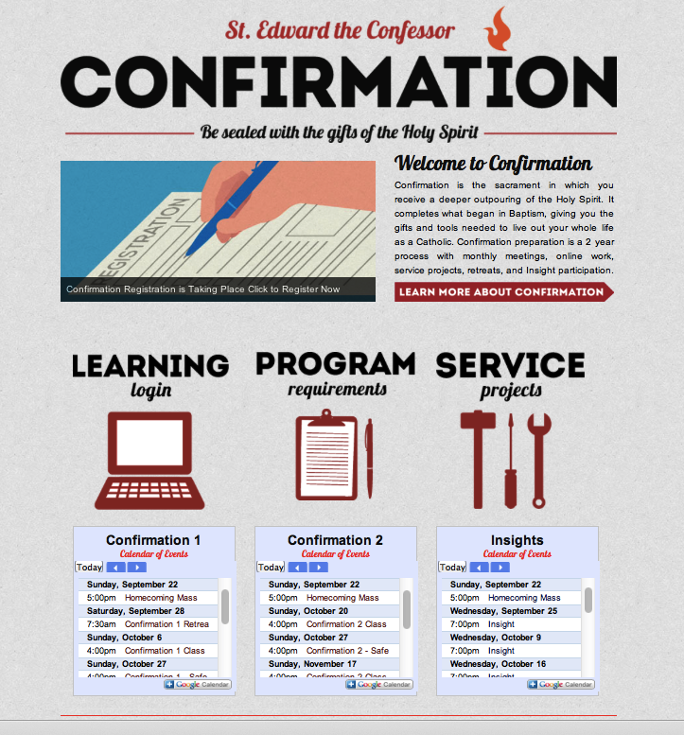

Slide 88
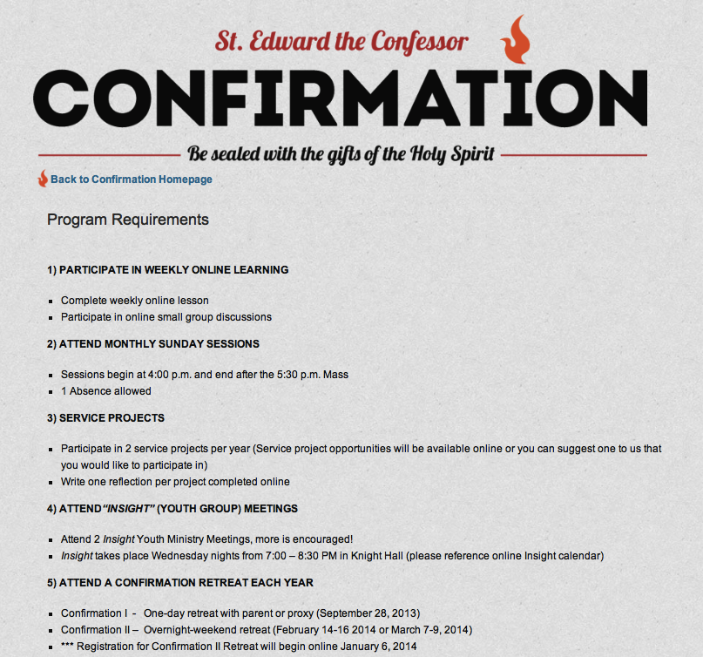

Slide 89
Mostly Online
Offering opportunities for individuals, families, and small groups to utilize the digital platform as their primary learning setting and provide opportunities for regular interaction in face-to-face, gathered settings or in a web conference format, such as a Google+ Hangout.
  Parent webinar programs delivered to parents at home in four-month semesters: three webinars followed by a parent gathering at church; three more webinars and concluding with a parent gathering at church.

Slide 90
Mostly Online
  Online learning resources for self-study or small group study, and gathering at the conclusion to share their insights with others who participated.
  Online Bible study where groups can meet regularly in a physical setting or virtually through Skype or a Google+ Hangout for sharing their learning.
  Selected online courses and activities from colleges, seminaries, and religious organization for individualized learning with the option for a mentor or small group gathering.

Slide 91

Web Conferencing
Online Course, Small Group,
Workshop, or 1-1 Mentoring
Broadcast a Presentation
Record the Presentation

Slide 92
Fully Online
The rise of high quality and easily accessible online religious content—courses, activities, print and e-books, audio and video programs, and content-rich websites—has made designing online faith formation feasible.
  Online Bible and theology courses, video programs, webinars for individual study

Slide 93
Fully Online
  Online prayer and spirituality center where people can access daily prayer reflections and devotions, offer prayer intentions, pray for others, learn about spiritual practices, download prayer activities for the home
  Online parent resource center with the best knowledge, practices, and tools for parenting (print, audio, video)
  Online retreat experience

Slide 94
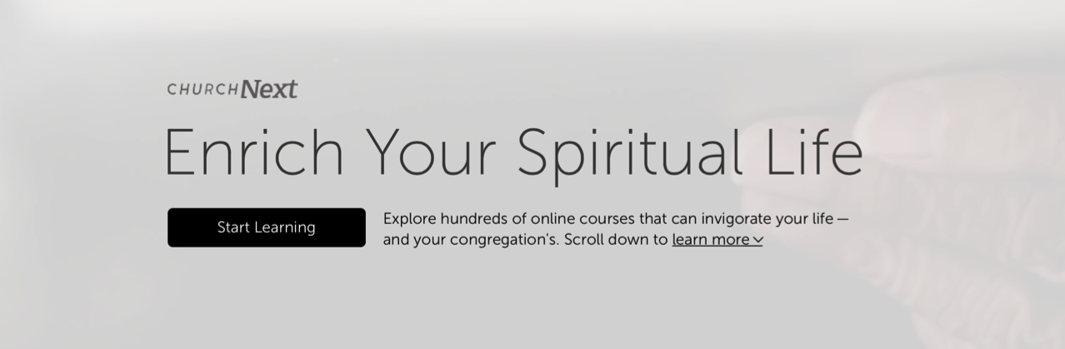
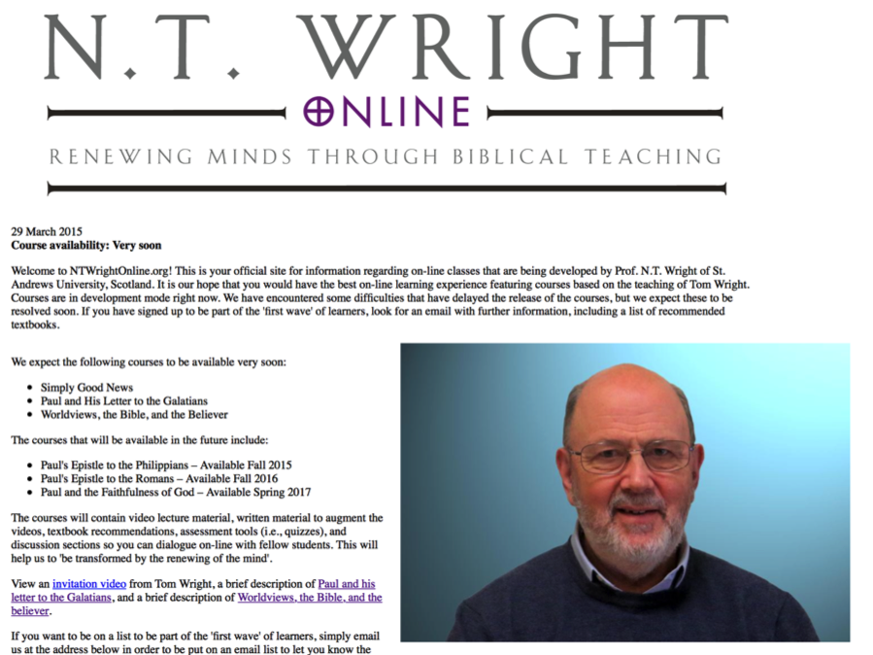

Slide 95
Emerging Roles
Current Roles
Emerging Roles
Developing religious content
Designing programming
Managing programming
Teaching/Facilitating programming
Designing learning environments—architecture
Curating religious content and experiences

Slide 96

Part 5. Curation

Slide 97
Emerging Roles
Current Roles
Emerging Roles
Developing religious content
Designing programming
Managing programming
Teaching/Facilitating programming
Designing learning environments—architecture
Curating religious content and experiences

Slide 98
What is Content Curation
(Beth Kanter)
Content curation is the process of sorting through the vast amounts of content on the web and presenting it in a meaningful and organized way around a specific theme.
The work involves sifting, sorting, arranging, and publishing information.
A content curator picks the best content that is important and relevant to share with their community.
It isn’t unlike what a museum curator does to produce an exhibition: They identify the theme, they provide the context, they decide which paintings to hang on the wall, how they should be annotated, and how they should be displayed for the public.

Slide 99
Faith Formation Curators
A Faith Formation Curator is a trusted guide who continually finds, groups, organizes, evaluates, and connects the best and most relevant content and experiences on a specific topic to match the needs of a specific audience.

Slide 100
Curating Religious Content
Research & Organize Resources
Identify Potential Resources for Programming
Evaluate Resources
Select & Connect Resources to programming

Slide 101
Build a Curation Support System
Develop trusted expert curators to assist.
Develop a list of high quality online resource centers.
Subscribe to faith formation blogs and newsletters.

Slide 102
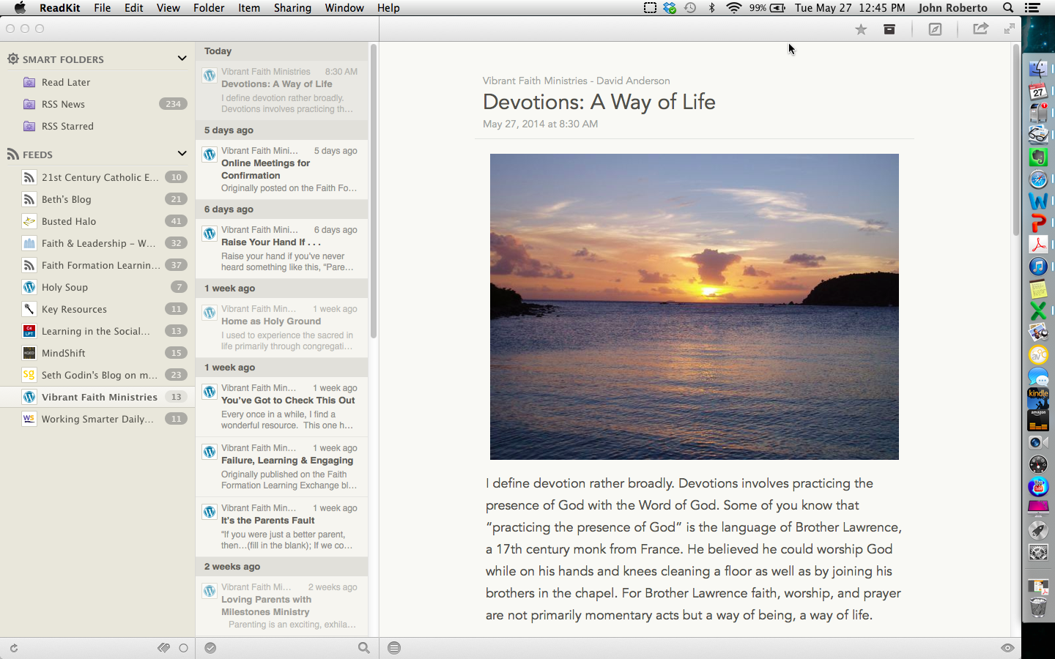
Curate with ReadKit - Mac & iOS

Slide 103
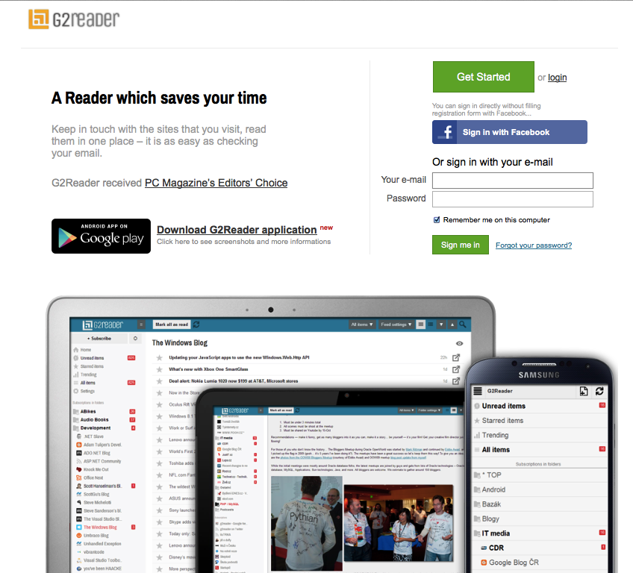
Curate with G2Reader - PC & Android

Slide 104
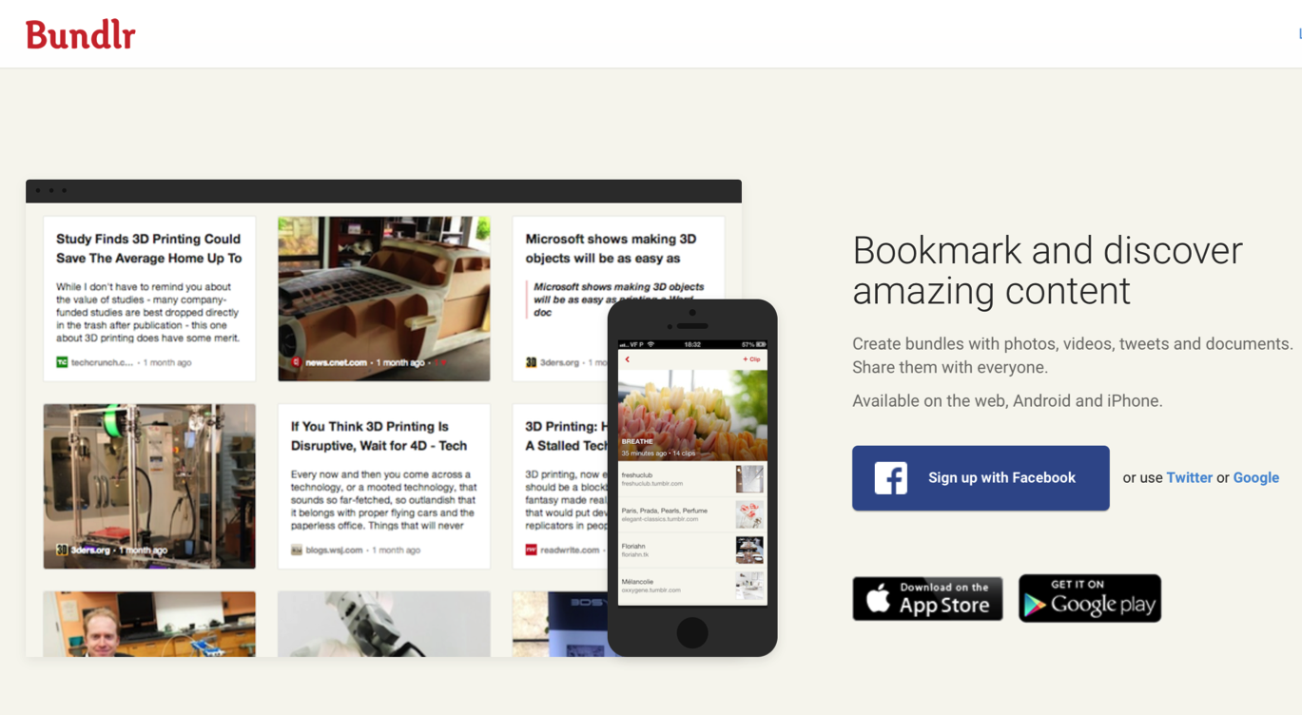
Curate with Social Bookmarking

Slide 105
Research Checklist
People: teachers, mentors/guides, program leaders, small group leaders, guest presenters
Community programs: churches, agencies, organizations,
Educational institutions: colleges, seminaries, educational organizations
Retreat and spiritual life centers, monasteries
Regional and national denominational programs, events, websites
Museums
Books (with study guides) & E-books
Apps
Audio podcasts & audio learning programs
Videos & Video learning programs
Online courses & online activities
Television shows
Organizational websites
Resource center websites

Slide 106
Evaluation Criteria
Biblical content and interpretation
Theological content and emphasis
Developmental appropriateness
Ethnic-Cultural appropriateness
Inclusive of diversity
Respect for diverse ways of learning
Appearance and visual appeal
Ease-of-Use
Quality of Experience
Applicable: Able to be incorporated into daily and home life

Slide 107
Curating Religious Content
Research & Organize Resources
Identify Potential Resources for Programming
Evaluate Resources
Select & Connect Resources to programming

