Slide 1
Interpreting the Religious & Spiritual Needs of People Today

Slide 2
Driving Forces
Driving forces are the forces of change—social, economic, political, technological, educational, cultural, and religious—that are most likely to affect the future shape of faith formation and significantly influence the nature or direction of the faith formation scenarios.

Slide 3
Driving Forces: Outside-In Thinking

Slide 4
Driving Forces
1. Declining number of Christians & growing number with no religious affiliation
10% drop in the number of Christians
15% of all Americans claim no religious affiliation
25% of all 18-29 year olds
The challenge to Christianity in the U.S. does not come from other religions but from a rejection of all forms of organized religion.

Slide 5
Driving Forces
This growing non-religious minority reduces the traditional societal role of congregations in family celebrations of life-cycle events.
Forestalling of religious rites of passage, such as marriage and baptism, and the lowering expectations on religious funeral services, could have long lasting consequences for religious institutions.

Slide 6
Driving Forces
Generational Change
If only the youngest cohort in society changes (and then persists in that new direction throughout their own life cycle), society as whole changes inexorably but almost imperceptibly, like a massive supertanker changing course.
If the differences between one generation and the next are small, then generationally based social change will be real (and significant) but very slow. If for some reason a younger generation deviates substantially from its predecessors, then the aggregate social change may be quick—significant over a few decades.

Slide 7
Driving Forces
Three Seismic Shifts
Major Shock: The Sixties Revolution
Aftershock #1 (1970s-80s): The Rise of Evangelicals and Conservative Churches, and the Religious Right
Aftershock #2 (1990s-2000s): The Rise of Secular Generations

Slide 8
Driving Forces
The rise of the Nones in the 1990s was heavily driven by generational factors.
The incidence of Nones was about 5-7% in the pre-boomer generations who reach adulthood before 1960
Double to about 10-15% among the boomers (who came of age in the 1960s, 70s, and 80s)
After 2000 doubled again to about 20-30% among the post-boomers (who came of age in the 1990s and 2000s).

Slide 9
Driving Forces
Being raised with no religion fueled cohort change
The Nones were disproportionately raised in nonreligious backgrounds, so some of them are the children of boomers who have discard formal religious affiliations a generation ago.
On the other hand, the rise of the Nones is apparent even among young people whose parents were religiously observant.

Slide 10
Driving Forces
Putnam and Campbell suggest the dramatic contrast between a young generation increasingly liberal on certain moral and lifestyle issues (though still potentially open to religious feelings and ideals) and an older generation of religious leaders who seemed to them consumed by the political fight against homosexuality and gay marriage was an important source of the second aftershock.

Slide 11
Driving Forces
When asked why the rejected religious identification, the new Nones reported that “they became unaffiliated, as least in part, because they think of religious people as hypocritical, judgmental, or insincere. Large numbers also say they became unaffiliated because they think that religious organizations focus too much on rules and not enough on spirituality. This youthful generation seems unwilling or unable to distinguish the stance of the most visible, most political, and most conservative religious leaders from organized religion in general.

Slide 12
Driving Forces
2. Increasing number of people becoming more “Spiritual” and less “Religious”
Today, 18% of 18-39 year olds say that are “spiritual, but not religious” compared to only 11% a decade ago.
People’s spiritual inclinations do not lead them to be involved in an organize religious community.
Religious tinkering: In our increasingly pluralistic society, to be “spiritual” is more likely to represent an eclectic spirituality, drawing not only from the various streams of Christianity, but including elements of other religious traditions

Slide 13
Driving Forces
3. Declining Participation in Churches
Steady erosion in Mass attendance:
44% in 1987 37% in 1999
33% in 2005 30% in 2010
CARA: 22% attend Mass every week
Pre-Vatican II (before 1940): 60%
Vatican II (1941-60): 35%
Post-Vatican II (Gen X 1960-79): 26%
Post-Vatican II (Millennial 1980-99): 15%

Slide 14
Driving Forces
Marrying later and beginning families later
Dramatic decline in the number of marriages in the Church
50% decline in the past 20 years
33% of Post-Vatican II Catholics marry outside the Church
Increase in interfaith marriages
40% among Post-Vatican II generation
50% of all non-Latino marriages

Slide 15
Driving Forces
Participation Trends in the Catholic Church 2001-2010
(Using figures from the Official Catholic Directory)
2001 2008 2010
Catholic population 65.3 million 68.1 68.5
Parishes 19,496 18,674 17,958
Marriages 257,000 192,000 -
Infant Baptisms 1 million 887,000 857,410
Adult Baptisms 162,000 124,000 119,00
First Communions 893,000 822,000 -
Confirmations 629,000 622,000 -
Children (parish) 3.5 million 3.1 million 3.1 million
Teens (parish) 767,000 722,000 689,552
Grade school 2 million 1.6 million 1.5 million
HS students 682,000 674,380 611,723

Slide 16
Driving Forces
4. Increasing Diversity & Pluralism in U.S. Society
Diversity of ethnic cultures and nationalities
No single authority exercises supremacy; no single belief or ideology dominations
Tapestry of religious and spiritual alternatives and choices
Crisscrossing religious boundaries
“Spiritual tinkerers”

Slide 17
Driving Forces
5. Influence of Individualism on Christian Identity and Community
Religious identity is more autonomous and deliberate today.
Decline in the perceived necessity of communal or institutional structures as constituent of religious identity.

Slide 18
Driving Forces
6. Changing Structures & Patterns of Family Life in the U.S.
Delaying marriage
Having fewer children and later in life
Decreasing number of children in two-parent households
Increasing number of unmarried couples living together
Increasing time caring for children

Slide 19
Driving Forces
7. Declining Family Religious Socialization
Parent Influence: The single most important social influence on the religious and spiritual lives of adolescents is their parents.
Embedded Family Religious Practices: Effective religious socialization comes about through specific religious activities that are firmly intertwined with the daily habits of family life.

Slide 20
Driving Forces
Inherited vs. Choosing Religion
Less than two-thirds of all Americans simply inherit their parents’ religion.
Fidelity to one’s parents’ religion is twice as high among blacks and Latinos as among whites and Asian Americans.
So all things considered, roughly 35-40% of all Americans and 40-45% of white Americans have switched at some point away from their parents’ religion.
It is misleading to think of religious identity in contemporary America as an inherited and stable characteristic.

Slide 21
Driving Forces
The most important factor predicting religious retention is whether a person’s family of origin was religiously homogeneous and observant, or not.
Children of mixed marriages are much more likely to leave the faith within which they were raised—more likely to become Nones or attend religious services rarely. People who were involved as children in religious activities are significantly less likely to leave their parents’ faith as adults.
More and more Americans are choosing their religion independently of both their family of origin and their current family.
Many Americans—at least one third and rising—nowadays choose their religion rather than simply inheriting it. Religion in America is increasingly a domain of choice, churn, and surprisingly low brand loyalty.

Slide 22
Driving Forces
“. . . teenagers with seriously religious parents are more likely that those without such parents to have been trained in their lives to think, feel, believe, and act as serious religious believers, and that that training “sticks” with them even when the leave home and enter emerging adulthood”

Slide 23
Driving Forces
“Emerging adults who grew up with seriously religious parents are through socialization more likely (1) to have internalized their parents religious worldview, (2) to possess the practical religious know-how needed to live more highly religious lives, and (3) to embody the identity orientations and behavioral tendencies toward continuing to practice what they have been taught religiously.”

Slide 24
Driving Forces
“At the heart of this social causal mechanism stands the elementary process of teaching—both formal and informal, verbal and nonverbal, oral and behavioral, intentional and unconscious, through both instruction and role modeling. We believe that one of the main ways by which empirically observed strong parental religion produced strong emerging adult religion in offspring is through the teaching involved in socialization.”
(Souls in Transition: The Religious & Spiritual Lives of Emerging Adults by Christian Smith with Patricia Snell)

Slide 25
Driving Forces
8. Increasing Numbers of Adults 65 and Older
By 2030, when all Baby Boomers will have turned 65, fully 18% of the nation’s population will be at least 65.
In the United States today Americans over 65 now outnumber teenagers by nearly two to one. America is in the midst of a demographic revolution, but this revolution is about much more than longevity.
America is witnessing the emergence of a new stage of life between adult midlife and old age.

Slide 26
Driving Forces
[This is] the period in which individuals begin to think about, plan for, and actually disengage from their primary career occupations and the raising of children; develop new identities and new ways to be productively engaged; establish new patterns of relating to spouses, children, siblings, parents, friends; leave some existing relationships and begin new ones. As in adolescence, people in the midcourse years are thinking about and enacting role shifts that are both products of their past and precursors of their future life course.
(Phyllis Moen, “Midcourse: Navigating Retirement and a New Life Stage”)

Slide 27
Driving Forces
9. Increasing Impact of Digital Media & Web Technologies
93% of teens & young adults are online
“Computer in your pocket” - increasing mobile access - iPhone
8-18 year olds spend on average 7½ hours a day with media

Slide 29
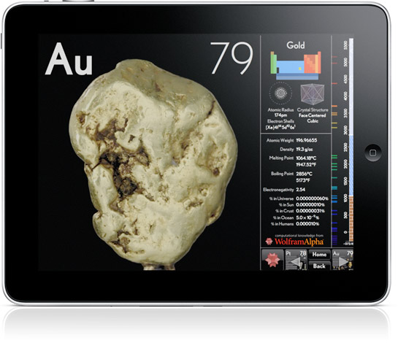

Slide 32
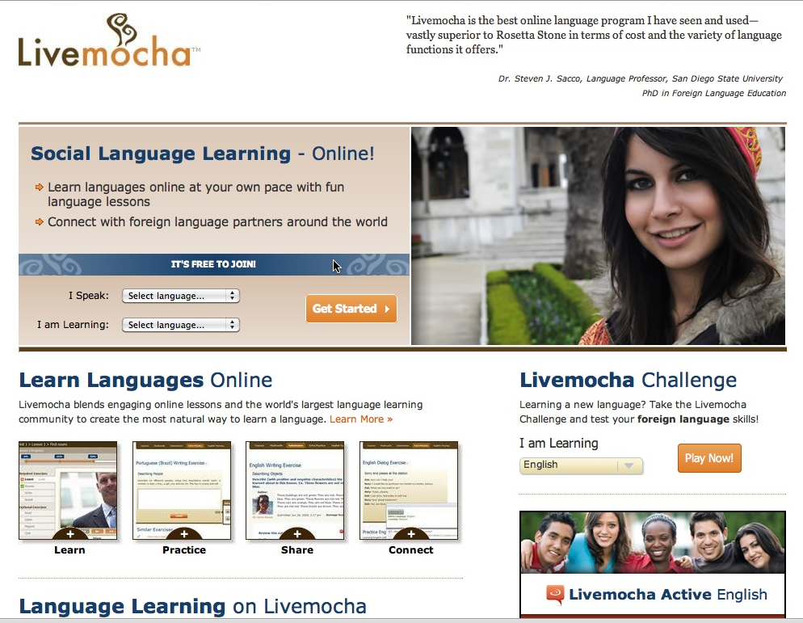

Slide 33
Four Scenarios

Slide 34
4 Scenarios
Scenarios are built around critical uncertainties about the external environment. That is, the stories are based on different outcomes of a few key uncertainties that are both most important to the future of faith formation in Christian churches and most uncertain in terms of future outcome.

Slide 35
4 Scenarios
Two Critical Uncertainties
Will trends in U.S. culture lead people to become more receptive to organized religion, and in particular Christianity or will trends lead people to become more resistant to organized religion and Christianity?
Will people’s hunger for and openness to God and the spiritual life increase over the next decade or will people’s hunger for and openness to God and the spiritual life decrease.

Slide 36
Matrix
Dominant Cultural Attitude toward Organized Religion
Receptive
Low High
People’s Hunger for God and the Spiritual Life
Resistant

Slide 37
4 Scenarios
Receptive to Scenario #4 Uncommitted but Participating | Organized Religion Scenario #1 Vibrant Faith and Active Engagement
Low Hunger Scenario #3 Unaffiliated and Uninterested Resistant to | for God High Scenario #2 Spiritual but Not Religious Organized Religion

Slide 38
Scenario #4 + digital media & web 2.0 + family faith formation, especially young families + milestones faith formation + pathways to deepen faith & engagement | Scenario #1 + digital media & web 2.0 + targeting the iGeneration & Millennials + targeting young families + targeting Baby Boomers + empowering the community to share their faith
Scenario #3 + using digital media & web 2.0 + Third Place settings + community-based ministry, e.g., transforming the world projects | Scenario #2 + digital media & web 2.0 + Third Place settings + targeting spiritual seekers + discipleship apprenticeships + developing pathways to deepen faith & engagement

Slide 39
Apply
Applying the 4 Scenarios
Who are the people in your community in each scenario? Describe them.
What are the religious and spiritual needs of people in each scenario? Describe one or two aspects of their religious and spiritual needs.
How is your church addressing the spiritual and religious needs of people in each scenario?

Slide 40
Assess
Assessing the Impact of the 4 Scenarios
What are the challenges that each scenario presents for your parish community?
What are the opportunities that each scenario presents for your parish community?
What are the implications of not addressing each scenario?
What are the implications of addressing each scenario?

Slide 41
Tools
Tool #1. Inventory
Tool #2. Life Issues & Spiritual and Religious Needs
Focus Group Interviews
Profile of Spiritual and Religious Needs in Each Scenario

