Slide 1
Responding to the Religious and Spiritual Needs of People Today

Slide 2
Strategies
Faith Formation through the Life of the Whole Church
Faith Formation using Digital Media & Web Technologies
Family Faith Formation
Intergenerational Faith Formation
Generational Faith Formation:
iGeneration (2000 - )
Millennials (1980-1999)
Gen X (1964-1979)
Boomers (1946-1964)
Builders (1945 and earlier)

Slide 3
Strategies
Milestones Faith Formation
Faith Formation in Christian Practice
Transforming the World
Spiritual Formation
Multi-Ethnic Faith Formation
Faith Formation for Spiritual Seekers
Apprenticeships in Discipleship
Pathways to Vibrant Faith and Active Engagement

Slide 4
Strategies
Faith Formation in Third Place Settings
Empowering the Community to Share their Faith
Interfaith Education and Dialogue

Slide 5
4 Scenarios
Receptive to Scenario #4 Uncommitted but Participating | Organized Religion Scenario #1 Vibrant Faith and Active Engagement
Low Hunger Scenario #3 Unaffiliated and Uninterested Resistant to | for God High Scenario #2 Spiritual but Not Religious Organized Religion

Slide 6
Scenario #4 + digital media & web 2.0 + family faith formation, especially young families + milestones faith formation + pathways to deepen faith & engagement | Scenario #1 + digital media & web 2.0 + targeting the iGeneration & Millennials + targeting young families + targeting Baby Boomers + empowering the community to share their faith
Scenario #3 + using digital media & web 2.0 + Third Place settings + community-based ministry, e.g., transforming the world projects | Scenario #2 + digital media & web 2.0 + Third Place settings + targeting spiritual seekers + discipleship apprenticeships + developing pathways to deepen faith & engagement

Slide 7
Digital Faith Formation
Blend face-to-face, interactive faith formation with virtual faith formation using web-based technologies and digital media to provide 24x7 faith formation for all ages and generations, anytime and anywhere.

Slide 8
Digital Faith Formation
Face-to-Face
Interactive
Transformative Experiences
Online Community & Blog
Courses & Webinars
Small Groups Study
User-Generated Content
Learning Resources
Audio, Video, Print

Slide 9
Digital & Face-t0-Face
Face-to-Face
Virtual
On Your Own
At Home
In Small Group
In Large Group
In Church
In Community & World
Activity
Activity
Activity
Spiritual & Religious Needs
Topics or Themes

Slide 10
Approach #1
Begin with people’s participation in face-to-face learning activities and extend the learning online.
Sponsor a parish program on the Gospel of Matthew in preparation for Cycle A (a family or intergenerational program, a 3-session adult program, a youth meeting, etc.)
Extend and deepen the learning with online resources
weekly commentaries for each Sunday of Cycle A
online Bible study program (independent or with a small group) on the Gospel of Matthew
a university course on the Gospel of Matthew on iTunes U
an online blog that allows people to post their reflections on each Sunday’s reading and invites discussion online

Slide 11
Approach #2
Begin with people’s participation in online learning activities and invite them to in parish learning programs
Develop an online spiritual formation center (website) for your church using a variety of already existing resources:
daily fixed hour prayer (liturgy of the hours)
weekly and seasonal prayer resources
links to prayer sites around the world
an online retreat (A thirty-four week retreat for Everyday Life from Creighton University
online courses with spiritual guides like Thomas Merton, Joyce Rupp, Henri Nouwen, Joan Chittister from SpiritualityandPractice.com
prayer center to pray for people in the community
links to videos on prayer (YouTube)
online blog for sharing prayer practices and experiences

Slide 12
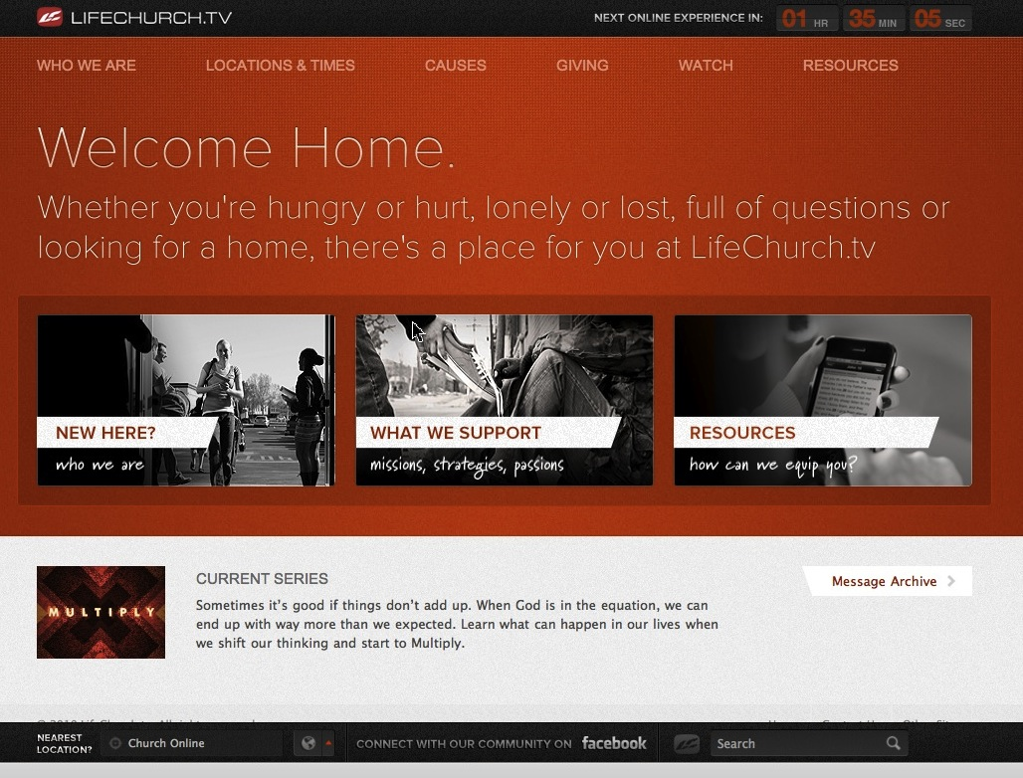

Slide 13
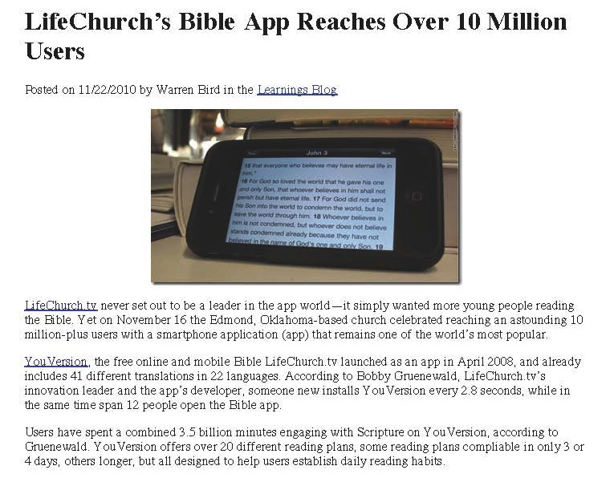

Slide 14
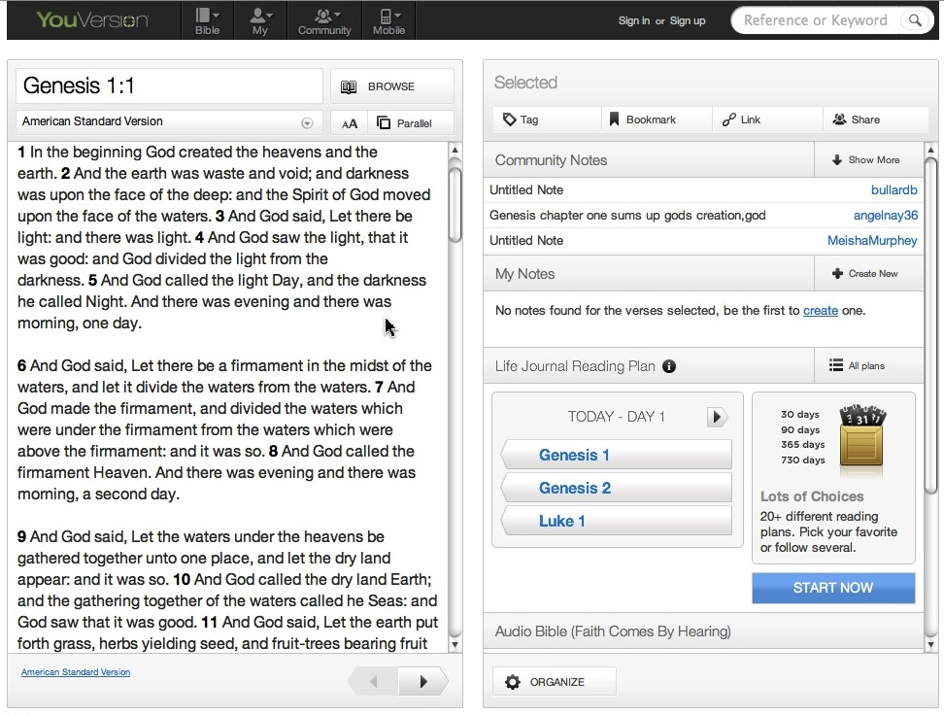

Slide 17
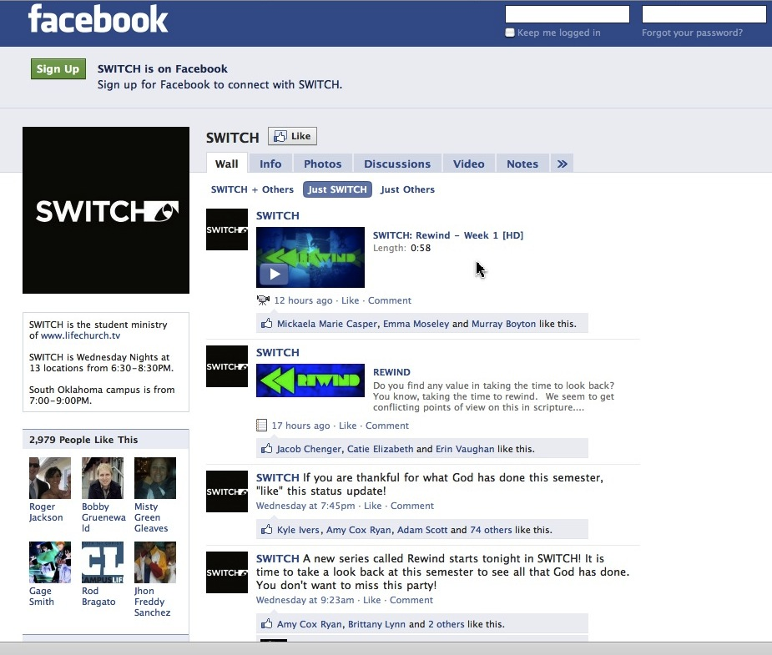

Slide 21
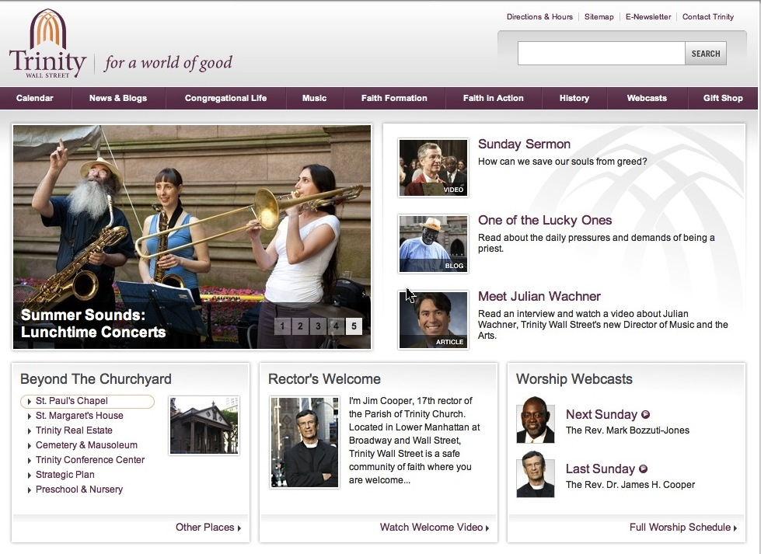

Slide 22
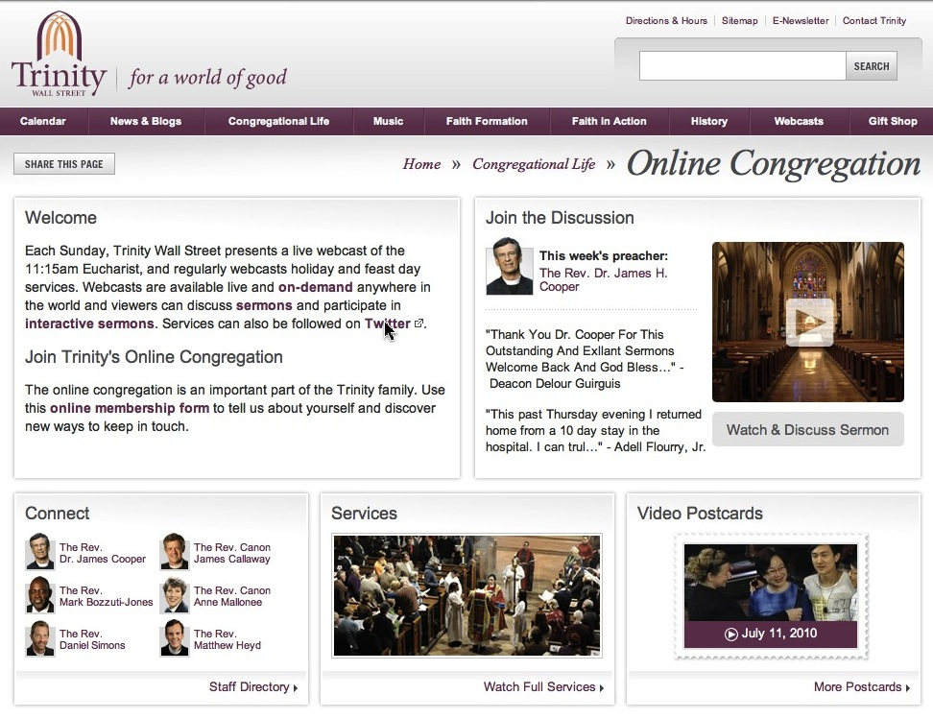

Slide 23
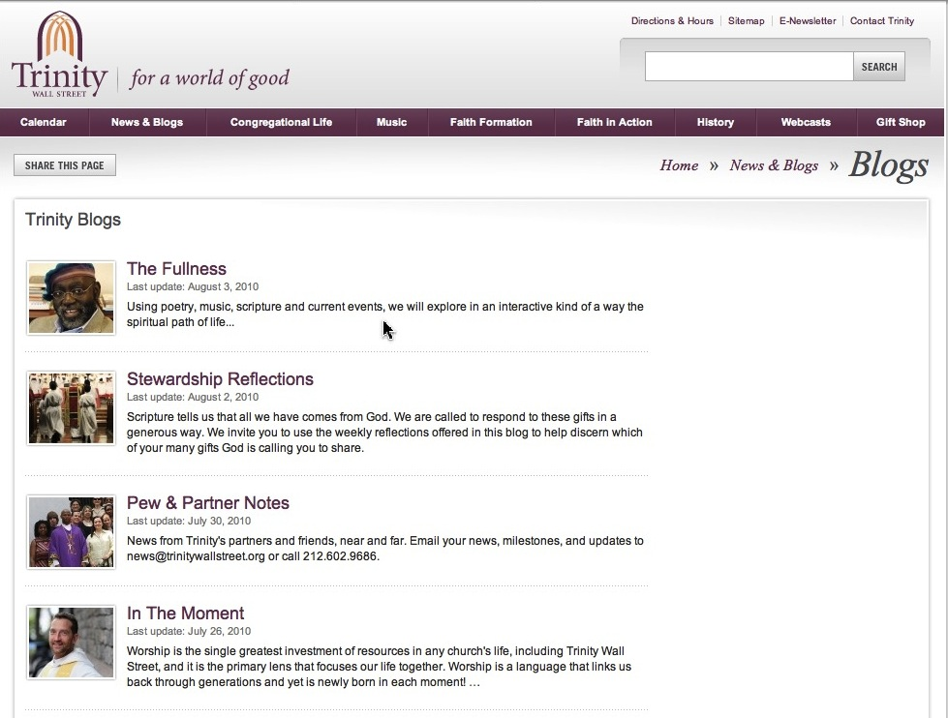

Slide 24
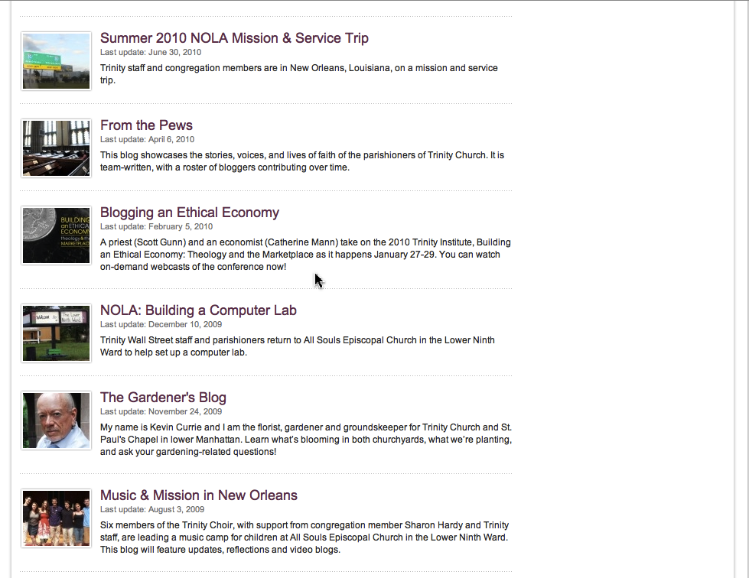

Slide 25
Family Faith Formation
Strengthen family religious socialization, especially in the first decade of life—by nurturing a vibrant faith in parents and equipping them with the skills and tools for developing faith at home.
Develop the home as a center of faith formation by promoting foundational family faith practices: caring conversations, rituals and traditions, prayer, Bible reading, and service.

Slide 26
Family Faith Formation
Educate and equip parents to embed foundational faith practices into the daily experience of family life.
Develop family programs: milestone faith formation, family learning, family service
Engage families more fully in the life and ministries of the church community.

Slide 27
Family Faith Formation
Family Socialization: Begin faith formation early in life – at Baptism and focusing on early childhood.
family faith formation at home – family faith practices
parent formation
parent support system / mentoring
resources for the first 5-6 years of life
milestone faith formation

Slide 29
Generational & Intergenerational
Lifelong faith formation that is generationally-specific, developed around the specific characteristics of the five generations in a faith community AND intentionally intergenerational across all generations in learning, service/mission, worship, community life

Slide 30
Intergenerational
What does
Intentionally Intergenerational
intergenerational learning: large group and small group
intergenerational Bible study
intergenerational service projects and mission trips
infuse intergenerational relationships into existing age-group programming , e.g., mentoring

Slide 31
Intergenerational
What does
Develop a faith formation curriculum for the whole community using intergenerational learning.
Church Year Feasts and Seasons
Creed & Catholic Beliefs
Sacraments
Morality / “Ten Commandments for Today”
Justice, Peace, Care for Creation, Service, Catholic Social Teaching
Prayer Practices and Traditions

Slide 32
Intergenerational
What does
Example: Church Year Feasts and Seasons
Dec Advent & Christmas Seasons (Preparing for and Birth of the Messiah)
Feb Lenten Season (Praying, Fasting, Almsgiving)
Mar Triduum
(Death of the Messiah)
April Easter Season (Resurrection of the Messiah)
May Feast of Pentecost
(Mission of the Church)
Nov Feast of All Saints (Communion of Saints)

Slide 33
Generational
What does
Generationally-Specific
iGeneration (2000 - )
Millennials (1980-1999)
Generation X (1964-1979)
Boomers (1946-1964)
Builders (up to 1945)

Slide 34
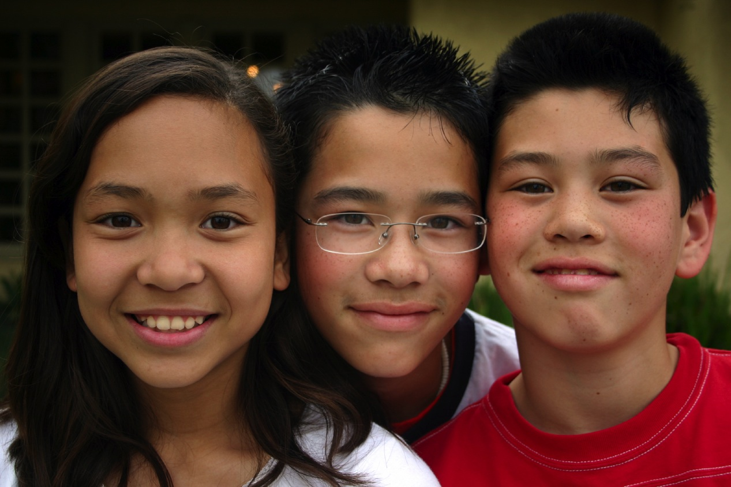

Slide 35
iGeneration
digital natives: web, social networking, digital media
formed by media & visual learners
ability to use technology to create a vast array of content
openness to change
desire for immediacy
learning style: active, engaged, creative (project-centered), visual, practice & performance, digital

Slide 37
Millennials
Expressive Communalism
Emerging adults have embedded their lives in spiritual communities in which their desire and need for both expressive/experiential activities, whether through art, music, or service-oriented activities, and for a close-knit, physical community and communion with others are met. They are seeking to develop a balance for individualism and rational asceticism through religious experience and spiritual meaning in an embodied faith.

Slide 38
Millennials
The dominant characteristic was a desire for a theologically grounded belief that makes sense cognitively, combined with nonrational expressive tendencies—they want a faith that makes cognitive sense to them and that is also an expressive, embodied spiritual experience. Young adult Christians are searching for a more holistic faith than what a purely cognitive and rational approach can offer. They are seeking both a deep spiritual experience and a community experience, each of which provides them with meaning in their lives, and each of which is meaningless without the other.
(Finding Faith by Richard Flory & Donald Miller)

Slide 39
Millennials
Expressive Communalism
expressive/experiential faith activities (worship, learning, rituals, prayer) and physical community with others
a faith that makes cognitive sense to them and that is also an expressive, embodied spiritual experience

Slide 40
Millennials
Creating deeper community through small groups
Making a difference through service
Experiencing worship – reflecting their culture and revering and revealing God (visual, musical, artistic, experiential)
Exploring the Bible and Christian tradition with depth, questioning, and applying faith to life
Utilizing the technology to communicate the message and to connect people
Building cross-generational relationships
Forming the spiritual life – spiritual practices & disciplines

Slide 41
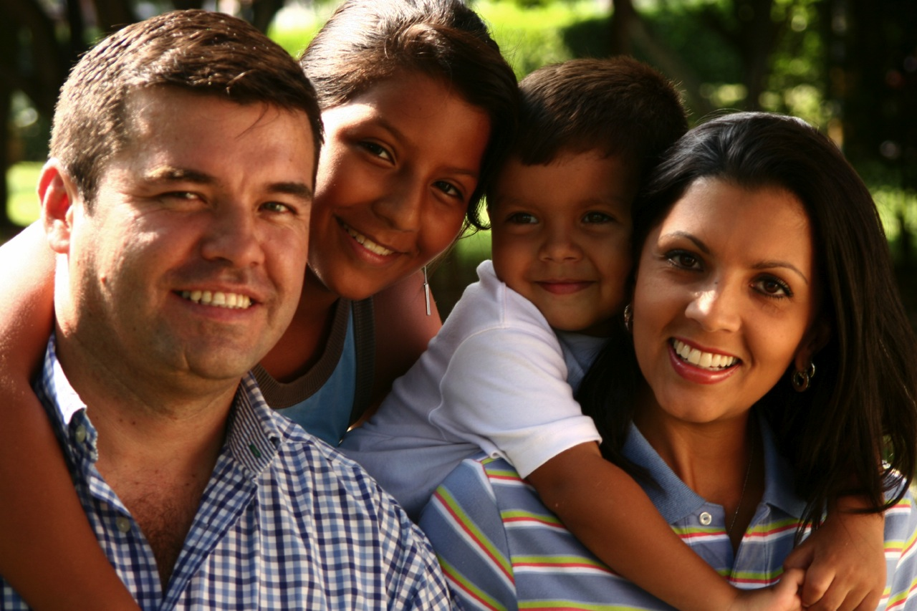

Slide 42
Generation X
Desire first for community and belonging, and second for personal fulfillment. Personal fulfillment comes through commitment to the community, and through the experience of belong to such a religious/spiritual community.
Religious truth, while important to them, is not a fixed target, and is found through their religious experience, not in texts and doctrines. Truth, for Xers, is best conveyed through stories and myth, and is authenticated through the lived experience of themselves and others, rather than through the pronouncements—and propositional arguments—of external authorities.

Slide 43
Generation X
Generation X is moving from written text to narrative and image as a basis for religious belief. Image and story have become dominant and text background.
There is a move from the essentially individualistic spiritual quest that characterizes baby boomers to a religious/spiritual identity rooted in the larger community.
Greater individual authority in religious and moral decisions.

Slide 44
Generation X
Religious identity chosen through experience and study.
Choosing a specific community, rather than committing to a larger denomination.
Being experientially engaged in a religious community, not “show up and watch”
interpersonal relationships with people who express and explore their religious identities in similar ways

Slide 45
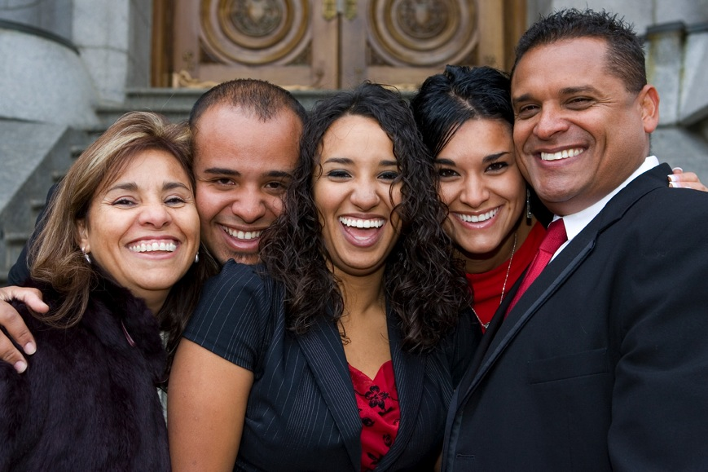

Slide 46
Baby Boomers @ 60

Slide 47
Baby Boomers
Service: Boomers want to do something interesting and challenging. They are ready to jump into a worthwhile cause where they feel that can make a significant difference. Boomers want service opportunities that have a mission. They want do to do things that give their lives purpose, meaning, and fulfillment. They want to know their contributions truly matter. Show Boomers how they might use their past work experiences as tools for service. Help them tap into their passion.

Slide 48
Baby Boomers
Spiritual Growth: Later Adulthood is a season of significant life transitions and people are more responsive to religion. A second reason is Boomers quest to find meaning and purpose in life as they enter the second half of life and evaluate the things that really provide lasting fulfillment. A third reason adults are open to faith and spiritual growth is their desire for meaningful relationships.
small group faith formation
host events that appeal to interests & needs
service opportunities

Slide 49
Baby Boomers
Intergenerational Relationships: Developing intergenerational relationships is one of the best ways to break age-related stereotypes, to share faith across generations, and to help the church become more unified
encourage generations to serve together
form groups according to similar interests rather than age
encourage adults to pray for young people and vice versa
host strategic intergenerational events
ask adults to tell their stories, at events or programs, and capture them on video or in print

Slide 51
Builder Generation
Spiritual enrichment: “spirituality of aging” programs, spiritual disciplines and practices, retreats, rituals to acknowledge life transitions
Learning: book clubs, classes and courses, Bible study, small groups, trips
Nutrition and wellness: exercise programs, nutrition classes, healthy meals with programs
Intergenerational: activities, coaching, mentoring
Service: tutoring, service—local and global, church ministry
Community: social activities, trips, dinners, pilgrimages

Slide 52
Milestones
Faith Formation
Develop faith formation (learning, worship/ritual, faith practices) around lifecycle milestones, sacramental celebrations, and life transitions to deepen people’s faith, strengthen their engagement in church life, and equip them with practices for living their faith.

Slide 53
Milestones Faith Formation
Birth / Baptism & Anniversaries of Baptism
Welcoming Young Children to Worship
Starting Faith Formation at Church
Starting School
Blessing of Backpacks
First Communion
Receiving a first Bible
Confirmation
Graduation (HS, College)
A New Home / Apartment
Career / First Job
Engagement
Wedding
Retirement or AARP Card
Adult Transitions
Death / Funeral

Slide 54
Faith Stepping Stones
Stone 1: Raising a Healthy Baby
physical, emotional and spiritual needs of infants and their parents; nightly blessing as a family faith practice.
Stone 2: Raising a Healthy Preschooler
physical, emotional and spiritual needs of preschoolers and their parents; add prayer to the nightly blessing as a faith practice

Slide 55
Faith Stepping Stones
Stone 3: Entry Into School
physical, emotional and spiritual needs of kindergarteners and their parents; share highs & lows with children and add it to their nightly prayers and blessing
Stone 4: My Bible
120 key verses in young readers’ Bibles; reading a Bible verse nightly, continue with highs & lows, prayer and blessing nightly

Slide 56
Faith Stepping Stones
Stone 5: Livin’ Forgiven
Passover to Lord’s Supper, with nightly confession and absolution added to the faith practices of Bible reading, highs & lows, prayer and blessing
Stone 6: Surviving Adolescence
theological reflection (i.e. setting the Bible verse and the highs & lows of the day together to ask “What is God saying to us today?”), adding to confession/ absolution, Bible reading, highs & lows, prayer and blessing continue

Slide 57
Faith Stepping Stones
Stone 7: Confirmation As Ordination
youth and parents look at their confession, their confirmation, and their call.
Stone 8: Graduation Blessing
seniors and their parents look back God’s blessings, look to the moment, and look to the future of their new callings

Slide 58
Milestones Faith Formation
Prepare
Celebrate/Experience
Deepen/Extend

Slide 59
Milestones Faith Formation
a ritual celebration or a blessing marking the milestone with the whole church community
a home ritual celebration or blessing marking the milestone
a learning program, often for the whole family or intergenerational, that prepares the individual and the whole family for the milestone and for faith practice at home
a tangible, visible reminder or symbol of the occasion being marked
resources to support continuing faith growth and practice after the milestone

Slide 60
Christian Practices
What does
“In my view, an essential task of education in faith is to teach all the basic practices of the Christian faith. The fundamental aim of Christian education in all its forms, varieties, and settings should be that individuals—and indeed whole communities—learn these practices, be drawn into participation in them, learn to do them with increasingly deepened understanding and skill, learn to extend them more broadly and fully in their own lives and into their world, and learn to correct them, strengthen them, and improve them.”
(Craig Dykstra)

Slide 61
Christian Practices
What does
Make Christian practices central to faith formation for all ages and generations, at church and home, by focusing on historic Christian practices: honoring the body, celebrating life, discernment, dying well, eating well, forgiving, healing, hospitality, keeping Sabbath, managing household life, living in community, praying, reading the Bible, singing our lives, testimony and witness, and transforming the world (caring for creation, doing justice, peacemaking, serving).

Slide 62
Christian Practices
What does
Form people in Christian practices through educational programs, apprenticeships, and immersion experiences that give people a firsthand experience of a Christian practice, equip people to live the Christian practice in their daily lives, and guide reflection on living the practices.
Incorporate Christians practices education into faith formation programming for all ages and generations.

Slide 63
Christian Practices
What does
“Living Well: Real Faith for Real Life”
How to Care for Your Body
How to Celebrate Life
How to Make Tough Choices (Discernment)
How to Eat Well
How to Forgive Yourself and Others
How to Keep a Sabbath Day of Rest
How to Manage Household Life
How to Pray Well
How to Read the Bible and Enjoy It!
How to Serve Others

Slide 64
Christian Practices
What does
Develop Christian practices apprenticeships where people of all ages can learn how to live a practice from “Practice Mentors.”
Develop immersion experiences for people of all ages using the faith community’s lived experience of the Christian practices.

Slide 65
Christian Practices
Offer people of all ages a variety of Christian practice immersion experiences that give people a firsthand experience of a Christian practice, and guide them in living the practice in their daily lives. For example:
hospitality
managing household life
caring for the body
forgiveness

Slide 66
Christian Practices
What does
Incorporate Christian practices into all faith formation.
focus for the whole year
focus for a season
focus for a month
connect to worship
connect to milestones

Slide 67
Mission &Service
Make formation for service and engagement in local and global action projects an essential component of faith formation for all age groups and families every year: serving the poor and vulnerable, working for justice to ensure the rights of all people, being a peacemaker, and caring for creation.

Slide 68
Mission & Service
local and global
“developmental” with increasing depth and scope:
introduction: several hours to a full day
short term: multi-day and local
weeklong and national mission trips
global expedition of one or more weeks

Slide 69
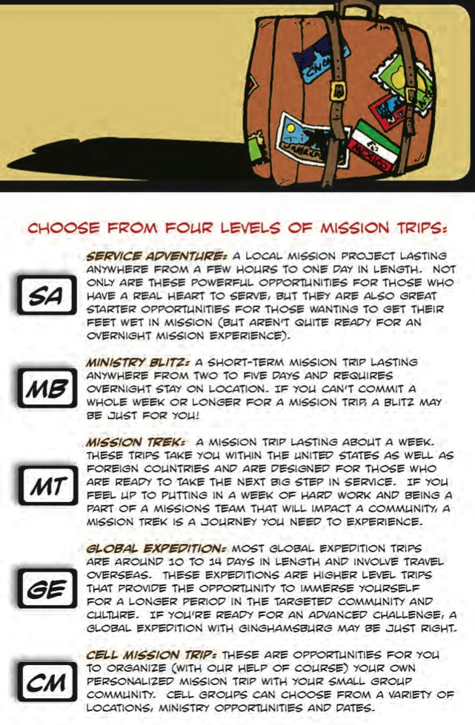

Slide 70
Mission & Service
Incorporate an educational component into all service/mission projects that includes knowledge of the justice issues being addressed, the teachings of Scripture and the Christian tradition on the issues, skills for the specific service/mission project, and reflection on the service/mission involvement.

Slide 71
Mission & Service
Experience
Social Analysis
Theological Reflection
Service & Action for Justice

Slide 72
Mission & Service
Mobilize the Whole Faith Community through an Annual Church-Wide Project. Develop an annual church-wide justice and service project with local-global connections. Focus on a project, such as adopting a local or global action project organized by an organization, or focus an annual theme, such as poverty, care for creation, or peacemaking. For each annual theme develop a comprehensive set of programs and resources (often available from organizations you partner with) for all age groups, families, and the whole community.

Slide 73
Mission & Service

Slide 74
Mission & Service
Sponsor local and global service/mission projects that are designed for the participation of people from the wider community, providing a public presence of the church in the community—from local efforts to feed the hungry, house the homeless, and improve education by adopting a public school to global projects that build schools, care for AIDS victims, and provide wells for water. The church partners with other churches and agencies to establish a serving presence in the community where people who are passionate about transforming the world, but not involved in church life, can work side-by-side with church members and see the Gospel in action.

Slide 75
Spiritual Formation
Respond to the hunger of people of all ages and generations for growing in relationship and intimacy with God and exploring more deeply the life of the Spirit by providing formation in spiritual disciplines and practices throughout life.

Slide 76
Spiritual Formation
Lectio Divina
Scripture Reflection
Spiritual Reading
Contemplation
Praying with Art and Music
Fixed-hour Prayer
The Examen
Sabbath
Discernment
Fasting
Prayer Styles & Traditions

Slide 77
Spiritual Formation
Teach the spiritual practices & disciplines through courses, workshops, immersion experiences
Incorporate spiritual formation into all faith formation programming
Offer retreat experiences for all ages and for families
Provide spiritual mentors and guides

Slide 79
Ethnic & Cultural Diversity
Develop faith formation so that is inclusive of a diversity of ethnic cultures and their religious traditions and expressions
Develop culturally-specific faith formation that inculturates the Gospel message and Christian tradition so that it is proclaimed and taught in the language and culture of people.
Develop intercultural faith formation that brings people of different ethic groups together for learning, relationship building, faith sharing, praying, serving, and celebrating.

Slide 80
Faith Formation with Spiritual Seekers
Offer a guided process for spiritually hungry people to become spiritually committed and join in small communities with other seekers for spiritual growth and support.
Create new expressions of Christian community designed especially for spiritual seekers.
Offer an apprenticeship in discipleship for spiritually hungry people who want to grow in relationship with Jesus Christ and the Christian way of life.

Slide 81
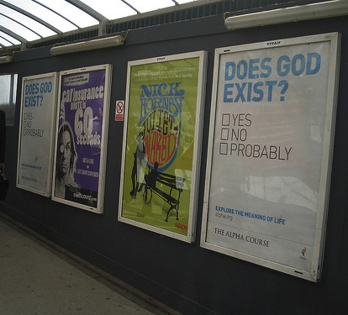
Faith Formation with Spiritual Seekers

Slide 82
Faith Formation with Spiritual Seekers

Slide 84
Faith Formation with Spiritual Seekers
Introduction Dinner: Is there more to life than this?
Week 1: Who is Jesus?
Week 2: Why did Jesus die?
Week 3: How can we have faith?
Week 4: Why and how do I pray?
Week 5: Why and how should I read the Bible?
Week 6: How does God guide us?
Week 7: How can I resist evil?
Week 8: Why & how should we tell others?
Week 9: Does God heal today?
Week 10: What about the Church?
Weekend: Who is the Holy Spirit? What does the Holy Spirit do? How can I be filled with the Holy Spirit? How can I make the most of the rest of my life?

Slide 85
Discipleship Apprenticeships

Slide 86
Third Place Settings
Establish a Third Place gathering space in the community, that offers hospitality, builds relationships, hosts spiritual conversations, provides programs and activities, and nourishes the spiritual life of people.

Slide 88
Third Place Settings
Here is one recent story submitted from the Lifetree Director in Reading, PA recounting their experience from the VERY FIRST night they opened.
"Last evening was amazing. We were concerned that we might have too many people and need to turn some away, so we prayed that God would bring just the right number. Off the Avenue Café (where Lifetree is hosted) holds about 48 people. Last evening 47 people showed up. Counting our host that makes 48.The discussion during the event and after was amazing. I actually think the topic could have been about peanut butter cups because the people that showed up just wanted to talk and they wanted to talk about God. We had discussions from feelings to predestination to angels to loss to reincarnation the list goes on and on. People just didn't want to leave. I was up until about 1 AM because I was so excited. Thank you so much for helping us enter this new area of ministry it is going to change our community and us.”

Slide 89
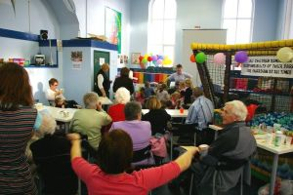
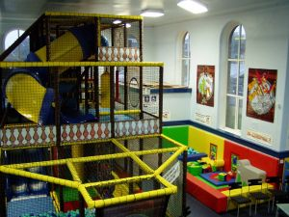
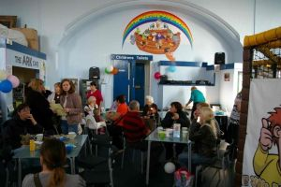
The Wesley Playhouse

Slide 90
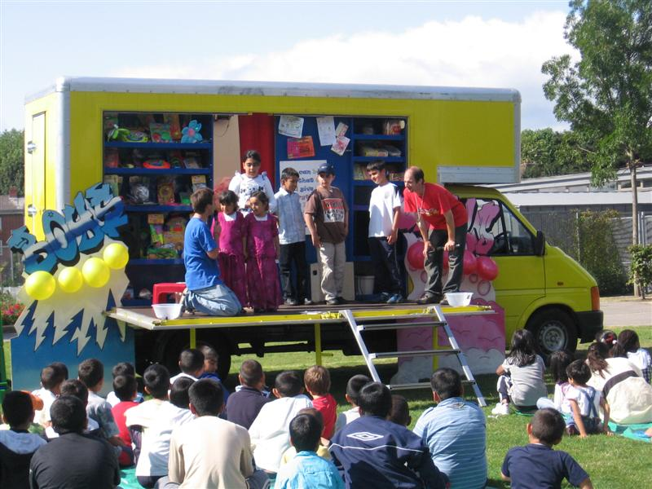
Sidewalk Van

Slide 91
Pathways to Vibrant Faith & Active Engagement
Develop processes that gradually deepen people’s relationship with Jesus Christ, their engagement in church life, and their practice of the Christian faith with a special focus on the needs of the “spiritual but not religious” and “the uncommitted but ”participating.”

Slide 92
Pathways to Vibrant Faith & Active Engagement
Our Lady of Soledad Catholic Parish
Mini-Retreat 101: “Catholics Alive!”
“What does it mean to be a follower of Christ?”
Mini-Retreat 201: “Alive and Growing Spiritually!”
maturing in the Catholic faith
Mini-Retreat 301: “Alive and Gifted!”
discerning how to serve God in ministry
Mini-Retreat 401: “Alive in the World!”
living as witnesses for Christ, as contagious Catholic Christians
Mini-Retreat 501: “Alive to Praise God!”
Catholic worship and the sacraments

Slide 93
Empowering the Community to Share their Faith
Empower people of vibrant faith and active engagement in the church community—individuals, small groups, and the whole faith community—to share their faith with those who not involved in a church community or spiritually committed.

Slide 94
Empowering the Community to Share their Faith
…evangelism is anything you say or do to help another person move into closer relationship with God, or into Christian community.
(George Hunter III)
The heart of evangelism is having an alive relationship with God, being part of a church you love, and caring that people outside the church find what you’ve discovered.
(Martha Grace Reese)
Evangelism is to cooperate with the Holy Spirit and others to bring one person one step closer to Christ.
(Evangelical Covenant Church)

Slide 95
Empowering the Community to Share their Faith

Slide 96
Empowering the Community to Share their Faith
Step One. Church Leader’s Study: Unbinding the Gospel
Step Two: All-Church Saturation Study: Unbinding Your Heart: 40 Days of Prayer & Faith Sharing.
six-week, church-wide, small group E-vent!
pray each day’s scripture and prayer exercise and work with a prayer partner
study a chapter of the book with their small group
worship with sermons, music, and prayers centered on the week’s chapter

Slide 97
Empowering the Community to Share their Faith
Step Three: An Experiment in Prayer and Community: Unbinding Your Soul.
a no-obligation experience of substantial spiritual discussion, prayer and community for people who aren’t connected with a church
church members invite their friends into a four-week small group experience with short study chapters, an individual prayer journal, prayer partner activities, and group exercises.

Slide 98
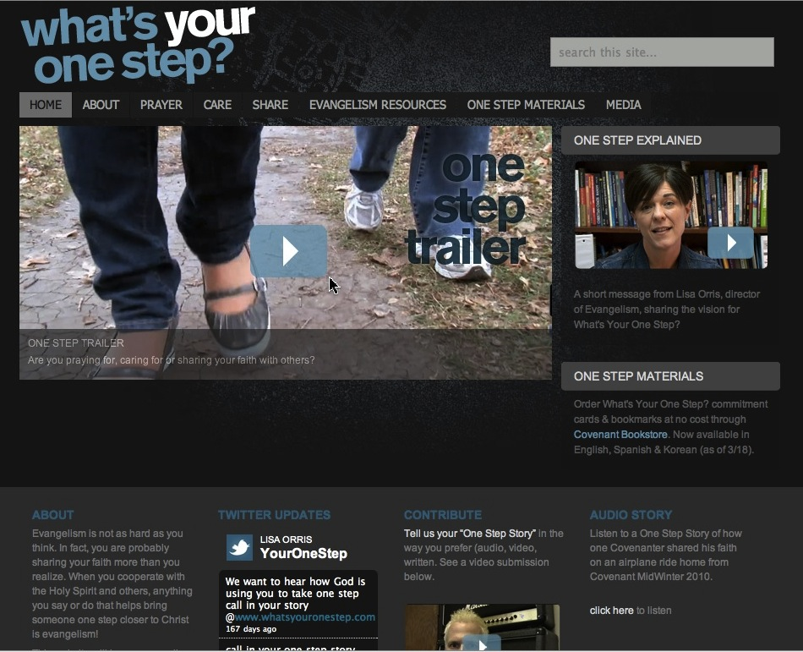

Slide 99
Designing New Initiatives
Selecting Needs
Consulting
Strategies
Generating Ideas
Evaluating Ideas
Designing a Plan
Implementing a Small Scale Initiative
Implementing to a Wider Audience

Slide 100
Designing New Initiatives
Step 1. Select a priority need.
Step 2. Consult strategies & innovations.
Step 3. Generate creative ideas.
Step 4. Evaluate the ideas.
Step 5. Design an implementation plan.
Step 5. Implement the initiative through small scale prototyping.
Step 7. Implement the initiative with a wider audience and continue evaluation and improvements.

