Slide 1
Topic 4. Capacity Building

Slide 2
Capacity Building
Capacity building is whatever is needed to bring an organization to the next level of operational, programmatic, financial, or organizational maturity, in order to more effectively and efficiently fulfill its mission.
Activities that improve and enhance an organization’s ability to achieve its mission and sustain itself over time:
identifying a communications strategy, improving volunteer recruitment, identifying more efficient uses of technology, and engaging in collaborations with community partners.
When capacity building is successful, it strengthens an organization’s ability to fulfill its mission over time and enhances the organization’s ability to have a significant, positive impact on lives and communities.

Slide 3
What is Required?
1. What will implementing plans for strengthening parish vitality, developing innovations, and/or reaching new audiences require of the parish?
What will it require of Parish Leadership (e.g., competencies, skills, processes and procedures)?
What will it require in People Resources (e.g., committees, ministries, parish organizations, parishioners)?
What will it require in Material Resources (e.g., facilities, technologies, print and digital resources)?
What will it require in Financial Resources?
What will it require in Collaborating and Partnering with organizations outside the parish (e.g., local churches and synagogues, school/colleges, community organizations, diocesan agencies)?

Slide 4
What Resources Do You Have?
2. What resources (capacity) can the parish community and its leadership bring to strengthening parish vitality, developing innovations, and/or reaching new audiences?
People Resources: What resources (gifts, talents, competencies) can you identify in the people of your parish, community, local educational institutions, and religious organization who can take a leadership role in implementing your plan?
Organizational Resources: What resources (programs, services) can you identify in organizations, such as local churches and synagogues, school/colleges, community organizations, retreat and conference centers, diocesan agencies, and religious organizations, that you can utilize in implementing your plan?

Slide 5
What Resources Do You Have?
Print and Media Resources: What print and media resources from publishers, educational institutions, commercial media, and religious organizations can you use in implementing your plan?
Web and Social Media Technologies, and Digital Media: What digital and online resources can you use in implementing your plan (websites, online activities, online courses, social networks)? How will you utilize a parish website, social media, and web technologies to implement your plan?
Material Resources: What physical settings (facilities) in the parish and in the community are available for implementing your plan?
Financial Resources: What sources of financial assistance are available for implementing your plan (parish budget, fundraising, participant fees, grants, sponsorships)?

Slide 6
Developing a Lifelong Faith Formation Network

Slide 7
Features of a Lifelong Faith Formation Network
1. A Lifelong Faith Formation Network addresses the diverse life tasks and situations, spiritual and religious needs, and interests of all ages and generations in the four scenarios by offering a variety of content, programs, activities, and resources.

Slide 8
Features of a Lifelong Faith Formation Network
2. A Lifelong Faith Formation Network guides individuals and families in discerning their spiritual and religious needs and creating personal learning pathways—a seasonal or annual plan for faith growth and learning.

Slide 10
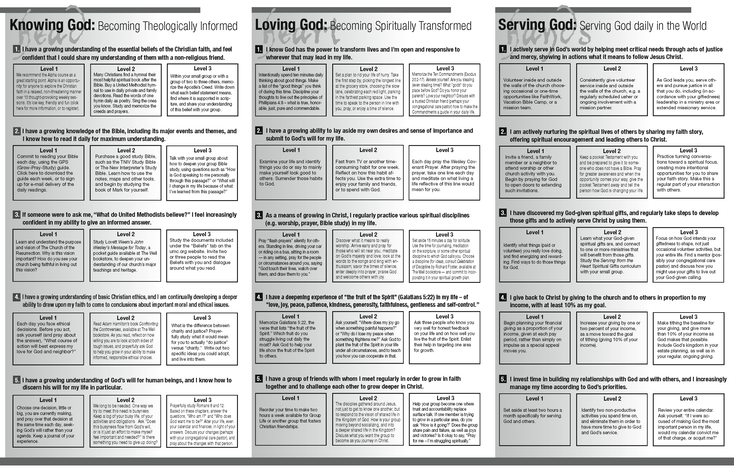

Slide 11
Features of a Lifelong Faith Formation Network
3. Lifelong Faith Formation Network incorporates informal learning, as well as formal learning in faith formation.

Slide 12
FORMAL | LEARNING
classes & workshops speaker series online courses small group Bible study | self-study Bible study social networking faith-sharing groups
INTENTIONAL | UNEXPECTED
reading /watching a DVD mentoring service/mission activity program at the library or local bookstore | internet surfing watching a movie TV show shopping at a home improvement store
INFORMAL | LEARNING

Slide 13
Features of a Lifelong Faith Formation Network
4. A Lifelong Faith Formation Network utilizes a variety of faith formation models to address the diverse life tasks and situations, religious and spiritual needs, and interests of people:
learning on your own
at home
in small groups
in large groups
in the congregation
in the community and world

Slide 14
Features of a Lifelong Faith Formation Network
5. A Lifelong Faith Formation Network blends face-to-face, interactive faith formation programs and activities with virtual, online faith formation programs, activities, and resources.
web-based technologies and digital media provide 24x7 faith formation for all ages and generations, anytime and anywhere

Slide 15
Virtual & Physical Faith Formation
Face-to-Face
Interactive
Transformative Experiences
Online Community & Blog
Courses & Webinars
Small Groups Study
User-Generated Content
Learning Resources
Audio, Video, Print

Slide 16
Approach #1
Begin with people’s participation in face-to-face learning activities and extend the learning online.
Sponsor a parish program on the Gospel of Matthew in preparation for Cycle A (a family or intergenerational program, a 3-session adult program, a youth meeting, etc.)
Extend and deepen the learning with online resources
weekly commentaries for each Sunday of Cycle A
online Bible study program (independent or with a small group) on the Gospel of Matthew
a university course on the Gospel of Matthew on iTunes U
an online blog that allows people to post their reflections on each Sunday’s reading and invites discussion online

Slide 17
Approach #2
Begin with people’s participation in online learning activities and invite them to in parish learning programs
Develop an online spiritual formation center (website) for your church using a variety of already existing resources:
daily fixed hour prayer (liturgy of the hours)
weekly and seasonal prayer resources
links to prayer sites around the world
an online retreat (A thirty-four week retreat for Everyday Life from Creighton University
online courses with spiritual guides like Thomas Merton, Joyce Rupp, Henri Nouwen, Joan Chittister from SpiritualityandPractice.com
prayer center to pray for people in the community
links to videos on prayer (YouTube)
online blog for sharing prayer practices and experiences

Slide 18
Lifelong Faith Formation Network
Face-to-Face
Virtual
On Your Own
At Home
In Small Group
In Large Group
In Church
In Community & World
Activity
Activity
Activity
Spiritual & Religious Needs
Topics or Themes

Slide 19
Features of a Lifelong Faith Formation Network
6. A Lifelong Faith Formation Network incorporates communities of practice to connect individuals and groups throughout the congregation.

Slide 20
Network Plan
People - Age Group - Family - Generation | Life Task, Religious and Spiritual Need | Faith Formation Program, Activity or Resource | Faith Formation Model - on your own - at home - small group - large group - congregation - community and world | Dates and Times | Location - physical/ facility - online/ website

Slide 21
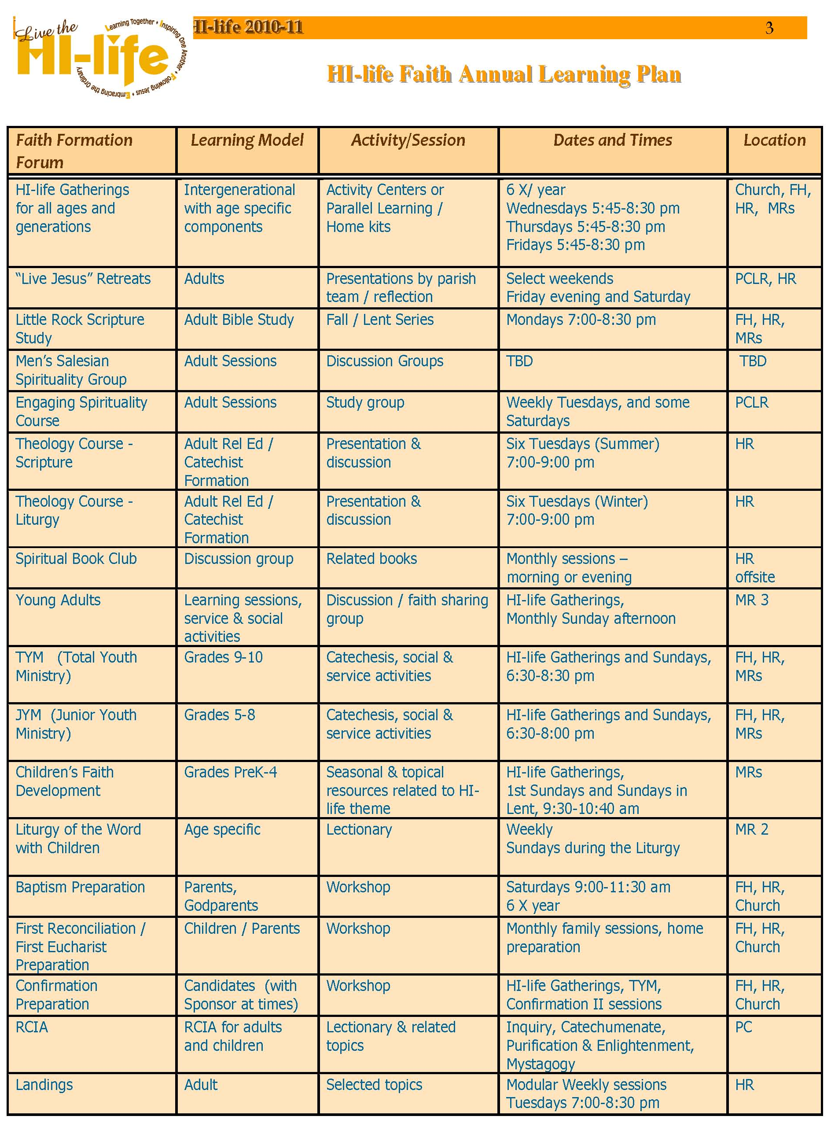

Slide 22
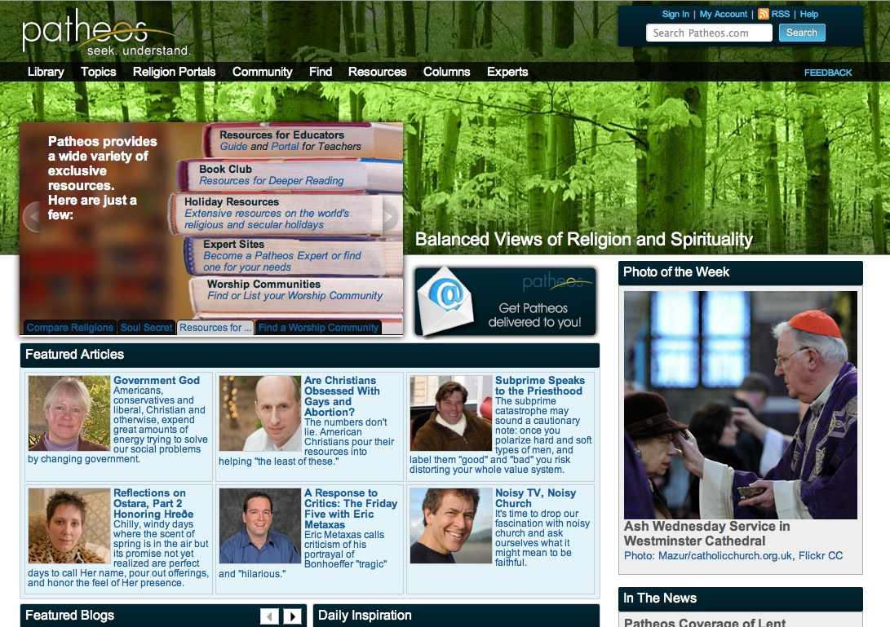

Slide 23
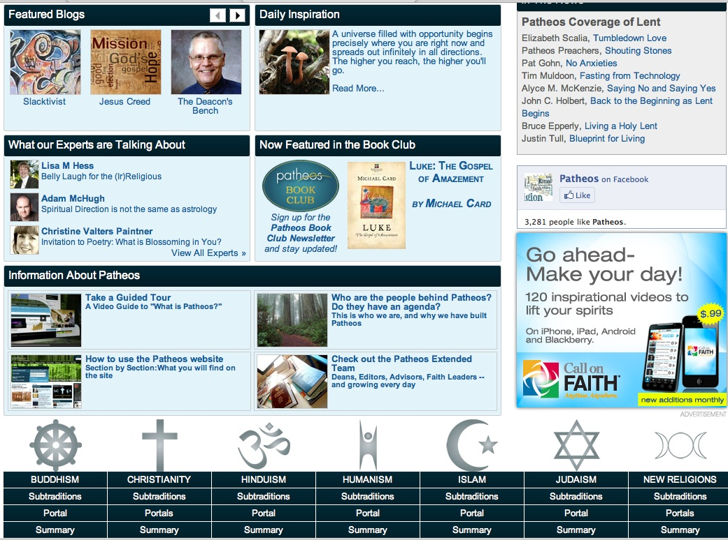

Slide 24
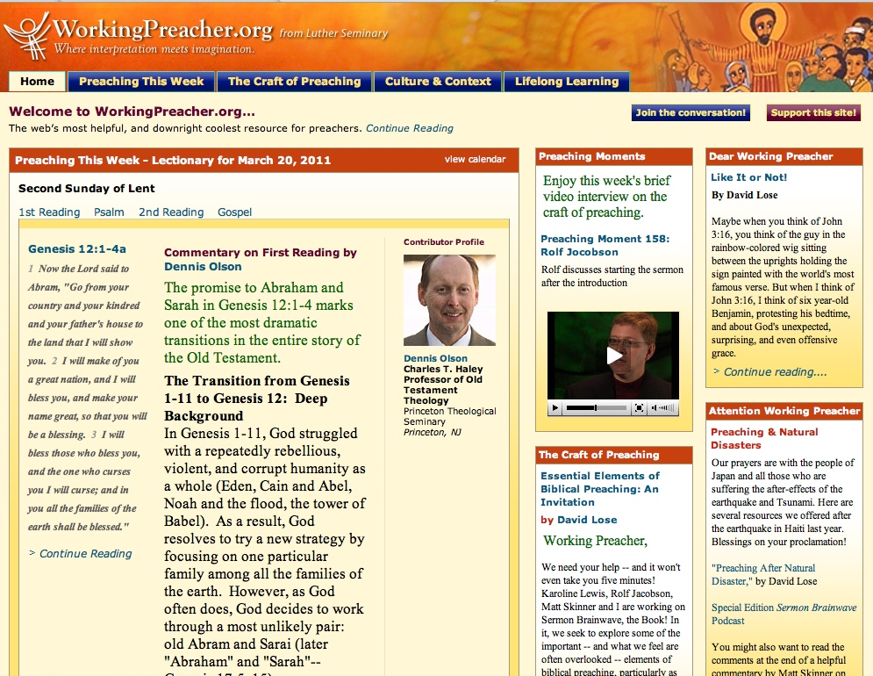

Slide 25
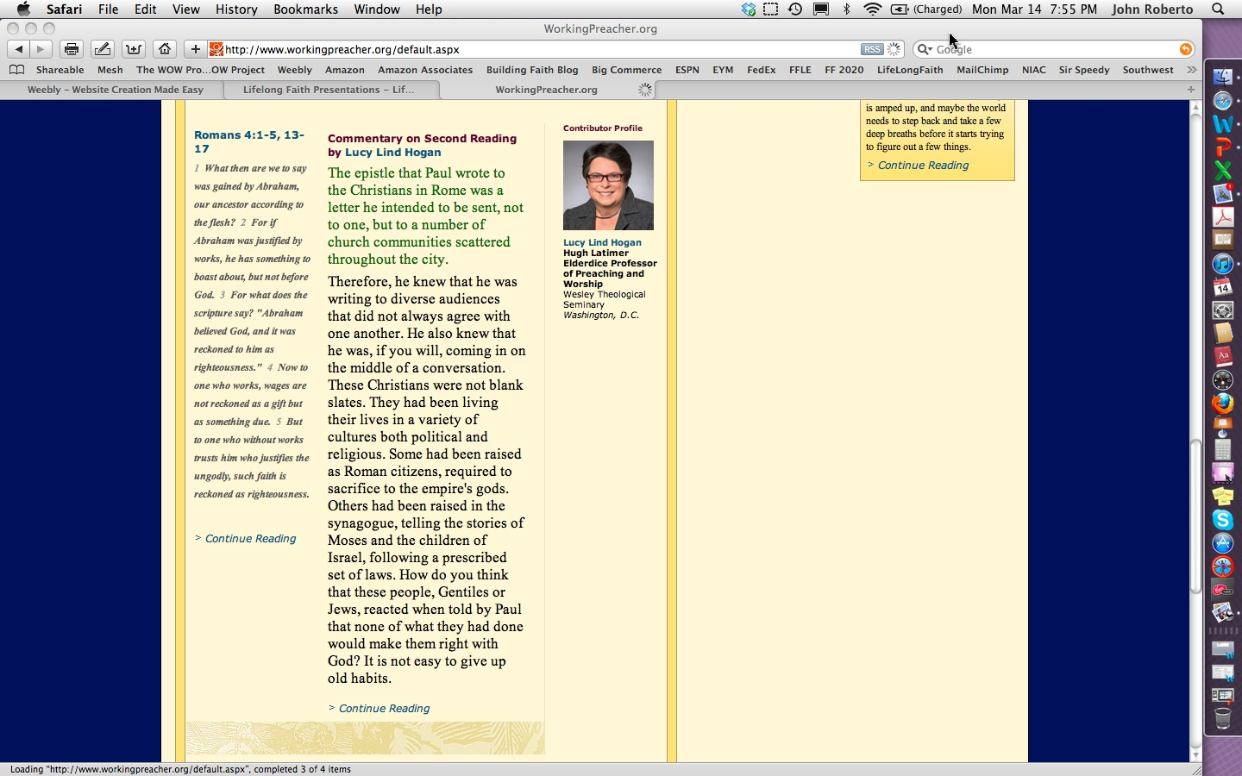

Slide 27
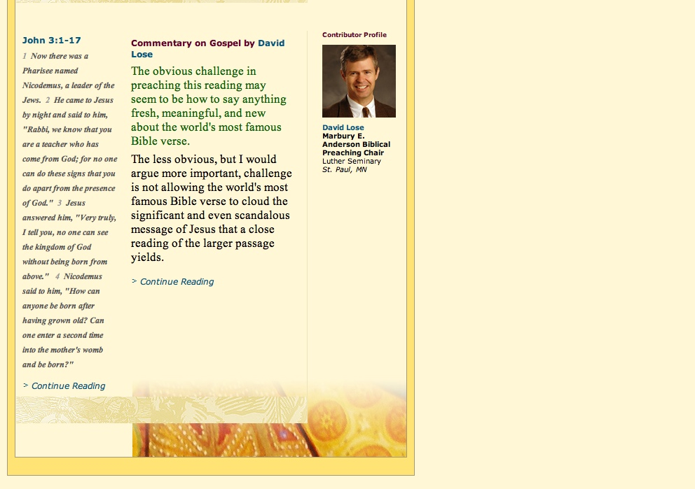

Slide 28
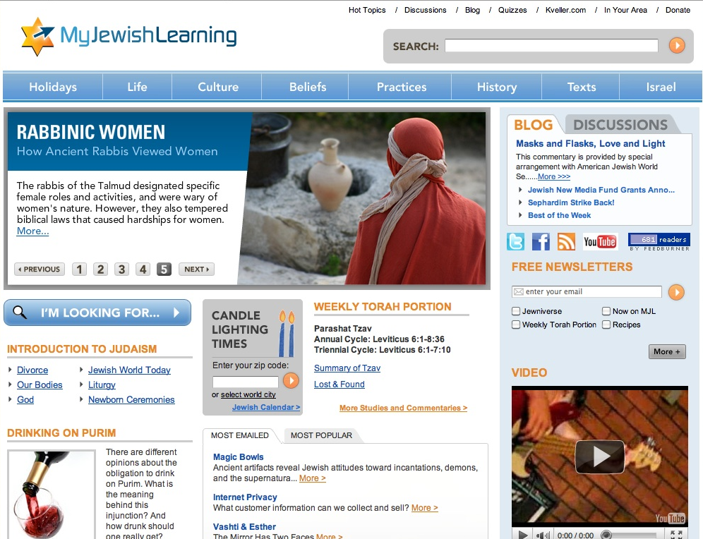

Slide 29
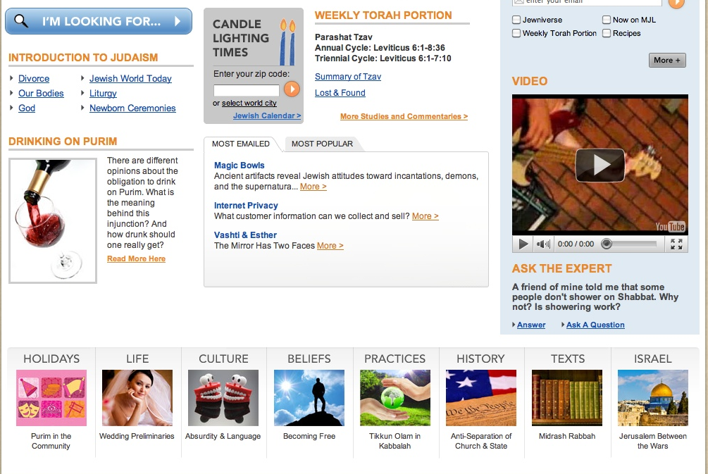

Slide 30
Leadership for Faith Formation 2020
New Leadership Roles for 2020
Becoming an Adaptive Leader
Becoming an Innovative Leader
Becoming a “Blue Ocean” Leader
Becoming a Change Leader
Becoming a Culturally Intelligent Leader
Becoming a Curator of Content

Slide 31
Leadership for Faith Formation 2020
The Content Curator
locating and evaluating valuable content
organizing and connecting content so that it is as accessible as possible
creating and re-purposing content when it adds to the underlying value
capitalizing on the Social Web to build connections and context
building trusted relationships with learners and other curators
designing learning experiences

Slide 32
