Slide 1
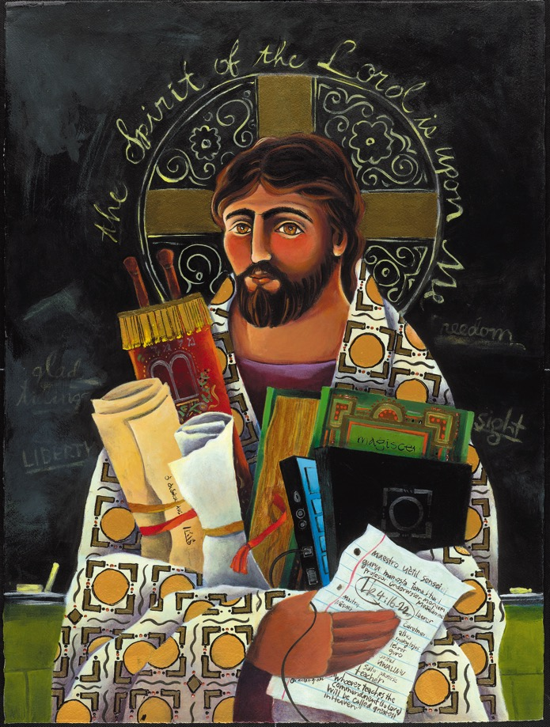
Designing faith formation for the 21st Century
John Roberto
jroberto@lifelongfaith.com www.LifelongFaith.com

Slide 2
Design a Network: Content
Caring Relationships
Celebrating the Seasons
Celebrating Rituals & Milestones
Learning the Christian Tradition
Praying & Spiritual Formation
Reading the Bible
Serving, Working for Justice, & Caring for Creation
Worshipping God
Missional
Life Issues
Life-Stage
Major Programs
Faith Community
Content Area
Content Area
Content Area
Content Area
Content Area
Content Area

Slide 3
Whole Community Network
Faith Community
Children & Families
Youth and Families
Young Adults
Mid-life Adults
Mature Adults
Older Adults

Slide 4
Families with Children
Faith
Formation
Network
Intergenerational Faith Community
For Parents
Faith Practices @ Home: Seasons of the Year
Sunday Worship
@ Home
Faith Practices @Home: Bible & Learning the Faith
Children’s Programs & Events
Faith Practices @Home: Rituals & Milestones
Faith Practices @ Home: Service
Family Life Assets
Missional / Discovering Faith

Slide 5
Adult
Faith Formation
Network
Faith Enrichment
Sunday Worship
Intergenerational Faith Community
Grand-parents
Spiritual Enrichment
Life Issues & Milestones
Scripture Enrichment
Liturgical Seasons
Service & Mission
Missional & Discovering Faith

Slide 6
Programming
Topic
Activity 1
Resource
Resource
Activity 3
Resource
Resource
Activity 2
Resource
Resource

Slide 7
Design a Season of Programming
Fall Season: September 1 – January 1
Winter/Spring Season: January 1 – May 1
Summer Season: May 1 – September 1
Fall
Winter-Spring
Summer

Slide 8
Digitally-Enabled Faith Formation
- Identify opportunities for blended faith formation.
Online Faith Formation
Mostly Online with Regular Interaction in Gathered Sessions
Online Faith Formation & Gathered Sessions (Flipped Classroom)
Gathered Program with Supportive Online Content
Gathered Program with Online Components beyond the Program

Slide 9
Design a Season
Identify the season.
Add continuing age-group programs.
Add intergenerational programs and events.
Add redesigned, digitally-enabled programming
Select new programming ideas.
Develop the final version of the plan:
  Select the program ideas for each content area
  Schedule the programming, e.g., a monthly focus

Slide 10
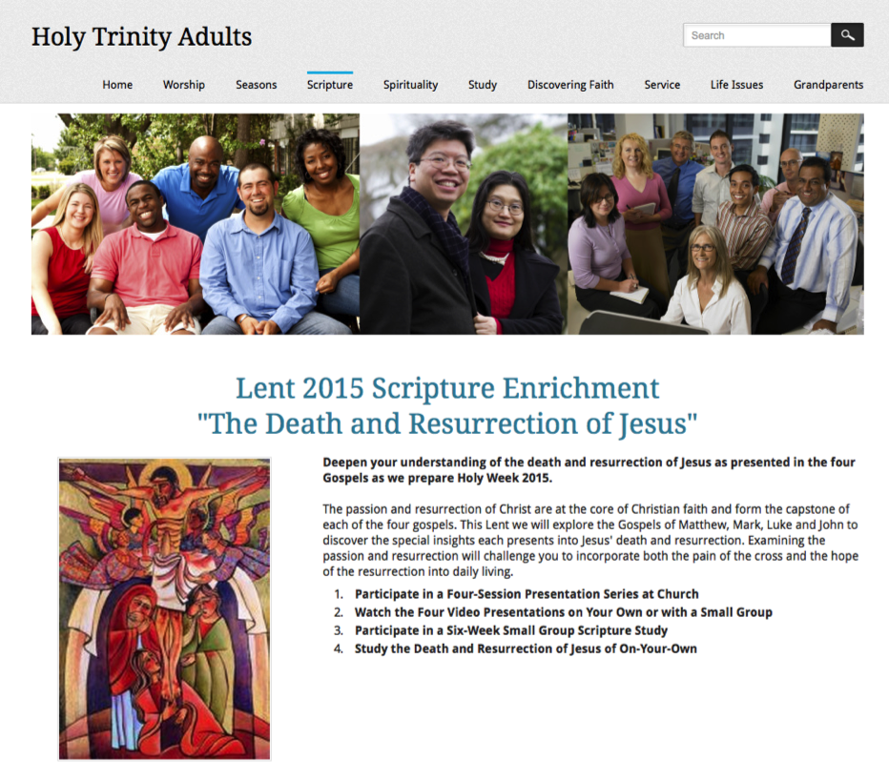
Programming a Page

Slide 11
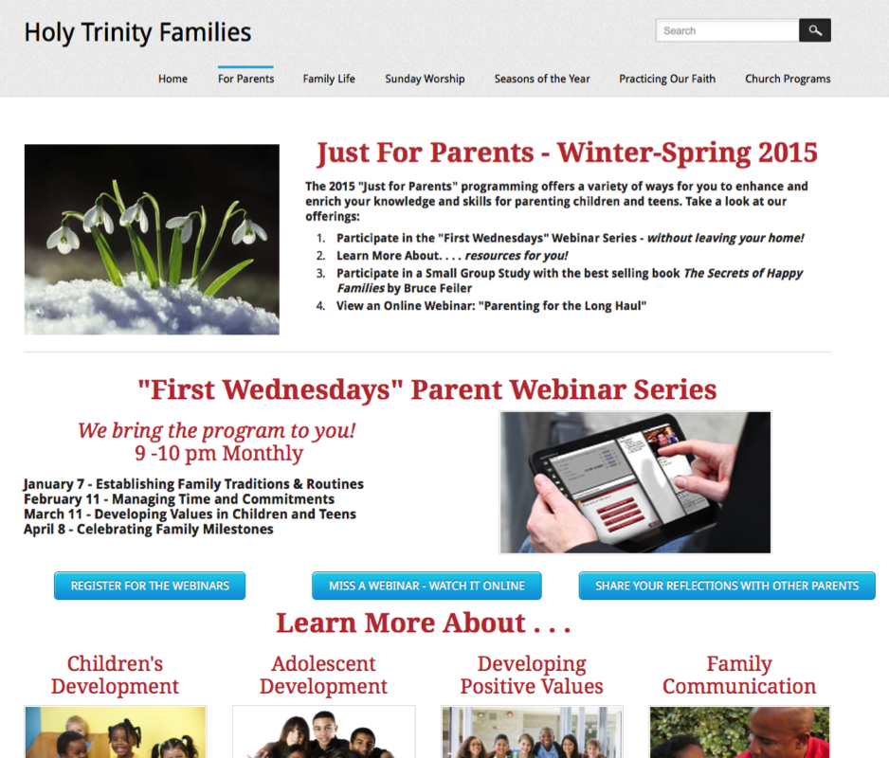
Programming a Page

Slide 12
Families with Children
Faith
Formation
Network
Intergenerational Faith Community
For Parents
Faith Practices @ Home: Seasons of the Year
Sunday Worship
@ Home
Faith Practices @Home: Bible & Learning the Faith
Children’s Programs & Events
Faith Practices @Home: Rituals & Milestones
Faith Practices @ Home: Service
Family Life Assets
Missional / Discovering Faith

Slide 13
Faith Practices
@ Home
Daily Devotion
Resources
Serving Others
Resources
Reading the Bible
Resources
Caring Conversations
Resources
Church Year Seasonal
Learning about Faith
Resources
Resources
Rituals
Resources
Children & Families
Network

Slide 14
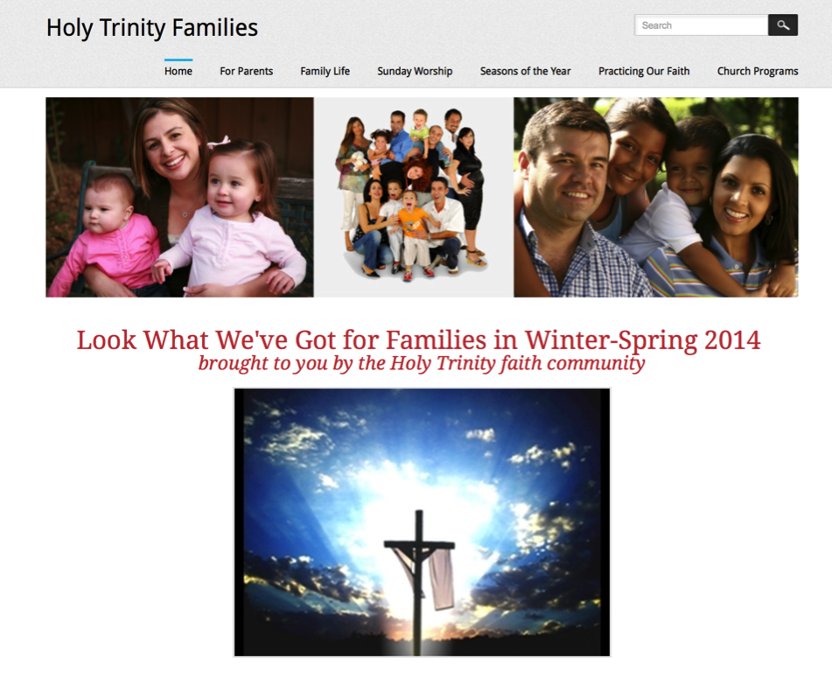
Family Faith Formation Network

Slide 15
Youth Faith Formation
Network
Service Projects Mission Trips
Faith Community
Prayer &
Spiritual Formation
Youth Leadership
Youth Programs
Bible Study & Religious Learning
For Parents
Milestones
Confirmation Program
Adolescent Life Issues
Parent-Teen Activities & Resources
Sunday Worship & Church Seasons
Missional

Slide 16
Prayer & Spiritual Life
Daily Devotion
Resources
Prayer Group
Resources
Spiritual Mentoring
Resources
Spiritual Practices Course
Resources
Retreat
Day at the Monastery
Online Prayer Intentions
Resources
Resources
Youth
Network

Slide 17
Young Adult Faith
Formation
Network
Justice, Service, Mission
Scripture Enrichment
Faith Community
Faith Enrichment
Spiritual Enrichment
Missional & Discovering Faith (Alpha Course)
Worship & Church Year
Life Issues, Transitions, & Milestones
Young Adult Peer Community

Slide 18
Adult
Faith Formation
Network
Faith Enrichment
Sunday Worship
Intergenerational Faith Community
Grand-parents
Spiritual Enrichment
Life Issues & Milestones
Scripture Enrichment
Liturgical Seasons
Service & Mission
Missional & Discovering Faith

Slide 19
Adult
Faith Formation
Network
Spiritual Enrichment
Online Courses
Retreats
Small Group Bible Study
Spiritual Book of the Month Club
Monthly Spiritual Practices Series
Apps & E-newsletters
Day at the Monastery
Online Prayer & Spirituality
Resource
Resource
Resources
Resources
Resource
Resource
Resource
Resource

Slide 20
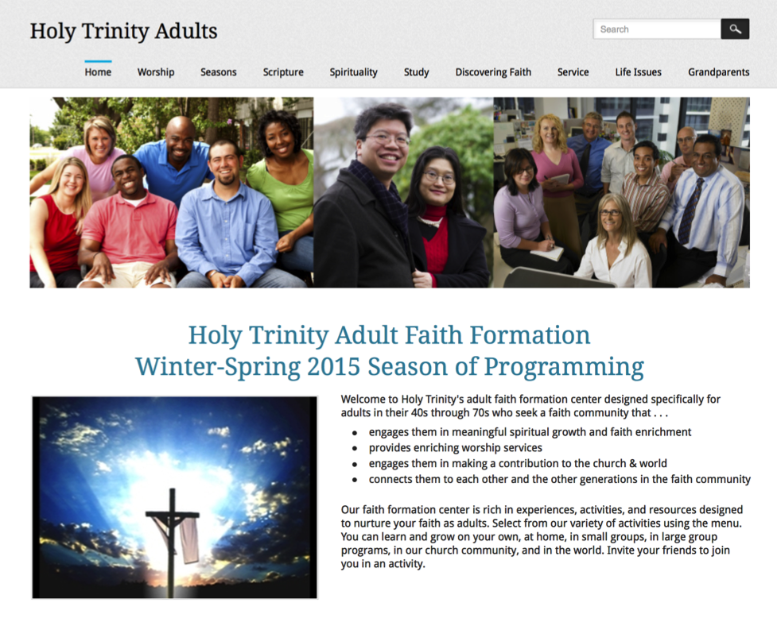
Adult Faith Formation Network

Slide 21

Build a Digital Platform
Other Platforms
www.wordpress.org www.wix.com www.squarespace.com

Slide 22
Build a Digital Platform
Choose a domain name.
Select a website template that is “mobile” responsive.
Create the primary navigation system (main menu) from the network content areas.
Build each webpage to incorporate all programs, activities, and resources for each content area.
Design the webpage for your target audience—write the website content to your audience.

Slide 23
Design Personalized Learning
Discerning Learning Needs
Working with a Mentor/Guide
Finding Resources on the Network
Engaging in Formation in a Variety of Learning Environments
Sharing Learning with Others
Reflecting on Growth & Identifying New Needs

Slide 24
Personalized Faith Formation
Personalized pathways for discipleship & faith growth. . . .
Guide people in discerning their religious and spiritual needs
Equip people with the resources and tools to learn and grow at their own pace
Provide mentoring and support for the journey

Slide 25
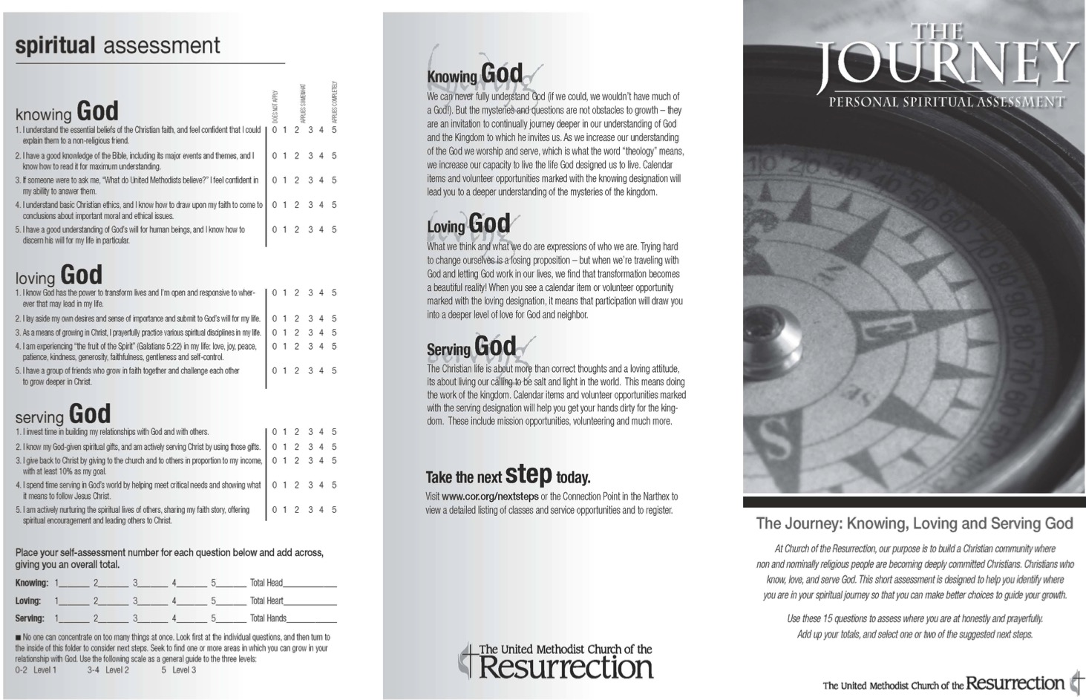

Slide 26
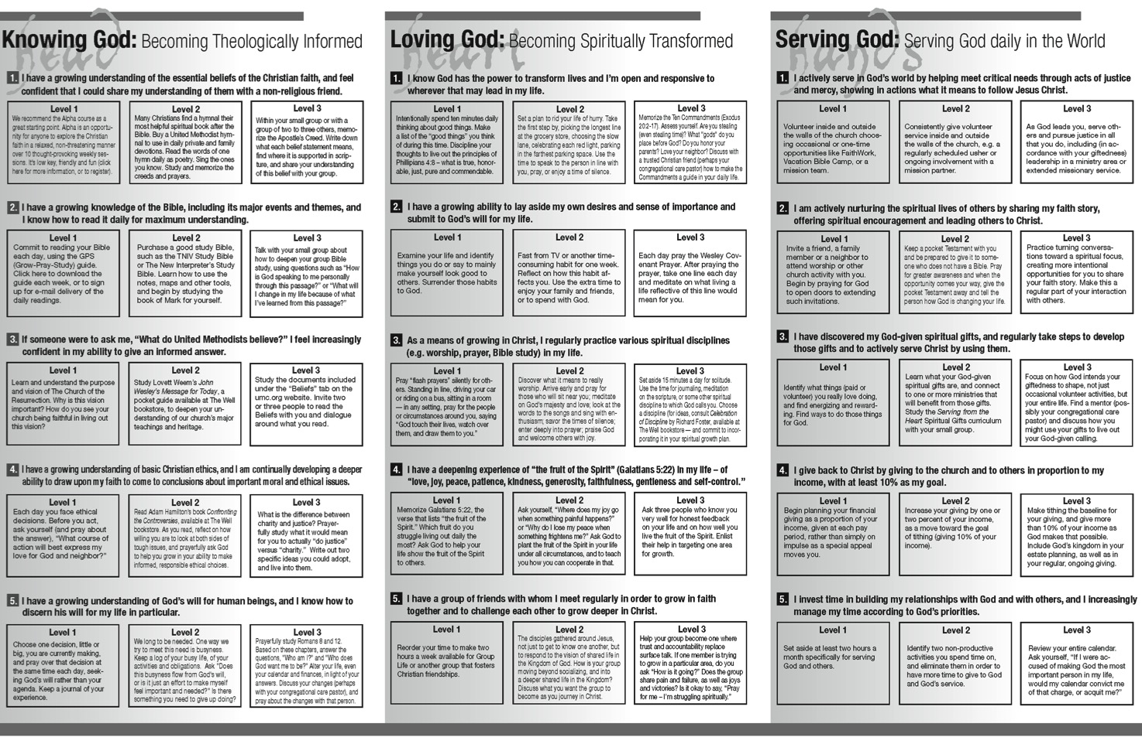

Slide 27
Test the Plan & Web Design
Let your user experience the network online. Show don’t tell. Let them review the website and the programming. Just the minimum context so they understand what to do. (Have computers or tablets available for people to use or ask them to bring a device to the focus group.)
Have them talk through their experience. For example, when appropriate, ask “Tell me what you are thinking as you are doing this.”
Actively observe. Watch how they use (and misuse!) the website. Don’t immediately “correct” what your user is doing.
Follow up with questions, such as: “Show me why this would (or would not) work for you.” “Can you tell me more about how this made you feel?” “Why? “ “Do you find things that interest you and connect with your life?” “Are there things you would have liked to see?”

Slide 28
Launch the Network
Be sure to pay careful attention to the titles and descriptions so that they capture people’s interests. Develop descriptions that are positive in tone, indicate clearly the content or focus of an activity.
Describe how your offerings respond to something within the lives of people. Highlight the relationship between the content and the particular spiritual or religious needs, interests, passions, concerns, or life issues of people.
Describe the 2-3 benefits of participating or engaging in faith formation.
Explain to people how to use the Network and how to access the activities and resources.

Slide 29
Promotional Ideas
Connect to (or extend from) a gathered event, program, ministry.
Use personalized invitations.
Establish a Facebook page for faith formation for Network announcements, updates, stories and photos from people engaged in faith formation, etc.
Use Twitter to announce updates, events, and invite reflections from people on their experiences in the Network.
Send email or regular e-newsletters to targeted groups (use a service like Constant Contact).
Provide ways to share experiences using blogs, Twitter, Facebook: videos, reports, photos, etc.

Slide 30
Connect to Social Networks
Our social network is made up of all the people we’re connected to, all the people they are connected to, all the people they are connected to, and so on.
You
Your Friends
Your Friends
Your Friends’ Friends
Your Friends’ Friends
Your Friends’ Friend’s Friends
Your Friends’ Friend’s Friends
Your Friends’ Friend’s Friends
Your Friends’ Friends
Your Friends’ Friends

Slide 31
Evaluate Programming

