Slide 1
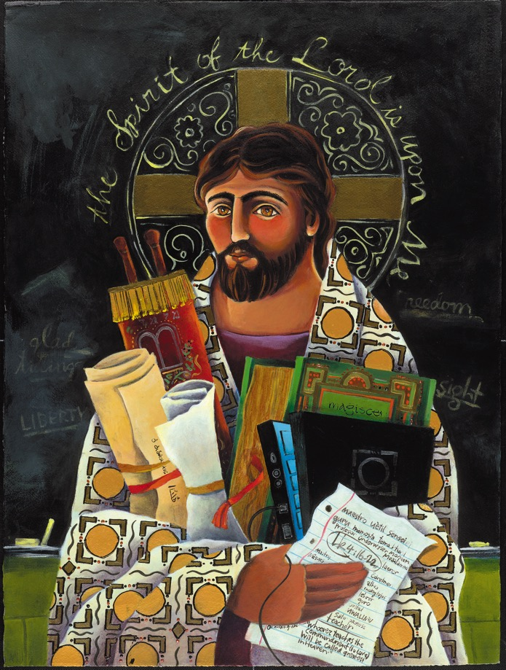
Reimagining faith formation for the 21st Century
John Roberto
jroberto@lifelongfaith.com www.LifelongFaith.com

Slide 2
4 Big Adaptive Challenges
Increasing diversity throughout American society in the length of the lifespan, in generational identities, in family structures and marriage patterns, and in the ethnic makeup of America
Rise of new digital technologies that are reshaping society, and the emergence of a connected, networked society
Dramatic changes and increasing diversity in the religious beliefs, practices, and affiliation of Americans
Decline in religious transmission from generation to generation

Slide 3
The “Old” Faith Formation Ecosystem
Church
Family
Ethnic Traditions
Community
Catholic School

Slide 4
A New Faith Forming Ecosystem
Intergenerational Faith Formation
Age Group/Generational Faith Formation
Family Faith Formation
Missional Faith Formation
Online & Digital Faith Formation

Slide 5
Intergenerational Community
Intergenerational faith formation and whole community faith experiences are at the center of all faith formation networks, engaging all ages and generations in the life and events of church life and the Christian faith and participation in intergenerational faith experiences.

Slide 6
Age Group Faith Formation
Age group and generational faith formation addresses the unique life tasks, needs, interests, and spiritual journeys of people at each stage of life.
Intergenerational Faith Community
Children & Parents
Youth & Parents
Young Adults
Mid-life Adults
Mature Adults
Older Adults

Slide 7
Family Faith Formation
Congregations equip families to become centers of learning, faith growth, and faith practice in 5 ways:
Nurturing family faith at home through eight faith forming processes
Parent faith formation
Parenting for faith growth training
Parenting education
Building strong families by developing family assets: nurturing relationships, establishing routines, maintaining expectations, adapting to challenges, and connecting to the community.

Slide 8
Missional Faith Formation
Missional faith formation expands and extends the church’s presence through outreach, connection, relationship building, and engagement with people where they live—moving faith formation out into the community.
Missional faith formation provides pathways for people to consider or reconsider the Christian faith, to encounter Jesus and the Good News, and to live as disciples in a supportive faith community.

Slide 9
Online & Digitally-Enabled Faith Formation
Faith formation utilizes the digital technologies and digital media to engage people with faith forming content anytime, any place, just-in-time; and that can extend and expand faith formation in physical, face-to-face settings into people’s daily lives through digital content and mobile delivery systems.

Slide 10
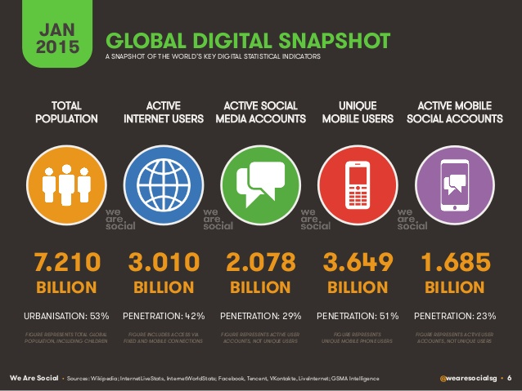

Slide 11
Triple Revolution
Internet Revolution
Mobile Revolution
Social Media Revolution
Information is now. . .
Portable
Personal
Participatory

Slide 12
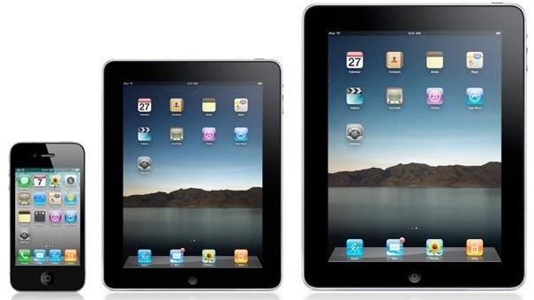
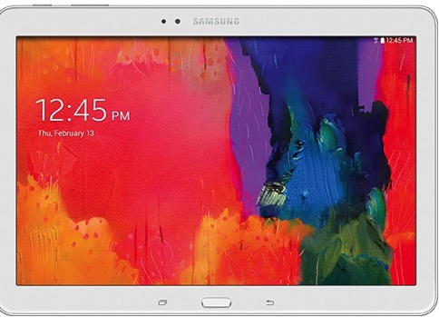
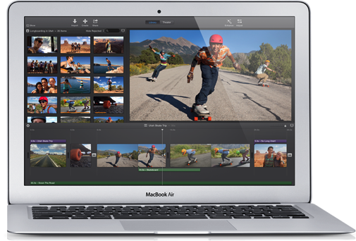
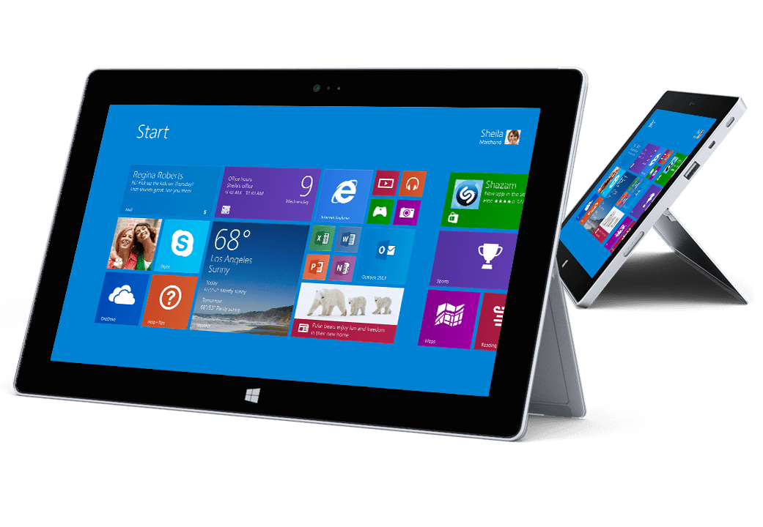

Slide 13
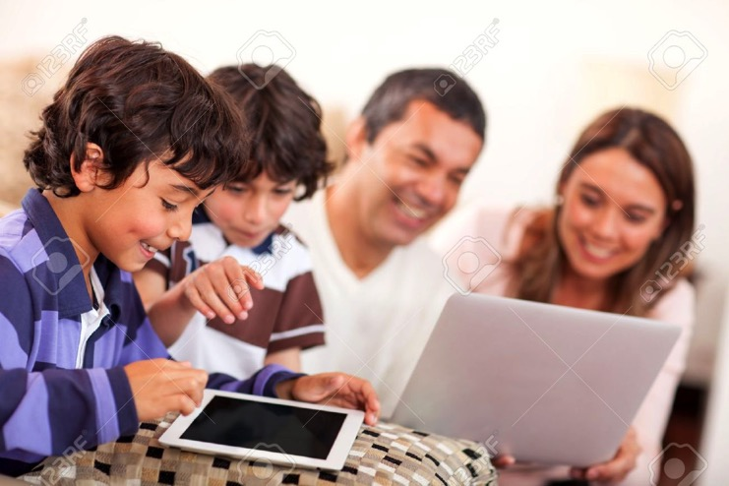
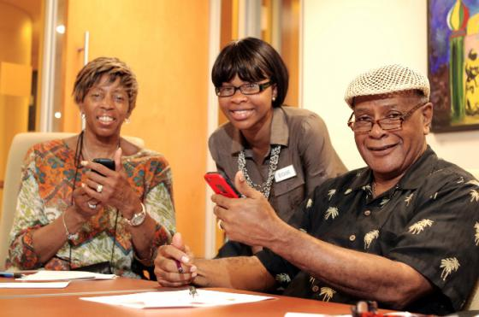
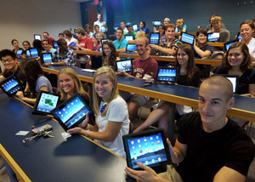

Slide 15
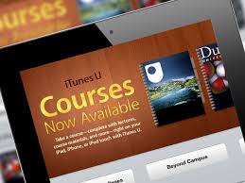

Slide 16
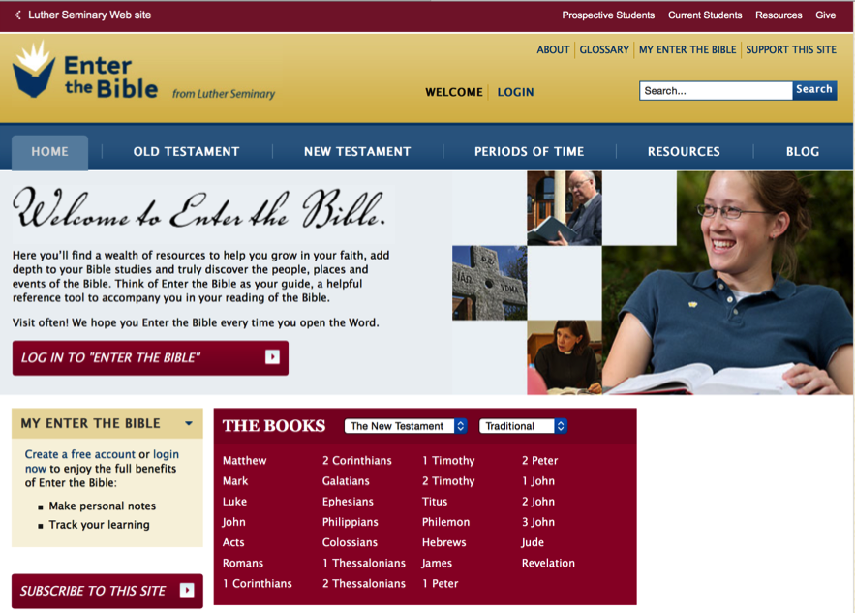
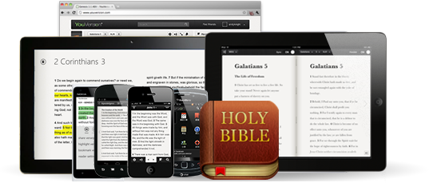
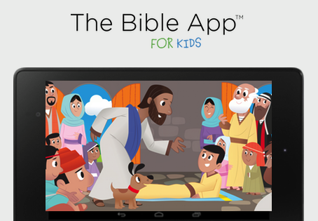

Slide 17
Digitally-Enabled Faith Formation
We now have the technology, online platforms, and digital content to:
engage people with a wide variety of faith forming content for all ages - anytime, any place
extend church events into people’s daily lives via online content and experiences
connect faith formation in gathered settings with faith formation in online settings
offer a variety of online faith formation content, experiences, and courses for self-study and small group study

Slide 18
Digitally-Enabled Faith Formation
Fully Online Faith Formation
Mostly Online with Regular Interaction in Gathered Sessions
Online Faith Formation & Gathered Sessions (Flipped Classroom)
Gathered Program with Supportive Online Content
Gathered Program with Online Components beyond the Program

Slide 19
Gathered with Online Content
A gathered program using online content from websites, videos from YouTube or other video sites, and blogs and other social media. With an abundance of high quality digital content, this first option is the easiest way to bring the digital world into a gathered program.

Slide 20
Gathered and Online Content
Connecting church programs or events with online content that extends and deepens the experience through learning, prayer, ritual, action, etc.
Sunday worship & church year feasts and seasons
Intergenerational & family programs
Children, youth, and adult classes & programs
Extended programs: mission trips, retreat experiences, and vacation Bible school, summer camp

Slide 21
Church Event or Program
At Home & Daily Life

Slide 22
Event or Program
TALK Conversation Activities
LEARN Read Listen Watch
ACT Practices Service Projects
PRAY Devotions Bible Reading Daily Prayer
SHARE Blog Facebook Video Projects

Slide 23
Example: Sunday Worship
Church Life ➔ | Daily & Home Life | ⬅ Online Life
Experience of Worship in the Congregation Sunday worship and lectionary Church year feasts and seasons Church rituals: baptism, communion, funerals, etc. | Experience of Sunday worship, rituals, and church year seasons in daily life Reflecting on the sermon and readings at home Practices: Lectio, etc. Application to daily living | Online worship, church year, and lectionary resources on the church’s faith formation website Lectionary commentaries online Video reflections and commentary Online activities and projects

Slide 24
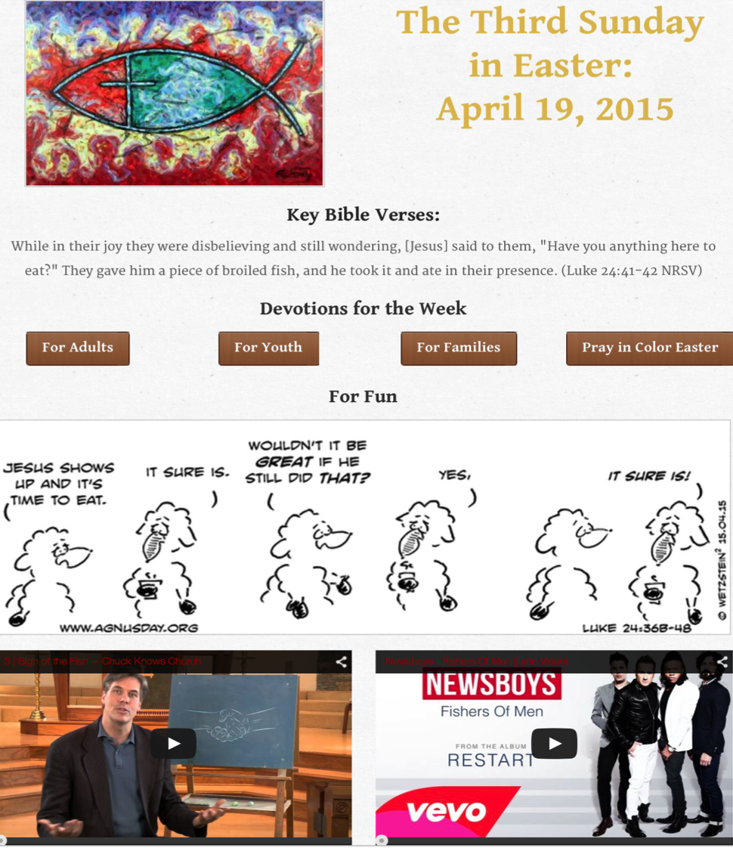

Slide 25
Example: 40-Day Lent Curriculum
Church Life ➔ | Daily & Home Life | ⬅ Online Life
Ash Wednesday Lenten Sunday liturgies Stations of the Cross Lenten prayer Lenten retreat Lenten service Lenten soup suppers | Fasting Praying Service/Almsgiving Lectionary reflection Family activities | Lenten learning resources Lenten calendar Daily Lenten prayer Weekly table prayer Video resources Online retreat experience

Slide 26
Online and Gathered
“Flip the classroom or program” by creating a digital platform to provide the content that people would learn in the gathered setting in an online learning space using print, audio, video, and more. And then transform the gathered program using interactive activities, discussion, project-based learning, and practice and demonstration.

Slide 27
Online and Gathered
Flip children’s programming: At home learning with parents (print, video, online); in-class application with activities, project-centered learning
Flip confirmation programming
Develop a online justice and service center

Slide 31
Mostly Online
Offering opportunities for individuals, families, and small groups to utilize the digital platform as their primary learning setting and provide opportunities for regular interaction in face-to-face, gathered settings or in a web conference format, such as a Google+ Hangout.
Parent webinar programs delivered to parents at home in four-month semesters: three webinars followed by a parent gathering at church; three more webinars and concluding with a parent gathering at church.

Slide 32
Mostly Online
Online learning resources for self-study or small group study, and gathering at the conclusion to share their insights with others who participated.
Online Bible study where groups can meet regularly in a physical setting or virtually through Skype or a Google+ Hangout for sharing their learning.
Selected online courses and activities from colleges, seminaries, and religious organization for individualized learning with the option for a mentor or small group gathering.

Slide 33
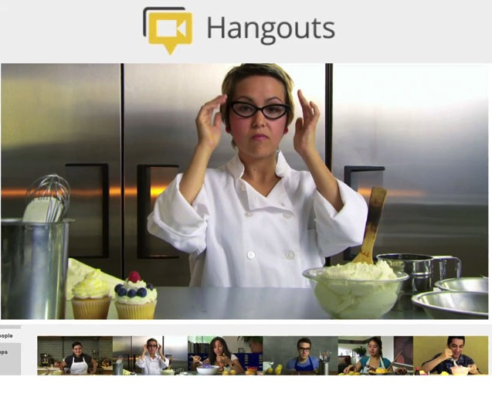
Web Conferencing
Online Course, Small Group, Workshop, or 1-1 Mentoring
Broadcast a Presentation
Record the Presentation

Slide 34
Fully Online
The rise of high quality and easily accessible online religious content—courses, activities, print and e-books, audio and video programs, and content-rich websites—has made designing online faith formation feasible.
Online Bible and theology courses, video programs, webinars for individual study

Slide 35
Fully Online
Online prayer and spirituality center where people can access daily prayer reflections and devotions, offer prayer intentions, pray for others, learn about spiritual practices, download prayer activities for the home
Online parent resource center with the best knowledge, practices, and tools for parenting (print, audio, video)
Online retreat experience

Slide 36
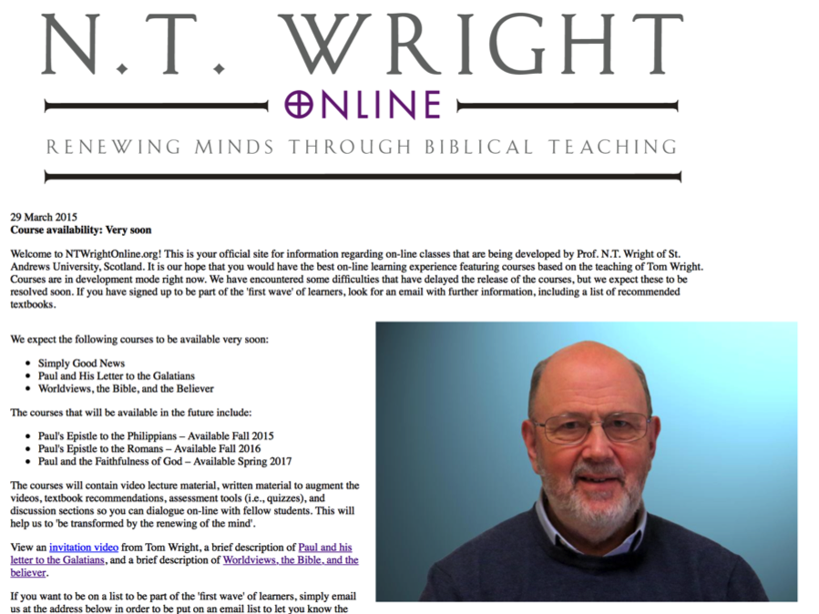

Slide 37
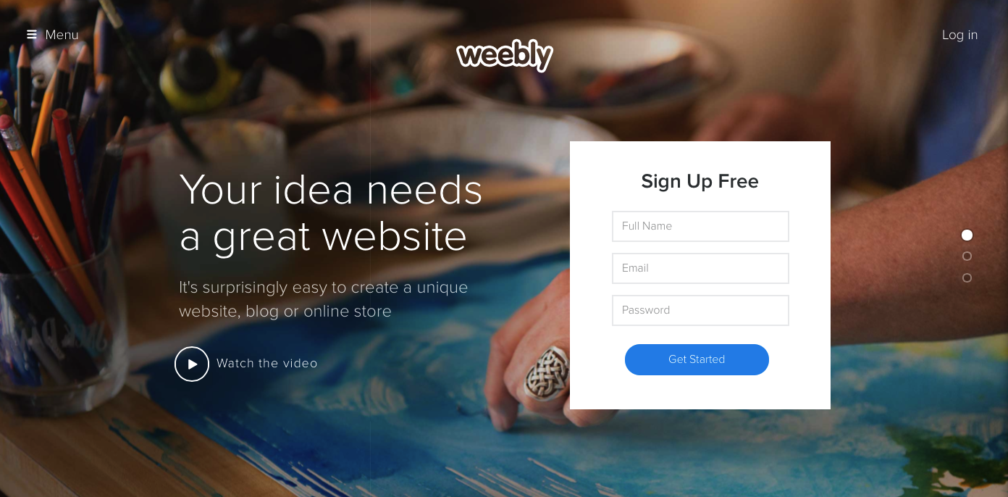
Digital Platform
Other Platforms
www.wordpress.org www.wix.com www.squarespace.com

Slide 38
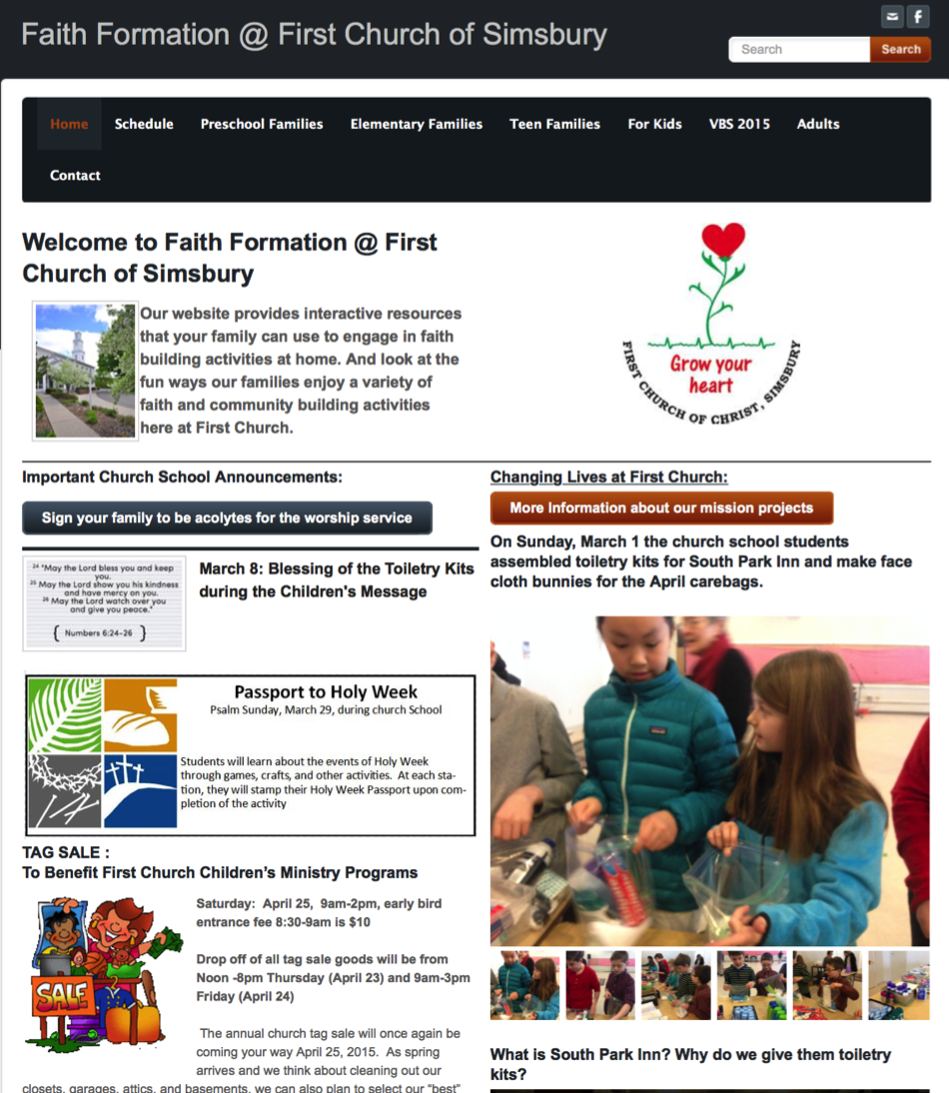

Slide 39
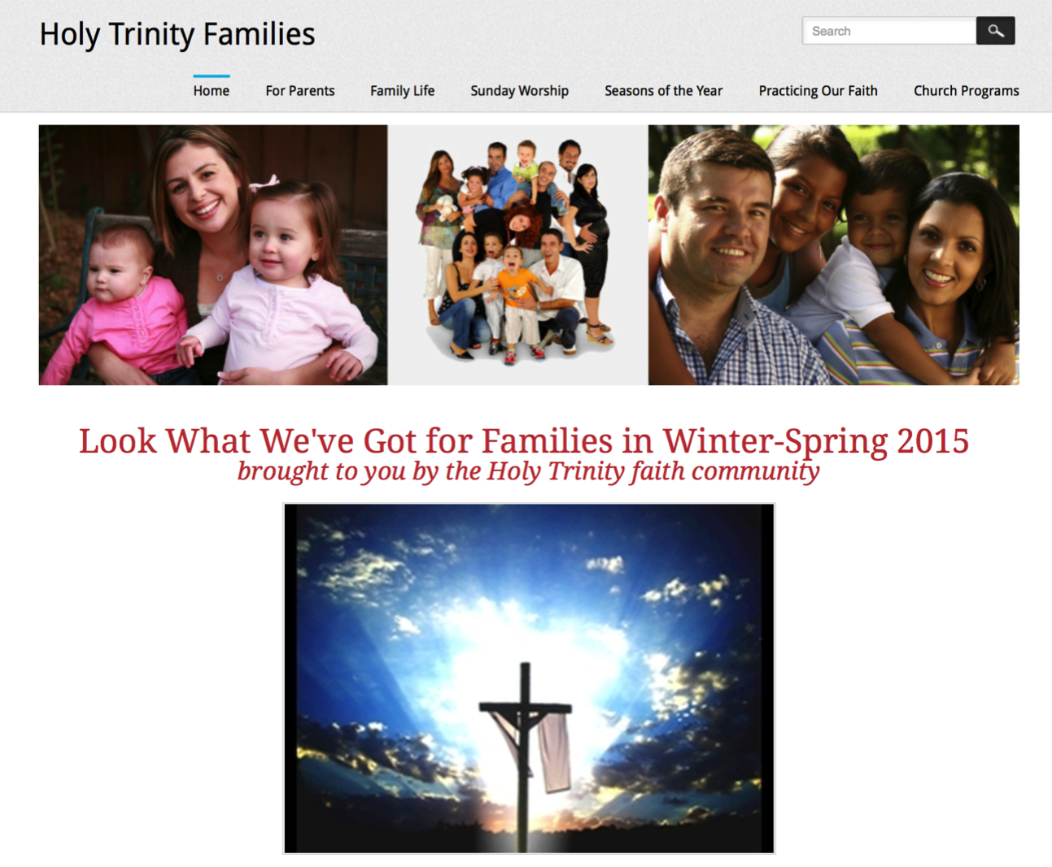

Slide 40
