Slide 1

Leading in the 21st Century
John Roberto
jroberto@lifelongfaith.com www.LifelongFaith.com

Slide 2
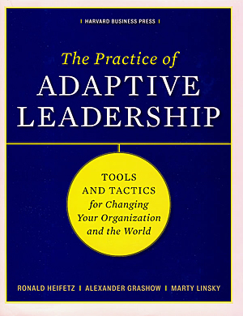
Adaptive Leadership
Leadership is the activity of mobilizing people to tackle tough challenges (problems) and do the adaptive work necessary to achieve progress and thrive.
(Ronald Heifetz and Marty Linsky)

Slide 3
Distinguishing Technical Problems from Adaptive Challenges
Technical problems (even though they may be complex) can be solved with knowledge and procedures already in hand.
Easy to identify.
Require change in just one or a few places; often contained within organizational boundaries
Everyday, people have problems for which they do, in fact, have the necessary know-how and procedures—technical problems.

Slide 4
Distinguishing Technical Problems from Adaptive Challenges
Adaptive challenges are situations for which solutions lie outside the current way of operation.
Difficult to identify (easy to deny). People often resist even acknowledging adaptive challenges
Require experiments, new discoveries, and adjustments from numerous places in the organization.
Without learning new ways—changing attitudes, values, and deep-seated behaviors—people cannot make the adaptive leap necessary to thrive in the new environment.
Calls for changes of heart and mind—the transformation of long-standing habits and deeply held assumptions and values.

Slide 5
Adaptive Change
People don’t resist change per se.
People love change when they know it’s a good thing. (No one gives back a winning lottery ticket.)
People resist loss. When change involves real or potential loss, people hold on to what they have and resist the change.
The common factor generating adaptive failure is resistance to loss. A key to leadership , then, is the diagnostic capacity to find out the kinds of losses at stake in a situation.
Adaptive leadership leadership almost always put you in the business of assessing, managing, distributing, and providing contexts for losses that move people through these losses to a new place.

Slide 6
Adaptive Change
Adaptive leadership is a process of conservation and loss.
“Of all that we care about, what must be given up to survive and thrive going forward?
“Of all that we care about, what elements are essential and must be preserved into the future, or we will lose precious values, core competencies, and lose who we are?”
As in nature, a successful adaption enables an organization or community to take the best from its traditions, identify, and history into the future.

Slide 7
You May Be Facing an
Adaptive Challenge If. . .
the solution requires operating in a different way than you do now. . .
the problem AND the solution require learning. . .
the solution requires shifting the authority and responsibility to the people who are actually affected. . .
the solution requires some sacrifice of your past ways of working or living. . .
the solution requires experimenting before you’re sure of the answer. . .
the solution will take a long time. . .
the challenge connects to people’s deeply held values. . .

Slide 8
Adaptive Leadership
Adaptive leadership is specifically about change than enables the capacity to thrive. New environments and new dreams demand new strategies and abilities, as well as the leadership to mobilize them.

Slide 9
The Adaptive Intervention Process
Observing events and patterns around you;
Interpreting what you are observing (developing multiple hypotheses about what is really going on; and
Designing interventions based on the observations & interpretations to address the adaptive challenge you have identified.
1. Observe
2. Interpret
3. Intervene

Slide 10
Facilitating Change

Slide 11
How People Change
People change what they do less because they are given analysis that shifts their thinking than because they are shown a truth that influences their feelings.
(John Kotter)

Slide 12
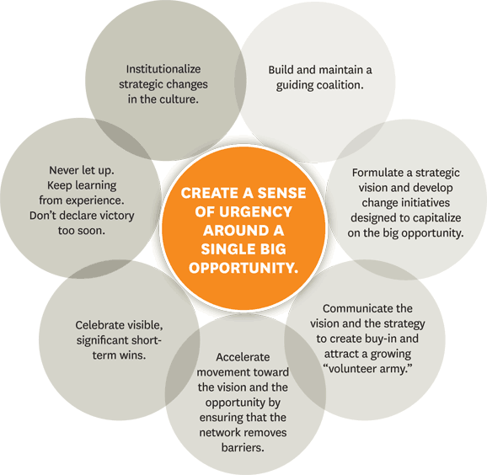


Slide 13
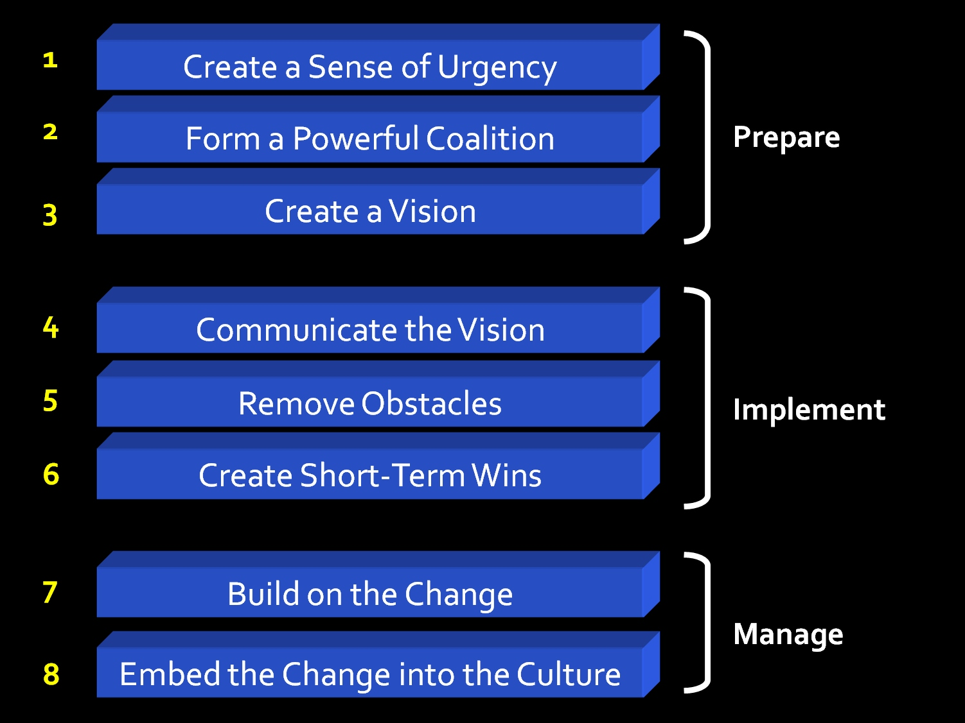
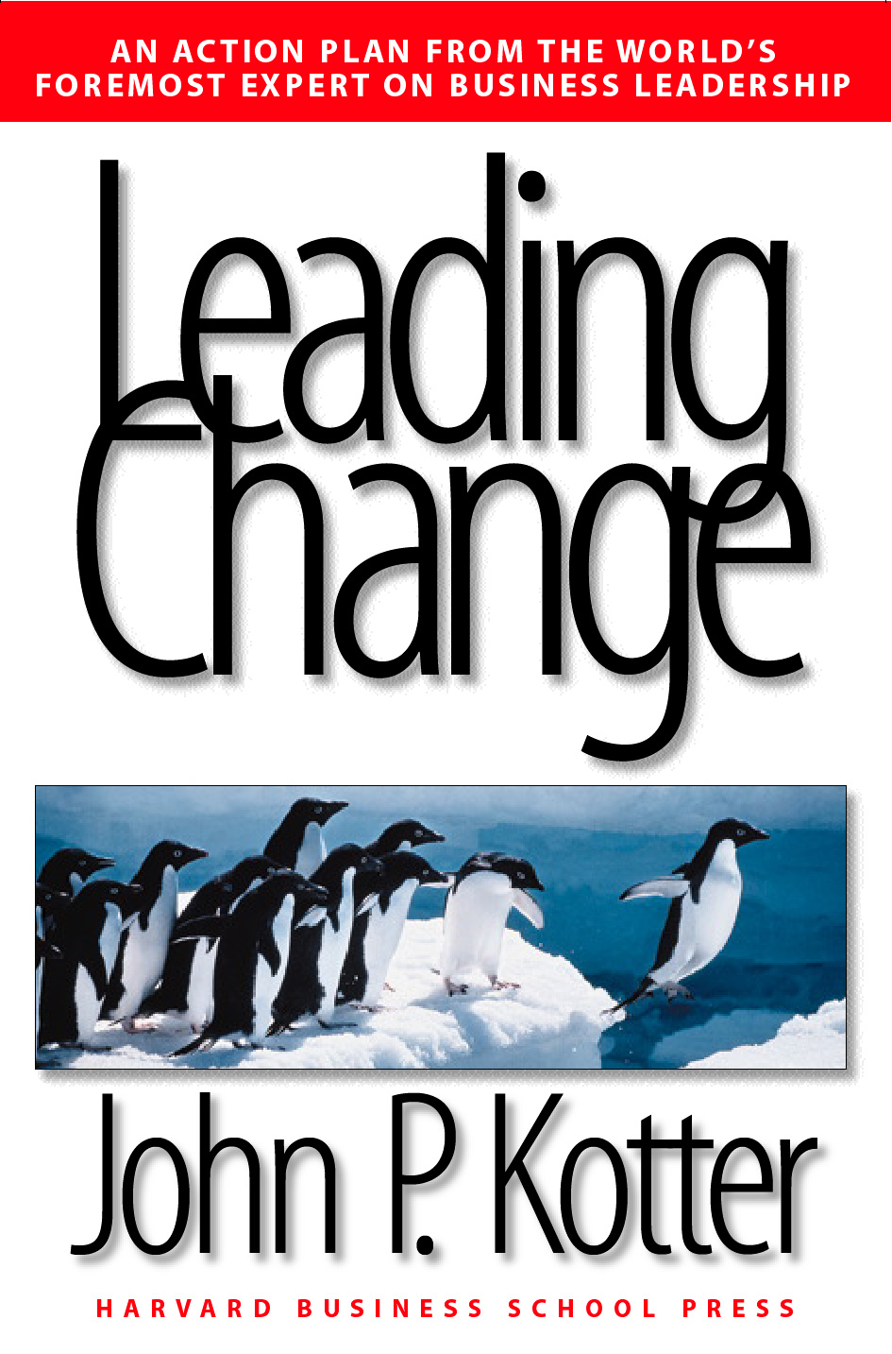
Kotter’s 8-Step Change Process

Slide 15
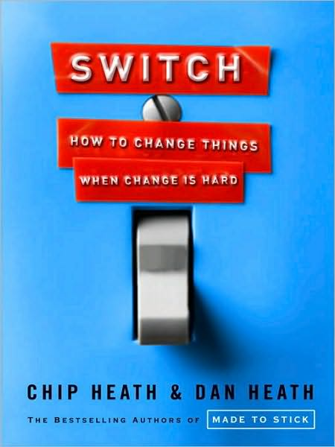
Switch: How to Change Things
When Change is Hard

Slide 16
A Framework for Change
Direct the Rider (the conscious mind), eliminating what looks like resistance but is more often a lack of clarity by providing crystal-clear direction.
  Following the bright spots: investigate what’s working and clone it.
  Script the critical moves: don’t think big picture, think in terms of specific behaviors.
  Point to the destination: change is easier when you know where you’re going and why it’s worth it.

Slide 17
A Framework for Change
Motivate the Elephant (the subconscious), eliminating what looks like laziness but is more often exhaustion by engaging emotions to get people on the same path as you.
  Find the feeling: knowing something isn’t enough to cause change. Make people feel something.
  Shrink the change: break down the change until it no longer spooks the Elephant.
  Grow your people: cultivate a sense of identity and instill the growth mindset.

Slide 18
A Framework for Change
Shape the Path (the situation), eliminating what looks like a people problem but is more often a situation problem, by making the environment more conducive to the change you seek.
  Tweak the environment: when the situation changes, the behavior changes. So change the situation.
  Build habits: when behavior is habitual, it’s “free”—it doesn’t tax the Rider. Look for ways to encourage habits.
  Rally the herd: behavior is contagious. Help it spread.

Slide 19
Things to Remember
Follow the bright spots: investigate what’s working and clone it.
Script the critical moves: don’t think big picture, think in terms of specific behaviors. Shrink the change.
Point to the destination: change is easier when you know where you’re going and why it’s worth it.
Find the feeling: knowing something isn’t enough to cause change. Make people feel something. Build an emotional and rational case for change.

Slide 20
Anchoring Change in the Culture
Culture changes only after you have successfully altered people’s actions, after the new behavior produces some group benefit for a period of time, and after people see the connection between the new actions and the performance improvement.
(John Kotter)

Slide 21
Facilitating Innovation

Slide 22
Small Scale Prototyping
Implement the faith formation network through small scale prototyping with a small group of your target audience.
Identify a group within the target audience for piloting or a limited launch of a project in order to test the project
Implement the project and get regular feedback on its implementation and effectiveness
Develop leaders through the piloting phase so that they can be involved in the wider launch of the project

Slide 23
Implementation Timeline
Season 1 | Season 2 | Season 3
Design Prototype with a small group of the potential audience Evaluate effectiveness Re-design | Expand reach to wider audience Continued evaluation | Integrate into regular offerings Continue expansion

Slide 24
Testing the Prototype
Testing is the chance to refine our solutions and make them better. Prototype as if you know you’re right, but test as if you know you’re wrong.
Refine our prototypes and solutions.
Learn more about our user. Testing is another opportunity to build empathy through observation and engagement—it often yields unexpected insights.
Test and refine our POV. Sometimes testing reveals that not only did we not get the solution right, but also that we have failed to frame the problem correctly.

Slide 25
Testing the Prototype
Prototyping is getting ideas and explorations out of your head and into the physical world.
In early explorations keep your prototypes rough and rapid to allow yourself to learn quickly and investigate a lot of different possibilities.
Prototypes are most successful when people (the design team, the user, and others) can experience and interact with them. What you learn from those interactions can help drive deeper empathy, as well as shape successful solutions.

Slide 26
Testing the Prototype
We prototype to:
  Learn: If a picture is worth a thousand words, a prototype is worth a thousand pictures.
  Solve disagreements: Can eliminate ambiguity, assist in ideation, and reduce miscommunication.
  Start a conversation: Can be a great way to have a different kind of conversation with users.
  Fail quickly and cheaply: Allows you to test a number of ideas without investing a lot of time and money up front.
  Manage the solution-building process: Encourages you to break a large problem down into smaller, testable chunks.

Slide 28
Anchoring Change in the Culture
Whenever you let up before the job
is done, critical momentum can be
lost and regression may follow.
(John Kotter)

