Slide 1
“The Seasons of Adult Faith Formation” A National Symposium on the Future of Adult Faith Formation October 1-3, 2015

Slide 2
Scenario Planning
Jay Ogilvy and Peter Schwartz describe scenarios as “narratives of alternative environments in which today’s decisions may be played out. They are not predictions. Nor are they strategies. Instead they are more like hypotheses of different futures specifically designed to highlight the risks and opportunities involved in specific strategic issues.”
The point is not to gather evidence for some “most probable” future. The point is rather to entertain a number of different possibilities in order to make better choices about the future of faith formation in the face of inevitable uncertainties.

Slide 3
Scenario Planning
Over the last forty years, in the face of increasing uncertainty and complexity, corporations and organizations have begun to apply scenario processes to their work. A famous example occurred in South Africa in 1991, when the creation of the Mont Fleur scenarios catalyzed a nationwide discussion about the possibilities for post-Apartheid South Africa. These scenarios were developed as the political negotiations between the ANC and the apartheid-era National Party were taking place. The scenarios were presented as alternative outcomes to difficult decisions that the key stakeholders in South Africa would have to make (for example, reconciliation versus revenge, the role of private property, minority rights for whites). The dialogue that stemmed from these scenarios enabled the stakeholders to think through the implications of their decisions and consequently adjust their strategies.

Slide 4
Scenario Planning
Take the Long-View. Taking the long view offers a more proactive and anticipatory approach to address the forces and see both challenges and opportunities more clearly.
Think from the “Outside-in.” Most organizations are surprised by discontinuous events because they spend their time thinking about what they are most familiar with: their own organization. They think from the inside—the things they can control—out to the world in which they operate. Thinking from the outside-in begins with pondering external forces—changes that might, over time, profoundly affect the organization, creating new risks and opportunities.
Embrace Multiple Perspectives. The introduction of multiple perspectives helps to better understand and challenge assumptions while painting an expansive picture of an issue or idea.

Slide 5
Outside-In Thinking

Slide 6
Scenario Planning Process
Identifying Driving Forces
Determining 2 Critical Uncertainties
Constructing a Scenario Framework & Writing Narratives
Developing Action Implications & Strategies

Slide 7
Focusing Question
What could adult faith formation in faith communities look like in five years (2016-2020)?
How can faith communities provide vibrant faith formation to address the four seasons of adulthood—young adults, midlife adults, mature adults, and older adults—over the next five years?
How can faith communities envision the shape of adult faith formation and design initiatives to respond proactively to the challenges and opportunities by 2020?

Slide 8
Identify Trends
Context
Religious
Generational
Technological
Economic
Ethnic-Cultural
Political

Slide 9
Identify Trends
Session 1: Identify Trends Affecting the Future of Faith Formation in Congregations
Presentation: “Significant Trends Affecting the Future of Faith Formation”
Group Work: Develop impact statements reflecting how the broad external trends impact adult faith formation.
Individual Work: Write impact statements.
Group Work: Share impact statements and identify up to 10 impact statements that reflect the group’s thinking.
Synthesizing: Group members write the 10 statements on Post-it Notes and post them on the newsprint sheet.
Large Group: View impact statements.

Slide 10
Impact Statements
One Impact Statement per note
Name the Category
Social
Cultural
Technological
Political
Economic
Educational
Religious
Write the Impact Statement in a phrase or sentence: How does this trend impact adult faith formation?

Slide 11
Identify Trends
Session 2 – Identify Trends Affecting Faith Formation in the 4 Seasons of Adulthood (2 Rounds)
Presentation by Symposium Team Members
Young Adults – Kyle Oliver (Northington Room)
Midlife Adults – Jim Merhaut (Riverdale Room)
Mature Adults – Janet Schaeffler (Talcott Room)
Older Adults – Dorothy Linthicum (Towpath Ballroom)
Questions / Discussion
Individual Work: Write 4-5 impact statements.
Group Work: Share impact statements, post the notes on newsprint, and cluster the notes into common themes that reflect the whole group’s thinking.

Slide 12
Identify Trends
Session 2 – Identify Trends Affecting Faith Formation in the 4 Seasons of Adulthood (2 Rounds)
Large Group Wrap-Up
Review of Group Reports
Preview of Work Ahead
Presentation of What a Scenario Matrix Looks Like
Individual “Homework” Time
Examine the “Impact Statements” & identify 3 or 4 of the most Critical Forces (degree of importance to the focusing question & degree of uncertainty surrounding those forces) affecting the future of adult faith formation in congregations over the next 5 years.

Slide 13
Select Critical Forces
Which forces are the most unpredictable or uncertain in terms of their outcome over the next 5 years? These are importance forces, but unpredictable in terms of how they may play out.

Slide 14
Critical Forces
Will desire for spirituality increase or decline in the next five years? 1
Will adults engage with/return to the church or be “done.”
Will technology drive community or isolation? 2
Will the church be stagnant or fluid in response to the demographic and cultural changes? 4
Will trust in church institutions increase or diminish? Will relevance and trust in faith communities and institutions increase or decrease? 3
How will mistrust of formal institutions impact adult faith formation? 1

Slide 15
Critical Forces
Will the changing dynamics of family life including the definition of marriage lead to more meaningful ways to mature in faith or will it decrease the capacity of families to be a place of faith formation?
Will financial stress cause churches to invest or divest in adult faith formation? 1
Will an increasingly customizable world hinder or promote our ability to form Christian faith? 2
Will increasingly societal diversity lead people to seek faith or turn away? 1
Will global/US socioeconomic system allow for more religious tolerance or intolerance/suppression? 1
Will church offer relevance 21st century adult faith formation or not?
Will faith communities focus on discipleship or propping up institutional structures? 4

Slide 16
Critical Forces
Will churches become more polarized and isolated, or more collaborative within and without? 1
Will society’s perception of a fluid definition of identity move toward traditional or nontraditional?
Will the world perceive the church as a grace-filled, diversity-accepting, justice-seeking place or as an isolated, angry, divided, self-protective place? 2 (with 13)
Will people become more community-engaged or community-disconnected? 1
Will church structures be more responsive/flexible or more unresponsive/rigid in raising up authentic and relational leaders?
Will evolving developments in technology lead people to an increasing or decreasing need for faith formation? 1

Slide 17
World
** Diversity in society 19 + 26
(ethnic, households/families, gender)
Faith communities------------------------Faith communities
Resisting diversity Embracing diversity
Busy, stressed, time-crunched, overwhelmed adults
13+16
Business as Usual AFF-----Responsive & Innovative AFF
A “Design Your Own Life” Culture
8 + 10
Standardized AFF------------------Customizing AFF
One size fits all One size fits one

Slide 18
Adult
** Adult desire/interest for developing their spiritual life
11 + 25
Decreasing-------------------------------------Increasing
Adult openness to belonging/participating in a faith community
14 + 13
Decreasing-------------------------------Increasing
Adult desire/interest/hunger in being engaged in adult faith formation in a faith community
13 + 15
Decreasing-------------------------------Increasing

Slide 19
Adult Faith Formation
Diversity in Society
(ethnic, households/families, gender)
Faith Communities Embracing Diversity
Decreasing Increasing
Adult desire/interest for developing their spiritual life
Faith Communities Resisting Diversity

Slide 20
Write Scenario Narratives
Session 4: Create Scenario Narratives for the Future of Adult Faith Formation
Develop several one-sentence descriptions of how you see the scenario quadrant playing out over the next 5 years.
This is a world in which….
Describe what’s happening to the adults – young, midlife, mature, older
Describe what’s happening in faith communities
Describe what’s happening in society
Etc.

Slide 21
Develop Strategies
Session 5: Envision the Future of Adult Faith Formation: Young Adult, Midlife Adults, Mature Adults, and Older Adults
Task: Develop strategies and practices for bringing each of the four scenario narratives to life in each season of adulthood.
Groups: Select a season of adulthood that you would like to focus.
Northington Room
Riverdale Room
Jackson Suite
Towpath Ballroom
2 Rounds of Idea Generating

Slide 22
Develop Strategies
Imagine that each of the four scenarios is the future and you are living and working in each of the four scenarios. For each scenario narrative consider: What actions can we take to develop a desirable future (or mitigate a negative one) in this scenario with our “season of adulthood”?
Programs Activities Resources
Online/digital Approaches
Practices Leadership Training
Focusing Question: What if….

Slide 23
Adult Faith Formation
Diversity in Society
(ethnic, households/families, gender)
Faith Communities Embracing Diversity
Decreasing Increasing
Adult desire/interest for developing their spiritual life
Faith Communities Resisting Diversity

Slide 24
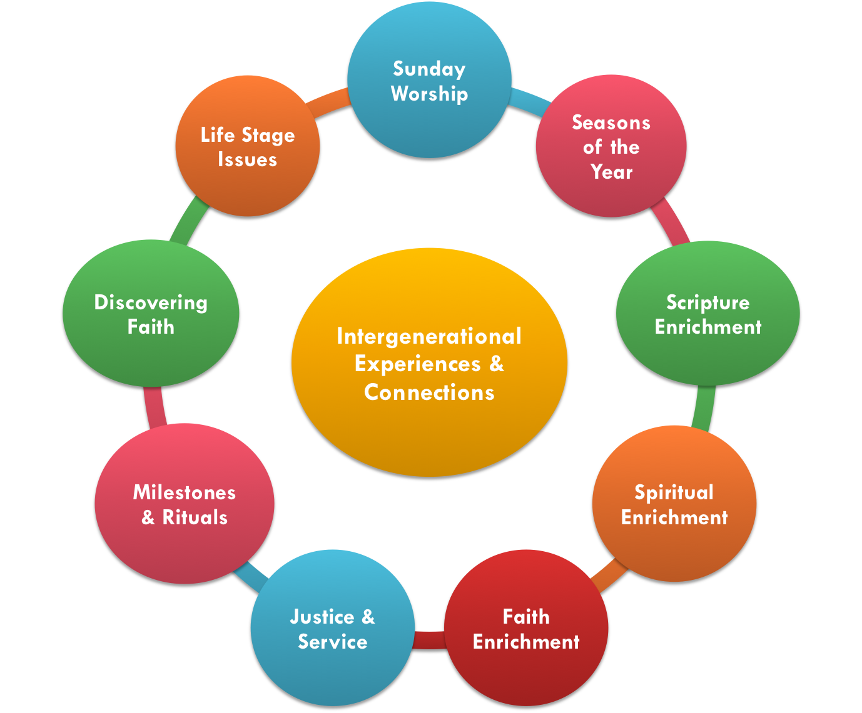
Scenario 1: Embracing & Increasing
Scenario 2: Resisting & Increasing
What if we developed an adult faith formation network with a variety of opportunities and experiences tailored specifically to the needs of different audiences in the faith community.

Slide 25
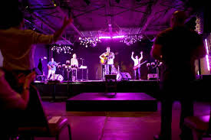
Scenario 3: Resisting & Decreasing
What if our faith community became a center for the arts and music and…. spiritual conversation

Slide 26
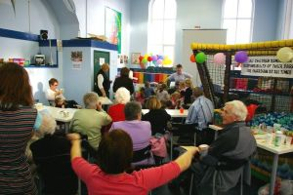
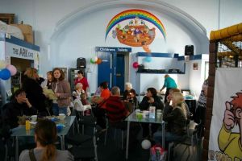
Scenario 4: Embracing & Decreasing
What if we created a family life center (in physical space and online space) that addresses the diversity of parents and grandparents – with a variety of programs, experiences, mentoring for young parents, etc. equipping them for

Slide 27
Session 7: Building an Agenda for Action
How could we use the adult faith formation scenarios and strategies in our tradition?
American Baptist
Christian Reformed
Cooperative Baptist Fellowship
Episcopal
Lutheran
Mennonite
Presbyterian
Roman Catholic
United Methodist
Unitarian Universalist
United Church of Christ

Slide 28
Build an Action Agenda
Develop an “Organizational” Agenda for Action: Develop a practical “next steps” agenda for their ministry setting, addressing questions like:
How do we build an “infrastructure” for the future of adult faith formation?
How do utilize training, resources, networking, support systems, online and digital media, etc.
Develop a “Personal” Agenda for Action

Slide 29
Scenario Examples

Slide 30
Faith Formation 2020
Two Uncertainties
Will trends in U.S. culture lead people to become more receptive to organized religion, and in particular Christianity or will trends lead people to become more resistant to organized religion and Christianity?
Will people’s hunger for and openness to God and the spiritual life increase over the next decade or will people’s hunger for and openness to God and the spiritual life decrease.

Slide 31
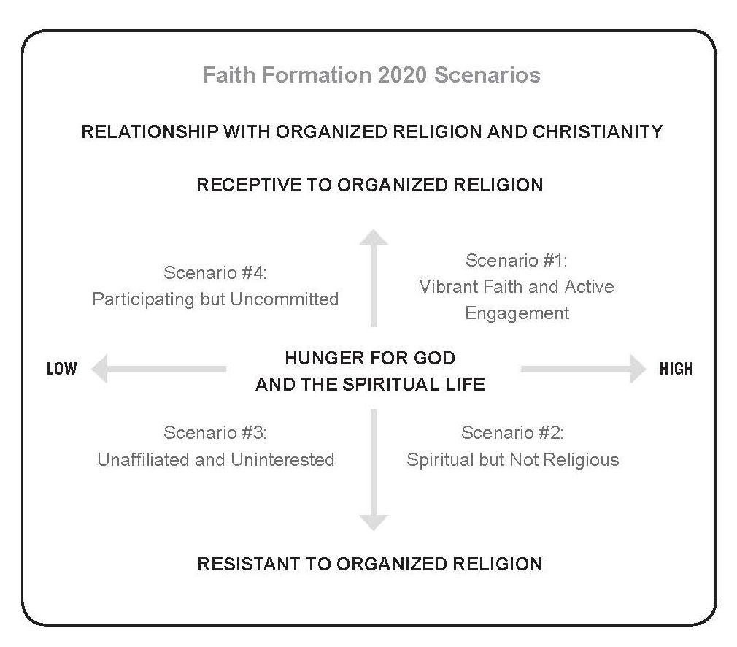
Faith Formation 2020

Slide 32
Episcopal Faith Formation
The Relationship of Technology and Community
Will the continuing evolution of technology enhance human community and connection or will technology diminish community and connections among people?
Diminished --------------------------------------------------- Enhanced
Response of the Episcopal Church to Changing Global Realities
Will the Episcopal Church’s response toward emerging global realities, such as increasing cultural diversity, economic uncertainty, and resource availability for all people, lead the Church toward an outward-focused engagement with the world or toward an inner-focused, separation from the world.
Separated ----------------------------------------------- Engaged

Slide 33
Episcopal Faith Formation
Response of the Episcopal Church to Changing Global Realities
Engaged
Diminished Enhanced
Relationship of Tech nology & Community
Separated

Slide 34
Episcopal Faith Formation
A Church Engaged in the World Community & Connection Diminished by Technology
A Church Engaged in the World
Community & Connection Enhanced by Technology
A Church Separated from the World Community & Connection Enhanced by Technology
A Church Separated from the World Community & Connection Diminished by Technology

Slide 35
Christian Brothers

Slide 36
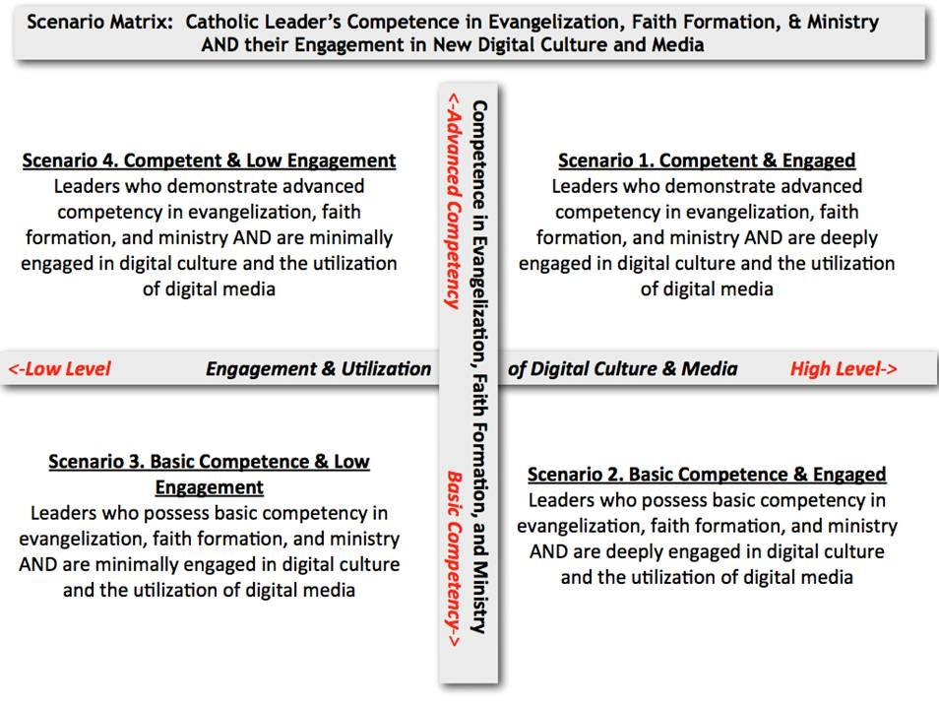
Future of Catholic Media in a Digital World

