Slide 1
Digital Faith Formation John Roberto jroberto@LifelongFaith.com

Slide 2
What new ways of learning and faith formation is the digital transformation making possible?

Slide 3
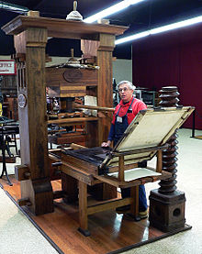
The Print Era (1500s - )

Slide 4
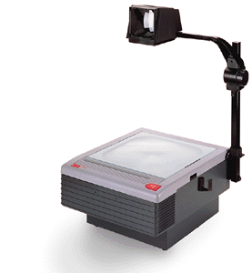
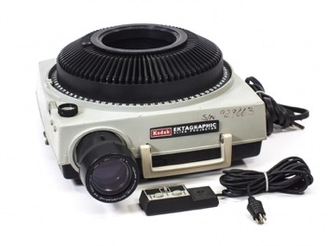
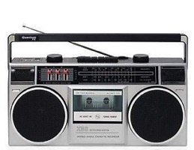
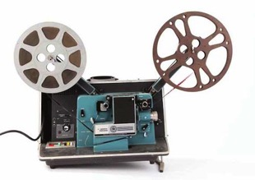
The Multimedia Era (1960s - )

Slide 5
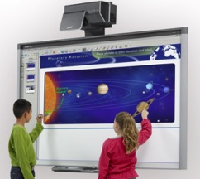
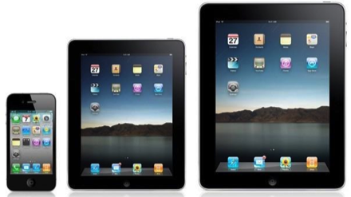
The Digital Era (2000s -)

Slide 6
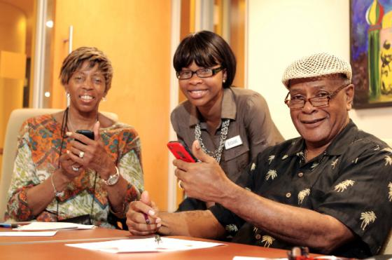

Slide 7
What is the Digital Transformation Making Possible?
Mobile faith formation – anytime, anyplace, 24x7
An abundance of high quality digital content for faith formation – audio, video, print, websites, digital learning platforms, apps, etc.
Personalizing faith formation – putting the person at the center of faith formation – not the program
Provide multiple ways to learn
Develop content in smaller units (micro-learning) that connect together
Content and tools to extend and expand faith formation in multiple environments
Self-organizing communities of learning and practice

Slide 8
#1. Multi-Environment Faith Formation
Faith Formation
Church
Daily Life
Community
Home
Online

Slide 9
Digital Faith Formation Strategies

Slide 10
Digitally Enabled & Digitally Connected Faith Formation

Slide 11
#2. Blended Models of Faith Formation
Extend a church event or program
Design one event or program, offer it in multiple platforms
Prepare for and follow-up an an event or experience
Flip a gathered program
Integrate online and gathered
Create online only experiences
Use webinars, Facebook live, podcasts, etc. to deliver programming directly to people

Slide 12
Extend the Event
Church Event or Program
At Home & Daily Life

Slide 13
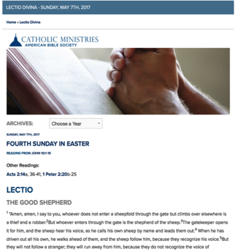
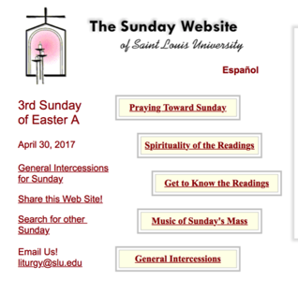
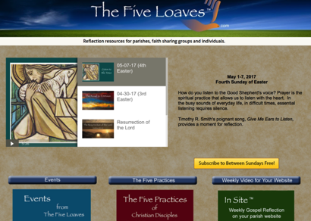
Sunday Worship
Learning
Praying
Reading the Bible: Daily Readings
Living

Slide 14
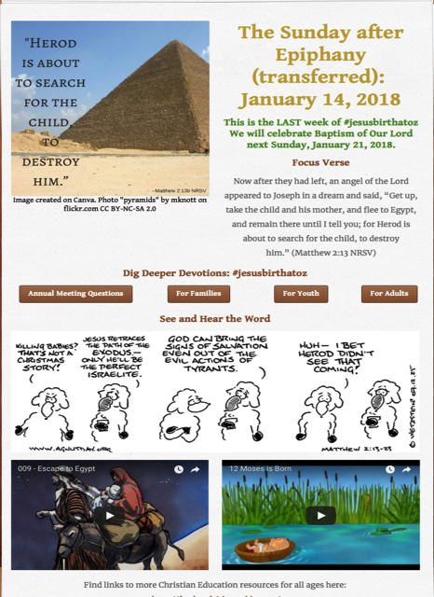
Tri-Saints Lutheran Hardy, NE

Slide 15
One Event/ Program, Multiple Formats
Multiple Formats
Digital Content to Extend & Provide New Ways to Experience
Social Media
Interaction
Communication
Demonstration
Connection
Gathered
Website
Small Group
Independent
Online
Event/Program

Slide 16
Build on an Event/Experience
Preparing
Experiencing
Living
How will you sustain/extend the event?
How will you design the event?
What types of experiences, programming, activities, and resources will you develop to prepare people for the event?
How will you engage age groups, families, and the faith community?
What types of experiences, programs, activities, and resources will you offer people?

Slide 17
Flip the Model
@ Home / Daily Life
Exploring the Content - print, audio, video, activities
@ The Program
Applying the Content: Create – Practice - Perform - Participate

Slide 18
Our Confirmation preparation program has two components: Once a month in-person classes and an online study. The online study is a place for students to develop their faith weekly by completing multi-media lessons which include videos, reading, Saint reflections, multiple-choice questions and online small group discussions. Each small group has their own online space to discuss faith topics, ask questions, and pray for one another. By having both in person classes and an online study we hope to help families learn more about their faith while respecting the many demands for their time.

Slide 19
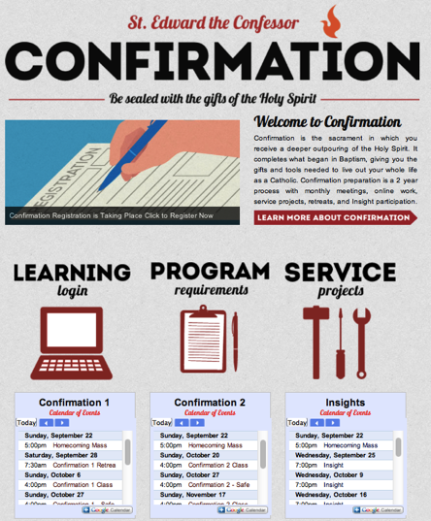
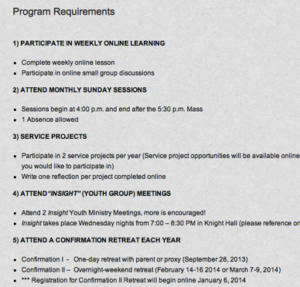
Confirmation

Slide 20
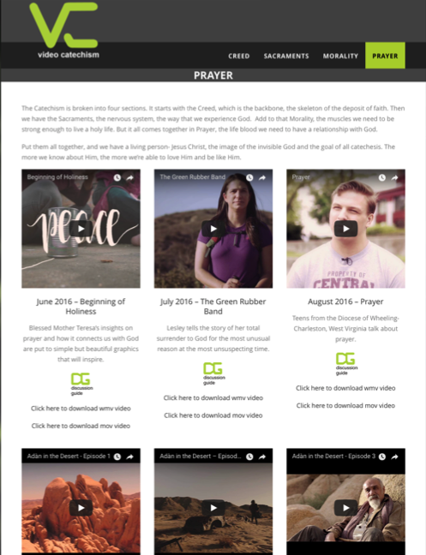

Slide 21
Integrate Online and Gathered

Slide 22
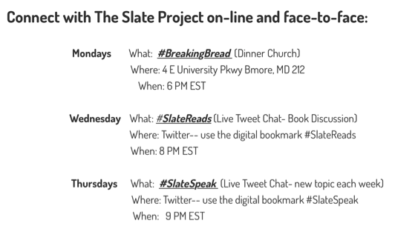
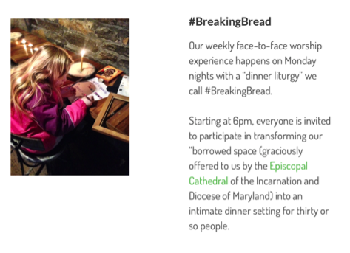

Slide 23
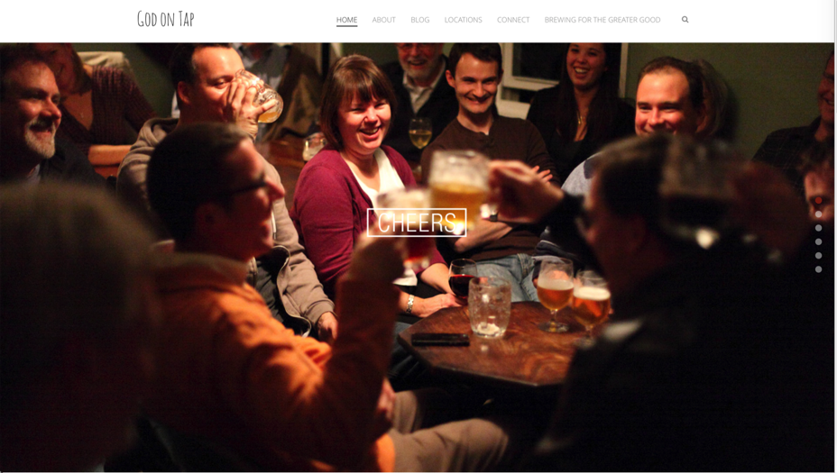
Integrate Online and Gathered

Slide 24
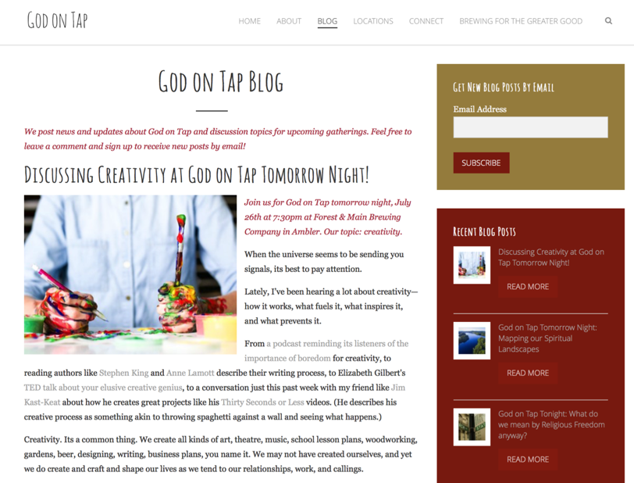

Slide 25
#3. Online Models of Faith Formation
Create online-only experiences
Use webinars, Facebook live, podcasts, etc. to deliver programming directly to people

Slide 26
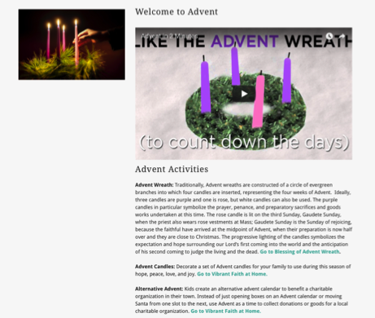
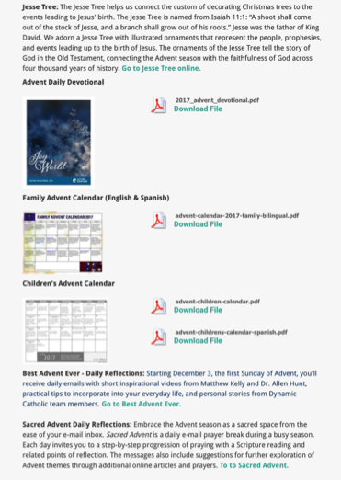
Advent or Lent Online “Curriculum”

Slide 27
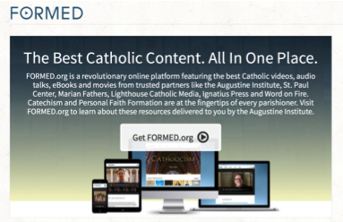
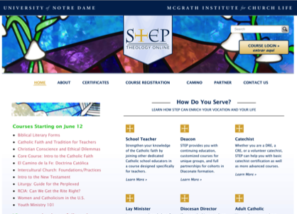
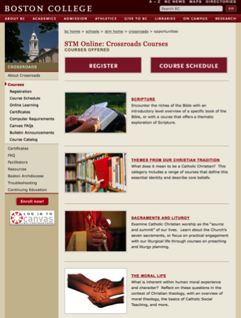
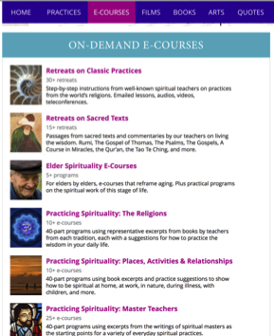
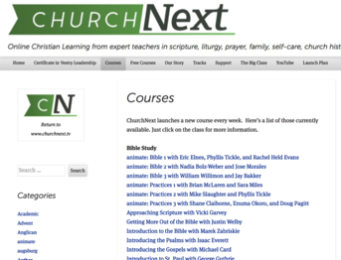
Online Learning

Slide 28
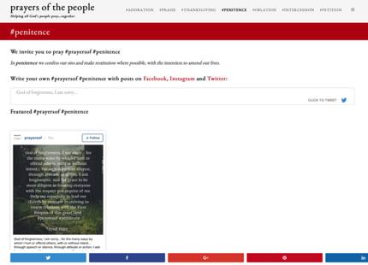
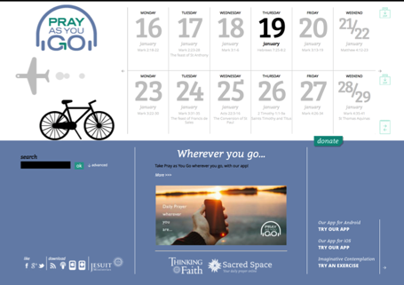
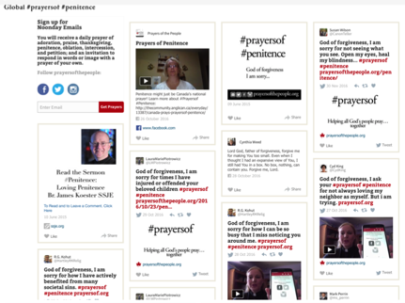
Online Prayer

Slide 29
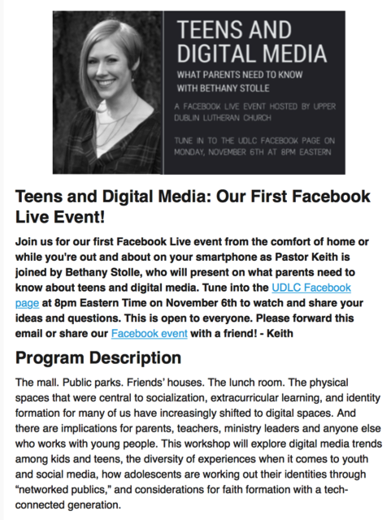
Webinar Live Presentation Upper Dublin Lutheran Church

Slide 30
#4. Personalizing Faith Formation

Slide 31
Virtual Learning Academy

Slide 32
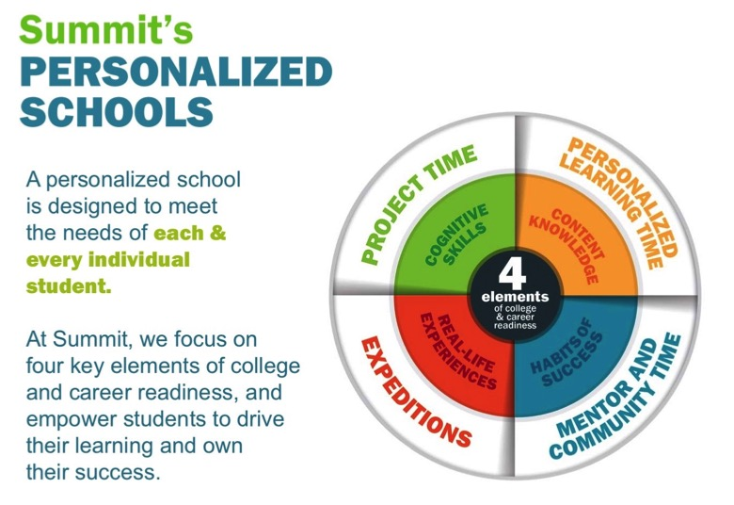
Summit Schools

Slide 33
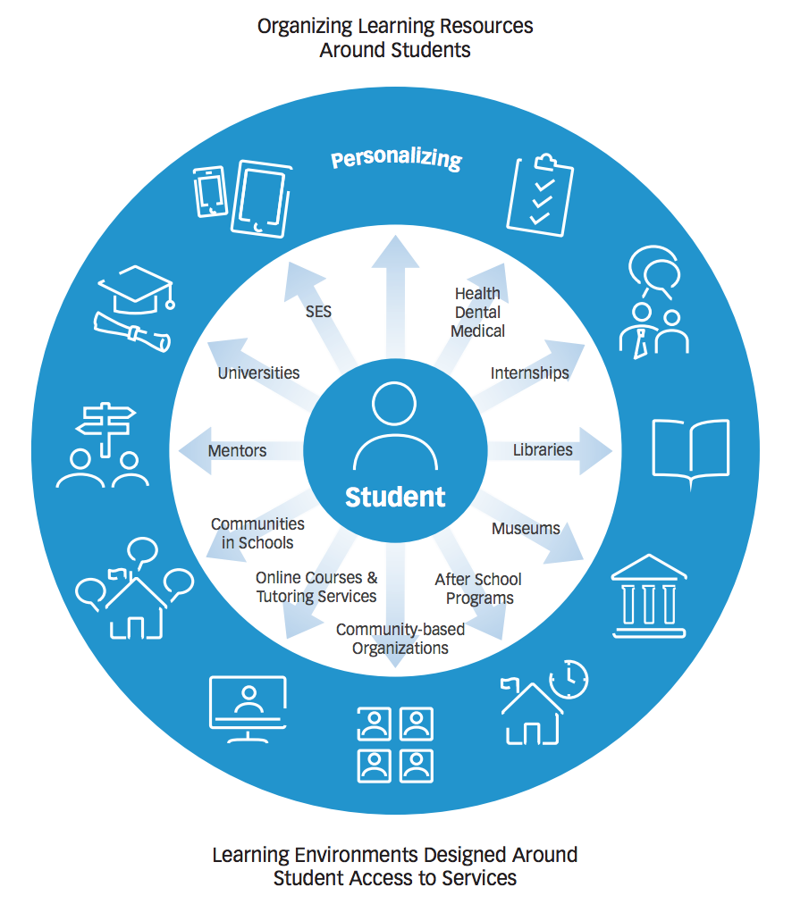
Personalizing Learning
Personalized learning is tailoring learning for each student’s strengths, needs and interests— including enabling student voice and choice in what, how, when and where they learn— to provide flexibility and supports to ensure mastery of the highest standards possible.

Slide 34
Two Ways to Approach Personalizing
Approach One: Personalize the Pathway for People
Develop pathways of faith maturing
Develop playlists of content and experiences tailored to the pathways
Upload playlists to a digital platform
Approach Two: Personalize the Offerings
Identify important life and religious needs of target audience(s) OR develop a pathways model
Develop a digital platform with content to address the needs
Format the content tailored to different spiritual-religious identities

Slide 35
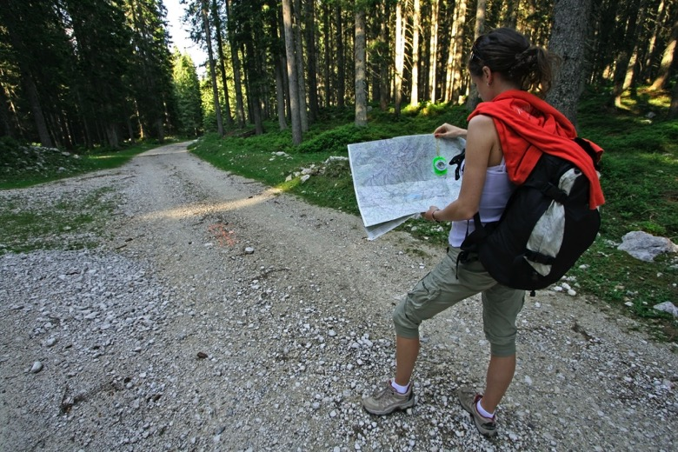
Approach 1. Personalize the Faith Pathways

Slide 36
A Pathways Model
A Pathway is a process for helping people discern where they are in their faith journey and to chart a path for faith growth—to get from where they are to a closer relationship with Jesus and a deeper practice of the Christian faith.
A Pathway is life-centered, reaching into every area of a person’s life.
A Pathway is holistic incorporating the whole person: head, heart, and hands.
A Pathway focuses on faith maturing.

Slide 37
Spiritual Religious Identities
Not Spiritual, Not Religious
Unaffiliated
The Spiritual but Not Religious
Uninvolved
Faith & Engagement – one among many priorities
Occasionals
Faith & Engagement at the Center of Life
Actives

Slide 38
Designing a Pathways Model
Identify a target audience(s)
Describe their life stage & religious-spiritual characteristics.
Identify how/where you will use the Pathways model
Sacraments/milestones
RCIA, evangelization, and new member processes
Gathered adult faith formation programming
Affinity groups
On-ramps where people might start the discipleship journey
Develop the content for the Pathways
Develop a ‘discernment continuum” that gives people a way to reflect on their current growth

Slide 39
Personalized Pathways of Faith Growth
Characteristic
1
Playlist of Experiences & Activities
2
Playlist of Experiences & Activities
3
Playlist of Experiences & Activities
4
Playlist of Experiences & Activities

Slide 40
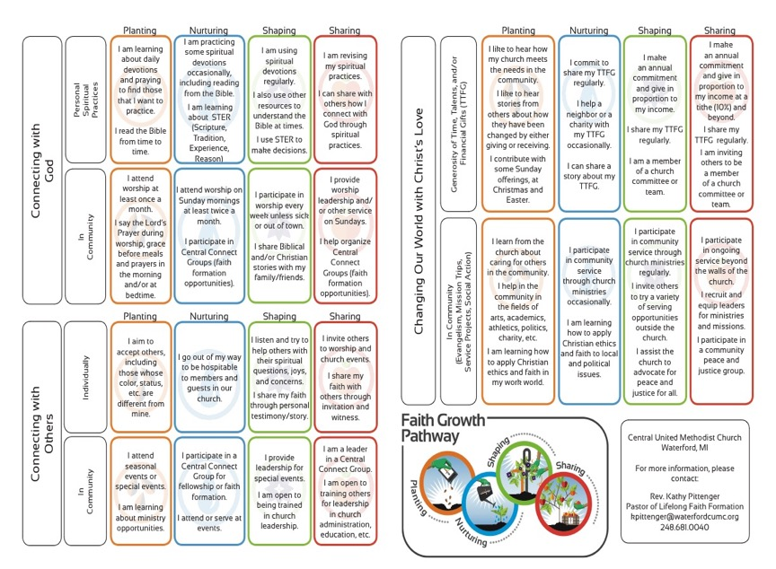

Slide 42
Designing Steps 1 & 2 Target Audience & Description
Surveys
Focus Groups
Interviews
Research Reviews
Sample Themes – Mature Adults
Dealing with retirement
Making life plans, finances, health
Becoming a grandparent
Making a difference in the community and world
Incorporating family changes and transitions
New ways of living and relating as a married couple
Caring for aging parents
Taking time to read the Bible and learn more about my faith
Growing spiritually and exploring spirituality for the 2nd half of life
Connecting with people my age; talking about things that matter to us
Dealing with loss

Slide 43
Designing Step 3 - How & Where
Identify how/where you will use the Pathways model
Sacraments/milestones
RCIA, evangelization, and new member processes
Gathered adult faith formation programming
Affinity groups
On-ramps where people might start the discipleship journey

Slide 44
Designing Step 4 – Content Designing Step 5 – Discernment
Develop the content for the Pathways
Life and faith characteristics of the target audience
Characteristics of mature faith
Develop a ‘discernment continuum” that gives people a way to reflect on their current growth
Inquiring--Getting Started--Making Progress--Going Deeper
How true: 1= not true from me , 3=somewhat true for me, 5=very true for me

Slide 45
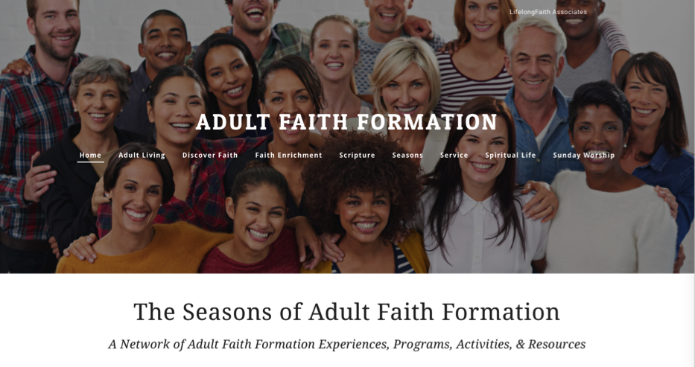
Approach #2. Personalize the Offerings

Slide 46
Personalize
For Life Stage Needs
For Spiritual-Religious Identity
For Adults’ Interests
For Time People Have for Activities

Slide 47
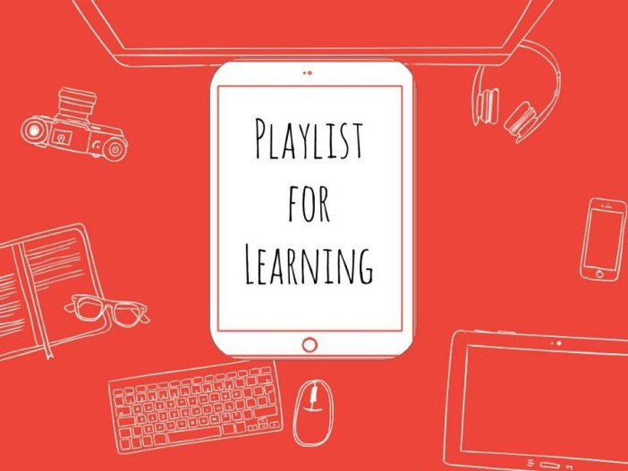
Playlists for Faith Formation

Slide 48
Personalized Pathways of Faith Growth
Characteristic
1
Playlist of Experiences & Activities
Playlist of Experiences & Activities
3
Playlist of Experiences & Activities
4
Playlist of Experiences & Activities
2

Slide 49
Learning Playlists
A learning playlist is a curated group of digital and local learning experiences and resources (e.g. videos, websites, books, games, articles, etc.).
A playlist weaves together these learning experiences into a sequenced pathway centered on a common theme.
Playlists broaden opportunities to engage in cohesive, interest-driven connected learning experiences that combine a variety of ways to learning: peer settings, family settings, intergenerational settings, community/world settings, and online settings.
Playlists create a rich network of experiences for learners.

Slide 50
Curating Playlists
Books
Audio / Podcasts
Video and movies
Apps and digital programming
Website content and activities
Courses, programs, workshops at church and online
Church life, ministries, and events
Small groups at church, home, community settings
Art, drama, music
Service and action projects, mission trips
Retreats
Field trips
Mentoring

Slide 51
Transforming Our Role
Balancing Both Roles
|---------------------------------------------------------------------------------------------------------|
Current Roles
Emerging Roles
Developing religious content
Designing programming
Managing programming
Teaching/Facilitating programming
Designing faith forming environments—architecture
Designing Digital Platforms for faith forming content
Curating religious content and experiences

Slide 52
New Leadership Roles
We are becoming learning architects who design and/or identify environments which can become settings for faith formation, e.g., homes, workplaces, coffee shops, online communities, and more. We can design content and experiences to “deliver” to that setting.
We are becoming designers of digital platforms (websites, social media) where people can connect with each other, access content, engage in learning activities, and more. These platforms provide 24x7 faith formation.
We are becoming curators of religious content and experiences. When there is an abundance of content, our role shifts from creator to curator. Curators are engaged in finding and identifying high quality content in all formats, matching it with the needs of people, providing the content on a digital platform (and often in gathered settings), and engaging people with the content.

Slide 53
Curating Faith Formation

Slide 54
What is Content Curation (Beth Kanter)
Content curation is the process of sorting through the vast amounts of content on the web and presenting it in a meaningful and organized way around a specific theme.
The work involves sifting, sorting, arranging, and publishing information.
A content curator picks the best content that is important and relevant to share with their community.
It isn’t unlike what a museum curator does to produce an exhibition: They identify the theme, they provide the context, they decide which paintings to hang on the wall, how they should be annotated, and how they should be displayed for the public.

Slide 55
Curating Religious Content
Research & Organize Resources
Identify Potential Resources for Programming
Evaluate Resources
Select & Connect Resources to programming

Slide 56
Develop Trusted Sources
Blogs Newsletters Websites
Denominations Curated Websites Religious Organizations
6-8 “Expert” Resource People

Slide 57
Develop a Research Checklist
People: teachers, mentors/guides, guest presenters
Community programs: churches, agencies, organizations,
Educational institutions: colleges, seminaries
Retreat and spiritual life centers, monasteries
Denominational programs, events, websites
Museums
Books (with study guides) & E-books
Apps
Audio podcasts & audio learning programs
Videos & video learning programs
Online courses & online activities
Television shows
Organizational websites
Resource center websites

Slide 58
Develop Evaluation Criteria
Biblical content and interpretation
Theological content and emphasis
Developmental appropriateness
Ethnic-Cultural appropriateness
Inclusive of diversity
Respect for diverse ways of learning
Appearance and visual appeal
Ease-of-Use
Quality of Experience
Applicable: Able to be incorporated into daily and home life

