Slide 1
What’s Working: Effective Practices

Slide 2
Youth Ministry Practices
What impact did involvement in youth ministry have on young people?
Deepen my relationship with Jesus
Understand my Christian faith better
Apply my faith to daily life
Make serious life choices (future, relationships, values)
Share my faith
These congregations are serious about making disciples of Jesus Christ.

Slide 3
Common YM Practices
Retreats
Service & Mission Trips
Bible Study & Religious Education
Prayer
Spiritual Support Groups
Youth-Oriented Worship
Special Events
Family & Intergenera-tional Activities
Peer Ministry & Youth Leadership

Slide 4
Youth Ministry Practices
Congregations have developed age-level ministries.
Marked by trusted relationships
Custom-designed ministry practices and activities
Caring atmosphere of high expectation
Multiple nurturing relationships and activities intentionally planned to create:
atmosphere of respect
growth
belonging
Generates an “alternative youth subculture

Slide 5
What Do Young Adults Want
A church that takes our experience seriously
A church that emphasizes the inclusive ministry of Jesus
A church that embraces that God is everywhere
A church that engages struggles and is open to dialogue
(Annie Selak)

Slide 6
Young Adult Ministry Practices: Summary
Creating deeper community through small groups
Making a difference through service
Experiencing worship – reflecting their culture and revering and revealing God (visual, musical, artistic, experiential)
Exploring the Bible and Christian tradition with depth, questioning, and applying faith to life
Utilizing the technology to communicate the message and to connect people
Building cross-generational relationships
Forming the spiritual life – spiritual practices & disciplines

Slide 7
Young Adult Ministry Pratices
Intentionally involving young adults in leadership
High quality worship; informal, innovative, experimental; use of new media and technology
Innovation and use of technology in communication
Hospitality: accepting of young adults (and everyone)
Intentional about reaching out and connecting with young adults
Investing time, energy, and money
Location (urban and suburban) and Newer Congregations
(FACT Research Studies)

Slide 8
Young Adult Ministry Practices
Creating deeper community
Making a difference through service
Experiencing worship
Conversing the content with religious depth
Leveraging technology
Building cross-generational relationships
Moving toward authenticity
Leading by transparency
Leading by team
“Characteristics of Churches Reaching Young Adults” (Lost & Found, Stetzer, Stanley, & Hayes)

Slide 9
Young Adult Ministry Practices
Young adults want to feel that there presence is valued.
Young adults want a sense of ownership in their congregations.
Young adults’ interests in religion are multifaceted.
Young adults thrive when they are “met where they are.”
Young adults welcome opportunities to feel emotionally affected.
Young adults respond to a theoretical and practice balance between the particular and universal.
(“Congregations that Get It” - Belzer, et al.)

Slide 10
Young Adult Ministry Practices
Congregations that provide a “home” for emerging adults; where older adults are welcoming, inviting them into leadership and participation.
Congregations that appreciate emerging adults – their ideas, their work, their prayers – and their limitations ($).
Congregations that offer short term, significant projects and involvements.
Congregations that are diverse, inclusive communities.

Slide 11
Young Adult Ministry Practices
Congregations that effectively use media and social networking, and that have a contemporary, current website.
Congregations that have a strong, nurturing pastor. They like good preaching and teaching. They like pastors who have a vision of the work of the Gospel in that congregation; and someone who has a good sense of outreach.
Congregations that provide worship at times they can come; and opportunities to gather and socialize.
Congregations that go “off campus” with ministry and faith formation.
(Changing Spirituality of Emerging Adults Project)

Slide 12
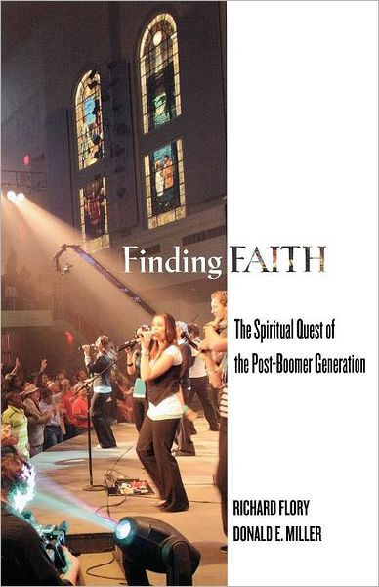
Young Adult Ministry Practices
“Religious Tinkering”: piecing together ideas about spirituality from many sources
“Expressive Communalism”
need for expressive/experiential activities
and physical community with others
and a faith that makes cognitive sense to them but is also an expressive, embodied spiritual experience.

