Slide 1
Faith Formation in a Missional Age
John Roberto, LifelongFaith Associates

Slide 2
Faith Formation in a Missional Age
Changing World, Adaptive Faith Formation
Envisioning 21st Century Faith Formation
Bringing the Vision to Life

Slide 3
Two Emerging Leadership Roles
Current Roles
NEW Network Roles
Developing religious content
Designing programming
Managing programming
Teaching/Facilitating programming
Designing learning environments—architecture
Curating religious content and experiences

Slide 4
Faith Formation Architects

Slide 5
Faith Formation Architects
Researching the life tasks and issues, interests and needs, and spiritual and religious needs of the age groups and generations
Planning, designing, and implementing faith formation networks – virtual and physical environments in which people can engage in faith formation experiences
Coordinating people, resources, and technologies to support faith formation networks

Slide 6
4. Design the Network
6. Implement the Network with a Wider Audience & Continue Evaluation and Improvements
3. Define the Group’s Point of View
2. Research the Target Audience
1. Identify a Target Audience
5. Create and Test a Network Prototype
Network Design Process

Slide 7
Innovation Design Process
Empathize
Define
Ideate
Test
Prototype
The d.School - Stanford School of Design

Slide 8
Virtual & Physical Environments
PHYSICAL ENVIRONMENTS
VIRTUAL ENVIRONMENTS
Church facilities
Home
Workplace
Schools
Camps
Retreat Centers
Museums
Libraries
Restaurants & coffee shops
Sports settings
Network Website
Website Resource Centers
Online Schools
YouTube, Ted Talks, etc.
Pinterest
Facebook
Twitter
Google+
Meeting Sites (Meetup)
Edmodo

Slide 9
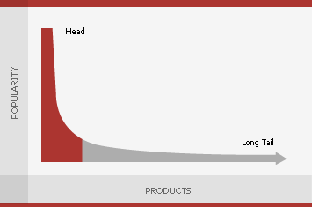
The Long Tail of Network Offerings

Slide 10
Service Projects Mission Trips
Youth Network
Parent-Teen Activities & Resources
Prayer & Spiritual Formation
Youth Leadership
Youth Group
Adolescent Life Issues
Bible Study & Religious Learning
Intergener-ational Connections
Parent Faith Formation
Parent Education & Support Groups
Milestones
Confirmation Program

Slide 13
Parent Faith Formation
Parenting Education & Support Groups
Whole Family Programs
Milestones
Mentors for Parents
Faith Practices: Bible, Prayer, Rituals. Service
Children’s Programs & Events
“Getting Started in Faith” Experiences
Bringing Sunday Worship Home
Intergenera- tional Experiences

Slide 16
Re-Purpose Gathered Programs
Gathered Event or Program
Stream It Live (Record It)
Learn in a Small Group
Extend Learning
Share Learning
Learn On Your Own

Slide 17
Extend Gathered Programs
Event or Program
TALK Conversation Questions
LEARN Watch a Video Listen to a Talk Read a Story
LIVE Action Project
PRAY Devotions, Bible Reading, Table Prayer
Parent Faith Growth Resources Targeted to their Needs
SHARE Write a Blog Entry Create & Share a Video or Project

Slide 18
Faith Formation Curators

Slide 19
Faith Formation Curators
A Faith Formation Curator:
is someone who continually finds, groups, evaluates, organizes, and shares the best and most relevant content and experiences on a specific topic to match the needs of a specific audience.

Slide 20
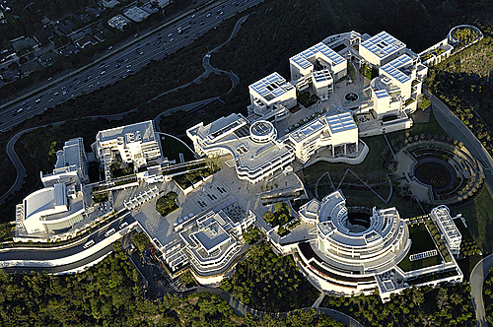
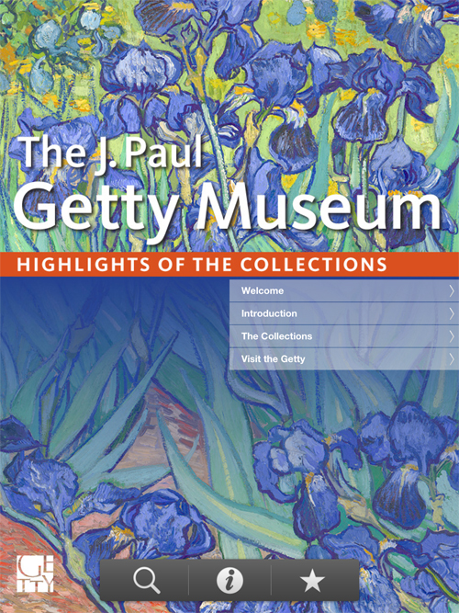
The collection of the J. Paul Getty Museum on display includes examples of pre-20th-century European paintings, drawings, illuminated manuscripts, sculpture, and decorative arts; and 19th- and 20th-century American and European photographs.

Slide 21
Why Curation?
The increasing diversity of the religious and spiritual needs and practices of people today require personalized and customized content and experiences
An overwhelming abundance of high quality faith formation resources: print, audio, video, programs and activities, apps, e-books, websites, and more
The rise of online providers of religious content and experiences—“open repositories” of freely accessible faith formation and learning content hubs

Slide 22
Why Curation?
There is a growing demand for trusted guidance in finding and selecting quality religious content and experiences. People are looking for trusted guides to help them select quality faith formation experiences and curated learning paths and resources to explore and learn more deeply on a specific topic.
The tools are now available for finding and accessing the content, storing it (websites), delivering it to people 24x7x365 (computers, iPhones, iPads, etc.), and communicating & connecting people to the content (Facebook, Twitter, email, text, etc.).

Slide 23
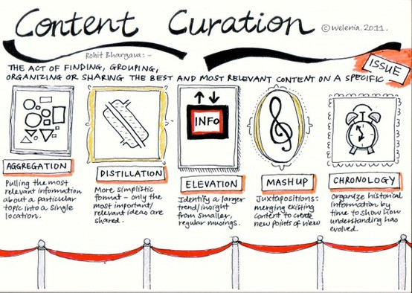

Slide 24
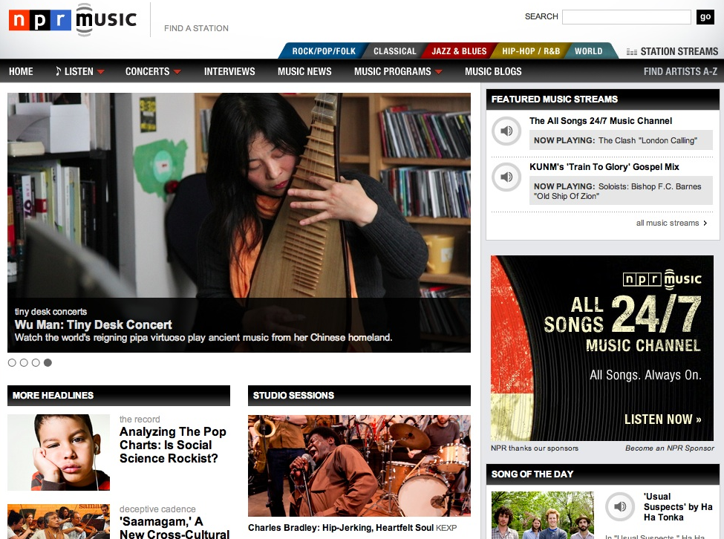

Slide 27
What Do You Curate?
Congregational Programs & Activities
Community Programs & Activities
People Resources
Print Resources
Audio & Video Resources
Art, Drama, and Music Resources
Online Content: Websites, Courses, Blogs
Apps & Digital Resources
And so much more. . . .

Slide 28
The Process of Curation
Research
Aggregate & Evaluate
Deliver
Communicate & Connect

Slide 29
Evaluation Standards
Biblical Content
Theological Content
Developmental Appropriateness
Ethnic-Cultural Appropriateness
Inclusivity
Ease-of-Use
Quality of Experience
__________________

Slide 30
Developing Trusted Sources
Blogs Newsletters Websites
Curated Websites & Organizations
6-8 “Expert” Resource People

Slide 34
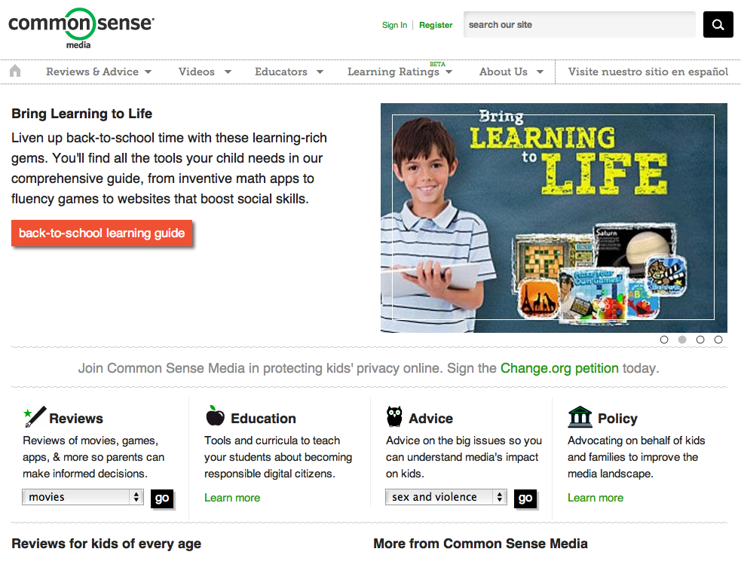

Slide 35
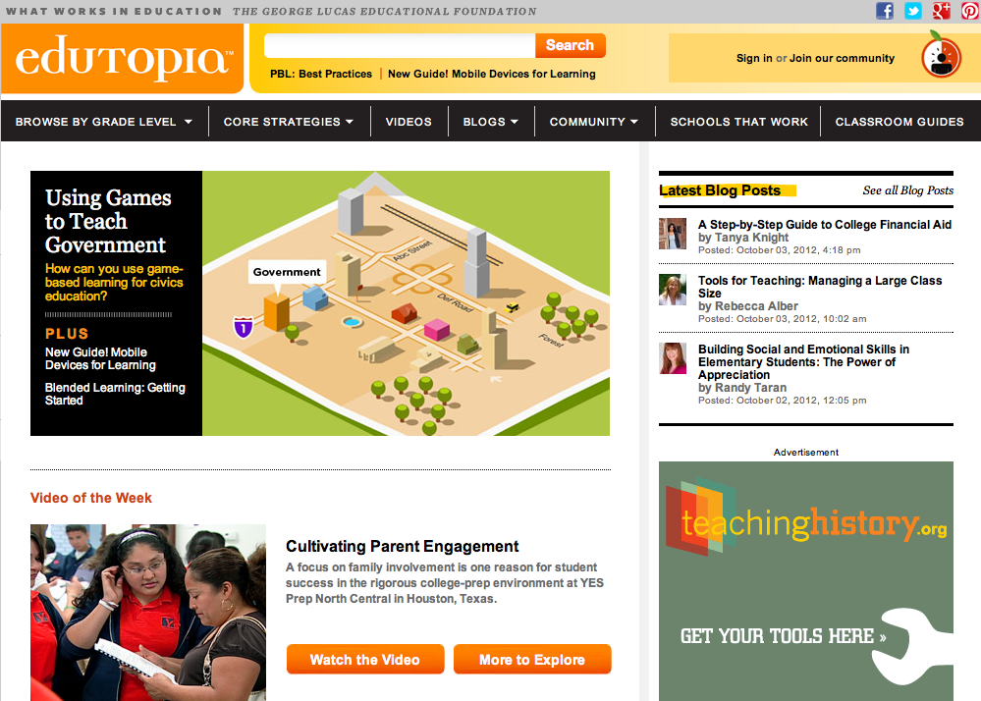

Slide 36
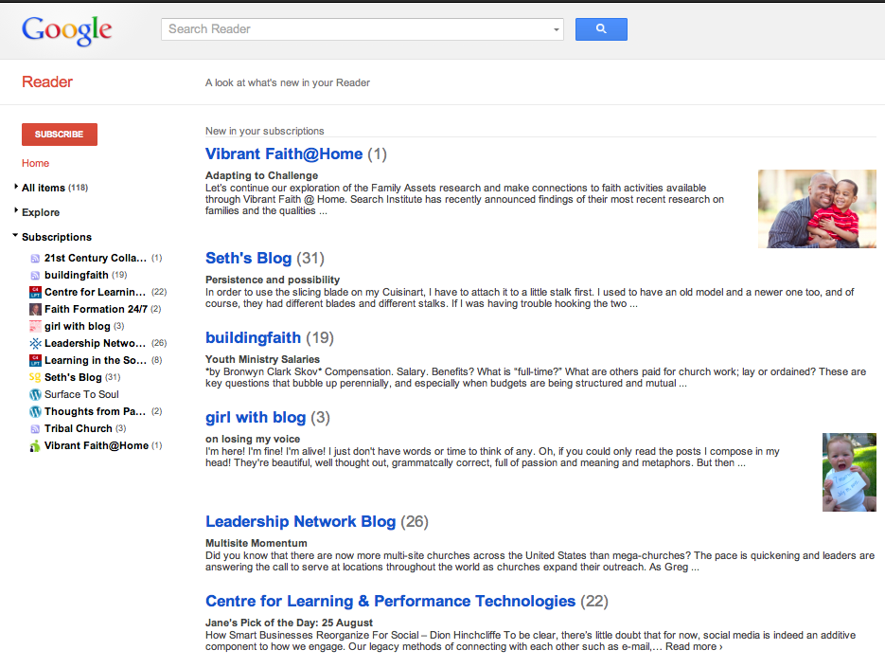

Slide 37
Things to Remember

Slide 38
Things to Remember: Change

Slide 39
Things to Remember: Change
Follow the bright spots: investigate what’s working and clone it.
Script the critical moves: don’t think big picture, think in terms of specific behaviors. Shrink the change.
Point to the destination: change is easier when you know where you’re going and why it’s worth it.
Find the feeling: knowing something isn’t enough to cause change. Make people feel something. Build an emotional and rational case for change.

Slide 40
Things to Remember: Motivation
Motivation 3.0 (Daniel Pink)
Autonomy: desire to direct our own lives
Mastery: urge to get better and better at something that matters
Purpose: the yearning to do what we do in the service of something larger than ourselves

Slide 41
Things to Remember: Connecting
Connect to (or extend from) a gathered event, program, ministry.
Establish a Facebook page for faith formation for Network announcements, updates, stories and photos from people engaged in faith formation, etc.
Use Twitter to announce updates, events, and invite reflections from people on their experiences in the Network.
Send e-mail, texts, or regular e-newsletters to targeted groups (Constant Contact).
Provide ways to share experiences using blogs, Twitter, Facebook: videos, reports, photos, etc.

Slide 42
Things to Remember: Connecting
Our social network is made up of all the people we’re connected to, all the people they are connected to, all the people they are connected to, and so on.
You
Your Friends
Your Friends
Your Friends’ Friends
Your Friends’ Friends
Your Friends’ Friend’s Friends
Your Friends’ Friend’s Friends
Your Friends’ Friend’s Friends
Your Friends’ Friends
Your Friends’ Friends

Slide 43
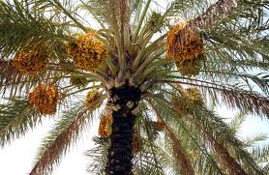
Hope

Slide 44
“The kingdom of God is as if someone would scatter seed on the ground, and would sleep and rise night and day, and the seed would sprout and grow, he does not know how. The earth produces of itself, first the stalk, then the head, then the full grain in the head. But when the grain is ripe, at once he goes in with his sickle, because the harvest has come.”
(Mark 4:26-29)

Slide 45
What is Hope?
It is the presentiment that imagination is more real and reality is less real that it looks. It is the hunch that the overwhelming brutality of facts that oppress and repress us is not the last word. It is the suspicion that reality is more complex than the realists want us to believe. That the frontiers of the possible are not determined by the limits of the actual; and in a miraculous and unexplained way life is opening up creative events which will open the way to freedom and resurrection…

Slide 46
So let us plant dates, even though we who plant them will never eat them. We must live by the love of what we will never see. That is the secret discipline. It is the refusal to let our creative act be dissolved away by our need for immediate sense experience and it is a struggled commitment to the future of our grandchildren. Such disciplined hope is what has given prophets, revolutionaries and saints, the courage to die for the future they envisaged. They made their own bodies the seed of their highest hope.
(Rubem A. Alves)

