Slide 1
Faith Formation for the 21st Century
Presenter: John Roberto

Slide 2
4 Big Adaptive Challenges
Increasing diversity throughout American society in the length of the lifespan, in generational identities, in family structures and marriage patterns, and in the ethnic makeup of America
Dramatic changes and increasing diversity in the religious beliefs, practices, and affiliation of Americans
Decline in religious transmission from generation to generation
Rise of new digital technologies that are reshaping society, and the emergence of a connected, networked society

Slide 3
Diversity
Diversity
Life-Span Diversity
Generational Diversity
Family Diversity
Ethnic Diversity

Slide 4
Religious Diversity
Not Religiously Affiliated
Spiritual but Not Religious
Minimal Engagement with Faith and Community
Vibrant Faith & Active Engagement

Slide 5
Concluding Thought
The world is now changing at a rate at which the basic systems, structures, and cultures built over the past century cannot keep up with the demands being placed on them. Incremental adjustments to how you manage and strategize, not matter how clever, are not up to the job. You need something very new to stay ahead in a age of tumultuous change and growing uncertainties.
(John Kotter, Accelerate: Building Strategic Agility for a Faster-Moving World

Slide 7
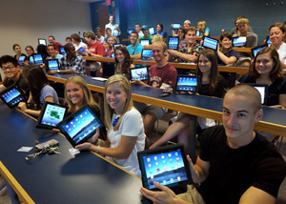

Slide 8
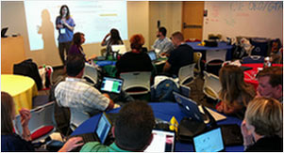
A shift from education to learning anywhere, anytime.
A shift from consumption of information to participatory learning.
A shift from institutions to networks.

Slide 9
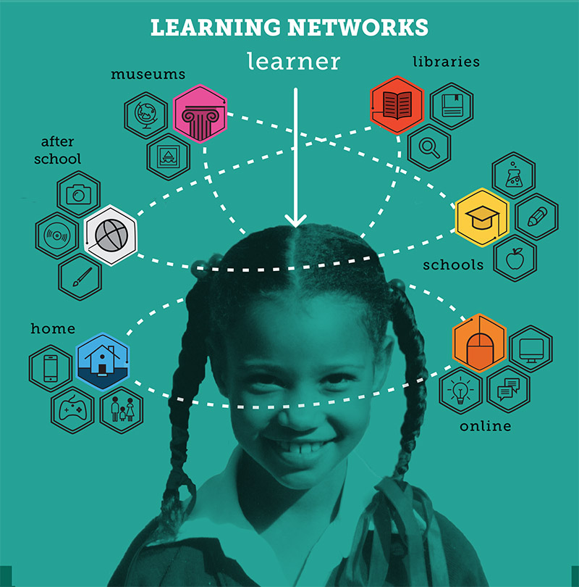

Slide 10
Faith Formation Networks
A network of relationships, content, experiences, & resources. . . .
Offering a variety of content, methods, formats, and delivery systems (online & physical settings) to address the diverse life tasks and situations, needs and interests, and spiritual and faith journeys of people.
Offering content and experiences that is responsive to the diverse religious and spiritual needs of people today—from the spiritually committed and engaged to the spiritual but not religious and the unaffiliated.
Offering multiple environments to address people’s busy lives and providing more ways to participate: self-directed, mentored, at home, in small groups, in large groups, church-wide, in the community, and in the world.

Slide 11
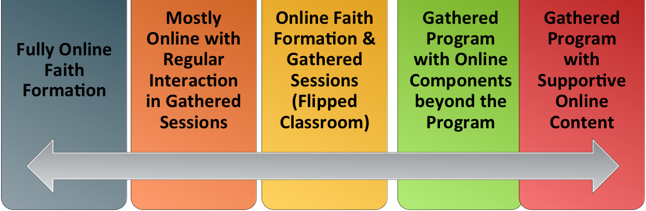
Faith Formation Networks
Digitally-Enabled
Blending gathered community settings with online learning environments and utilizing the abundance of digital media and tools for learning and faith formation

Slide 12
Individual Faith Formation Network
Bible
Course
Online course
Book
Mentor
Video Program
Bible study group
Bible app
Audio book/podcast
Organize a study group

Slide 13
Faith Formation Networks
Caring Relationships
Celebrating the Seasons
Celebrating Rituals & Milestones
Learning the Christian Tradition
Praying & Spiritual Formation
Reading the Bible
Serving, Working for Justice, & Caring for Creation
Worshipping God
Life Stage Issues
Missional
Faith Community
Content Area
Content Area
Content Area
Content Area
Content Area
Content Area

Slide 14
Faith Forming Processes
GROWTH IN FAITH
Caring Relationships
Rituals & Milestones
Church Year Seasons
Worshipping
Learning the Tradition
Praying
Spiritual Formation
Reading the Bible
Serving Working for Justice Caring for Creation

Slide 15
Family Faith Formation Network
For Parents
Seasons of the Year
Sunday Worship @ Home
Reading the Bible
Serving
Growing as a Family
Learning the Faith
Celebrating Rituals & Milestones
Children’s Programs
Praying & Growing Spiritually

Slide 16
Service & Mission Trips
Adolescent Faith Formation Network
Prayer & Spiritual Formation
Youth Leadership
Youth Programs
Bible Study & Religious Learning
For Parents
Confirmation
Adolescent Life Issues
Family Life
Missional Outreach

Slide 17
Faith Enrichment
Sunday Worship
Adult Faith Formation Network
Grand-parents
Spiritual Enrichment
Life Issues & Milestones
Scripture Enrichment
Liturgical Seasons
Service & Mission
Discovering Faith

Slide 18
Sample Themes –Adults
Dealing with retirement
Making life plans, finances, health
Becoming a grandparent
Making a difference in the community and world
Incorporating family changes and transitions
New ways of living and relating as a married couple
Caring for aging parents
Taking time to read the Bible and learn more about my faith
Growing spiritually and exploring spirituality for the 2nd half of life
Connecting with people my age; talking about things that matter to us
Dealing with loss

Slide 19
Adult Faith Formation Website

Slide 20
Faith Formation Playlists
Content Area
Activity 1
Resource
Resource
Activity 3
Resource
Resource
Activity 2
Resource
Resource

Slide 21
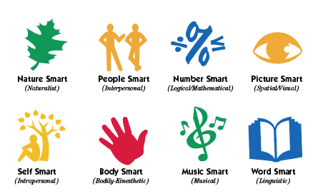
Faith Formation Playlists
Variety of Environments: Self-directed, mentored, at home, in small groups, in large groups, church-wide, in the community, and in the world.
Variety of Ways to Learn

Slide 22
Faith Formation Playlists
Digitally-Enabled: Blending gathered community settings with online learning environments and utilizing the abundance of digital media and tools for learning and faith formation

Slide 23
Adult Faith Formation Playlist
Spiritual Enrichment
Online Courses
Retreats
Small Group Bible Study
Spiritual Book of the Month
Spiritual Practices Series
Apps & E-newsletters
Day at the Monastery
Online Prayer & Spirituality
Resource
Resource
Resources
Resources
Resource
Resource
Resource
Resource

Slide 24
Faith Formation Playlists
Playlists are thematic learning plans that integrate a variety of ways to learn, multiple learning environments, and online and physical spaces—from which people can create their own faith formation plan.
Example: Spiritual Enrichment for Adults
Theme: “Spiritual Practices”
Spiritual Practices Course (5 sessions at church in one month)
Spirituality Over 50 Book Group (variety of times & places)
Online Daily Devotion Resources
Online Prayer Practices Resources
Online Course or Retreat with a Spiritual Master
Online Retreat
Website: http://holytrinityadults.weebly.com

Slide 25
Family Faith Formation Playlist
Seasons of the Year:
Monthly Event
Prayers & Devotion
Resources
Service Ideas
Resources
Bible Passages
Resources
Caring Conversations
Resources
Learning about the Event
Resources
Rituals
Resources

Slide 26
Adolescent Faith Formation Playlist
Prayer &
Spiritual Life
Weekly Devotion
Resources
Prayer Group
Resources
Spiritual Mentoring
Resources
Spiritual Practices Course
Resources
Retreat
Day at the Monastery
Online Prayer Intentions
Resources
Resources

Slide 27
3 Seasons of Programming
Fall Season:
Sept 1 – Jan 1
Winter/Spring Season: Jan 1 – May 1
Summer Season:
May 1 – Sept 1
Fall
Winter-Spring
Summer

Slide 28
Seasonal Plan & Calendar
Content Area (examples) |  | Programming | & Dates
 | Month 1 | Month 2 | Month 3 | Month 4
Scripture Enrichment
Faith Enrichment
Spiritual Enrichment
Service & Mission
Life Issues

Slide 29
Digitally-Enabled Strategies

Slide 30
Gathered using Online Content
A gathered program using online content from websites, videos from YouTube or other video sites, and blogs and other social media. With an abundance of high quality digital content, this first option is the easiest way to bring the digital world into a gathered program.

Slide 31
Gathered with Online Content
Connecting church programs or events with online content that extends and deepens the experience through learning, prayer, ritual, action, etc.
Sunday worship & church year feasts and seasons
Intergenerational & family programs
Children, youth, and adult classes & programs
Extended programs: mission trips, retreat experiences, and vacation Bible school, summer camp

Slide 32
Gathered with Online Content
Church Event or Program
At Home & Daily Life

Slide 33
Gathered with Online Content
Event or Program
TALK Conversation Activities
LEARN Read Listen Watch
ACT Practices Service Projects
PRAY Devotions Bible Reading Daily Prayer
SHARE Blog Facebook Video Projects

Slide 34
Example: Sunday Worship
Church Life ➔ | Daily & Home Life | ⬅ Online Life
Experience of Worship in the Congregation Sunday worship and lectionary Church year feasts and seasons Church rituals: baptism, communion, funerals, etc. | Experience of Sunday worship, rituals, and church year seasons in daily life Reflecting on the sermon and readings at home Practices: Lectio, etc. Application to daily living | Online worship, church year, and lectionary resources on the church’s faith formation website Lectionary commentaries online Video reflections and commentary Online activities and projects

Slide 35
Online and Gathered
“Flip the classroom or program” by creating a digital platform to provide the content that people would learn in the gathered setting in an online learning space using print, audio, video, and more. And then transform the gathered program using interactive activities, discussion, project-based learning, and practice and demonstration.
Flip children’s programming: At home learning with parents (print, video, online); in-class application with activities, project-centered learning
Flip confirmation programming
Develop a online justice and service center

Slide 36
Online and Gathered

Slide 37
Online and Gathered

Slide 38
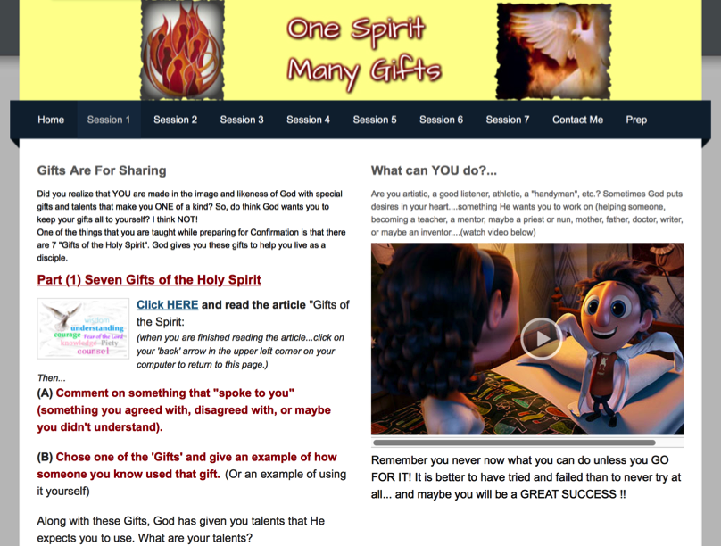
Online and Gathered

Slide 39
Mostly Online
Utilizing the digital platform as the primary learning setting and providing opportunities for interaction in gathered settings.
Parent webinar programs delivered to parents at home in four-month semesters: three webinars + a parent gathering; three more webinars + a parent gathering.
Online learning resources for self-study or small group study, and gathering at the conclusion to share their insights.
Online Bible study where groups can meet regularly in a physical setting or virtually on Skype or Google+ Hangout.
Selected online courses and activities from colleges, seminaries, and religious organization for individualized learning with the option for a mentor or small group.

Slide 40
Fully Online
The rise of high quality and easily accessible online religious content—courses, activities, print and e-books, audio and video programs, and content-rich websites—has made designing online faith formation feasible.
Online Bible and theology courses, video programs, webinars for individual study
Online prayer & spirituality center where people can access daily prayer reflections and devotions, offer prayer intentions, pray for others, learn about spiritual practices, download prayer activities, etc.
Online parent resource center
Online retreat experience

Slide 41
Example: 40-Day Lent Curriculum
Church Life ➔ | Daily & Home Life | ⬅ Online Life
Ash Wednesday Lenten Sunday liturgies Stations of the Cross Lenten prayer Lenten retreat Lenten service Lenten soup suppers | Fasting Praying Service/Almsgiving Lectionary reflection Family activities | Lenten learning resources Lenten calendar Daily Lenten prayer Weekly table prayer Video resources Online retreat experience

Slide 42
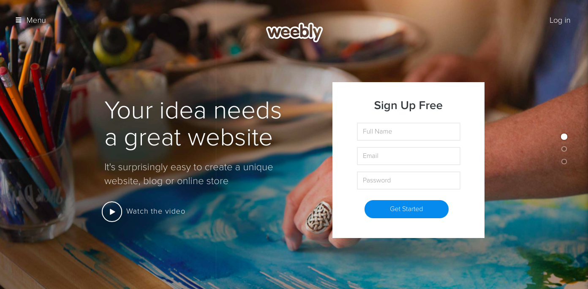
Build a Digital Platform
Other Platforms
www.wordpress.org www.wix.com www.squarespace.com

