Slide 1
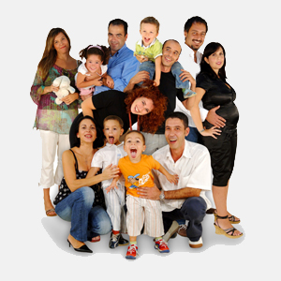
Diocese of Buffalo Families at the center of Faith
Session One
Presenters
Leif Kehrwald & John Roberto

Slide 2
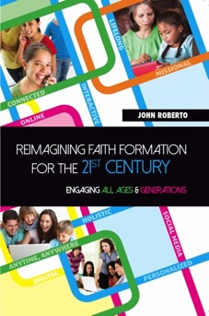
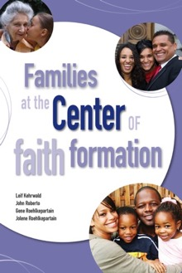
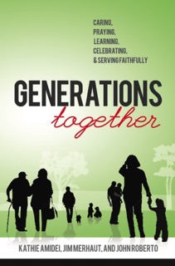
Lifelong Faith Books www.LifelongFaith.com

Slide 3
The Program: Wednesday
Topic 1. Families in the 21st Century
A Profile of 21st Century Families
The Role of Families in Faith Forming
Transforming our Approach
Topic 2. Strategies for Developing Ministry with 21st Century Families: Presentation & Application to Parish Life
Part 1. Family Faith at Home
Discovering God in everyday life
Forming faith at home through the life cycle
Forming faith through milestones
Part 2. Family Life and Parent Formation
Developing a strong family life
Empowering parents and grandparents as faith formers
Part 3. Families in the Parish Community
Celebrating seasonal events through the year
Encountering God in the Bible through the year
Connecting families intergenerationally

Slide 4
The Program: Thursday
Topic 3. Designing a Plan for Parish Ministry with Families
Part 1. Digitally Enabled and Connected Approaches, Methods, and Media for Ministry with Families: Presentation and Application
Part 2. A Parish Plan for Ministry with Families
Topic 4. Preparing to Launch a Parish Plan and New Initiatives with Families
Processes and tools to introduce new family initiatives and manage change in the parish community
Curating resources
Developing a digital platform

Slide 5
Comprehensive Family Plan Children/Teens + Parents + Grandparents
Family Faith at Home
Family Engagement in the Intergenerational Faith Community
Family Life & Parent Formation
Three Elements of a Family Plan

Slide 6
Comprehensive Family Plan
Young Children
Older Children
Young Adolescents
Older Adolescents
Family Faith @ Home
God in Everyday Life
Faith Practices
Milestones
Intergenerational Faith Community
Seasonal Events
Bible through the Year
Intergenerational Connections & Experiences
Family Life & Parent/Grandparent Formation
Strong Family Life
Parents & Grandparents as Faith Formers

Slide 7
What are our priorities?
We are underinvesting in our families and therefore unable to support, empower, and equip families so that they can invest time, energy, and relational intimacy in forming the faith of children and teens at home and in daily life.

Slide 8
The Big Picture: Faith Forming Ecology
Digitally Enabled and Connected
Faith Forming Ecology
Inter-genera-tional
Family
Life Cycle
Missional
Digitally Enabled and Connected
Digitally Enabled and Connected
Digitally Enabled and Connected

Slide 9
Wondering. . . .
What does a vibrant and vital family faith look like in a 21st century world?
How do we meaningfully engage/connect with today’s families?
How do we empower/equip/resource families to transmit faith at home - to practice a vital and vibrant faith?
How do we reach families who are not involved in a faith community or feel religion is not important?

Slide 10
Believing. . . .
God is actively present in family life.
Parents and the family are the most important religious influence on religious transmission.
Faith is formed through the day-to-day religious practices of the family and the ways parents model their faith and share it.
Faith is formed when there is a substantial investment of thought, time, and intimacy by parents in faith transmission.
Faith is formed in relationships – at home and in the intergenerational faith community.
Faith is formed in developmentally-appropriate ways over time.

Slide 11
Part 1 What’s Changing

Slide 12
Changing. . . .
Family structure, variety of living arrangements
Work & $ – 70% of mothers work outside home
Complexity of family life, managing/balancing time and commitments
Generations at home: Gen Xer & Millennial parents, iGen (Gen Z) children and teens
Religious practice, participation, & affiliation
Faith transmission and practice at home

Slide 13
What’s Changing?
Diversity of Family Forms
No single family arrangement encompasses the majority of children today.
Two-parent, married couple households are on the decline.
Children and adolescents live in a variety of family arrangements that change and evolve over the course of a child’s life.

Slide 14
What’s Changing?
Mothers Working Outside the Home
70% of all mothers of children younger than 18 and 64% of mothers with preschool-aged children work outside of the home
About three-fourths of all employed moms are working full time.
About thirty percent of mothers living with children younger than 18 are at home with the children.

Slide 15
What’s Changing?
Family Life is Complex
Parents are busier than even—and often “overwhelmed”—managing and balancing work, education, family life, young people’s activities, and their own personal lives. Today’s family is far more complex than in prior decades as parents deal with constant and accelerating change.

Slide 16
What’s Changing?
Parents Want Honest, Ethical, Caring Children
Parents want their children to be honest and ethical as adults, caring and compassionate, and hardworking.
The top values that are important for them to teach include (in order):
1) being responsible, 2) hard work, 3) religious faith, 4) helping others, 5) being well mannered, 6) independence, 7) empathy, 8) obedience, 9) persistence, 10) creativity, 11) tolerance, and 12) curiosity

Slide 17
What’s Changing?
Parents Have Different Approaches to Digital World
There is a widespread adoption of new digital technologies and mobile devices that are transforming the way parents and children relate, communicate, work, and learn.
Parents can be divided into three groups based on how they limit or guide their children’s screen time with each group representing about one-third of all parents:
digital limiters
digital enablers
digital mentors

Slide 18
What’s Changing?
Generational Diversity
Gen X Parents (mid 30s-mid 50s)
Millennial Parents (20s-mid 30s)
Generational approaches to parenting and family life
Gen X parents approach child-rearing as a set of tangible practices that will keep their children safe, reasonably happy, well-behaved, and ready to take on life’s challenges. They practice protective parenting.
Millennial parents, reflecting their values of individuality and self-expression, focus more on a democratic approach to family management, encouraging their children to be open-minded, empathetic, and questioning—and teaching them to be themselves and try new things. They are moving away from the overscheduled days of their youth, preferring a more responsive, less directorial approach to activities. (Responsive Parenting)

Slide 19
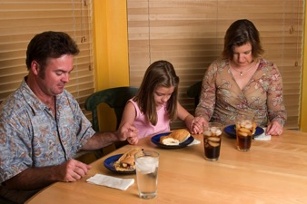
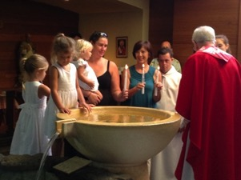
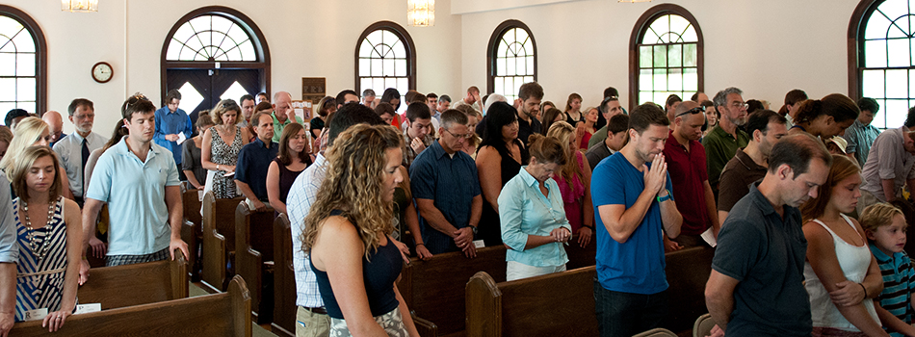
What’s Changing?

Slide 20
What’s Changing?
Spiritual-Religious Diversity
Parents and families reflect an increasing diversity in religious beliefs, practices, and affiliation.
23% of Generation Xers and over 34% of Millennials are not religious affiliated and the number of unaffiliated Millennials is growing.
Families of Generation X and Millennial parents are participating less in church life and Sunday worship. Religion and spirituality may be important to families today, but for many it is not usually expressed by participation in churches

Slide 21
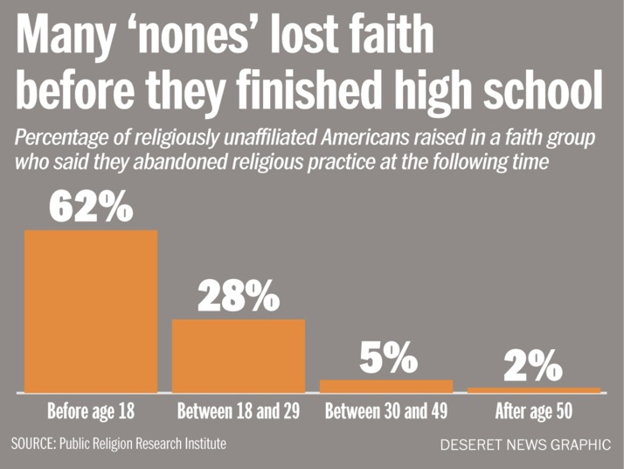
What’s Chaning

Slide 22
What’s Changing
Unaffiliateds
Occasionals (Minimal Engagement with Faith and Community)
Spirituals (Spiritual but Not Religious)
Actives (Vibrant Faith & Active Engagement)

Slide 23
What’s Changing?
Significant indicators, such as religious identification as a Christian, worship attendance, marriages and baptisms in the church, and changing generational patterns, point to a decline in family religious socialization across all denominations.
There is also a decline in religious traditions and practices at home. Gen X and Millennial parents often lack the religious literacy and religious experiences necessary for faith transmission.

Slide 24
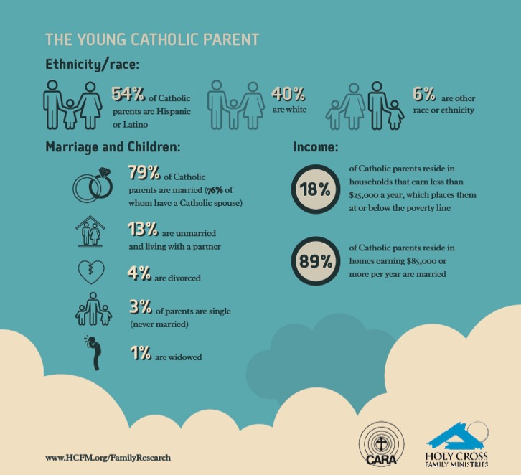

Slide 25
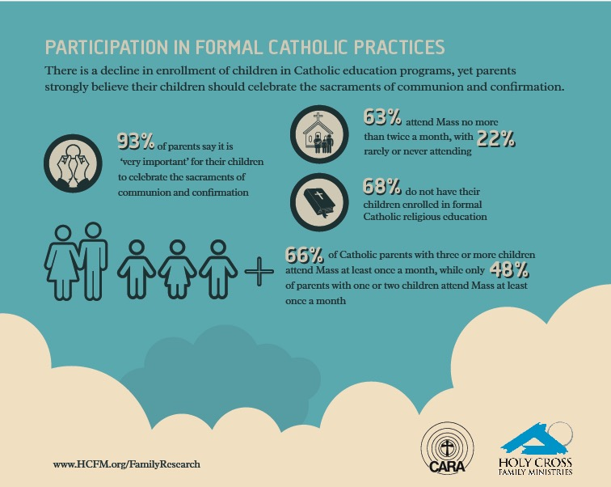

Slide 26
Part 2 What Makes a Difference in Faith Growth

Slide 27
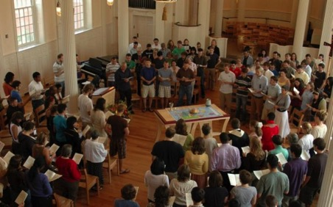
What Makes a Difference?
Primary Influence: Parents and the Family
Secondary Influence: The Congregation and Significant Adults

Slide 28
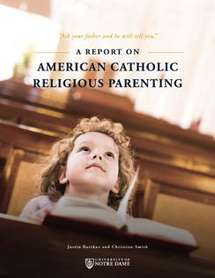
What Makes a Difference?
The primary mechanisms by which Catholic identity becomes rooted in children’s lives are not Catholic schooling or sacramental preparation, but rather the day-to-day religious practices of the family and the ways parents model their faith and share it in conversation, collaboration, and exposure to outside religious opportunities.
(Burtkus and Smith)

Slide 29
What Makes a Difference?
This is all to say that the definitive causal agents in the religious and spiritual outcomes of American youth are neither clergy nor youth ministers, neither educators nor the voices of popular culture and media, but parents.
(Burtkus and Smith)

Slide 30
What Makes a Difference?
Sponsor of the Catholic Faith
Gatekeeper of the Catholic Faith
Interpreter of the Catholic Faith
As “sponsors,” “gatekeepers,” and “interpreters” of the Catholic faith for their children, parents give children a glimpse of what Catholicism seems to be all about and whether or not it can meaningfully inform one’s day-to-day life.
(American Catholic Religious Parenting, Burtkus and Smith)

Slide 31
What Makes a Difference?
Parents by the power of their personality, practices, and way of being, model and generate the culture of the household (both explicitly and implicitly).
Parents produce, induce, and interpret the household’s experiences of Christian faith.
Parents are one influence among others - they are nevertheless the dominant influence which orders and shapes the way children experience other influences, i.e. they constellate children’s experiences of various cultural currents, including religion.

Slide 32
One of the most basic suggestions of our findings is that young adults arrive at a sense of their fundamental identity and worldview not by weighing all possible intellectual arguments for and against a proposed way of life, but rather by roughly adopting the worldview of those mentors who left the deepest impression upon them—and who loved them and cared for them the most. It should come as no surprise, then, that the emergence of the new generation of dedicated young Catholics will rise and fall with the choices of their parents.
(American Catholic Religious Parenting, Burtkus and Smith)

Slide 33
Pope Francis, Joy of the Gospel
The family is the primary setting for socialization, since it is where we first learn to relate to others, to listen and share, to be patient and show respect, to help one another and live as one. The task of education is to make us sense that the world and society are also our home; it trains us how to live together in this greater home. In the family, we learn closeness, care and respect for others. . . . Every day the family has to come up with new ways of appreciating and acknowledging its members (276)

Slide 34
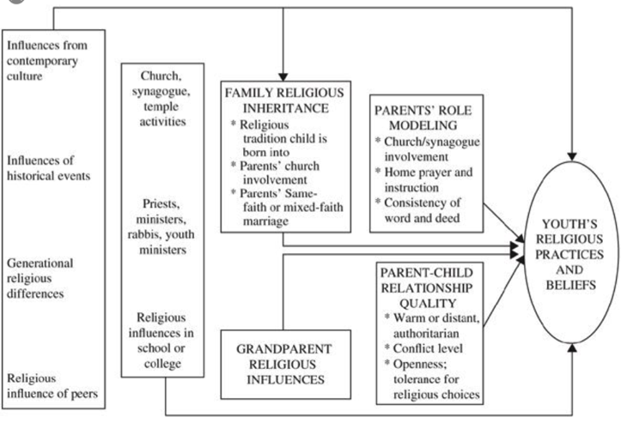
What Makes a Difference?

Slide 35
What Makes a Difference?
Parents’ personal faith and practice
Parent-child relationship: close, warm
Parents’ modeling and teaching a religious faith
Parents’ involvement in church life and Sunday worship
Grandparents’ religious influence & relationship
Religious tradition a child is born into
Parents of the same faith
Family conversations about faith
Family religious practices: prayer, reading the Bible, service to others, celebrating holidays/rituals

Slide 36
Practices that Make a Difference Survey
926 Parents & Grandparents
74% Active @ church
35% Parenting children
30% Parenting teens
43% Parenting young adults
30% Grand-parents

Slide 37
Practices that Make a Difference
79% Pray together
77% Worship together
76% Eat together
71% Celebrate rituals & holidays
58% Serve those in need
55% Engage in family conversations
51% Nurture my own faith as a parent

Slide 38
Practices that Make a Difference
Top Four Practices
Frequency
79% - Praying as a family
77% - Participating in Sunday worship as a family
76% - Eating together as a family
71% - Celebrating rituals and holidays at home
Engage in the practice at least once a week or more.
80% - Praying
80% - Sunday worship
91% - Eating together
74% - Celebrating rituals

Slide 39
Practices that Make a difference
Next Highest
58% - Serving people in need as a family (23% once a week+)
55% - Having family conversations (77% once a week+)
51% - Taking time to grow in your own faith as a parent (74% once a week+)

Slide 40
Congregation Response
Raise awareness
Be highly relational
Facilitate like-to-like
Create support networks
Curate good resources
Teach the basics of faith
Leverage "gathered" => home practice

Slide 41
Part 3 Transforming Our narrative

Slide 42
Transforming Our Narrative
From a primary focus on. . . . | Toward an emphasis on. . . .
Viewing the parish as the center of faith forming | Recognizing and equipping the family as the center of faith forming
Forming the faith of individuals | Forming the faith of the whole family
Engaging individuals in church life | Engaging the whole family in church life
Prescribing programs and activities for the family and its members | Building faith formation around the lives and needs of families and parents
Doing things “to” of “for” families | Sharing power with families and treating them as partners

Slide 43
Transforming Our Narrative
From a primary focus on. . . . | Toward an emphasis on. . . .
Starting with messaging to families | Start with listening to families
Buying into negative stereotypes of families | Highlight families’ strengths and resilience
Giving families expert advice about what to do | Encouraging families to experiment with new practices
Focusing on parenting as a set of techniques | Emphasizing parenting as a relationship
Intimidating parents with policies and requirements | Informing parents of their role and empowering them to fulfill their role as faith formers of children and teens

Slide 44
We Need Adaptive Change
Adaptive challenges are situations for which solutions lie outside the current way of operating.
Adaptive change requires learning - experiments, new discoveries, and adjustments from numerous places in the organization.
Without learning new ways—changing attitudes, values, and deep-seated behaviors—people cannot make the adaptive leap necessary to thrive in the new environment.
Calls for changes of heart and mind—the transformation of long-standing habits and deeply held assumptions and values.

Slide 45
We Need Adaptive Change Because. . .
the solution requires operating in a different way than you do now. . .
the problem AND the solution require learning. . .
the solution requires shifting the authority and responsibility to the people who are actually affected. . .
the solution requires some sacrifice of your past ways of working or living. . .
the solution requires experimenting before you’re sure of the answer. . .
the solution will take a long time. . .
the challenge connects to people’s deeply held values. . .

Slide 46
Transforming Our Practice
Family Faith at Home
Family Engagement in the Intergenerational Faith Community
Family Life & Parent Formation

Slide 47
Transforming Our Practice: Strategies
Family Faith @ Home
God in Everyday Life
Faith Practices
Milestones
Faith Community
Seasonal Events
Bible through the Year
Intergenerational Connection
Family Life & Parents
Strong Family Life
Parents & Grandparents as Faith Formers

Slide 48
Transforming Our Practice
Developing New Strategies & Initiatives
Transforming Current Programming to Engage Families

Slide 49
Transforming Our Practice: Immersive Environments
Home
Church
Community & World
Online

Slide 50
Transforming our Practice: Abundance of Resources
Faith Forming Programming
Faith Forming Resources
Print
Audio
Video
Online
Digital Technologies and Tools

Slide 51
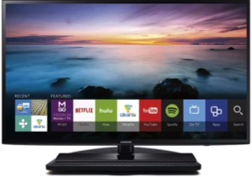
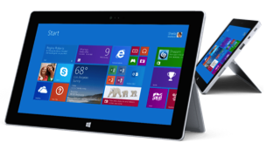
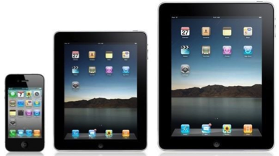
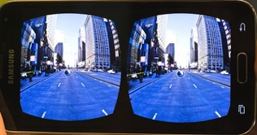
Transforming Our Practice

Slide 52
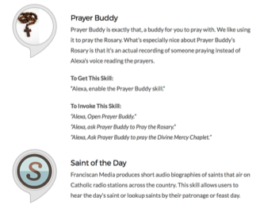
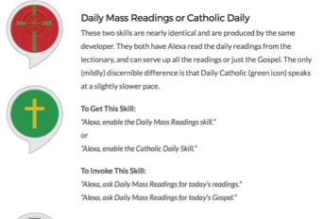
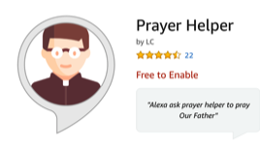
Catholic Faith on Amazon Echo

Slide 53
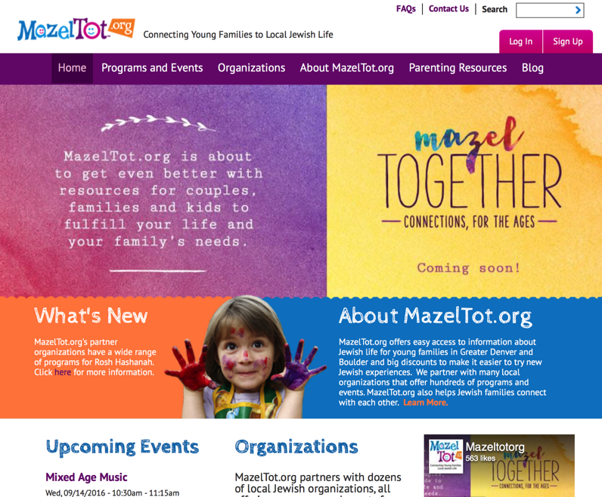

Slide 54
Family Faith Formation Online

Slide 55
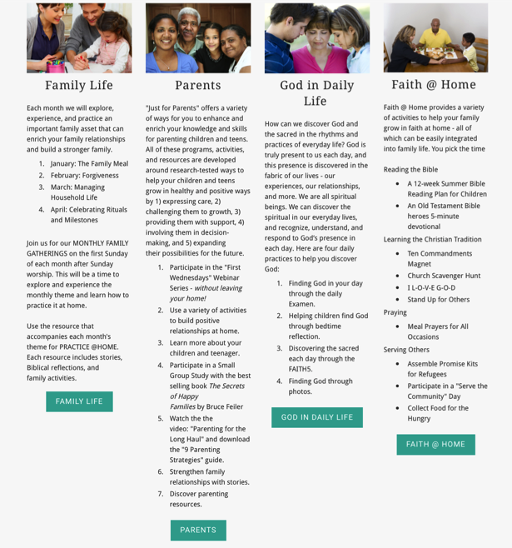

Slide 56
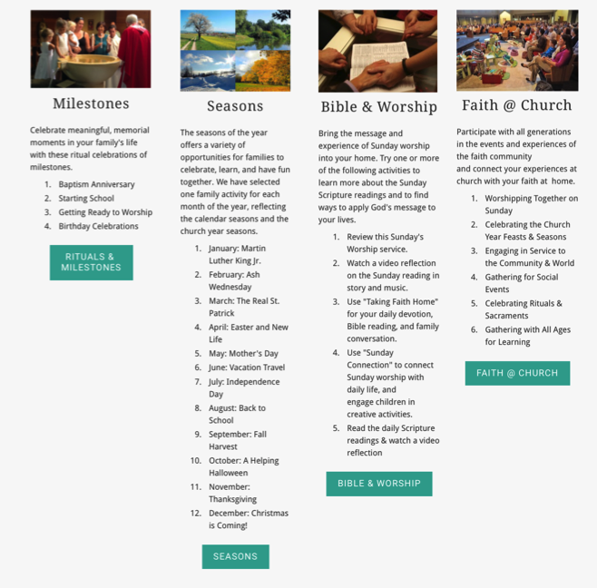

Slide 57
Transforming Our Role
Current Roles
Emerging Roles
Developing religious content
Designing programming
Managing programming
Teaching/Facilitating programming
Designing faith forming environments—architecture
Designing Digital Platforms for faith forming content
Curating faith forming content & experiences

