Slide 1
The Future of Adult Faith Formation Scenarios & Strategies 2015 Symposium

Slide 2
LifelongFaith.com (Symposium) ReimagineFaithFormation.com (Adults)

Slide 3
Scenario Planning
Jay Ogilvy and Peter Schwartz describe scenarios as “narratives of alternative environments in which today’s decisions may be played out. They are not predictions. Nor are they strategies. Instead they are more like hypotheses of different futures specifically designed to highlight the risks and opportunities involved in specific strategic issues.”
The point is not to gather evidence for some “most probable” future. The point is rather to entertain a number of different possibilities in order to make better choices about the future of faith formation in the face of inevitable uncertainties.

Slide 4
Scenario Planning Process
Identifying Driving Forces
Determining 2 Critical Uncertainties
Constructing a Scenario Framework & Writing Narratives
Developing Action Implications & Strategies

Slide 5
Focusing Question
What could adult faith formation in faith communities look like in five years (2016-2020)?
How can faith communities provide vibrant faith formation to address the four seasons of adulthood—young adults, midlife adults, mature adults, and older adults—over the next five years?
How can faith communities envision the shape of adult faith formation and design initiatives to respond proactively to the challenges and opportunities by 2020?

Slide 6
Outside-In Thinking

Slide 7
Identify Trends
Context
Religious
Generational
Technological
Economic
Ethnic-Cultural
Political

Slide 8
Select Critical Forces
Which forces are the most unpredictable or uncertain in terms of their outcome over the next 5 years? These are importance forces, but unpredictable in terms of how they may play out.

Slide 9
World
Diversity in society
(ethnic, households/families, gender)
Faith communities------------------------------------Faith communities
Resisting diversity Embracing diversity
Busy, stressed, time-crunched, overwhelmed adults
Business as Usual AFF------------------Responsive & Innovative AFF
A “Design Your Own Life” Culture
Standardized AFF------------------------------------Customizing AFF
One size fits all One size fits one

Slide 10
Adult
Adult desire/interest for developing their spiritual life
Decreasing---------------------------------------------Increasing
Adult openness to belonging/participating in a faith community
Decreasing---------------------------------------------Increasing
Adult desire/interest/hunger in being engaged in adult faith formation in a faith community
Decreasing--------------------------------------------Increasing

Slide 11
Scenario Matrix
Diversity in Society
Faith Communities Embracing Diversity
Decreasing Adult Desire and Interest in Spiritual Life Increasing
Faith Communities Resisting Diversity

Slide 12
Future of AFF Scenarios
Diversity in Society
Faith Communities Embracing Diversity
Faith Communities Embracing Diversity & Adult Desire & Interest in the Spiritual Life Decreasing | Faith Communities Embracing Diversity & Adult Desire & Interest in the Spiritual Life Increasing
Decreasing Adults Desire & Interest | in the Spiritual Life Increasing
Faith Communities Resisting Diversity & Adults Desire & Interest in the Spiritual Life Decreasing | Faith Communities Resisting Diversity & Adults Desire & Interest in the Spiritual Life Increasing
Faith Communities Resisting Diversity

Slide 13
Example #1
Diversity in Society
Faith Communities Embracing Diversity
Faith Communities Embracing Diversity & Adult Desire & Interest in the Spiritual Life Decreasing | Faith Communities Embracing Diversity & Adult Desire & Interest in the Spiritual Life Increasing
Decreasing Adults Desire & Interest | in the Spiritual Life Increasing
Faith Communities Resisting Diversity & Adults Desire & Interest in the Spiritual Life Decreasing | Faith Communities Resisting Diversity & Adults Desire & Interest in the Spiritual Life Increasing
Faith Communities Resisting Diversity

Slide 14
Example #2
Diversity in Society
Faith Communities Embracing Diversity
Faith Communities Embracing Diversity & Adult Desire & Interest in the Spiritual Life Decreasing | Faith Communities Embracing Diversity & Adult Desire & Interest in the Spiritual Life Increasing
Decreasing Adults Desire & Interest | in the Spiritual Life Increasing
Faith Communities Resisting Diversity & Adults Desire & Interest in the Spiritual Life Decreasing | Faith Communities Resisting Diversity & Adults Desire & Interest in the Spiritual Life Increasing
Faith Communities Resisting Diversity

Slide 15
Example #3
Diversity in Society
Faith Communities Embracing Diversity
Faith Communities Embracing Diversity & Adult Desire & Interest in the Spiritual Life Decreasing | Faith Communities Embracing Diversity & Adult Desire & Interest in the Spiritual Life Increasing
Decreasing Adults Desire & Interest | in the Spiritual Life Increasing
Faith Communities Resisting Diversity & Adults Desire & Interest in the Spiritual Life Decreasing | Faith Communities Resisting Diversity & Adults Desire & Interest in the Spiritual Life Increasing
Faith Communities Resisting Diversity

Slide 16
Example #4
Diversity in Society
Faith Communities Embracing Diversity
Faith Communities Embracing Diversity & Adult Desire & Interest in the Spiritual Life Decreasing | Faith Communities Embracing Diversity & Adult Desire & Interest in the Spiritual Life Increasing
Decreasing Adults Desire & Interest | in the Spiritual Life Increasing
Faith Communities Resisting Diversity & Adults Desire & Interest in the Spiritual Life Decreasing | Faith Communities Resisting Diversity & Adults Desire & Interest in the Spiritual Life Increasing
Faith Communities Resisting Diversity

Slide 17
Scenario 1
The first scenario describes a world in which adults have a desire and interest in developing their spiritual life and faith communities are embracing the diversity in the adult population—including ethnic/cultural, sexual/gender, socio-economic, family styles, and religiosity. In this world faith communities are developing approaches, strategies, and programming that respond to diversity and engage adults in growing spiritually.

Slide 18
Scenario 2
The second scenario describes a world in which adults have a desire and interest in developing their spiritual life and faith communities are not embracing the diversity in the adult population. In this world faith communities may recognize the desire and interest of adults in the spiritual life, but provide little or no adult faith formation for any adults or provide faith formation that is focused on a particular adult population, such as active adult members of the faith community or parents or older adults. There is little recognition of the diversity of the adult population or of the uniqueness of each season of adulthood.

Slide 19
Scenario 3
The third scenario describes a world in which adults are uninterested in developing their spiritual life and faith communities are not embracing the diversity in the adult population. In this world adults experience little need for God and the spiritual life and are typically not affiliated with organized religion or established churches. Many of these faith communities have “given-up” on adult faith formation. They provide little or no adult faith formation for any adults, besides occasional opportunities directed to the active adult members of the faith community or parents with children in educational programming.

Slide 20
Scenario 4
The fourth scenario describes a world in which adults are uninterested in developing their spiritual life and faith communities are embracing the diversity in the adult population. In this world faith communities are working to develop approaches, strategies, and programming that address diversity and respond to lives of adults who are uninterested in faith and spirituality and uninvolved in the faith community.

Slide 21
Future of AFF Scenarios
Diversity in Society
Faith Communities Embracing Diversity
Faith Communities Embracing Diversity & Adult Desire & Interest in the Spiritual Life Decreasing | Faith Communities Embracing Diversity & Adult Desire & Interest in the Spiritual Life Increasing
Decreasing Adults Desire & Interest | in the Spiritual Life Increasing
Faith Communities Resisting Diversity & Adults Desire & Interest in the Spiritual Life Decreasing | Faith Communities Resisting Diversity & Adults Desire & Interest in the Spiritual Life Increasing
Faith Communities Resisting Diversity

Slide 22
strategy idea
Scenario 1: Embracing & Increasing
Scenario 2: Resisting & Increasing
Offer a wide variety of adult faith formation opportunities and experiences tailored specifically to the needs of different audiences in the faith community.

Slide 23
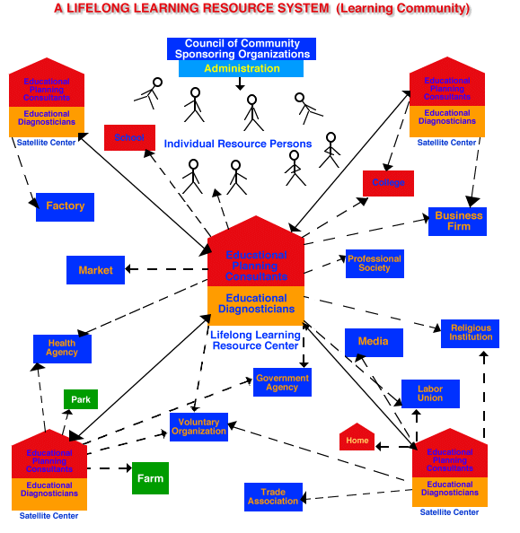
Malcolm knowles

Slide 24
Adult Faith Formation Network
A network of relationships, content, experiences, & resources. . . .
Variety of content, methods, formats, and delivery systems (online & gathered) to address the diverse life tasks and situations, needs and interests, and spiritual and faith journeys of people.
Responsive to the diverse religious and spiritual needs of people today—from the spiritually committed to the spiritual but not religious and the unaffiliated.
Multiple environments: self-directed, mentored, at home, in small groups, in large groups, church-wide, in the community, and in the world.

Slide 25
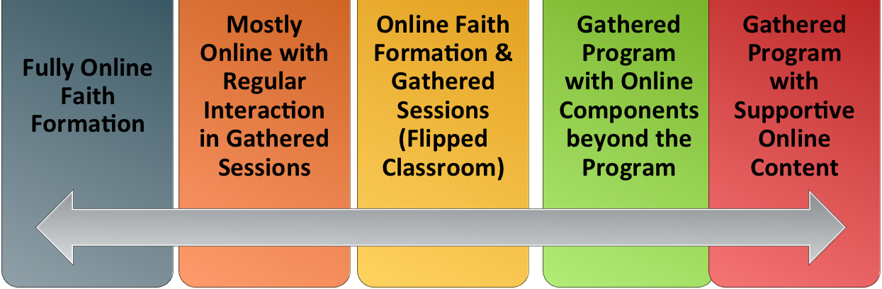
Adult Faith Formation Network
Digitally Enabled, Digitally Connected, and Online

Slide 26
Faith Enrichment
Sunday Worship
Adult Faith Formation Network
Grand-parents
Spiritual Enrichment
Life Issues & Milestones
Scripture Enrichment
Liturgical Seasons
Service & Mission
Discovering Faith

Slide 27
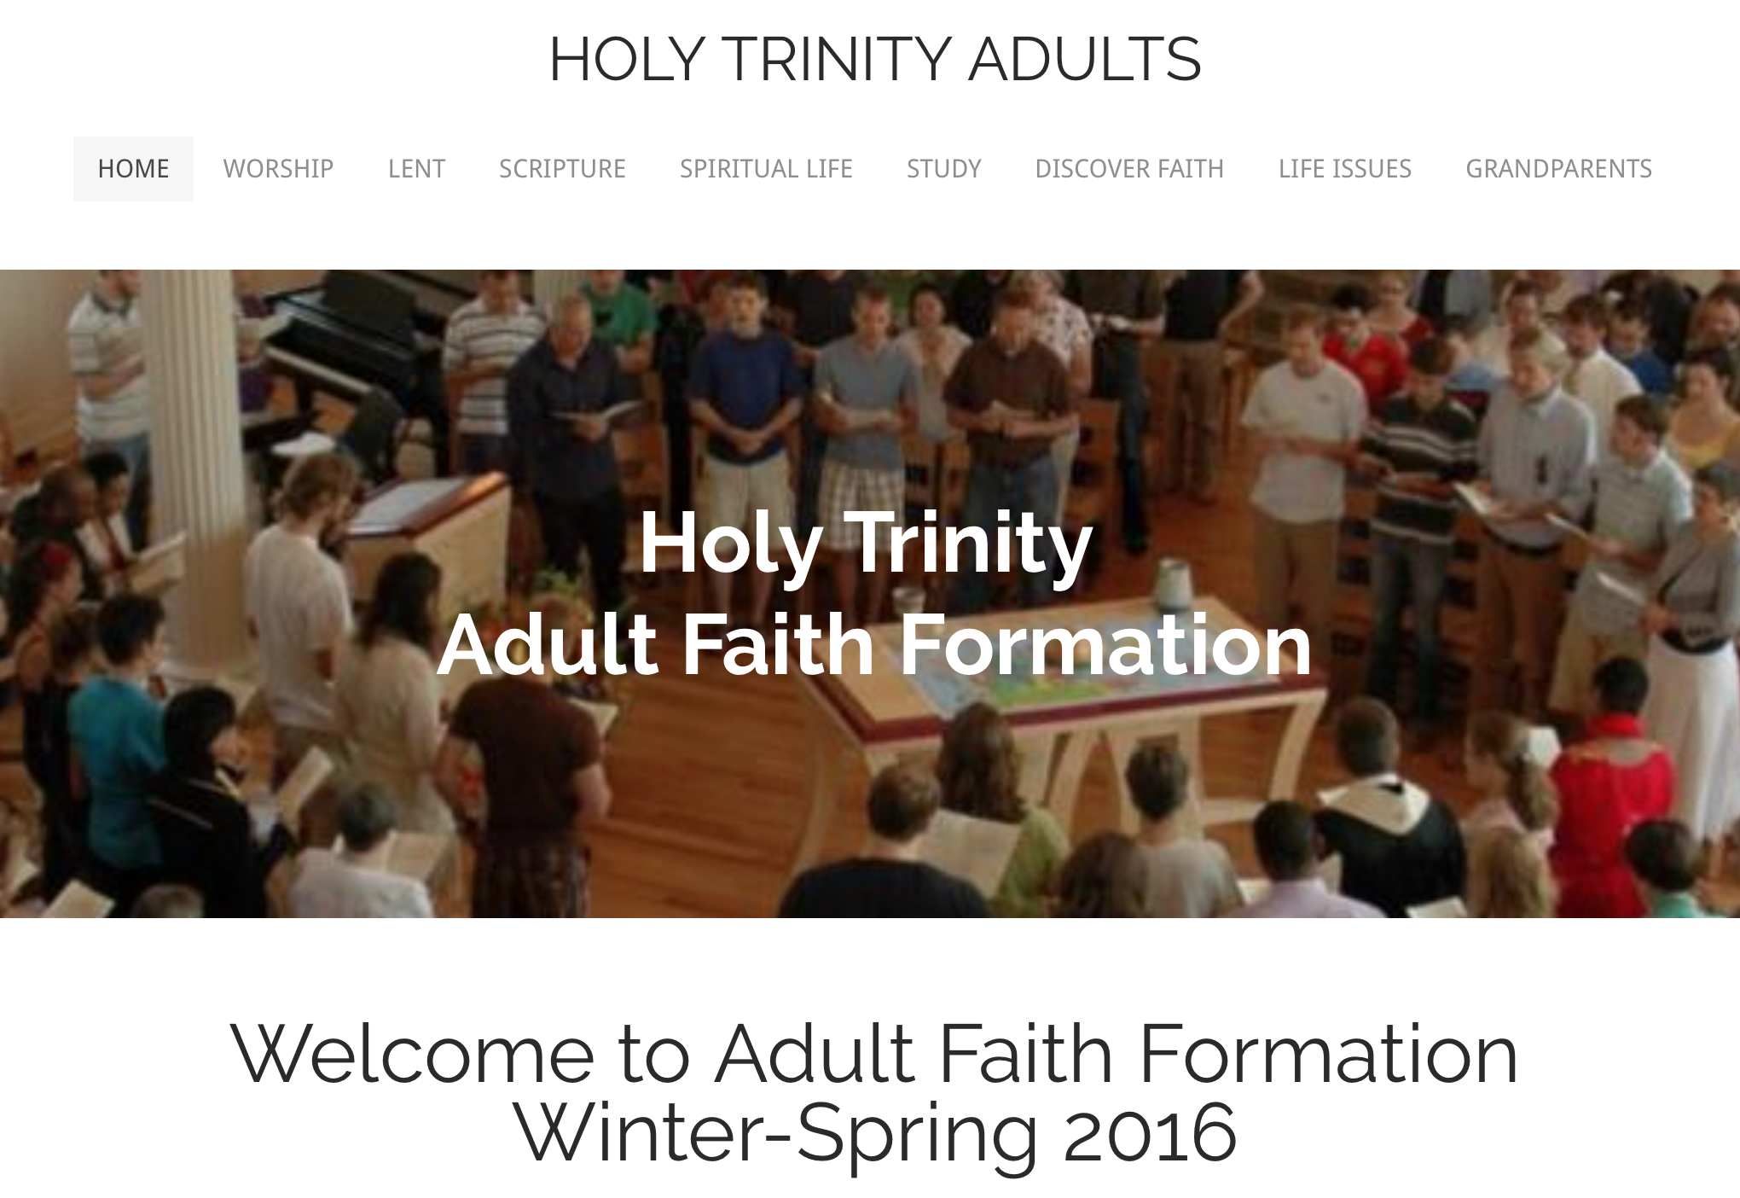
http://holytrinityadults.weebly.com

Slide 28
Adult Faith Formation Playlists
Playlists are thematic learning plans that integrate a variety of ways to learn, multiple learning environments, and online and physical spaces—from which people can create their own faith formation plan.
Example: Spiritual Enrichment for Adults
Theme: “Spiritual Practices”
Spiritual Practices Course (5 sessions at church in one month)
Spirituality Over 50 Book Group (variety of times & places)
Online Daily Devotion Resources
Online Prayer Practices Resources
Online Course or Retreat with a Spiritual Master
Online Retreat

Slide 30
Strategy Idea
Scenario 3: Resisting & Decreasing
Start with who you have. . . .
Grandparents – faith formers of their grandchildren
Mature adults (Boomers & Builders)
Milestones celebrations of adulthood
Intergenerational experiences at church, e.g., Sunday worship add-ons
Connecting with parents/grandparents through children’s programs, e.g., add a component to VBS

Slide 31
Strategy idea
Scenario 4: Embracing & Decreasing
Move AFF off-campus, out into people’s lives
AFF in a café, homes, community centers
AFF on the go: online adult faith formation
Life-centered AFF
Community events with a spiritual theme: arts, concerts, film festivals, etc.

Slide 32
LifelongFaith.com (Symposium) ReimagineFaithFormation.com (Adults)

