Slide 1
Intergenerational Christian Formation: Bringing the Generations Together Again

Slide 2
Blessings
God is rebuilding the ruins,
restoring places long devastated, renewing the broken places in your life.
(from Isaiah 61)

Slide 3
May the God of hope fill you with all joy and peace as you trust in him, so that you may overflow with hope by the power of the Holy Spirit.
(Romans 15:13)

Slide 4
God is calling you to the place where your deep gladness and the world’s deep hunger meet. This is your work in his kingdom.
(from Frederick Buechner)

Slide 5
Be strong and courageous; do not be frightened or dismayed; for the LORD God is with you wherever you go.
(from Joshua 1)

Slide 6
May you be like Ruth and like Esther; may you be deserving of praise; may you come to be a shining name among us.
May the Lord protect and defend you. May the Lord preserve you from pain. May the LORD favor you with happiness and peace.
(from “Fiddler on the Roof”)

Slide 7
Principles #2
Through IFF people learn the ways of the community of practice as they participate authentically and relationally with more experienced members of the culture; people learn Christian ways from more experienced members of the culture through intergenerational Christian communities.

Slide 8
Principles #3
Through IFF
people identify with their community of practice as they are allowed to participate legitimately in the activities to be learned; as children and new believers (and others) participate in relational community doing “Christian” things with those further down the road, they come to identify with the believing community.

Slide 9
What is it about intergenerational settings that uniquely and especially fosters spiritual growth and development?

Slide 10
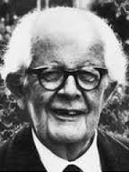
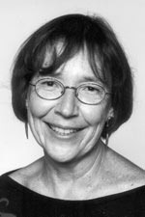
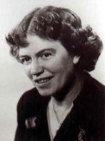
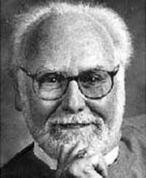
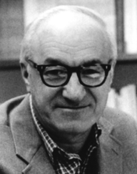
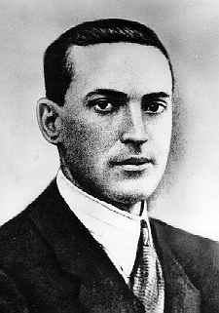
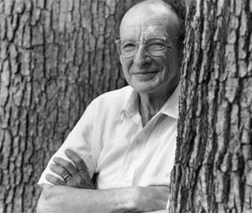
Why do intergenerational experiences especially nurture spiritual formation?

Slide 11
Sociocultural Perspective and Lev Vygotsky
1896-1934
Vygotsky's work promotes the idea that for persons to learn concepts
- they must experience them
- and socially negotiate their meaning
- in authentic, complex learning environments.
Zone of Proximal Development (potty training theory)

Slide 12
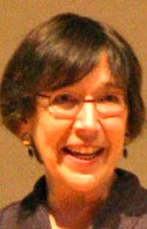
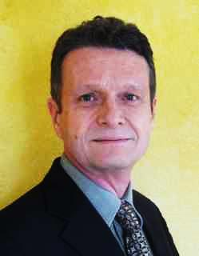
Situated learning and communities of practice
Jean Lave Etienne Wenger

Slide 13
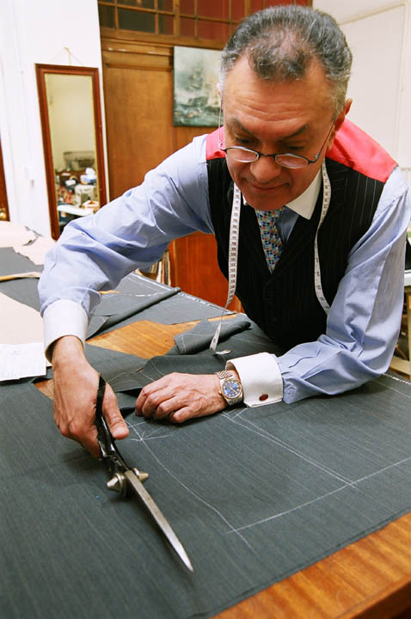
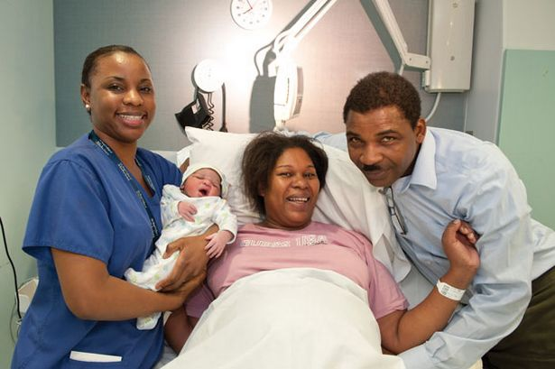
Situated Learning
Lave and Wenger (1991) examined several apprenticeship situations:
midwives
tailors
non-drinking alcoholics
butchers

Slide 14
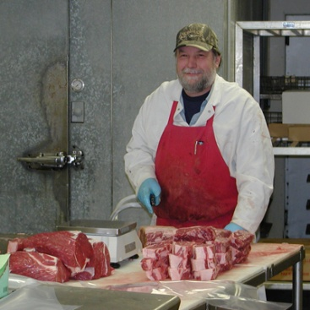
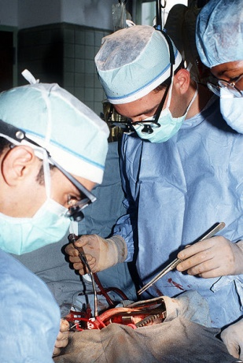
Situated Learning
Lave and Wenger concluded that:
Learners must
be given access to the practices they are expected to learn and
be able to have genuine participation in the activities and concerns of the group.
Learners
are relatively peripheral at first
must actually practice the activities themselves.

Slide 15
Situated Learning
Situated learning activities forge a person who now identifies with the community of practice.
This sounds like what we have been saying for years:
To be a Christian one must participate fully in Christian community.

Slide 16
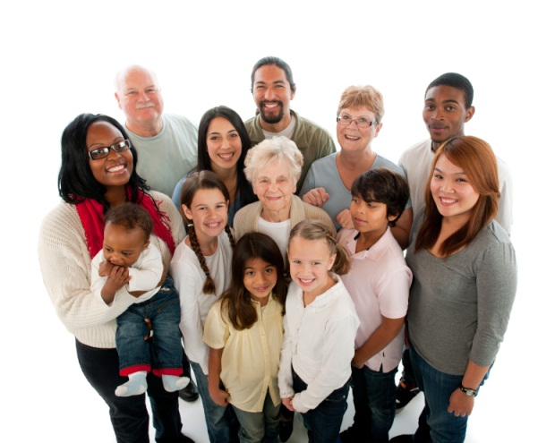
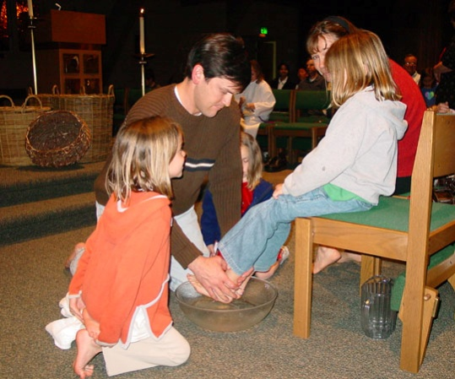
Situative/Sociocultural Learning Theory
Summary of rationale:
People learn best in authentic, complex environments
The best learning happens when children (and teens and adults) participate with more experienced members of the culture.
Persons identify with their communities of practice as they are allowed to participate legitimately in the activities to be learned.

Slide 17
No better place exists for the most number of people to learn Christian ways from more experienced members of the culture than in intentionally intergenerational Christian communities.
However . . . for intergenerational Christian formation to happen, the generations must be together; they must know each other; and they must experience life in the body of Christ together.

Slide 18
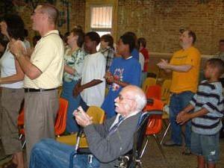
Sociocultural Perspective and Christian Formation
Persons learn to be members of their community as they:
actively participate in that particular identified social community,
learning alongside those who are further ahead in the journey.

Slide 19
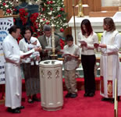
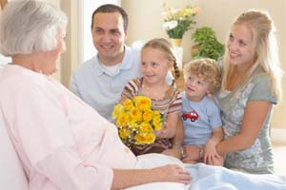
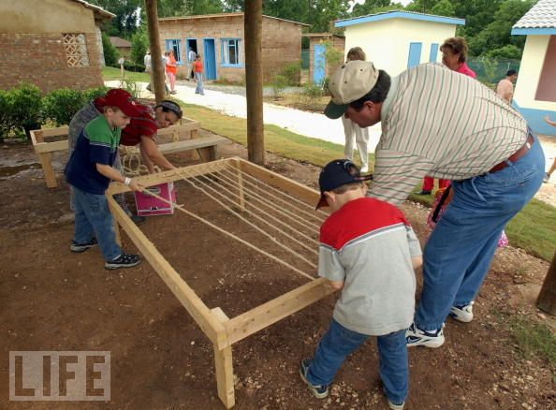
What happens?
“The person has been . . . transformed into a practitioner, a newcomer becoming an old-timer,
whose changing knowledge, skills, and discourse are part of a developing identity—
in short, a member of a community of practice” (Lave and Wenger, 1991, p. 122).

Slide 22
Practicing Spiritual Disciplines Intergenerationally: Lectio Divina
"... these are the things God has revealed to us by his Spirit. The Spirit searches all things, even the deep things of God” (1 Corinthians 2:9-10).

Slide 23
Practicing Spiritual Disciplines Intergenerationally: Lectio Divina
Lectio Divina
Read | Lectio | Reading
Meditate | Meditatio | Reflecting
Pray | Oratio | Responding
Contemplate | Contemplatio | Remaining

Slide 24
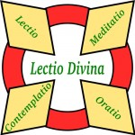
Practicing Spiritual Disciplines Intergenerationally: Lectio Divina
Organized:
8 groups
2 adult leaders (one male, one female)
2 youth leaders
4-5 teenagers in each group
8-10 adults in each group
Met weekly for 12 weeks

Slide 25
Practicing Spiritual Disciplines Intergenerationally: Lectio Divina
Studied: Stories of Jesus in Matthew
Choice of passages suggested each week, for example one week the choices were from Matthew 8: 1-9:34:
The man with leprosy 8:1-4
Faith of the centurion 8:5-13
Cost of following Jesus 8:18-22
Jesus calms the storm 8:23-27
Jesus heals a paralytic 9:1-8
Calling of Matthew 9:9-13
Dead girl and sick woman 9:18-26

Slide 26
Practicing Spiritual Disciplines Intergenerationally: Lectio Divina
Process: African Bible Study
One person reads passage slowly while everyone listens for a single word or phrase that catches their attention
Sit in silence one full minute to give everyone time to think about their word or phrase
Each person shares the word or phrase that they have chosen with the rest of the group
Another person reads the passage while each person thinks about how this passage overlaps with what is happening in their life today.
Sit in silence another 60 seconds

Slide 27
Practicing Spiritual Disciplines Intergenerationally: Lectio Divina
Process continues:
Each person shares (briefly) how this passage overlaps with what is happening in their life.
A third person reads the passage slowly one last time.
Allow five minutes for all to consider:
- From what I have heard or shared, what do I believe God wants me to do or be?
- Is God inviting me to change in any way?
Each person shares their insights/responses.
Each person prays for the person on their right.
Conclude by praying the Lord’s prayer together.

Slide 30
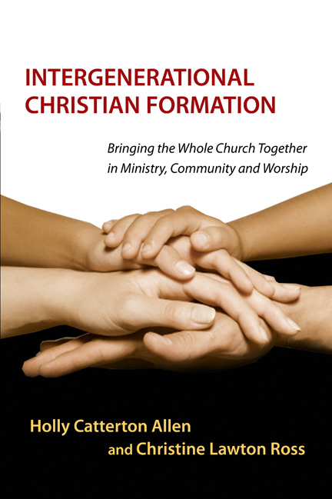
Intergenerational Christian Formation:
Why should we bring the generations together?
Som Sabadell flashmob - YouTube
http://youtu.be/OdXfUrj8eHw

Slide 31
Bringing the generations back together again

Slide 32
Bringing the generations back together again

Slide 33
Bringing the generations back together again

Slide 34
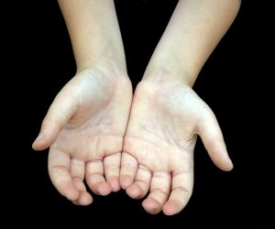
Bringing the generations back together again

Slide 36
Bringing the generations back together again

Slide 37
Fundamental Premise
Intergenerational faith experiences uniquely nurture spiritual growth and development in both adults and children

Slide 38
Terms: Intergenerational
characteristically intergenerational is meant to involve adults-with-children (White, 1988, p. 21)
Other terms: interage, cross-generational (not multi-generational)
the generations are to be involved with each other
in mutual activities
in group experiences together
with several from each of the generations present.

Slide 39
Best Recommendation
Intergenerational small groups

Slide 40
What is an intergenerational small group?
“two or more different age groups interacting in learning, growing, and developing in the faith,
through common experiences of fellowship
worship
sharing, and
relationships" (Prest, 1993, p. 15).

Slide 41
What happens in intergenerational small groups ?
Icebreakers
Worship
Prayer
Special blessing times

