Slide 1

Faith Formation for the
Generations & Seasons of Adulthood
John Roberto (jroberto@LifelongFaith.com)

Slide 2


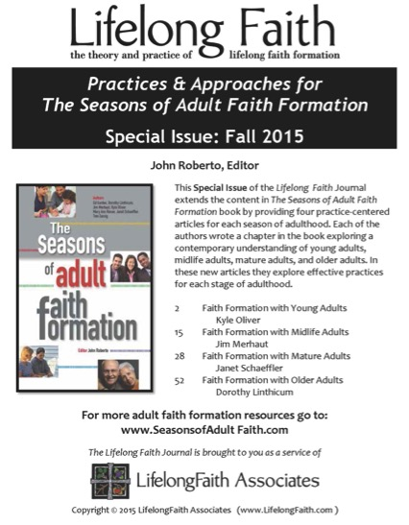
LifelongFaith.com – Journal
ReimagineFaithFormation.com – Adults

Slide 3
The Seasons of Adulthood
Seasons of Adulthood
Life Issues
Young Adults (20s-30s)
  Millennial Generation
Midlife Adults (40s-mid 50s)
  Generation X
Mature Adults (mid 50s–75)
  Baby Boom Generation
Older Adults (75+)
  Building Generation
Physical & Cognitive Changes
Developmental Tasks
Family Life Cycle
Faith Development
Spiritual-Religious Identities
Generational Characteristics

Slide 4
Transforming Our Approach
Networks of Faith Formation
Providing an abundance of content & experiences developed around the needs and lives of adults available on demand, 24x7
Using multiple environments: independent, mentored, at home/daily life, small group, large group, church-wide, and in the world
Building a digital platform that integrates all faith formation content and experiences seamlessly
Using digitally-connected strategies to enhance and expand all faith formation programming
Designing episodic engagements and micro-learning experiences
Creating personalized pathways for adult faith formation

Slide 5
Transforming Our Role
Balancing Both Roles
|---------------------------------------------------------------------------------------------------------|
Current Roles
Emerging Roles
Developing religious content
Designing programming
Managing programming
Teaching/Facilitating programming
Designing faith forming environments—architecture
Designing Digital Platforms for faith forming content
Curating religious content and experiences

Slide 6
Designing adult faith formation

Slide 7
Develop Project-Centered Teams
Coordination
Design
Curation
Marketing
Communication
Technical

Slide 8
Design Process
Task 1. Research the Target Audience(s) & Identify Needs
Task 2. Build the Faith Formation Network Design
Task 3. Generate Programming Ideas for the Network
Task 4. Plan a Network Season of Programming
    Add current programming and events
    Redesign current programming by using a digital strategy
    Design faith formation playlists
Task 5. Build the Digital Platform
Task 6. Test the Seasonal Plan with the Target Audience
Task 7. Launch the Seasonal Faith Formation Network
Task 8. Evaluate the Season of Programming
Task 9. Design the New Season of Programming

Slide 9
Research the Needs of Adults
Surveys
Focus Groups
Interviews
Research Reviews
Sample Themes – Mature Adults
Dealing with retirement
Making life plans, finances, health
Becoming a grandparent
Making a difference in the community and world
Incorporating family changes and transitions
New ways of living and relating as a married couple
Caring for aging parents
Taking time to read the Bible and learn more about my faith
Growing spiritually and exploring spirituality for the 2nd half of life
Connecting with people my age; talking about things that matter to us
Dealing with loss

Slide 10
Empathy Map
SAY What do you hear your target group saying? | DO What actions and behaviors do you notice in your target group?
THINK What might your target group be thinking? What does this tell you about their beliefs/convictions? | FEEL What emotions might your target group be feeling?

Slide 11
Build the Network
Caring Relationships
Celebrating the Seasons
Celebrating Rituals & Milestones
Learning the Christian Tradition
Praying & Spiritual Formation
Reading the Bible
Serving, Working for Justice, & Caring for Creation
Worshipping God
Missional
Life Stage Issues
Target Audience
Content Area
Content Area
Content Area
Content Area
Content Area
Content Area

Slide 12
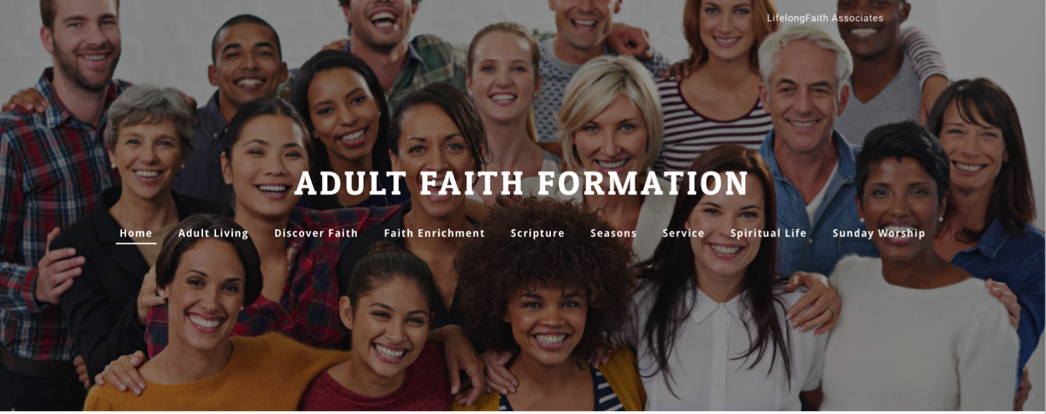
Adult Faith Formation Network
Adult Living
Discovering Faith
Faith Enrichment
Scripture
Seasons of the Year
Service
Spiritual Life
Sunday Worship

Slide 13
Generate Programming
Content Areas | Current Programs | Redesign Ideas | New Ideas

Slide 14
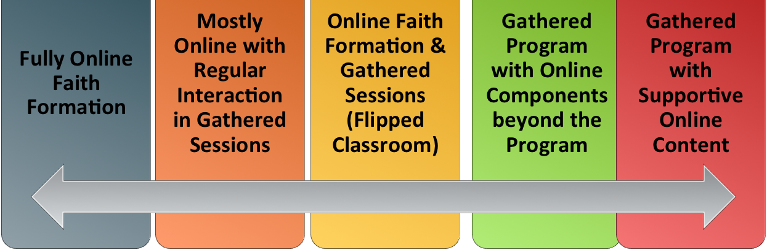
Use Digital Strategies
Extend the event or program
One program, multiple formats
Build on a program: Prepare – Experience – Live
Flip the program
Integrate online and gathered
Online-only programs and activities

Slide 15
Three Seasons of Programming
Fall
Winter-Spring
Summer
Fall Season: September 1 – January 1
Winter/Spring Season: January 1 – May 1
Summer Season: May 1 – September 1

Slide 16
Develop a Seasonal Plan
& Calendar
Content Area (examples) |  | Programming | & Dates
 | Month 1 | Month 2 | Month 3 | Month 4
Scripture Enrichment
Faith Enrichment
Spiritual Enrichment
Service & Mission
Life Issues

Slide 17
Develop Faith Formation Playlists
Playlists are thematic learning plans that integrate a variety of ways to learn, multiple learning environments, and online and physical spaces—from which people can create their own faith formation plan.

Slide 18

Design the Website
Other Platforms
www.wordpress.org www.wix.com www.squarespace.com

Slide 19
Digital Platform
Website
Social Media
Communication

Slide 20
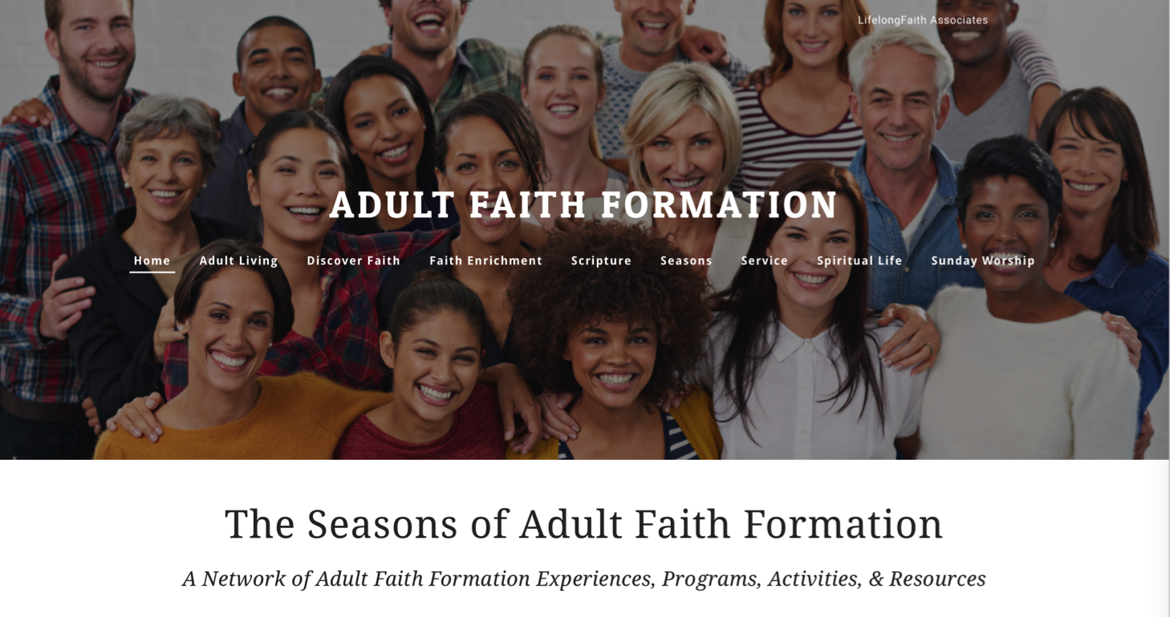
Adult Faith Formation Network

Slide 21
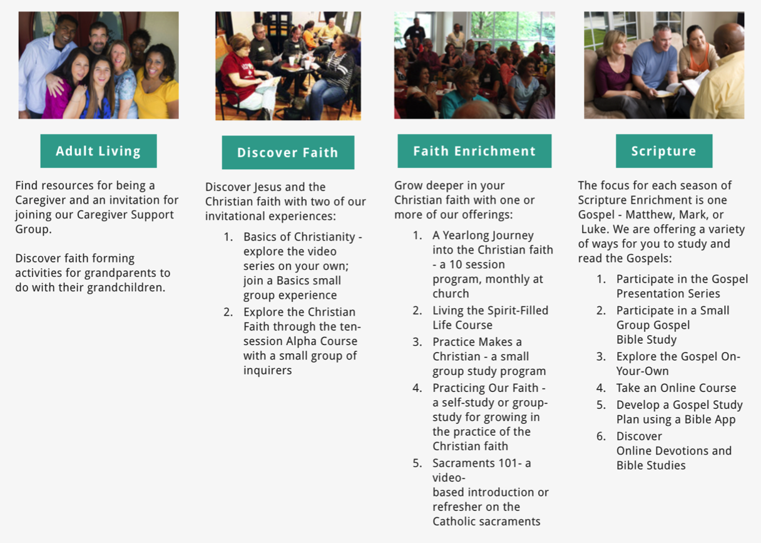
Playlists of Content & Experiences

Slide 22
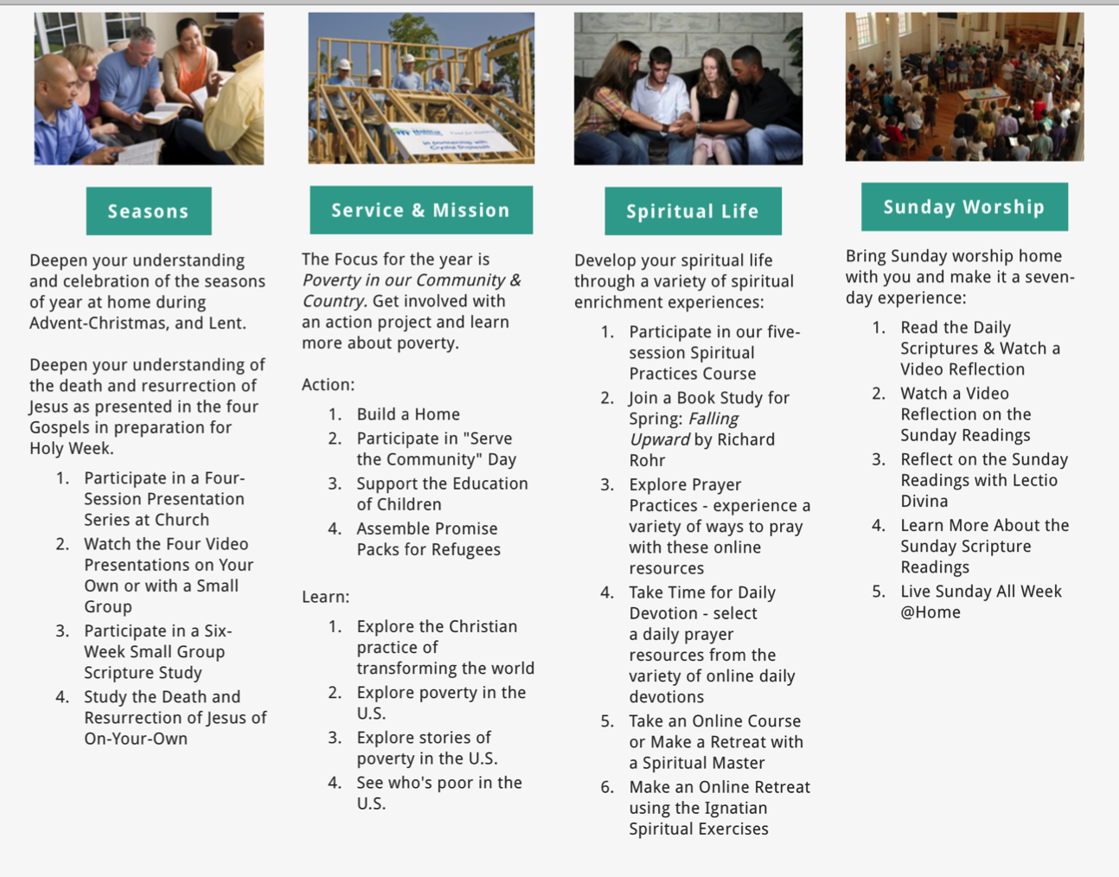

Slide 23
Test the Plan & Website
Let your user experience the network online. Show don’t tell. Let them review the website and the programming. Just the minimum context so they understand what to do. (Have computers or tablets available for people to use or ask them to bring a device.)
Have them talk through their experience, e.g., “Tell me what you are thinking as you are doing this.”
Actively observe. Watch how they use (and misuse!) the website. Don’t immediately “correct” what your user is doing.
Follow up with questions, such as: “Show me why this would (or would not) work for you.” “Can you tell me more about how this made you feel?” “Why? “ “Do you find things that interest you and connect with your life?” “Are there things you would have liked to see?”

Slide 24
Launch the Network
Be sure to pay careful attention to the titles and descriptions so that they capture people’s interests. Develop descriptions that are positive in tone, indicate clearly the content or focus of an activity.
Describe how your offerings respond to something within the lives of people. Highlight the relationship between the content and the particular spiritual or religious needs, interests, passions, concerns, or life issues of people.
Describe the 2-3 benefits of participating or engaging in faith formation.
Explain to people how to use the Network and how to access the activities and resources.

Slide 25
Promotion Ideas
Connect to (or extend from) a gathered event.
Use personalized invitations.
Establish a Facebook page for faith formation for announcements, updates, stories and photos from people engaged in faith formation, etc.
Use Twitter to announce updates, events, and invite reflections from people on their experiences.
Send email or e-newsletters to targeted groups (use a service like Constant Contact, Mail Chimp, Flocknote).
Provide ways to share experiences using blogs, Twitter, Facebook: videos, reports, photos, etc.

Slide 26
Marketing in Four Steps – Seth Godin
The first step is to invent a thing worth making, a story worth telling, a contribution worth talking about.
The second step is to design and build it in a way that people will actually benefit from and care about.
The third one is the one everyone gets all excited about. This is the step where you tell the story to the right people in the right way.
The last step is so often overlooked: The part where you show up, regularly, consistently and generously, for years and years, to organize and lead and build confidence in the change you seek to make.
(http://sethgodin.typepad.com/seths_blog/2016/08/marketing-in-four-steps.html)

Slide 27
Connect to Social Networks
Our social network is made up of all the people we’re connected to, all the people they are connected to, all the people they are connected to, and so on.
You
Your Friends
Your Friends
Your Friends’ Friends
Your Friends’ Friends
Your Friends’ Friend’s Friends
Your Friends’ Friend’s Friends
Your Friends’ Friend’s Friends
Your Friends’ Friends
Your Friends’ Friends

Slide 28
Evaluate Programming

Slide 29
Personalize adult faith formation

Slide 30
Personalize Faith Formation
Personalized pathways for discipleship & faith growth. . . .
Guide people in discerning their religious and spiritual needs
Equip people with the resources and tools to learn and grow at their own pace
Provide mentoring and support for the journey

Slide 31
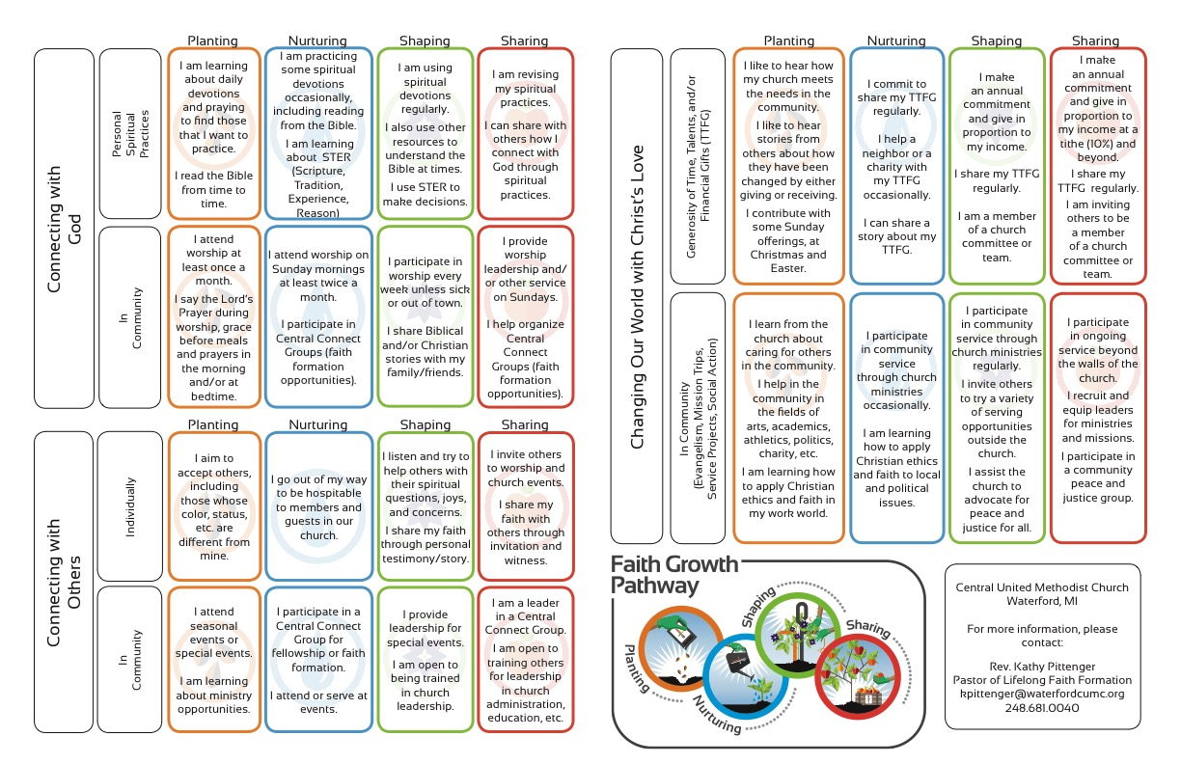

Slide 32
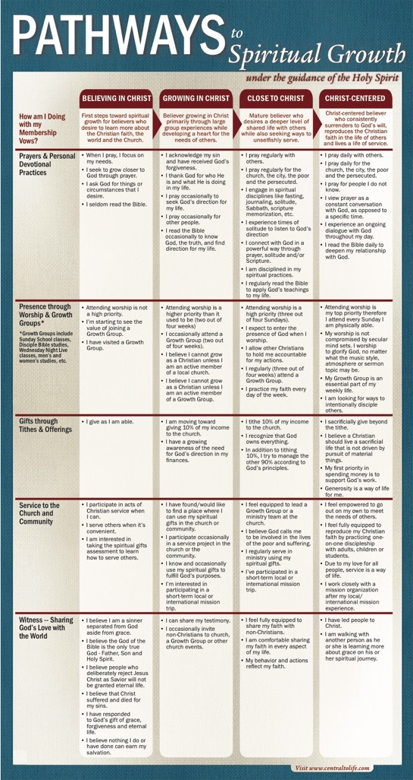

Slide 33
Personalizing Faith Formation
1. Assessing Learning Needs & Competencies
2. Working with a Mentor to Develop a Plan
3. Finding Programs and Resources
4. Engaging in Learning
5. Sharing with the Others
6. Reflecting on Growth and Identifying New Needs

Slide 34
Build a Curation Support System
Develop trusted expert curators to assist.
Develop a list of high quality online resource centers.
Subscribe to faith formation blogs and newsletters.

Slide 35
Develop Trusted Sources
Blogs
Newsletters Websites
Denominations Curated Websites Religious Organizations
6-8 “Expert” Resource People

Slide 36
Develop a Research Checklist
People: teachers, mentors/guides, guest presenters
Community programs: churches, agencies, organizations,
Educational institutions: colleges, seminaries
Retreat and spiritual life centers, monasteries
Denominational programs, events, websites
Museums
Books (with study guides) & E-books
Apps
Audio podcasts & audio learning programs
Videos & video learning programs
Online courses & online activities
Television shows
Organizational websites
Resource center websites

Slide 37
Develop Evaluation Criteria
Biblical content and interpretation
Theological content and emphasis
Developmental appropriateness
Ethnic-Cultural appropriateness
Inclusive of diversity
Respect for diverse ways of learning
Appearance and visual appeal
Ease-of-Use
Quality of Experience
Applicable: Able to be incorporated into daily and home life

Slide 38
Digitally Enabled & Connected Strategies

Slide 39
Extend the Event
Church Event or Program
At Home & Daily Life

Slide 40
One Event/ Program, Multiple Formats
Multiple Formats
Digital Content to Extend & Provide New Ways to Experience
Social Media
Interaction
Communication
Demonstration
Connection
Gathered
Website
Small Group
Independent
Online
Event/Program

Slide 41
Build on an Event/Experience
Preparing
Experiencing
Living
How will you sustain/extend the event?
How will you design the event?
What types of experiences, programming, activities, and resources will you develop to prepare people for the event?
How will you engage age groups, families, and the faith community?
What types of experiences, programs, activities, and resources will you offer people?

Slide 42
Flip the Model
@ Home / Daily Life
Exploring the Content
- print, audio, video, activities
@ The Program
Applying the Content:
Create – Practice - Perform - Participate

Slide 43
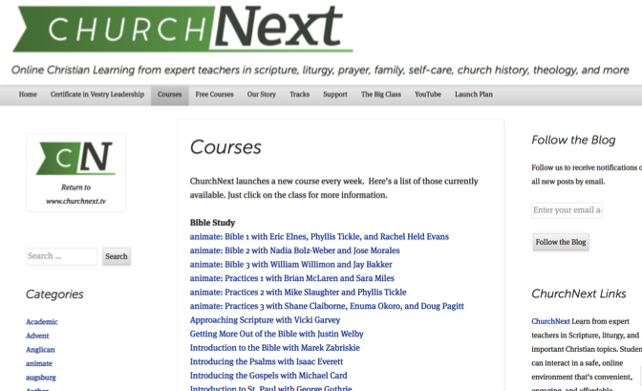

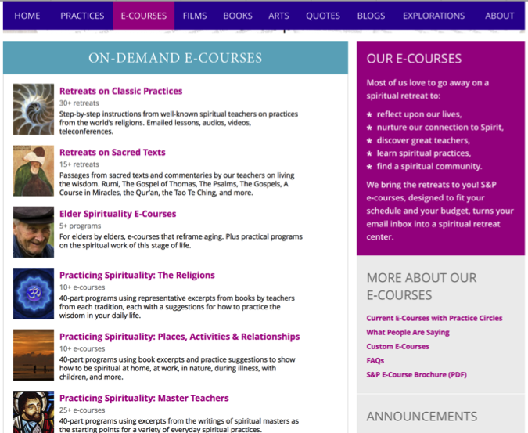
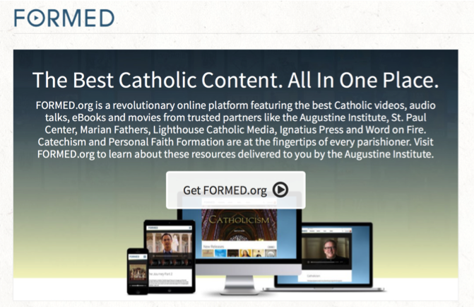
Flip the Model with Christian Initiation

Slide 44
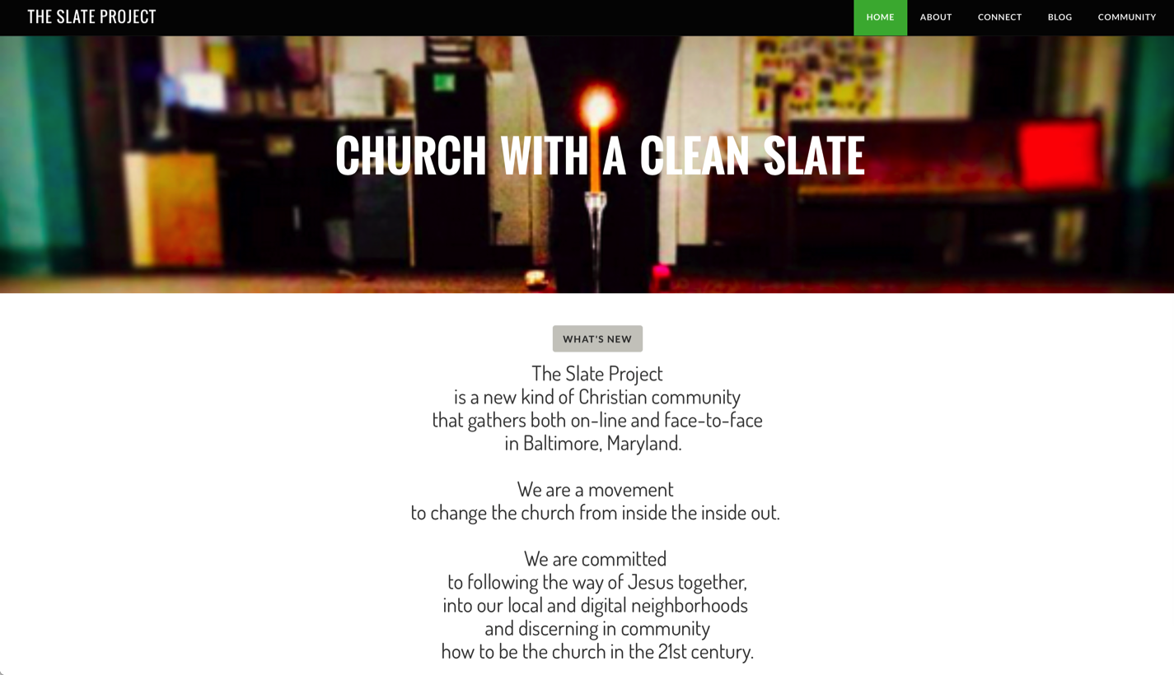
Integrate Online and Gathered

Slide 45
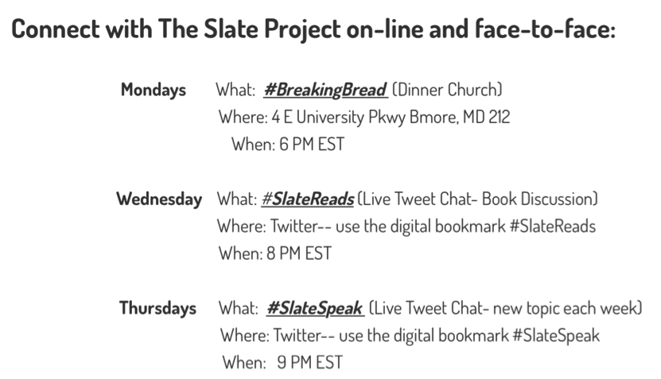
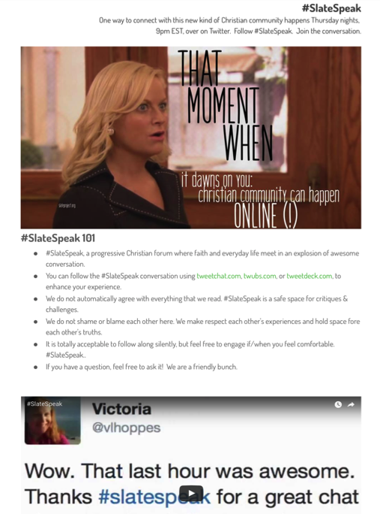
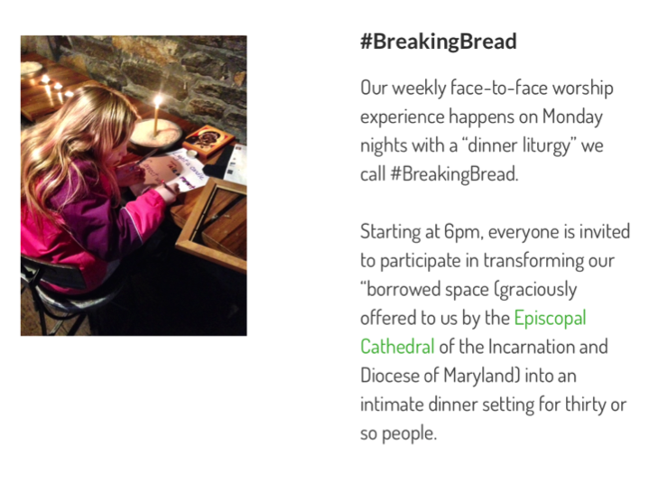
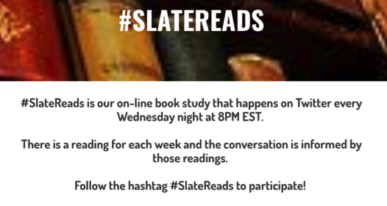

Slide 46
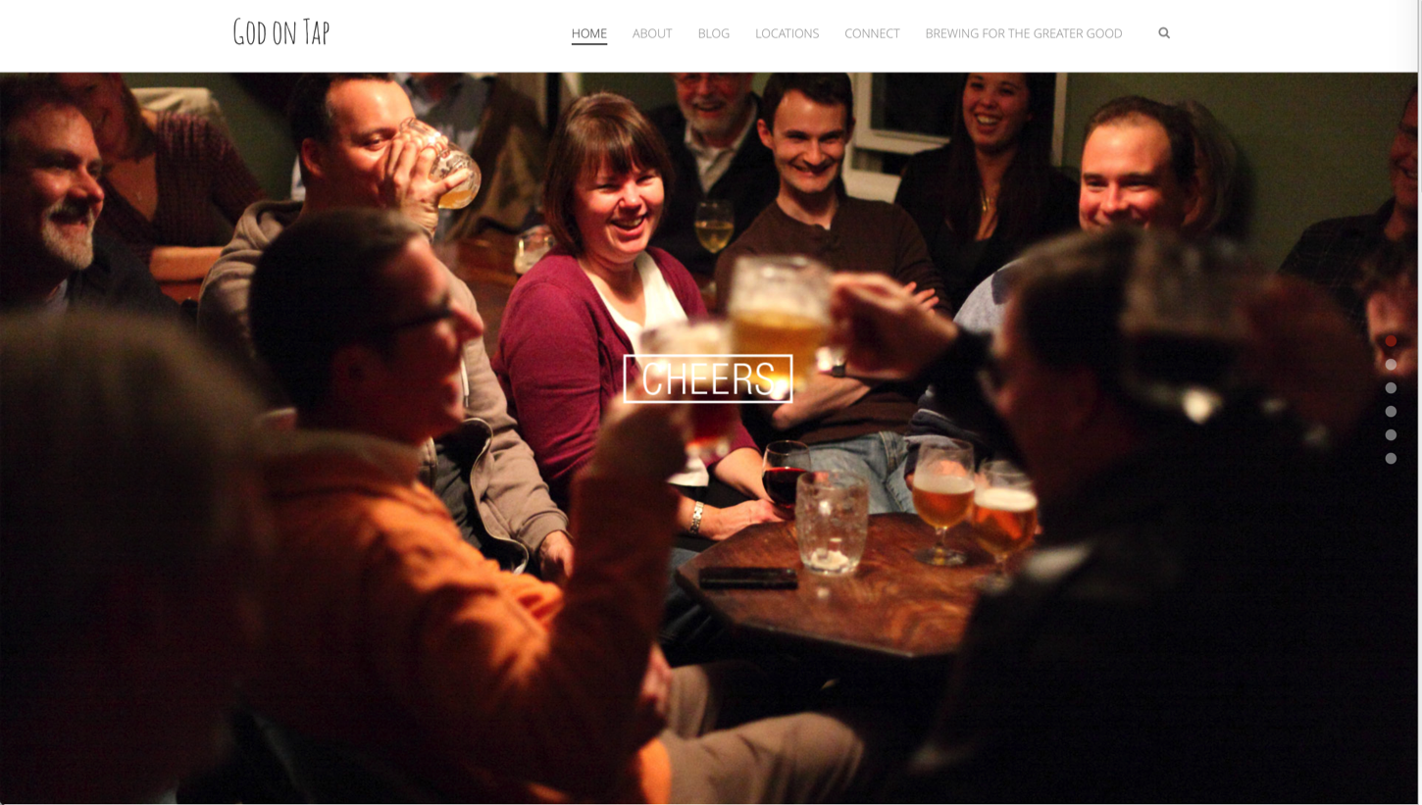
Integrate Online and Gathered

Slide 47
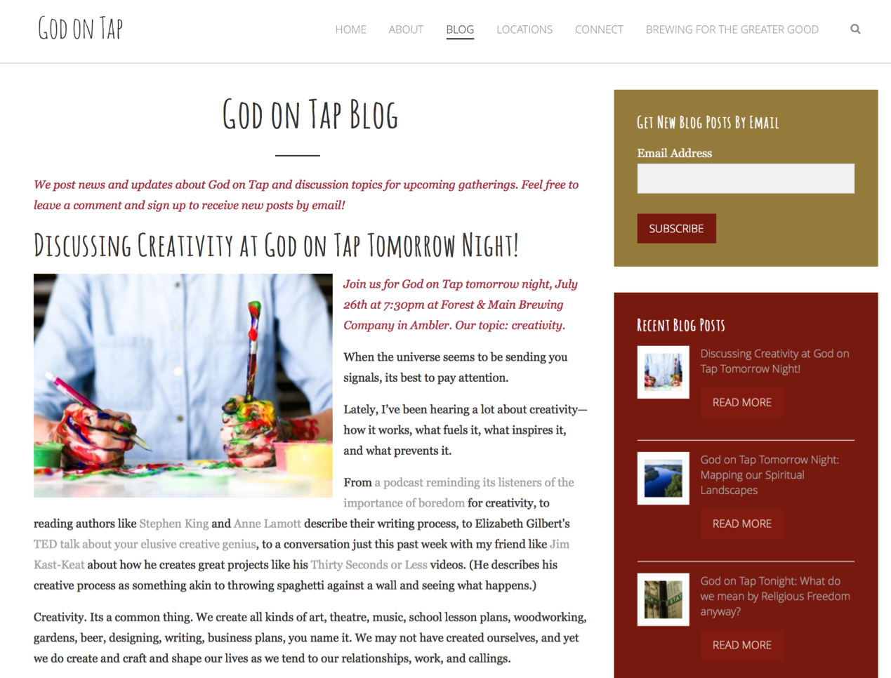

Slide 48
Online 40-Day Lent Curriculum
Church ➔ | Daily & Home | ⬅ Online
Ash Wednesday Lenten Sunday liturgies Stations of the Cross Lenten prayer Lenten retreat Lenten service Lenten soup suppers | Fasting Praying Service/Almsgiving Lectionary reflection Family Lenten activities | Lenten learning resources Lenten calendar Daily Lenten prayer Weekly table prayer Video resources Online retreat experience

Slide 49
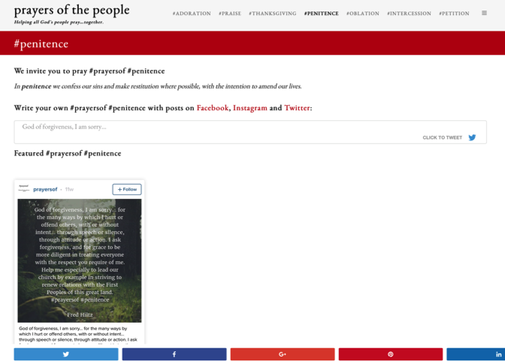
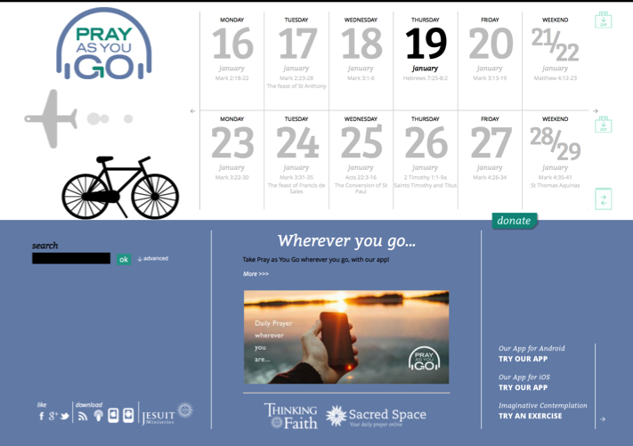
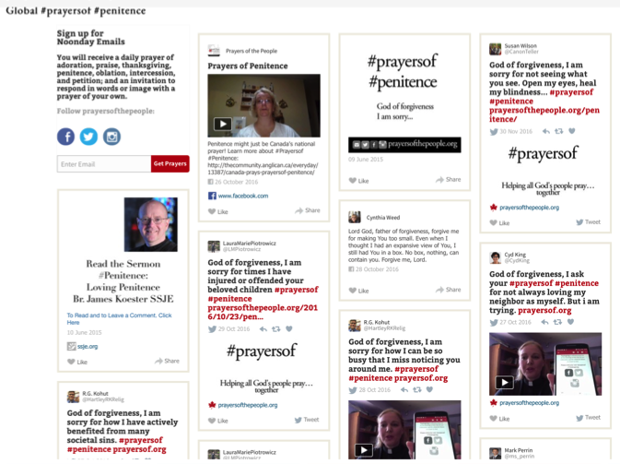
Online Prayer

Slide 50
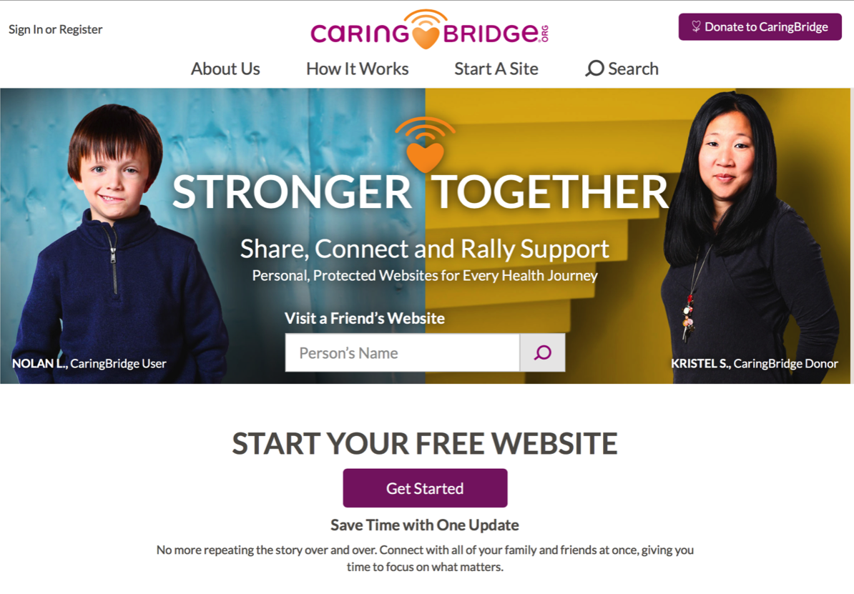
Online Pastoral Care

Slide 51
Others can better write about Nelson Mandela's impact on the world stage, on how he stood up for the dignity of all people and on how he changed our world.
For those that seek to make a change in the world, whether global or local, one lesson of his life is this:
You can.
You can make a difference.
You can stand up to insurmountable forces.
You can put up with far more than you think you can.
Your lever is far longer than you imagine it is, if you choose to use it.
If you don't require the journey to be easy or comfortable or safe, you can change the world.
(Seth Godin)

