Slide 1
Consultants Session Kenora Catholic Schools
Presenter
John Roberto

Slide 2
What is consultation?
Ronald Lippitt and Gordon L. Lippitt describe consultation as. . .
“the process of seeking or giving professional help.” “Professional consultation is the effective managing of a helping relationship between client and consultant, and as such it is a problem-focused interaction process. The goal of consultation is learning, growth, change and, well along on the path of problem-solving, a problem solution. An effective consultation, therefore, has a problem-solving focus.”
Consultation seeks to empower the client to find a solution(s) to the identified problem.

Slide 3
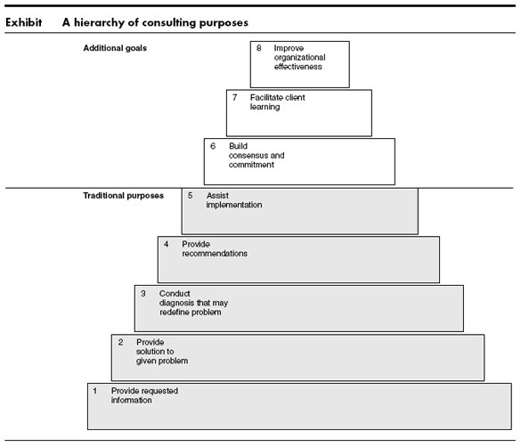
Hierarchy of Consulting Purposes

Slide 4
Consultant Roles
Peter Block defines a consultant as “a person who is trying to have some influence over a group or organization but has no direct power to make changes or implement programs. This understanding of the role of the consultant is essential to an effective consultation.
A consultant works through a mediator (whether an individual person or a group of people) to help change the behavior of a specific target (again an individual or group).
The target is a single individual or group with behavior to be modified.
The mediator is an individual or group capable of influencing the behavior of the target.
The consultant is a person or a group of people with the knowledge or skills or programs or vision or methodology that can help the mediator influence the target.
Consultant
Mediator
Target

Slide 5
Consultant Roles
Advocate Role. The consultant presents a vision, theory, research, policy, etc. as the basis for planning (positional or content advocacy). The consultant uses a proven process to guide the work (methodological advocate).
Technical Specialist. The consultant provides specialized knowledge, skill, resources that the client does not have.
Trainer/Educator. The consultant provides skills training for individuals or groups to organize and implement a solution.
Collaborator in Problem-Solving. The consultant contributes ideas and examples to assist planning and problem-solving.
Alternative Identifier. The consultant helps the group identify its own solutions to the problem.
Fact Finder. The consultant seeks out information for the individual or group and/or assists with data collection and surveys.
Process Specialist. The consultant facilitates planning and assists the group to maintain healthy team work.
Reflector. The consultant reflects back to the group what he or she is hearing from the group’s deliberations.

Slide 6
Consultation Process
Phase I: Contact, Entry, and Relationship Establishment
The Initiative for Making First Contact
2. Helping Identify and Clarify the Need for Change
Exploring the Readiness for Change
Exploring the Potential for Working Together
Phase II: Agreement to Work Together
What Outcomes are Desired?
Who Would Need to Do What?
Time Perspective & Accountability
Phase III: Planning
Consultant delivers the agreed upon service.
Phase IV: Implementation and Evaluation
Successful Action-Taking
Evaluation and Guiding Feedback
Revising Action and Mobilizing Additional Resources
Follow-up Support and Termination

Slide 7
Dealing with Resistance
Peter Block in Flawless Consulting reminds us that resistance is natural in a consulting process because we are dealing with growth, learning, and change. Resistance is inherent in all change processes. He says that there are two underlying concerns that cause most resistance: control and vulnerability. To deal with resistance he recommends the following strategies:
Identify when resistance is taking place.
View resistance as a natural process and a sign that you are on target.
Support the person in expressing the resistance directly.
Do not take the expression of the resistance personally or as an attack on you or your competence
There are three steps for handling resistance:
Identify what form the resistance is taking. Pick up the cues: Trust what you see more than what you hear. Listen to yourself. Listen for repetition and telltale phrases.
Name the resistance, in a neutral, non-punishing way.
Be quiet, let the person respond.
Remember to give two good faith responses to every question. The third time a question is asked, interpret it as a form of resistance.

