Slide 1

Leading in the 21st Century
John Roberto
jroberto@lifelongfaith.com www.LifelongFaith.com

Slide 2
How do I get rid of the fear?
Alas, this is the wrong question.
The only way to get rid of the fear is to stop doing things that might not work, to stop putting yourself out there, to stop doing work that matters.
No, the right question is, "How do I dance with the fear?"
Fear is not the enemy. Paralysis is the enemy.
(Seth Godin)

Slide 3
Leading

Slide 4
Leadership 1.0 (Susan Lang)
Organizational—Think hierarchical organization flow-charts. A strong emphasis was placed on putting the correct structure in place.
Centralized—Denominations were generally the central holders of resources and information, which they dispersed from a given location.
Authority-based—Established authorities and expertise provided the answers to questions.
Agenda-driven—Ministry grew out of a set agenda and often used a “command and control” model.

Slide 5
Leadership 2.0 (Susan Lang)
Leadership 2.0 is growing out of the post-Christendom and the Internet age. The shape of relational, networked leadership is still emerging and will be very contextual. Leadership 2.0 is:
Relational—The focus is on developing and nurturing relationships and links.
Decentralized—Resources are distributed throughout a networked congregation and ministry. Each person is recognized as a connector to his or her own resources and networks.
Collaborative—Collaboration builds on conversations and recognizes that we are all teachers, we are all learners, and we are always stronger together than we are alone.
Focused on emergence—Recognizes that discernment is important for leaders, because God’s presence and action among us emerge and often change over time.

Slide 6

Accelerate – John Kotter
The world is now changing at a rate at which the basic systems, structures, and cultures built over the past century cannot keep up with the demands being placed on them. Incremental adjustments to how you manage and strategize, not matter how clever, are not up to the job. You need something very new to stay ahead in a age of tumultuous change and growing uncertainties.
(Accelerate: Building Strategic Agility for a Faster-Moving World

Slide 7
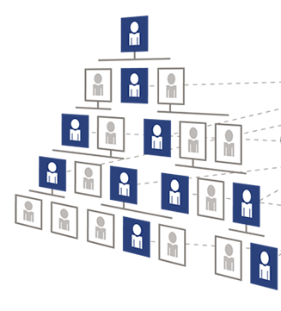
Operating System 1 – Hierarchy
With a well structured hierarchy and with managerial processes that are driven with skill, this mature organization can produce incredibly reliable and efficient results on a weekly, quarterly or annual basis. Such an operating system lets people do what they know how to do exceptionally well

Slide 8
Operating System 2 – Network
What we need is a second operation system, which is organized like a network next to the existing hierarchy. This network based operating system complements rather than overburdens the hierarchy, freeing the latter to do what it is optimized to do

Slide 9
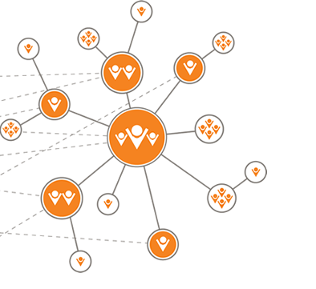
Informal Networks of Change Agents
Operate under the hierarchical radar to make something new happen faster. The processes in this network look less like management and more like mobilized leadership

Slide 10
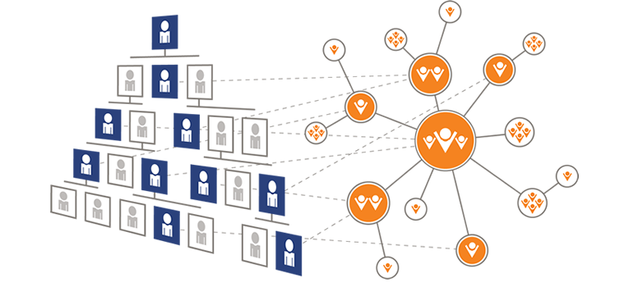
Dual System: Hierarchy and Network
The network organization contains no bureaucratic layers and command-and-control prohibitions. The network permits a level of individualism, creativity, and innovation that the hierarchical organization simply can not provide.

Slide 11
Management vs. Leadership
MANAGEMENT
LEADERSHIP
Planning
Budgeting
Organizing
Staffing
Measuring
Problem-solving
Doing what we know how
to do exceptionally well
Constantly producing
reliable, dependable results
Establishing direction
Aligning people
Motivating people
Inspiring
Mobilizing people to achieve astonishing results
Propelling us into the future

Slide 12
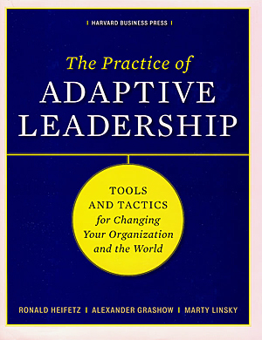
Adaptive Leadership
Leadership is the activity of mobilizing people to tackle tough challenges (problems) and do the adaptive work necessary to achieve progress and thrive.
(Ronald Heifetz and Marty Linsky)

Slide 13
Technical vs. Adaptive
Technical problems (even though they may be complex) can be solved with knowledge and procedures already in hand.
Easy to identify.
Require change in just one or a few places; often contained within organizational boundaries
Everyday, people have problems for which they do, in fact, have the necessary know-how and procedures—technical problems.

Slide 14
Distinguishing Technical from Adaptive
Adaptive challenges are situations for which solutions lie outside the current way of operation.
Difficult to identify (easy to deny). People often resist even acknowledging adaptive challenges
Require experiments, new discoveries, and adjustments from numerous places in the organization.
Without learning new ways—changing attitudes, values, and deep-seated behaviors—people cannot make the adaptive leap necessary to thrive in the new environment.
Calls for changes of heart and mind—the transformation of long-standing habits and deeply held assumptions and values.

Slide 15
Adaptive Change
People don’t resist change per se.
People love change when they know it’s a good thing. (No one gives back a winning lottery ticket.)
People resist loss. When change involves real or potential loss, people hold on to what they have and resist the change.
The common factor generating adaptive failure is resistance to loss. A key to leadership , then, is the diagnostic capacity to find out the kinds of losses at stake in a situation.
Adaptive leadership leadership almost always put you in the business of assessing, managing, distributing, and providing contexts for losses that move people through these losses to a new place.

Slide 16
Adaptive Change
Adaptive leadership is a process of conservation and loss.
“Of all that we care about, what must be given up to survive and thrive going forward?
“Of all that we care about, what elements are essential and must be preserved into the future, or we will lose precious values, core competencies, and lose who we are?”
As in nature, a successful adaption enables an organization or community to take the best from its traditions, identify, and history into the future.

Slide 17
You May Be Facing an Adaptive Challenge If. . .
the solution requires operating in a different way than you do now. . .
the problem AND the solution require learning. . .
the solution requires shifting the authority and responsibility to the people who are actually affected. . .
the solution requires some sacrifice of your past ways of working or living. . .
the solution requires experimenting before you’re sure of the answer. . .
the solution will take a long time. . .
the challenge connects to people’s deeply held values. . .

Slide 18
Adaptive Leadership
Adaptive leadership is specifically about change than enables the capacity to thrive. New environments and new dreams demand new strategies and abilities, as well as the leadership to mobilize them.

Slide 19
The Adaptive Intervention Process
Observing events and patterns around you;
Interpreting what you are observing (developing multiple hypotheses about what is really going on; and
Designing interventions based on the observations & interpretations to address the adaptive challenge you have identified.
1. Observe
2. Interpret
3. Intervene

Slide 20
Adaptive Design Process
DISCERN: Is your church facing technical problems for which technical fixes will be appropriate or is your church facing adaptive challenges or is your church facing both?

Slide 21
Adaptive Design Process
IDENTIFY: What are the significant adaptive challenges confronting your church?

Slide 22
Adaptive Design Process
INTERPRET: What you are observing about this adaptive challenge.
  Is there any part of this challenge that is new and that might need a different strategy than what is usually done?
  Who are the key stakeholders, and how might they be positively affected or negatively affected? How would they describe the situation and the stakes for them?
  How generalized is the urgency to do something or do you have to figure out how to ripen the issue?
  What are the adaptive elements of this challenge/situation, and what are the technical aspects?
  Is this only organization facing this challenge/situation? What responses are others making?

Slide 23
Adaptive Design Process
IDENTIFY INTERVENTIONS that could address the adaptive challenge.

Slide 24
Adaptive Design Process
DESIGN INTERVENTIONS based on the observations & interpretations to address the adaptive challenge.
Listen to the Environment
Experiment & Innovate
Evaluate & Learn What Works
Modify Programs & Plans

Slide 25
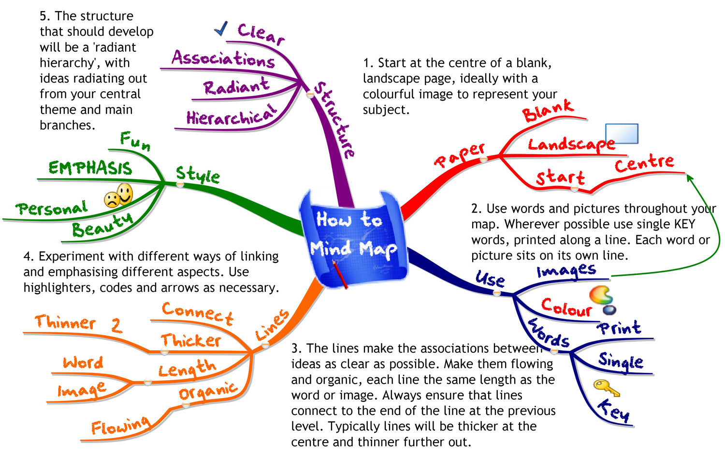
Generating Ideas: Mindmapping

Slide 26
Script the Moves
Design Phase:
    Project Statement: Description + Target Audience + Materials Needed
    Develop a task force
    Consult - focus group to give feedback
Pilot Phase
    Find a target audience
    Implement and get regular feedback
    Develop leaders through the project
Evaluation Phase
Modify and Launch for Larger Audience

Slide 27
Adaptive Design Process
THINK HARD ABOUT YOUR FRAMING. Thoughtful framing means communicating your intervention in a way that enables group members to understand what you have in mind, why the intervention is important, and how they can help carry it out. A well-framed intervention strikes a chord in people, speaking to their hopes and fears. It starts where they are, not where you are. And it inspires them to move forward. Think about the balance between reaching people above and below the neck. Some groups and some people need data first, before the emotion. For others, it is the reverse. Connect your language to the group’s espoused values and purpose.

Slide 28
Adaptive Design Process
HOLD STEADY. When you have made an intervention, think of it as having a life of its own. Do not chase after it. The idea will make its way through the system, and people will need time to digest it, think about it, discuss it, and modify it. If you think of it as “yours,” you are likely to get overly invested in your own image of it. Once you have made an intervention, your idea is theirs. The key is to stay present and keep listening.

Slide 29
Adaptive Design Process
ANALYZE THE FACTIONS that begin to emerge. As people begin to discuss the intervention, pay attention to who seems engaged, who starts using the new language or pieces of your idea as if it were their own. Listen for who resists the idea. Use these observations to help you see the contours of the factions that various people represent on the issue.

Slide 30
Adaptive Design Process
KEEP THE WORK AT THE CENTER OF PEOPLE’S ATTENTION. Avoiding adaptive work is a common human response to the prospect of loss. Avoidance is not shameful; it is just human. Expect that your team will find ways to avoid focusing on the adaptive challenge in doing their diagnosis as well as in taking action. Resistance to your intervention will have less to do with the merits of your idea and mostly to do with the fears of loss your idea generates.

Slide 31
Adaptive Design Process
Get allies. You need to share the burden of keeping the work at the center of people’s attention.
Understand. Try to understand the impact of new directions on the constituents behind the people in your working group, and how the pleasure or displeasure of those constituents is going to play out in the behavior of the person. Then think about how you can help that person with their problem, e.g., presenting the idea to their group or making sure the person receives credit for making the new idea happen.
Threat & Loss. To help the members of your team who are worried about their own people, interpret their group’s resistance in terms of threat and loss. Dealing with the fears of loss requires a strategy that takes these losses seriously and treats them with respect.

Slide 32
Build an Adaptive Culture
Elephants on the table are named.
Responsibility for the organization is shared.
Independent judgment is expected.
Leadership capacity is developed.
Reflection and continuous learning are institutionalized.

Slide 33
Facilitating Change

Slide 34
How People Change
People change what they do less because they are given analysis that shifts their thinking than because they are shown a truth that influences their feelings.
(John Kotter)

Slide 35

Switch: How to Change Things
When Change is Hard

Slide 36
A Framework for Change
Direct the Rider (the conscious mind), eliminating what looks like resistance but is more often a lack of clarity by providing crystal-clear direction.
  Following the bright spots: investigate what’s working and clone it.
  Script the critical moves: don’t think big picture, think in terms of specific behaviors.
  Point to the destination: change is easier when you know where you’re going and why it’s worth it.

Slide 37
A Framework for Change
Motivate the Elephant (the subconscious), eliminating what looks like laziness but is more often exhaustion by engaging emotions to get people on the same path as you.
  Find the feeling: knowing something isn’t enough to cause change. Make people feel something.
  Shrink the change: break down the change until it no longer spooks the Elephant.
  Grow your people: cultivate a sense of identity and instill the growth mindset.

Slide 38
A Framework for Change
Shape the Path (the situation), eliminating what looks like a people problem but is more often a situation problem, by making the environment more conducive to the change you seek.
  Tweak the environment: when the situation changes, the behavior changes. So change the situation.
  Build habits: when behavior is habitual, it’s “free”—it doesn’t tax the Rider. Look for ways to encourage habits.
  Rally the herd: behavior is contagious. Help it spread.

Slide 39
Things to Remember
Follow the bright spots: investigate what’s working and clone it.
Script the critical moves: don’t think big picture, think in terms of specific behaviors. Shrink the change.
Point to the destination: change is easier when you know where you’re going and why it’s worth it.
Find the feeling: knowing something isn’t enough to cause change. Make people feel something. Build an emotional and rational case for change.

Slide 40
Anchoring Change in the Culture
Culture changes only after you have successfully altered people’s actions, after the new behavior produces some group benefit for a period of time, and after people see the connection between the new actions and the performance improvement.
(John Kotter)

Slide 41
Facilitating Innovation

Slide 42
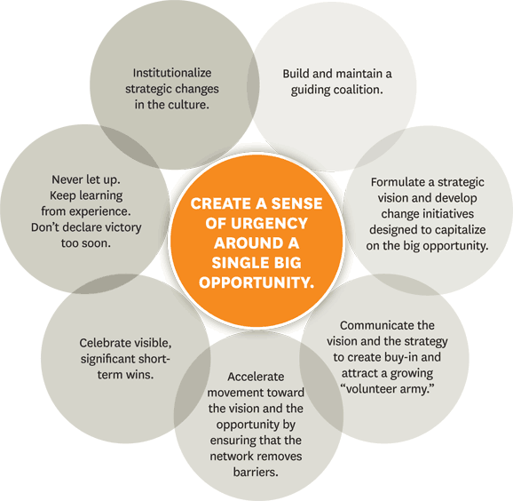

Slide 43
Small Scale Prototyping
Implement the faith formation network through small scale prototyping with a small group of your target audience.
Identify a group within the target audience for piloting or a limited launch of a project in order to test the project
Implement the project and get regular feedback on its implementation and effectiveness
Develop leaders through the piloting phase so that they can be involved in the wider launch of the project

Slide 44
Implementation Timeline
Season 1 | Season 2 | Season 3
Design Prototype with a small group of the potential audience Evaluate effectiveness Re-design | Expand reach to wider audience Continued evaluation | Integrate into regular offerings Continue expansion

Slide 45
Testing the Prototype
Testing is the chance to refine our solutions and make them better. Prototype as if you know you’re right, but test as if you know you’re wrong.
Refine our prototypes and solutions.
Learn more about our user. Testing is another opportunity to build empathy through observation and engagement—it often yields unexpected insights.
Test and refine our POV. Sometimes testing reveals that not only did we not get the solution right, but also that we have failed to frame the problem correctly.

Slide 46
Testing the Prototype
Prototyping is getting ideas and explorations out of your head and into the physical world.
In early explorations keep your prototypes rough and rapid to allow yourself to learn quickly and investigate a lot of different possibilities.
Prototypes are most successful when people (the design team, the user, and others) can experience and interact with them. What you learn from those interactions can help drive deeper empathy, as well as shape successful solutions.

Slide 47
Testing the Prototype
We prototype to:
  Learn: If a picture is worth a thousand words, a prototype is worth a thousand pictures.
  Solve disagreements: Can eliminate ambiguity, assist in ideation, and reduce miscommunication.
  Start a conversation: Can be a great way to have a different kind of conversation with users.
  Fail quickly and cheaply: Allows you to test a number of ideas without investing a lot of time and money up front.
  Manage the solution-building process: Encourages you to break a large problem down into smaller, testable chunks.

Slide 49
Anchoring Change in the Culture
Whenever you let up before the job
is done, critical momentum can be
lost and regression may follow.
(John Kotter)

Slide 50
Others can better write about Nelson Mandela's impact on the world stage, on how he stood up for the dignity of all people and on how he changed our world.
For those that seek to make a change in the world, whether global or local, one lesson of his life is this:
You can.
You can make a difference.
You can stand up to insurmountable forces.
You can put up with far more than you think you can.
Your lever is far longer than you imagine it is, if you choose to use it.
If you don't require the journey to be easy or comfortable or safe, you can change the world.
(Seth Godin)

Slide 51
Gracious God, make our lives holy.
Grant each of us the gifts of your Spirit: love, joy, peace, patience, kindness, faithfulness, and courage.
Send your Spirit into our lives that we may proclaim your Word and be your servants in the world.
Send your comforting Spirit to all who are in trouble and distress.
Send your healing Spirit to all who are victims of injustice.
Send your peace-filled Spirit to keep all nations from hatred and war.
Send your liberating Spirit that we may be peacemakers, justice advocates, healers, and prophets in our world today
Gracious God, give us the courage to be signs of hope for all your people. Amen.

Slide 52
Lord my God, to you and to your service I devote myself, body, soul and spirit.
Fill my memory with the record of your mighty works;
enlighten our understanding with the light of your Holy Spirit;
and may all the desires of my heart and will
center in what you would have me do.
Make me an instrument of your salvation for the people entrusted to my care, and grant that by my life and teaching I may set forth your true and living Word.
Be always with me in carrying out the duties of my faith.
in prayer, quicken my devotion;
in praises, heighten my love and gratitude;
in conversation, give me readiness of thought and expression;
and grant that, by the clearness and brightness of your holy Word, all the world may be drawn into your blessed kingdom
All this I ask for the sake of your Son our Savior Jesus Christ. Amen.

