Slide 1

The Church as a Center of Lifelong Learning & Faith Formation for All Ages & Generations
John Roberto

Slide 2

Developing a Lifelong Plan
Download the Planning Guide & PowerPoint Presentation
from the Lifelong Faith Website:
Home Tab
New Jersey
John Roberto
(jroberto@lifelongfaith.com)
LifelongFaith.com

Slide 3




Resources

Slide 4
How can a church become a center for lifelong learning and faith formation for its members and the whole community?

Slide 5
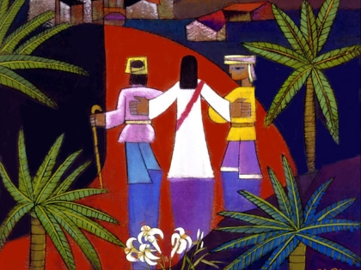
Accompanying people throughout life as they learn, mature, and practice their faith

Slide 6
Faith for a Lifetime
Lifelong
Children
Teens
Young Adults
Older Adults
Midlife Adults
Mature Adults
40s-50s
0-5
6-10
11-14
14-18
20s-30s
60s-70s
80+

Slide 7
Faith for a Lifetime
Lifewide
Life
Situations
Religious & Spiritual Life
Life Stage Tasks

Slide 8
For All Religious Practices & Identities
Not Spiritual, Not Religious
Unaffiliated
Spiritual but Not Religious
Uninvolved
Moderate Faith Practice & Occasional Engagement
Occasionals
Vibrant Faith & Engagement at the Center of Life
Actives

Slide 9
Thinking Systemically

Slide 10
Need to Think and Act Systemically
Systems thinking is a way of helping us view the challenges we face in faith formation from a broader perspective that includes seeing the whole life span and the context of people’s lives today, rather than seeing only a specific issue or concern in isolation.
If a problem (or challenge) lingers on, despite our attempts to solve it, maybe the problem is systemic (and not a people or resource problem).
By focusing on the entire system of faith formation, we can attempt to identify solutions that address as many problems as possible in the system. The positive effect of those solutions leverages improvement throughout the system. Thus, they are called “leverage points” in the system. This priority on the entire system and its leverage points is called whole systems thinking.

Slide 11
The 7 Elements of Lifelong Formation

Slide 12

What If…
“The whole idea behind Salt, Fat, Acid, Heat is that if we can learn how to use those four elements—which play a role in everything that we cook—we can learn how, why, and when to use them, and make any- thing taste good with or without a recipe. The rest, she says, is just a combination of cultural, seasonal, or technical details, for which we could consult cookbooks and experts, histories, and maps.”

Slide 13

Elements of Lifelong Faith Formation
A Vision of Maturing in Faith
Practices for Forming a Christian Way of Life
Intergenerational Relationships and Faith Forming Experiences
Family Faith and Practice
Networks of Life Stage Formation
Pathways to Faith Growth
Playlists of Faith Forming Experiences

Slide 14
A Vision of Lifelong Maturing in Faith
Jesus & Discipleship
Bible
Beliefs & Teachings
Moral Living
Service, Justice, Creation
Worship & Church Seasons
Community Life
Gifts & Talents
Prayer & Spiritual Life

Slide 15
Maturing in Faith Goals
Jesus
Developing and sustaining a personal relationship and commitment to Jesus Christ
Discipleship
Living as a disciple of Jesus Christ and making the Christian faith a way of life
Bible
Reading and studying the Bible—its message, meaning, and application to life today
Teachings
Learning the Christian story and foundational teachings of the Catholic faith and integrating its meaning into one’s life
Praying
Praying—together and by ourselves—and seeking spiritual growth through spiritual disciplines

Slide 16
Maturing in Faith Goals
Morality
Serve, Justice
Worshipping God with the community at Sunday worship, ritual celebrations, and the seasons of the church year
Being actively engaged in the life, ministries, and activities of the faith community
Gifts
Living with moral integrity guided by Christian ethics and values
Living the Christian mission in the world—serving those in need, caring for God’s creation, and acting and advocating for justice and peace.
Worship
Engaged
Practicing faith in Jesus Christ by using one’s gifts and talents within the Christian community and in the world

Slide 17
Many Ways to Address a Goal
Goal
Variety of Content & Programs
Variety of Resources & Formats
Variety of Times & Scheduling
@ Church
@ Home
Large Group, Small Group, Mentored
Online Only
Hybrid

Slide 18
A Living Faith
Head
Know
Heart
Relate
Hands
Practice

Slide 19
Holistic Faith Formation
Intergenerational
Family
Peers or
Life Stage

Slide 20
Intergenerational
Connecting with Generations
Multigenerational to Intergenerational
Age-Specific to Intergenerational
New Intergenerational Programming
Neighborhood and Community
At every stage of life people need to be connected to other generations and have intergenerational faith forming experiences

Slide 21
Family
Focus on parents – the most significant influence on the religious and spiritual outcomes of young people – their faith and practice, the parent-child relationship, modeling and teaching, family conversations, family faith practices.
Focus on home life – the primary way by which a religious identity becomes rooted in children’s lives are the day-to-day religious practices of the family and the ways parents model their faith and share it.
Focus on faith practices – that make a significant difference in nurturing the faith of children and teens at home. Raising religious children should primarily be a practice-centered process, not a didactic teaching program.
Focus on parent’s relationship with child and parenting style – warmth and love, balancing religious firmness with flexibility and continuity with agency, talking about religious matters during the week, listening more and preaching less.

Slide 22
Family
Encourage parents to grow in faith and become faith formers
Equip parents to incorporate faith practices into family life at home
Engage parents in education and formation, as well as the whole family in faith forming experiences and program
Young Children
Family & Parents
Older Children
Family & Parents
Young Adolescents
Family & Parents
Older Adolescents
Family & Parents
@ Church & Home
@ Church & Home
@ Church & Home
@ Church & Home

Slide 23
Programming
Networks of Faith Formation
a wide variety of faith-forming experiences in intergenerational, family, and life stage settings
a variety of content, programs, activities, and resources
content personalized to their spiritual-religious growth
a variety of formats: on your own, mentored, at home, in small groups, and in large groups
in-person, online, and hybrid
anytime, anywhere
Children & Parents
Teens
Young Adults
Midlife Adults
Mature Adults
Older Adults
Families

Slide 24
Programming
Build a Menu of Participation
Intergenerational
Family
Peers or
Life Stage
Intergenerational Experiences
Family Experiences
@ Home and @ Church
Age-Group Experiences

Slide 25
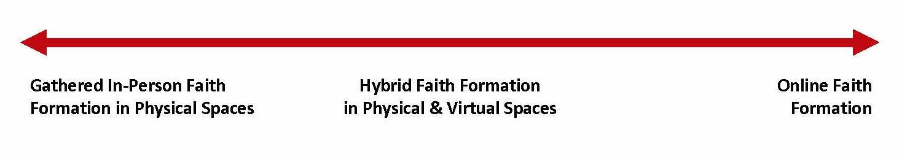
Programming
Synchronous and Asynchronous
Gathered Programming
Hybrid Programming
Gathered & Online
Online Programming

Slide 26
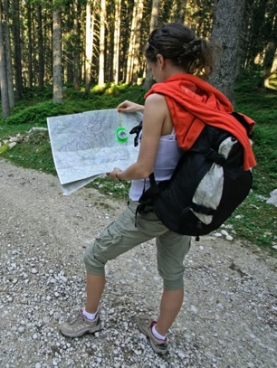
Pathways
- Personalizing -
Fashioning faith formation around the faith journeys of families and individuals at every stage of life
Guiding each person in his or her growth toward greater maturity in faith

Slide 27
Pathways
Goals or Themes | 1 = I’m a beginner in this aspect of my faith. | 2 = I’m growing in this aspect of my faith | 3 = I’m maturing and going deeper in this aspect of my faith. | 4 = I’m sharing my faith and gifts with others.
Relationship with Jesus
Living as a disciple
Bible
Prayer
Moral Living
Service / Justice
Tradition/Teachings
Worship
Gifts & Talents

Slide 28

Playlists
24x7 Faith Formation
The idea of a playlist is simple: it is a sequence of activities and resources on a topic designed for individual and/or small group learning, usually available on a digital platform.

Slide 30
Developing a Lifelong Plan
* Whole Church - All Ages & Stages
* Life Stage(s)
* Sacraments marriage-baptism-eucharist-confirmation
Establish goals for lifelong faith
Develop a model of lifelong faith
Incorporate intergenerational
Program networks for life stages
Create pathways to personalize faith formation
Design playlists for 24x7 learning
Incorporate family
Integrate the elements and build a digital platform
Implement

Slide 31
Application

Slide 32
Building toward Lifelong
Children
Teens
Young Adults
Older Adults
Midlife Adults
Mature Adults
40s-50s
0-5
6-10
11-14
14-18
20s-30s
60s-70s
80+
Goals
Head– Heart - Practice
Intergenerational – Family – Life Stage
Network Programming
Pathways (Personalize)
Playlists

Slide 33
Family
Young Children
Family & Parents
Older Children
Family & Parents
Young Adolescents
Family & Parents
Older Adolescents
Family & Parents
@ Church & Home
@ Church & Home
@ Church & Home
@ Church & Home
Family faith practices
Celebrating milestones:
Celebrating church year seasons
Parenting practices and skills appropriate to the stage of life
Parenting for faith
Family-centered gatherings and programs at church

Slide 34
Families with Children 0-5
Baptism preparation that engages the parents in their own faith growth and prepares them for nurturing faith in young children
Mentors from the church community (e.g., grandparents) to accompany parents on the journey from Baptism to start of school
Faith practices - Bible stories, prayers, meal rituals, values
Seasons of the year activities
Milestones - birthdays, baptism anniversaries, “first” milestones, entry to preschool and kindergarten
Parenting knowledge - understanding young child development and practices for effective parenting of young children
Parenting for faith skills - reading a Bible story, praying with a young child, having faith conversations
Online group for parents of young children
Gatherings for parents and for families at church
At Church
At Home
Online
Hybrid

Slide 35
Faith Formation Networks
Family Faith Practice
https://www.familyfaithpractice.com
Seasons of Adult Faith
https://www.seasonsofadultfaith.com

Slide 36
Designing and Implementing

Slide 37
Involvement Over Time
Year One
Year Two
Year Three

Slide 38

Planning sustain – enhance – expand - create
Short-Term Planning – ideas that can be integrated into existing plans and programs OR can be designed and implemented quickly in the 2022-23 program year
Mid-Term Planning – ideas that need more design time and that can be implemented within one or two years (2023-24)
Long-Term Planning – ideas that need design time, piloting and testing, and then implementation over the next several years

Slide 39
Capacity Building

Slide 40
Capacity Building
Start with your strengths and assets
In the church
In the community
In the diocesan church
In national organizations
In online resource centers

Slide 41
Developing Leadership
Work with the time commitments that fit people’s schedules. If leaders can serve for one day or one weekend per year, then have an opportunity ready for them. If leaders can serve for a month (four weeks) in the fall and again in the spring, have four-week program options for them.
Offer a variety of roles. Many people don’t want to teach or lead a pro- gram but would like to mentor or guide people one-to-one or in a small group. Develop mentoring relationships for people to learn how to pray, to serve those in need, and much more.
Develop leadership roles with fewer tasks and divide up a large leadership role into smaller responsibilities. It’s easier to find and prepare people for a more limited and clearly defined leadership role, than to find a leader to do a large job. It is also a way to involve more leaders in a project or program.

Slide 42
Developing Leadership
Design a program with a primary leadership role (teaching, presenting, facilitating activities) and support roles. For example, a children’s pro- gram might have a lead teacher (or two) and adults or youth who serve as small group activity leaders. Small group activity leaders make a four- week commitment each year. The same could apply to any other program where there are lead presenters or facilitators and small group leaders.
Design programming in shorter units of time. Rather than a twenty-four- week program with one leader, create four, six-week minicourses—each with a different leader. Eight-week programs can be conducted in two four-week minicourses.

Slide 43

Next Steps - A Guided Process of Developing a Lifelong Plan
Online Sessions:
January through June 2023
Write Me: jroberto@lifelongfaith.com

